Slide 1
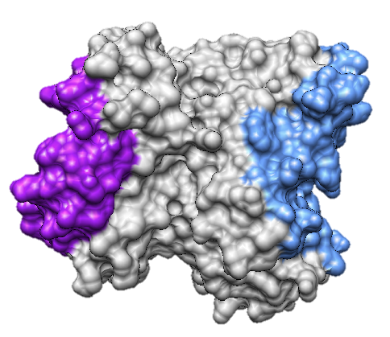
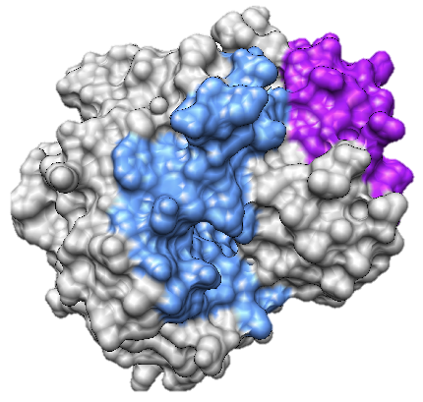
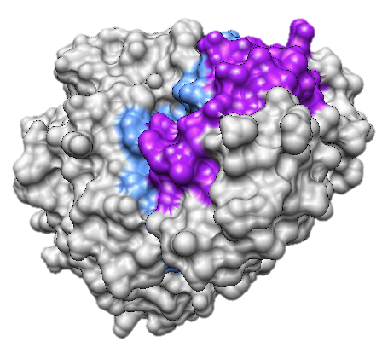
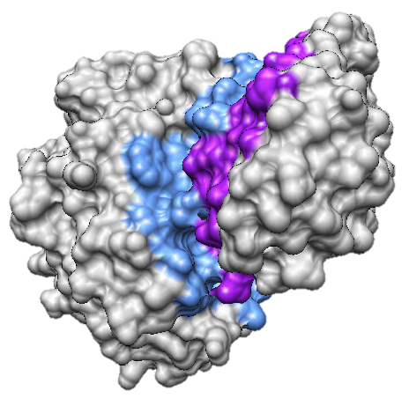
0.07%
9.09%
45.02%
45.81%
NN
0.75
FF
0.59
0.69
0.83
0.93
BB
FB
0.96

Slide 2
0.07%
9.09%
45.02%
45.81%
NN
0.84
FF
0.56
0.75
0.75
0.92
BB
FB
0.90

Slide 3
0.07%
9.09%
45.02%
45.81%
NN
0.70
FF
0.41
0.57
0.73
0.91
BB
FB
0.89

Slide 4
45.02%
45.81%
9.09%
0.07%
NN
0.42
FF
0.30
0.44
0.75
0.89
BB
FB
0.88

