Slide 1
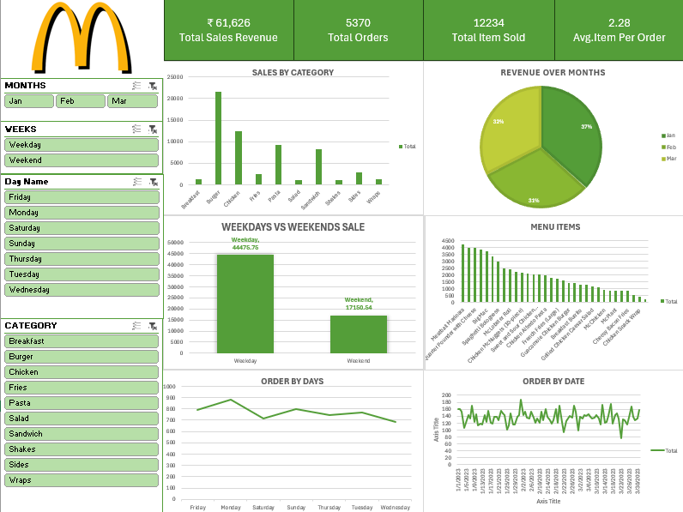
McDonald’s Sales Analysis Dashboard
Executive Summary & Key Insights

Slide 2
Executive Summary
• Total revenue: 61,626
• Highest-revenue category: Burger
• Most frequently ordered menu item: Angus Third Pounder
• Average items per order: 2.28 per order
• Weekday vs weekend trend: [Weekday Sales = ₹44,475.78], [Weekend Sales = ₹17,150.54]
• Top 5 menu items contribute: Meatball Marinara
: Angus Third Pounder
: Quarter Pounder with Cheese
: Bulgogi Burger
: Big Mac

Slide 3
Key Findings
Burger
Which category generates the most revenue? Finding: [ENTER FROM DASHBOARD]
Monday
Which days have the highest order volume? Finding: [ENTER FROM DASHBOARD]
Angus Third Pounder
Which item is ordered most frequently? Finding: [ENTER FROM DASHBOARD]

Slide 4
Sales & Order Behavior
• Average items per order: [2.28]
• Order volume by time of day: [Monday]
• Weekday vs weekend sales: [Weekdays have high sale than weekends]
• Best-performing month: [March + 21123 sales + 4186 items sold + 1840 orders]

Slide 5
Top 5 Menu Items

Slide 6
Conclusion
• Revenue is concentrated in [Burger].
• [Angus Third Pounder] is the most frequently ordered menu item.
• Orders are highest during [Monday].
• [Mrach] shows the strongest overall sales performance.
• The top 5 menu items represent an important share of sales and should be monitored closely.

