Slide 1
Online store - Web Application
School of Computer & Information Sciences
Regis University
Dr. Kevin Pyatt
Student. Badr Alsakali
Summer / 2019

Slide 2

Objective
The system (Online-store) is web-site to help customers to make some process such as buy and upload the items to App - for sell online.

Slide 3
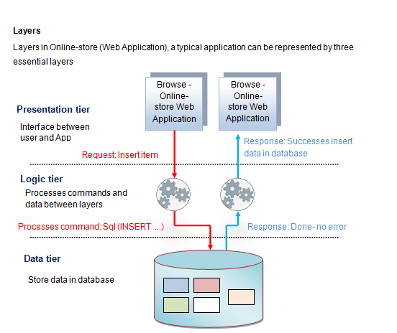

Slide 4
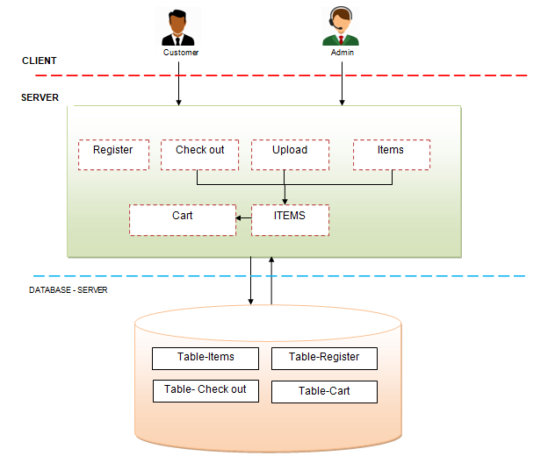

Slide 5
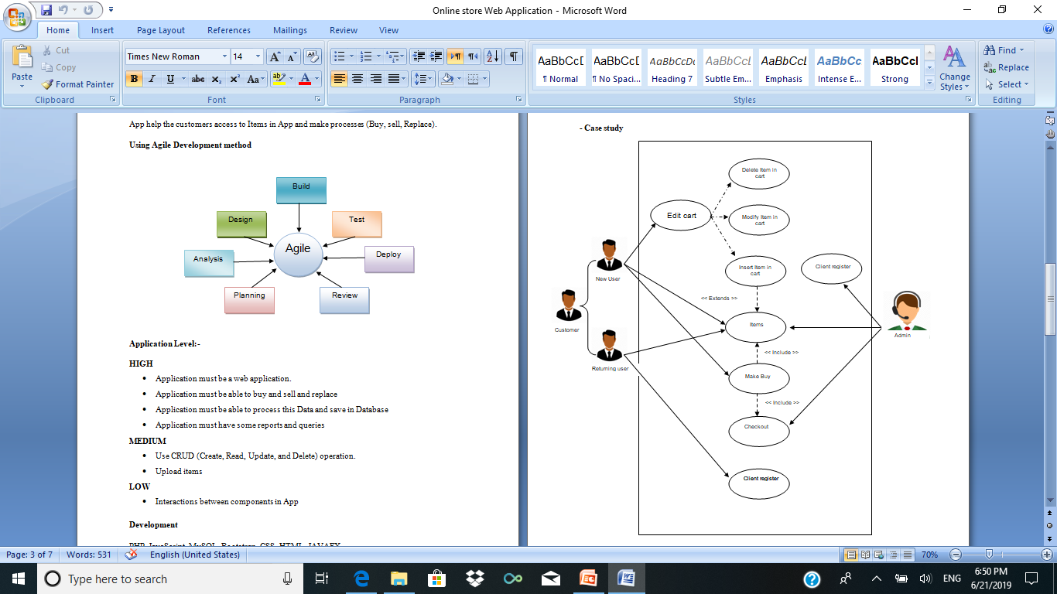
Case study

Slide 6


Development
PHP, JavaScript, MySQL, Bootstrap, CSS, HTML, JAVAFX

Slide 7
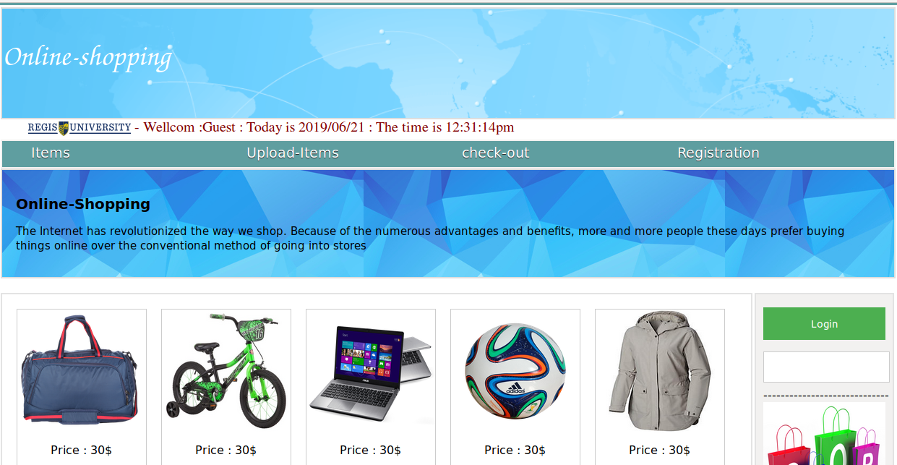
Main page

Slide 8


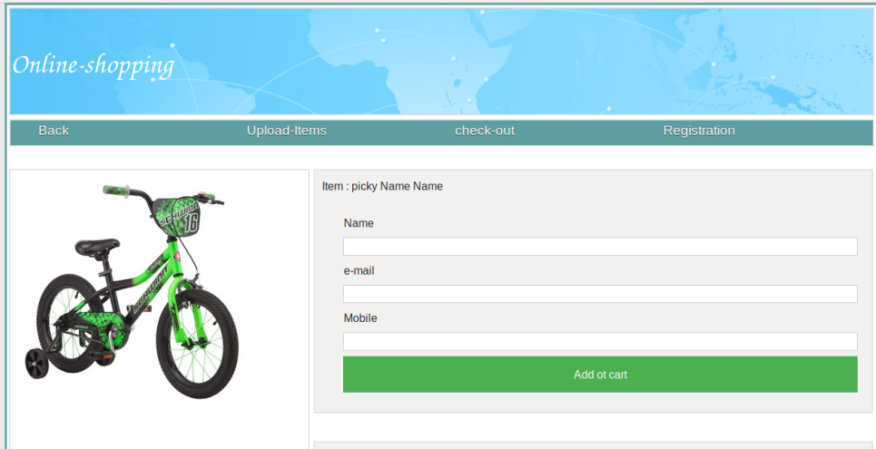
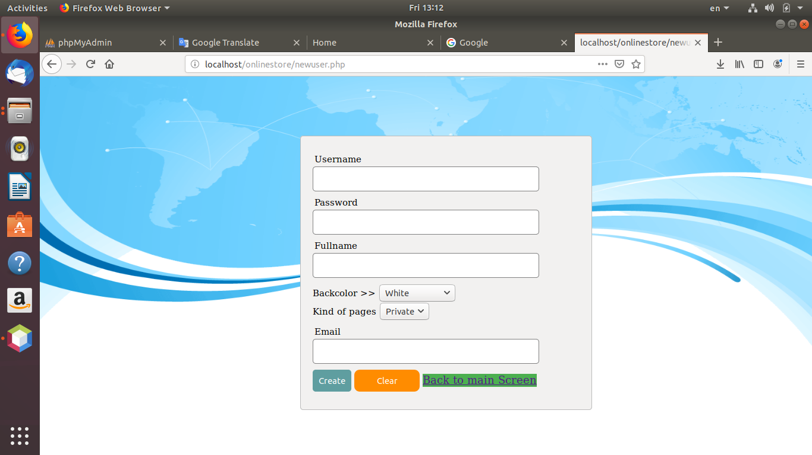


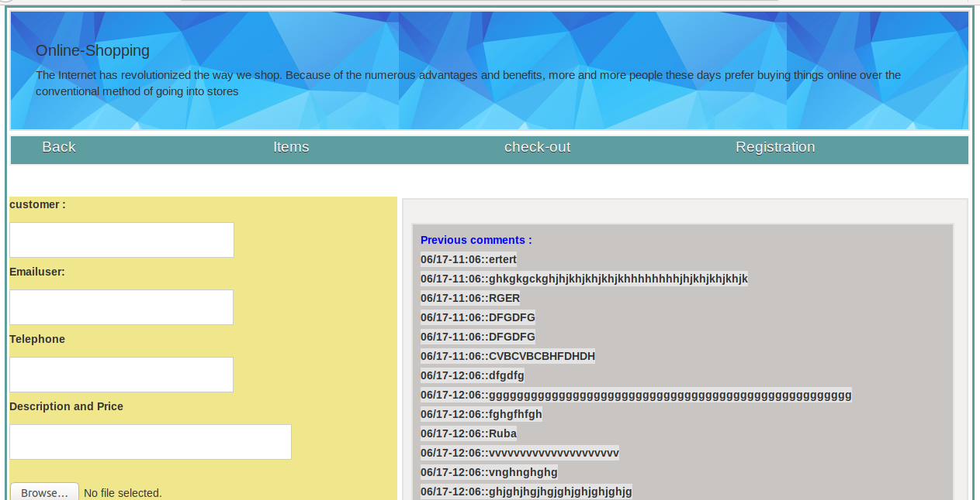
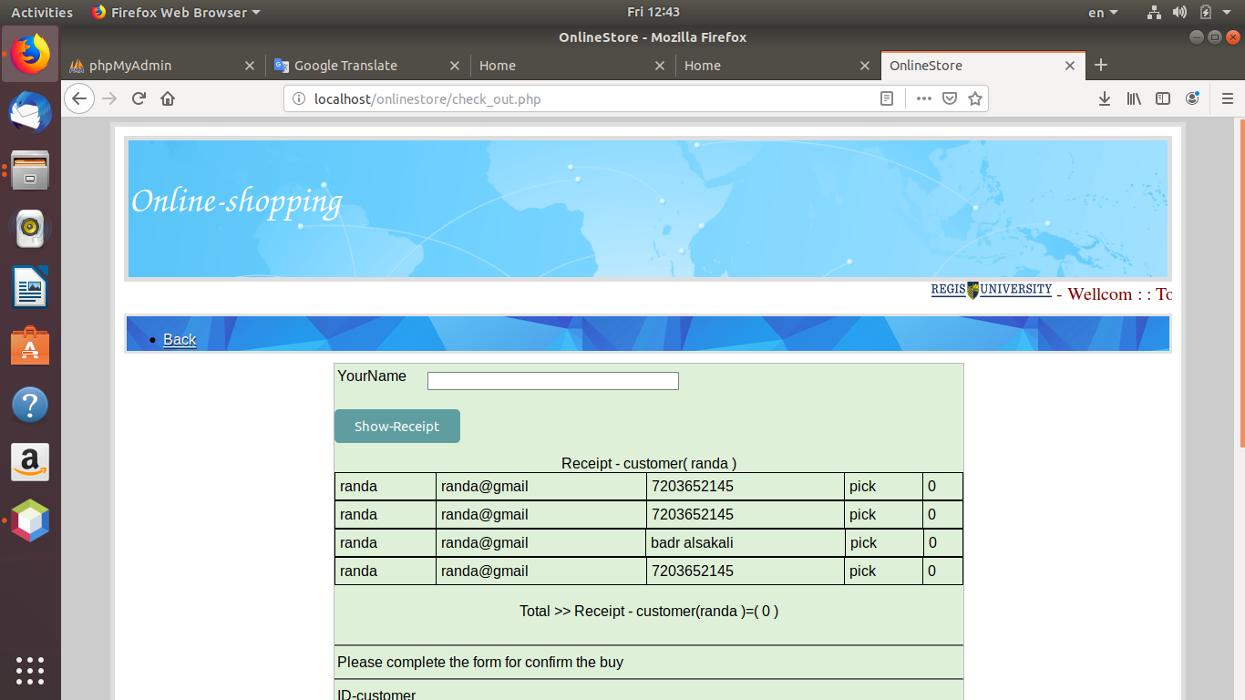
Items page –Add item To cart
Registration page – Add new user
Upload page –Add item To App
check out page – Byu

Slide 9
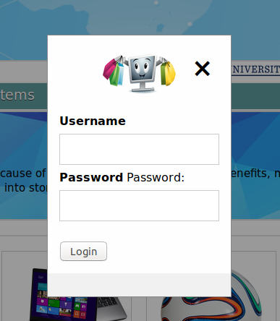
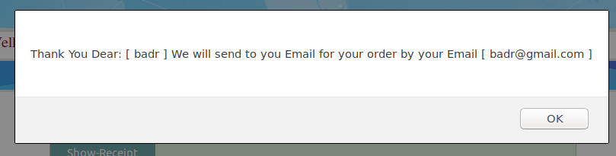
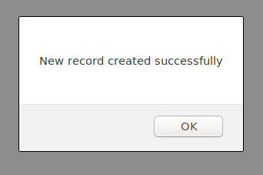
Forms for Login and Alerts
Login
Alerts

Slide 10
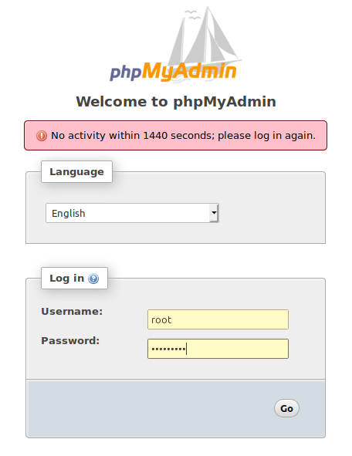
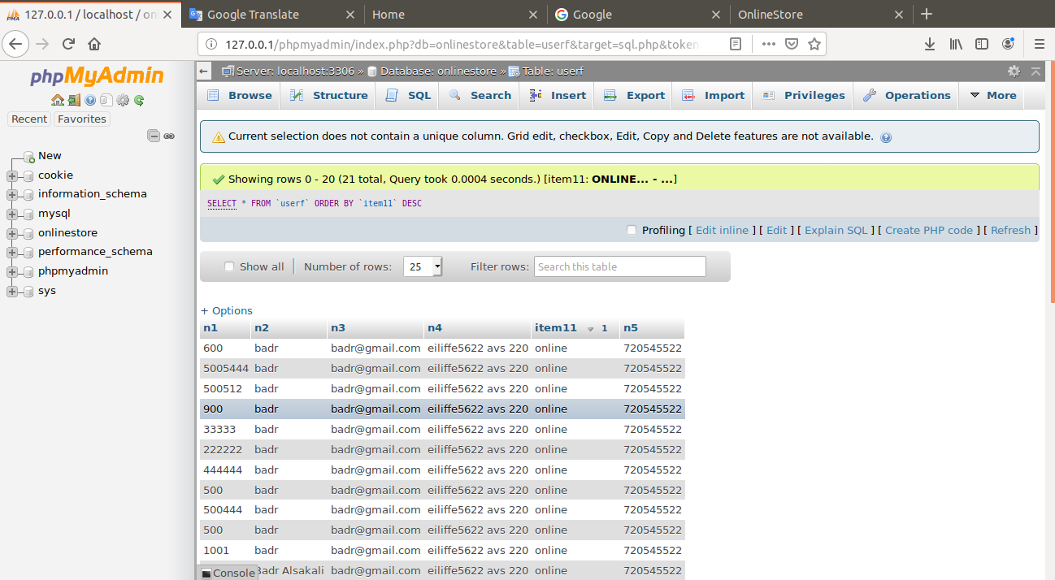
- Create database “ onlinestore”
- Create tables
- Edit fields
- Make Dump
phpMyAdmin

