Slide 1

APMP Professional Certification
Demonstrates advocacy of best practices achieved through leadership and communication

Slide 2
Why pursue professional certification?
Demonstrates:
Significant contribution to the profession
Thought leadership and champion for improvement
Competent managing senior level stakeholder and organizational engagement
Ability to lead by directing others to achieve broad-reaching goals
Superior communication and presentation skills (BoK)
Sustainability of the impact

Slide 3
Three steps
1
Demonstrate a SIGNIFICANT IMPACT
2
Assessment of SOFT SKILLS
3
Demonstrate COMMUNICATIONS SKILLS

Slide 4
Show your impact
To achieve PROFESSIONAL certification, you must …
BE A CURRENT APMP MEMBER who holds Practitioner certification
HAVE 7 YEARS’ experience in bid and proposal environment
PROVIDE A REFERENCE who can rate your leadership, communications and behavioral skills
COMPLETE THE PPIP or Proposal Professional Impact Paper explaining how you have had a significant impact on your organization and/or the profession
ATTEND A TIMED COMPETENCY BASED INTERVIEW during which you present your impact slides and answer questions

Slide 5
Select an impact
The impact you choose must represent a significant achievement demonstrating personal commitment and initiative, and provide a sustainable improvement in areas such as:
Customer interaction
Proposal and bid management
Individual or organizational development
Proposal processes or infrastructure improvement
The impact must show:
you were personally responsible
Managed senior stakeholders buy in and expectations
Led the impact tasks and activities.
You must be able to demonstrate that your organization, a client’s organization, or the proposal profession had a quantifiable gain

Slide 6
What is your impact
Once you have decided on your impact, consider how you can answer each of the following questions:
What significant contribution does this impact make to your organization or the profession?
Which senior level stakeholders and stakeholders within the organization had to be engaged and how did you manage their expectations throughout?
How did you demonstrate that you led others to achieve your impact?
How did you demonstrate thought leadership?
Which ways or methods, did you use to demonstrate superior communication and presentation skills?
What did you do, or put in place, to ensure that your impact is sustainable?

Slide 7
Examples of impact
Set up team to diagnose root cause(s) and build corrective action to address re-occurring outcomes from lessons learned
Educated sales and marketing communities on the business benefits of bid professionalism
Led creation of common terminology and techniques across proposal teams
Changed perception of role of proposal support within organization or on a specific pursuit, resulting in sustained professionalism and quality of activity.
Developed and delivered a white paper discussing culture change and how it improved win rates across the organization
Presented a case study of how best practices were followed at an APMP meeting or conference
Contributed to or, extended a specific topic in the APMP Body of Knowledge, describing the research required.

Slide 8
Slide design is important and assessed
1
Be compliant with the
APMP PPIP template
Follow the APMP template exactly, do not re-order or interfere with the slide headings
2
Use PowerPoint to communicate information well
Use a good balance of graphics and bullets
3
Demonstrate good
Presentation technique
Consistently apply the best practice principles documented in the APMP BoK. Reference ‘Developing and Delivering Presentations’

Slide 9
The PPIP: your story in 12 slides
1-2
Summary of Your Impact (1 or 2 slides)
Describe what your impact was or provided for your organization or the profession
Describe how you understood the impact was required
Describe who needed to be involved to ensure your impact was a success
Describe how you measured the results

Slide 10
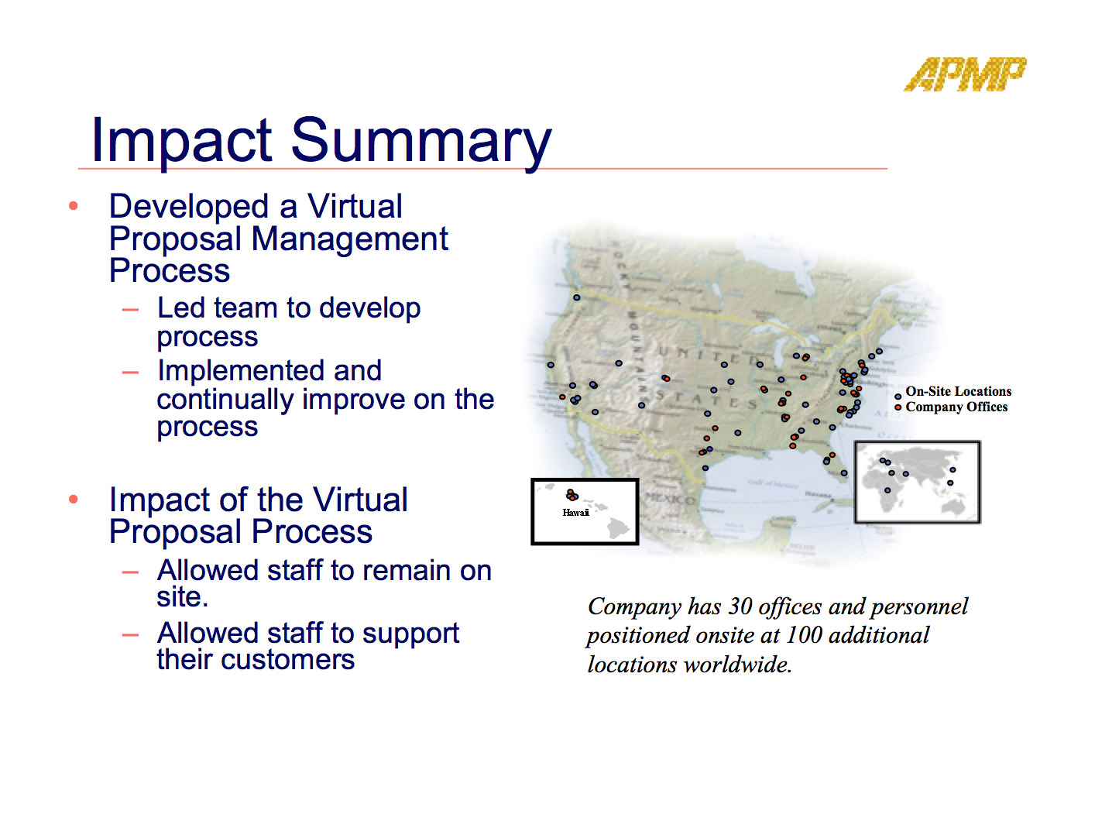
Example of an impact summary (IN 1 SLIDE)

Slide 11
The PPIP: up to 9 slides for the detail
3-4
5-6
7-8
The Situation (1 or 2 slides)
The Tasks (1 or 2 slides)
The Activities (1 or 2 slides)
What was the challenge within your organization or profession that required your impact
Who the key senior stakeholders were and how you achieved their buy-in
Who the wider stakeholders were within your organization
The task(s) that required activities to achieve the desired results
Who the task(s) impacted and how they were impacted
Size of the effort required to complete the activities and over what time period
The activities that were undertaken to achieve each task
How you monitored, reported and communicated progress of the activities to all key stakeholders

Slide 12
Tasks vs Activities – what’s the difference?
Tasks:
A Task is a high level description of the different areas of work that need to be completed to achieve your impact.
Activities:
Activities are related to each task, a number of activities will have to be completed to achieve each task. Activities describe the detail of how each task has been completed.

Slide 13
The PPIP: your story in 12 slides
9-10
11-12
The Results (1 or 2 slides)
Continuing Professional Development (1 or 2 slides)
The results you achieved - actual benefits to your organization or the profession
Quantitative measures — hard performance indicators (e.g., specific financial figures – before and after win rates, capture rates, efficiencies in staff productivity) to quantify the effect
Qualitative measures —improvement in staff morale, or specific changed behaviors, especially if these can be associated to time or efficiency savings
Describe how you measured the results and made them sustainable in the organization
Your specific continuing professional development plan for the next 24 months
How these activities will benefit you and others within the profession

Slide 14
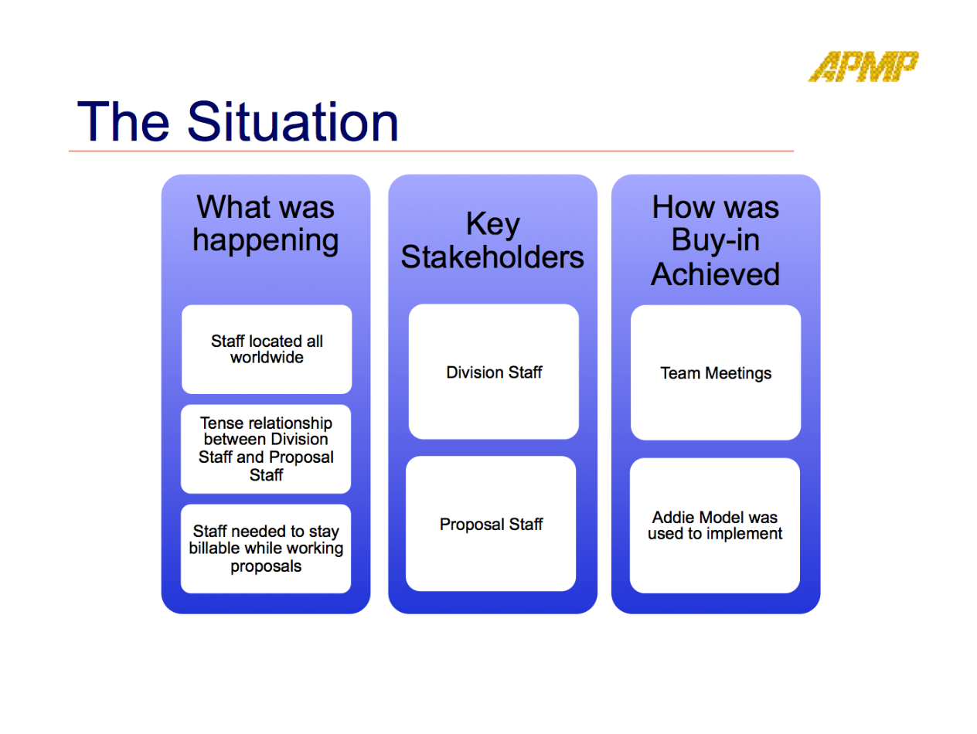
Example -the situation (1 OR 2 SLIDES)
Describe what your impact was or, provided for your organization or the profession
Describe how you understood the impact was required
Describe who needed to be involved to ensure your impact was a success
Describe how you measured the results

Slide 15
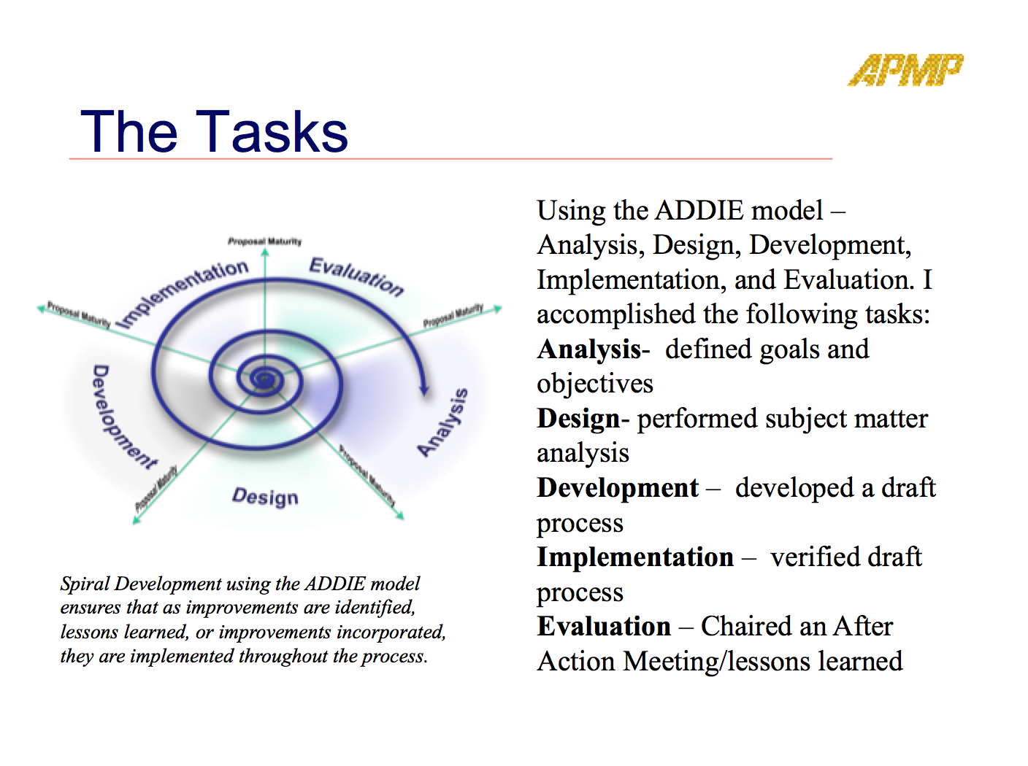
Example -the tasks (1 OR 2 SLIDES)
The task(s) that were required to achieve the desired results
Who the task(s) impacted and how they were impacted
The approach you took to ensure the task(s) were achievable

Slide 16
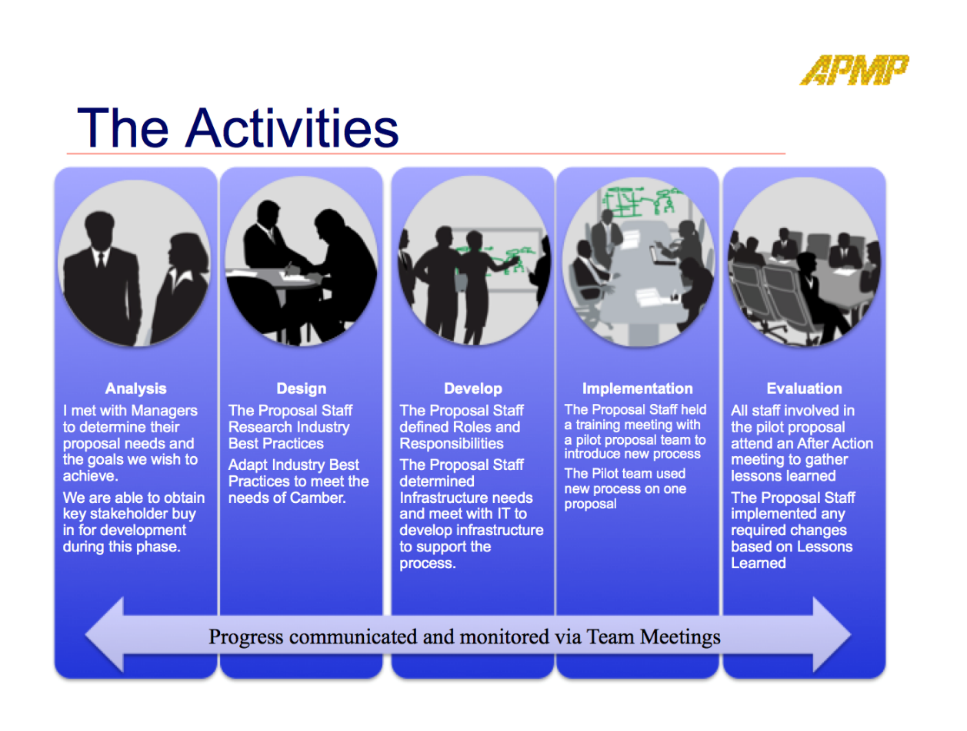
Example - the activities (1 OR 2 SLIDES)
The activities that were undertaken
How you set and managed the activity timeline
How you managed the activities to ensure completion
How you communicated progress of the activities to all key stakeholders

Slide 17
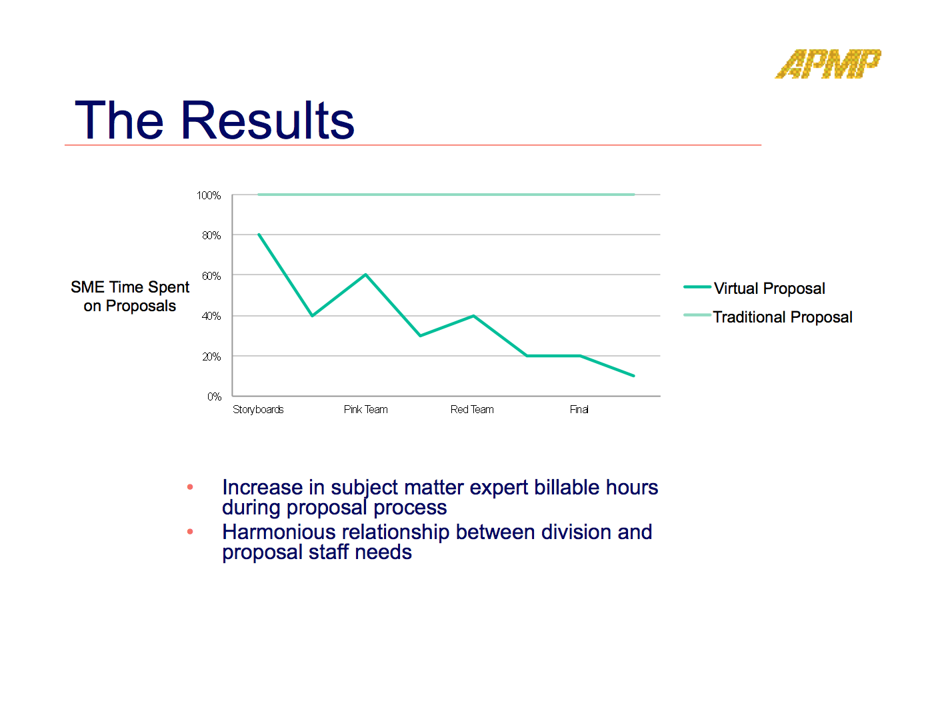
Example - the results (1 OR 2 SLIDES)
The results you achieved
How you made sure the results were sustainable
The actual benefits to your organization or the profession
Describe how you measured the results and benefit

Slide 18
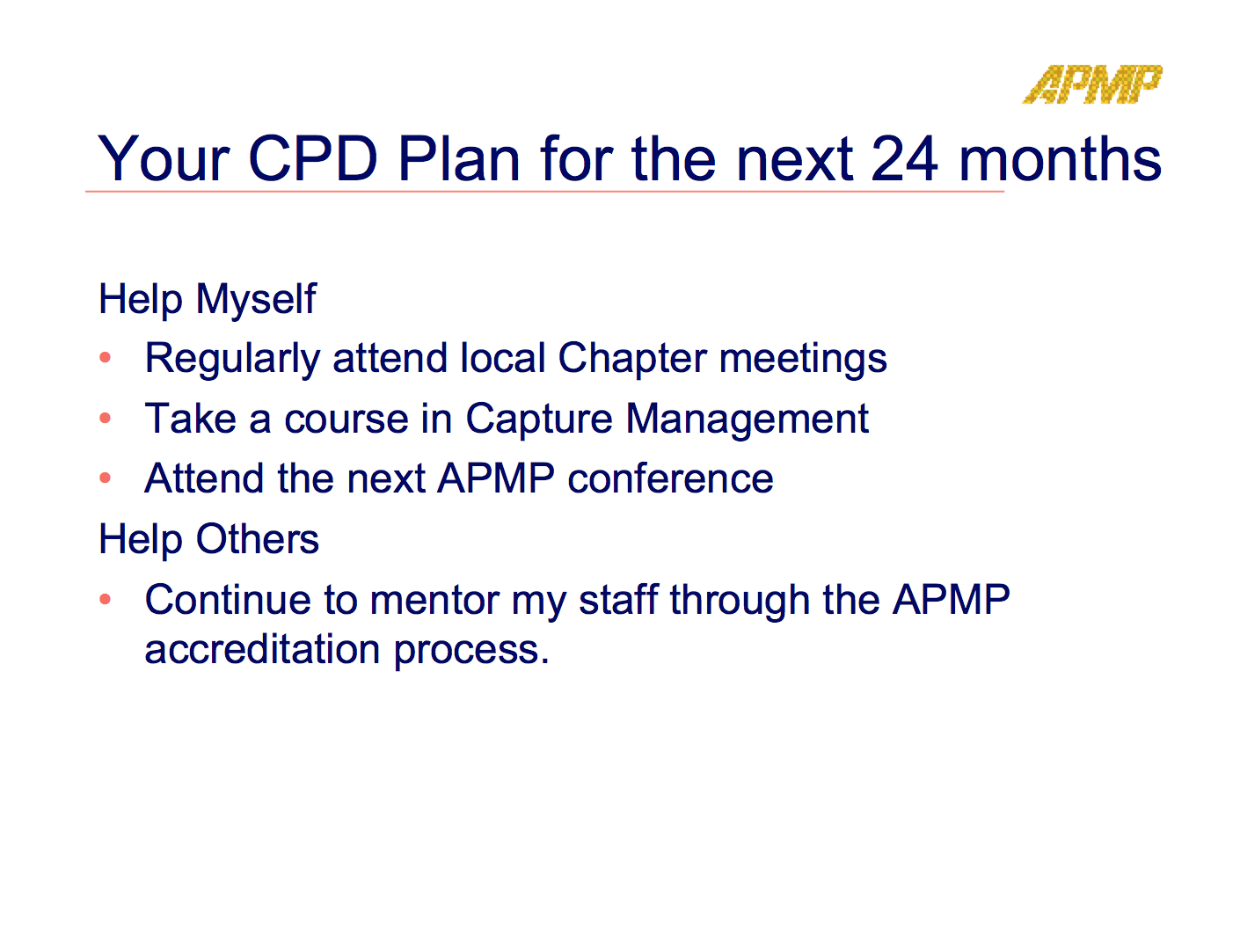
Example - CPD plan (1 OR 2 SLIDES)
Your continuing professional development plan for the next 24 months
How these activities will benefit you and others within the profession

Slide 19



PPIP Presentation / Q&A session
Your impact has been reviewed and approved — now it’s all about communications!
After your presentation, you will be asked 4 competency based questions
Time limit for your presentation is 20 minutes with questions limited to clarification

Slide 20
Example of interview question
“Give an example of a time when someone misunderstood what you were attempting to communicate to them. Explain why the misunderstanding occurred, how you resolved the situation and what you, personally, learned from this experience.”
Prepare and practice your answers ahead of time using STAR
Answers to the questions must be in the STAR format
You may think you know a “better” way, but STAR is the requirement

Slide 21
The STAR methodology
An international standard for answering behavioral questions
Situation — describe a situation or problem that you encountered within the context of the Impact you have described in your PPIP
Task — describe the task(s) that the situation required or your ideas for resolving the problem
Action — describe the action(s) you took, and the obstacles that you had to overcome
Results — highlight the outcomes achieved from the actions you took
Lessons Learned – describe the lessons that you learned from this situation

