Slide 1
FinSecure Pay: Automating a Cloud-Native DevOps Pipeline
Capstone - DevOps, Cloud and AI | Individual submission
• Business problem: small fintech needs a fast, repeatable, secure way to ship a transaction-validation API with minimal manual work.
• My role: DevOps engineer - source to production-style Kubernetes deployment, with security, monitoring, alerting and recovery.
• Solution: Git/GitHub -> Jenkins -> Maven/JUnit -> SpotBugs + Trivy gates -> Docker -> Kubernetes -> Prometheus/Grafana/Loki -> email alerts.
• Result: every change is built, tested, scanned, deployed, observed and can be rolled back from one pipeline.
• GitHub: https://github.com/badri35/capstone
• Jenkins (local): http://localhost:8081 | Grafana: http://localhost:3000 | Mailpit inbox: http://localhost:8025

Slide 2
Task 1 - Application and Version Control
Spring Boot 4 / Java 17 / Maven / JUnit 5
• GET /health -> {status: UP, version}
• POST /validate -> 200 APPROVED | 422 REJECTED + all failed rules | 400 malformed JSON
• Rules: id format, account format (8-20 A-Z0-9) and source != destination, 0 < amount <= 10,000.00 with <= 2 decimals, currency in USD/EUR/GBP/INR/SGD
• 19 tests: 14 unit (rules, boundaries, multi-error) + 5 MockMvc (HTTP contract, Prometheus endpoint)
• Business metric finsecure_transactions_total{result}; JSON logs to stdout
$ git log --oneline
457de4b chore: publish image under Docker Hub namespace badri3590
2f884f1 docs: README, design doc, monitoring/logging fixes, evidence and capstone deck
5c89eb3 Revert "test: introduce controlled failing test (pipeline must block deployment)"
60db28c test: introduce controlled failing test (pipeline must block deployment)
a47c498 security: migrate to Spring Boot 4.1.2 (Spring Framework 7) to clear remaining HIGH/CRITICAL CVEs
1e536db security: upgrade Spring Boot 3.3.5 -> 3.5.16 to remediate HIGH/CRITICAL CVEs
077c333 fix: defensive copy in ValidationResult (SpotBugs EI_EXPOSE_REP); add monitoring, scripts, design doc
b07ddff feat: Dockerfile, Kubernetes manifests and Jenkins pipeline with security gates
bbe9077 feat: Spring Boot transaction validation API with /health and /validate, JUnit 5 tests
$ mvn clean verify
Tests run: 19, Failures: 0, Errors: 0, Skipped: 0
BUILD SUCCESS

Slide 3
Tasks 2 & 3 - Containerisation and Kubernetes
Multi-stage non-root image; 2 replicas; probes; ConfigMap; LoadBalancer Service
• Dockerfile: Maven build stage -> eclipse-temurin:17-jre, non-root user, HEALTHCHECK, APP_VERSION build-arg
• Image pushed by the pipeline to Docker Hub: https://hub.docker.com/r/badri3590/finsecure-pay (tags 1.0.13, latest); /health tested in container: {status:UP,version:1.0.x}
• Deployment: 2 replicas, RollingUpdate (maxUnavailable 0), readiness + liveness probes on /actuator/health/*, resource limits, PDB
• ConfigMap: LOG_LEVEL, APP_ENV; optional Secret for API key
• Recovery: deleted a pod -> replacement Running 1/1 in ~15 s while service stayed up
• Manifests are cloud-neutral (Service type LoadBalancer) - verified on minikube; same YAML applies to EKS/AKS/GKE
## kubectl get deploy,pods,svc,cm
NAME READY UP-TO-DATE AVAILABLE AGE CONTAINERS IMAGES
deployment.apps/finsecure-pay 2/2 2 2 69m finsecure-pay docker.io/badri35/finse
NAME READY STATUS RESTARTS AGE IP NODE NOMINATED NOD
pod/finsecure-pay-7658cf45b8-cxwt6 1/1 Running 0 63s 10.244.0.15 minikube <none>
pod/finsecure-pay-7658cf45b8-fknrf 1/1 Running 0 52s 10.244.0.16 minikube <none>
NAME TYPE CLUSTER-IP EXTERNAL-IP PORT(S) AGE SELECTOR
service/finsecure-pay LoadBalancer 10.107.113.17 <pending> 80:30779/TCP 69m app=finsecure-pay
NAME DATA AGE
$ kubectl delete pod/finsecure-pay-7658cf45b8-cxwt6
pod "finsecure-pay-7658cf45b8-cxwt6" deleted from finsecure namespace
NAME READY STATUS RESTARTS AGE
finsecure-pay-7658cf45b8-6vx7w 0/1 Pending 0 0s
finsecure-pay-7658cf45b8-cxwt6 1/1 Terminating 0 63s
finsecure-pay-7658cf45b8-fknrf 1/1 Running 0 52s
finsecure-pay-7658cf45b8-6vx7w 0/1 ContainerCreating 0 0s
finsecure-pay-7658cf45b8-cxwt6 0/1 Error 0 63s
finsecure-pay-7658cf45b8-6vx7w 0/1 ContainerCreating 0 0s

Slide 4
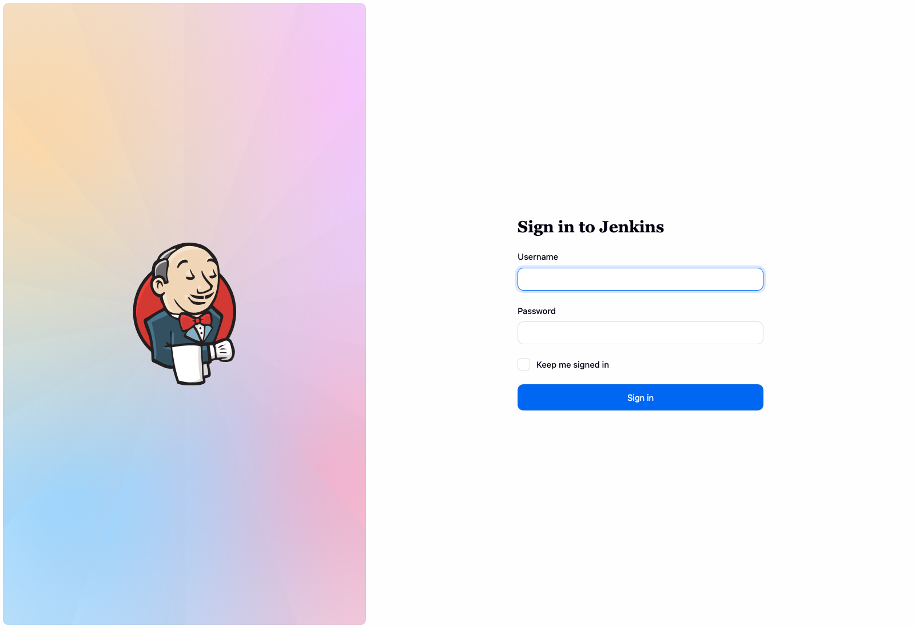
Task 4 - CI/CD Pipeline (Jenkins)
Checkout > Build > Test > Package > Security > Container Build > Image Scan > Push > Deploy
• Jenkinsfile in repo; SCM polling every minute triggers on commit
• #6 controlled failing test -> pipeline FAILED at Test; deployment untouched (still 1.0.5)
• #7 fixed -> rolled out 1.0.7 (rollout status OK)
• #8 ACTION=rollback -> back to 1.0.5
• Failed rollout auto-runs kubectl rollout undo
• Email on every build (Jenkins Email Extension)
Jenkins job history: builds 1-8

Slide 5
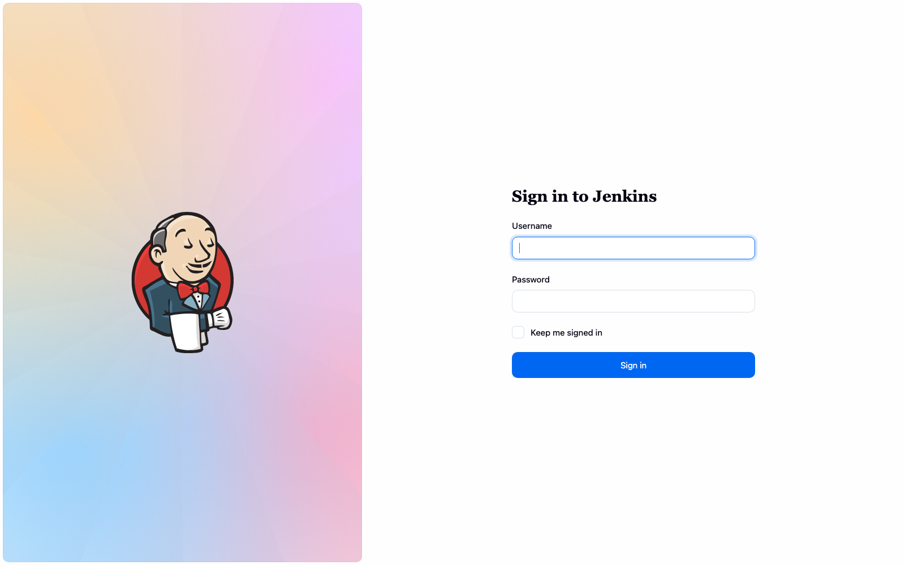
Task 5 - DevSecOps and Security Gates
SpotBugs (static analysis), Trivy fs (deps + secrets), Trivy image; HIGH/CRITICAL blocks release
• #2: SpotBugs found EI_EXPOSE_REP in ValidationResult -> fixed with defensive copies
• #3: Trivy: 38 HIGH/CRITICAL (8 CRITICAL) in Spring Boot 3.3.5 deps -> BLOCKED
• #4: Boot 3.5.16 still 11 findings (fix only in Spring Framework 7) -> BLOCKED
• #5: migrated to Spring Boot 4.1.2 -> 0 findings, image scan clean -> deployed
• Secrets: none in git; Jenkins credentials store (withCredentials); Grafana password generated into a K8s Secret; Trivy secret scan in the gate
Build #3: gate FAILED - Container Build/Push/Deploy skipped
$ trivy fs ... (after remediation)
│ pom.xml │ pom │ 0 │ - │
Legend:
$ trivy image finsecure-pay:1.0.5
app/app.jar jar 0 vulnerabilities (Clean)

Slide 6
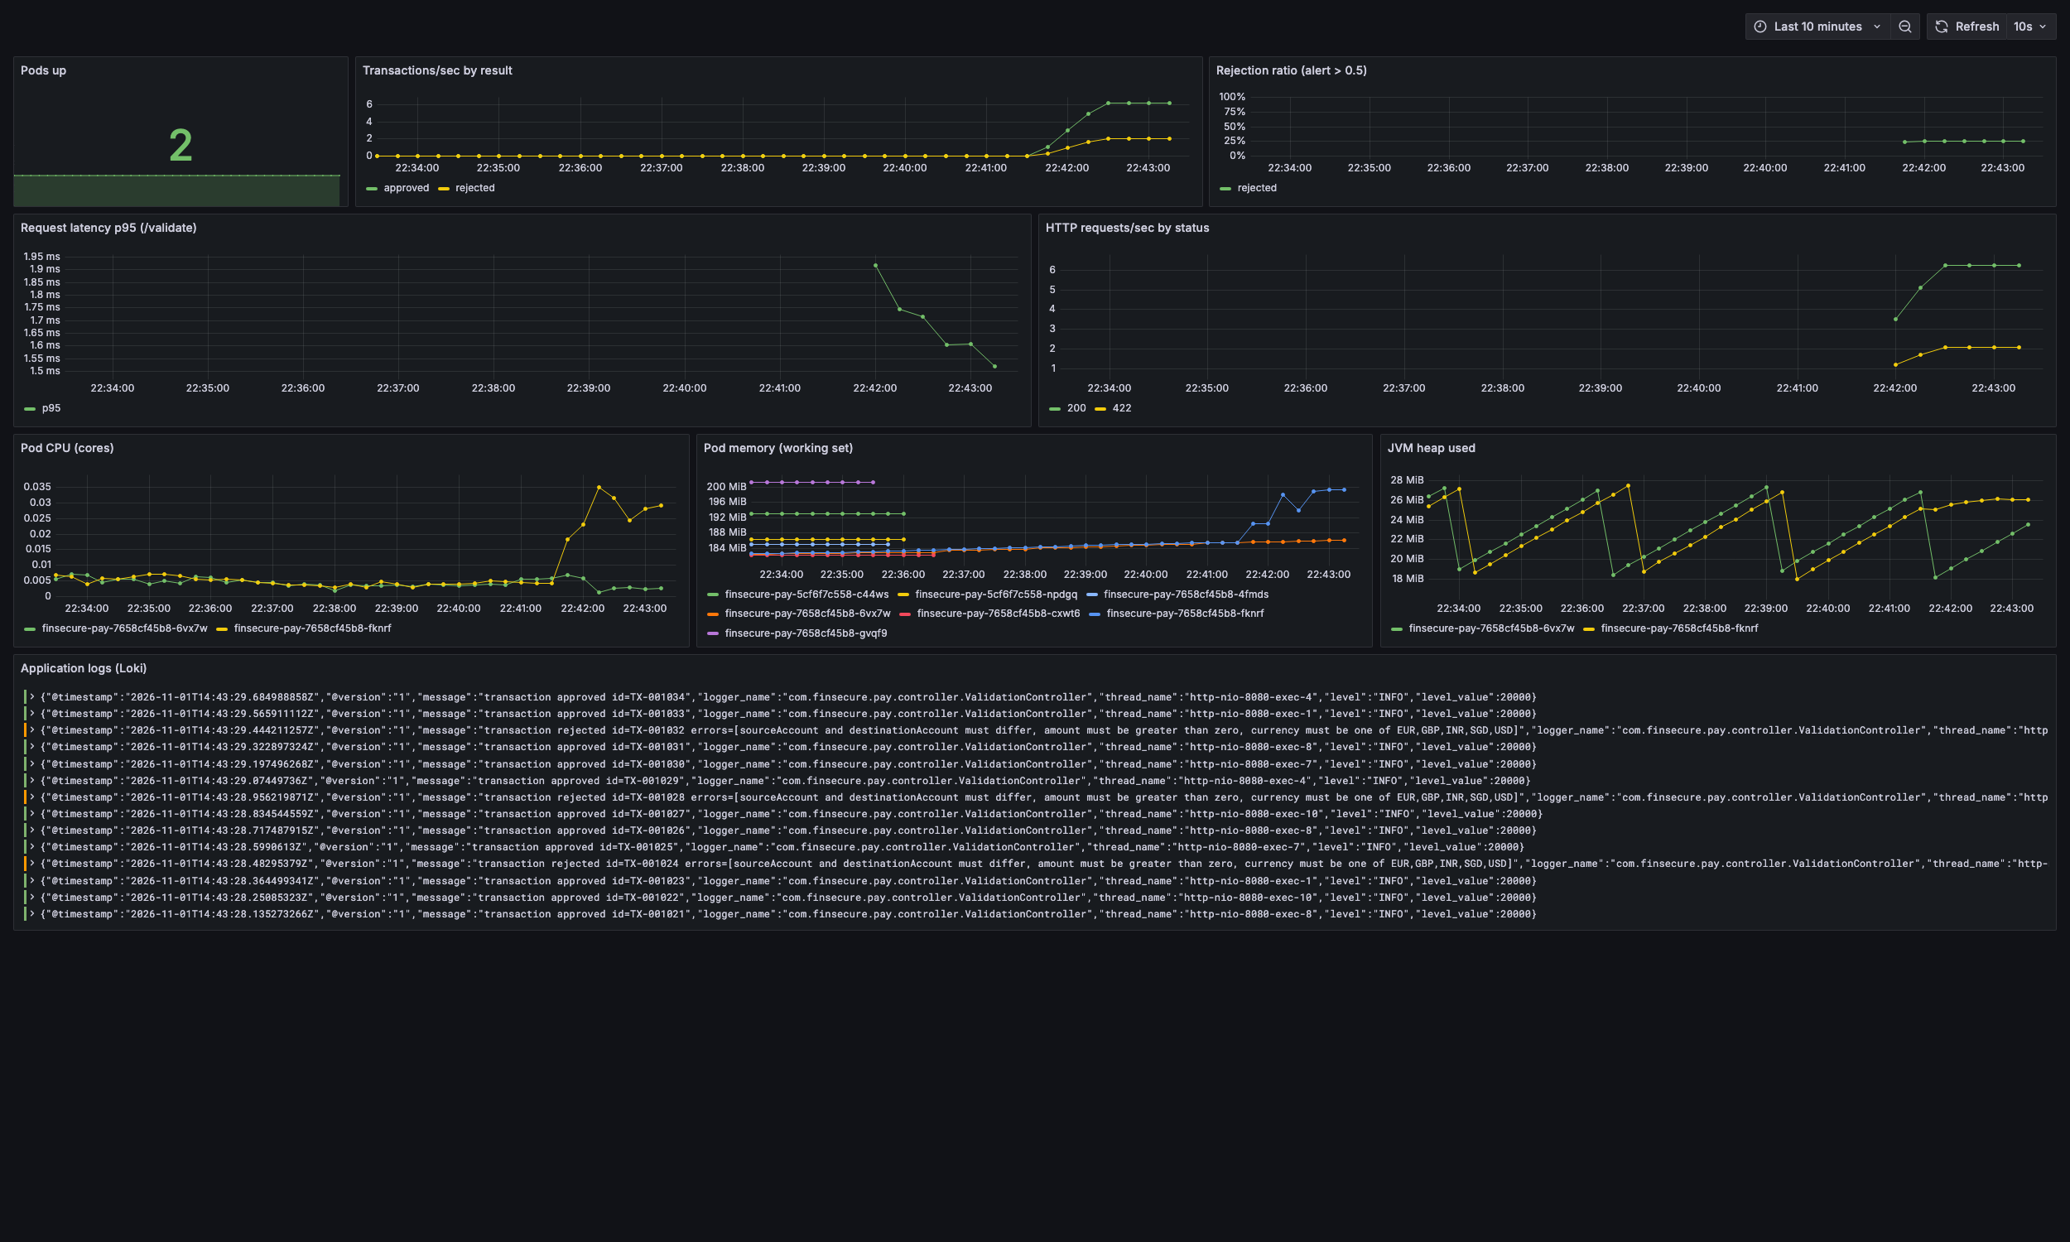
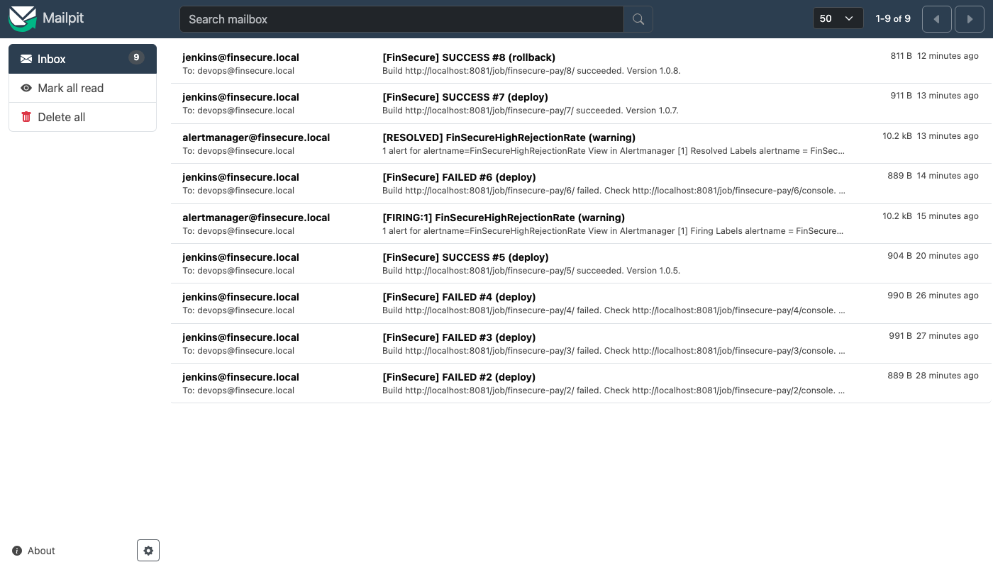
Task 6 - Monitoring, Alerting and Logging
Prometheus + Grafana + Alertmanager + Loki; email via SMTP (Mailpit)
Received alert + Jenkins build emails
• Alert FinSecureHighRejectionRate (>50% for 30s) triggered with bad traffic -> FIRING -> email received
• Also: InstanceDown, HighMemory
• Logs: kubectl logs -l app=finsecure-pay, or Grafana/Loki {app="finsecure-pay"}
Live Grafana dashboard: pods, tx/s, rejection ratio, p95 latency, CPU, memory, JVM heap, logs

Slide 7
Task 7 - Architecture and AI Use Case
End-to-end architecture
Developer
git push
GitHub
Jenkins
build+test
SpotBugs
Trivy fs
Docker build
Trivy image
Registry
Docker Hub
kubectl set image
rollout / undo
Kubernetes: Service (LB) -> 2 pods | ConfigMap | Secret | PDB
Prometheus
+ Alertmanager
Grafana
Promtail
-> Loki
SMTP
(email)
• AI use case: LLM-assisted incident triage + anomaly detection. On a firing alert, a service collects Prometheus series, Loki logs, rollout history and Jenkins build info, masks PII, and asks an LLM for probable cause, cited evidence and a recommended action (e.g. roll back to 1.0.5).
• Why AI: correlating logs/metrics/deploys is slow and static thresholds miss unseen patterns. Benefits: lower MTTR, fewer false pages.
• Governance: advisory only (human approves rollback), cite evidence, mask account/transaction data, private model endpoint, audit prompts, deterministic fallback alerts.
• Integration: second Alertmanager webhook receiver in the monitoring namespace querying the existing Prometheus/Loki APIs.

Slide 8
Core Test Cases and Results
All executed in this environment; evidence in repo /evidence
Test case | Result
Run unit tests | 19/19 pass (Jenkins #5, #7)
Controlled failing test | Jenkins #6 FAILED at Test; deployment not run; cluster stayed on 1.0.5
Run container, GET /health | {"status":"UP","version":"1.0.x"}
Inspect deployment | 2/2 pods Running and Ready (readiness probe)
Deploy new version | #7 rolled out 1.0.7 - rollout status successful
Delete a pod | Replacement created automatically, 2/2 Ready again
Critical/high finding | #3 and #4 blocked by Trivy gate; #5 clean after upgrade
Monitoring condition | Rejection-rate alert FIRING; email received in Mailpit
Rollback | #8 ACTION=rollback -> 1.0.5

Slide 9
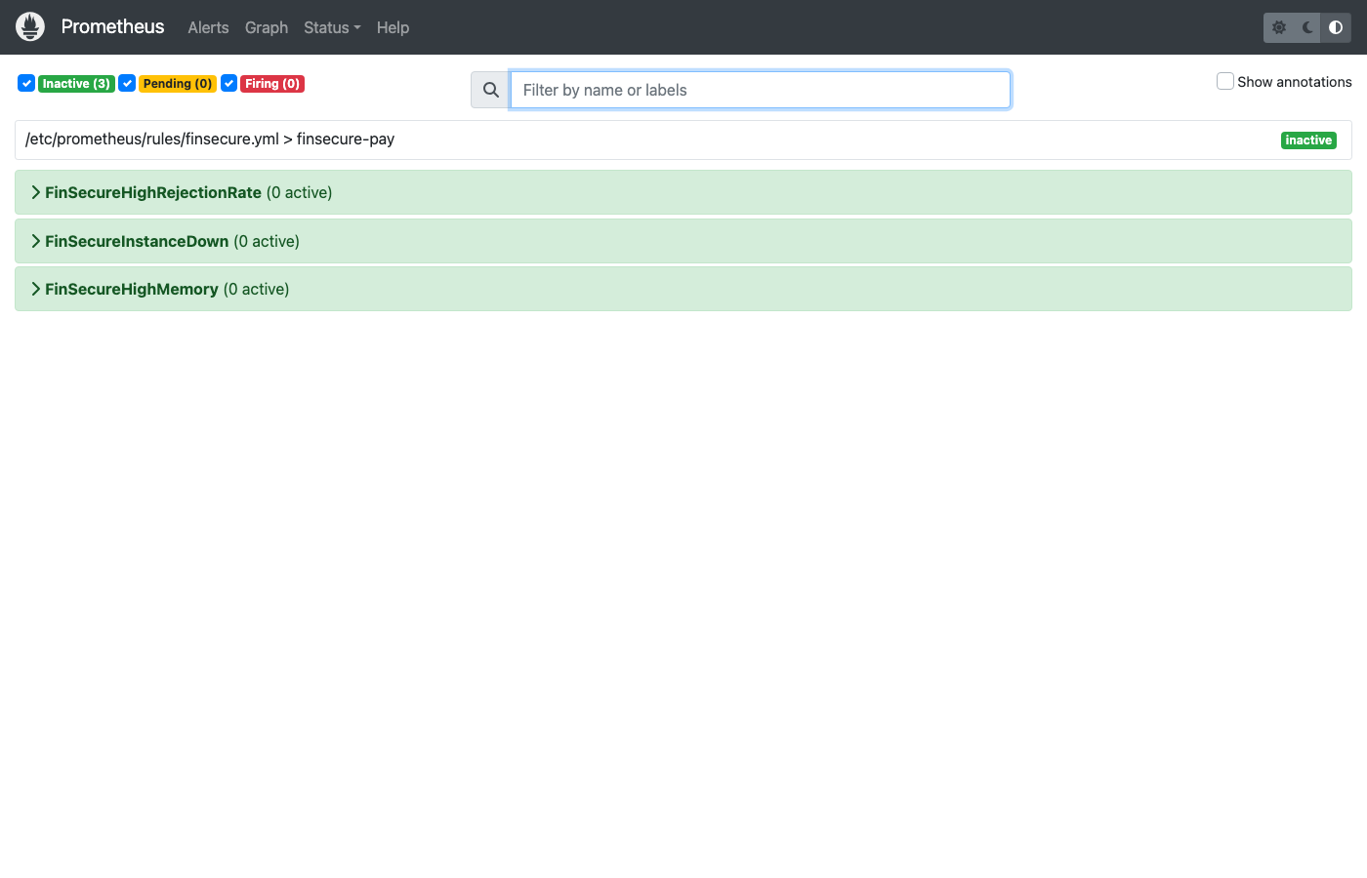
Additional Evidence - Failed Test and Rollback
Build #6: failed test stops the pipeline before deployment
Build #8: rollback to known-good version
• Rollback command inside the pipeline: kubectl rollout undo deploy/finsecure-pay
• Revision history keeps 5 releases (revisionHistoryLimit)
Prometheus alert FIRING

Slide 10
Lessons Learned and Future Improvements
• Lesson: a real baseline scan found real CVEs - gates are only convincing on real data; the fix required a major framework upgrade (Boot 3 -> 4).
• Lesson: multi-arch matters (no arm64 JRE-alpine tag); pin bases and test on target architecture.
• Lesson: observability needs to be validated end to end (Promtail discovery failed silently; static paths fixed it).
• Next: deploy to a managed cluster (EKS/AKS/GKE) with cloud secrets manager, Docker Hub push in pipeline, GitHub webhook trigger.
• Next: GitOps (Argo CD), HPA, cosign image signing + SBOM, OWASP ZAP DAST, Sonar quality gate, canary releases.
• Next: implement the AI triage service; add SLO-based alerts.
• Repository: https://github.com/badri35/capstone | Design doc: docs/DESIGN.md | Evidence: evidence/

