Slide 1
COURSE CURATOR AI
Dynamic, Personalized Syllabus Curation from Video Lectures
A Next-Gen E-Learning Platform targeting the VARK Learning Styles Model
Hackathon Submission Deck | Interactive AI Demo

Slide 2
The E-Learning Engagement Gap
Passive Learning Exhaustion
One-Size-Fits-All Approach
• Hours of raw, unstructured video lectures cause student burnout.
• No way to quickly search, revise key concepts, or map out dependencies.
• High drop-out rates in online courses due to monolithic timeline video players.
• Students absorb information differently (Visual, Auditory, Read-Write, Kinesthetic).
• Traditional platforms only present the raw video feed, neglecting active revision.
• No automated self-assessment or concept validation, preventing personalized mastery.

Slide 3
Our Solution: Course Curator AI
AI Syllabus Parser
Converts any educational video URL into logical, structured course modules and sequential topic nodes.
Interactive Concept Path
Visualizes prereqs and concept flows, letting students chart their learning paths organically.
Adaptive Learning Profiles
Real-time client telemetry tracks student interactions and dynamically adapts the UI tabs layout.

Slide 4
Dynamic VARK Personalization Engine
The platform monitors background user interactions to dynamically customize tab layouts, supporting diverse cognitive preferences:
👁️ Visual
🔊 Auditory
📝 Read-Write
⚡ Kinesthetic
Trigger:
Mindmap/Flowchart use
Trigger:
Video pauses & rewinds
Trigger:
Reading summaries
Trigger:
Quick quiz interactions
Prioritizes visual mindmaps and step-by-step logic workflows.
Surfaces full detailed video chapters with seeking and audio.
Features bulleted insights and in-depth structured concept overviews.
Loads interactive quizzes and immediate application modules first.

Slide 5
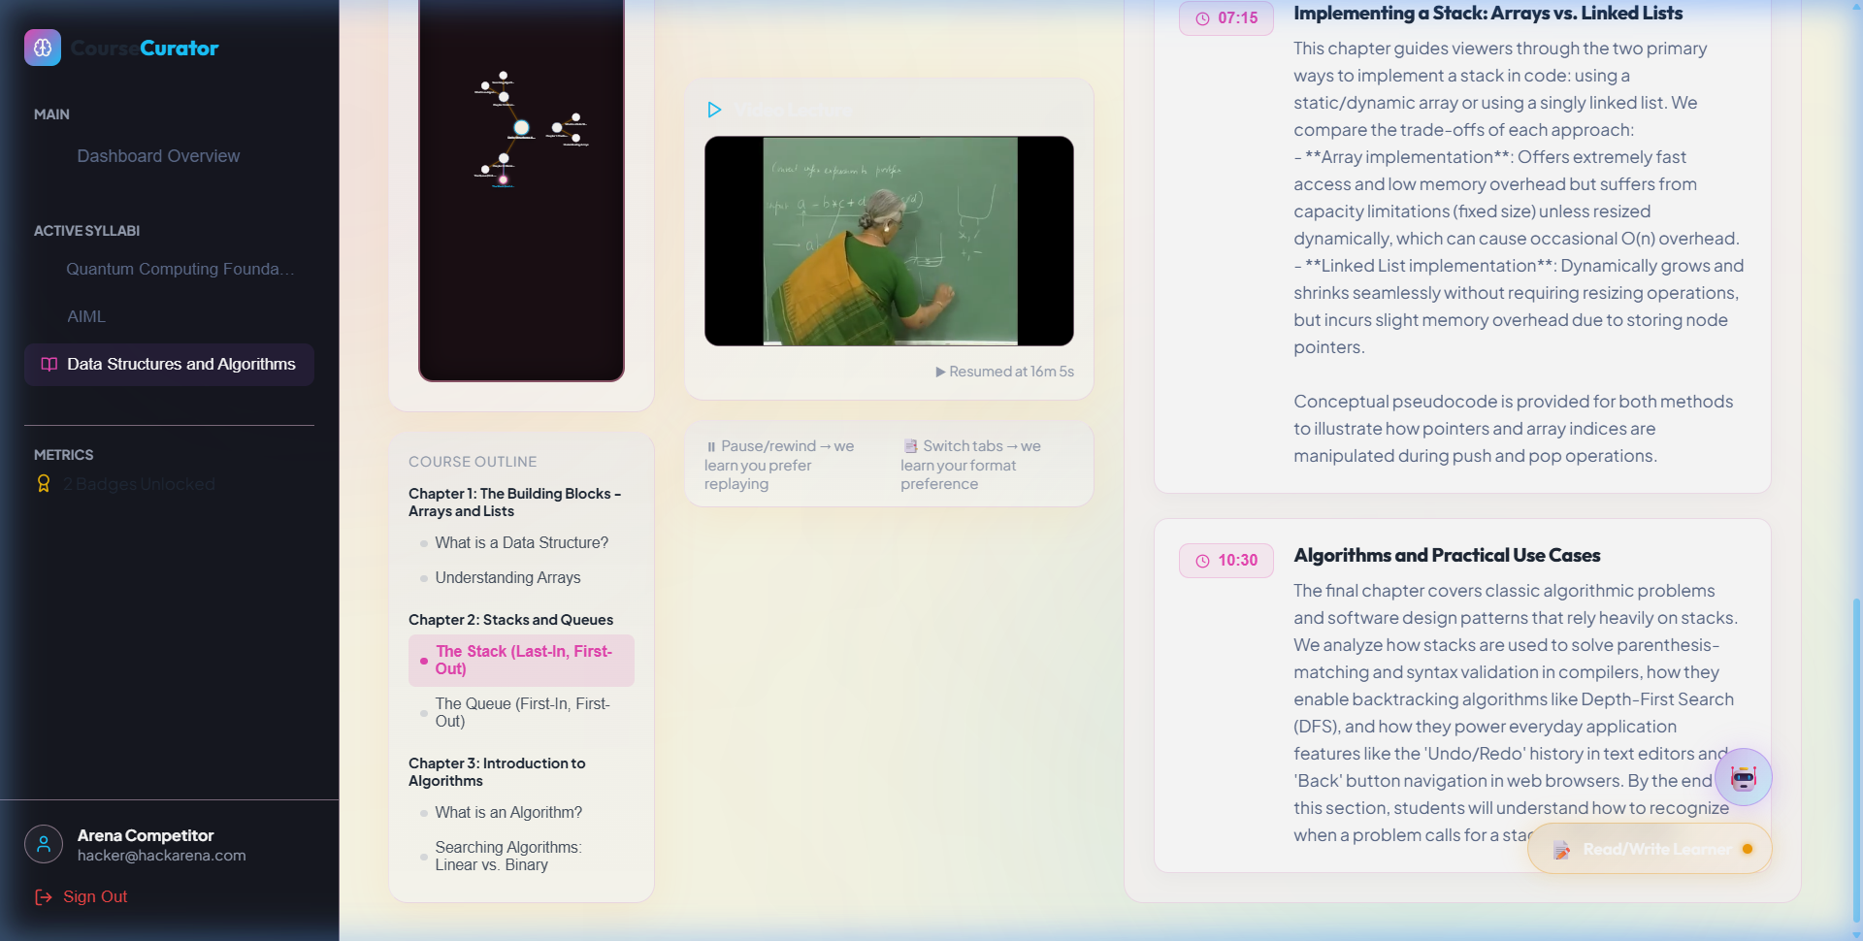
AI Video Chapters & Interactive Seek
• Automated transcription fetches video subtitles, feeding it to Gemini 3.5 Flash.
• Partitions video timeline into structured milestones with comprehensive conceptual details.
• Interactive seek button: Click any timestamp to immediately control and sync the video player.
• Rich local fallback databases guarantee detailed data structures course information is always offline-available.

Slide 6
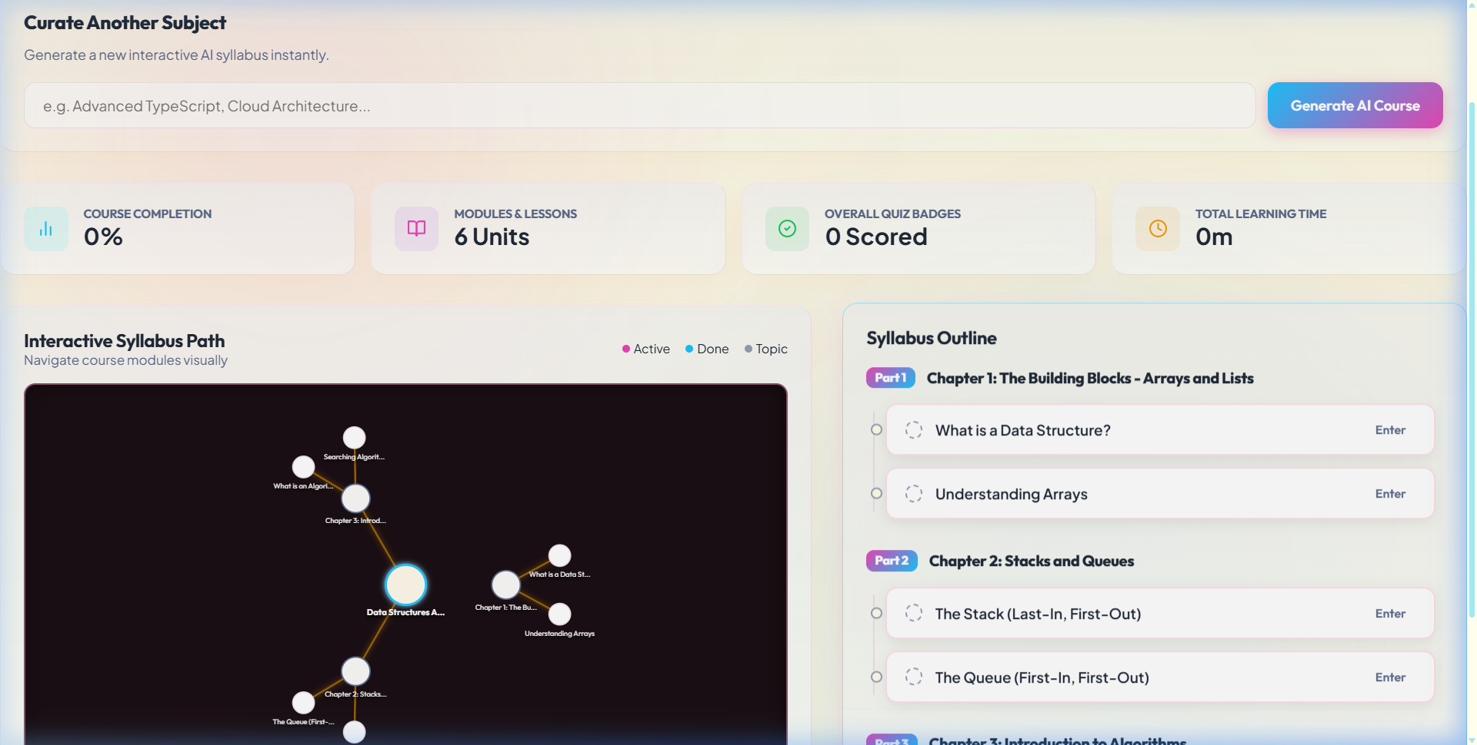
Syllabus Path & Mindmap Visualizations
• Graph nodes display dependencies, lock states, and completion ticks.
• Real-time updates sync topic nodes with progress metrics and quiz state.
• Direct concept links: Click any node to instantly populate mindmaps and flowcharts in the panel.
• High contrast "Spiritual Crimson" light theme and customized dark mode layouts support long study sessions.

Slide 7
Technical Architecture & Tech Stack
Frontend App
Next.js 14, React 18, Zustand state, Tailwind CSS
AI Integration
Google Gemini 3.5 Flash Model (Curator & Chapter Analyzer)
Metadata Retrieval
YouTube API & youtube-transcript scraper
Interactive UI Components
SVG Canvas Renderers (Mindmap & Flowcharts), custom HTML5 Video Player
Database / Sync
Supabase Database Integration & Progress tracking API

Slide 8
Thank You!
Let’s curate a more active, personalized, and efficient e-learning landscape.
Course Curator AI | Built for the BESCOM Hackathon

