Slide 1
Snowflake Module 4
Fern Pombiero
Credentials

Slide 2

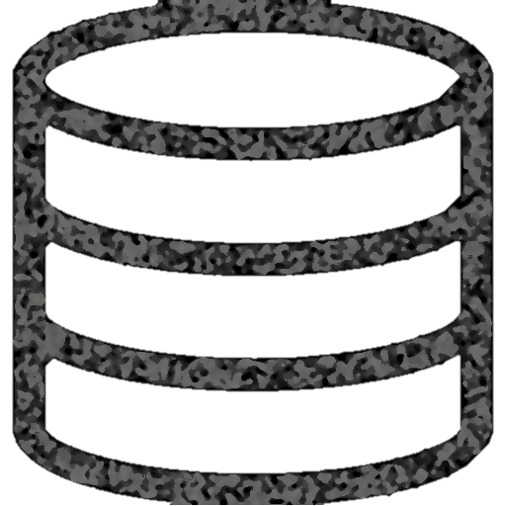
Snowflake Data Warehouse
Authentication and Access Control
Cloud
Services
Infrastructure Manager
Optimizer
Transaction Manager
Security
Virtual Warehouse
Virtual Warehouse
Virtual Warehouse
Query
Processing
Database
Storage

Slide 3
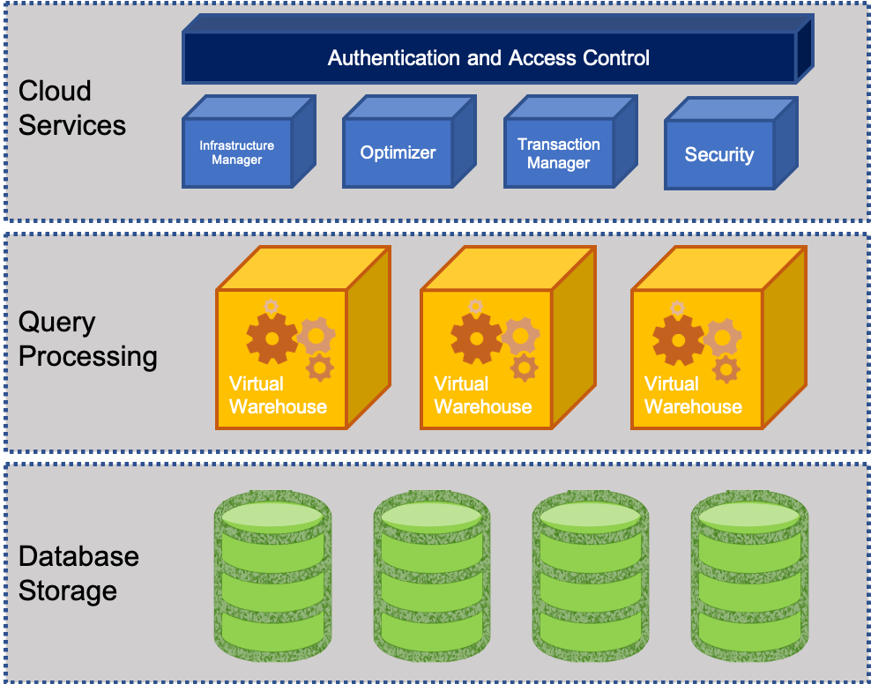
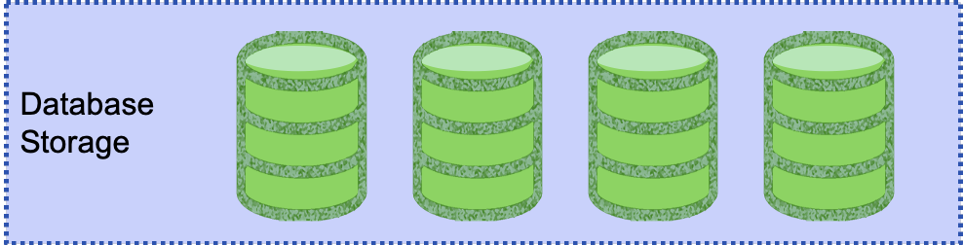
Efficient data storage in Snowflake Database Storage Layer
The storage layer contains tables, schemas, databases, and diverse data
If managed well storage layer can hold petabytes of data
Snowflake has scalable cloud blob storage type for storing structured and semi-structured data
Such as JSON, AVRO, and Parquet
Snowflake optimizes the metadata for easy extraction and query processing
Storage is made up of multiple micro partitions that are encrypted and scale automatically
Allows for efficient data retrieval and performance

Slide 4

Efficient data storage in Snowflake Query Processing Layer
This layer contains virtual warehouses where all the queries are run on each respective virtual warehouse
Allows for a scalable compute capacity
Each Virtual warehouse gets data from the storage layer and has it cached to the compute resources
Multiple VW operate simultaneously to maintain ACID and follow multiple parallel processing
ACID (Atomic, Consistent, Isolated and Durable) that ensure a database management system (DBMS) will make changes to data in a reliable
VW can auto-suspend, auto-resume, and have auto-scaling that can be built in

Slide 5
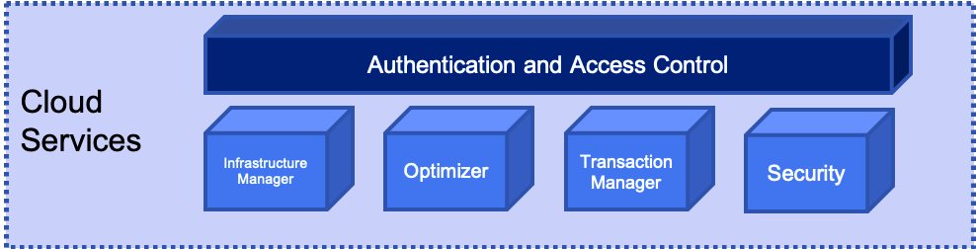
Efficient data storage in Snowflake Cloud Services Layer
This layer is the cerebrum of Snowflake where it maintains, optimizes, transacts on data, as well as provides security, and metadata management
Enables SQL client interface for DDL and DML like operations on data
VW can auto-suspend, auto-resume, and have auto-scaling that can be built in

Slide 6
Query Profile
Powerful tool for understanding the mechanics of queries
Identify potential performance bottlenecks
Available through the web interface
Provides a graphical representation of the main components of processing plan for the query
Provides statistics and details of the overall query

Slide 7
Add image of query profile

Slide 8
Understanding Micro-partitions vs Static partitions
Static partitioning - is used when the values for partition columns are known when loading data
Benefits
Works with data that is already known
Achieves acceptable performance and enables better scaling
Limitations
High maintenance cost to make changes
Data skew if partitions are not set up well
Disproportionately-sized partitions happen

Slide 9
Understanding Micro-partitions vs Static partitions
Micro partitioning – same value as static partitioning but removes the limitations
All data is Snowflake automatically divided into micro-partitions
Each micro-partition contains 50 MB – 500 MB of uncompressed data
(size is actually smaller since data is always stored compressed)
Groups of rows are mapped to individual micro-partitions and organized in columnar fashion
Allows for extreme granular pruning of large tables (millions of micro-partitions)
Benefits
Columnar Storage
Automatic
Efficient Scanning
Micro-partitions
Size is tiny
Overlapping Storage
DML
Notes:
Benefits
micro-partitions are derived automatically; do not need to be defined up-front or maintained by users.
micro-partitions are small in size (50 to 500 MB, before compression), which enables extremely efficient DML and fine-grained pruning for faster queries.
columnar storage - Columns are stored independently within micro-partitions
Columns are also compressed individually within micro-partitions.
Micro-partitions can overlap in their range of values, which, combined with their uniformly small size, helps prevent skew.
only the columns referenced by a query are scanned – efficient scanning
Snowflake automatically determines the most efficient compression algorithm for the columns in each micro-partition.
All DML operations (e.g. DELETE, UPDATE, MERGE) take advantage of the underlying micro-partition metadata to facilitate and simplify table maintenance. For example, some operations, such as deleting all rows from a table, are metadata-only operations.

Slide 10
Query Pruning
Snowflake enables precise pruning of columns in micro-partitions at query run-time, including columns containing semi-structured data
Date Hour Action Action_Category Feature Feature2 Feature3
1/1/2019
1/2/2019
.
.
.
.
.
7/14/2019
.
.
.
.
12/31/2019
1pm
12am
.
.
.
.
.
4pm
.
.
.
.
3am
xxxxx
yyyyy
.
.
.
.
.
zzzzz
.
.
.
.
www
xxxxx
yyyyy
.
.
.
.
.
zzzzz
.
.
.
.
www
xxxxx
yyyyy
.
.
.
.
.
zzzzz
.
.
.
.
www
xxxxx
yyyyy
.
.
.
.
.
zzzzz
.
.
.
.
www
xxxxx
yyyyy
.
.
.
.
.
zzzzz
.
.
.
.
www
1 year worth of data
Notes:
a query that specifies a filter predicate on a range of values that accesses 10% of the values in the range should ideally only scan 10% of the micro-partitions
For example, assume a large table contains one year of historical data with date and hour columns. Assuming uniform distribution of the data, a query targeting a particular hour would ideally scan 1/8760th of the micro-partitions in the table and then only scan the portion of the micro-partitions that contain the data for the hour column;
Snowflake uses columnar scanning of partitions so that an entire partition is not scanned if a query only filters by one column.
the closer the ratio of scanned micro-partitions and columnar data is to the ratio of actual data selected, the more efficient is the pruning performed on the table.
Time series data allows for sub second response time
Not all predicate expressions can be used to prune. For example, Snowflake does not prune micro-partitions based on a predicate with a subquery, even if the subquery results in a constant.

Slide 11
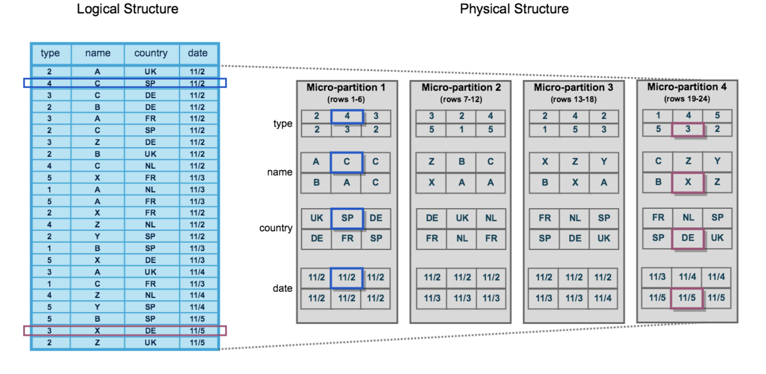
Data Clustering of Micro-Partitions
Clustering is a key factor in queries for unsorted tables which impacts query performance, particularly on very large tables
While Micro-Partitions data is stored in tables which is sorted/ordered along natural dimensions
e.g. date and/or geographic regions
Notes:
clustering metadata is collected and recorded for each micro-partition created during the process. Snowflake then leverages this clustering information to avoid unnecessary scanning of micro-partitions during querying, significantly accelerating the performance of queries that reference these columns.
The table consists of 24 rows stored across 4 micro-partitions, with the rows divided equally between each micro-partition. Within each micro-partition, the data is sorted and stored by column, which enables Snowflake to perform the following actions for queries on the table:
First, prune micro-partitions that are not needed for the query.
Then, prune by column within the remaining micro-partitions.
Note that this diagram is intended only as a small-scale conceptual representation of the data clustering that Snowflake utilizes in micro-partitions. A typical Snowflake table may consist of thousands, even millions, of micro-partitions.

Slide 12
Data Clustering of Micro-Partitions
Snowflake maintains clustering metadata for the micro-partitions in a table, including:
The total number of micro-partitions that make up the table
The number of micro-partitions containing values that overlap with each other (in a specified subset of table columns).
The depth of the overlapping micro-partitions
Clustering Depth average depth (1 or greater) of the overlapping micro-partitions for specified columns in a table
Monitoring the clustering “health” of a large table, particularly over time as DML is performed on the table.
Determining whether a large table would benefit from explicitly defining a clustering key

Slide 13
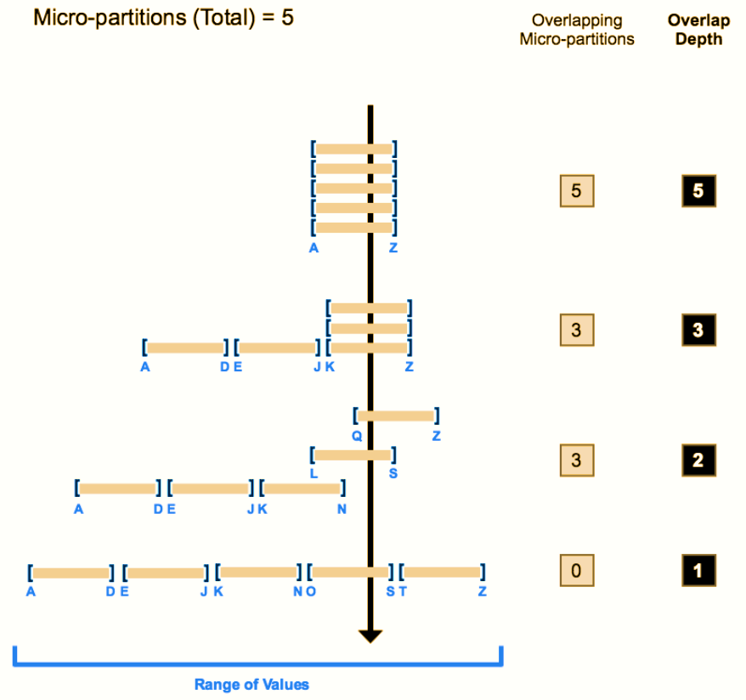
Data Clustering of Micro-Partitions
The line through shows the overlapping micro-partitions
The average depth shows how many overlap at any given moment
Clustering depth for a table is not an absolute or precise measure of a well clustered table
A well clustered table performs queries quickly
performance degrades if the table is likely no longer well-clustered
Notes:
The following diagram provides a conceptual example of a table consisting of five micro-partitions with values ranging from A to Z, and illustrates how overlap affects clustering depth:
As this diagram illustrates:
1. At the beginning, the range of values in all the micro-partitions overlap.
2. As the number of overlapping micro-partitions decreases, the overlap depth decreases.
3. When there is no overlap in the range of values across all micro-partitions, the micro-partitions are considered to be in a constant state (i.e. they cannot be improved by clustering).
The diagram is not intended to represent an actual table. In an actual table, with data contained in a large numbers of micro-partitions, reaching a constant state across all micro-partitions is neither likely nor required to improve query performance.

Slide 14
Data Clustering of Micro-Partitions

Slide 15
Clustering Keys

Slide 16
Clustered Tables

Slide 17
Automatic Clustering

Slide 18
Working with Temp tables and Transient tables

Slide 19
Views vs Secure views

