Slide 1
1.I have created by github account 2.And installed git and git bash.

Slide 2
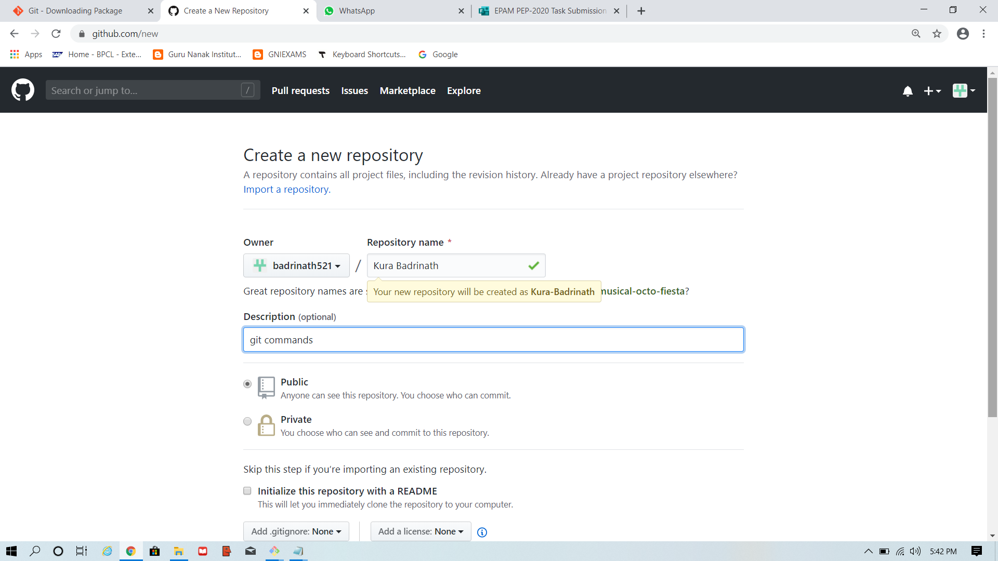
3.Repository

Slide 3
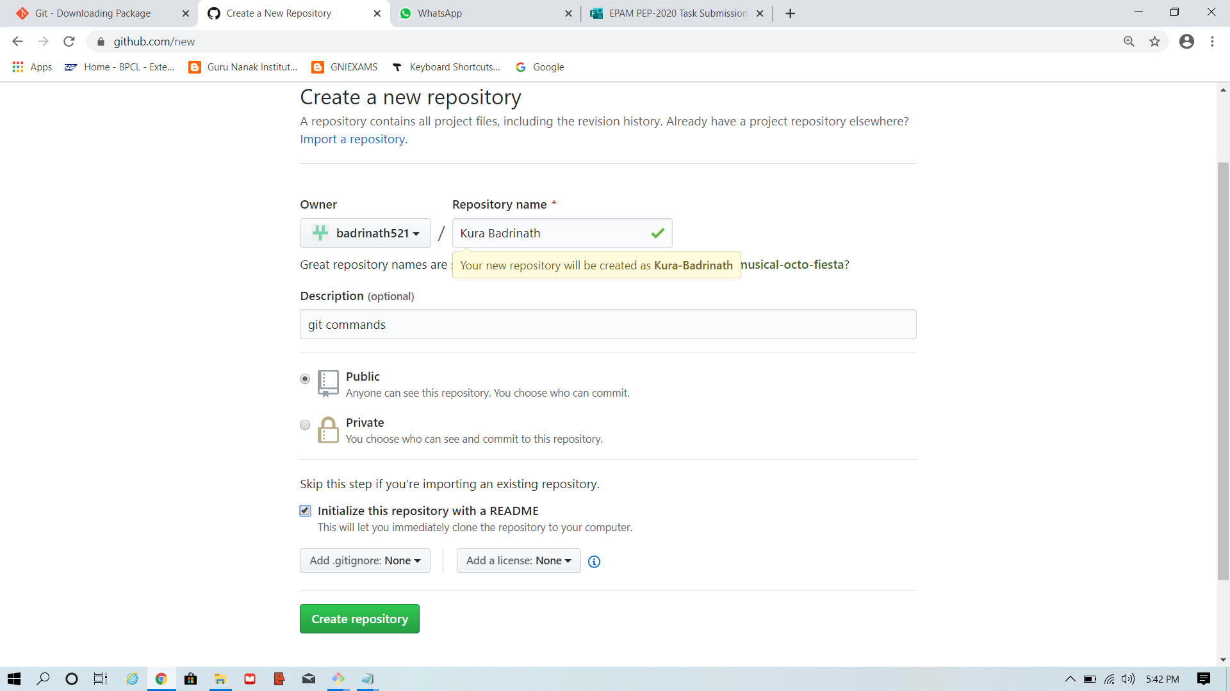
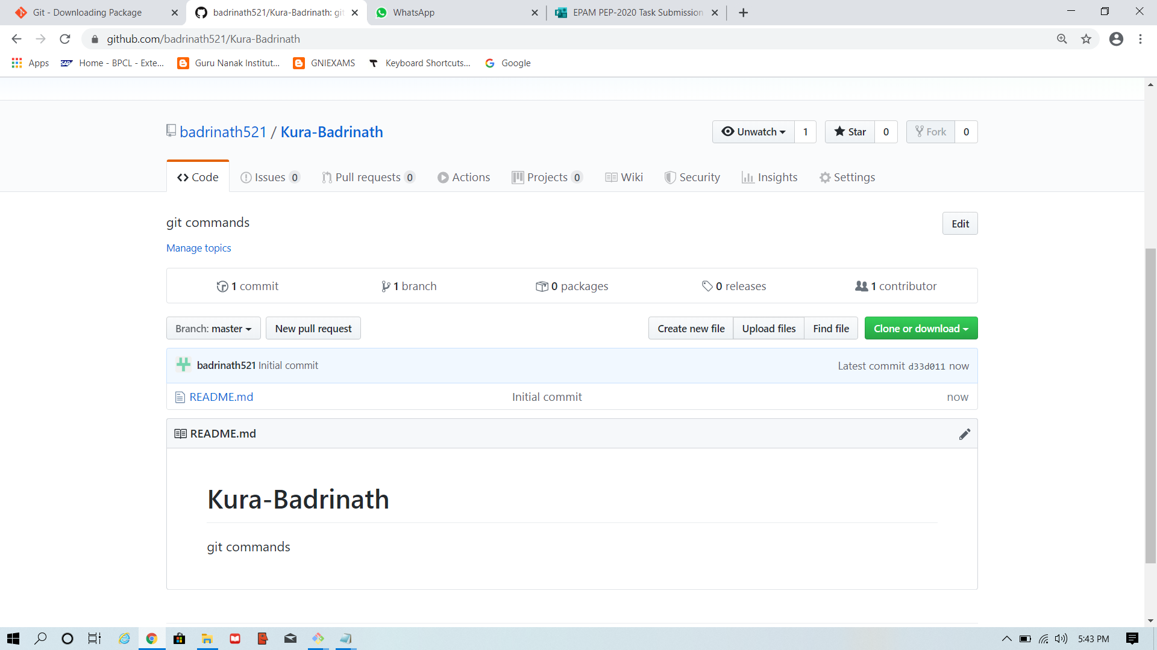
Creation of repository
Creating repository
Created repository

Slide 4
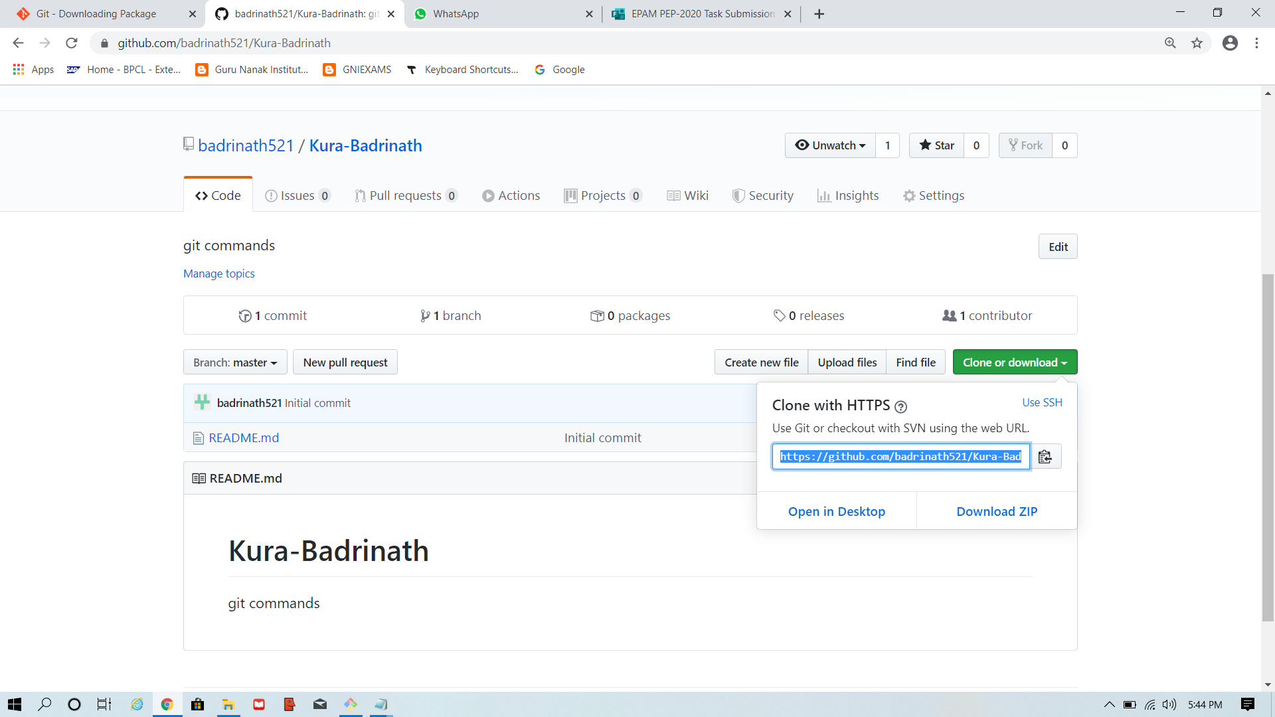
url

Slide 5
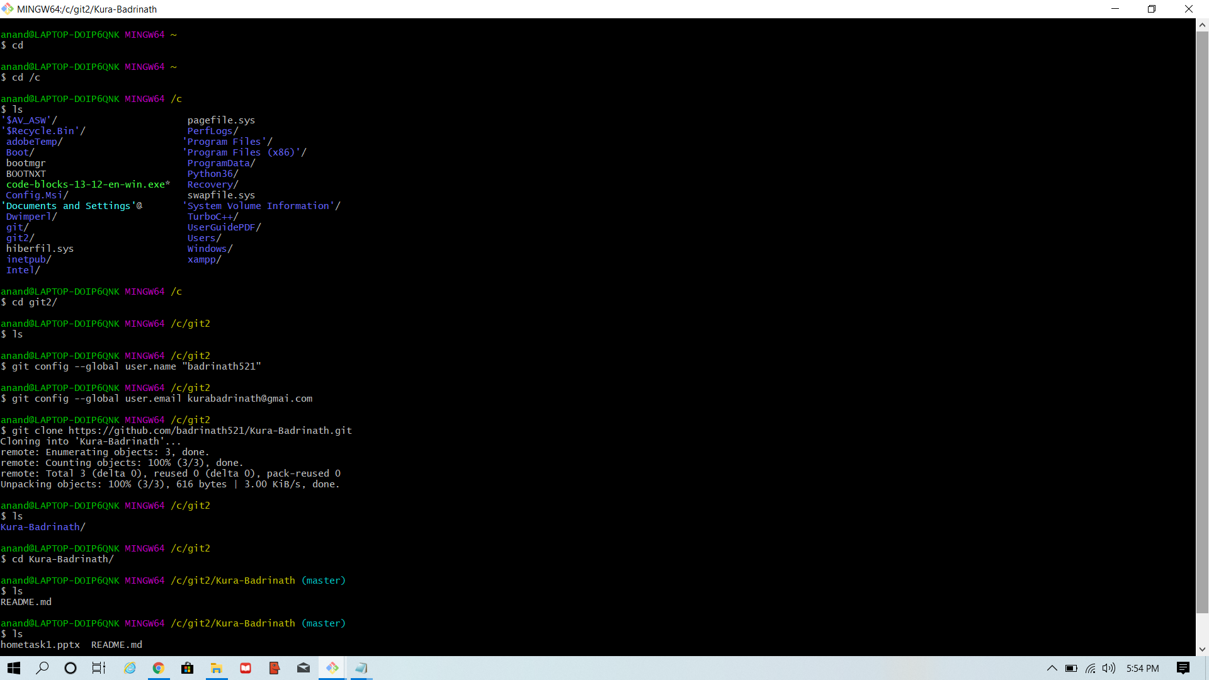
Config commands

