Slide 1
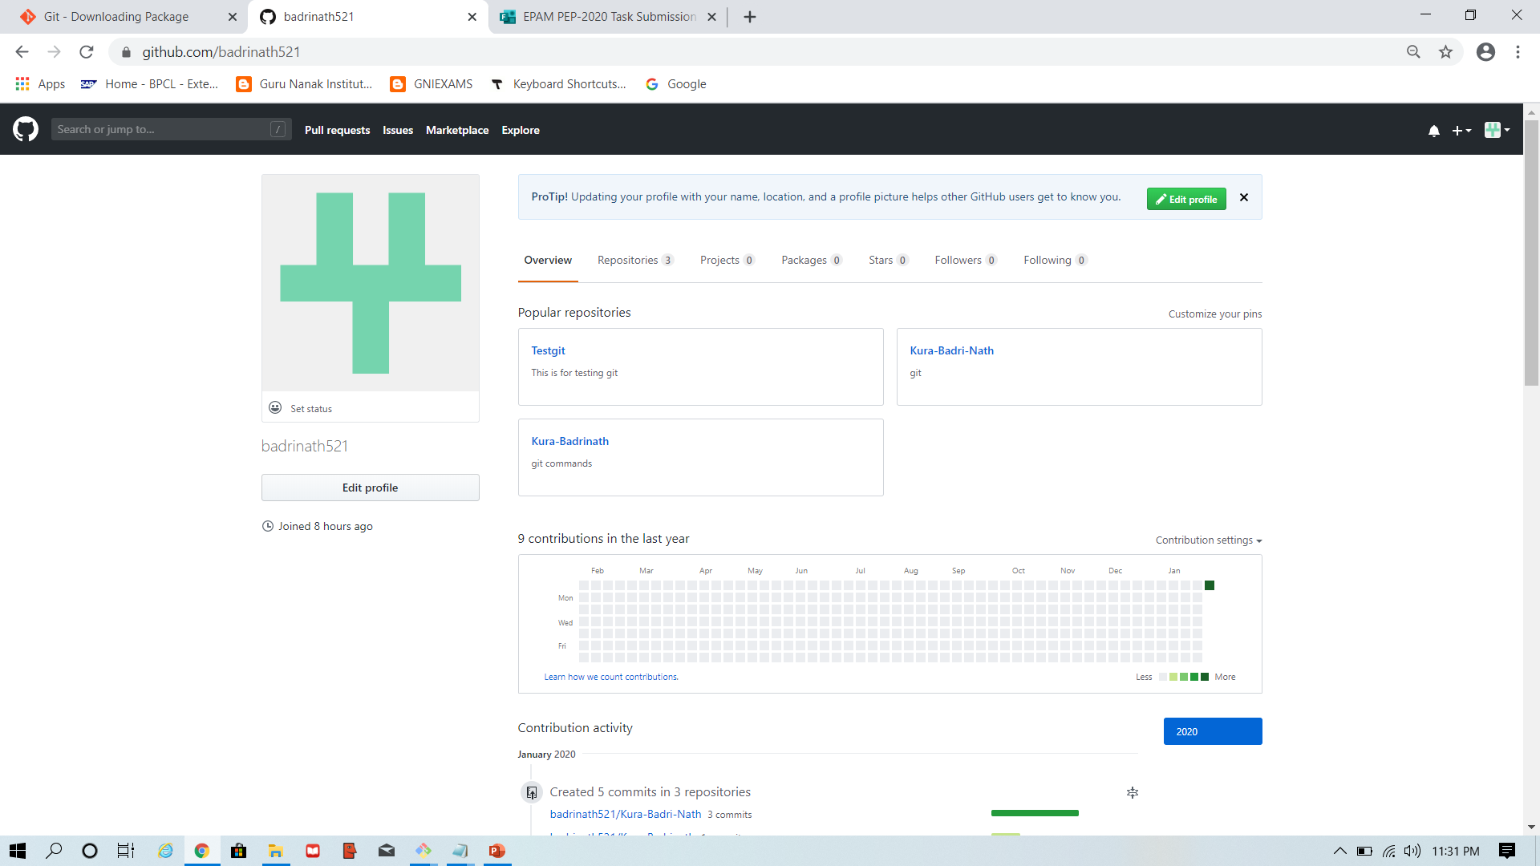
HOME TASK Step1:created github account and profile.

Slide 2
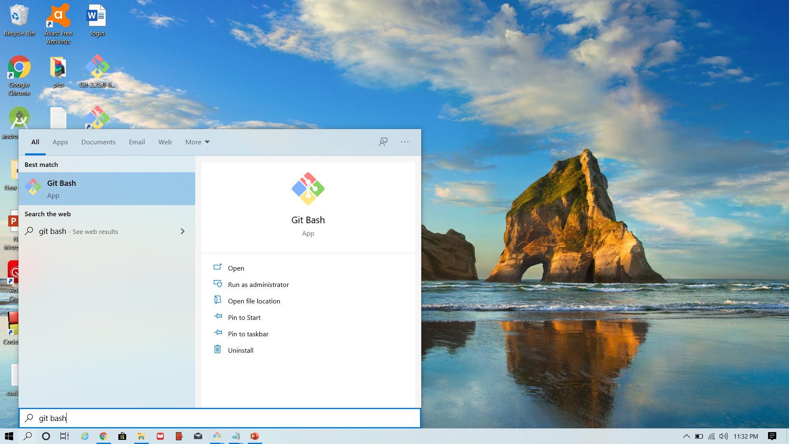
Step2:Installed git and git bash in my computer

Slide 3
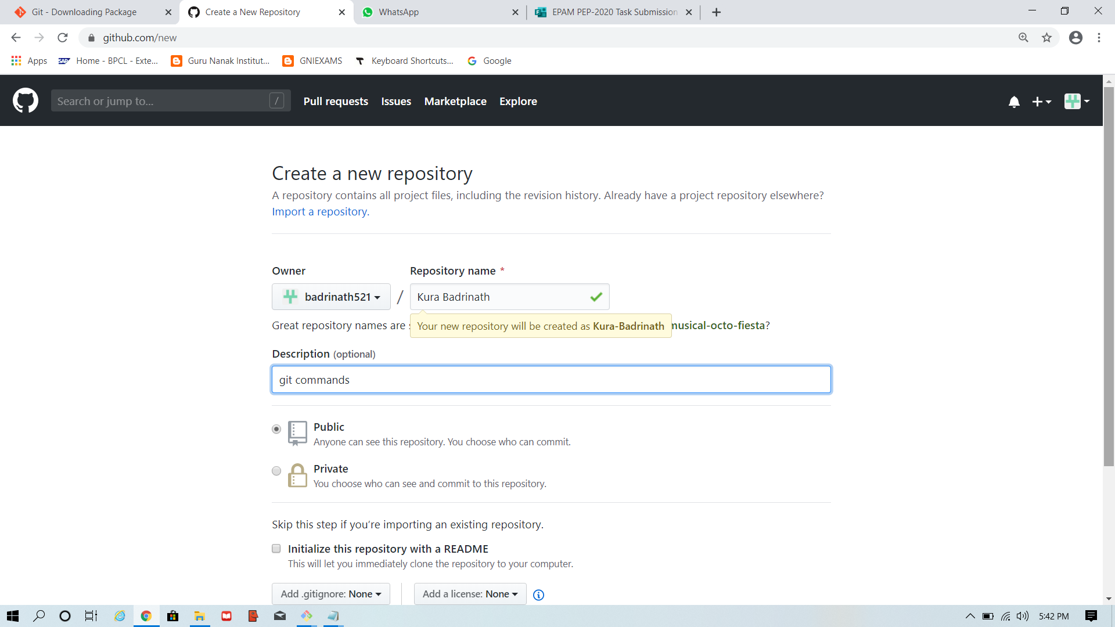
Step3.Repository

Slide 4
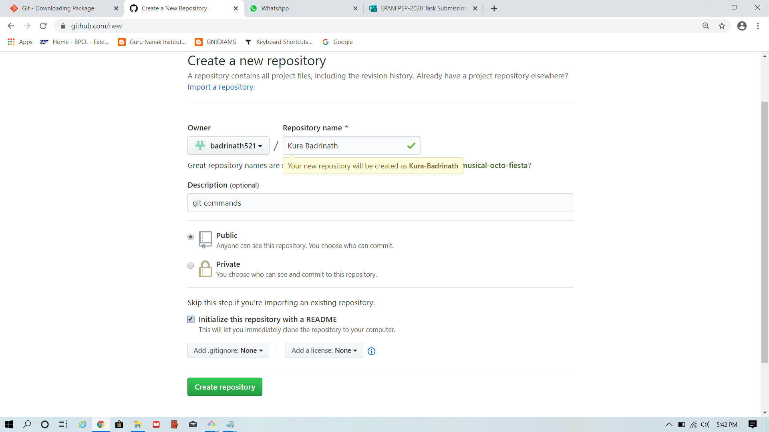
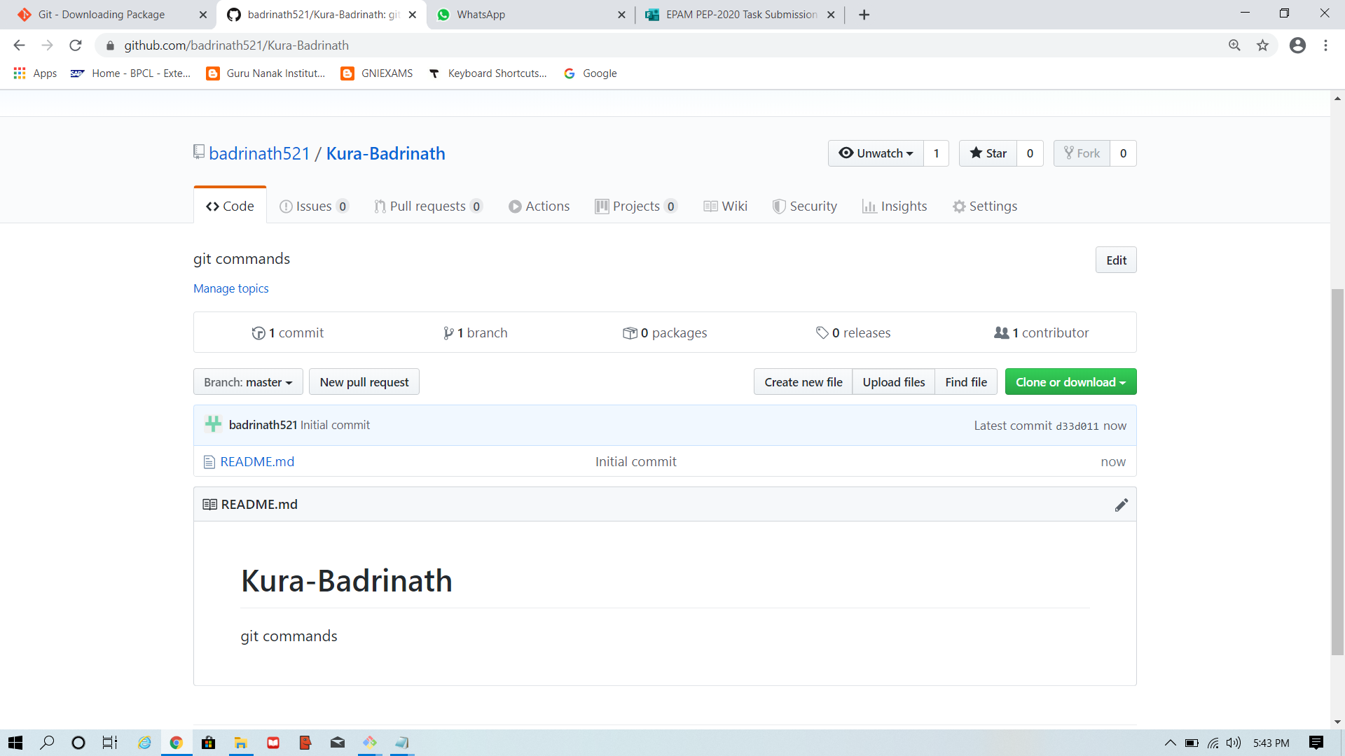
Creation of repository
Creating repository
Created repository

Slide 5
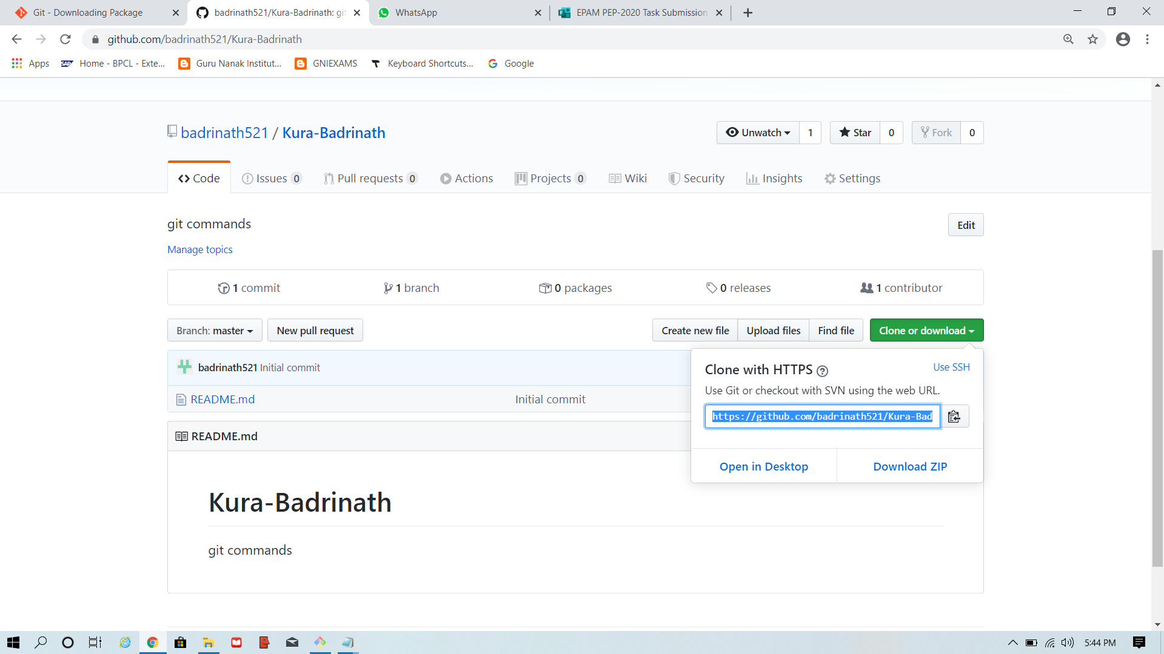
url

Slide 6
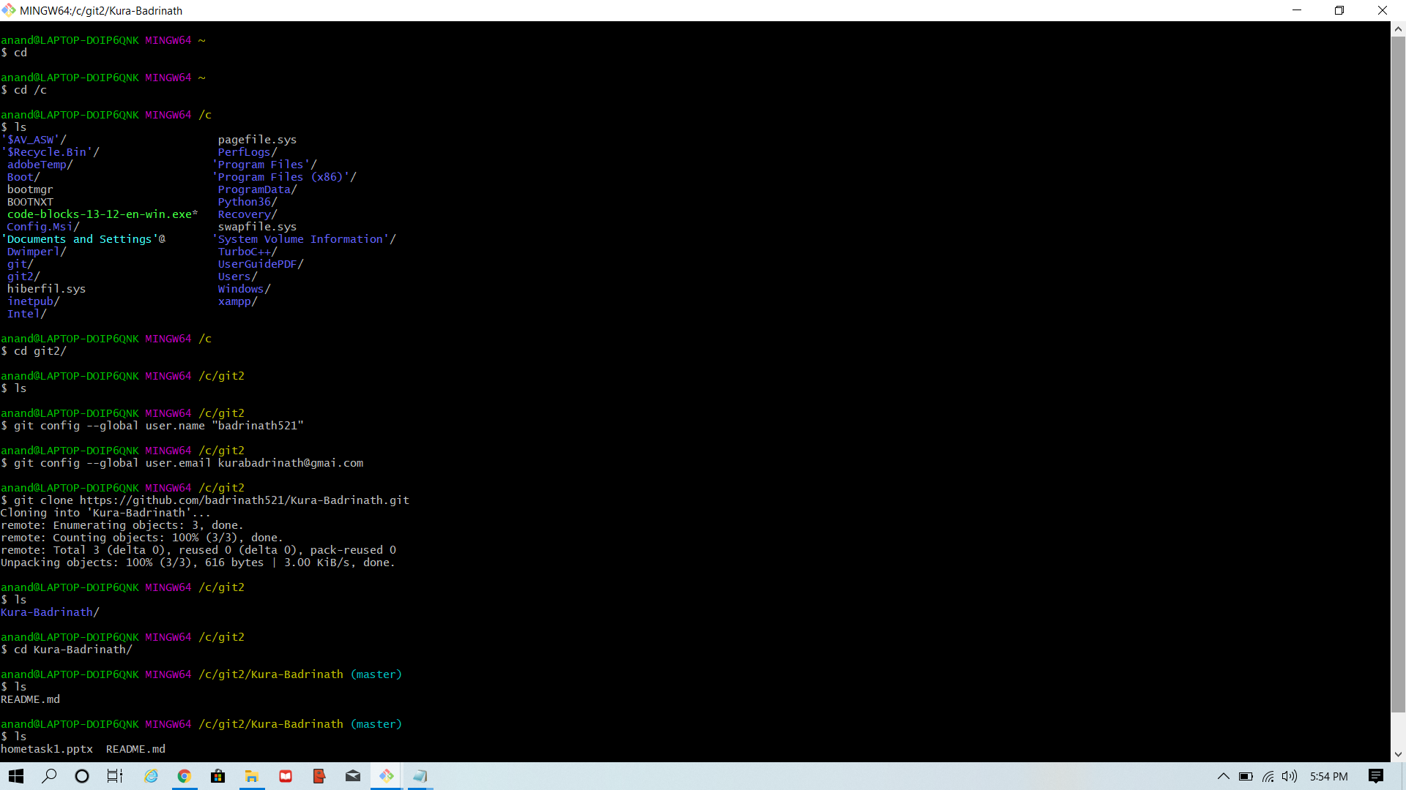
Config commands

Slide 7
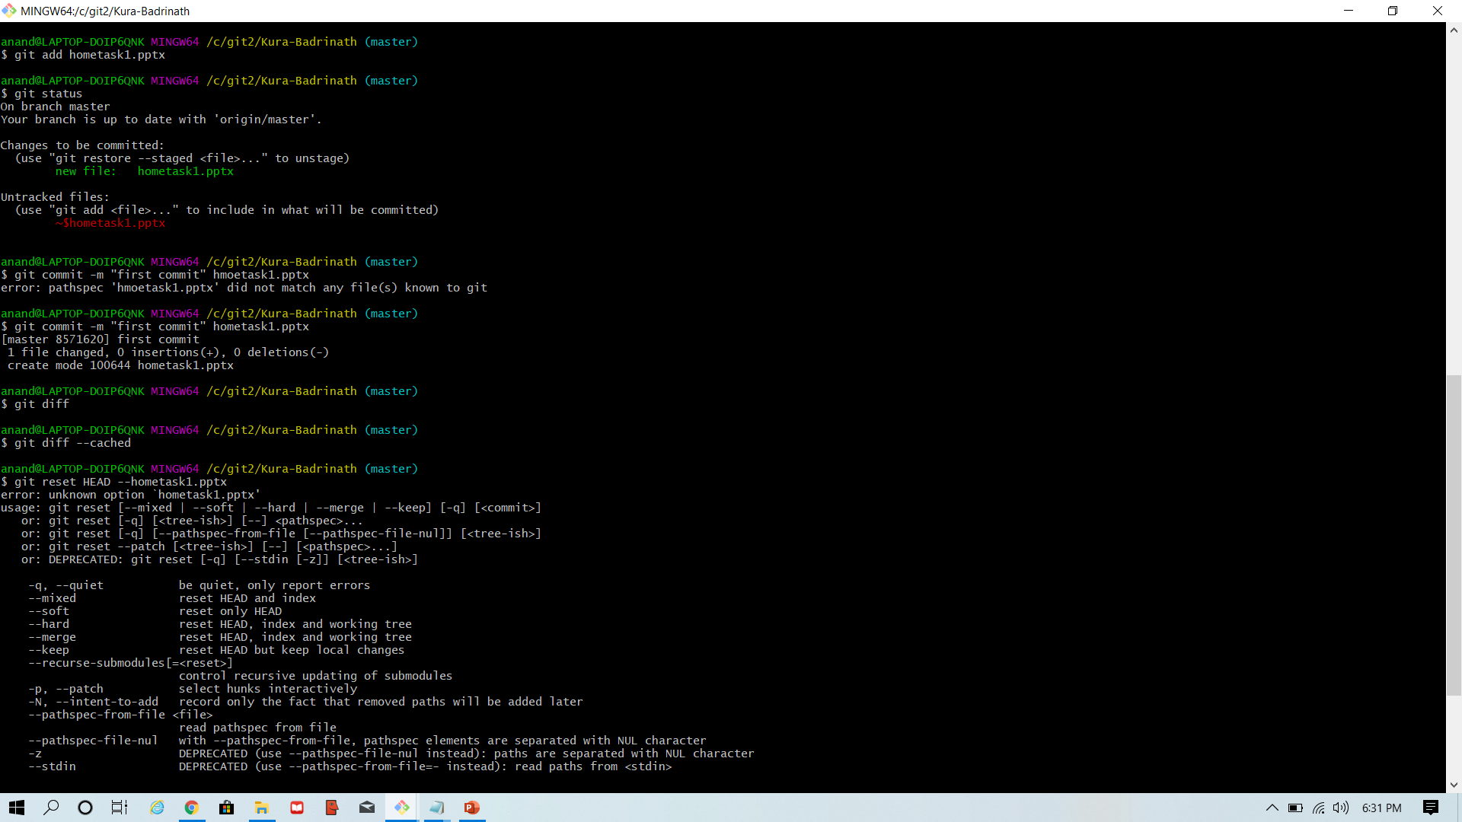
Add and commit command

Slide 8
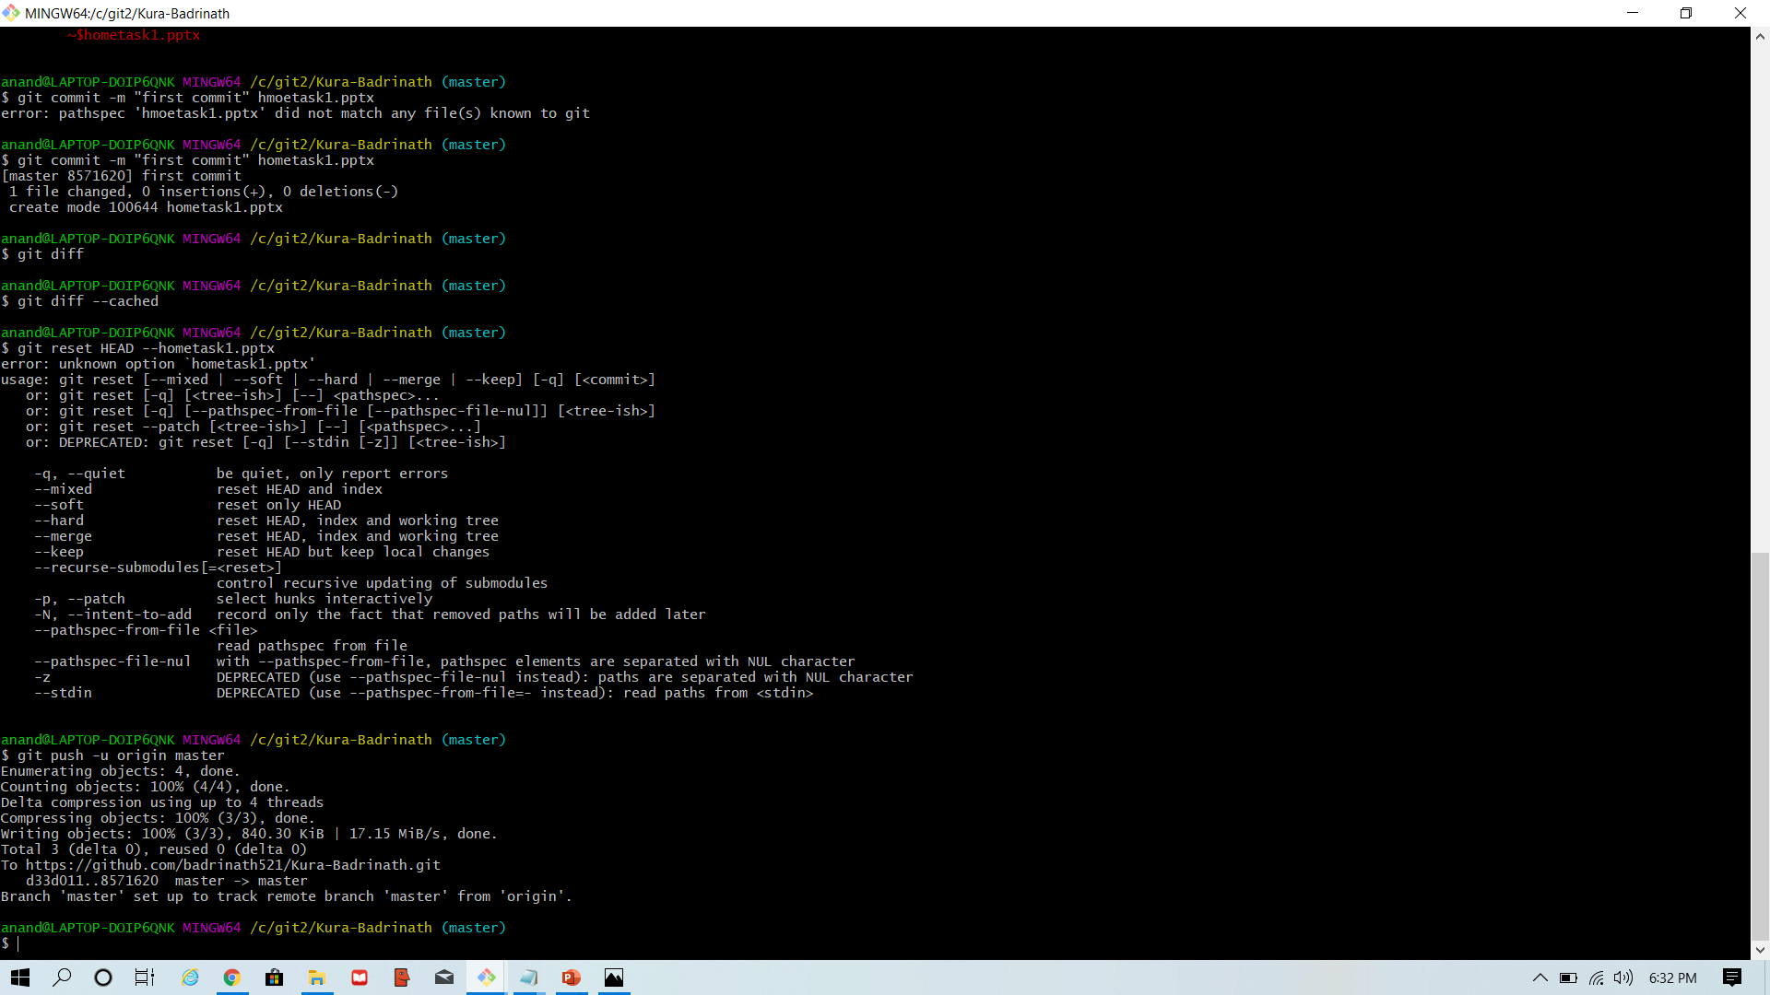
Step4:Pushing the changes into the remote server

Slide 9
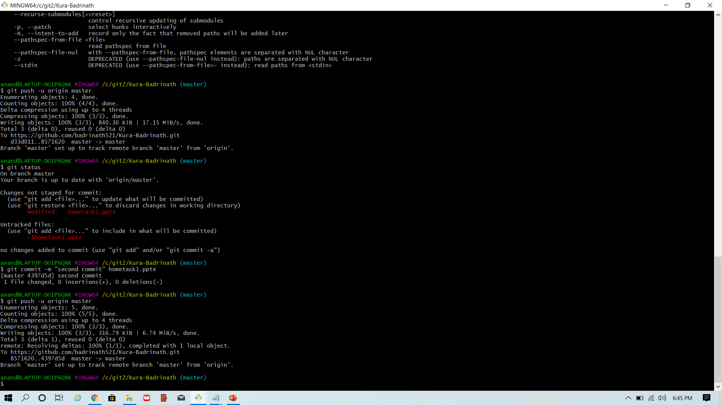
Changes made

Slide 10
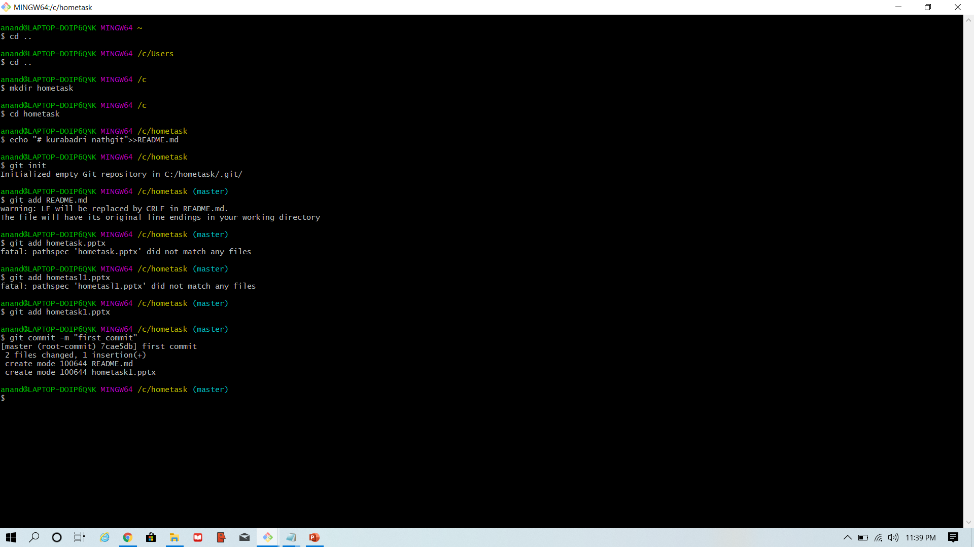
OR we can create repository using init command also

