Slide 1

PerfoTron
Badri Prasad Patra

Slide 2
Agenda
Vision , Solution, Mission
PerfoTron set up and usage diagrams
Recorded Demo
Q&A

Slide 3
Vison -> Solution -> Mission
Increase Adoption of Load and Performance Testing (Vision)
PerfoTron (Solution)
Build an open source Load Testing Platform (Mission)

Slide 4
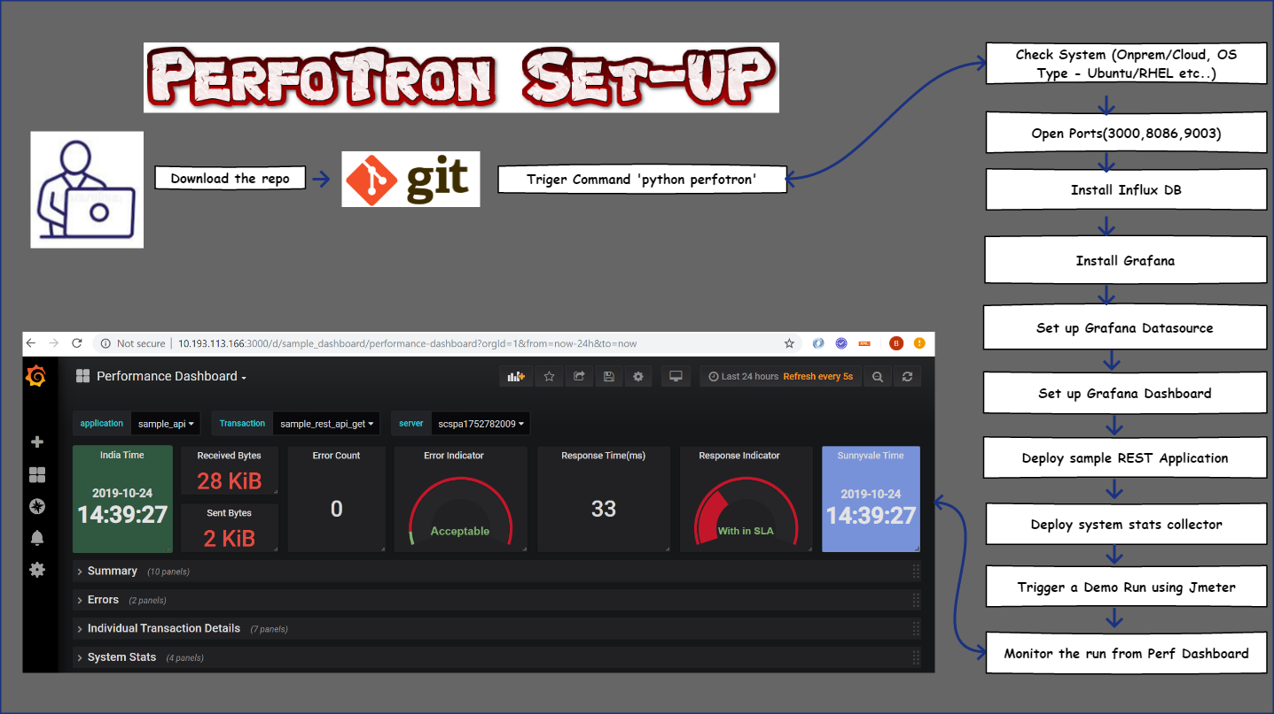

Slide 5
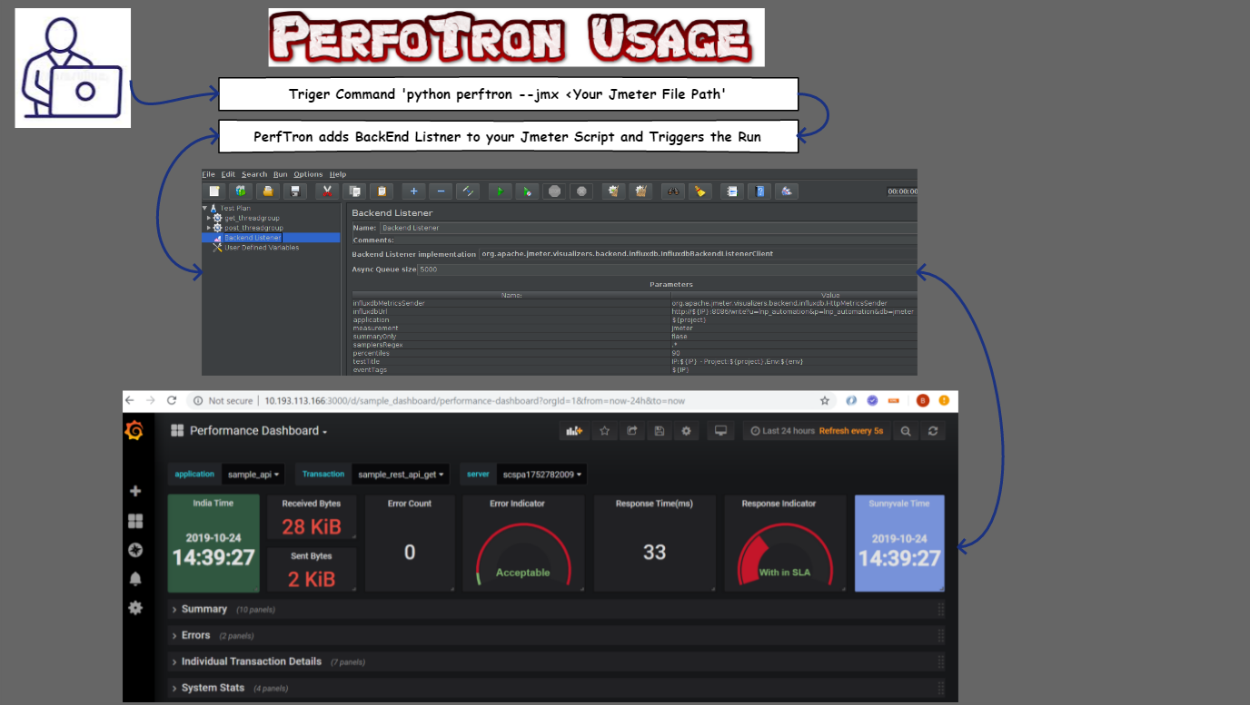

Slide 6
Supported Environments
On Premises
Google Cloud
AWS
Azure

Slide 7
Q&A

