Slide 1
Common Language Runtime(CLR)
By
Prasanth tulasi

Slide 2
What is CLR?
The .NET Framework provides a run-time environment called the common language runtime.
It runs the code and provides services that make the development process easier.
Compilers and tools expose the common language runtime’s functionality.
It enables us to write the code that benefits in managed environment execution.

Slide 3
Versions of CLR:
The version number of the .NET Framework doesn't necessarily correspond to the version number of the CLR it includes. The following table shows how the two version numbers correlate.
.NET Framework version | Includes CLR version
1.0 | 1.0
1.1 | 1.1
2.0 | 2.0
3.0 | 2.0
3.5 | 2.0
4 | 4
4.5 | 4

Slide 4
How is cross-platform achieved?
Cross-platform execution realized in two ways:
Apps are written against Framework Class Library (FCL), not underlying OS
Compilers generate generic assembly language which must be executed by the Common Language Runtime (CLR)

Slide 5
The Common Language Runtime (CLR)
The CLR defines a common programming model and a standard type system for cross-platform, multi-language development.”
All .NET-aware compilers generate Intermediate Language (IL) instructions and metadata.
The runtime's Just-in-Time (JIT) compiler convert the IL to a machine-specific (native) code when an application actually runs.
Because the CLR is responsible for managing this IL, the code is known as managed code.

Slide 6
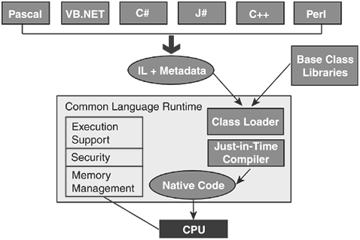

Slide 7
What contains in assembly code?
Manifest
Metadata
Intermediate Language(IL)

Slide 8
How does CLR works?
After executing the code it creates a .exe or .dll file.
When anybody(client) open .exe file it will sends a message to the operating system.
Operating system allocates memory for .NET framework and loads CLR & FCL to that memory.
After that control goes to the CLR.
CLR itself allocates memory for our application.
The area allocated by CLR to run our application is known as CLR.
The entire memory management is done by garbage collection with the help of CLR.

Slide 9
Benefits of CLR:
The runtime provides the following benefits:
Performance improvements.
The ability to easily use components developed in other languages.
Extensible types provided by a class library.
Language features such as inheritance, interfaces, and overloading for object-oriented programming.
Support for explicit free threading that allows creation of multithreaded, scalable applications.
Garbage collection.
Use of delegates instead of function pointers for increased type safety and security.

Slide 10
Thank You
From
Prasanth tulasi

