Slide 1
PRESENTATION
ON
(CONSTRUCTORS)
BY
ARKA PROVA ROY(C-2013-088)

Slide 2
What is a constructor?
Constructor is a method which gets executed automatically when we create or instantiate object of that class having constructor.
More Highlights of Constructor
A single class can have multiple constructors means we can have more than one constructor in a class. It is also called as overloaded constructor.
A benefit of using a constructor is that it guarantees that the object will go through a proper initialization before an object being used means we can pre-initialize some of the class variables with values before an object being used.
A constructor can be called another constructor by using "this" keyword. "this" keyword is the current instance of a class.

Slide 3
Types of Constructors :
Default Constructor
Parameterized Constructor
Copy Constructor
Static Constructor
Private Constructor

Slide 4
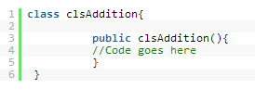
Syntax of a Constructor :
Constructors are declared by using the same class name without any return type.

Slide 5
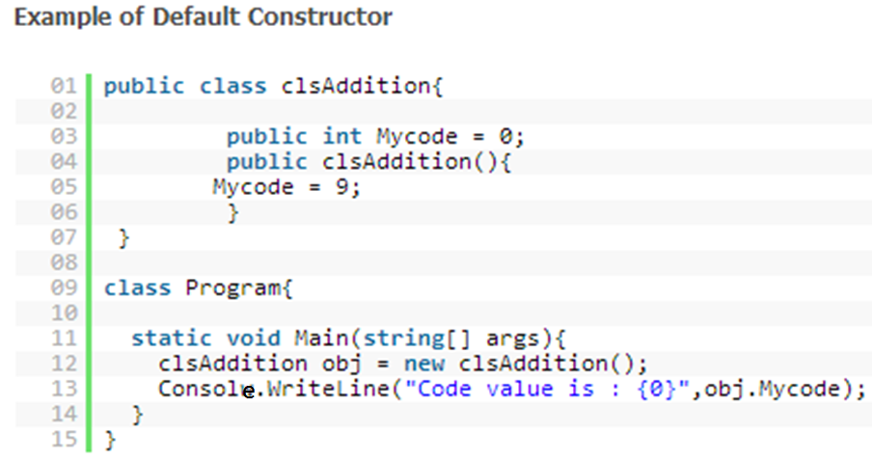
Default Constructor :
A constructor without any parameters is called as default constructor means a constructor which does not have any input parameter is known as default constructor.

Slide 6
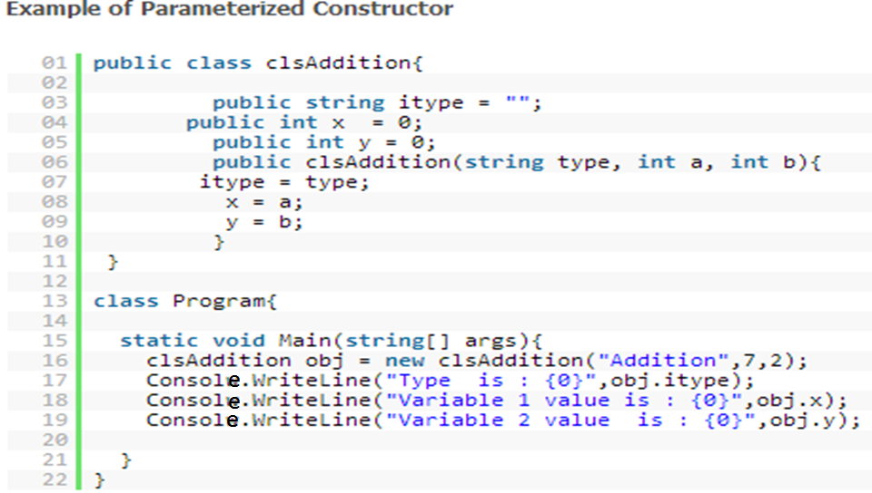
Parameterized Constructor :
A constructor having one or more parameters is called as parameterized constructor means a constructor which is having single input parameter or multiple input parameters of same data types or different data types are known as parameterized constructor.

Slide 7
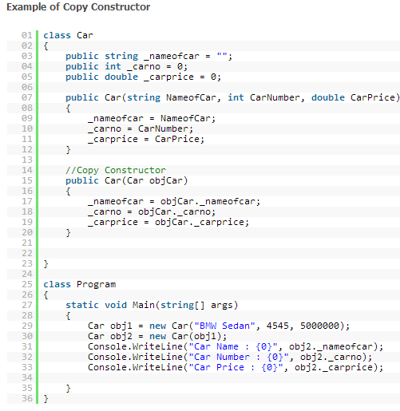
Copy Constructor :
A constructor that contains a parameter of same class type is called as copy constructor.
C# does not provide a copy constructor. A copy constructor enables you to copy the data stored in the member variables of an object of the class into another new object means it helps to copy data stored in one object into another new object of the same instance.

Slide 8
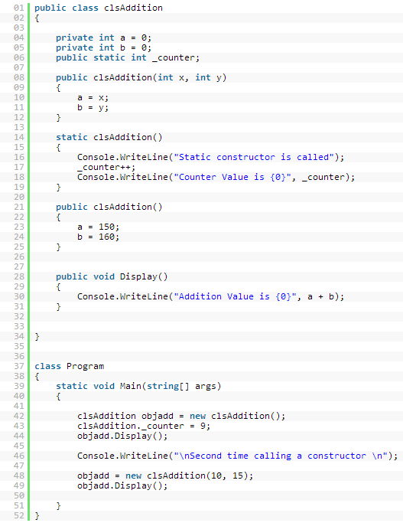
Static Constructor :
Static constructor should be parameter less means it should not contain any input parameter. Program will not execute if static constructor is having any input parameter.
Static constructor can be invoked once for any number instances are created and it is invoked only during the first initialization of instance. It is used to initialize static fields of the class

Slide 9
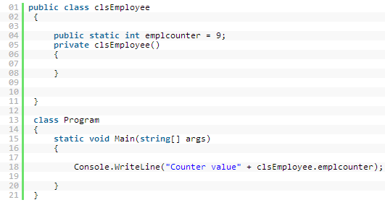
Private Constructor:
A constructor with "private" access modifier in a class is called as private constructor.
A class with private constructor cannot be inherited.
We cannot create an object of the class which is having a private constructor. Program will not allow us to create an object of a class having private constructor.

Slide 10
Thank You !!!!!

