Slide 1
DELEGATES IN C#
-POORVA LIMAYE

Slide 2
What is a Delegate?
Basically a function pointer, but are type safe.
Type safe = A delegate which is pointing to a return type of int cannot point to a return type of string.
A placeholder for a/some method(s).
It is a reference to a function/method. The function is attached to the delegate and will then can be called via the delegate object.
Similar to a function pointer, where functions can be assigned like a variable and called in the run time based on dynamic conditions.
Allow methods to be passed as parameters.

Slide 3
Allows us to specify what the function we'll be calling looks like, without having to specify which function to call.
has no knowledge of the class that implements the interface or delegate method.
We declare the signature of functions that this delegate can reference.

Slide 4
RULE:The name of your delegate can be anything. However, you must define the delegate to match the signature of the method it will point to.
Example
public delegate int DelegateName(int x, int y);
This delegate can point to any method
taking two integers and returning an integer.

Slide 5
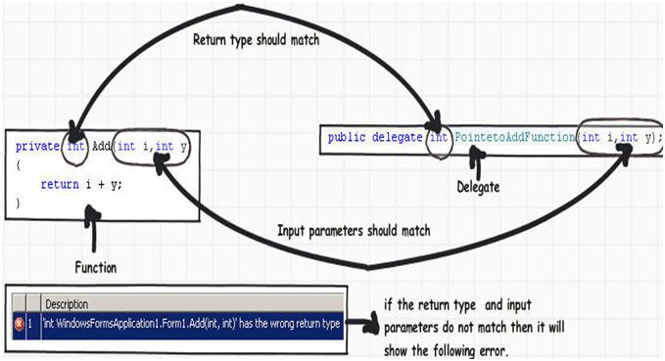

Slide 6
Steps to create a delegate
A delegate is a type, i.e. a class. Like any other class, in order to be used, it must be:
Declared and Instantiated
= > This will result in an object. The delegate object will hold a reference of a function. That object can then be:
Invoked
= > The function will then can be called via the delegate object.

Slide 7
1.Define:
delegate int SumDelegate(int x,int y);
"Please feel free to put any method that match this signature here and it will be called each time my delegate is called".
2.Create a Delegate Object:
SumDelegate objDelgate = null;
3.Refer:
objDelegate = Sum;
4. Invoke:
objDelegate.Invoke(10,20);

Slide 8
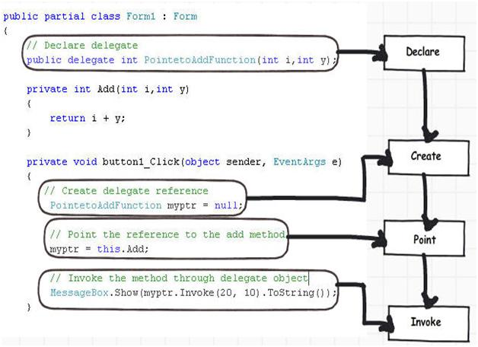

Slide 9
Multicast Delegates
Multicast =Delegate object can maintain a list of methods to call, rather than a single method.
Delegates can be chained together; i.e multiple methods can be called on a single event.
Adding a method += operator
Removing a method -=operator

Slide 10
Multicast delegate will invoke all the methods and functions associated with it after another sequentially.
Invocation happens in the same sequence as the attachment is done.
delegateptr += Method1;
delegateptr += Method2;
delegateptr.Invoke();
Invokes the Method1 and Method2 sequentially.

Slide 11
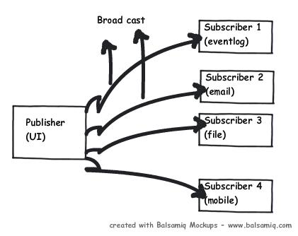
Publisher / subscriber kind of model:
Multiple error logging routines.
Broadcast the errors to the respective components.

Slide 12
Uses of delegates
1. Abstract and encapsulate a method (Anonymous invocation) Define an abstract pointer which can point to methods and functions.
2. Reusability - Delegates are extremely useful when wanting to declare a block of code that you want to pass around. 3. Multicasting - Sequential processing

Slide 13
THANK YOU!

