Slide 1
Events
- Aieshwarya Shedji

Slide 2
Introduction
What is an event?
Event Sender
Event Receiver

Slide 3
Event Handlers
What is an event handling?
Events use publisher-
subscriber model
Used with Delegates

Slide 4
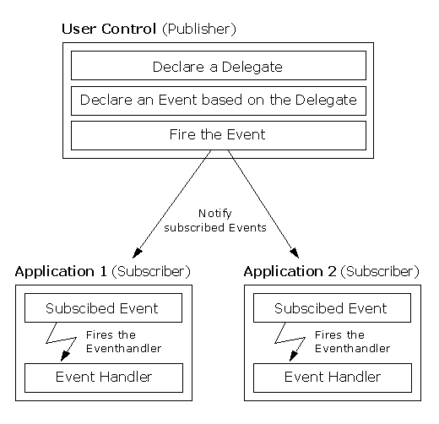

Slide 5
Declaring an Event
public delegate void
BoilerLogHandler(string status);
//Declaring event based on above delegate
public event BoilerLogHandler
BoilerEventLog;

Slide 6
Subscribing an Event
BoilerInfoLogger filelog = new BoilerInfoLogger("e:\\boiler.txt"); ….
BoilerEventLog += new
BoilerLogHandler(fileLog.Store);

Slide 7
Notifying Subscribers
Public void Store(){
If(BoilerEventLog!=null)
BoilerEventLog();
}

Slide 8
Passing Event PArameters
Parameters for events should be
passed as EventArgs.
Always pass the event publisher
(sender) as first parameter to
method
For Eg:
public delegate void MyHandler1
(object sender, MyEventArgs e);

Slide 9
Example
public class EventTest {
private int value;
public delegate void NumManipulationHandler();
public event NumManipulationHandler ChangeNum;
public void OnNumChanged() {
if (ChangeNum != null)
ChangeNum();
else
Console.WriteLine("Event fired!");
public EventTest(int n ) { SetValue(n); }
public void SetValue(int n) {
if (value != n) {
value = n;
OnNumChanged();
} } }

Slide 10
Continue..
public class MainClass
{
public static void Main() {
EventTest e = new EventTest(5);
e.SetValue(7);
e.SetValue(11);
Console.ReadKey();
}
}

Slide 11
Thank You

