Slide 1

RV College of Engineering
Go, change the world
ADVANCED DRIVER ASSISTANCE SYSTEM
1RV21MC067
NITHIN
Under the Guidance
Of
Dr. S Anupama Kumar
Associate Professor
Department of MCA
RV College of Engineering®
Bengaluru- 59
Date Department of MCA, RVCE 1/9

Slide 2

Go, change the world
RV College of
Engineering
Agenda
Introduction
Objectives
Literature Survey
Summary of Literature survey
Technical Relevance
Block Diagram of Proposed Methodology
Technological Developments
Key Competitors
Sustainability and Societal Concern
Proposed Work
Conclusion
References

Slide 3
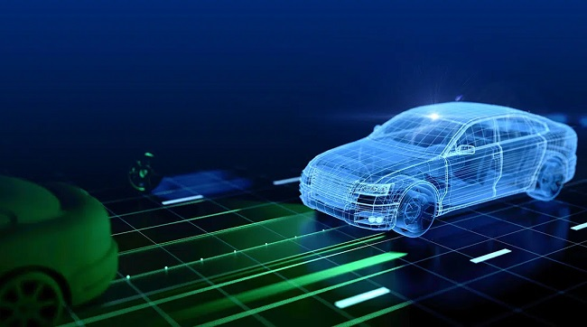
Go, change the world
RV College of
Engineering
Introduction
  ADAS is a cutting-edge technology suite designed to enhance vehicle safety, efficiency, and driver experience.
  ADAS integrates state-of-the-art sensors, cameras, radars, and advanced algorithms for intelligent decision-making.
  C:\College\final\Honda ADAS (Advanced Driver Assist System)

Slide 4
Go, change the world
RV College of
Engineering
Objectives
To improve Advanced Driver Assistance Systems (ADAS) by addressing challenges related to adverse weather conditions .
To strengthen the cybersecurity of ADAS systems and protect against potential threats arising from increased vehicle connectivity.
To optimize human-machine interaction in ADAS systems to ensure safe and reliable operation.

Slide 5
Go, change the world
RV College of
Engineering
Literature Survey
S No | Author and Paper title | Details of Publication | Summary of the Paper
1 | Sathiyanarayana R V; P. Getzial Anbu Mani; N. Karthick “Adaptive Speed Controller for Electric Vehicle using ADAS Technology” | 2023 5th International Conference on Smart Systems and Inventive Technology (ICSSIT) DOI: 10.1109/ICSSIT55814.2023.10060973 | In this paper, Adaptive Cruise Control is simulated using MATLAB - Simulink which is used to sense the forward vehicle’s speed and control our vehicle’s speed according to the situation. These decisions are made by the Microcontroller and decision-making algorithm which implemented within the ADAS system.
2 | Adnan Shaout; Abdelrahman Shaout; Sadhvi Ajit Varagiri “ADAS Technology Classifications Using a Modified Agile Process” | 2022 International Arab Conference on Information Technology (ACIT) DOI: 10.1109/ACIT57182.2022.9994175 | The goal of this research paper is to study the existing state of art technologies in this field, presenting a comprehensive classification of the already existing ADAS systems, as well as future technologies that are still pending research, into exclusive categories. Each category is explained in detail for why that technology fell into that specific category.
3 | Frederico Luiz Martins de Sousa; Maurício José da Silva; Ricardo Creonte Câmara de Meira Santos; Mateus Coelho Silva “Deep-Learning-Based Embedded ADAS System” | 2021 XI Brazilian Symposium on Computing Systems Engineering (SBESC) DOI: 10.1109/SBESC53686.2021.9628316 | In this paper the lane detection is the objective of infer if the driver is deviating from the correct track path. We also propose that the application is deployed and usable in embedded platforms such as NVIDIA’s Jetson family products, to measure applicability we use FPS as a metric both on Jetson Nano and Jetson TX2.

Slide 6
Go, change the world
RV College of
Engineering
Literature Survey
S No | Author and Paper title | Details of Publication | Summary of the Paper
4 | Ahmed AbdelHamed; Girma Tewolde; Jaerock Kwon “Simulation Framework for Development and Testing of Autonomous Vehicles” | 2020 IEEE International IOT, Electronics and Mechatronics Conference (IEMTRONICS DOI: 10.1109/IEMTRONICS51293.2020.9216334 | The paper will also discuss the configuration of the sensors, such as the camera, LiDAR, and RADAR, that are later used as part of a sensor fusion technique that shows the usability of the developed environment.
5 | Mihir Mody; Shashank Dabral; Mayank Magla; Hetul Sanghvi; Niraj Nandan; Kedar Chitnis; Brijesh Jadhav; Raja Shekha “High Quality Image Processing System for ADA” | 2019 IEEE International Conference on Electronics, Computing and Communication Technologies (CONECCT) DOI: 10.1109/CONECCT47791.2019.9012938 | The paper discusses objective image quality measurement and comparison with a couple of existing solutions in market. The results clearly demonstrate the advantages of the proposed solution in terms of feature set and captured image/video quality.
6 | Jinzhang Peng; Lu Tian; Xijie Jia; Haotian Guo; Yongsheng Xu; Dongliang Xie; Hong Luo; Yi Shan; Yu Wang “Multi-task ADAS system on FPGA” | 2019 IEEE International Conference on Artificial Intelligence Circuits and Systems (AICAS) DOI: 10.1109/AICAS.2019.8771615 | In this paper, we establish a multi-task learning framework for lane detection, semantic segmentation, 2D object detection, and orientation prediction on FPGA. The performance on FPGA is optimized by software and hardware co-design.
7 | Weifeng Wang; Mengfan Zheng; Jian Wan; Nengchao Lyu “Advanced Driver Assistance Systems and Risk Identification in Cooperative Vehicle Infrastructure System Environment” | 2019 5th International Conference on Transportation Information and Safety (ICTIS) DOI: 10.1109/ICTIS.2019.8883825 | This paper is Based on the convenience of information interaction of CVIS technology, the on-board information interaction framework integrating vehicle and roadside sensing data is designed. In the proposed CVIS-based ADAS, on-board and roadside devices can separately detect obstacle vehicles according to their respective detection algorithms

Slide 7
Go, change the world
RV College of
Engineering
Literature Survey
S No | Author and Paper title | Details of Publication | Summary of the Paper
8 | Cristian Olariu, Juan Diego Ortega, J. Javier Yebes “The role of cloud-computing in the development and application of ADAS” | 2018 26th European Signal Processing Conference (EUSIPCO) DOI: 10.23919/EUSIPCO.2018.8553029 | This paper investigates the requirements involved in processing camera streams on the fly in the vehicle and the possibility of off-loading the processing load onto the cloud in order to reduce the cost of the in-vehicle hardware.
9 | Sowmya Shree B.V, A. Karthikeyan “Computer Vision based Advanced Driver Assistance System Algorithms with Optimization Techniques-A Review” | 2018 Second International Conference on Electronics, Communication and Aerospace Technology (ICECA) DOI: 10.1109/ICECA.2018.8474604 | In this paper there is discussion about various implementation details of computer vision based ADAS algorithms. And also discuss about few optimization techniques such as Kalman filter, HOG, Haar, LinSVM, SIFT, usage of different neural networks to achieve high performance rate so driver can respond quickly to real time situations.
10 | S Raviteja, R Shanmughasundaram “Advanced Driver Assitance System (ADAS)” | 2018 Second International Conference on Intelligent Computing and Control Systems (ICICCS) DOI: 10.1109/ICCONS.2018.8663146 | An Image processing algorithm is developed in python using OpenCV library to track the lanes and gives an acoustic warning in advance if there is lane departure or blind spot detection.

Slide 8
Go, change the world
RV College of
Engineering
Summary of Literature Survey
The literature highlights the importance of sensor technologies, including radar, lidar, cameras, and ultrasonic sensors, in enabling the detection and tracking of objects and potential hazards on the road.
Machine learning techniques, particularly deep learning models, have shown promise in enhancing the performance of ADAS systems by improving object recognition and enabling predictive capabilities.
Research has also examined the impact of ADAS technologies on driving behavior, including driver distraction, trust in automation, and potential unintended consequences.
The literature survey reveals the evolving nature of ADAS technologies, with ongoing research and development aiming to enhance their capabilities, improve their integration with autonomous driving systems, and address emerging challenges.

Slide 9
Go, change the world
RV College of
Engineering
Technical Relevance
ADAS's technical relevance lies in its ability to significantly improve road safety by using advanced sensors and AI algorithms to detect potential dangers and provide timely warnings or interventions to drivers.
ADAS optimizes driving behavior through features like adaptive cruise control and traffic sign recognition, leading to improved fuel efficiency and reduced emissions.
The development and implementation of ADAS drive progress in several technical fields. Research in computer vision, sensor technology, and artificial intelligence continuously improves ADAS capabilities, making it more accurate, reliable, and adaptable to various driving scenarios.

Slide 10
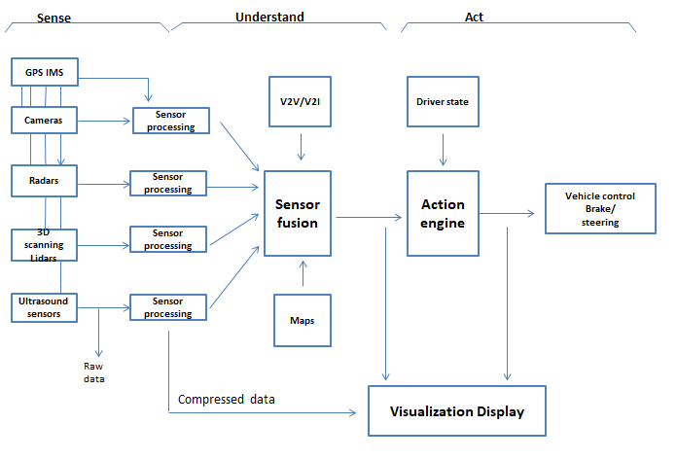
Go, change the world
RV College of
Engineering
Block Diagram

Slide 11
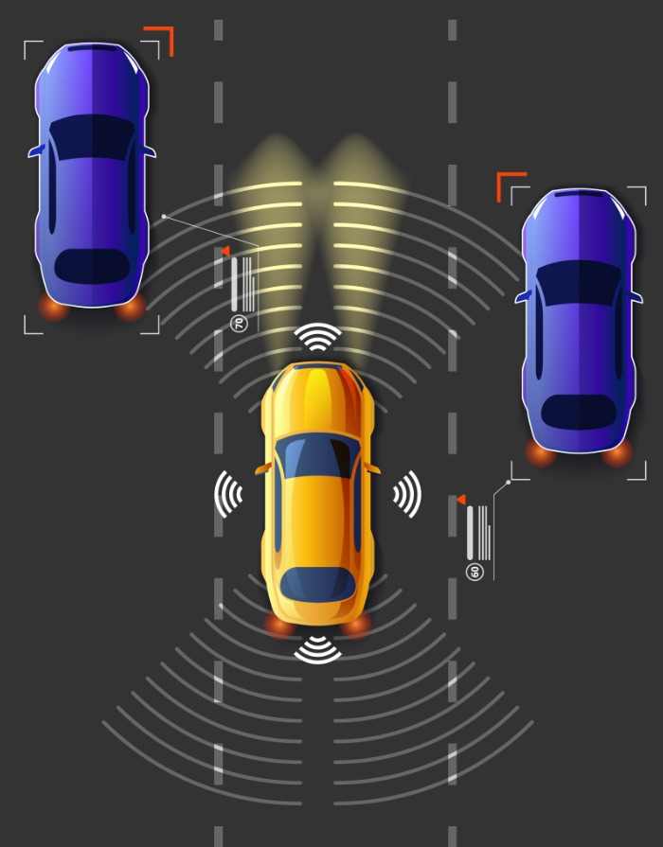
Go, change the world
RV College of
Engineering
Tools and Technologies
Multi-Object Tracking (MOT) algorithm:

Slide 12
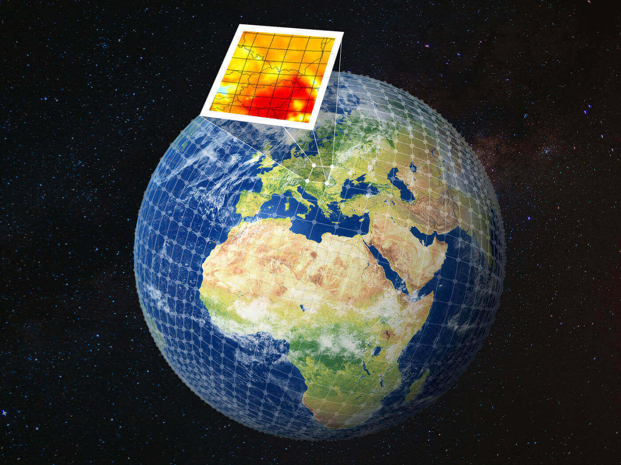
Go, change the world
RV College of
Engineering
Tools and Technologies
2.Numerical Weather Prediction (NWP):

Slide 13
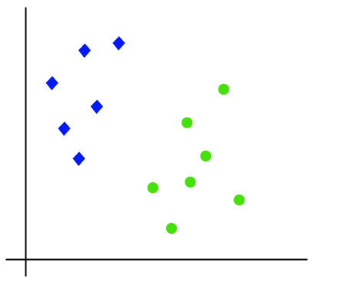
Go, change the world
RV College of
Engineering
Tools and Technologies
3.Support Vector Machines (SVM):

Slide 14

Go, change the world
RV College of
Engineering
Tools and Technologies
4. Transport Layer Security (TLS)

Slide 15

Go, change the world
RV College of
Engineering
Tools and Technologies
5. Intrusion Detection Systems (IDS):

Slide 16

Go, change the world
RV College of
Engineering
Tools and Technologies
6. Natural Language Processing (NLP):

Slide 17
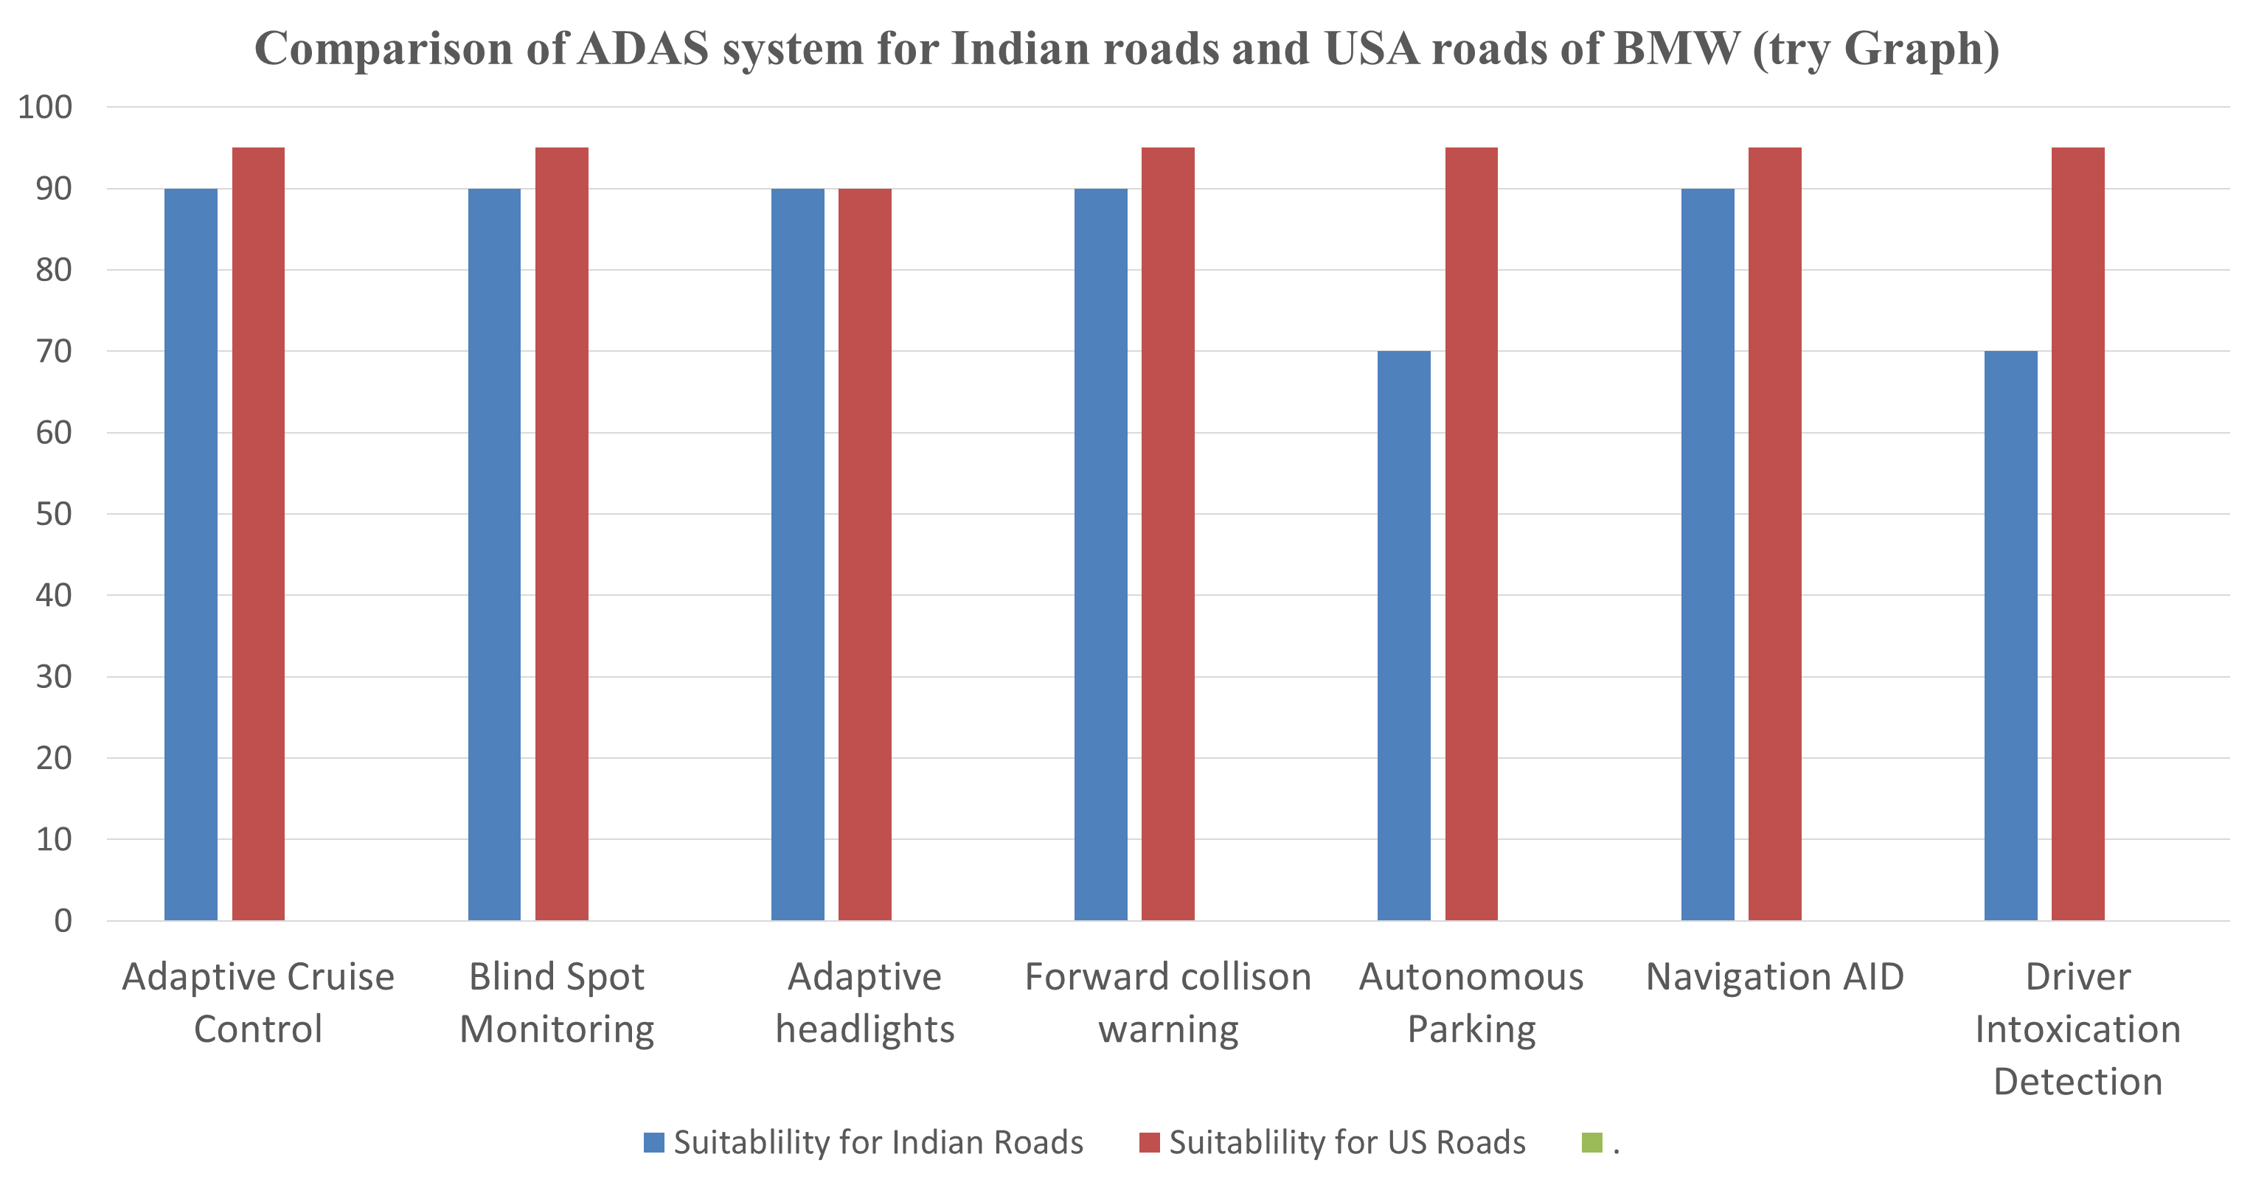
Go, change the world
RV College of
Engineering

Slide 18
Go, change the world
RV College of
Engineering
Sustainability
Addressing Adverse Weather Conditions:
The use of advanced environmental modeling techniques, such as Numerical Weather Prediction (NWP), Data Assimilation, Ensemble Modeling, and Downscaling Techniques, can significantly enhance the system's ability to predict and adapt to adverse weather conditions by continuously updating and improving these models with real-time weather data, ADAS systems can stay up-to-date with changing weather patterns.

Slide 19
Go, change the world
RV College of
Engineering
Sustainability
Strengthening Cybersecurity in ADAS Systems:
The increasing connectivity of vehicles and ADAS systems poses cybersecurity challenges that need continuous attention and monitoring.
A sustainable solution involves implementing robust cybersecurity measures, such as encryption, secure communication protocols, and intrusion detection systems.

Slide 20
Go, change the world
RV College of
Engineering
Sustainability
Optimizing Human-Machine Interaction (HMI):
Creating a sustainable solution for optimizing human-machine interaction in ADAS systems involves user-centric design principles and ongoing usability testing.
Continuously gathering feedback from users and incorporating it into iterative design improvements allows for an HMI that meets user needs and preferences.

Slide 21
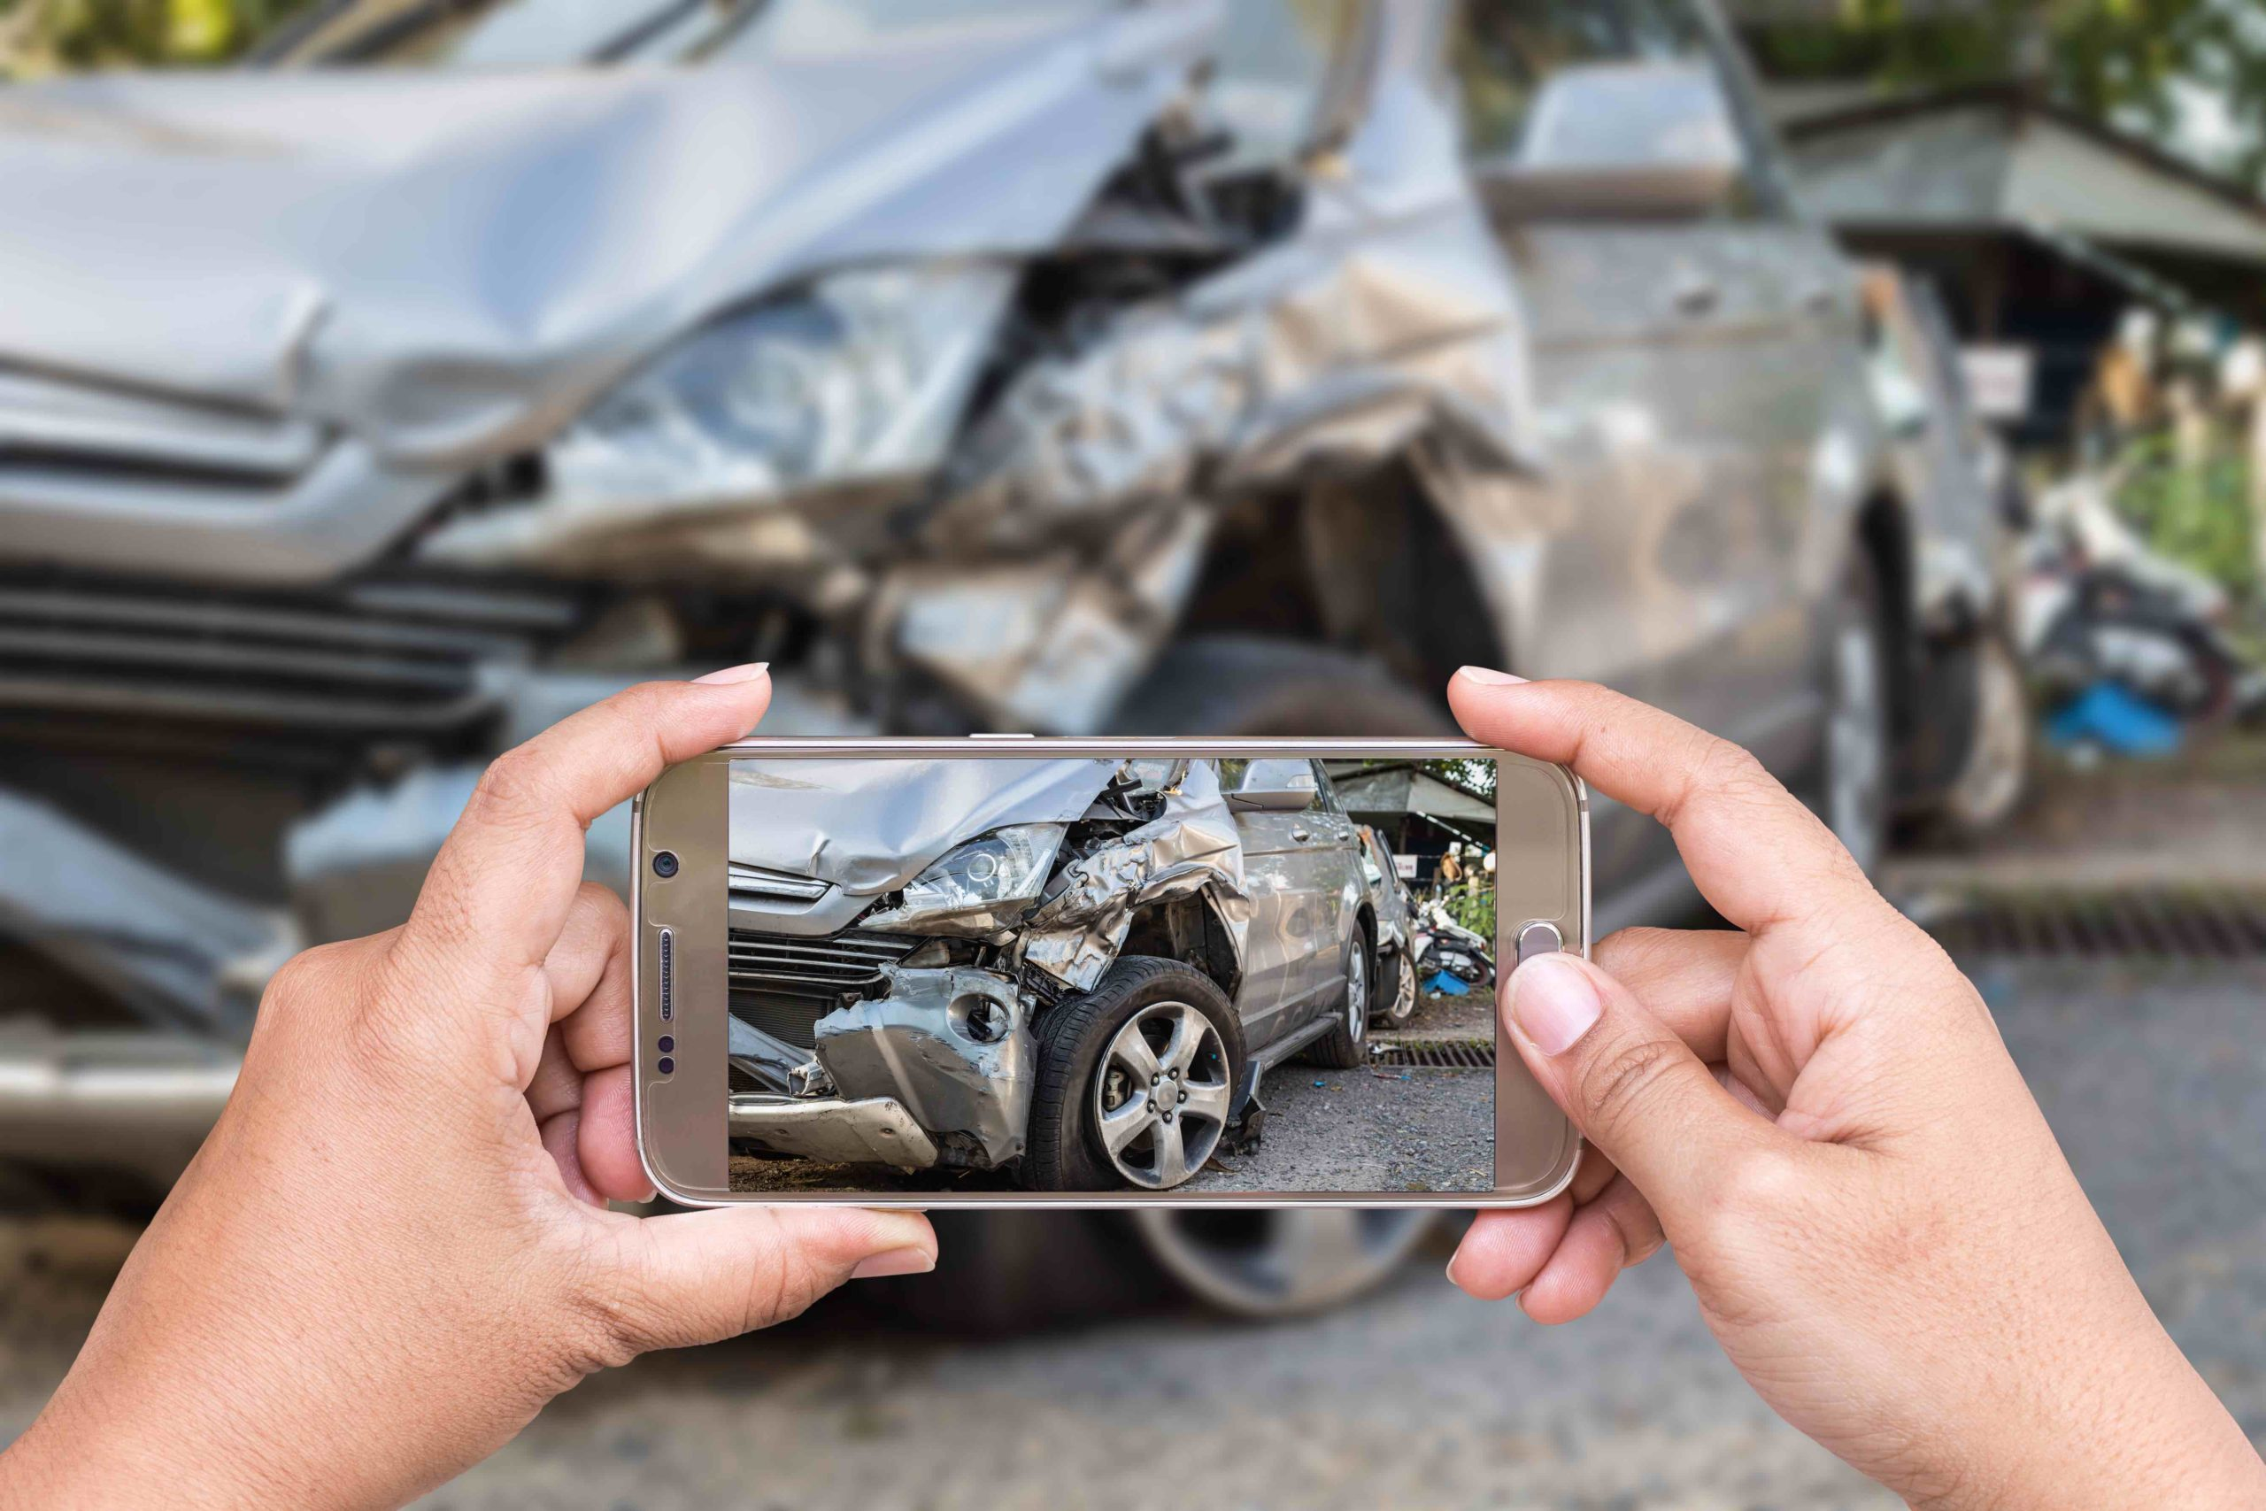

Go, change the world
RV College of
Engineering
Societal Concern
Road Safety and Accidents Reduction
Traffic Congestion and Emissions

Slide 22


Go, change the world
RV College of
Engineering
Societal Concern
Mobility for Elderly and Disabled
Environmental Conservation and Energy Efficiency

Slide 23
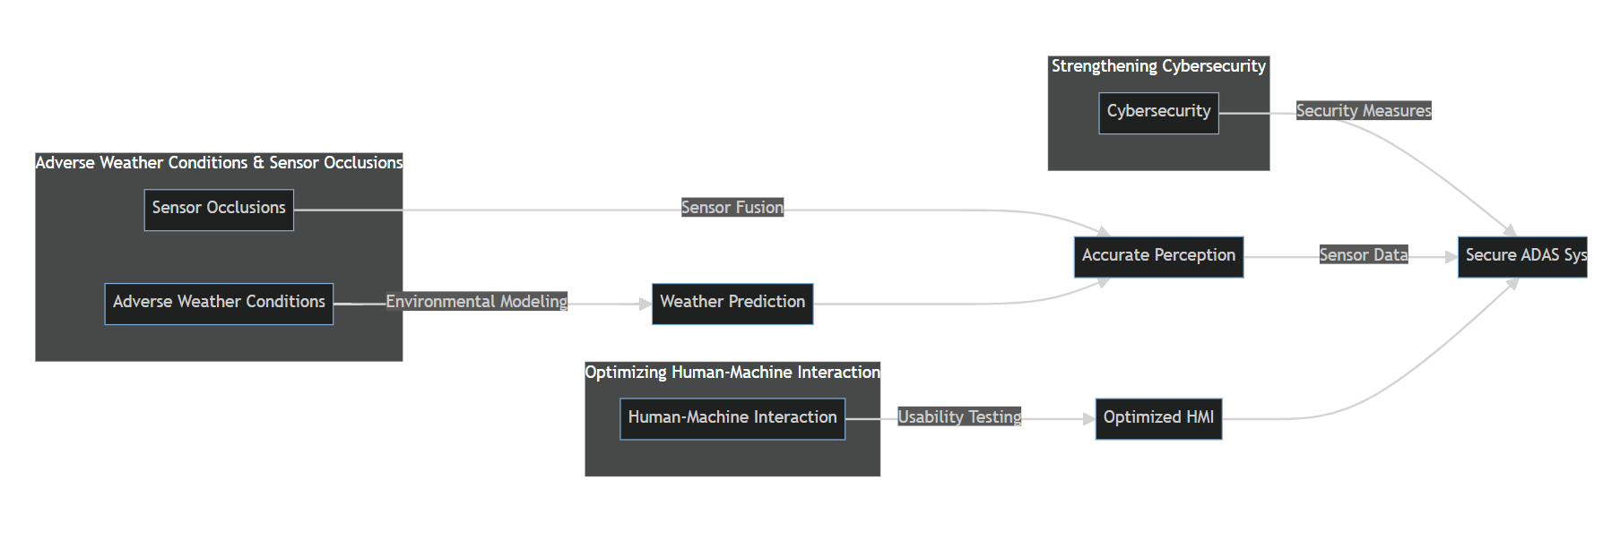
Go, change the world
RV College of
Engineering
Proposed Solution

Slide 24
Go, change the world
RV College of
Engineering
Proposed Solution
To overcome sensor limitations, ADAS systems can employ sensor fusion techniques.
Sensor fusion involves integrating data from multiple sensors to obtain a more comprehensive and accurate view of the surroundings.
By combining information from different sensors, the system can compensate for the shortcomings of individual sensors.
For example, radar sensors can be more reliable in adverse weather conditions, while cameras provide high-resolution images for detailed object recognition.
Advanced algorithms can analyze and interpret the fused data to improve object detection and reduce false alarms.

Slide 25
Go, change the world
RV College of
Engineering
Proposed Solution
Ensuring robust cybersecurity measures is essential to protect ADAS systems from potential attacks.
Implementing secure communication protocols, data encryption, and strong authentication mechanisms can help safeguard the system's integrity and prevent unauthorized access.
Regular software updates and patches can address known vulnerabilities.
Employing intrusion detection and prevention systems can also aid in identifying and mitigating potential cybersecurity threats in real-time.

Slide 26
Go, change the world
RV College of
Engineering
Proposed Solution
Designing user-friendly interfaces and intuitive interaction methods is critical to promoting effective human-machine interaction.
ADAS systems can employ natural language processing and voice commands to facilitate clear communication with drivers.
Visual and auditory cues should be well-designed and appropriately timed to deliver information without overwhelming the driver.
Proper driver training and education on ADAS functionalities can also enhance driver understanding and trust in the system.

Slide 27
Go, change the world
RV College of
Engineering
CONCLUSION
In conclusion, sensor fusion techniques play a crucial role in enhancing the capabilities of ADAS systems by combining data from multiple sensors for improved perception and safety.
However, robust cybersecurity measures are equally vital to safeguard these advanced systems from potential attacks and ensure their reliable and secure operation.
Implementing secure protocols, encryption, and monitoring systems can help protect ADAS systems from cyber threats and ensure public trust in autonomous driving technologies.

Slide 28
Go, change the world
RV College of
Engineering
Future work
Integration of ADAS technologies with autonomous driving systems to enable higher levels of automation and improve overall vehicle autonomy.
Exploration and implementation of advanced sensor technologies, such as solid-state lidar, to enhance the perception capabilities of ADAS systems and improve object detection and tracking in various driving conditions.
Continued research and development in artificial intelligence and machine learning algorithms to enhance the performance and predictive capabilities of ADAS systems. This includes improving object recognition accuracy, fine-tuning decision-making algorithms, and enhancing the overall intelligence of the system.

Slide 29
Go, change the world
RV College of
Engineering
References
[1] Adaptive Speed Controller for Electric Vehicle using ADAS Technology | IEEE Conference Publication | IEEE Xplore
[2] ADAS Technology Classifications Using a Modified Agile Process | IEEE Conference Publication | IEEE Xplore
[3] Deep-Learning-Based Embedded ADAS System | IEEE Conference Publication | IEEE Xplore
[4] Simulation Framework for Development and Testing of Autonomous Vehicles | IEEE Conference Publication | IEEE Xplore
[5] High Quality Image Processing System for ADAS | IEEE Conference Publication | IEEE Xplore
[6] Multi-task ADAS system on FPGA | IEEE Conference Publication | IEEE Xplore
[7] Advanced Driver Assistance Systems and Risk Identification in Cooperative Vehicle Infrastructure System Environment | IEEE Conference Publication | IEEE Xplore
[8] The role of cloud-computing in the development and application of ADAS | IEEE Conference Publication | IEEE Xplore
[9] Computer Vision based Advanced Driver Assistance System Algorithms with Optimization Techniques-A Review | IEEE Conference Publication | IEEE Xplore
[10] Advanced Driver Assistance System (ADAS) | IEEE Conference Publication | IEEE Xplore

Slide 30
Go, change the world
RV College of
Engineering
References
[11] T. H. El-Bawab, I. A. Elaksher, and E. M. El-Kholy, "A Comprehensive Survey on Vision-Based Advanced Driver Assistance Systems for Pedestrian Detection," in Journal of Sensors, vol. 2021, Article ID 6666089, 28 pages, 2021.
[12] F. N. L. Nascimento, C. J. M. Silva, D. J. Santos, A. L. B. Cavalcante and A. L. F. de Araújo, "A Comprehensive Review of Lidar-Based Perception in Advanced Driver Assistance Systems," in Sensors, vol. 21, no. 4, p. 1391, February 2021.
[13] F. Manzoor, T. Hussain, A. Khan, K. Saeed and M. Zia-ur-Rehman, "A Comprehensive Review of Wireless Communication Technologies for Advanced Driver Assistance Systems," in Sensors, vol. 21, no. 4, p. 1279, February 2021.
[14] C. Wang, L. Wu, Q. Cai, F. Li and C. Yu, "A Survey of Deep Reinforcement Learning for Autonomous Driving and Advanced Driver Assistance Systems," in IEEE Transactions on Intelligent Transportation Systems, vol. 22, no. 10, pp. 5722-5739, Oct. 2021.
[15] R. N. B. da Silva, P. L. C. Ferreira, R. A. R. de Lima, G. C. Brito, F. S. Medeiros and J. C. T. Mendonca, "A Comprehensive Review on GNSS-Based Positioning Technologies for Advanced Driver Assistance Systems," in IEEE Access, vol. 9, pp. 20257-20277, 2021.
[16] Y. Huang, J. Huang, M. Tang, J. Liu and Z. Luo, "A Comprehensive Review on Advanced Driver Assistance Systems Based on 3D Lidar Perception," in IEEE Access, vol. 9, pp. 16866-16882, 2021.
[17] T. Wang, Y. Zhang, Z. Hu, Z. Zhao and Y. Liu, "A Comprehensive Survey on Radar-Based Advanced Driver Assistance Systems," in IEEE Access, vol. 9, pp. 14562-14582, 2021.
[18] S. Kim, S. Park and T. Kim, "A Comprehensive Review on Perception Algorithms for Autonomous Vehicles and Advanced Driver Assistance Systems," in IEEE Access, vol. 9, pp. 20623-20648, 2021.
[19] F. L. M. Diniz, L. F. Mendes, D. F. Nascimento, G. S. Lima, A. M. D. Moreira and R. T. de Sousa Júnior, "A Survey on Autonomous Vehicle Simulators for Advanced Driver Assistance Systems," in IEEE Access, vol. 9, pp. 20910-20929, 2021.
[20] A. B. Chakravarthy, C. Kamath, R. Thimmaraja and S. Kumar, "A Comprehensive Review of Localization Techniques for Advanced Driver Assistance Systems," in IEEE Access, vol. 9, pp. 23883-23907, 2021.

