Slide 1

Seasonal Agriculture Performance Analysis
BADUGU SANDHYA
Seshadri rao gudlavalleru engineering college
AICTE STU ID :STU6a6cba89dc4861785510537

Slide 2

PROBLEM STATEMENT
Agricultural performance varies across seasons due to changes in environmental conditions, farming practices, resource availability, and market conditions. However, raw agricultural data does not clearly reveal these seasonal differences and patterns.
This project analyzes agricultural data to identify seasonal trends, performance variations, and key relationships in order to generate meaningful insights for better agricultural planning and decision-making.

Slide 3
Project Description
Seasonal Agriculture Performance Analysis is a data analytics project focused on understanding how agricultural performance varies across different seasons, regions, crops, farming practices, environmental conditions, resource usage, and economic factors. The project involves data cleaning, exploratory data analysis, statistical analysis, KPI evaluation, and interactive Power BI visualization to identify seasonal patterns, compare agricultural outcomes, and discover relationships between farming conditions and performance. The analysis aims to generate evidence-based insights and data-driven recommendations that can support better seasonal agricultural planning and resource management.

Slide 4

WHO ARE THE END USERS?
Farmers – to understand which seasons, crops, and farming conditions give better performance.
Agricultural Planners & Departments – to support seasonal agricultural planning and resource allocation.
Agricultural Researchers – to study seasonal patterns, crop performance, and environmental relationships.
Agribusinesses & Agritech Companies – to understand crop production, resource usage, and profitability patterns.
Government & Policy Makers – to support evidence-based agricultural policies and programs.
Agricultural Consultants – to provide data-driven recommendations to farmers and agricultural organizations.

Slide 5

Technology Used
Python – Data cleaning, preprocessing, and analysis
Pandas & NumPy – Data manipulation and numerical analysis
Matplotlib & Seaborn – Data visualization and EDA
Jupyter Notebook – Analysis documentation
Power BI – Interactive dashboard development and data visualization
DAX – KPI calculations and measures in Power BI
CSV – Dataset/file format
GitHub – Project documentation and version control

Slide 6
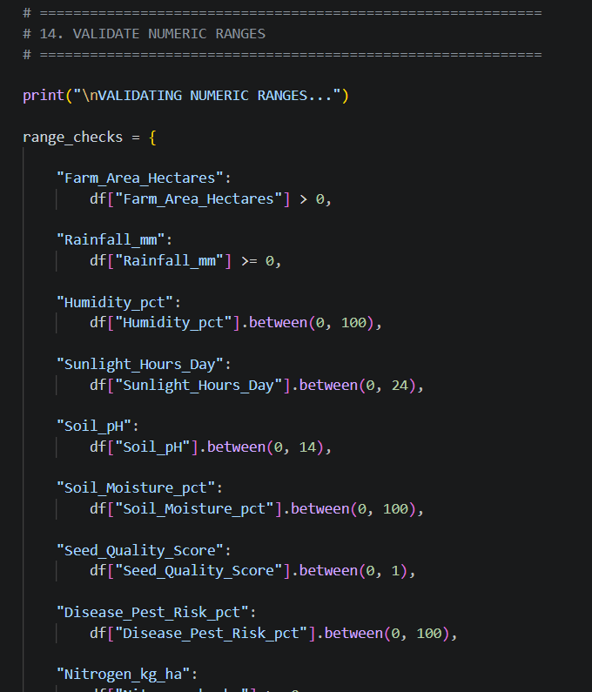
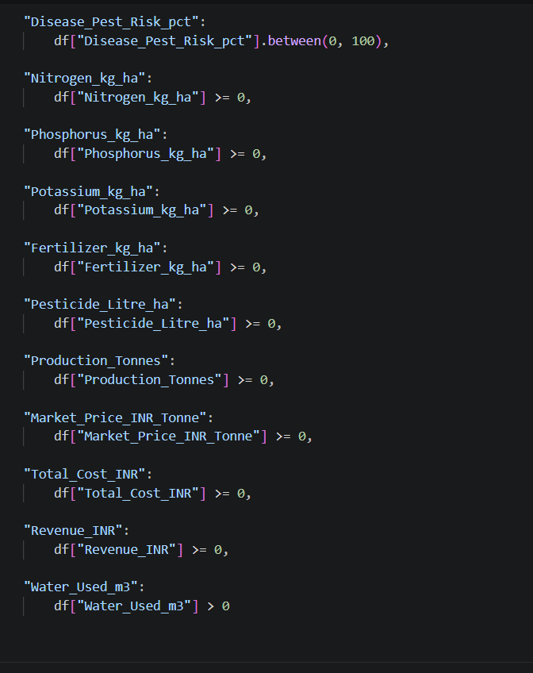
RESULTS

Slide 7
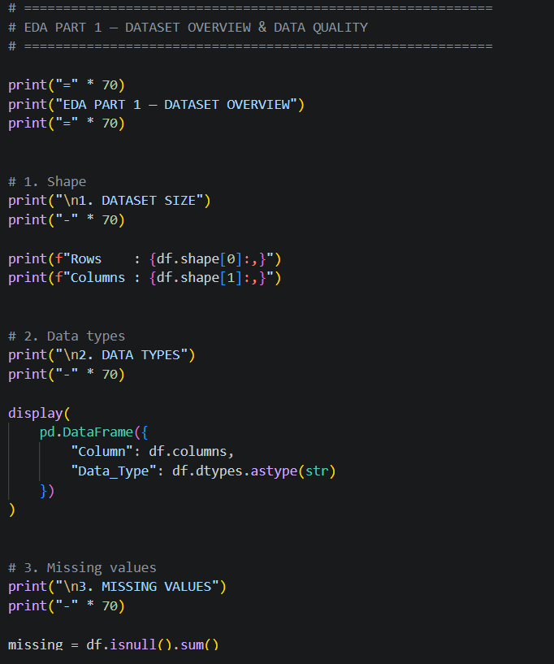
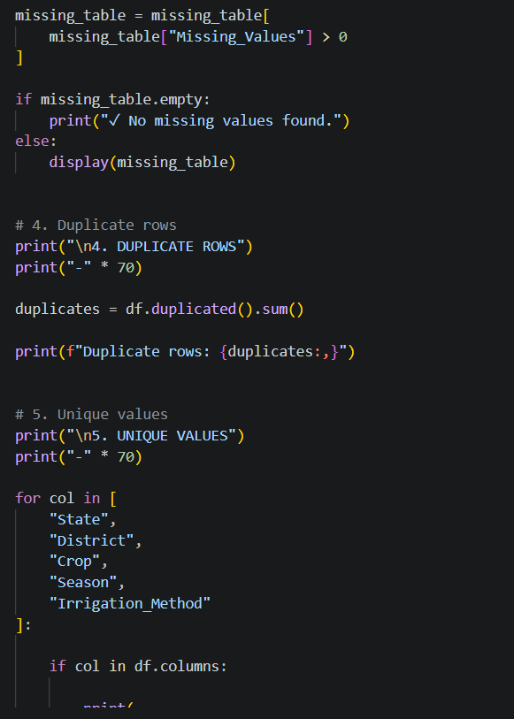
RESULTS

Slide 8
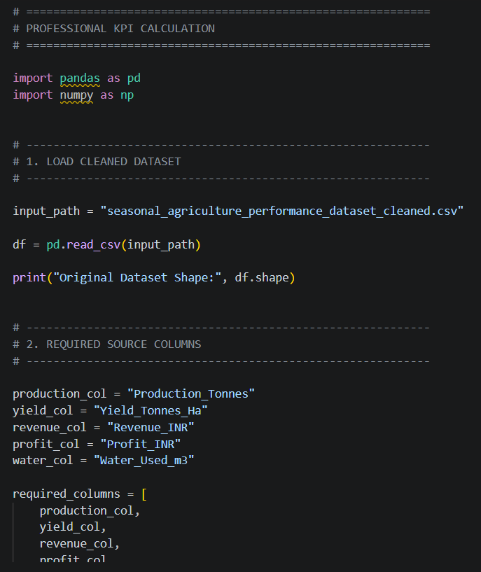
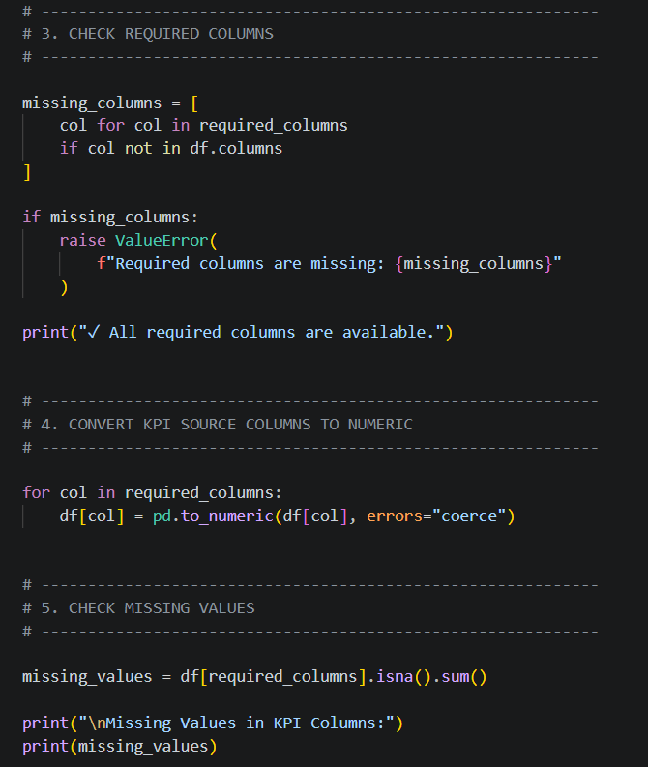
RESULTS

Slide 9
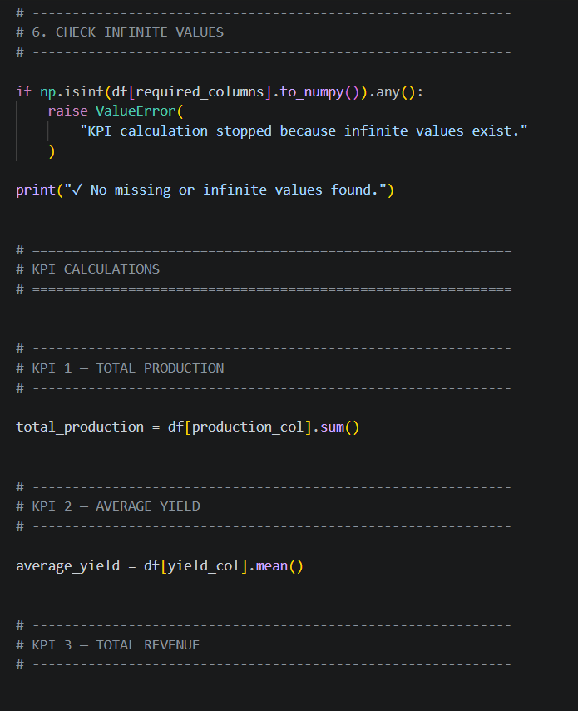
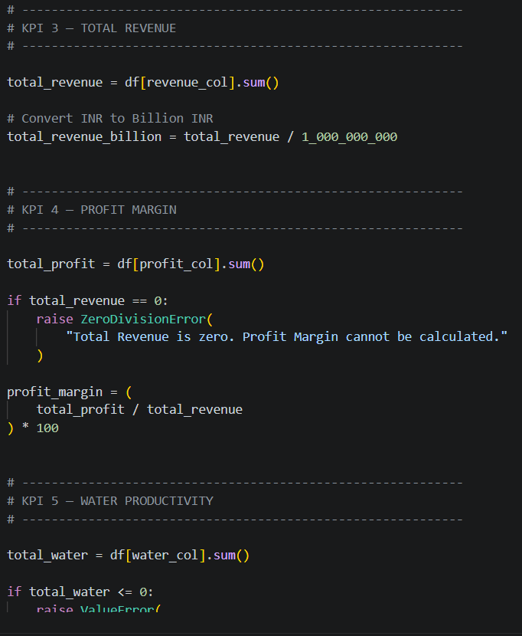
RESULTS

Slide 10
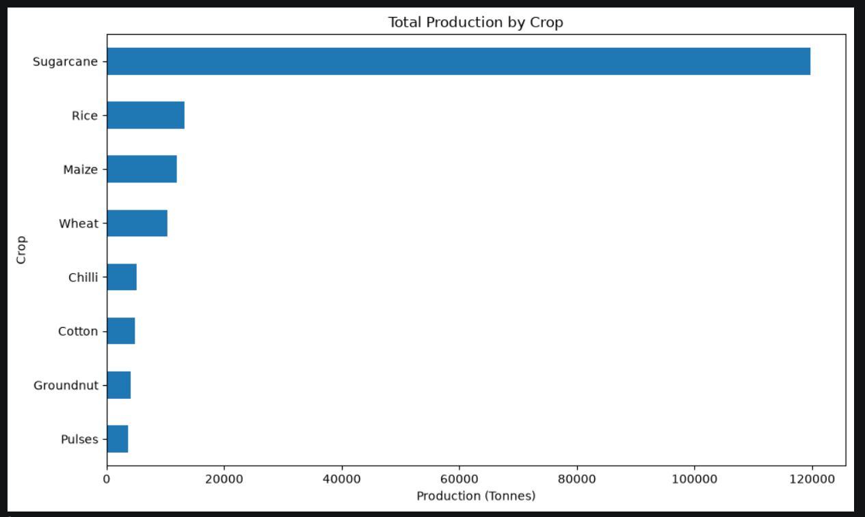
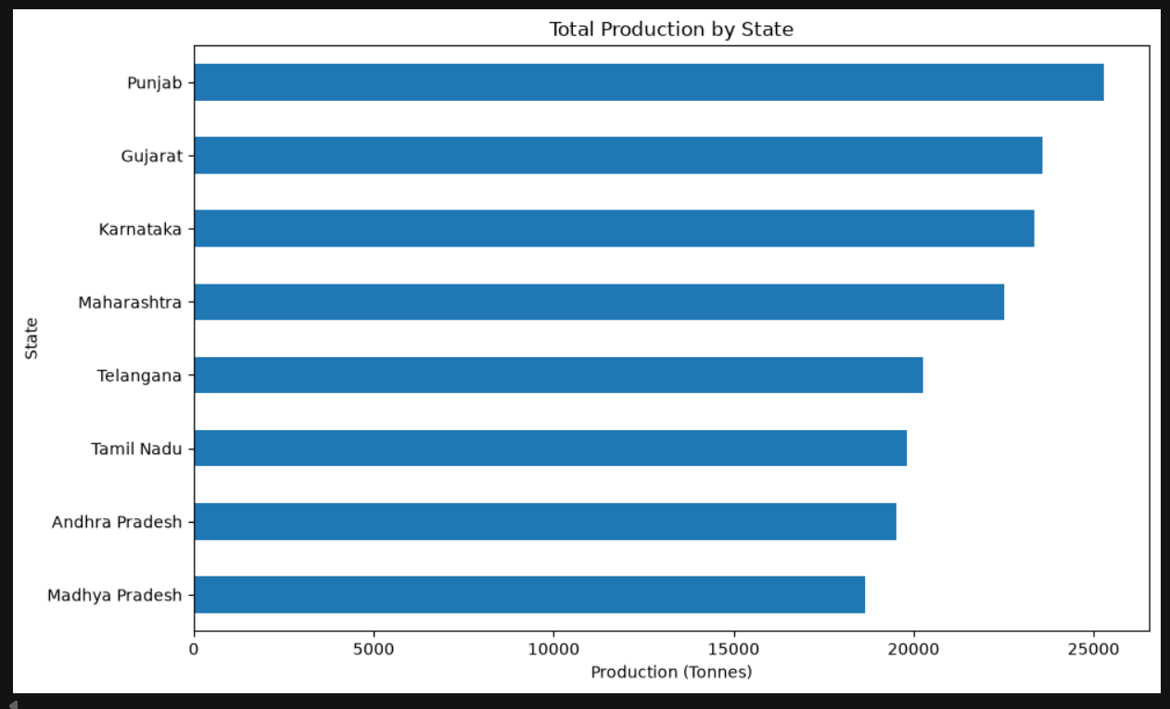
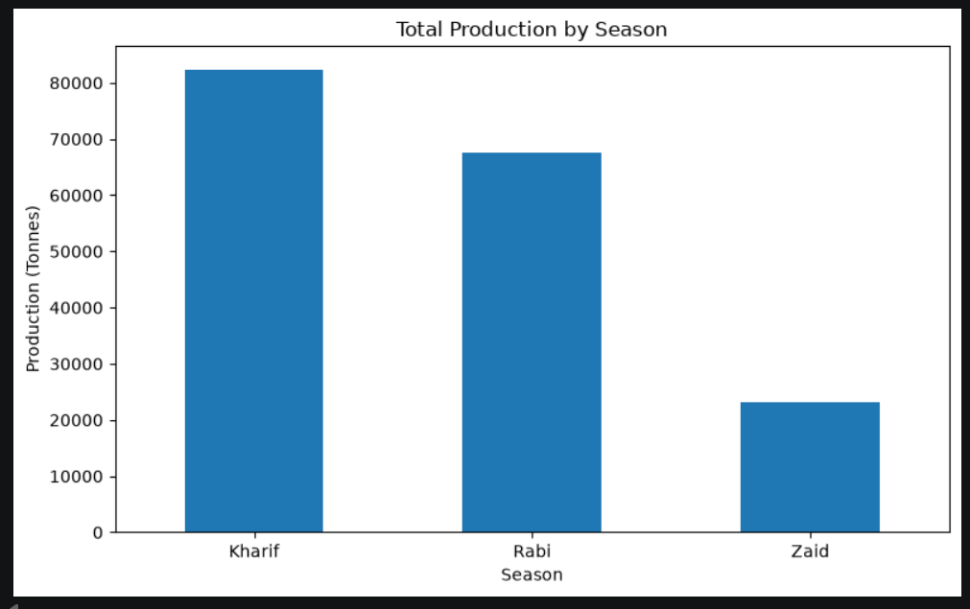
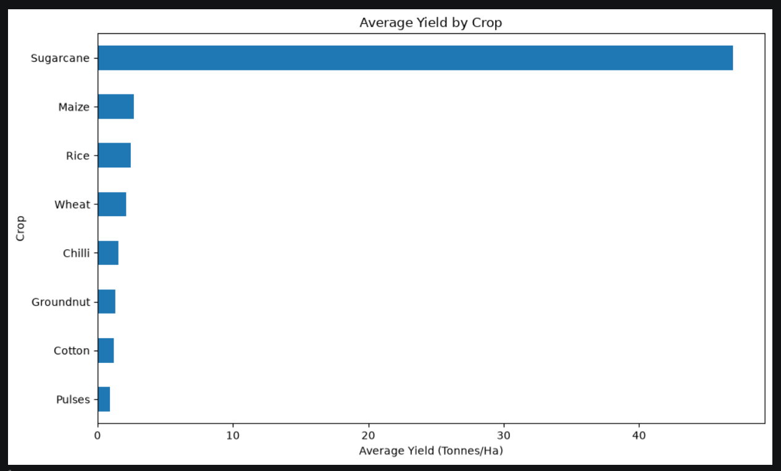
RESULTS

Slide 11
Future scope
Predict crop yield using Machine Learning.
Recommend the best crop for each season and region.
Add real-time weather data.
Analyze market prices and suggest profitable crops.
Help farmers save water and reduce costs.
Create a mobile/web application for farmers.
Add AI-based recommendations for better farming decisions.

Slide 12
GitHub Link
https://github.com/badugusandhya123-ops/VOIS-Project.git

Slide 13
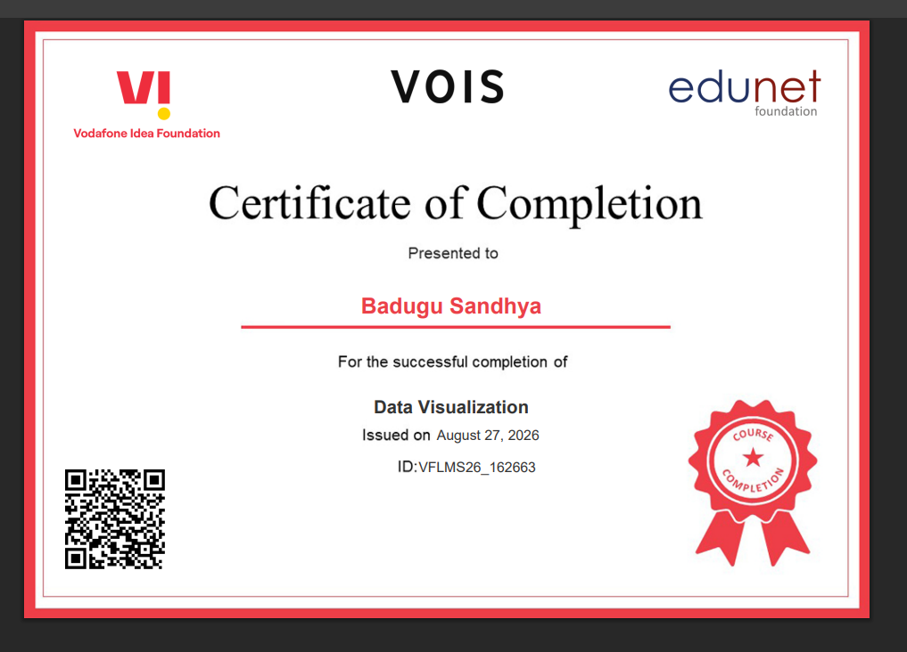
VOIS Course completion certificate -
Course name- Data Visualization

Slide 14
Thank you
.
.

