Slide 1
HACKSPHERE 2024-25
BRANCH :- INFORMATION TECHNOLOGY
Group No. :- 2 (SY)
Group Name:-
Team Members:-
PARAS BADWAIK (42)
ADITYA CHAVHAN (19)
UTKARSH LAMBADE (62)

Slide 2
Problem Statement
xt
ISSUES :-
1) Lack of self awareness among people.
2) Hard to find nutrition tracking platform for Self-Auditing.
3) Proper and diverse diet plans.
4) Health conditions and restrictions.
5) User Engagement.

Slide 3
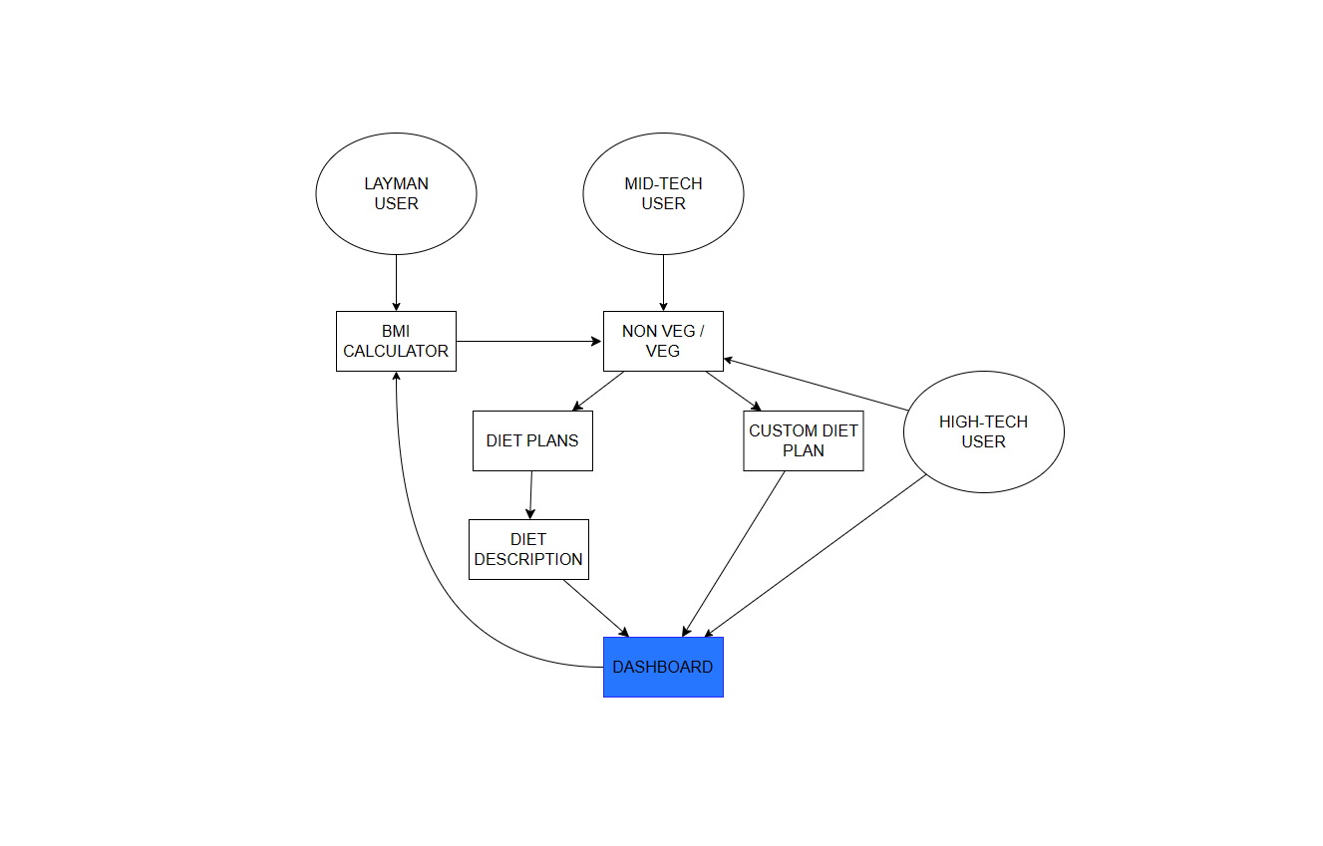
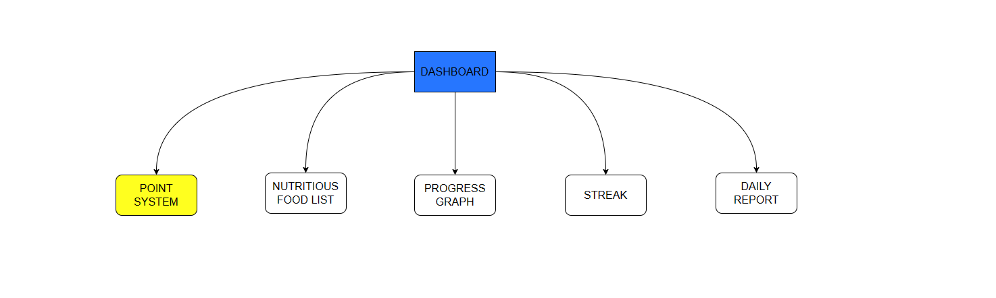
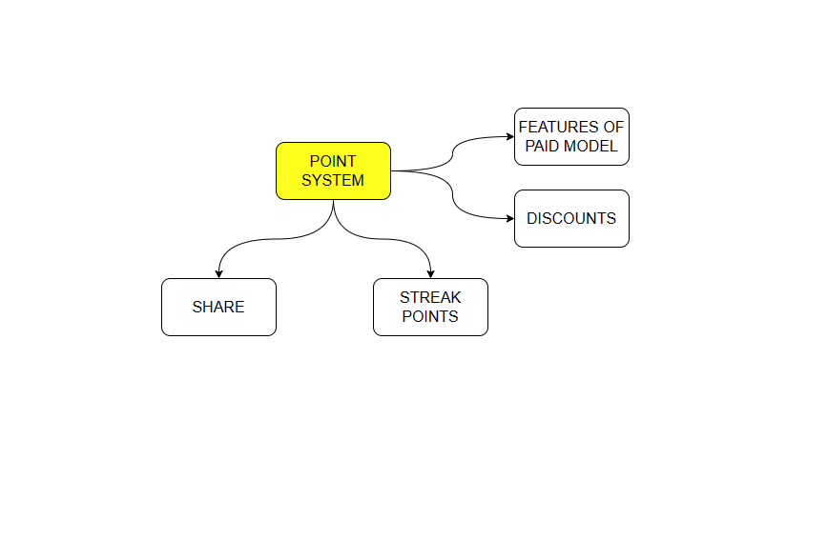
Flowchart of workflow

Slide 4
Advantages to our Solution
1) Daily Progress Graph
2) Daily report generation
3) User Friendly for every category of user.
4) Different Diet Plans for Veg and Non-Veg User
5) Description for every type of Diet Plan.
6) BMI based diet plan.
7) Streak used for maintaining discipline.

Slide 5
Drawbacks
Mindset and Discipline of the user plays an important role in maintaining proper nutrition, So app can only provide the neccesary help for maintaining and tracking one’s progress .
Show Stopper
Inaccurate user information can lead to irrelevant diet plans.

