Slide 1
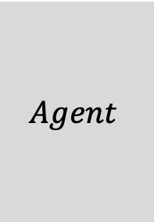
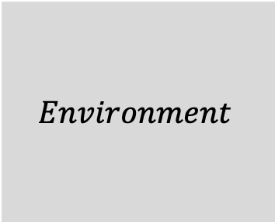



$$Environment$$
$$state s_{t}∈𝒮$$
$$Agent$$
$$action a_{t}∈𝒜$$
$$reward r_{t}∈ℝ$$

Slide 2




$$a_{t}$$
$$s_{t}$$
$$s_{t+1}$$
$$r_{t+1}$$

Slide 3
Model
Value / Policy
Simulated Experience
Values (TD update)
Planning
Acting
Policy
Direct RL
Model
Experience
Model Learning

