Slide 1
Detection and Identification of Pool Balls using Computer Vision
Simon Have & Jesper Bækdahl

Slide 2
Agenda
Introduction
Human Interaction Detection
Ball Detection
Ball Identification
Test and Conclusion

Slide 3
Introduction
System overview:

Slide 4
Human interaction detection
Why detection?
Inclined to be ”paranoid” towards detection.
False postive
Type I
False negative
Type II

Slide 5
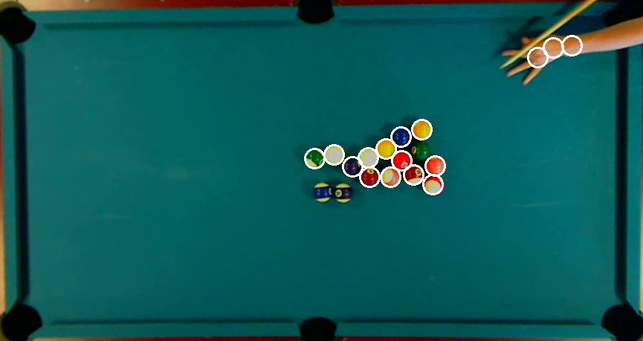
Human interaction detection
Without:

Slide 6
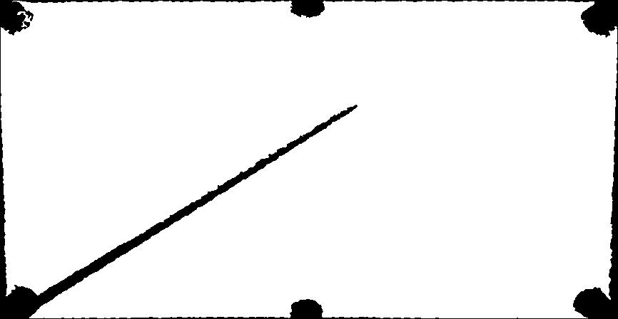
Human interaction detection
Occlusion factors:
Area and Perimeter.
Perimeter-factor > Threshold
Area-factor < Threshold

Slide 7
Human interaction detection
Other methods:
-Background subtraction
-Histograms (chain code comparison)
-Sensors

Slide 8
Human interaction detection
Video

Slide 9
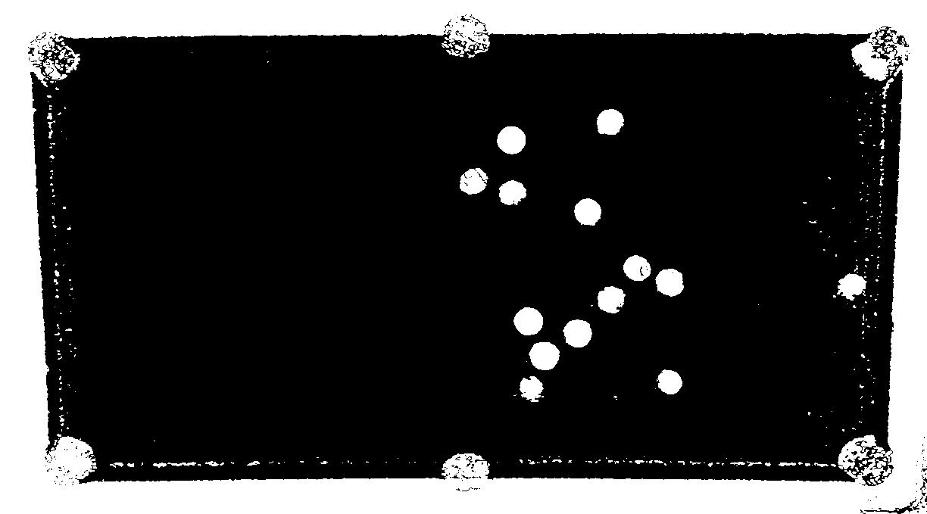
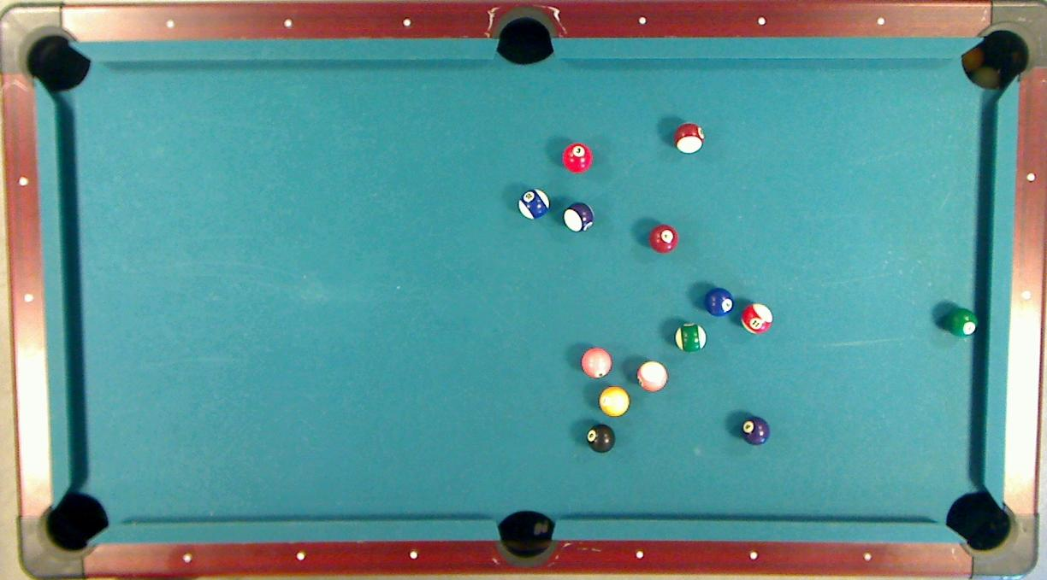
Ball Detection – Preliminary segmentation

Slide 10
Ball Detection – Probability Estimation
Discard background pixels
Determine primary color
Count primary colored pixels
Count white pixels

Slide 11
Ball Detection – Probability Estimation
24%
93%

Slide 12
Ball Detection – Best Candidates Selection
96%
98%

Slide 13
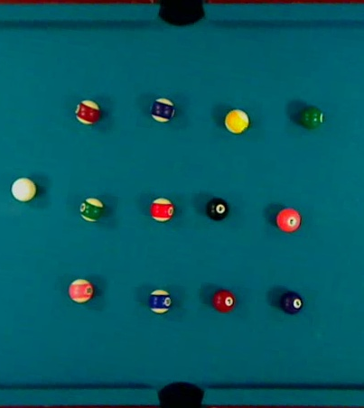
Ball Identification - Calibration
Select balls
Compute mean RGB
Determine white content in cue ball

Slide 14
Ball Identification – Color Comparison
Euclidean distance
Vector angle
Difficulties amongst similar colored balls
Light green
RGB = 178, 254, 178
D
A
Light brown
RGB = 236, 220, 154
Dark green
RGB = 148, 212, 148
C
B
Dark brown
RGB = 197, 183, 128
12°
RGB = 0, 0, 0

Slide 15
Ball Identification
Video

Slide 16
Test
Table detection
Implicitly tested
Good results
Human interaction detection
Good results, but with room for improvement
Ball detection
Good results in all environments

Slide 17
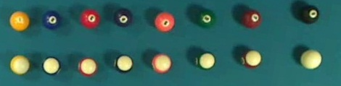
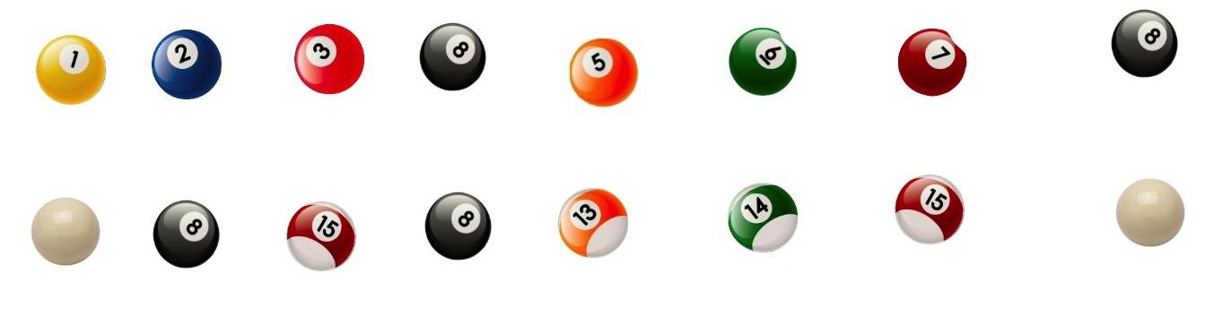
Test – Ball identification

Slide 18
Conclusion
Working prototype
Successful detection of table & balls
Problems with ball identification
Sensitive to color light changes
Camera problems
Unsolved bugs in software

Slide 19
Demo
In multi media lab.

