Slide 1
ZIP
Simon Have and Jesper Bækdahl

Slide 2
Outline
History and usage
Algorithm
LZ77
Huffman
Implementation and test

Slide 3
History and usage
Popular format for file compression
Created as a replacement for ARC format
Open format – can be implemented by everyone

Slide 4
Algorithm
Files are stored separately allowing partial extraction
Compression methods:
Stored (No compression)
Shrunk
Reduced
DEFLATE
LZ77
Huffman

Slide 5

LZ77
Uses dictionary consisting of already encoded data
Can give better compression than compression of single symbols only

Slide 6
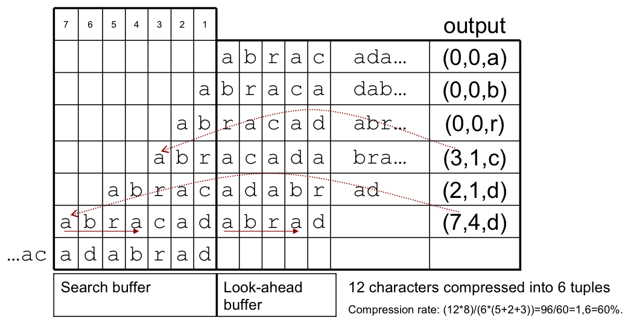
LZ77 Encoding

Slide 7
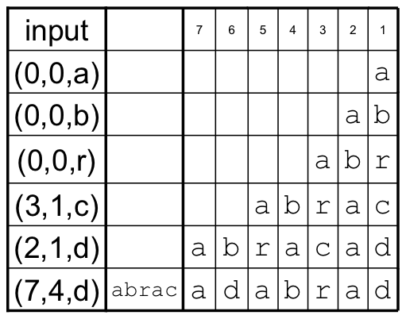
LZ77 Decoding

Slide 8
Huffman
Codes the most common symbols with the shortest bit patterns
Not implemented in this project

Slide 9
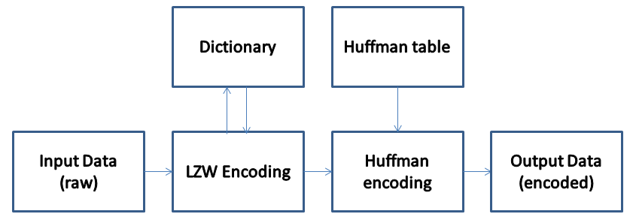
Implementation
ZIP headers not implemented
Implemented LZW in MATLAB
Used MATLAB implementation for Hufman

Slide 10
Test
Compression of 3.35 KB text file
Working but slow
Compression ratio:
Ours: 2.1
Windows Zip: 2.22

