Slide 1
Detection and Identification of Pool Balls using Computer Vision
Simon Have & Jesper Bækdahl

Slide 2
Agenda
Introduction
Table Detection
Human Interaction Detection
Ball Detection
Ball Identification
Test and Conclusion

Slide 3
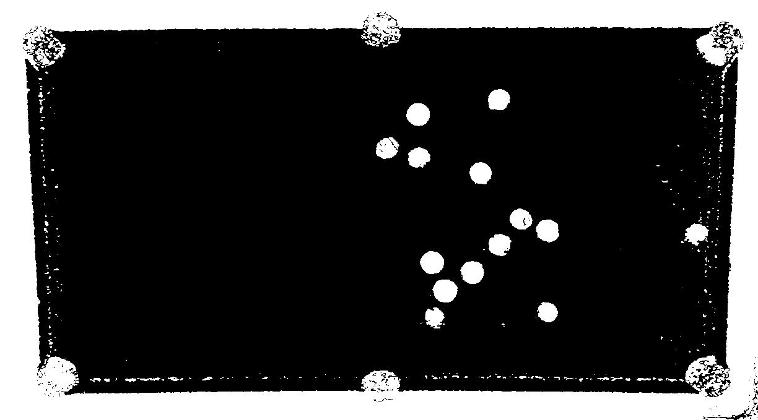
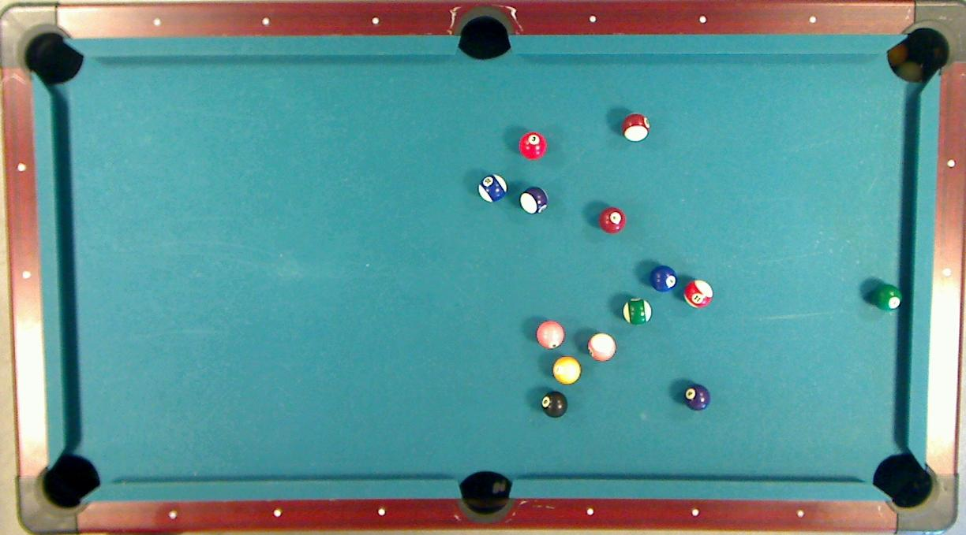
Ball Detection – Preliminary segmentation

Slide 4
Ball Detection – Probability estimation
24%
93%

Slide 5
Ball Detection – Preliminary segmentation
98%

