Slide 1
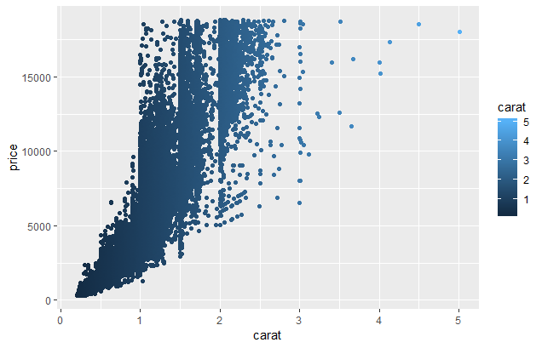
What is effective about this? What is not?

Slide 2
What is effective about this? What is not?
Effective
Data density (information per unit area), Data/ink ratio: maximize use of ink for data
No optical illusions
Accessibility: color blind color choices
Not effective
Extraneous grid lines, unnecessary color
Accessibility: font sizes (presentations vs manuscripts)

Slide 3
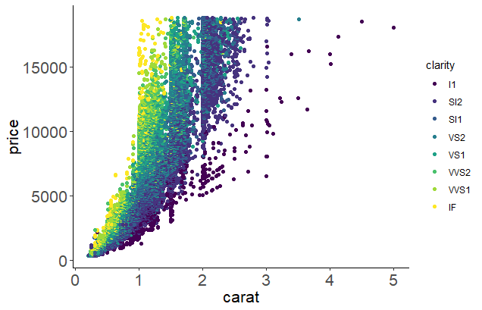
What is effective about this? What is not?
Effective
Increased data density (information per unit area) with colors
Data/ink ratio: maximize use of ink for data
No optical illusions
Accessibility: color blind color choices
Improvements
Removed grid lines
Made color a different grouping variable
Increased font size for readability

Slide 4
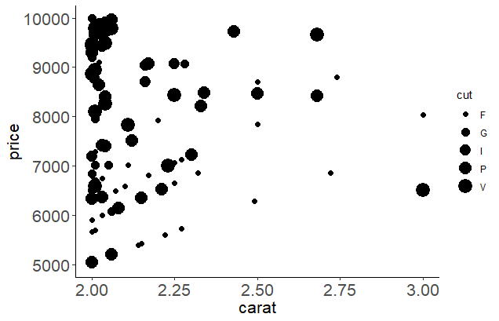
What is clear about this? What is misleading?

Slide 5
What is clear about this? What is misleading?
Clear
Chart design consistent throughout
Units appropriate
Not clear
Symbols and axes proportional to numbers represented (problem with pie charts, area in general)
Lack of context: did not show all relevant data
Clear labels (minimize abbreviations)

Slide 6
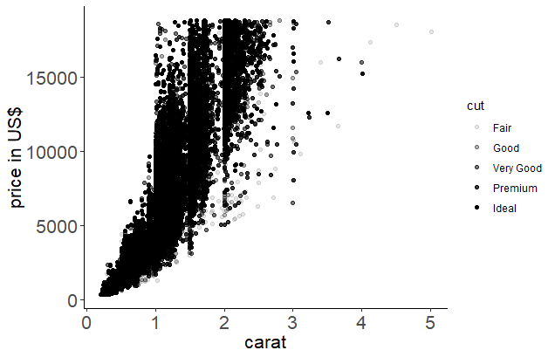
What is clear about this? What is misleading?
Clear
Chart design consistent throughout
Units appropriate
Improvements
Removed area-cut relationship
Lack of context: did not show all relevant data
Clear labels – not abbreviated

