Slide 1
Data-driven visualizations
We’ll be doing group activities –
please sit with at least one other person!

Slide 2
Goals for today
choose a sentence, table, or graph
maximize data portrayed to a reader
present your data with clarity

Slide 3
Get started
Work in groups of 2 or more (table as a group is good)
Introduce yourselves with name and describe research in 1-3 words

Slide 4
First, choose your visualization
Match your data and hypothesis to graph type with “chart of charts”

Slide 5
So, what’s your data?
Match your data and hypothesis to graph type with “chart of charts”
Place | Population
Norman, OK, USA | 122,843
Stillwater, OK, USA | 49,829

Slide 6
Step 1: how many data points?
Two
Is that “a few”?
Place | Population
Norman, OK, USA | 122,843
Stillwater, OK, USA | 49,829

Slide 7
Step 1: how many data points?
Two
Several, or more than several?
Let’s say “several”
Place | Population
Norman, OK, USA | 122,843
Stillwater, OK, USA | 49,829

Slide 8
Step 1: how many data points?
Two
Several, or more than several?
Let’s say “several”
Write a sentence
Place | Population
Norman, OK, USA | 122,843
Stillwater, OK, USA | 49,829

Slide 9
Step 1: how many data points?
Two
Several, or more than several?
Let’s say “several”
Write a sentence
Check with your colleagues
Place | Population
Norman, OK, USA | 122,843
Stillwater, OK, USA | 49,829

Slide 10
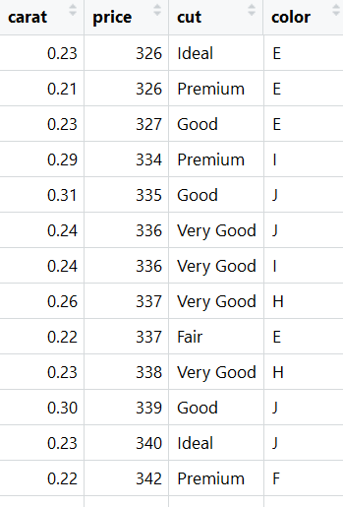
Another example with a larger dataset
Step 1: how many data points do you have?
53,940 rows
“More than a few”

Slide 11
Another example with a larger dataset
How many variables do you have?

Slide 12
Another example with a larger dataset
How many variables do you have?
4 columns/variables
Two numeric
Two categorical
Which we are going to use depends on our question

Slide 13
Another example with a larger dataset
Let’s start with our two numeric variables

Slide 14
Another example with a larger dataset
Let’s start with our two numeric variables
Are your data currently raw or summaries?

Slide 15
Another example with a larger dataset
Let’s start with our two numeric variables
Are your data currently raw or summaries?
Is your x / predictor / independent variable numeric or categorical?

Slide 16
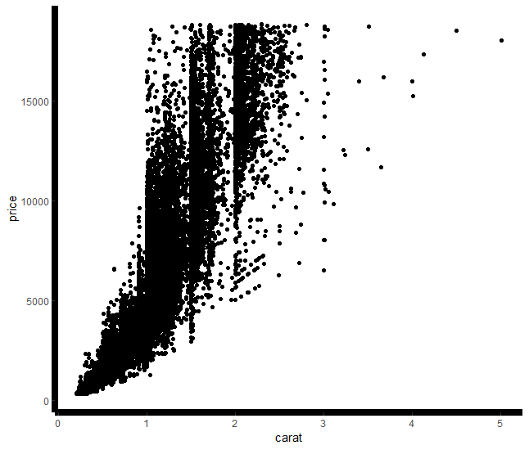
Another example with a larger dataset
Let’s start with our two numeric variables
Are your data currently raw or summaries?
Is your x / predictor / independent variable numeric or categorical?
Make a scatterplot

Slide 17
What if our question includes the groups?
Go back to “variables 3+ are”
(just right of step 1)

Slide 18
What about our grouping variables?
Variables 3+ are…

Slide 19
What if our question includes the groups?
Variables 3+ are…

Slide 20
What if our question includes the groups?
We know we want a scatterplot

Slide 21
What about our grouping variables?
Variables 3+ are…
How many grouping variables?

Slide 22
What about our grouping variables?
Variables 3+ are…
How many grouping variables?
Two = “few”??

Slide 23
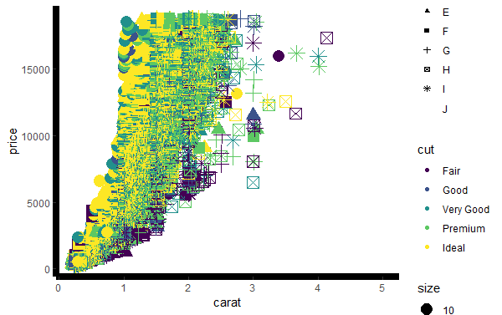
What about our grouping variables?
Variables 3+ are…
How many grouping variables?
Two = “few”??
Distinguish by symbols and colors

Slide 24
What about our grouping variables?
Variables 3+ are…
How many grouping variables?
Two = “few”??
Distinguish by symbols and colors
Ask your colleagues

Slide 25
What about our grouping variables?
Variables 3+ are…
How many grouping variables?
Two = “few”??
Distinguish by symbols and colors
Ask your colleagues
Reviewer 3: “can’t read your plot”

Slide 26
What if our question includes the groups?
Go back to how many grouping variables?
“Few” vs “few to many” – let’s try the other choice

Slide 27
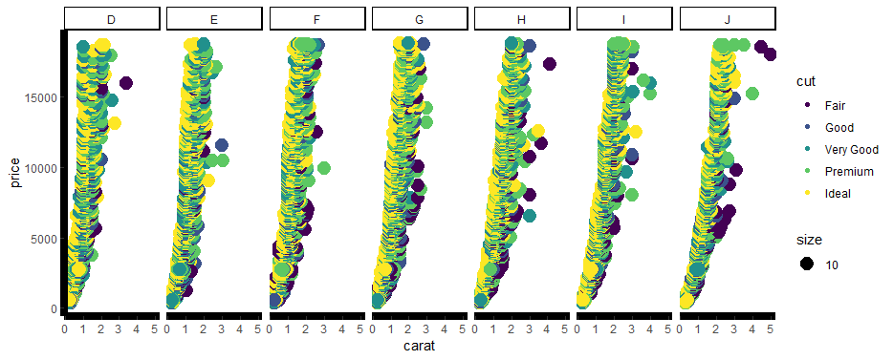
What if our question includes the groups?
Go back to how many grouping variables?
“Few” vs “few to many” – let’s try the other choice
Plot data in panels

Slide 28
What if our question includes the groups?
Go back to how many grouping variables?
“Few” vs “few to many” – let’s try the other choice
Plot data in panels
Reviewer 3: “Not bad now”

Slide 29
Step 1 summary
We’ve chosen a visualization type based on our data structure and question
Next, let’s make our visualization more effective in transmitting information to the viewer

Slide 30
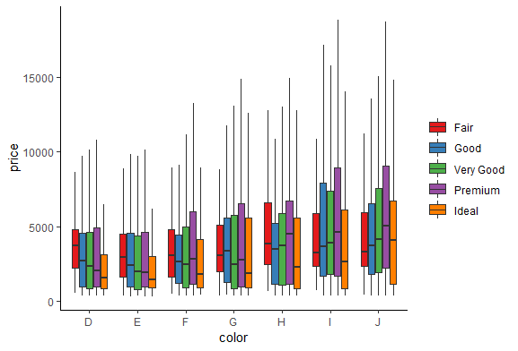
Step 2: effective visuals
Accessibility

Slide 31
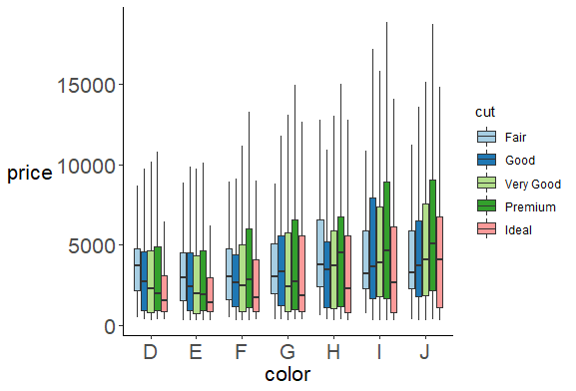
Step 2: effective visuals
Accessibility

Slide 32
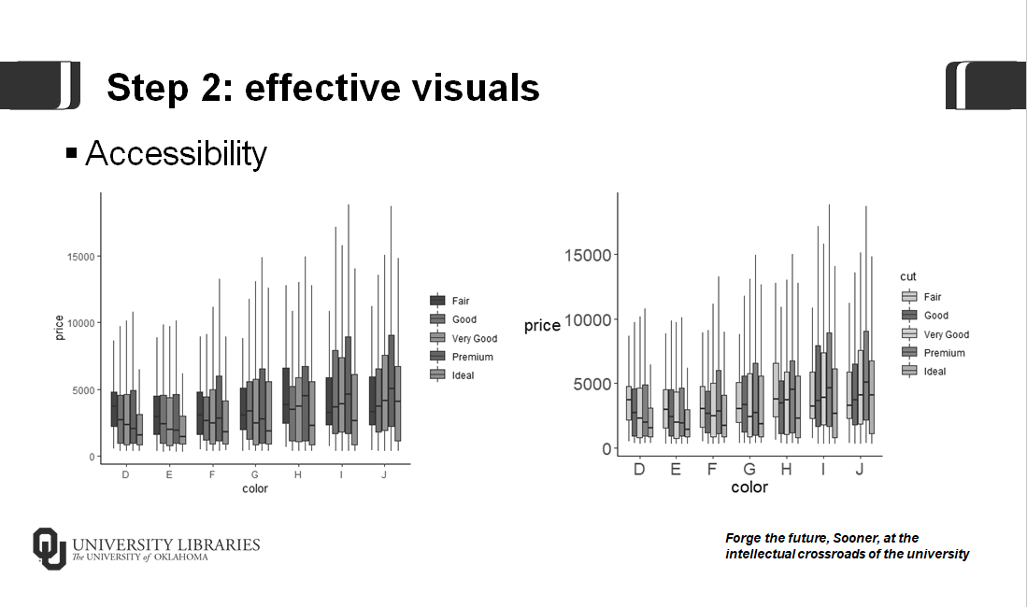
Step 2: effective visuals

Slide 33
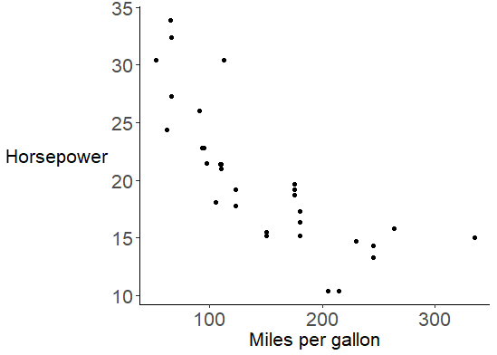
Step 2: effective visuals
Summaries

Slide 34
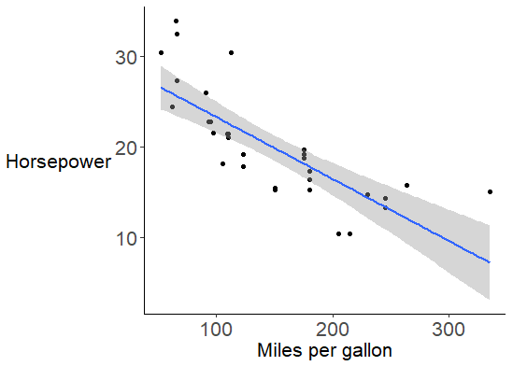
Step 2: effective visuals
Summaries

Slide 35
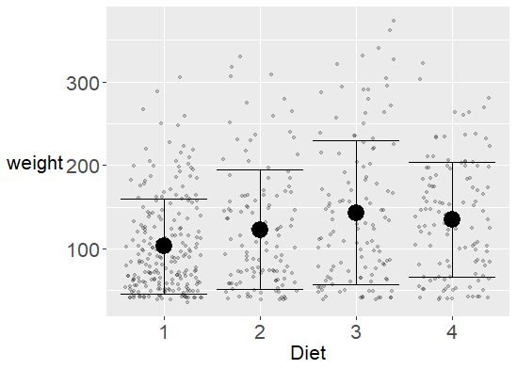
Step 2: effective visuals
Data/ink ratio

Slide 36
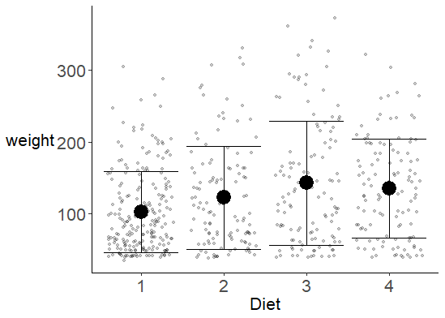
Step 2: effective visuals
Data/ink ratio

Slide 37
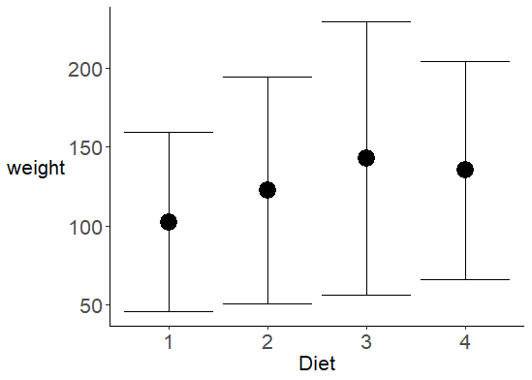
Step 2: effective visuals
Data density (data/whitespace ratio)

Slide 38
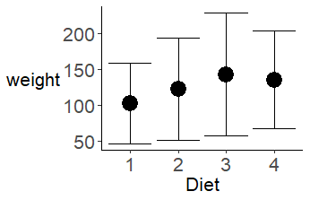
Step 2: effective visuals
Data density (data/whitespace ratio)

Slide 39
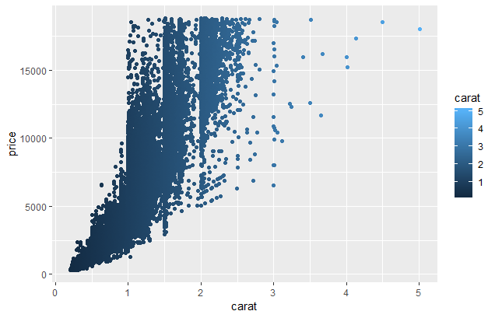
What is effective about this? What is not?

Slide 40
What is effective about this? What is not?
Effective
No related items needing connected
Not effective
Extraneous grid lines
Unnecessary background
Low contrast
Font sizes (presentations vs manuscripts)

Slide 41
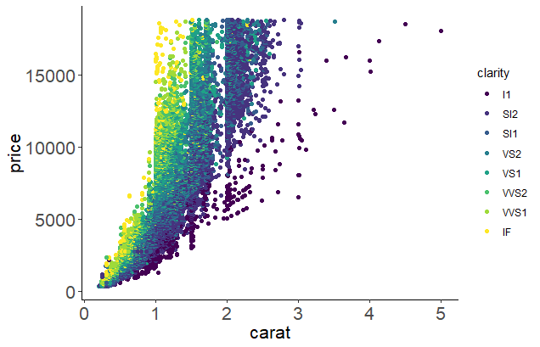
What improvements can we make?
Increased data density with colors
Color contrasts
Removed grid lines
Increased font size for readability

Slide 42
What else could we improve?
Grayscale colors
Increase legend size
What is clarity? Is it ordered?
For a presentation, rotate y-axis label to horizontal
Add thousands delimiters to large numbers

Slide 43
Step 2 summary
We’ve made our visualization more effective in transmitting information to the viewer
Now we’ll check it for clarity

Slide 44
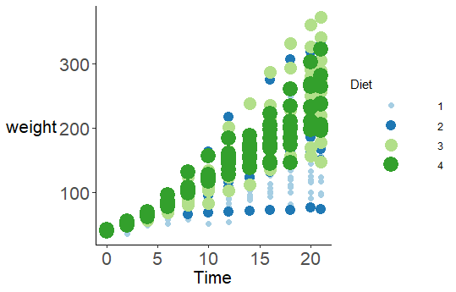
Step 3: clear visuals
Symbols and axes proportional

Slide 45
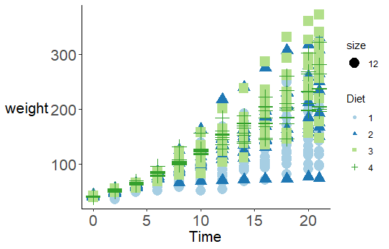
Step 3: clear visuals
Symbols and axes proportional

Slide 46
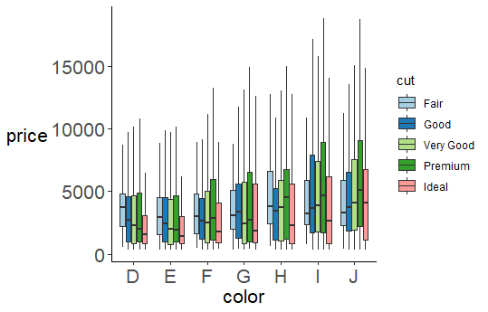
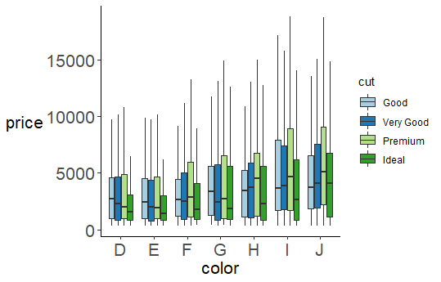
Step 3: clear visuals
Clear labels/symbology consistent with rest of document

Slide 47
Step 3: clear visuals
Clear labels/symbology consistent with rest of document

Slide 48
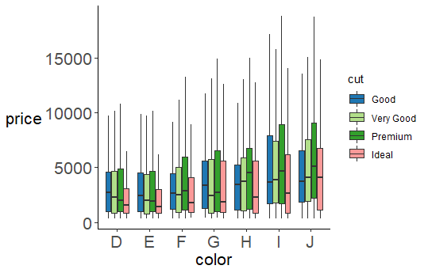
Step 3: clear visuals
Clear labels/symbology consistent with rest of document

Slide 49
Step 3: clear visuals
Clear labels/symbology consistent with rest of document

Slide 50
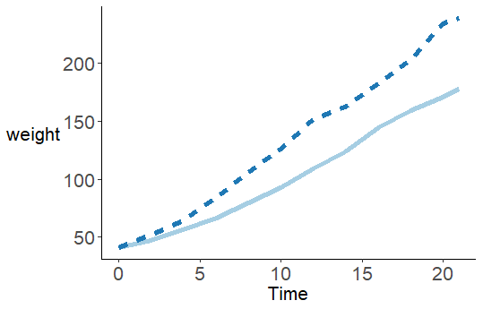
Step 3: clear visuals
Reduce lack of context

Slide 51
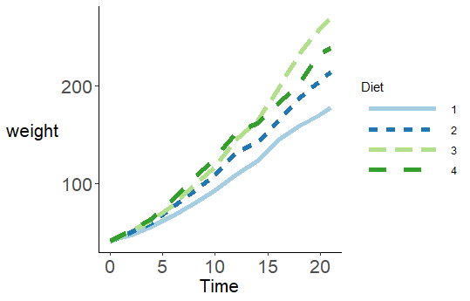
Step 3: clear visuals
Reduce lack of context

Slide 52
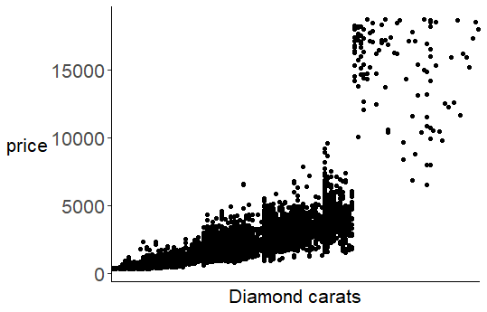
Step 3: clear visuals
Do not change chart design partway through – can be done accidentally by having unevenly spaced numbers as categories!

Slide 53
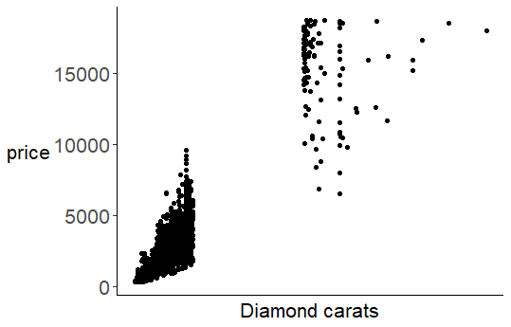
Step 3: clear visuals
Do not change chart design partway through – can be done accidentally by having unevenly spaced numbers as categories!

Slide 54
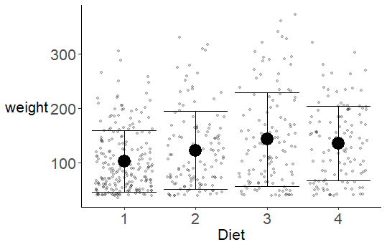
Step 3: clear visuals
Meet your goal – what is your question or hypothesis?
“Here we demonstrate four diets affect chicken weight divergently over time.”

Slide 55
Step 3: clear visuals
Meet your goal – what is your question or hypothesis?
“Here we demonstrate four diets affect chicken weight divergently over time.”

Slide 56
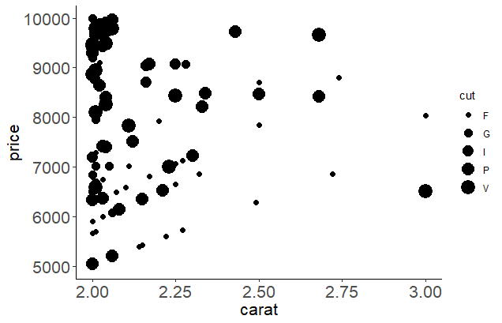
What is clear or misleading about this?

Slide 57
What is clear or misleading about this?
Clear
Chart design consistent throughout
Units appropriate
Potentially misleading
Symbols and axes proportional to numbers represented (problem with pie charts, area in general)
Lack of context: did not show all relevant data
Clear labels (minimize abbreviations)

Slide 58
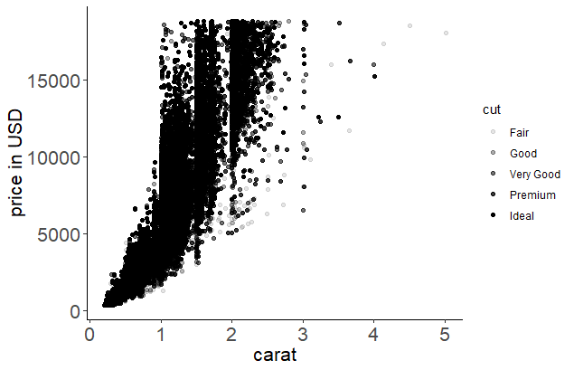
What improvements can we make?
Removed area-cut relationship
Show full range of data
Units for y-axis
Labels not abbreviated

Slide 59
What else could we improve?
Decide if data density in interior is acceptable
Make “fair” easier to see from a distance (darker color)
Make all points easier to see from a distance (larger size)
Consider goal – do we need all cut categories? Do we need a summary instead?

Slide 60
Step 3 summary
We’ve made our visualization clear and effective to get our result to the viewer
Next, resources to learn more

Slide 61
Step 4: get help and learn more
Digital Skills Hub Calendar https://calendar.ou.edu/dsh
Carpentries workshops https://libraries.ou.edu/carpentries
Information Specialists @ DAVIS https://libraries.ou.edu/davis
Read Tufte’s The Visual Display of Quantitative Information on Reserves at Circulation Desk (4 hour checkout)
This slide deck available on our curriculum archive at https://osf.io/a9yt5/

Slide 62
Please take 3 min to help us improve
Survey link: http://bit.ly/oulib_davis_workshop
Workshop topic: Data-driven visualizations
Workshop date: April 4, 2019
Notes:
For those who didn’t bring a device, offer to email them via EventBrite

