Slide 1

Statistical analysis of wine factory
Marzieh Baes
Code Academy Berlin

Slide 2
Outline of presentation
Overveiw of data
Outlier detection
Data analysing:
- quality of wine
- corrolation of parameters
- Anova test
Conclusions

Slide 3
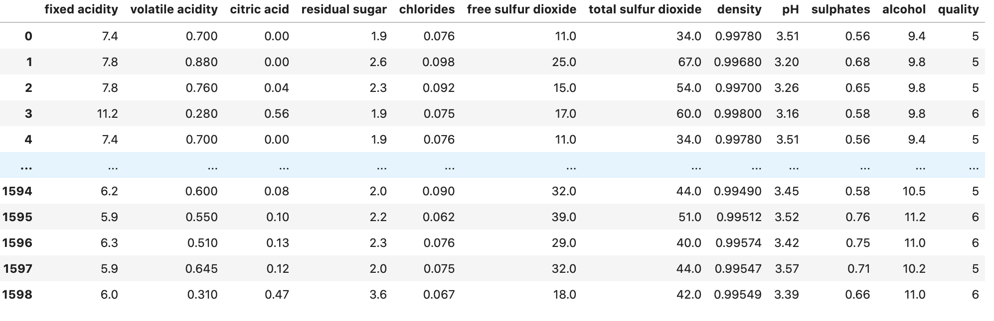
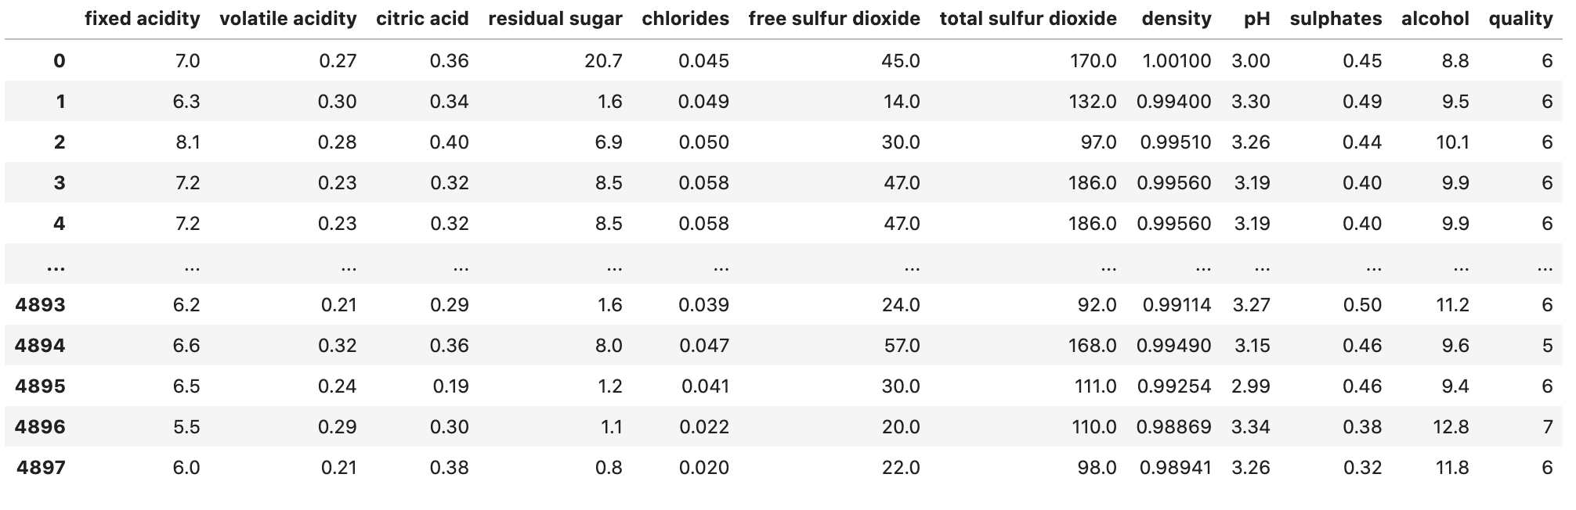
Overview of data
Red wine: n =1599
White wine: n= 4898

Slide 4
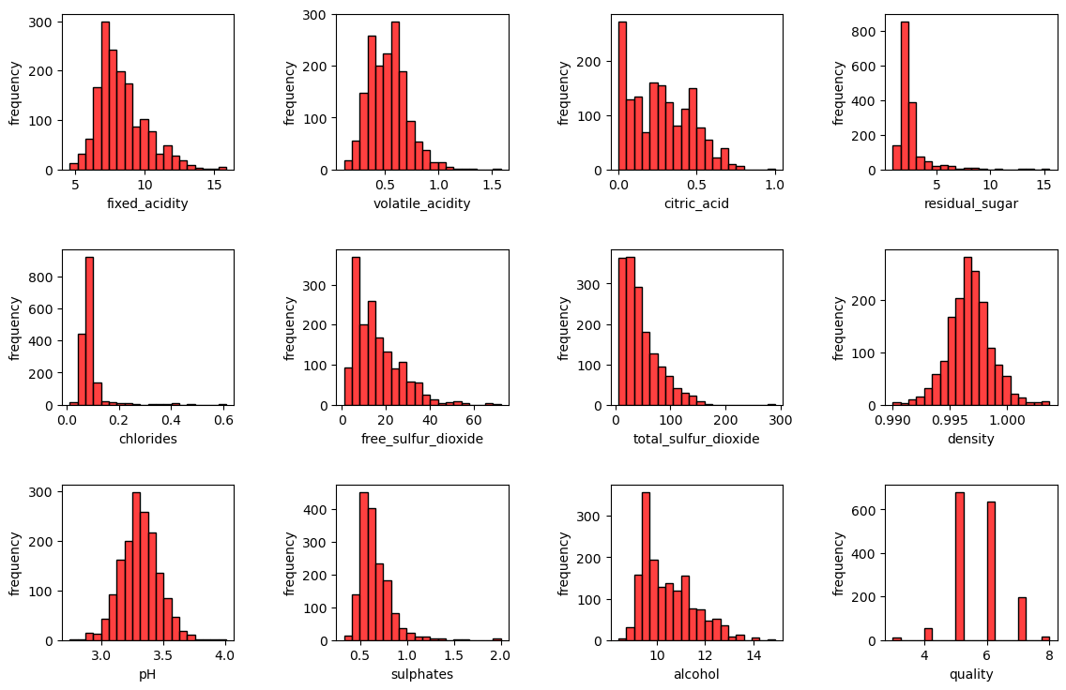
Overview of data

Slide 5
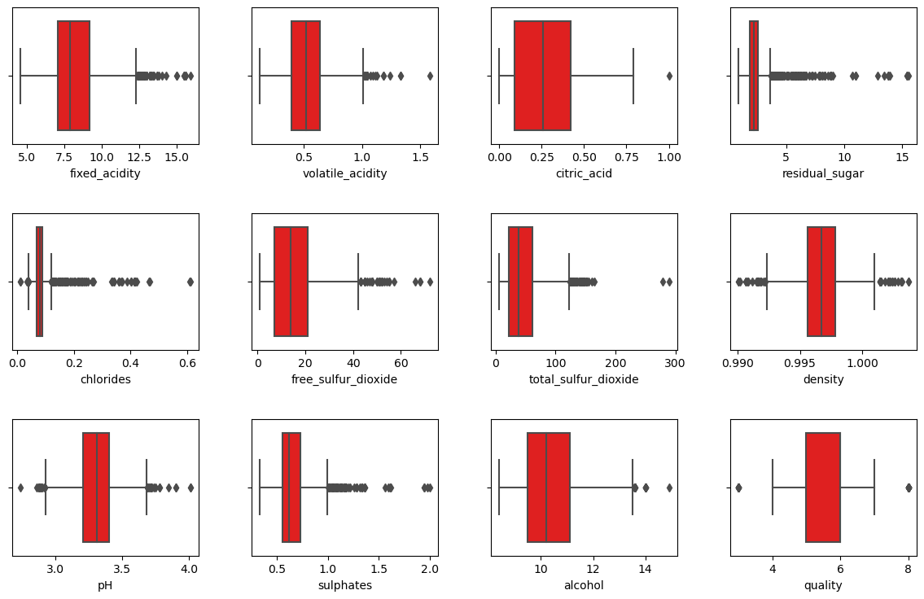
Overview of data

Slide 6
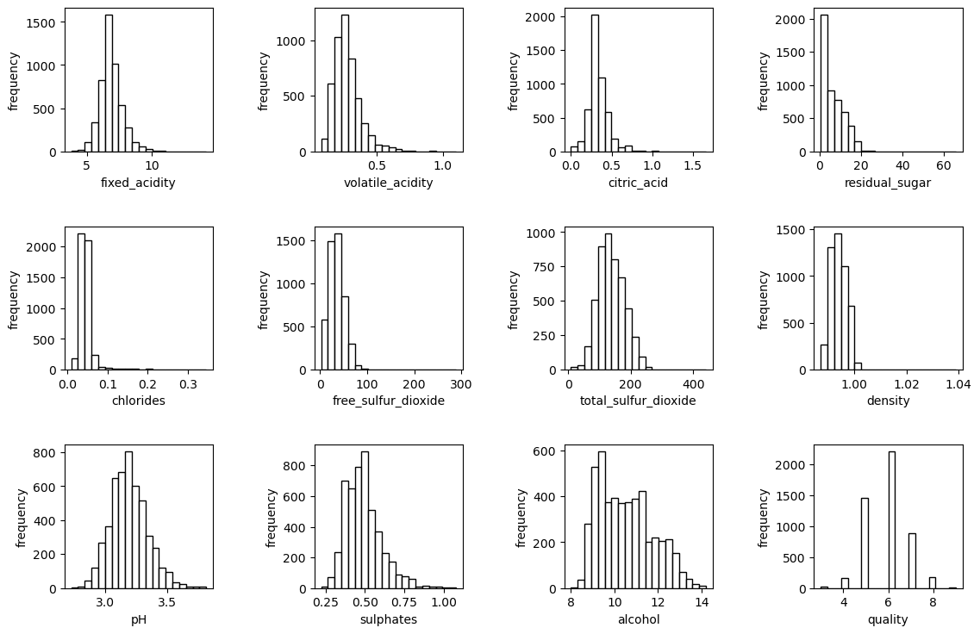
Overview of data

Slide 7
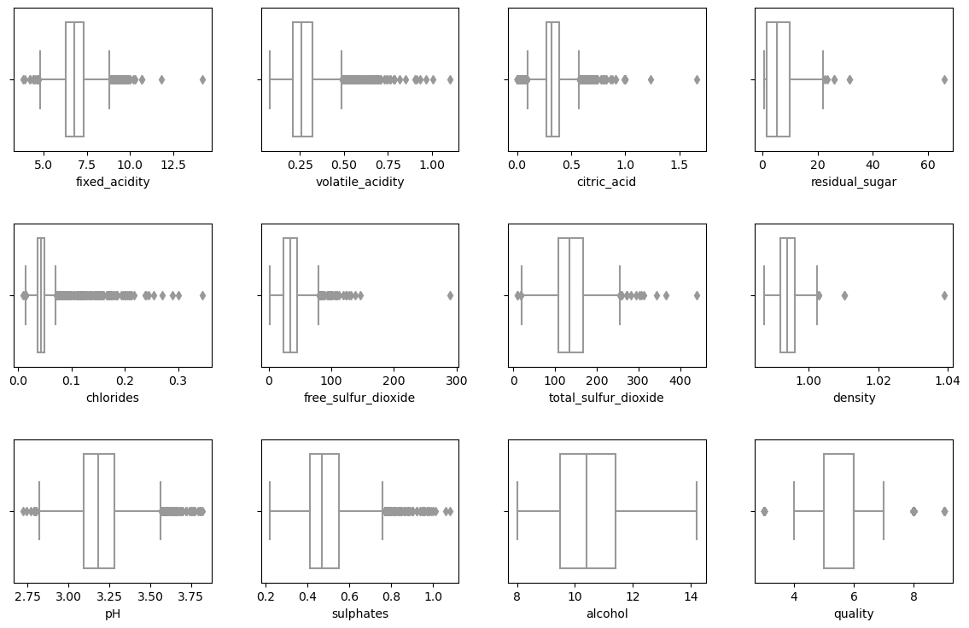
Overview of data

Slide 8
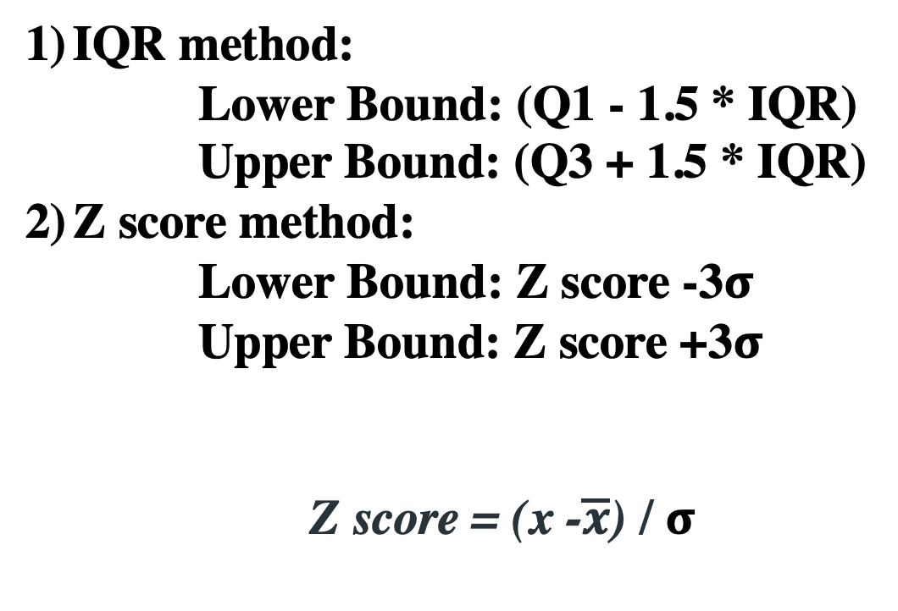
Outliers detection
IQR method:
Lower Bound: (Q1 - 1.5 * IQR)
Upper Bound: (Q3 + 1.5 * IQR)
Z score method:
Lower Bound: Z score -3$σ$
Upper Bound: Z score +3$σ$
Z score = (x -$\overline{x}$) / $σ$

Slide 9
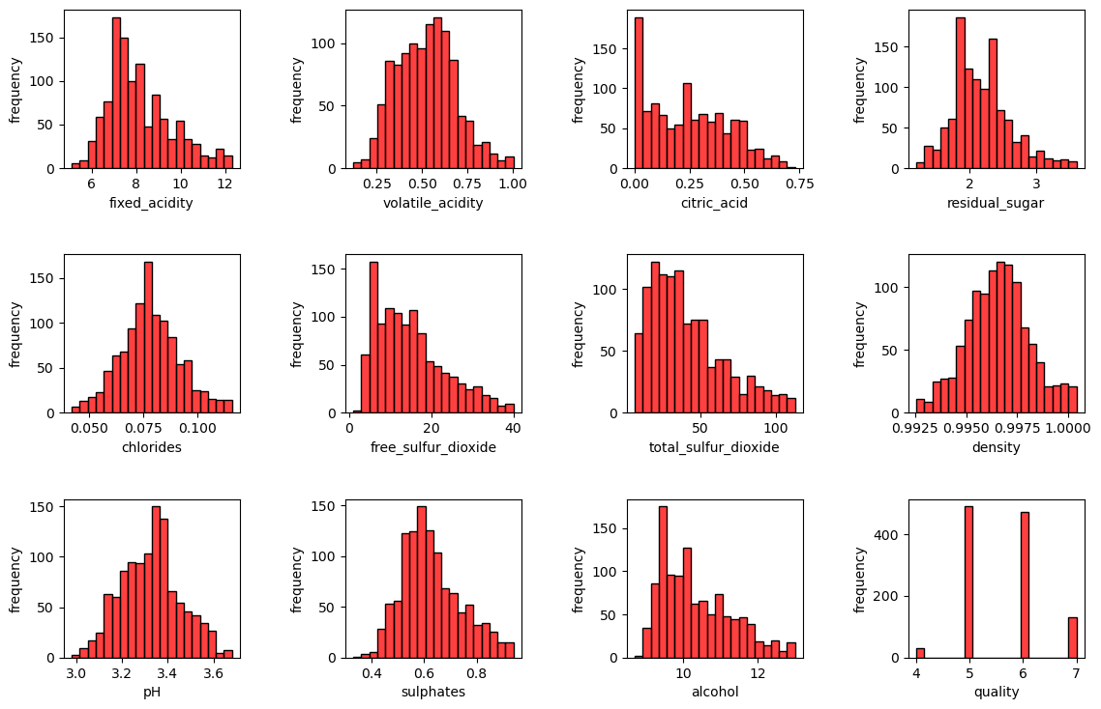
Outliers detection
IQR method:

Slide 10
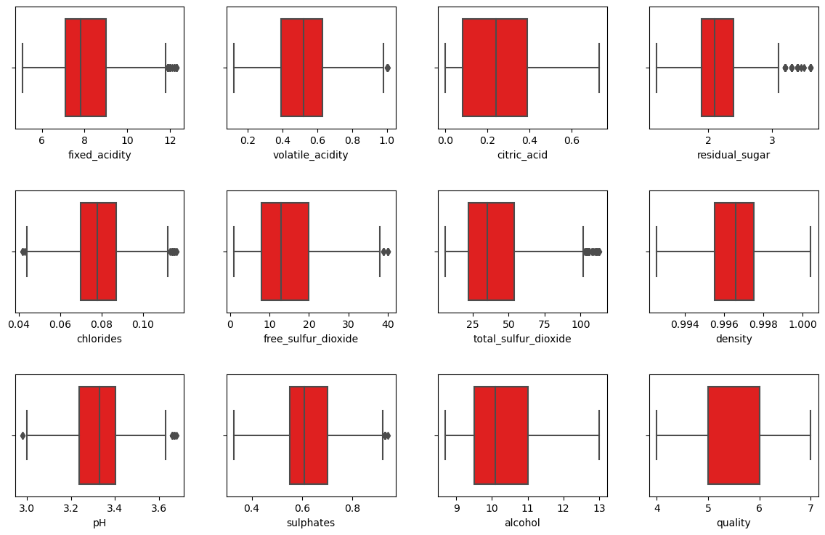
Outliers detection
IQR method:

Slide 11
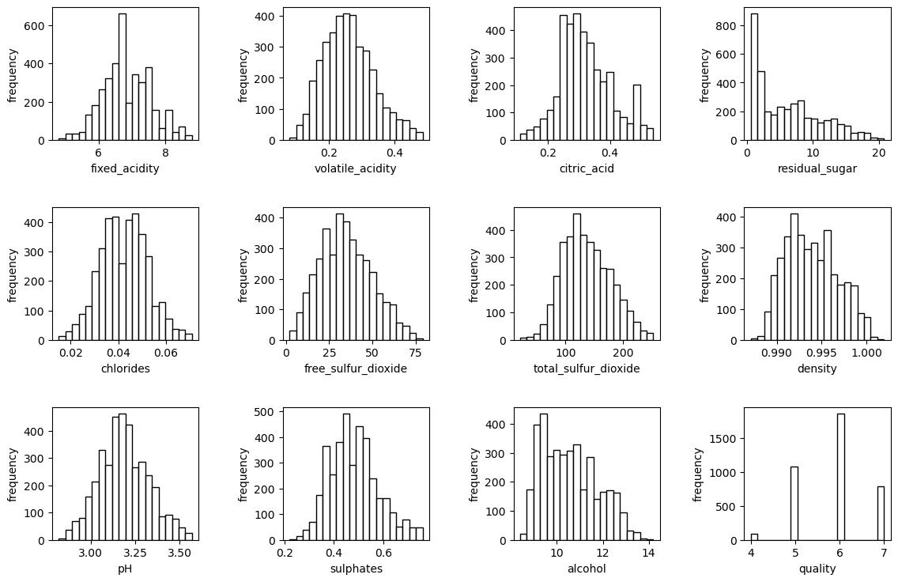
Outliers detection
IQR method:

Slide 12
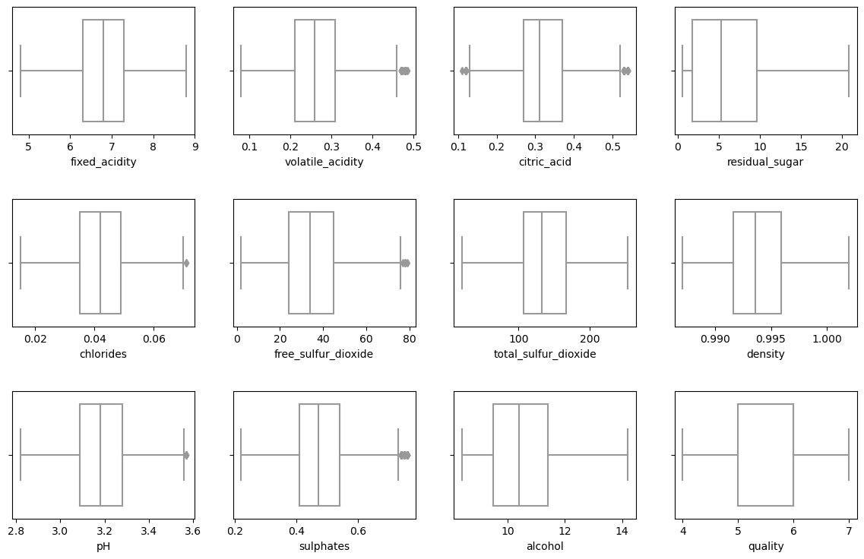
Outliers detection
IQR method:

Slide 13
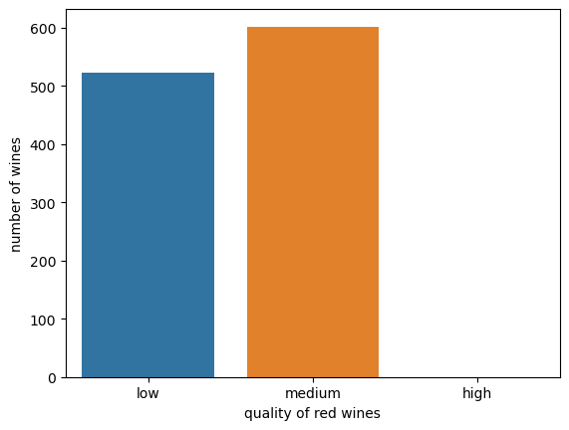
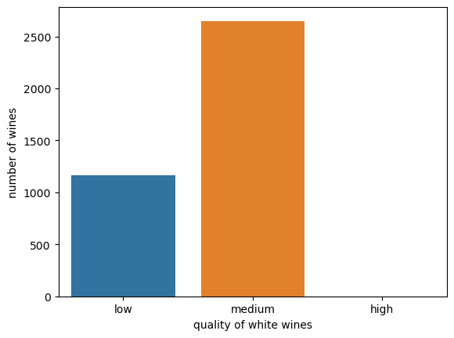
Outliers detection
IQR method:
White wines: n= 3815 (10.83% outliers)
Red wines: n=1124 (4.75 % outlies)
Red Wines
White Wines

Slide 14
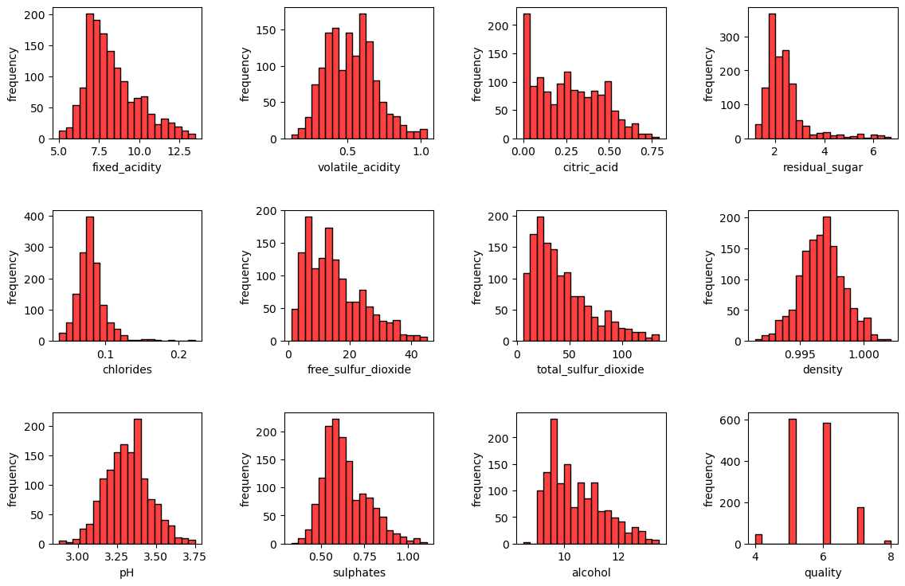
Outliers detection
Z score method:

Slide 15
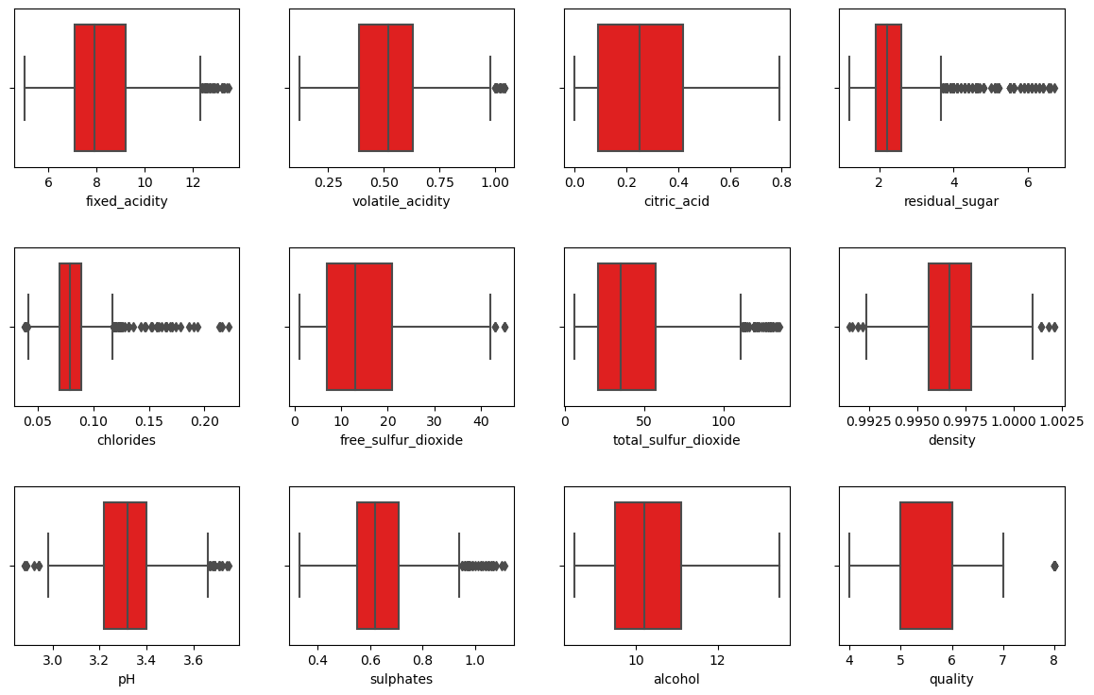
Outliers detection
Z score method:

Slide 16
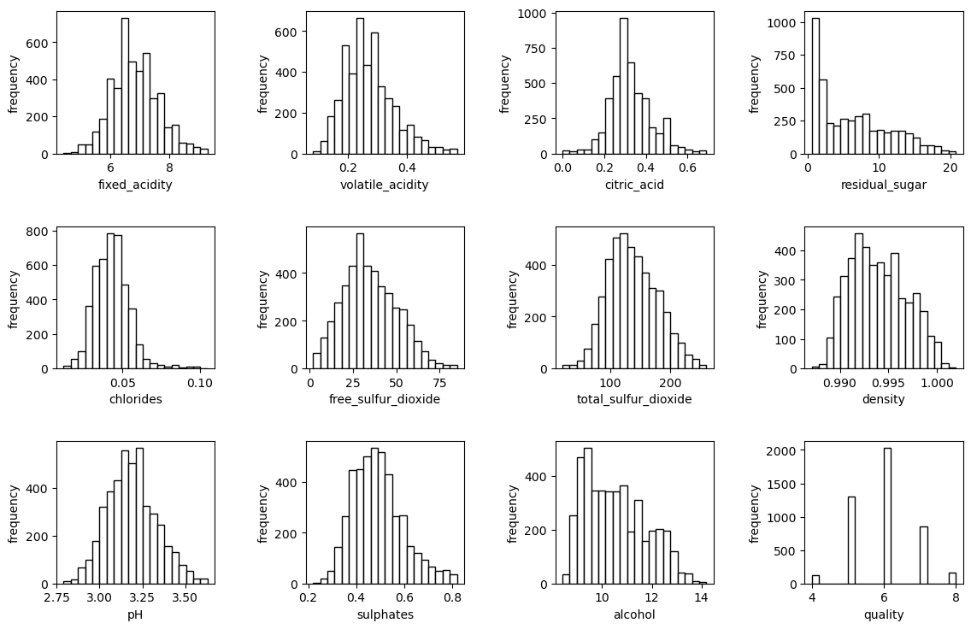
Outliers detection
Z score method:

Slide 17
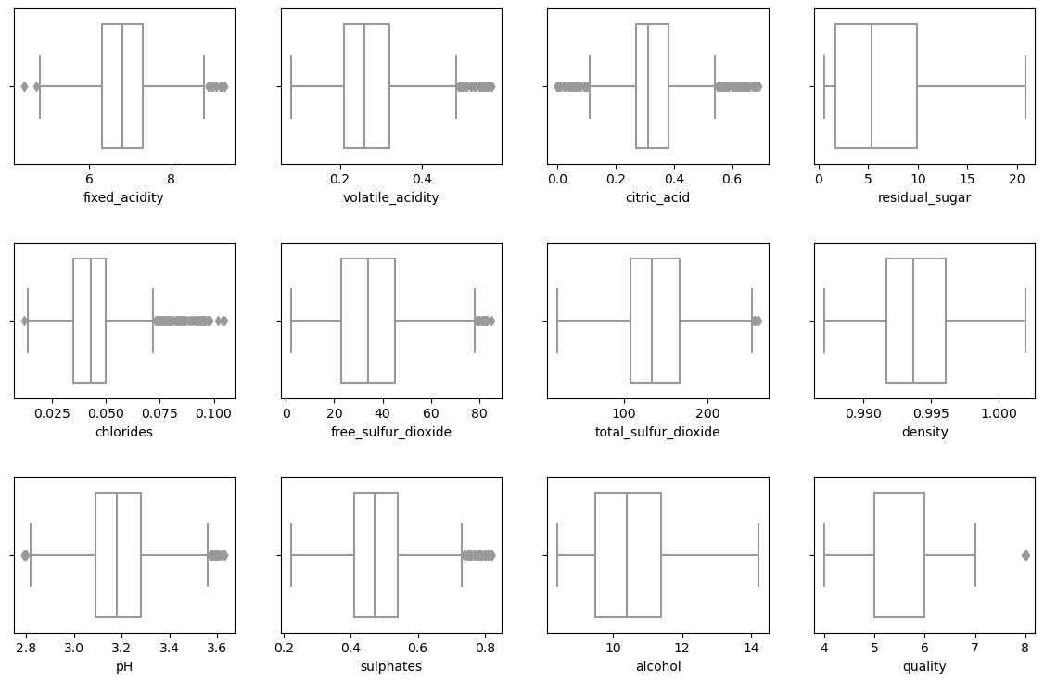
Outliers detection
Z score method:

Slide 18
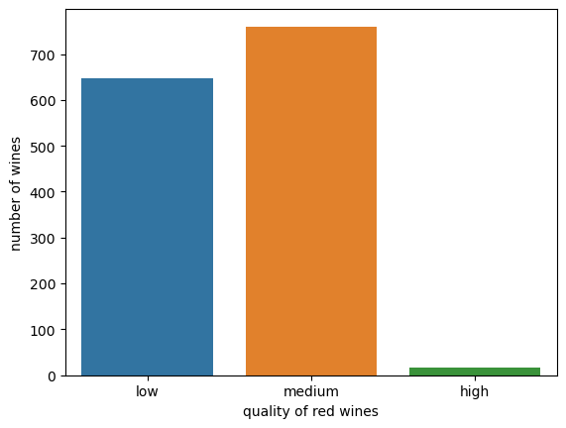
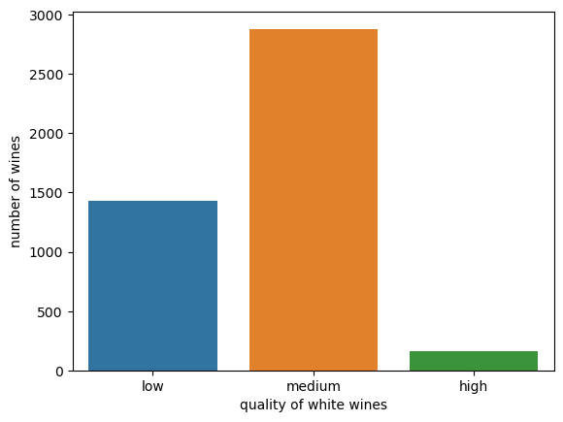
Outliers detection
Z score method:
White wines: n= 4469 (4.29% outliers)
Red wines: n=1424 (1.75 % outlies)
Z score method:
Red Wines
White Wines

Slide 19
Outliers detection
Z score method:
White wines: n= 4469 (4.29% outliers)
Red wines: n=1424 (1.75 % outlies)
Z score method:
Red Wines
White Wines
IQR method:
White wines: n= 3815 (10.83% outliers)
Red wines: n=1124 (4.75 % outlies)
White wine: n= 4898
Red wine: n =1599

Slide 20
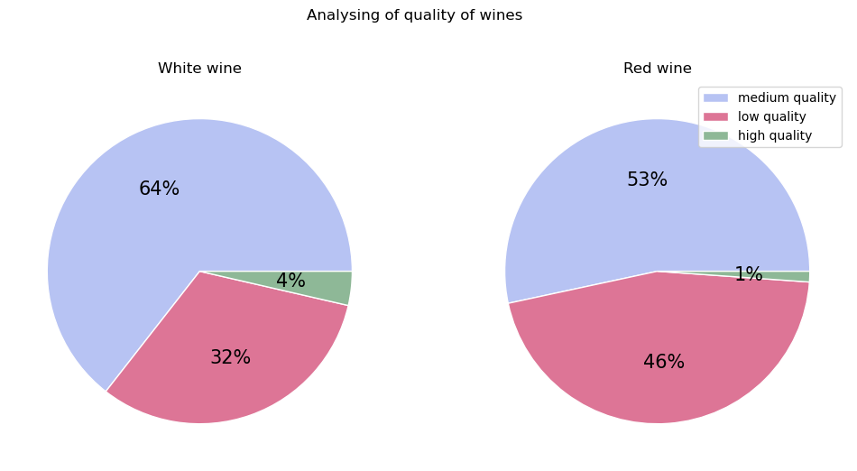
Analysisng data: quality of wines
Low quality: quality score <= 5
Medium quality: 5 <= quality score <= 7
High quality: quality score > 7

Slide 21
Analysisng data: corrolation

Slide 22
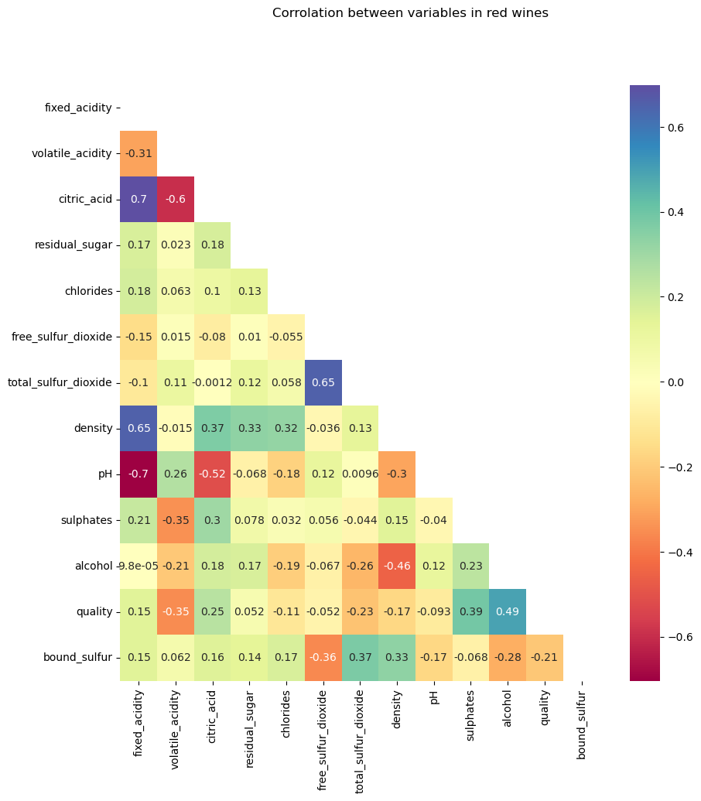
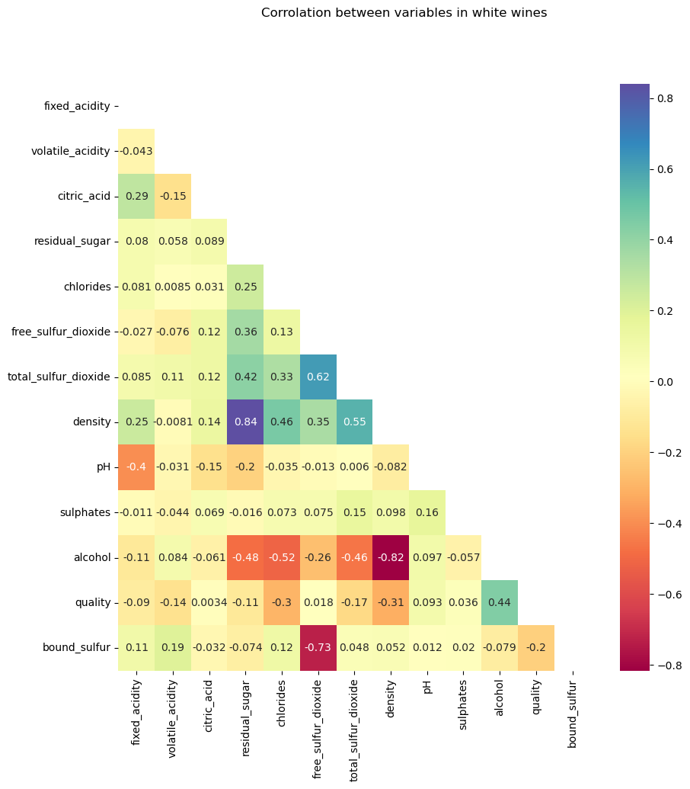
Analysisng data: corrolation

Slide 23
Analysisng data: corrolation

Slide 24
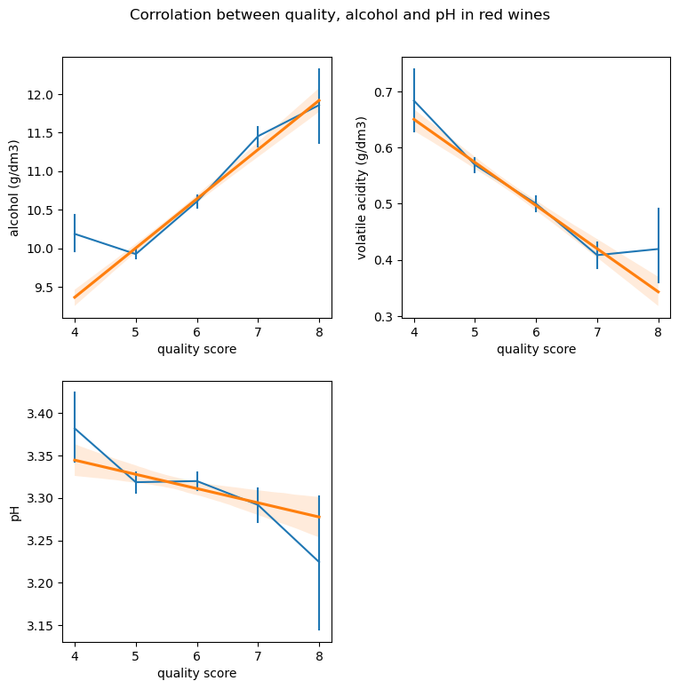
Analysisng data: corrolation

Slide 25
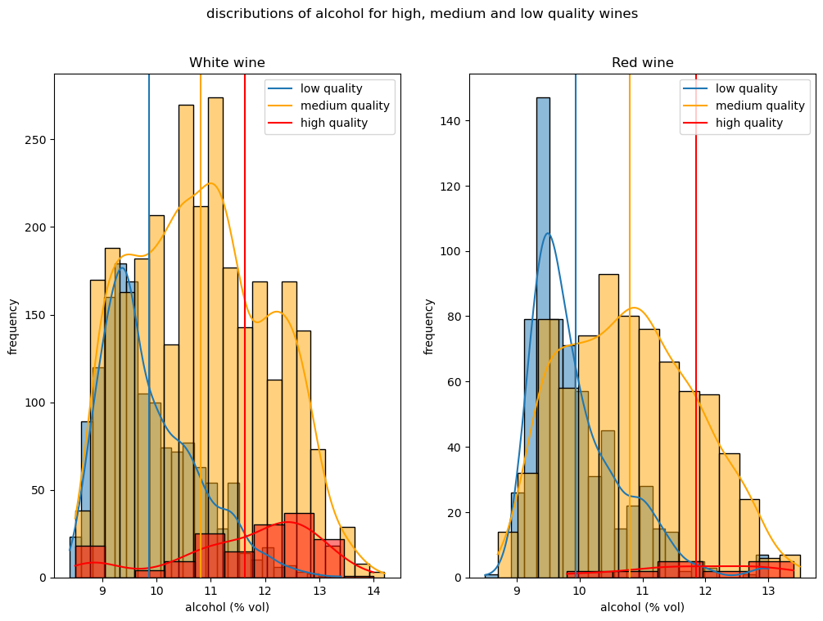
Analysisng data: Avona test

Slide 26
Analysisng data: Avona test
Red wine:
f = 179.1372
P = 4.1732e-7
f critical = 3.0021
White wine:
f = 424.0815
p = 2.3573e-169
f critical = 2.9977

Slide 27
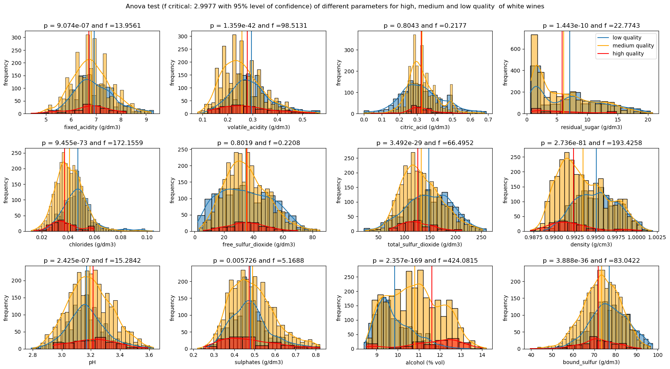
Avona test

Slide 28
Avona test

Slide 29
Analysisng data: corrolation

Slide 30
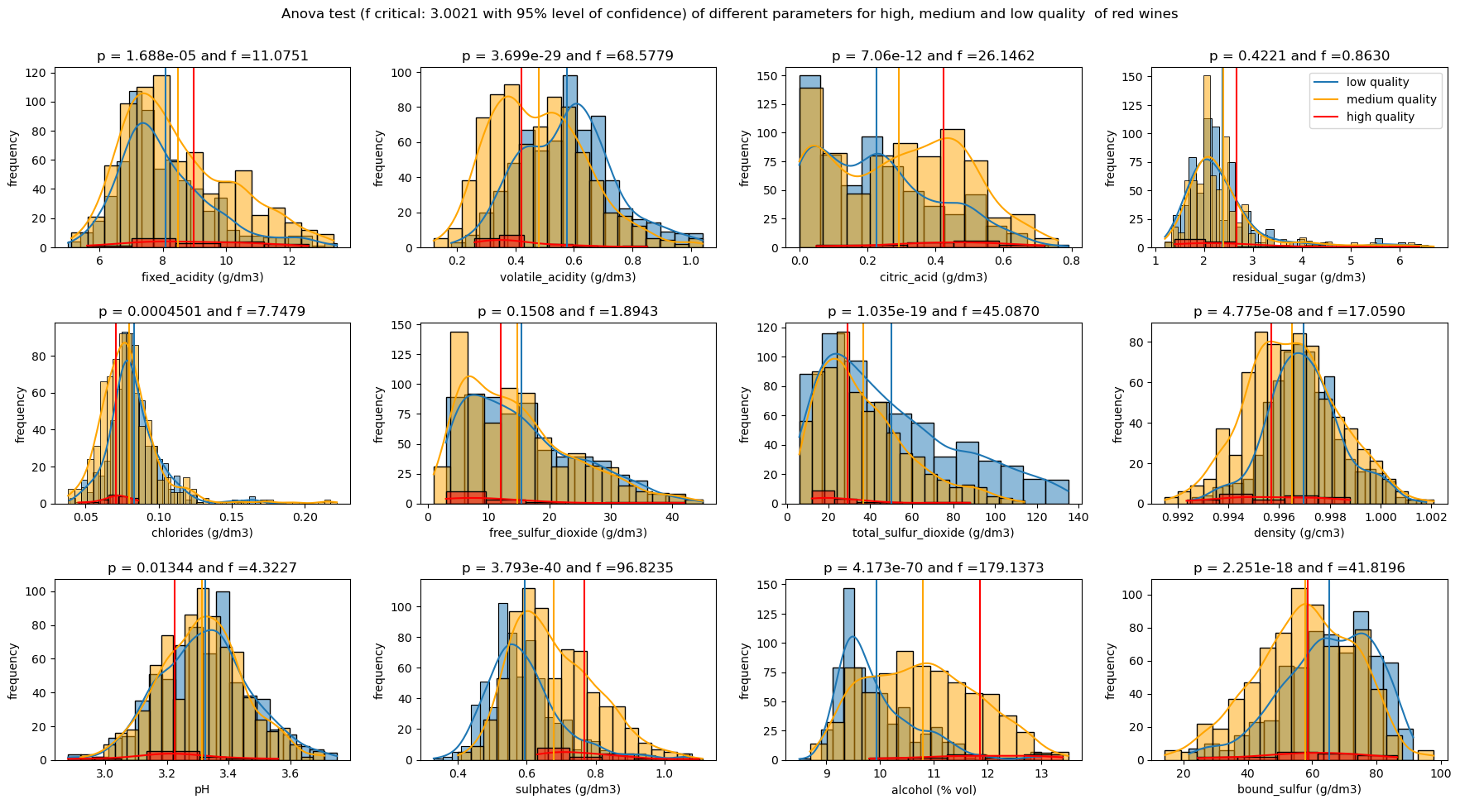
Avona test

Slide 31
Avona test

Slide 32
Analysisng data: corrolation

Slide 33
Conclusions
Z score outlier detection works better for the crurrent data sets.
In the data stes, white wines have higher quality than red wines.
Based on Anova test:
- free sulfur dioxide has minor affect on the quality of wines.
- citric acid does not have significant effect on the quality of
white wines.
- residual sugar has negligible influence on the quality of red
wines.
- in the confidence level of 90 % the mean pH is the same in all
quality groups of red wines.

Slide 34
Thank you very much for your attension

