Slide 1

Statistical analysis of wine factory
Marzieh Baes
Code Academy Berlin

Slide 2
Outline of presentation
Overveiw of data
Outlier detection
Data analysing:
- quality of wine
- corrolation of parameters
- Anova test
Conclusions

Slide 3
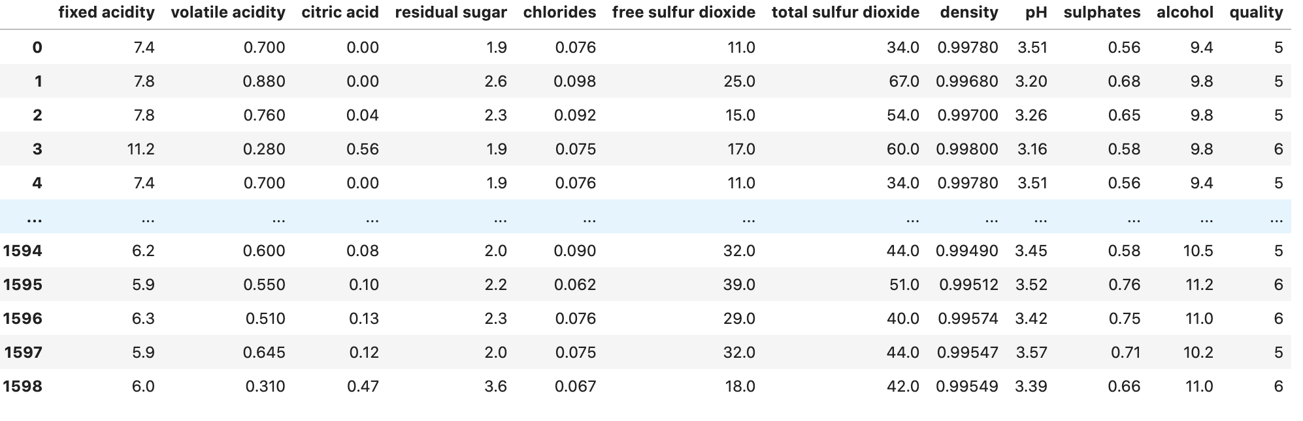
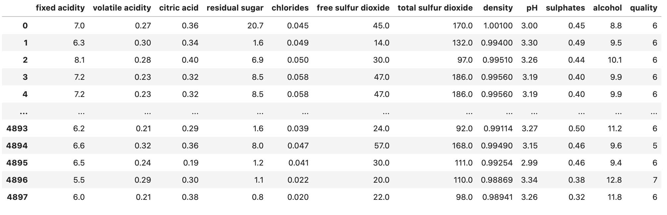
Overview of data
Red wine: n =1599
White wine: n= 4898

Slide 4
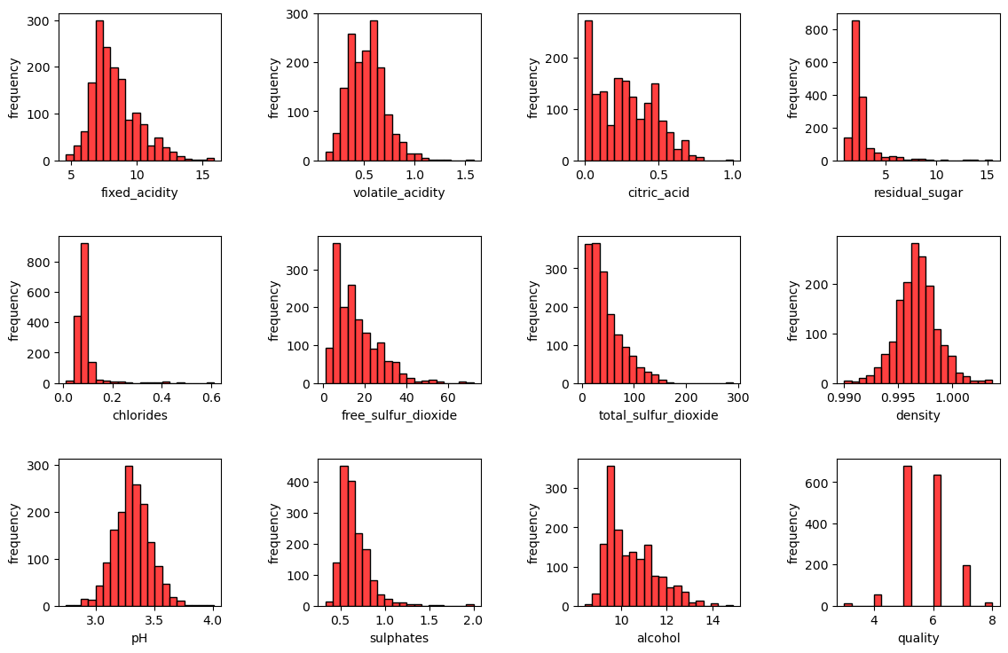
Overview of data

Slide 5
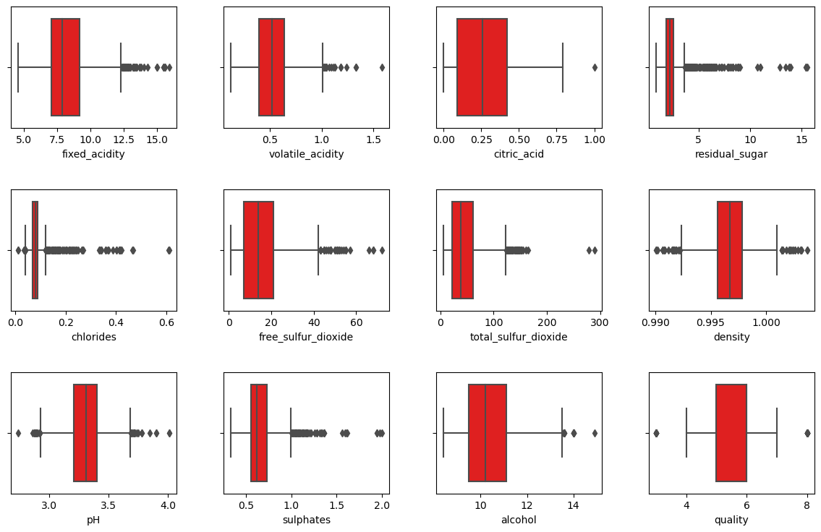
Overview of data

Slide 6
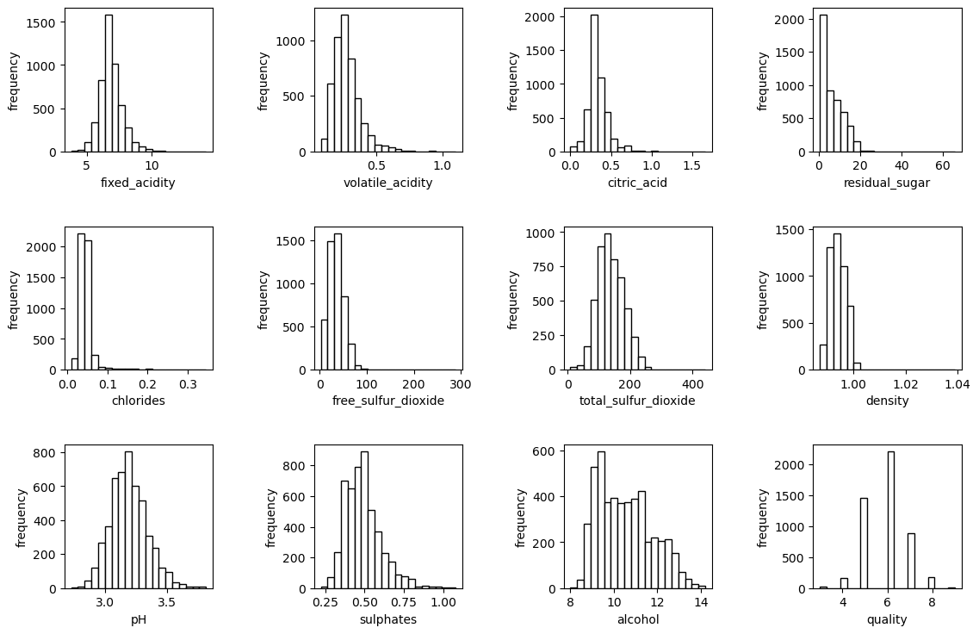
Overview of data

Slide 7
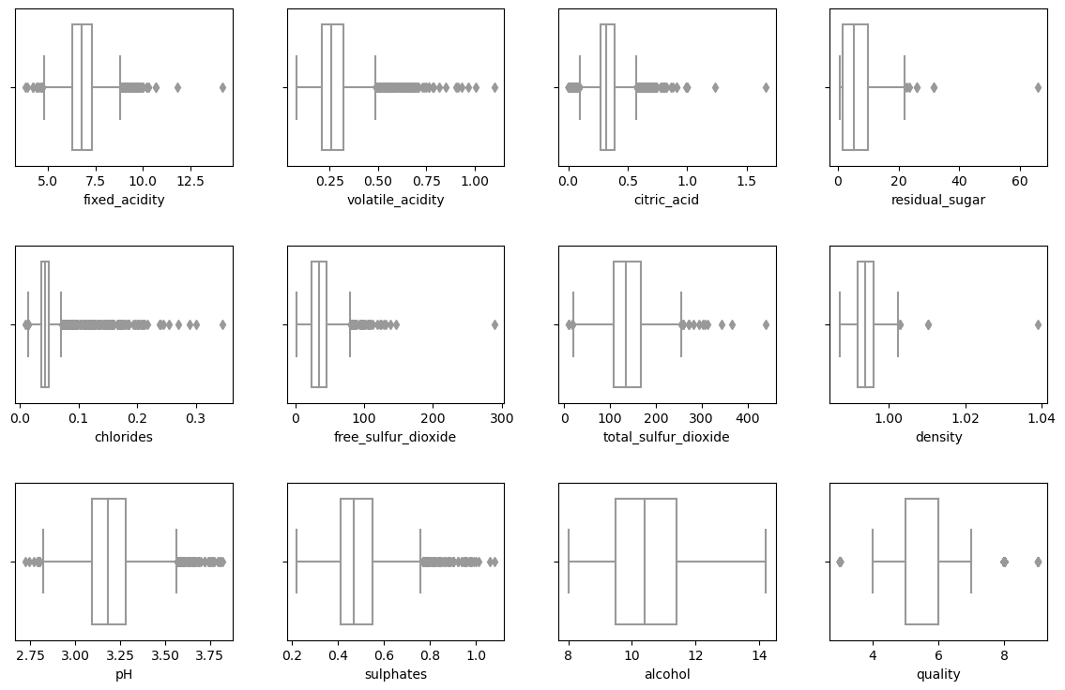
Overview of data

Slide 8
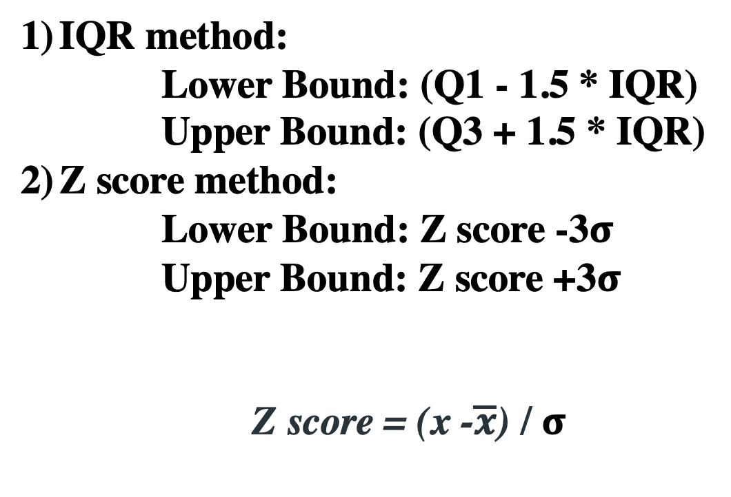
Outliers detection
IQR method:
Lower Bound: (Q1 - 1.5 * IQR)
Upper Bound: (Q3 + 1.5 * IQR)
Z score method:
Lower Bound: Z score -3$σ$
Upper Bound: Z score +3$σ$
Z score = (x -$\overline{x}$) / $σ$

Slide 9
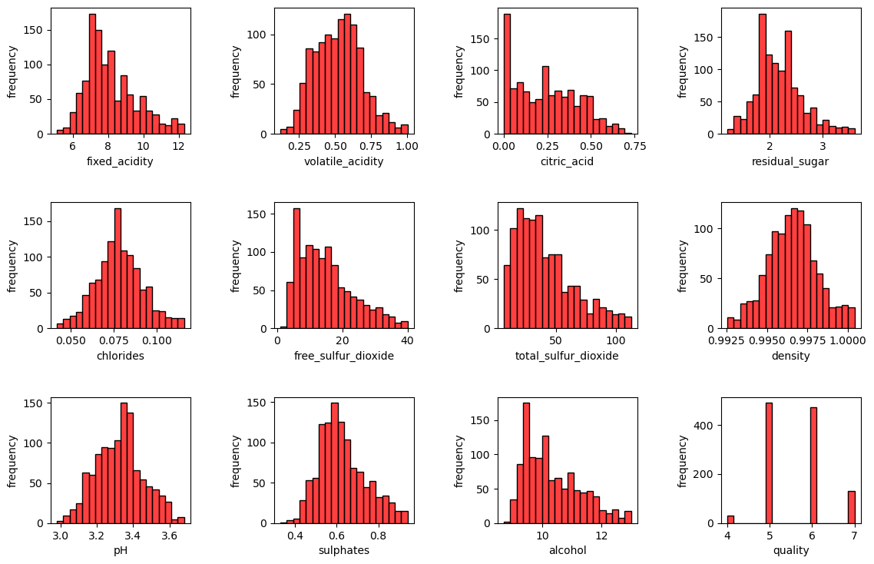
Outliers detection
IQR method:

Slide 10
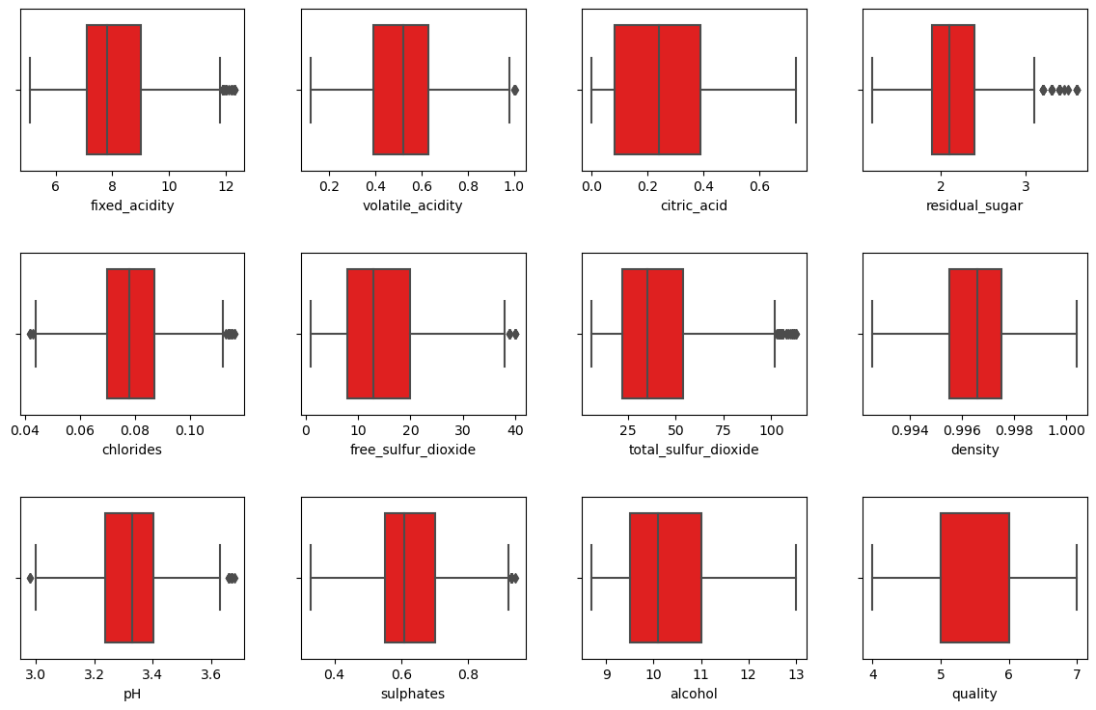
Outliers detection
IQR method:

Slide 11
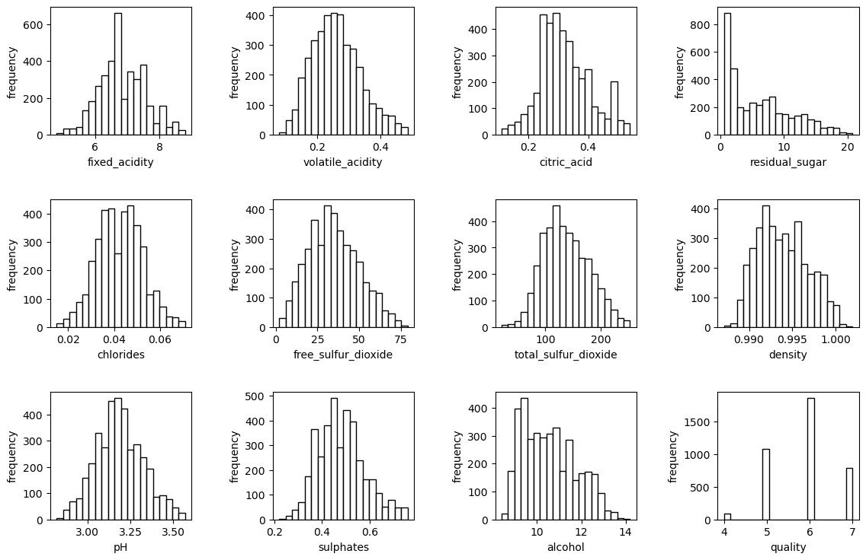
Outliers detection
IQR method:

Slide 12
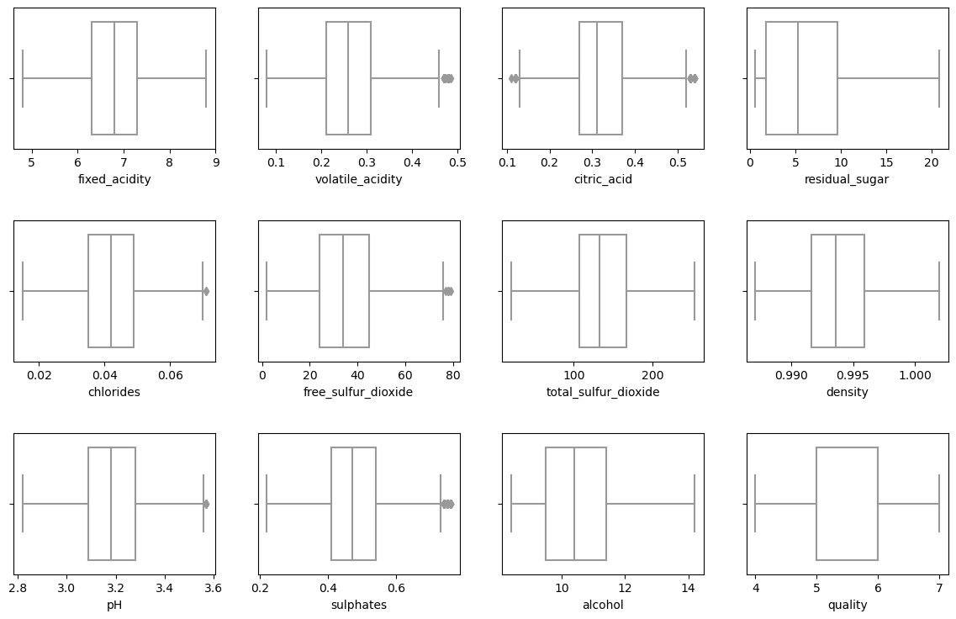
Outliers detection
IQR method:

Slide 13
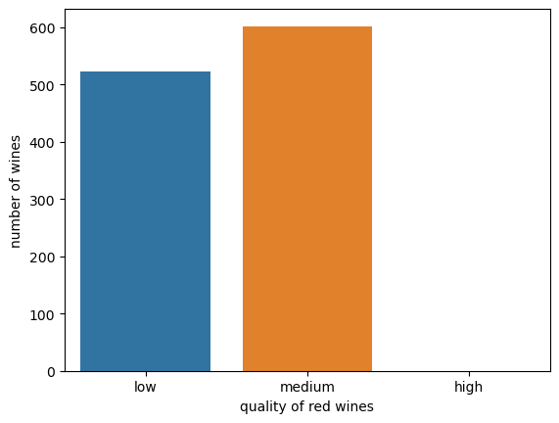
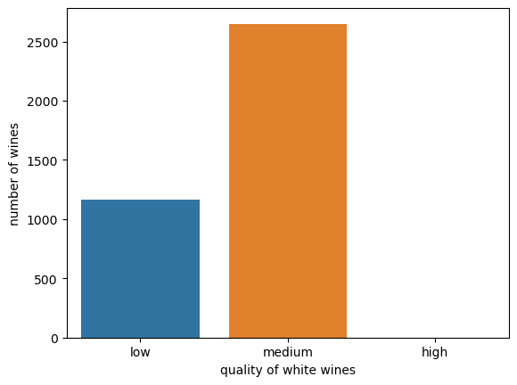
Outliers detection
IQR method:
White wines: n= 3815 (10.83% outliers)
Red wines: n=1124 (4.75 % outlies)
Red Wines
White Wines

Slide 14
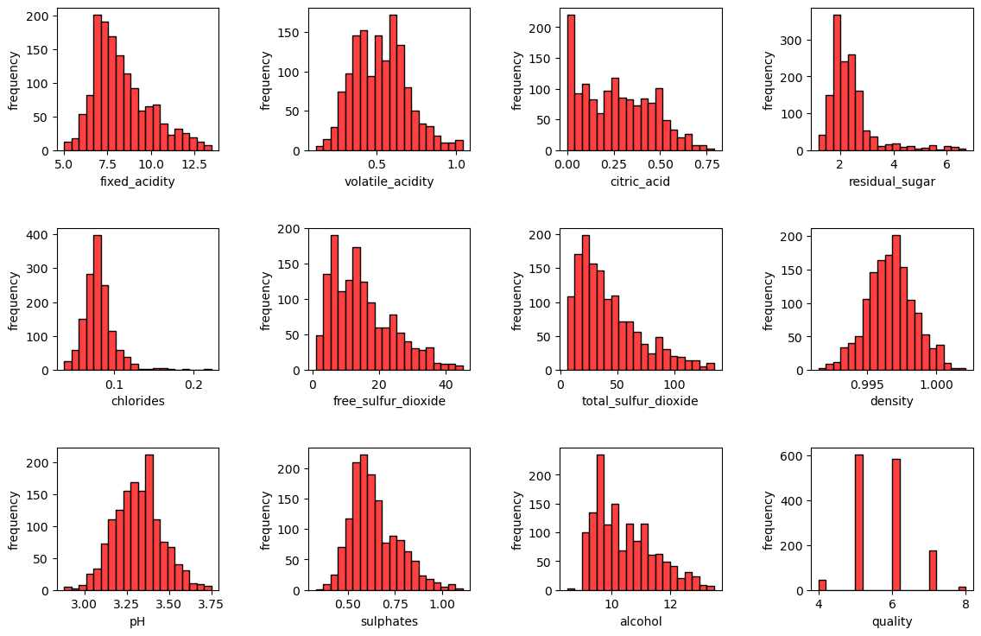
Outliers detection
Z score method:

Slide 15
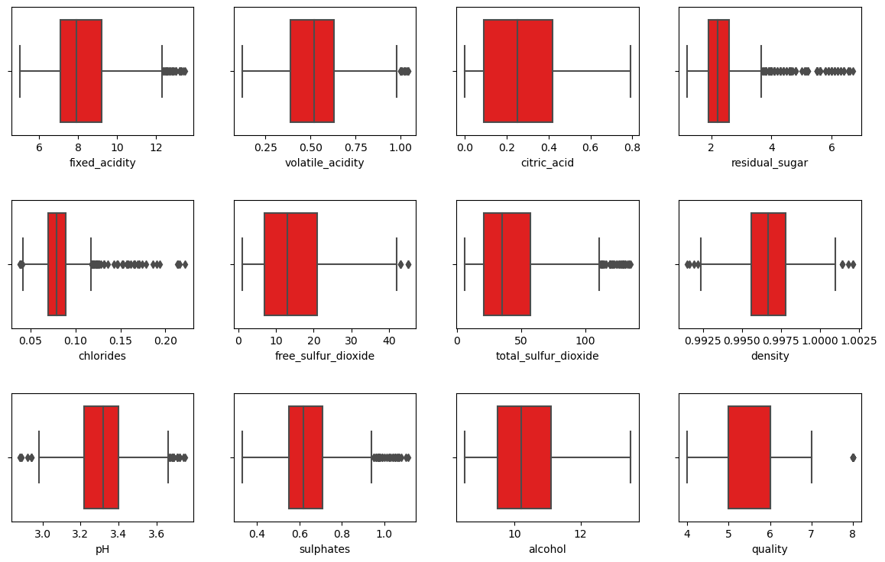
Outliers detection
Z score method:

Slide 16
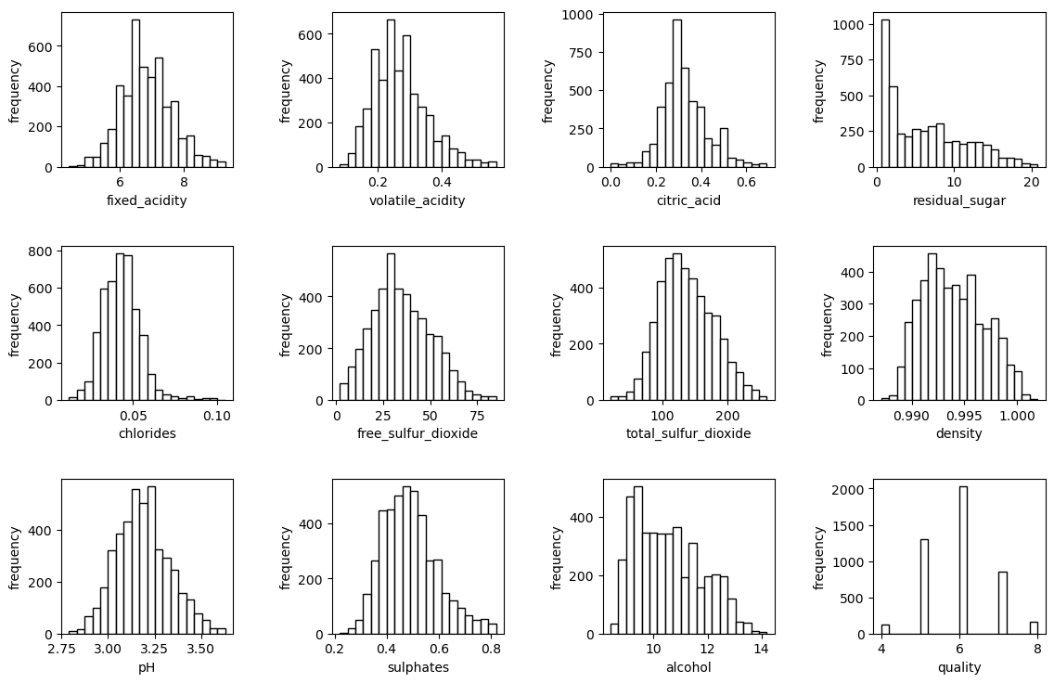
Outliers detection
Z score method:

Slide 17
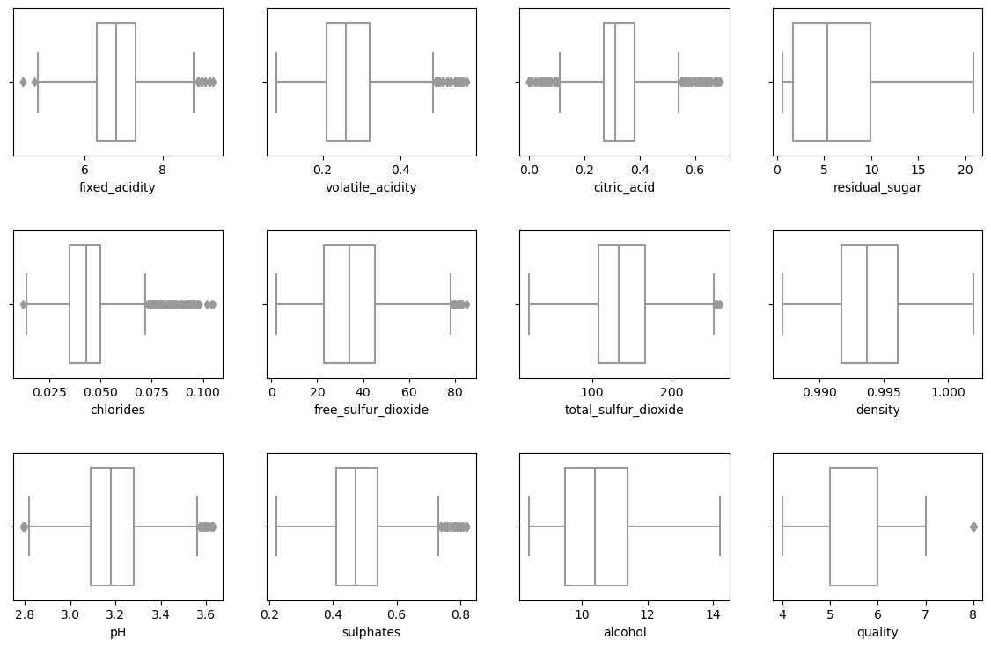
Outliers detection
Z score method:

Slide 18
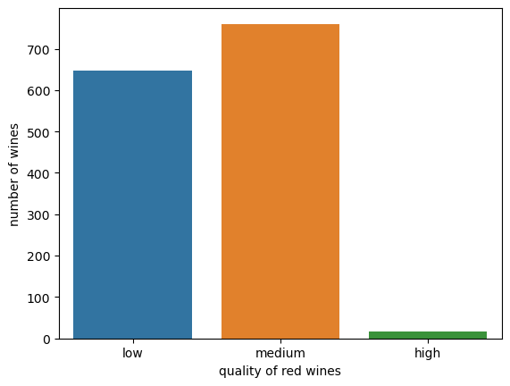
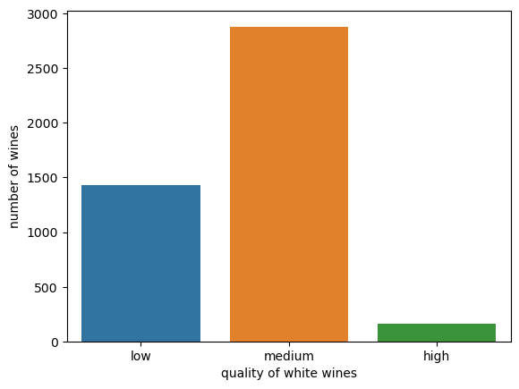
Outliers detection
Z score method:
White wines: n= 4469 (4.29% outliers)
Red wines: n=1424 (1.75 % outlies)
Z score method:
Red Wines
White Wines

Slide 19
Outliers detection
Z score method:
White wines: n= 4469 (4.29% outliers)
Red wines: n=1424 (1.75 % outlies)
Z score method:
Red Wines
White Wines
IQR method:
White wines: n= 3815 (10.83% outliers)
Red wines: n=1124 (4.75 % outlies)
White wine: n= 4898
Red wine: n =1599

Slide 20
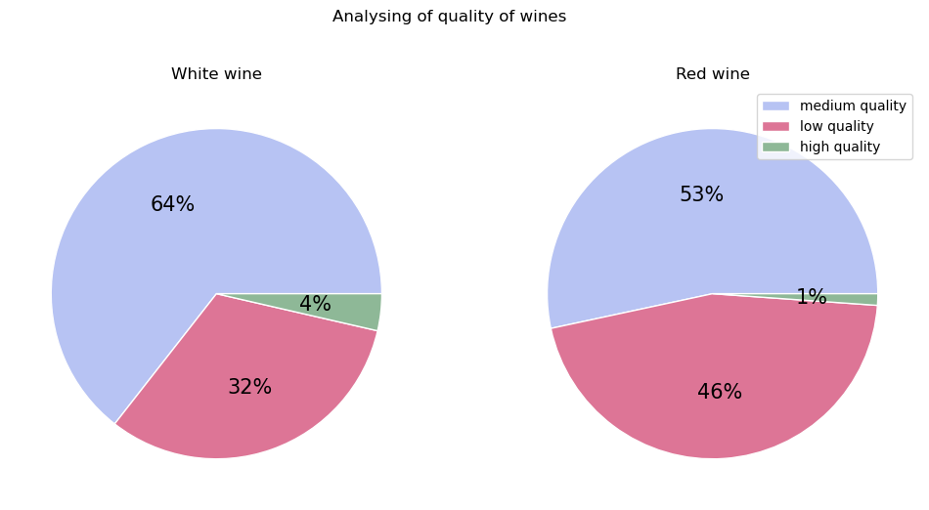
Analysisng data: quality of wines
Low quality: quality score <= 5
Medium quality: 5 <= quality score <= 7
High quality: quality score > 7

Slide 21
Analysisng data: corrolation

Slide 22
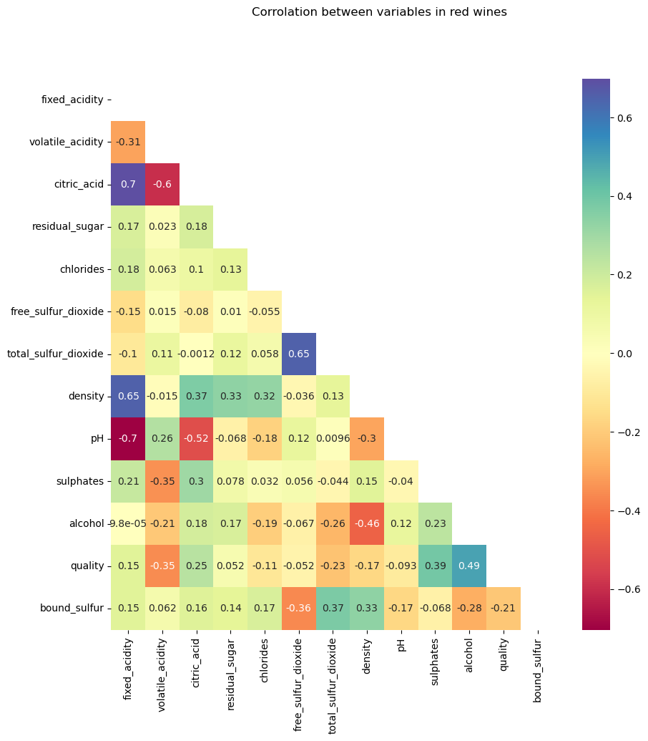
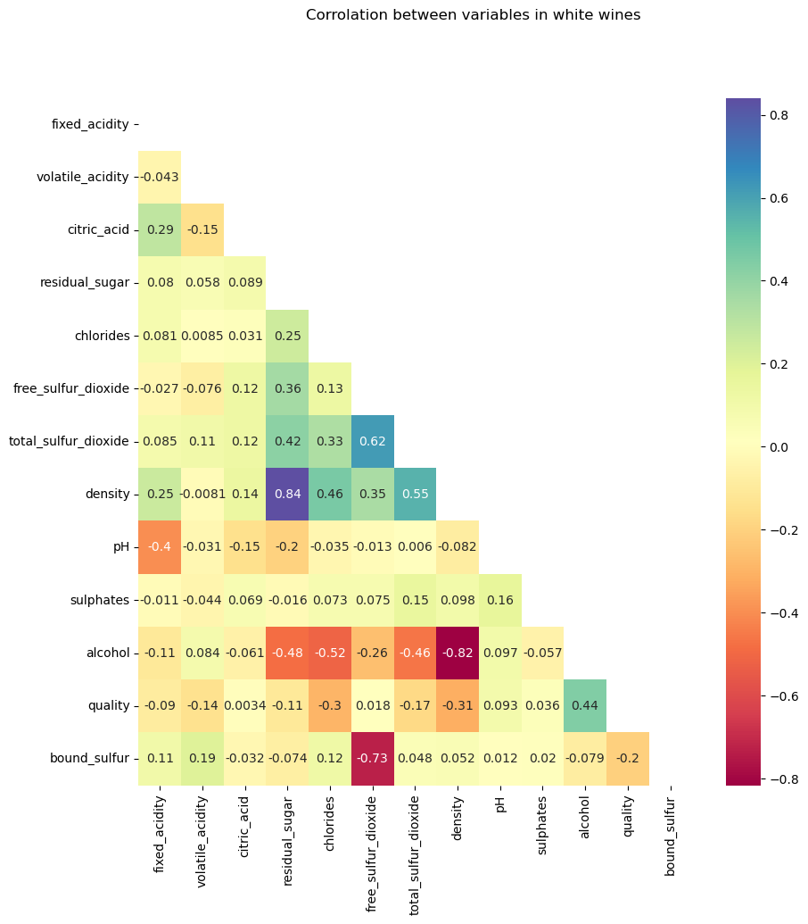
Analysisng data: corrolation

Slide 23
Analysisng data: corrolation

Slide 24
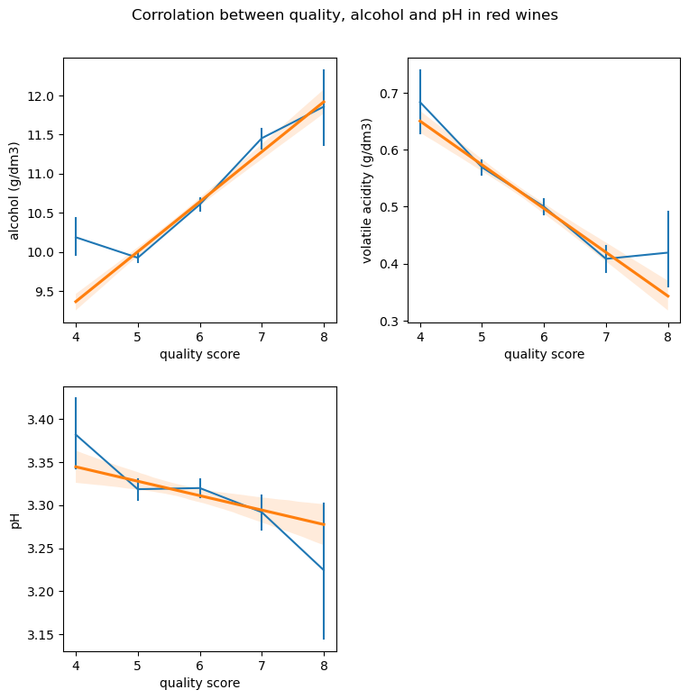
Analysisng data: corrolation

Slide 25
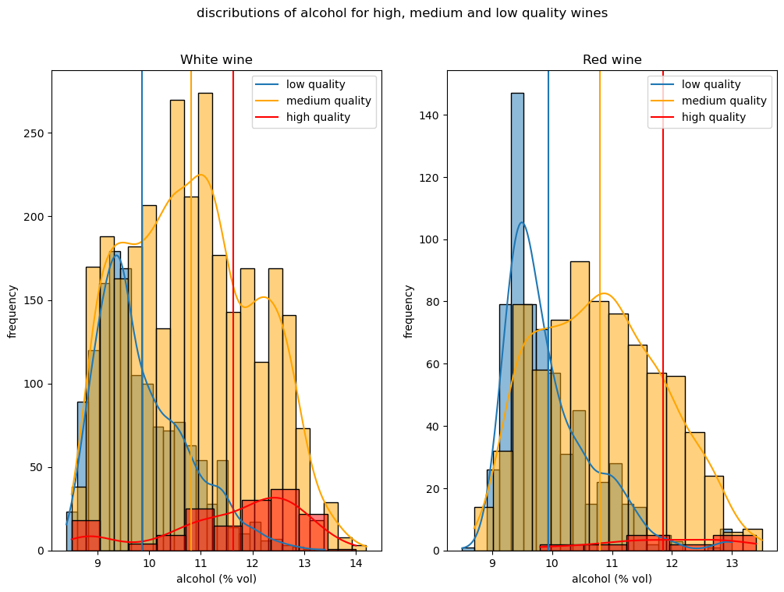
Analysisng data: Avona test

Slide 26
Analysisng data: Avona test
Red wine:
f = 179.1372
P = 4.1732e-7
f critical = 3.0021
White wine:
f = 424.0815
p = 2.3573e-169
f critical = 2.9977

Slide 27
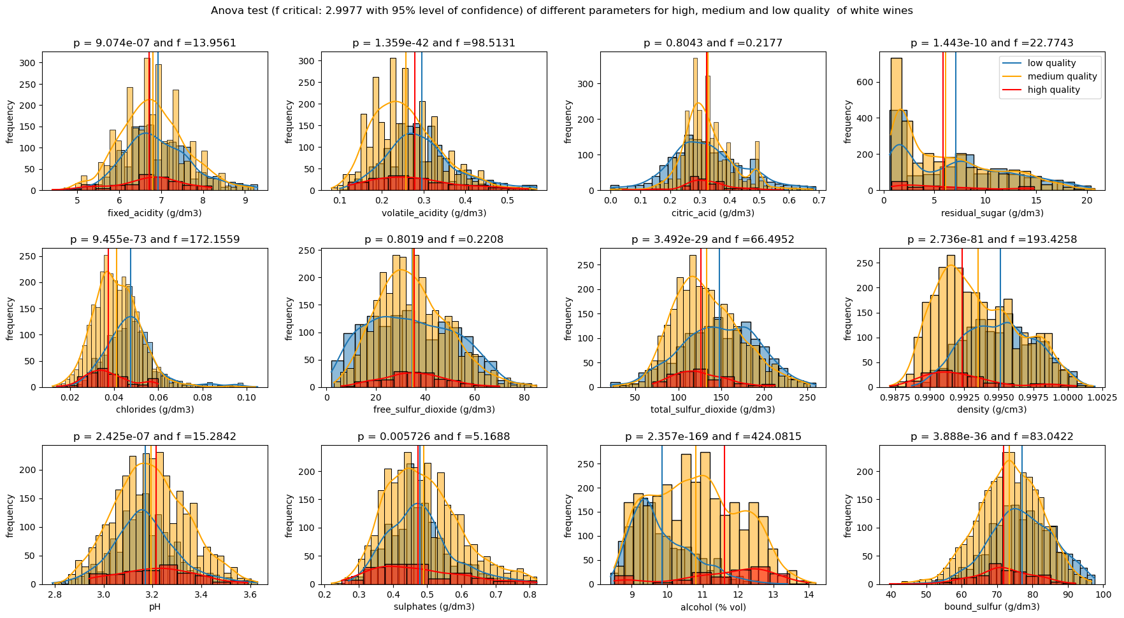
Avona test

Slide 28
Avona test

Slide 29
Analysisng data: corrolation

Slide 30
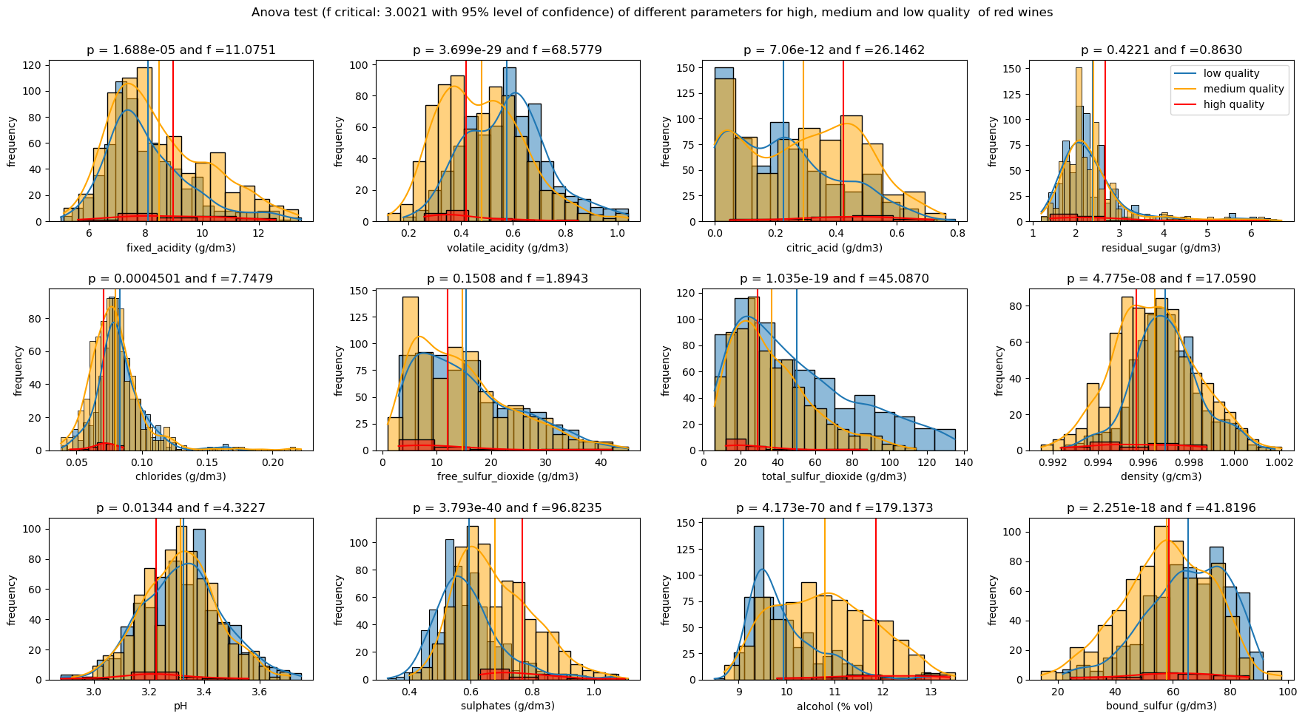
Avona test

Slide 31
Avona test

Slide 32
Analysisng data: corrolation

Slide 33
Conclusions
Z score outlier detection works better for the crurrent data sets.
In the data stes, white wines have higher quality than red wines.
Based on Anova test:
- free sulfur dioxide has minor affect on the quality of wines.
- citric acid does not have significant effect on the quality of
white wines.
- residual sugar has negligible influence on the quality of red
wines.
- in the confidence level of 90 % the mean pH is the same in all
quality groups of red wines.

Slide 34
Thank you very much for your attension

Slide 35
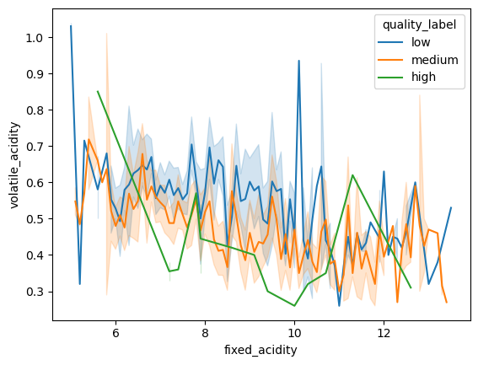
Correlation of acids with quality of red wines

Slide 36
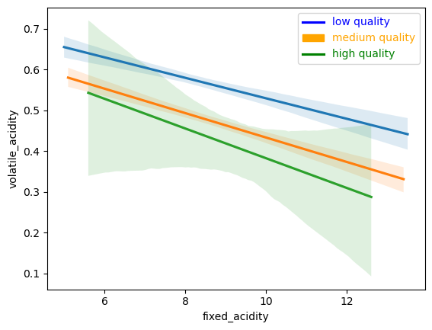
Correlation of acids with quality of red wines

Slide 37
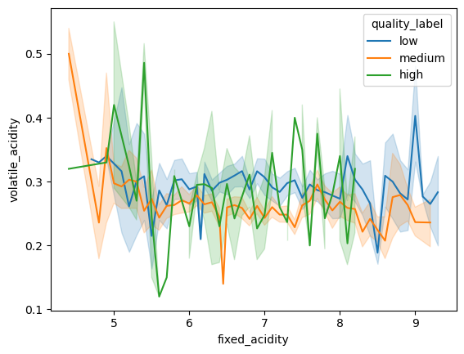
Correlation of acids with quality of white wines

Slide 38
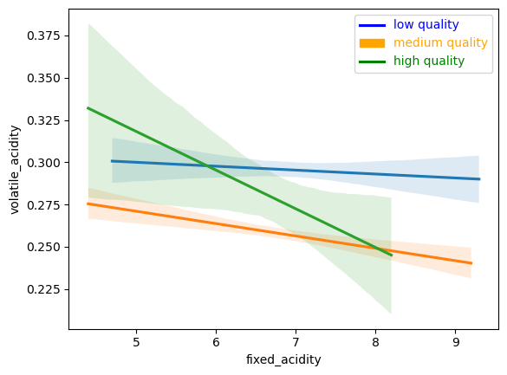
Correlation of acids with quality of white wines

Slide 39
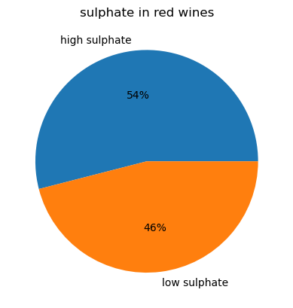
Sulphates in red wines
Low sulphate: < 0.6
High sulphate: >= 0.6

Slide 40
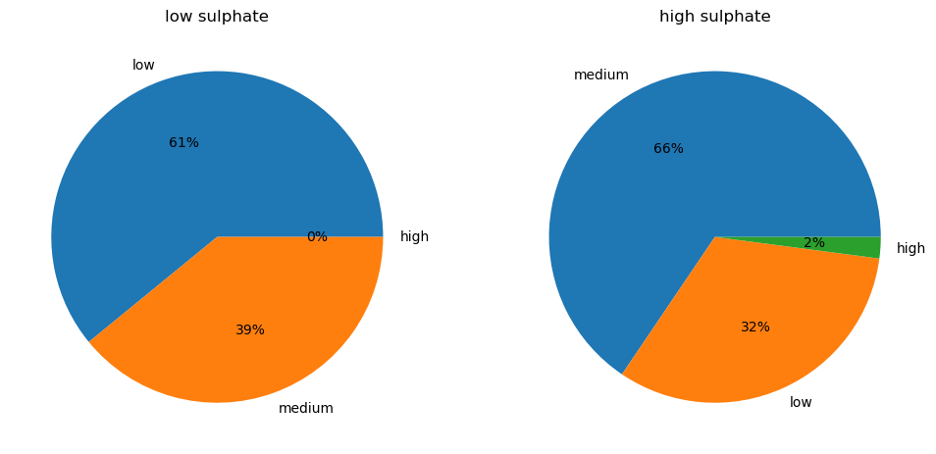
Sulphates in red wines
Low sulphate: < 0.6
High sulphate: >= 0.6

Slide 41
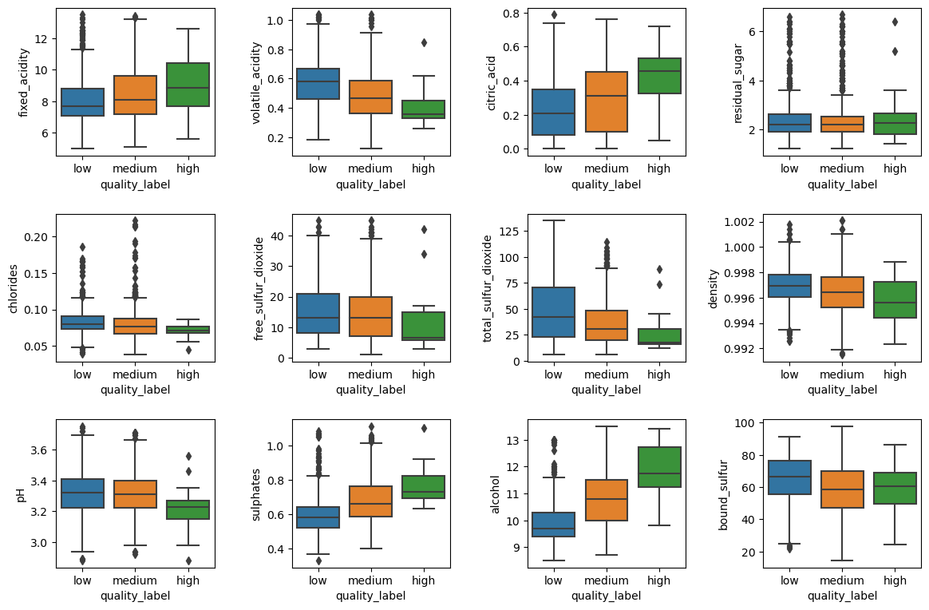
Red wines quality box plot

Slide 42
Avona test

Slide 43
Red wines quality box plot

Slide 44
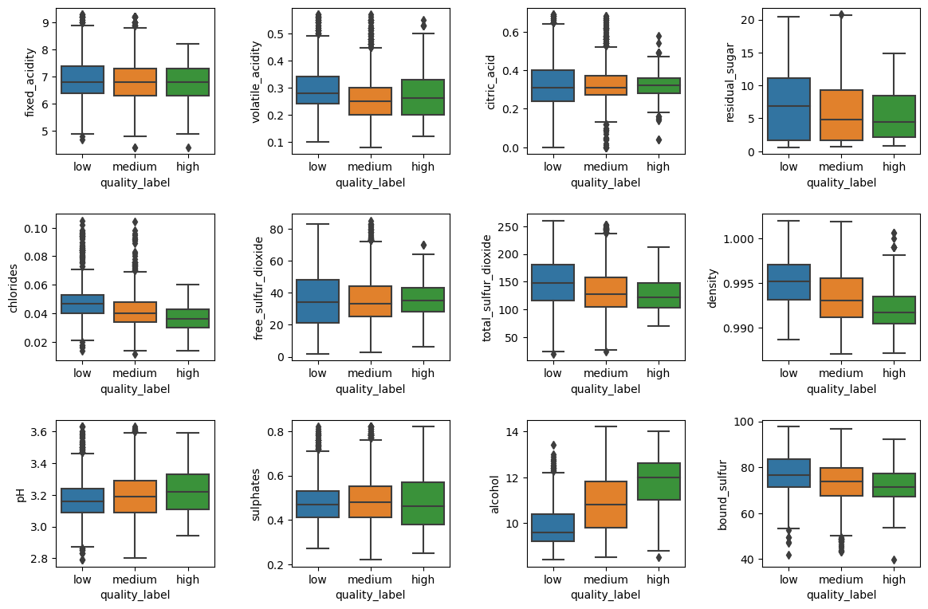
White wines quality box plot

Slide 45
Avona test

Slide 46
White wines quality box plot

Slide 47
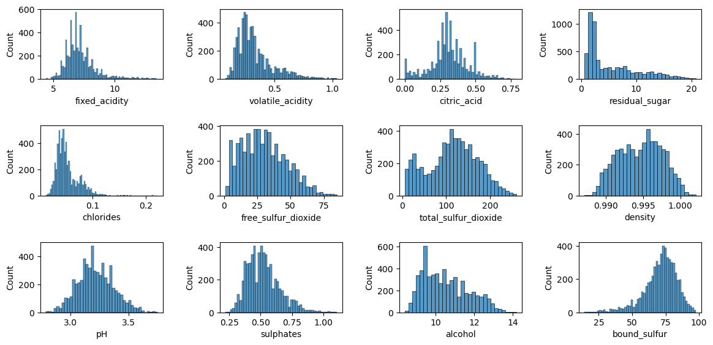
Total wines

Slide 48
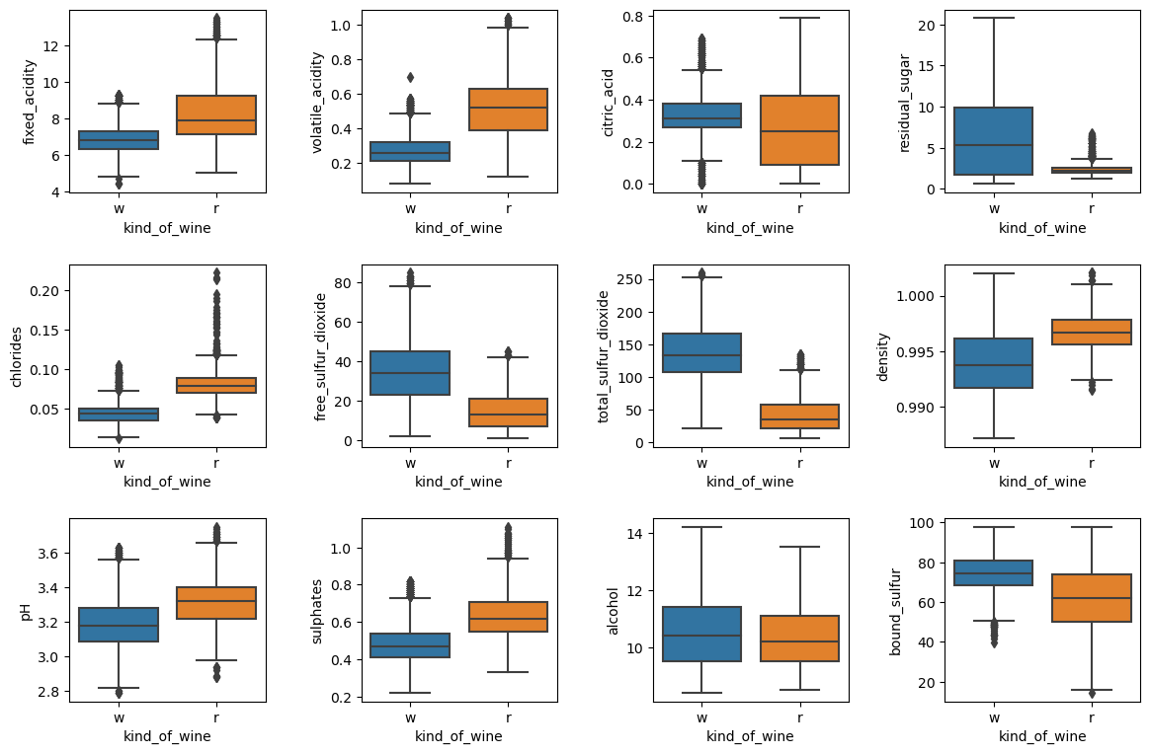
Total wines

Slide 49
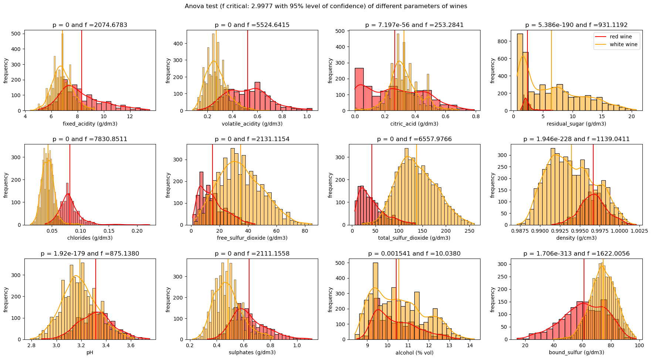
Total wines

Slide 50
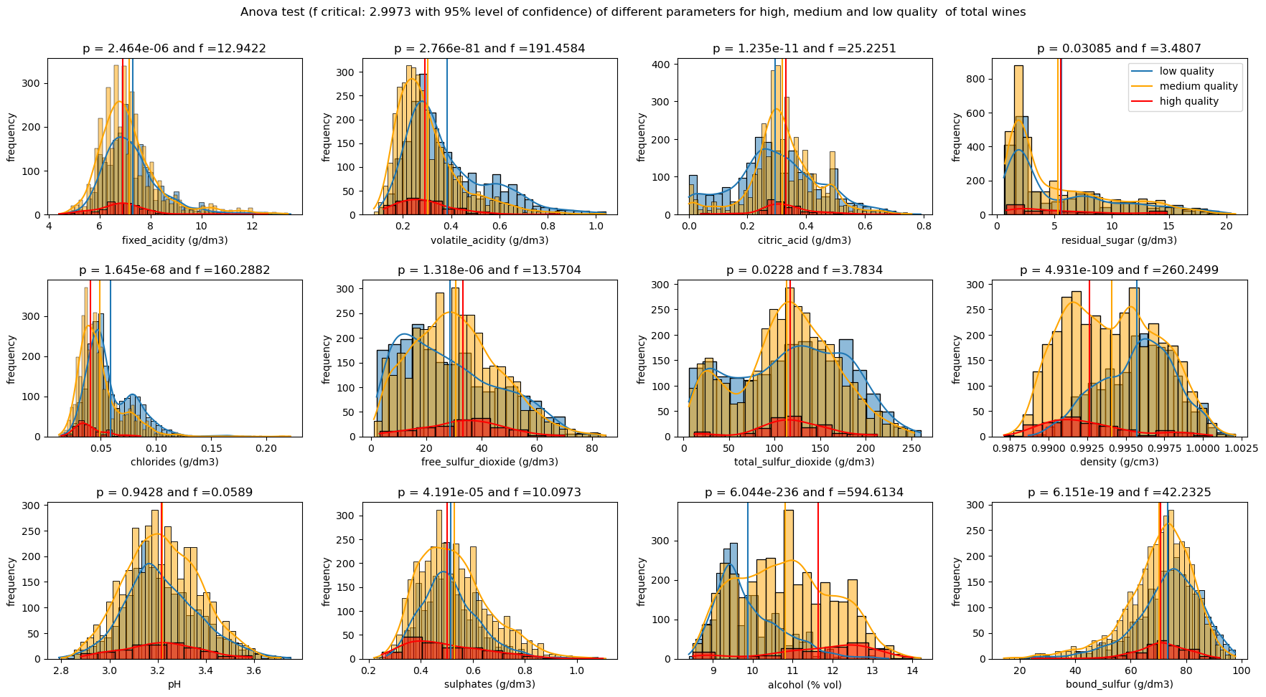
Total wines

Slide 51
Total wines: two way Anova test:
Anova test of volatile_acidity :
sum_sq df F PR(>F)
C(quality_label) 3.849092 2.0 166.181173 6.196629e-71
C(kind_of_wine) 63.774732 1.0 5506.836881 0.000000e+00
C(quality_label):C(kind_of_wine) 1.096269 2.0 47.330451 4.056553e-21
Residual 68.177405 5887.0 NaN NaN
Anova test of citric_acid :
sum_sq df F PR(>F)
C(quality_label) 0.458190 2.0 14.096864 7.805902e-07
C(kind_of_wine) 3.786756 1.0 233.009654 1.267906e-51
C(quality_label):C(kind_of_wine) 1.374516 2.0 42.288902 5.818926e-19
Residual 95.672564 5887.0 NaN NaN

Slide 52
Total wines: two way Anova test:
Anova test of free_sulfur_dioxide :
sum_sq df F PR(>F)
C(quality_label) 1.372190e+01 2.0 0.034249 0.966331
C(kind_of_wine) 4.194326e+05 1.0 2093.737409 0.000000
C(quality_label):C(kind_of_wine) 4.209403e+02 2.0 1.050632 0.349782
Residual 1.179326e+06 5887.0 NaN NaN
Anova test of alcohol :
sum_sq df F PR(>F)
C(quality_label) 1356.294903 2.0 589.150347. 5.848261e-234
C(kind_of_wine) 1.147737 1.0 0.997113. 3.180512e-01
C(quality_label):C(kind_of_wine) 2.990817 2.0 1.299158. 2.728397e-01
Residual 6776.290756 5887.0 NaN NAN

Slide 53
Total wines

Slide 54
Red wines quality box plot

Slide 55
Conclusions
In red wines, decreasing volatile acidity and groth of fixed acidity increases the quality of wines but it has no effect in the.
More than half of red wines have high sulphates. Medium quality red wines have the highest sulphates.
Sulphates and alcohol increase with increasing the quality of red wines while free sulfure and total sulfur dioxides have invert effects.
Density, residual sugar and chlorides decrease with increasing the quality of white wines, while has an inverse effect.
Fixed acidity, volatile acidity, chlorides, density, pH and sulphates are high in red wines, free and total sulfur dioxides and residual sugar are lower. The alcohol is almost the same in both wines

Slide 56
Thank you very much for your attension

