Slide 1
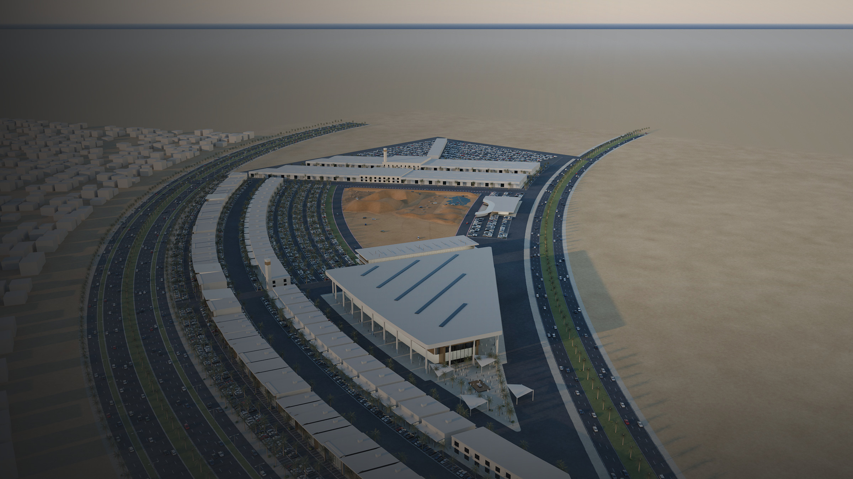
CONCEPT PRESENTATION · MUNICIPALITY OF JEDDAH
Jeddah Motor District
An integrated automotive destination: retail, experiences, heritage and events in one district
[Date] · [Presenter name, organisation]
NEW CONCEPT VISUALISATION · ILLUSTRATIVE
Notes:
PURPOSE: Open with the whole district in one image before any detail.
TALKING POINTS:
- JMD is proposed as a destination built around automotive culture, not a conventional dealership strip.
- This image shows the full concept layout as drawn in the latest plan (FINAL 8-10-2026): curved showroom frontage, lifestyle boulevard, arena and launch plaza, Collectors' Club, off-road experience, service village.
- Everything shown is at concept stage and for discussion.
SOURCE: Layout = FINAL_8-10-2026.dwg. Render = new illustrative visualisation (heights, materials, landscape and surrounding context are illustrative).

Slide 2
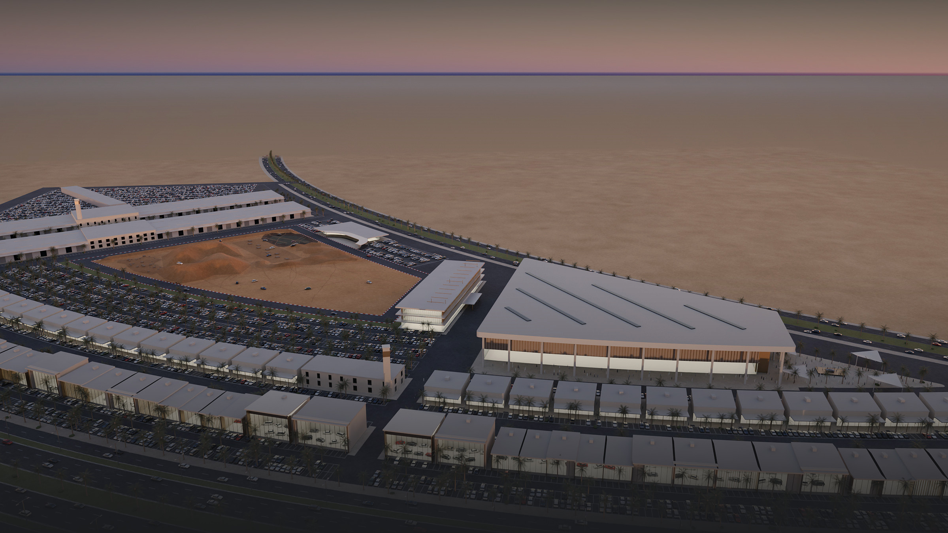
NEW CONCEPT VISUALISATION · ILLUSTRATIVE
THE VISION
More than an automotive retail destination
BUY & MAINTAIN
EXPERIENCE & LEARN
GATHER & CELEBRATE
Brand showrooms, test drives and a dedicated light-service and spare-parts village in one place.
Off-road driving, simulators and automotive heritage, open to visitors who are not buying a car.
A flexible arena, launch plaza and Collectors’ Club for launches, exhibitions and events.
Notes:
PURPOSE: State the central idea in one sentence, then the three things the district does.
TALKING POINTS:
- Commercial core: showrooms, lifestyle retail, service village.
- Public experience: off-road, simulators, heritage museum; people can visit without purchasing.
- Events: arena, launch plaza, club — a reason to return.
SOURCE: Programme from JMD Concept 1 (pp.2–23) and the narration. Image = new illustrative dusk view of the DWG layout.

Slide 3
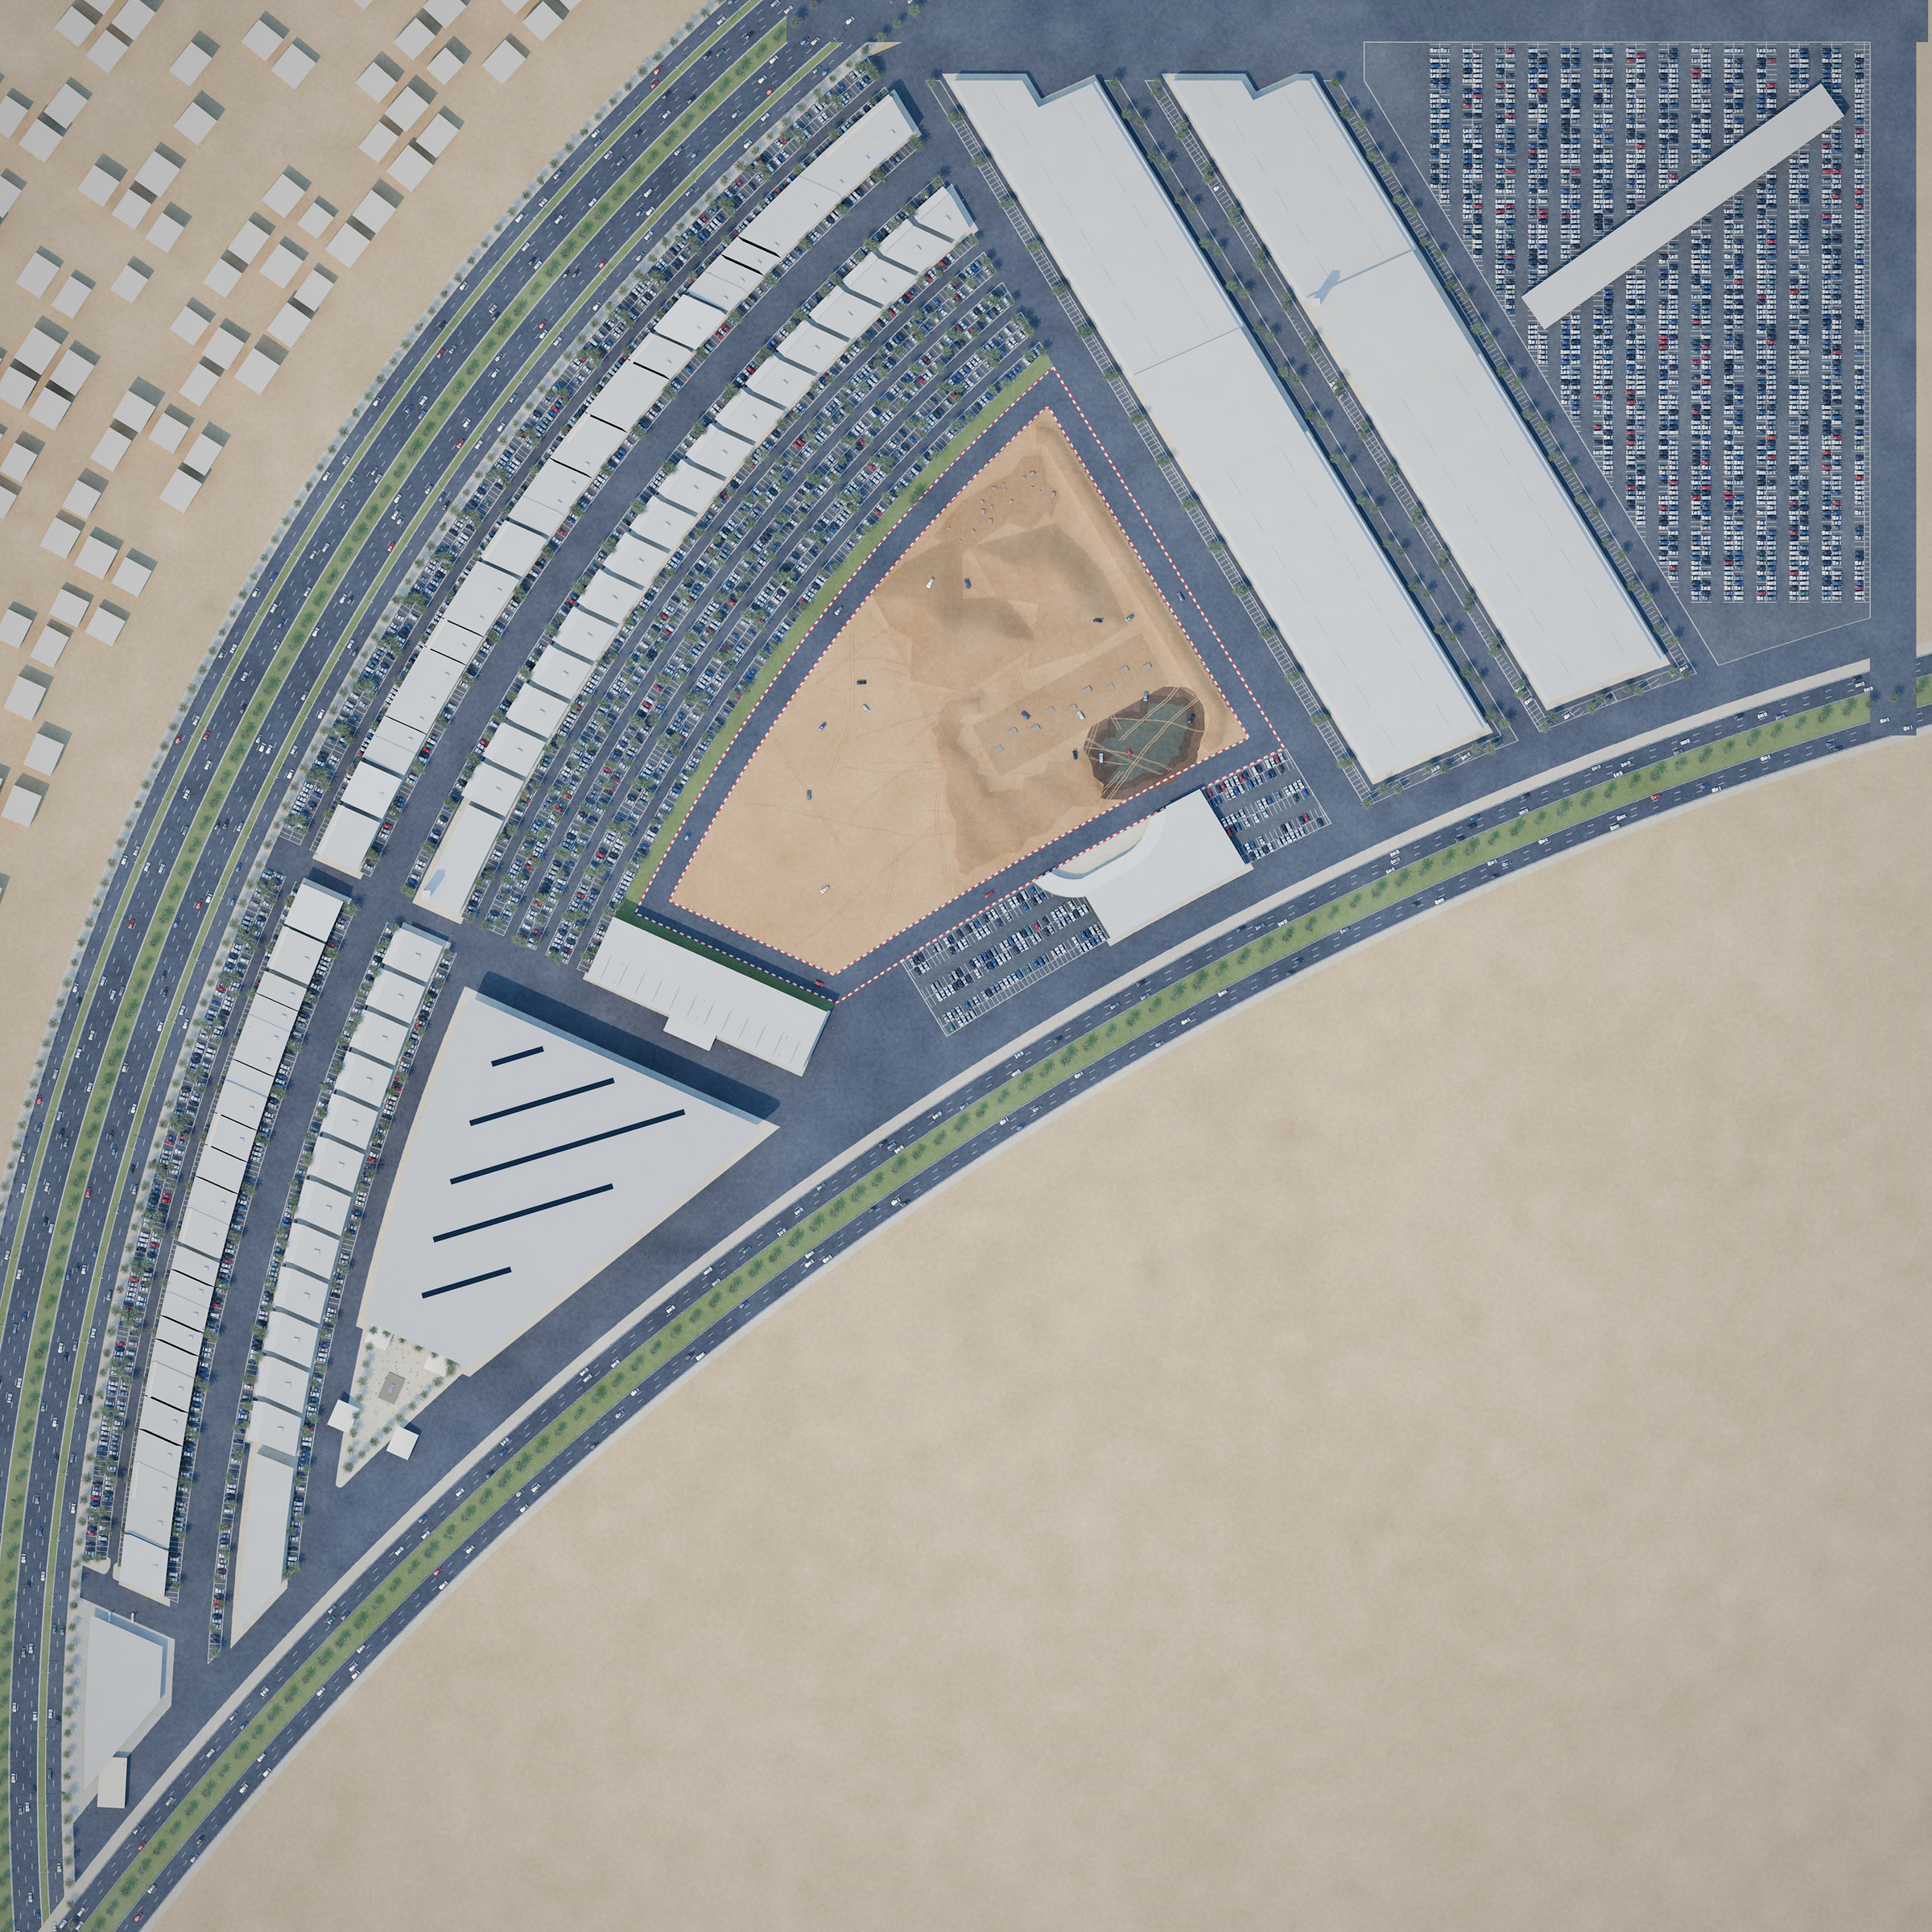
One district, three kinds of place
PROJECT COMPONENTS AND DISTRICT ORGANISATION
COMMERCIAL
1
Automotive showroom district (52 units)
11
9
2
Lifestyle & retail boulevard
8
VISITOR ATTRACTIONS & EVENTS
3
Grand automotive arena (7 divisible halls)
2
4
Outdoor launch plaza
1
6
5
Collectors’ Club
11
7
6
Off-road experience & test-drive loop
5
7
Test-drive centre & guest parking
OPERATIONS & SUPPORT
3
8
Light-service & spare-parts village
9
Dealer storage & vehicle preparation
4
10
Energy hub
12
11
Mosques (2)
10
12
District management
Layout: FINAL 8-10-2026 drawing. Heights, landscape, roads beyond the boundary and surrounding context are illustrative.
NEW CONCEPT VISUALISATION · ILLUSTRATIVE · NORTH UP
Notes:
PURPOSE: Show the complete district and how it is organised before discussing individual buildings.
TALKING POINTS:
- Commercial frontage (1–2): showrooms face the main road; the lifestyle boulevard faces the showrooms.
- Visitor and event core (3–7): arena and launch plaza at the southern tip, Collectors' Club at the hinge, off-road and test-drive in the centre.
- Operations (8–12): service village, dealer storage and vehicle preparation sit at the back, away from the public frontage.
FACTS (measured from FINAL_8-10-2026.dwg, indicative): 52 showroom units (23 standard, 21 premium, 7 flagship, 1 flagship-plus); 29 shop units; 7 arena hall bays ≈12,900 m²; 58 light-service units.
CAUTION: The museum and simulator hall are not located on the current drawing — see slides 11–12.
SOURCE: DWG = confirmed layout; numbering and grouping = new.

Slide 4
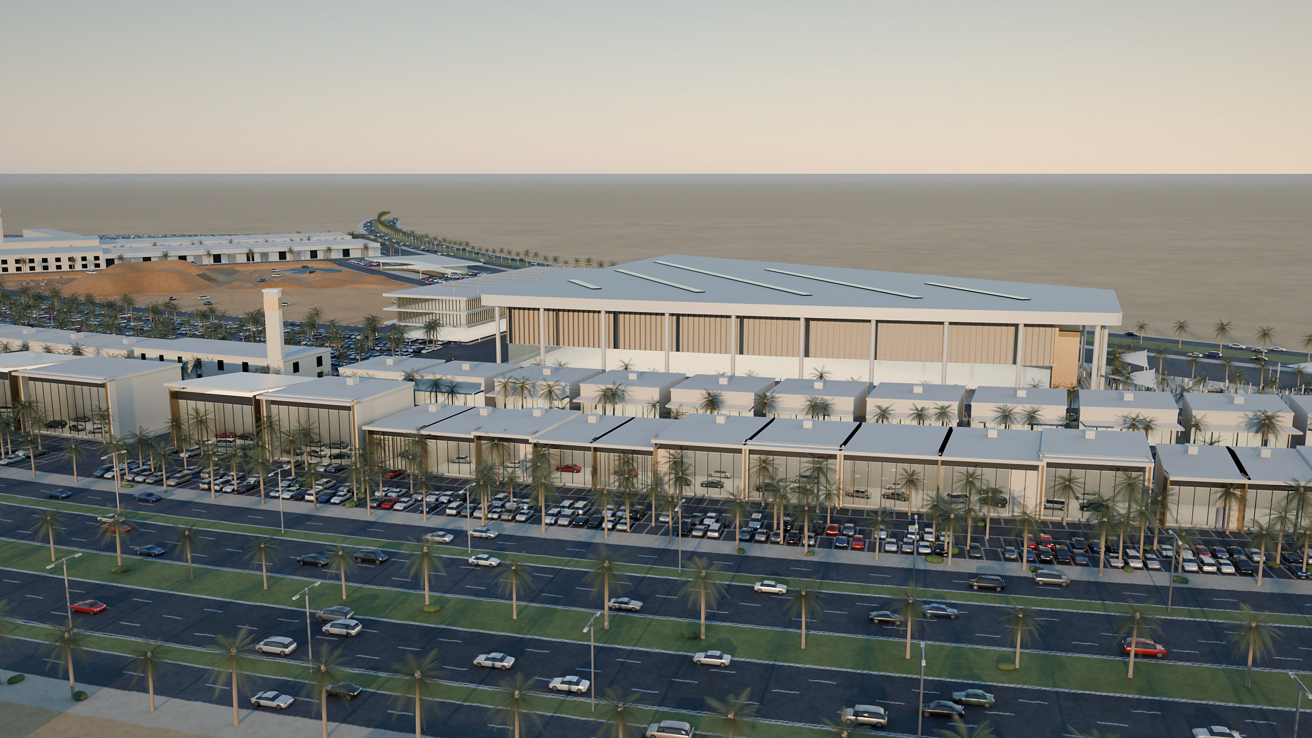
A clear address on the main road
URBAN INTEGRATION AND ARRIVAL
FRONTAGE ADDRESS
The showroom row lines the main-road frontage, set behind customer parking and a landscaped verge.
ACCESS FROM TWO SIDES
The front road serves visitors and showrooms. The south-east road serves events and operations.
PARKING AT EACH DESTINATION
Parking bays are distributed between the rows and next to the arena, test-drive centre and service village.
NEW CONCEPT VISUALISATION · ILLUSTRATIVE
FOR DISCUSSION Access points, junction arrangements and event-day traffic require a traffic impact study and municipal coordination.
Notes:
PURPOSE: Explain how the district meets the city: road frontage, access, parking.
TALKING POINTS:
- The frontage road is shown with an illustrative cross-section; the narration identifies the frontage as Madinah Road — to be confirmed for the selected site.
- Entry/exit positions, junction design and parking quantities are not yet assessed.
SOURCE: Layout = DWG. Road cross-section, context massing = illustrative assumptions. Road name per narration (S2) and earlier masterplan (S5) — not shown on the DWG.

Slide 5
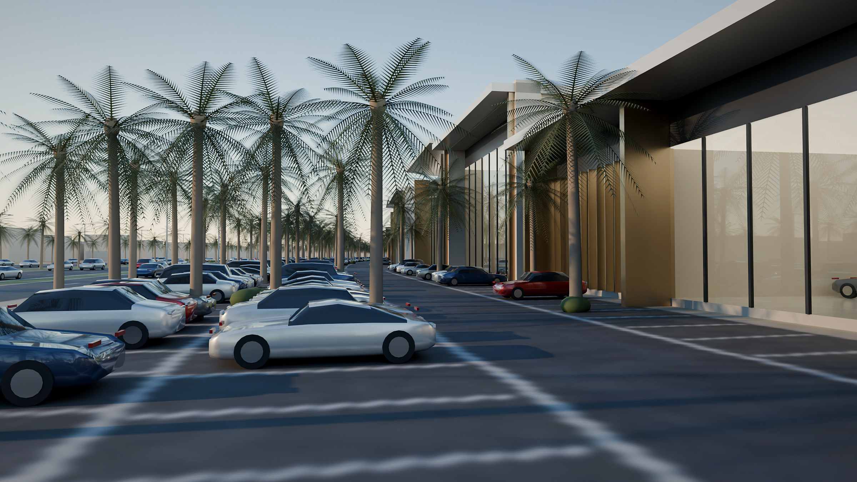
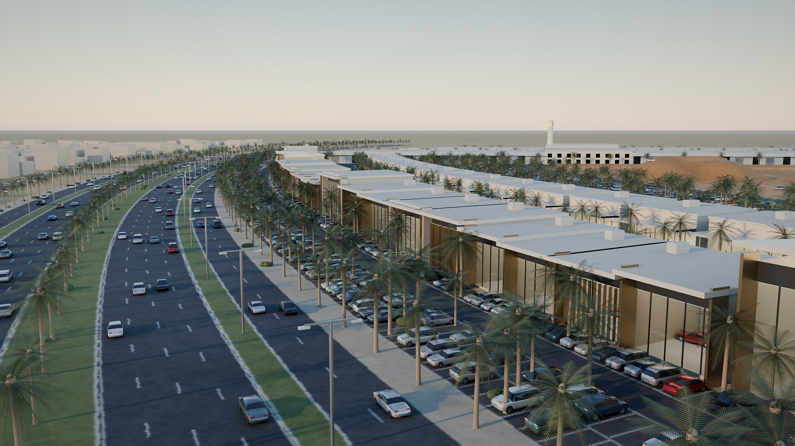
A coordinated frontage of brand showrooms
AUTOMOTIVE SHOWROOM DISTRICT
ONE FRONTAGE, MANY BRANDS
52 showroom units in standard, premium and flagship sizes, joined by one plinth, roof line and shading canopy.
CUSTOMER PARKING AT THE DOOR
Each showroom faces its own parking bay and the frontage service drive.
NEW CONCEPT VISUALISATION · ILLUSTRATIVE
Notes:
PURPOSE: Show the street-level character of the showroom frontage.
TALKING POINTS:
- Unit sizes and arrangement follow the DWG: 23 standard (~240 m²), 21 premium (~350–370 m²), 7 flagship (~390–460 m²), 1 flagship-plus (540 m²).
- Heights 9–14 m and the façade kit are illustrative design development.
- Brand bands are deliberately left blank: no brand commitments are implied.
SOURCE: DWG footprints; design language from JMD Concept 1 pp.3–6 and 31–33; voice notes 1–2 stress the street-level feeling of the boulevard; render new.

Slide 6
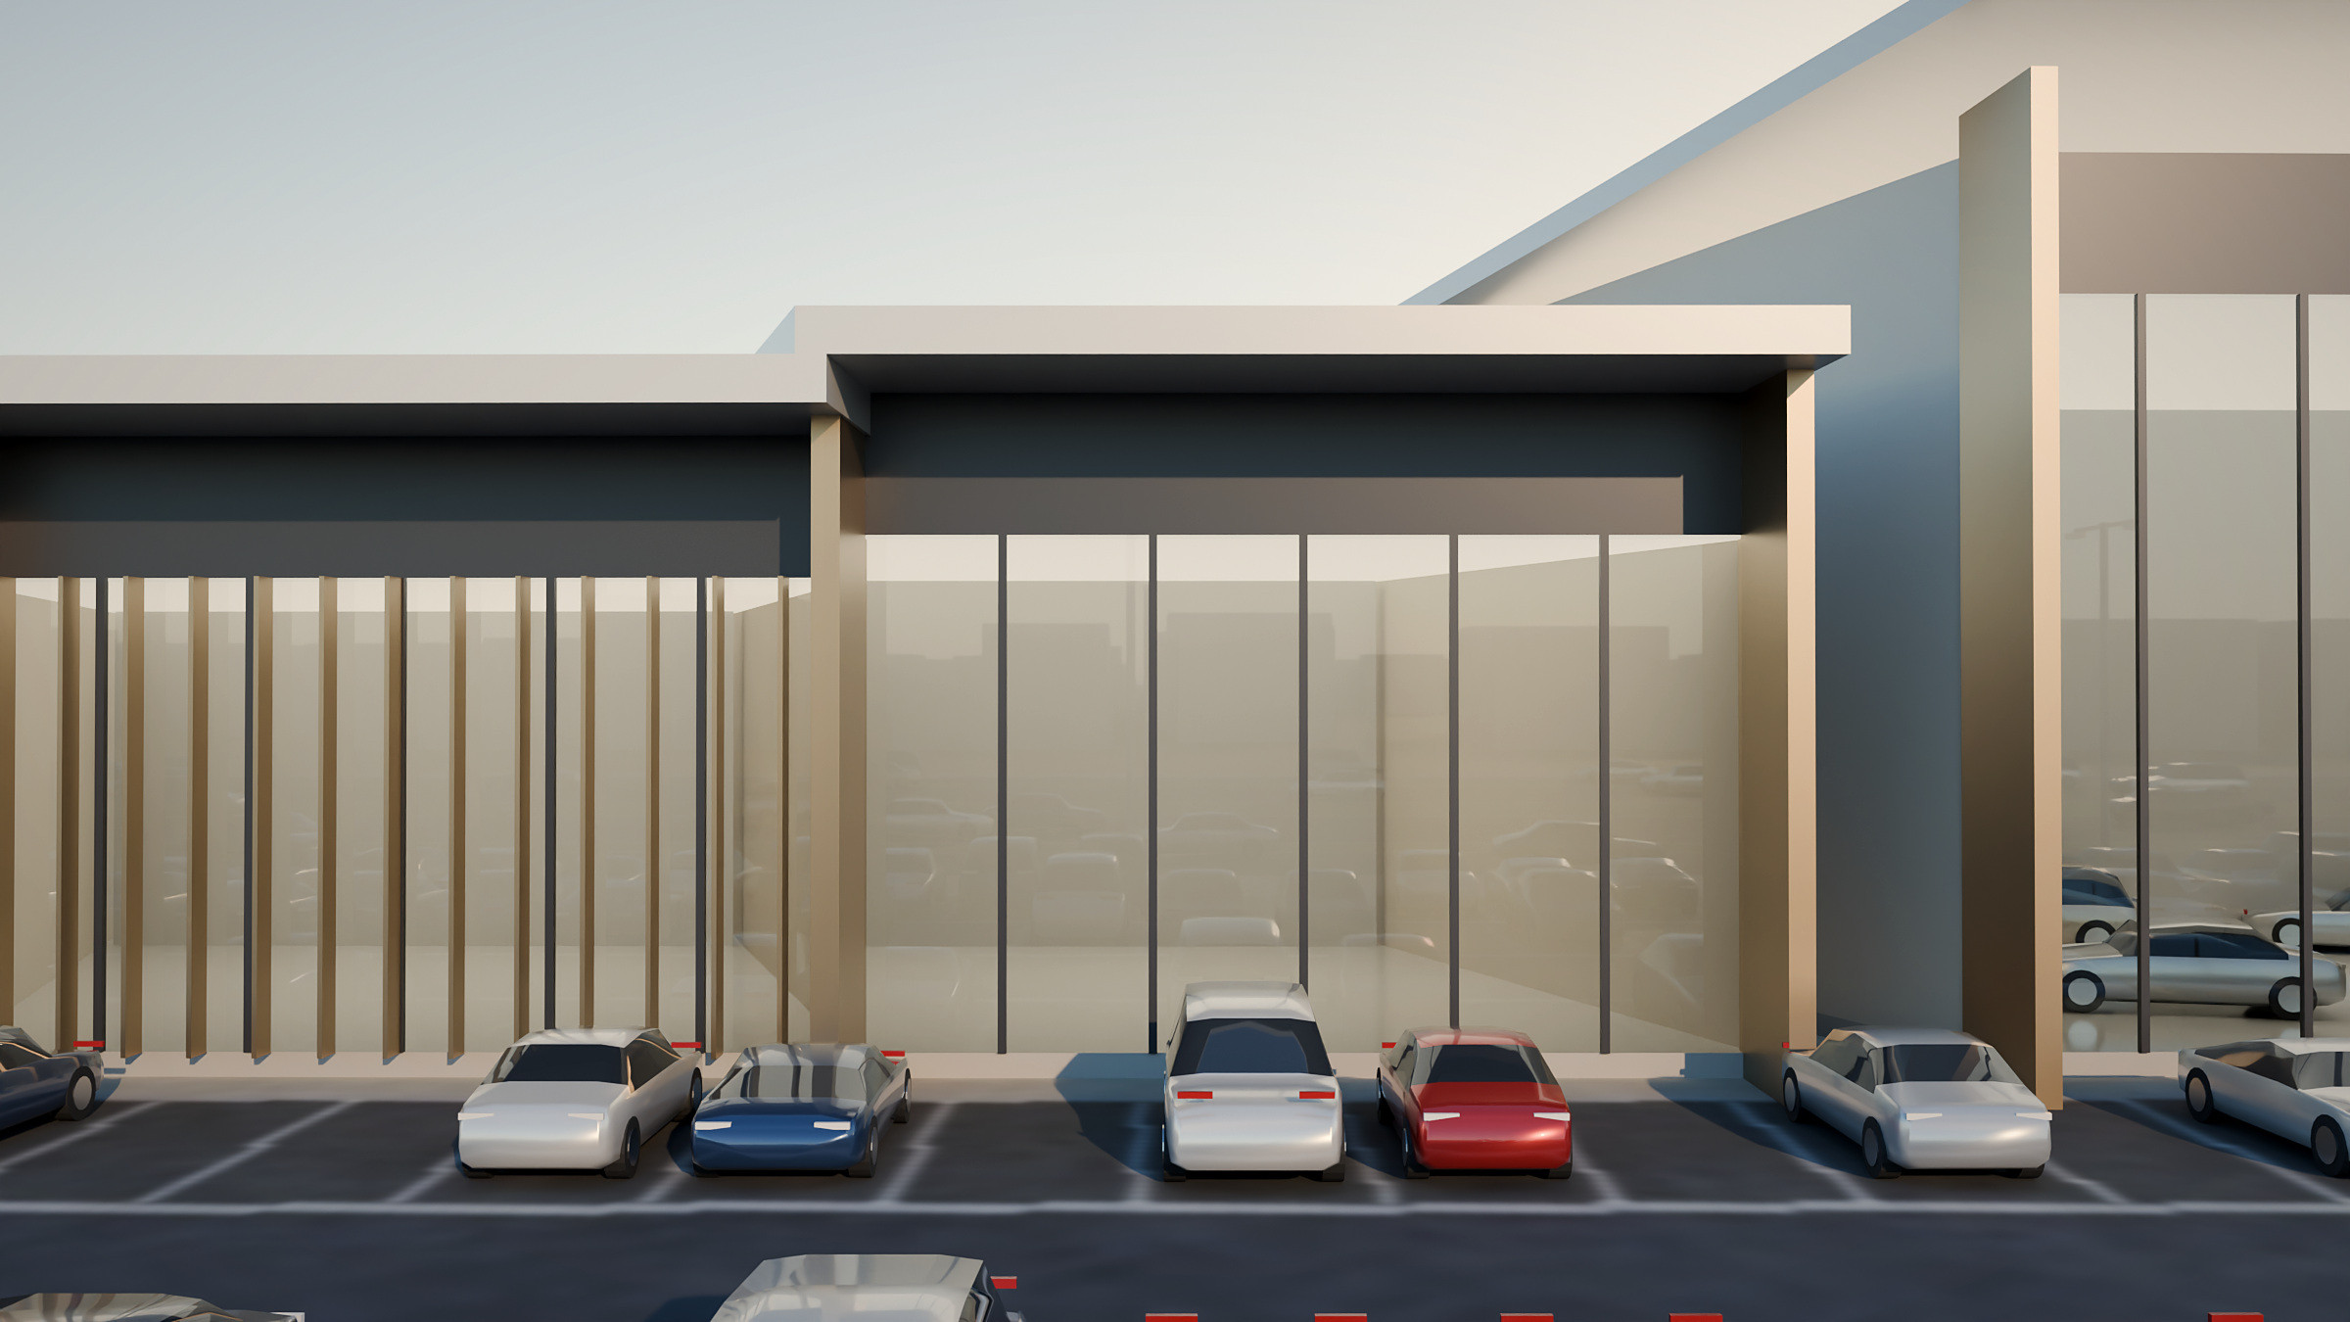
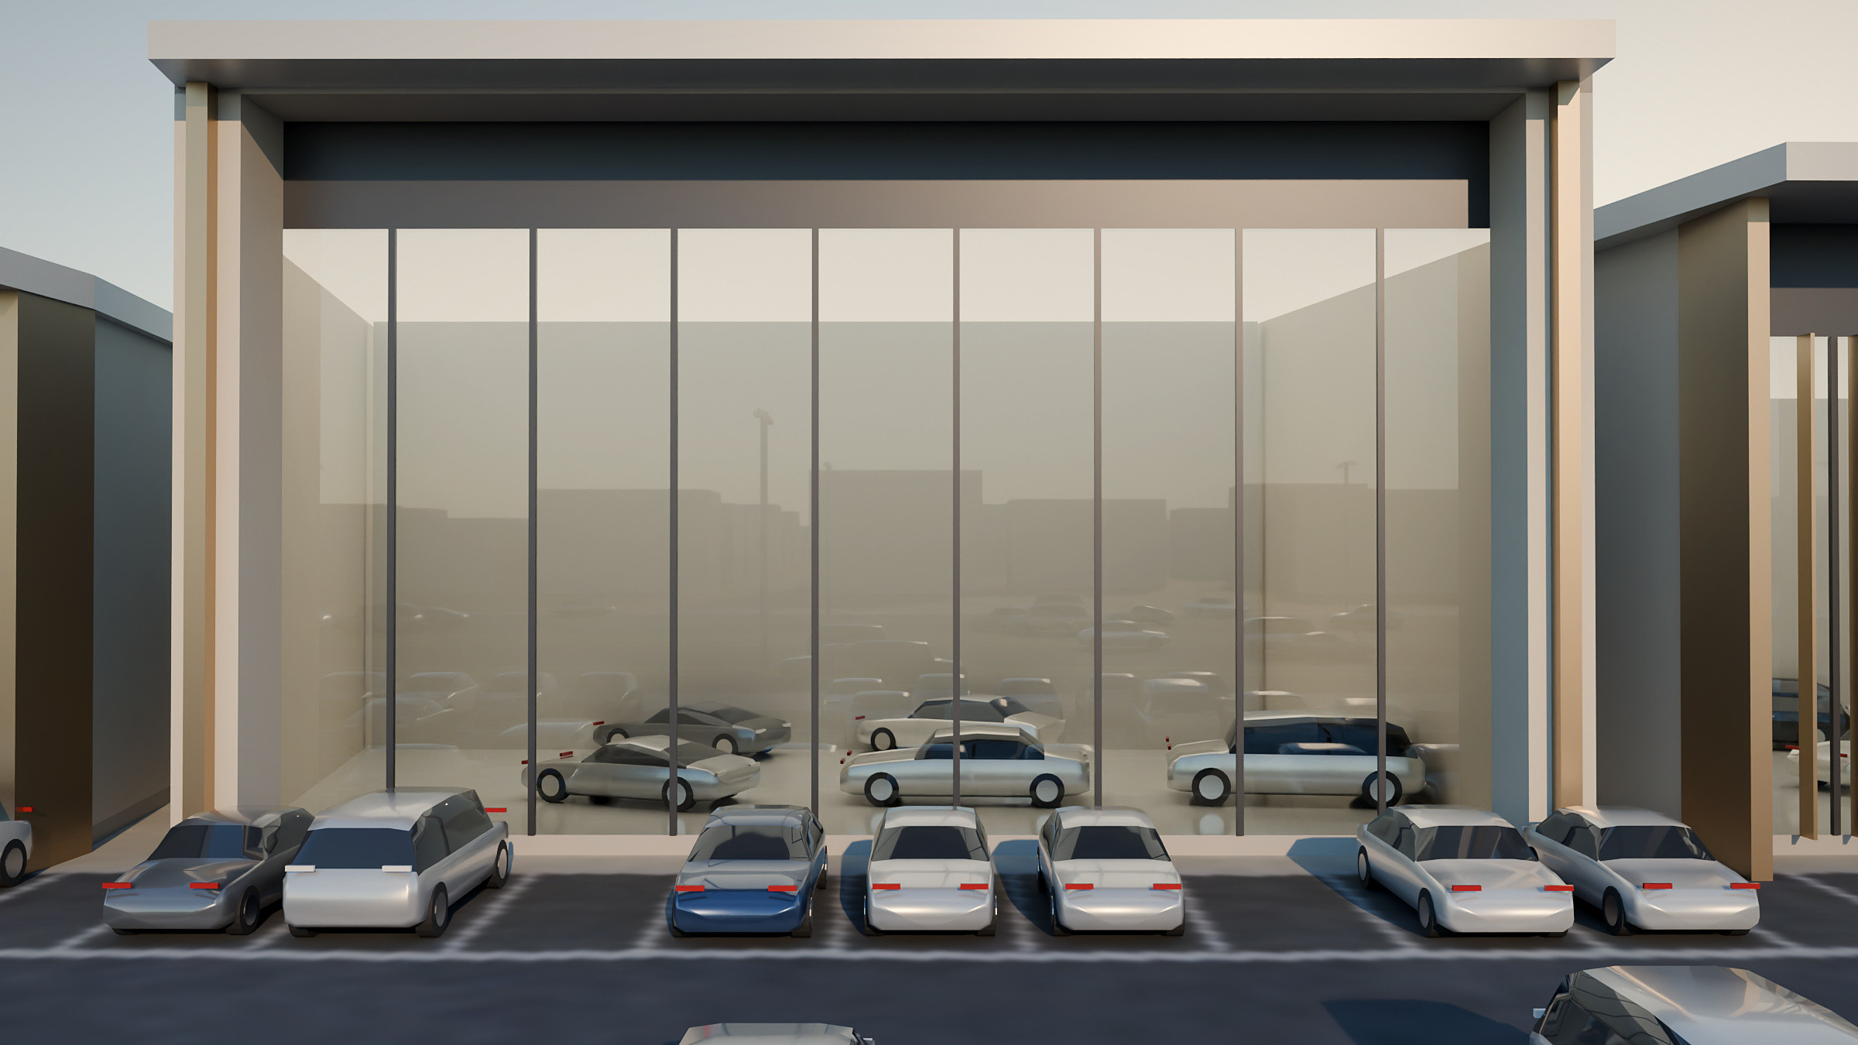
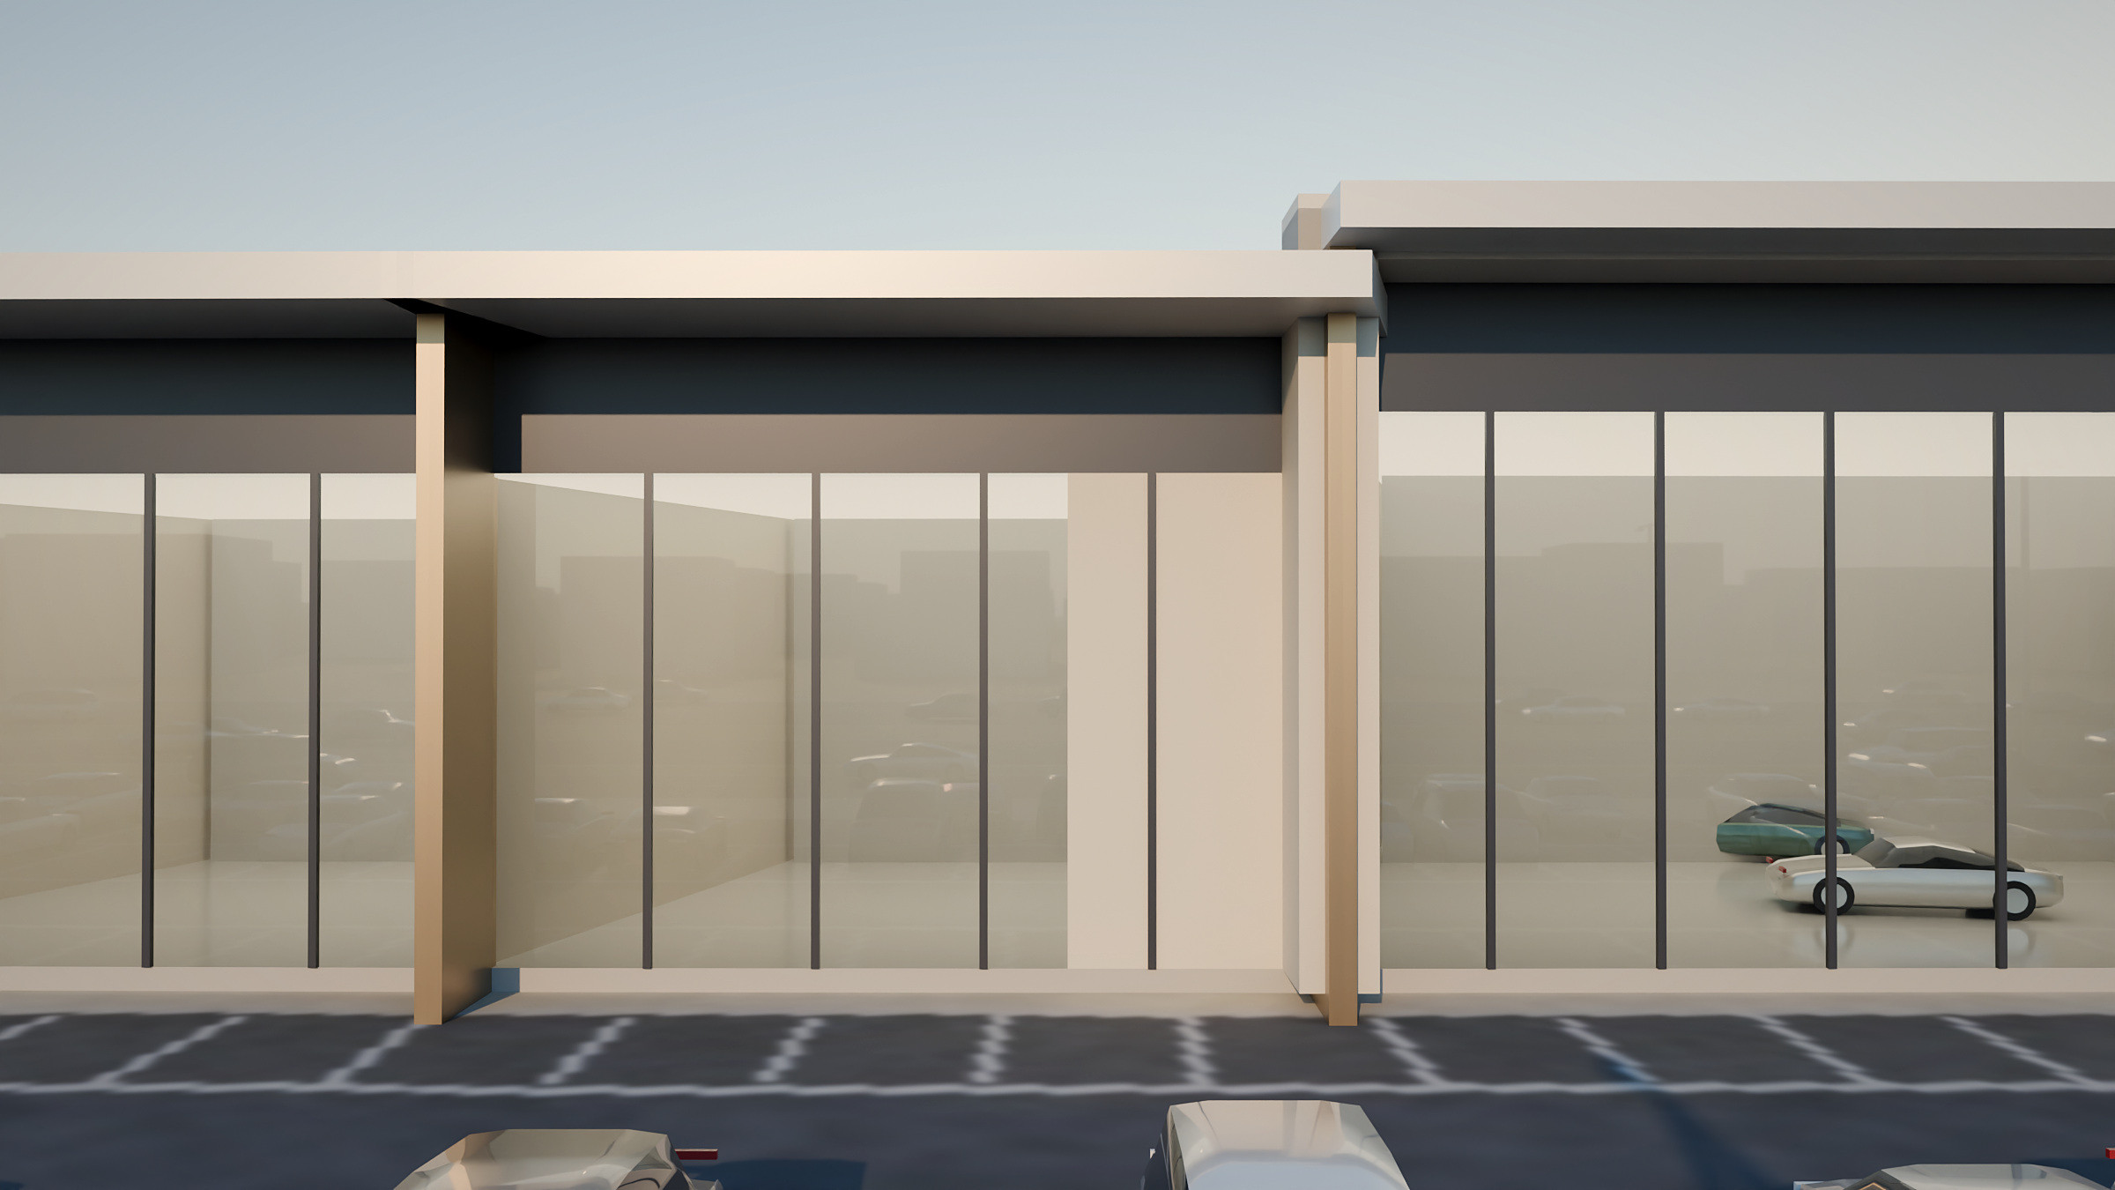
Brand expression within one district language
INDIVIDUAL SHOWROOM IDENTITIES
VERTICAL LOUVRE + MINIMAL
CONTEMPORARY FRAME
STONE & GLASS
Bronze fins shade the glass; a minimal neighbour sits beside it.
A protruding stone portal marks a flagship or premium brand.
A solid limestone pier balances a fully glazed display.
SHARED BY EVERY SHOWROOM common plinth · roof edge and front canopy · bronze corner blades · graphite brand band (left blank for each brand) · limestone-tone side walls
NEW CONCEPT VISUALISATION · ILLUSTRATIVE · PALMS OMITTED FOR CLARITY
Notes:
PURPOSE: Answer "will it look uniform?" — brands get identity, the district stays coherent.
TALKING POINTS:
- Voice-note intent: showrooms should have different possible looks rather than identical, typical boxes.
- Five façade options from the concept (louvre, minimal, frame, stone & glass, angled canopy) are applied as a kit of parts.
- Shared plinth, roof line, bronze blades and the blank brand band keep the frontage coherent.
SOURCE: Options = JMD Concept 1 p.5; application = new design development; renders new.

Slide 7
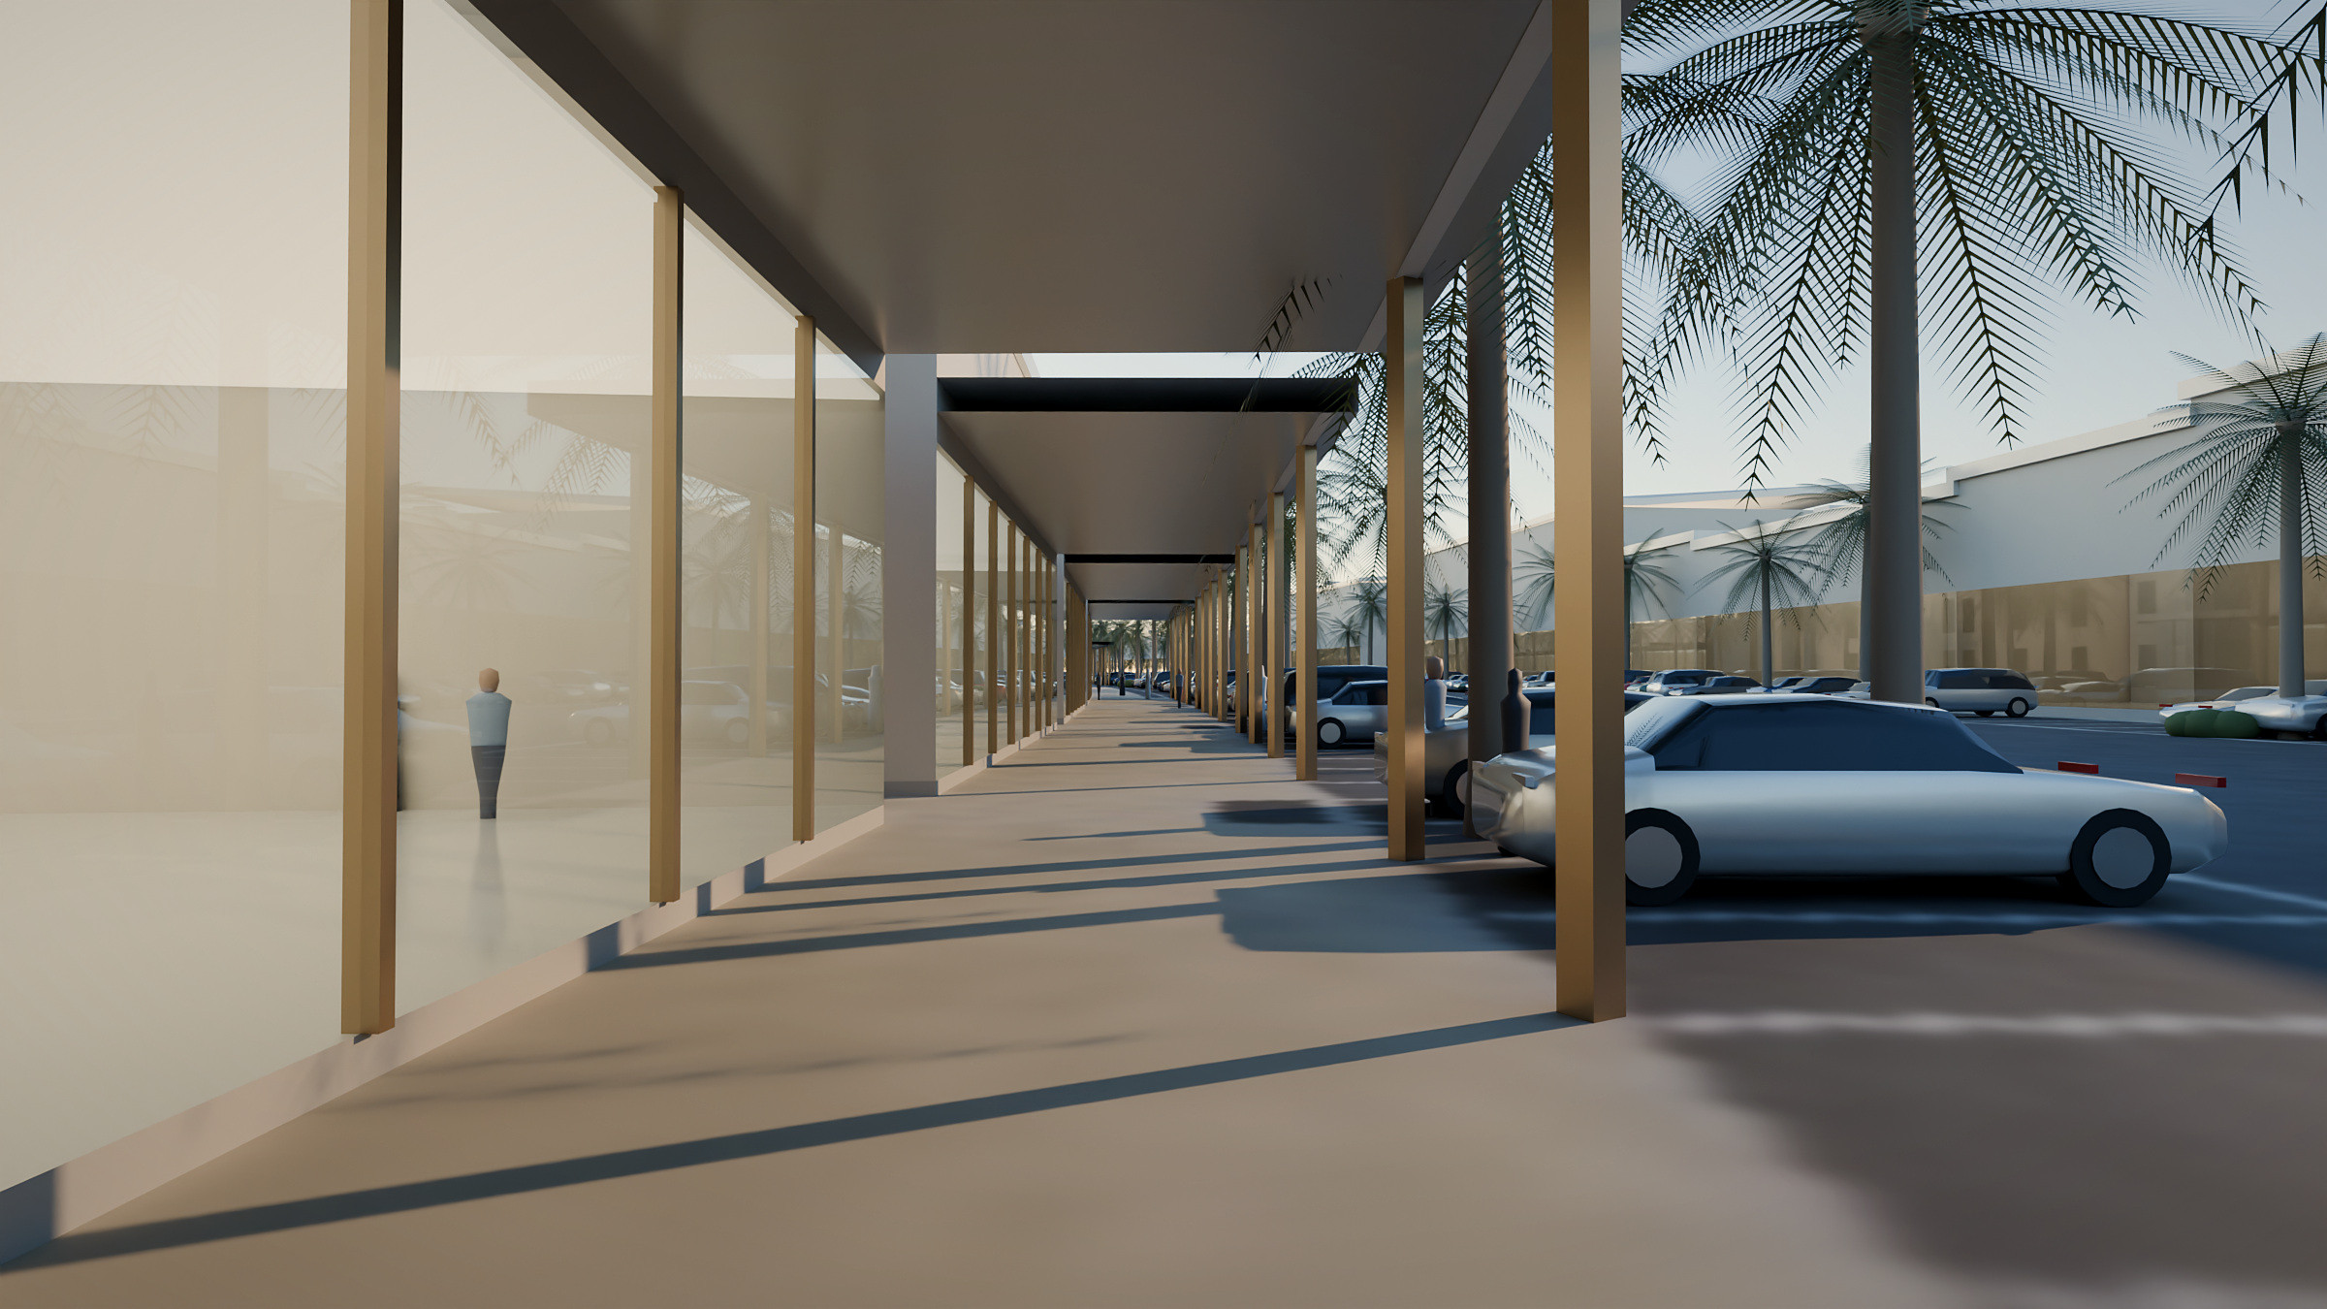
Shaded retail facing the showroom row
COMMERCIAL AND LIFESTYLE BOULEVARD
BEHIND THE SHOWROOMS
29 units for automotive accessories, brand lifestyle and design stores, cafés and food & beverage.
CONTINUOUS SHADE
A 5.5 m deep arcade on slender bronze columns provides shaded walking along the whole row.
OPEN TO ALL VISITORS
People can visit without buying a car, which keeps the district active through the day and evening.
NEW CONCEPT VISUALISATION · ILLUSTRATIVE
FOR DISCUSSION Pedestrian crossings between the showroom and retail rows, shade standards and F&B outdoor seating.
Notes:
PURPOSE: Show the public, pedestrian side of the district.
TALKING POINTS:
- The retail row is drawn as 29 units facing the showroom row across the internal drive.
- Tenant mix is indicative (voice note 2 examples: accessories shops, a brand design store, cafés); arcade and shade are design proposals.
SOURCE: DWG footprints (labelled "commercial shop"); programme from JMD Concept 1 p.13 and earlier masterplan zone 7; render new.

Slide 8
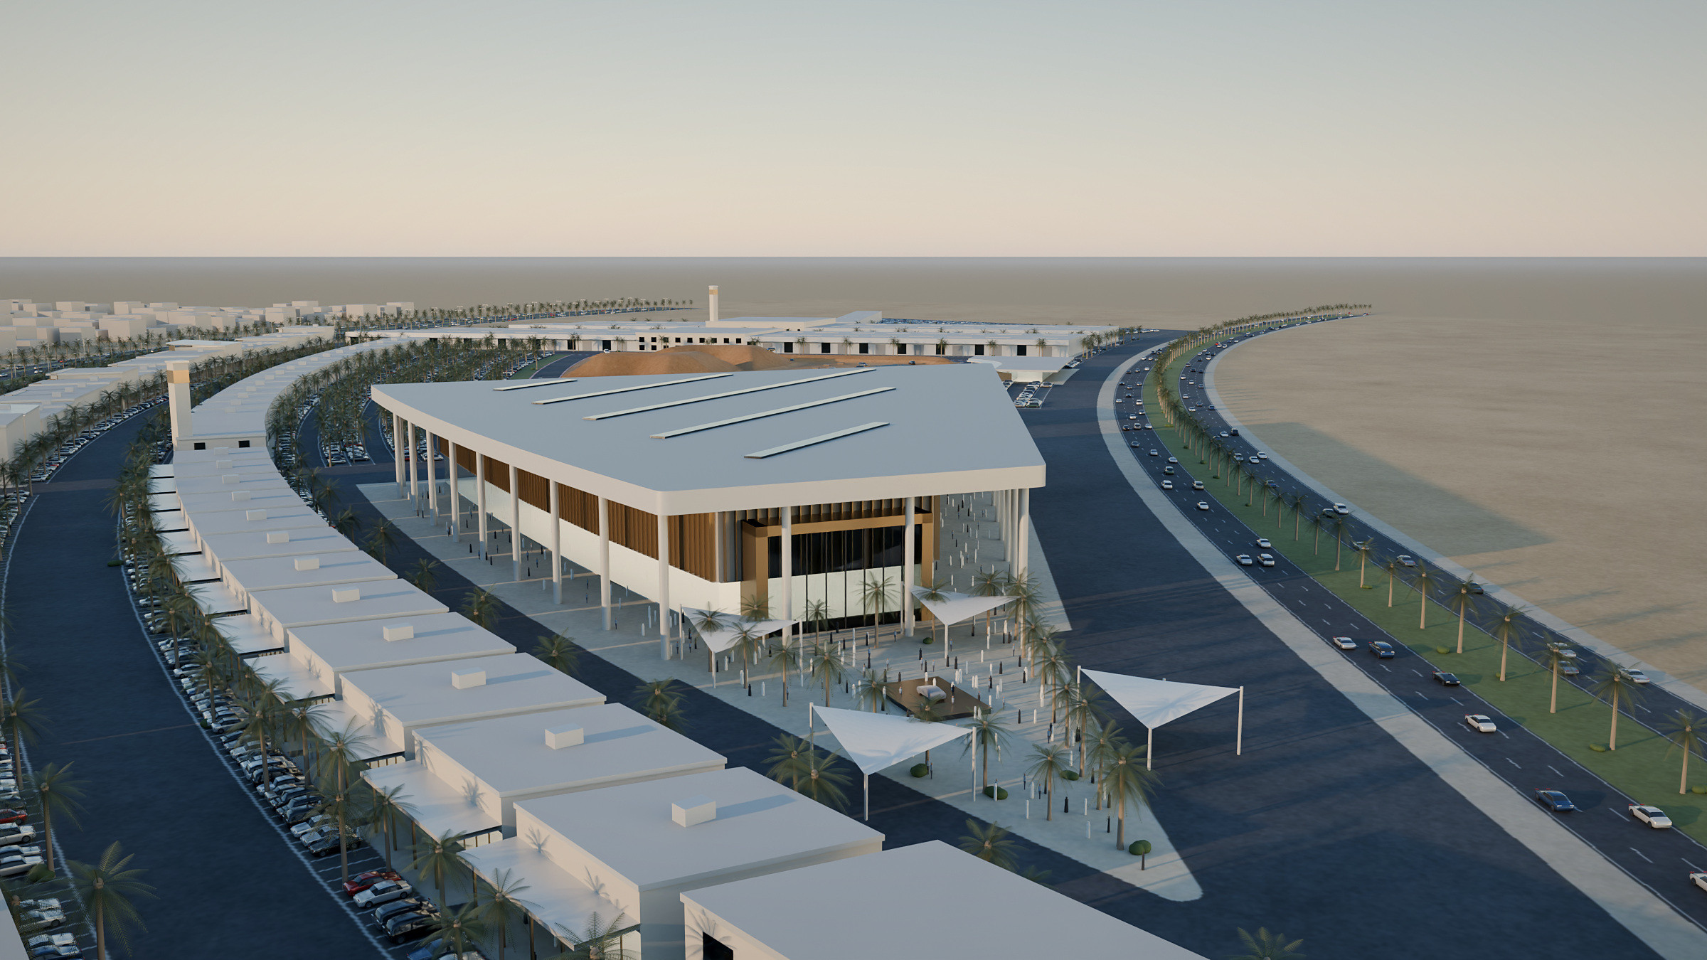
A landmark venue at the district’s southern tip
GRAND AUTOMOTIVE ARENA
AS DRAWN
7 divisible hall bays, about 12,900 m², under one roof with a shaded concourse and an entrance on the launch plaza.
NEW CONCEPT VISUALISATION · ILLUSTRATIVE
Notes:
PURPOSE: Introduce the arena as the district's landmark and event anchor.
TALKING POINTS:
- Form follows the triangular site at the southern tip of the DWG; floating roof, glazed concourse, bronze-fin upper façade.
- Hall bays can operate separately or together (see next slide).
- Earlier concept images show different arena forms (glass dome, faceted pavilion); this deck consolidates on the current drawing.
SOURCE: DWG (arena halls ≈12,911 m²; concourse band ≈5,911 m²); render new. Capacities: not yet confirmed.

Slide 9
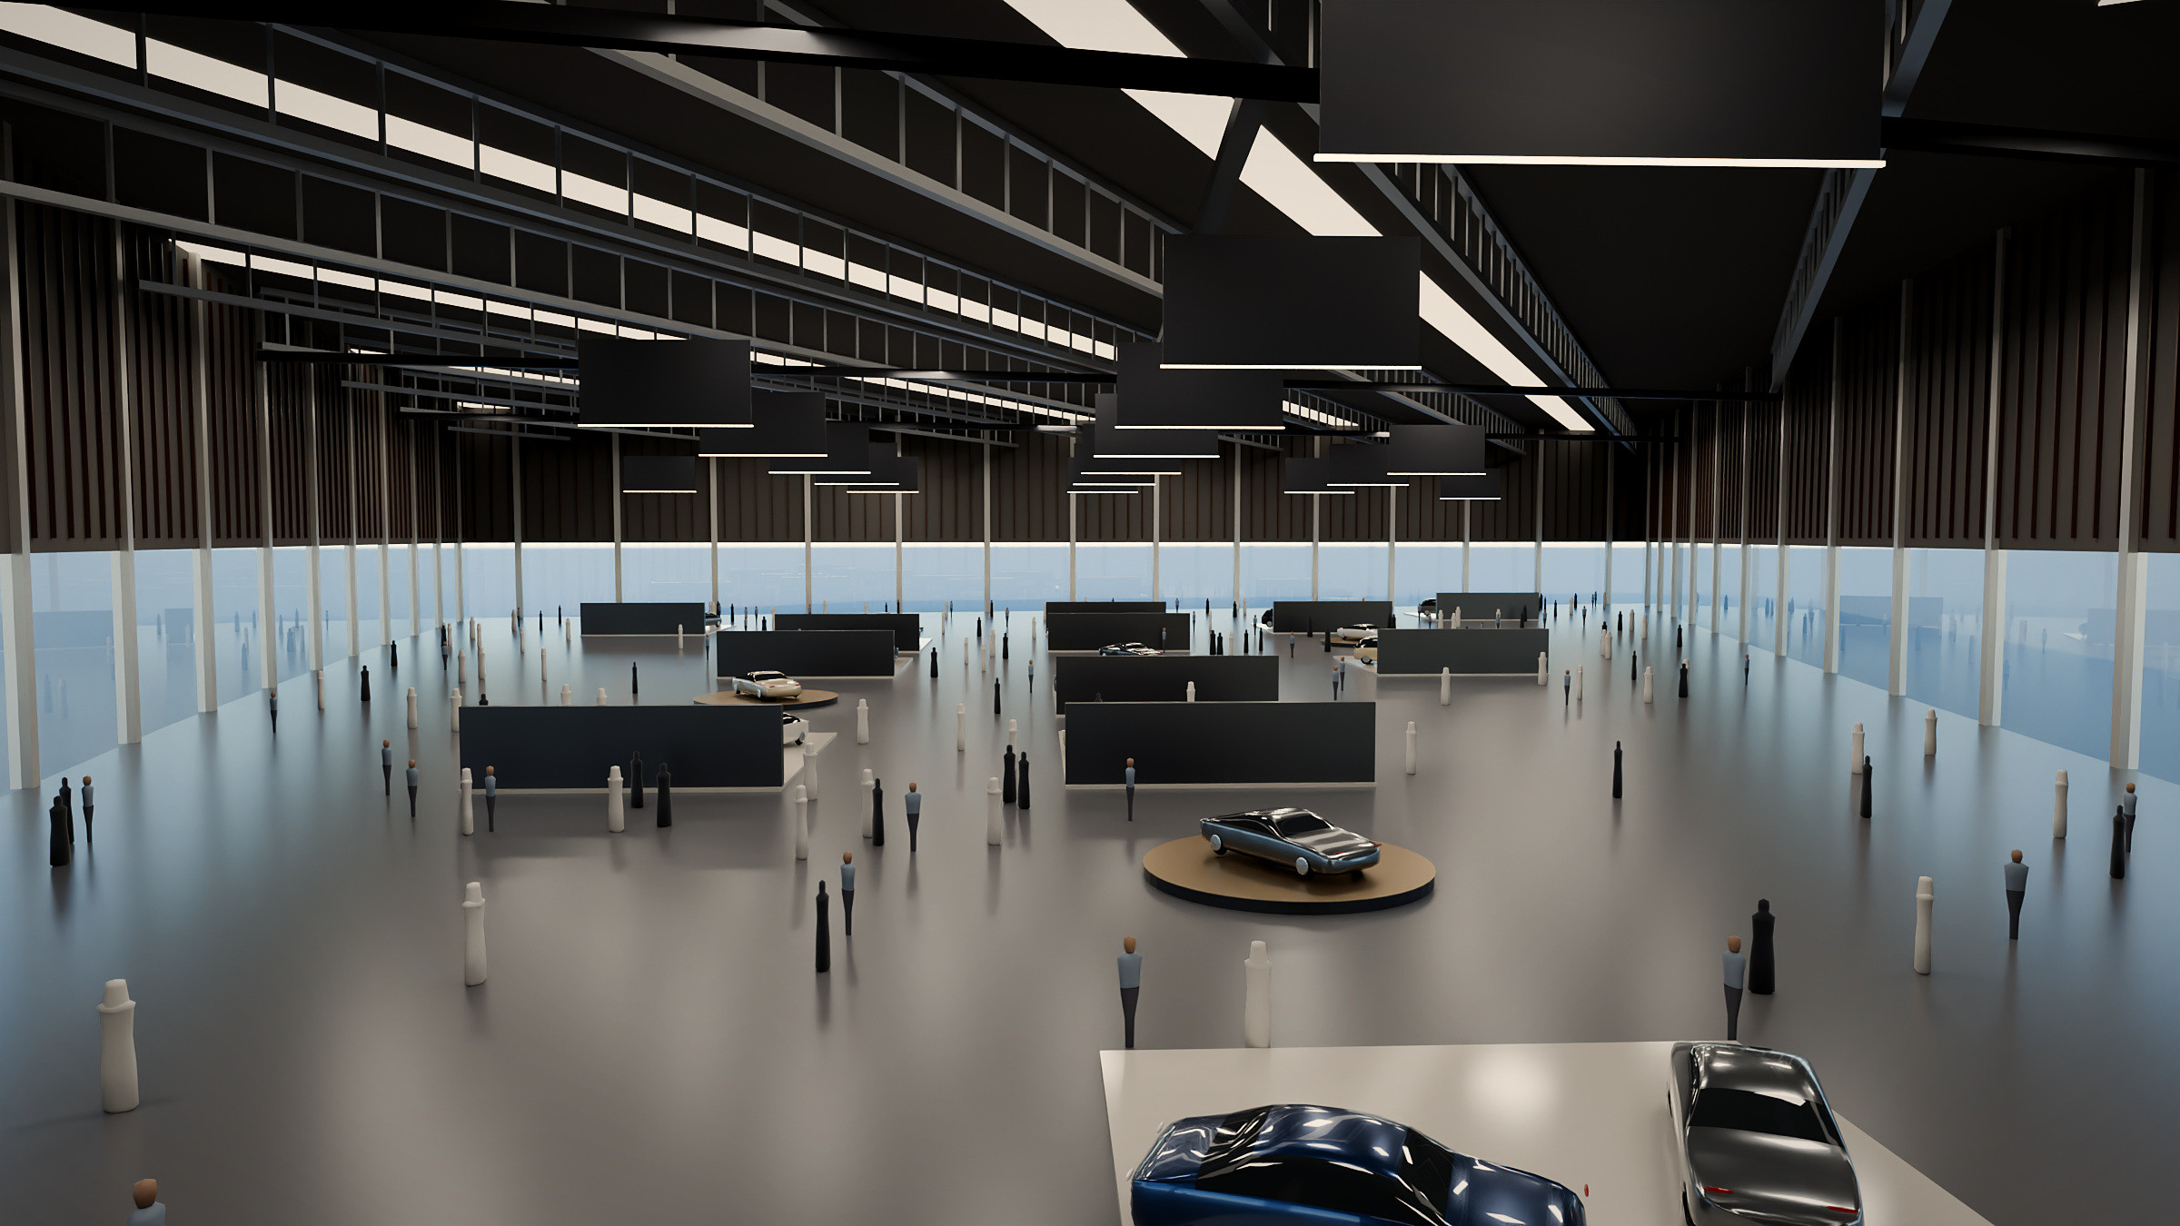
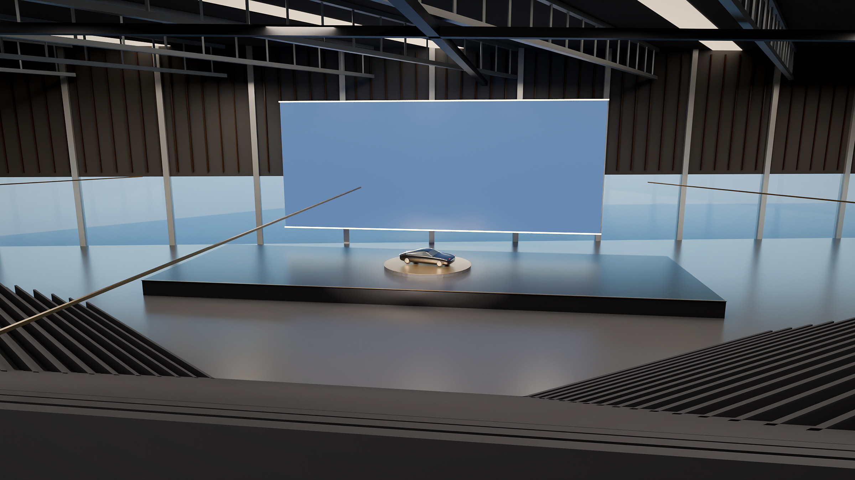
One floor, many configurations
GRAND ARENA — FLEXIBLE EVENTS
EXHIBITION MODE · ILLUSTRATIVE
180° THEATRE MODE · ILLUSTRATIVE
360° arena
270° arena
180° theatre
Runway
Exhibition
E-karting
[capacity TBC]
[capacity TBC]
[capacity TBC]
[capacity TBC]
[capacity TBC]
[capacity TBC]
Notes:
PURPOSE: Demonstrate flexibility — the same hall serves launches, motor shows, conferences and public events.
TALKING POINTS:
- The drawing divides the arena into 7 bays that can be used independently or combined (concept Mode 01–03).
- Six configurations from the concept: 360°, 270°, 180° theatre, runway, exhibition, e-karting.
- Capacities in the earlier concept vary by mode (approx. 4,500–12,000) and are NOT yet confirmed — placeholders left for the team.
SOURCE: Modes = JMD Concept 1 pp.17–23; hall geometry = DWG; interior renders and diagrams new and illustrative.

Slide 10
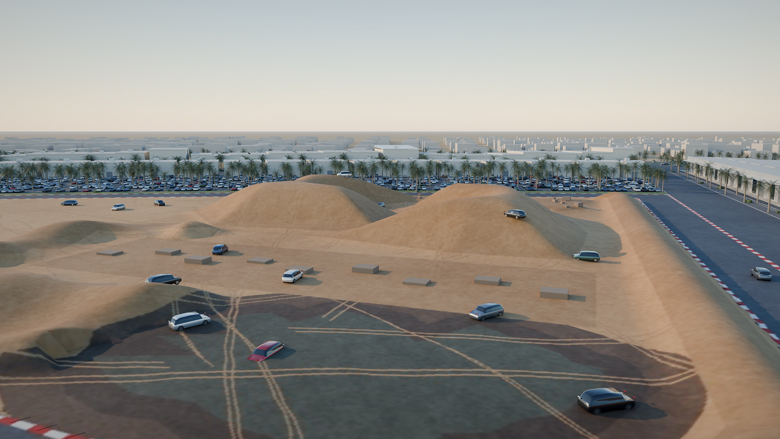
Real off-road terrain, inside the city
OFF-ROAD DRIVING EXPERIENCE
EXPERIENCE ZONES (AS DRAWN)
1
Hill climb and descent
2
Mud and water crossing
3
Dune field
4
Rock crawl
5
Axle-twister ramps
6
Side-slope section
7
Kerbed test-drive loop
Registration pavilion, drop-off, test-car and guest parking sit at the south-east entrance.
NEW CONCEPT VISUALISATION · ILLUSTRATIVE
FOR DISCUSSION Safety separation, dust and noise management, and operating hours next to public areas.
Notes:
PURPOSE: Explain the off-road experience and where it sits.
TALKING POINTS:
- The drawing defines the off-road zone (≈5.4 ha incl. loop) with 7 obstacle areas inside a test-drive loop.
- Voice-note intent: simulate a real off-road experience within an urban setting — five or six experiences such as mud, water, and driving up and down hills.
- Obstacle types and heights shown are illustrative (mounds ~10 m, mud/water crossing, rocks, ramps, side-slope).
- Earlier masterplan quoted a 2.5 km loop; the current drawing's loop is shorter — length to be confirmed.
SOURCE: DWG zones; JMD Concept 1 p.7 and project voice note 2 for intent; render new.

Slide 11
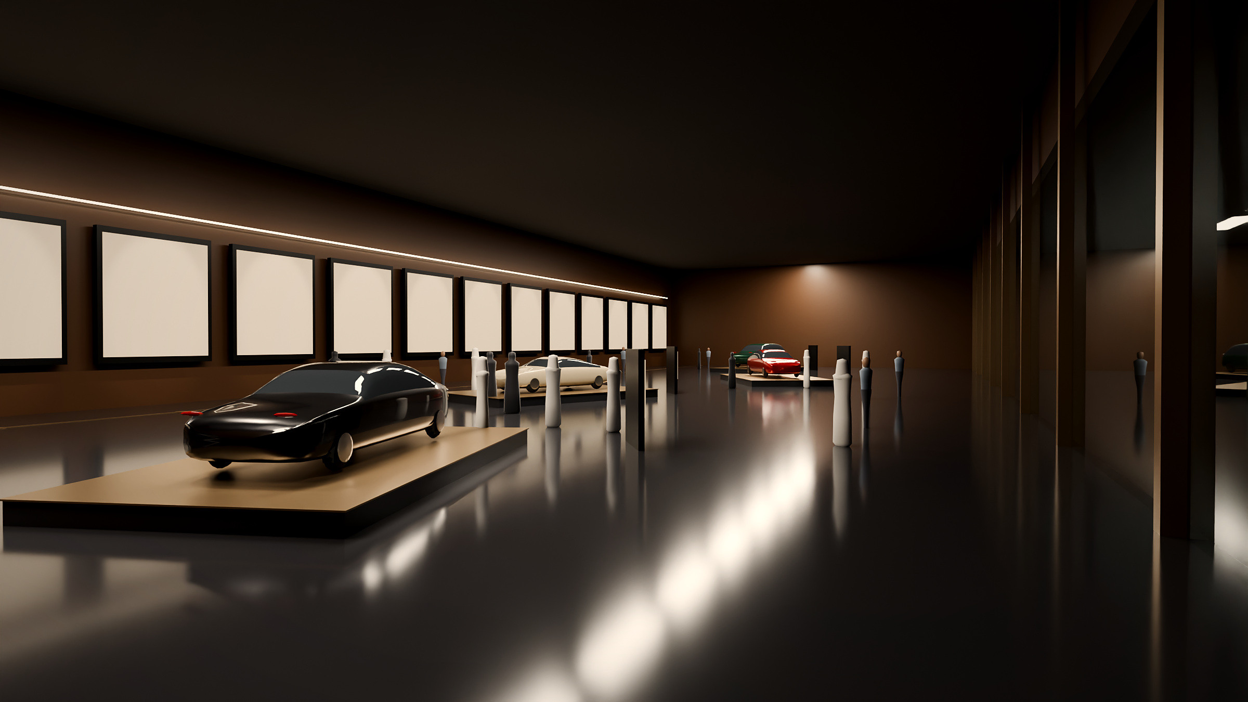
The stories behind the brands
WALL OF FAME — AUTOMOTIVE HERITAGE MUSEUM
HERITAGE, NOT SALES
A museum path through the corporate achievements of automotive companies: founders, milestones and collected cars.
CURATED CONTENT
Milestone panels and display cars are shown blank here. Content is to be curated with the brands.
LOCATION
[To be confirmed: it is not located on the current drawing. Options include the arena complex or next to the Collectors’ Club.]
NEW CONCEPT VISUALISATION · ILLUSTRATIVE
Notes:
PURPOSE: Introduce the museum as a heritage attraction (explicitly not a showroom).
TALKING POINTS:
- Focus (per voice note 2): a museum of the car companies' achievements as corporations — a visitor path past collected cars, founders and milestones. Explicitly not a showroom or sales space.
- Location and building form are open: the earlier concept shows two different exterior designs and the current drawing does not include the museum.
SOURCE: Intent = JMD Concept 1 pp.8–10 and voice note 2; interior render new and illustrative; location unresolved (register item).

Slide 12
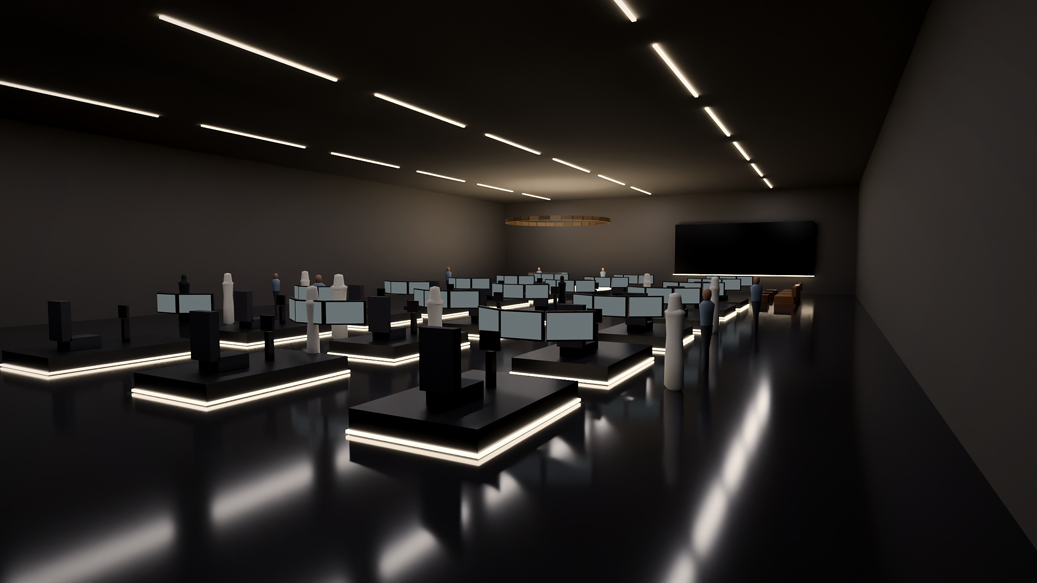
Experience driving many different cars
AUTOMOTIVE SIMULATOR HALL
FOR EVERY VISITOR
Multiple simulators let visitors experience driving specific cars, from a supercar to an off-roader or a city car.
COMPETITIVE & SOCIAL
Rows of rigs, a feature 360° pod and a lounge support sessions, leagues and corporate events.
LOCATION
[To be confirmed: it is not located on the current drawing.]
NEW CONCEPT VISUALISATION · ILLUSTRATIVE
Notes:
PURPOSE: Show an all-weather, all-ages attraction.
TALKING POINTS:
- Per voice note 2: multiple simulators, each giving the experience of driving a specific car (examples given ranged from supercars to an off-roader and a city car).
- Screens shown with neutral imagery; brand content would be licensed.
SOURCE: Intent = JMD Concept 1 pp.11–12; render new and illustrative; location unresolved.

Slide 13
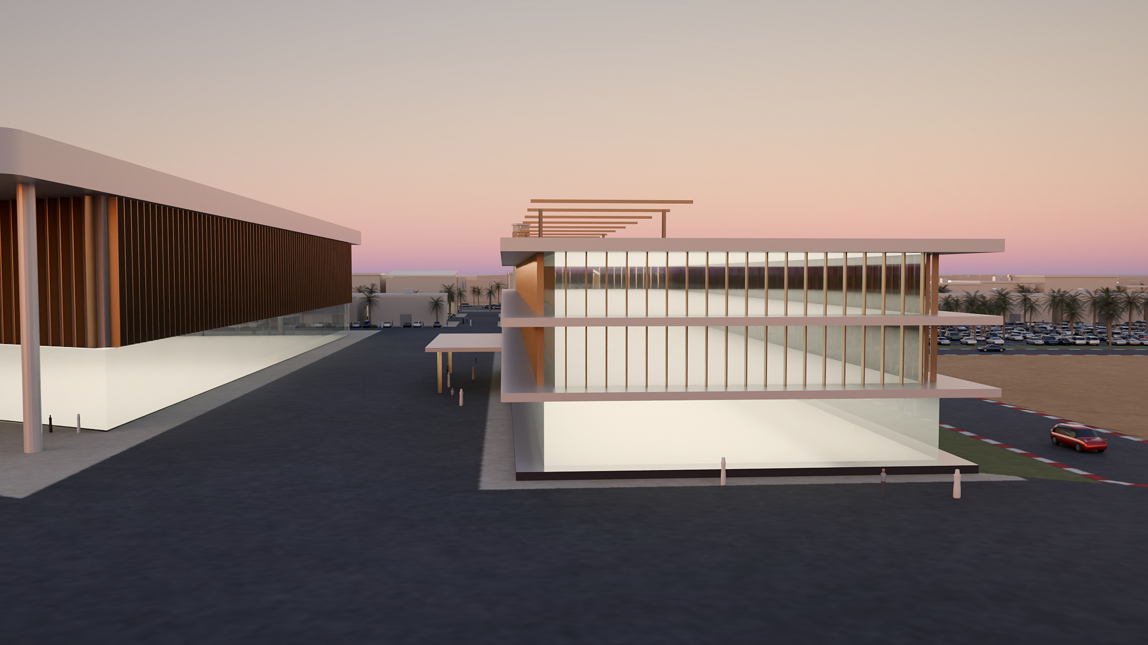
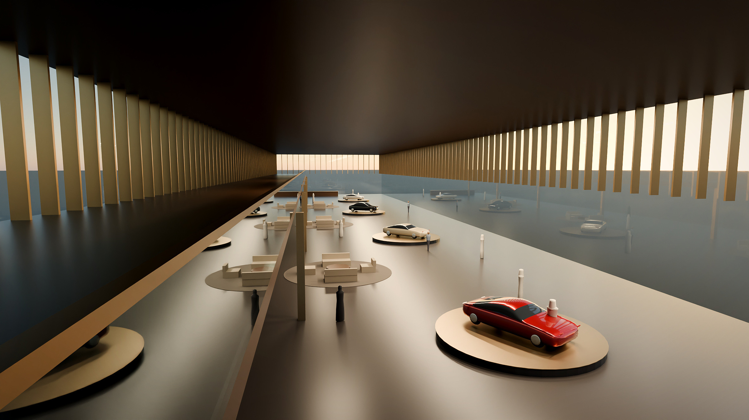
A home for rare and classic vehicles
COLLECTORS’ CLUB
EXTERIOR AT DUSK · ILLUSTRATIVE
GALLERY LOUNGE · ILLUSTRATIVE
THREE LEVELS
STORE OR SIMPLY MEET
AT THE HINGE
Glazed display gallery at ground level, members’ lounges above and a shaded roof terrace.
Members can store their cars or come to meet in the lounge and café, with valet drop-off.
Sits between the arena and the off-road field, close to events but discreet.
Notes:
PURPOSE: Present the exclusive club and its place in the district.
TALKING POINTS:
- Footprint as drawn: a 30 x 117 m bar (≈3,500 m²) between the arena and off-road zone.
- Per voice note 2: a club for collectors of luxury and collectible cars — members can store their cars or simply come to spend time (lounge, café).
- Three levels per the earlier concept; storage location (basement) to be confirmed.
SOURCE: DWG footprint; intent from JMD Concept 1 pp.14–15 and earlier masterplan zone 3; renders new.

Slide 14
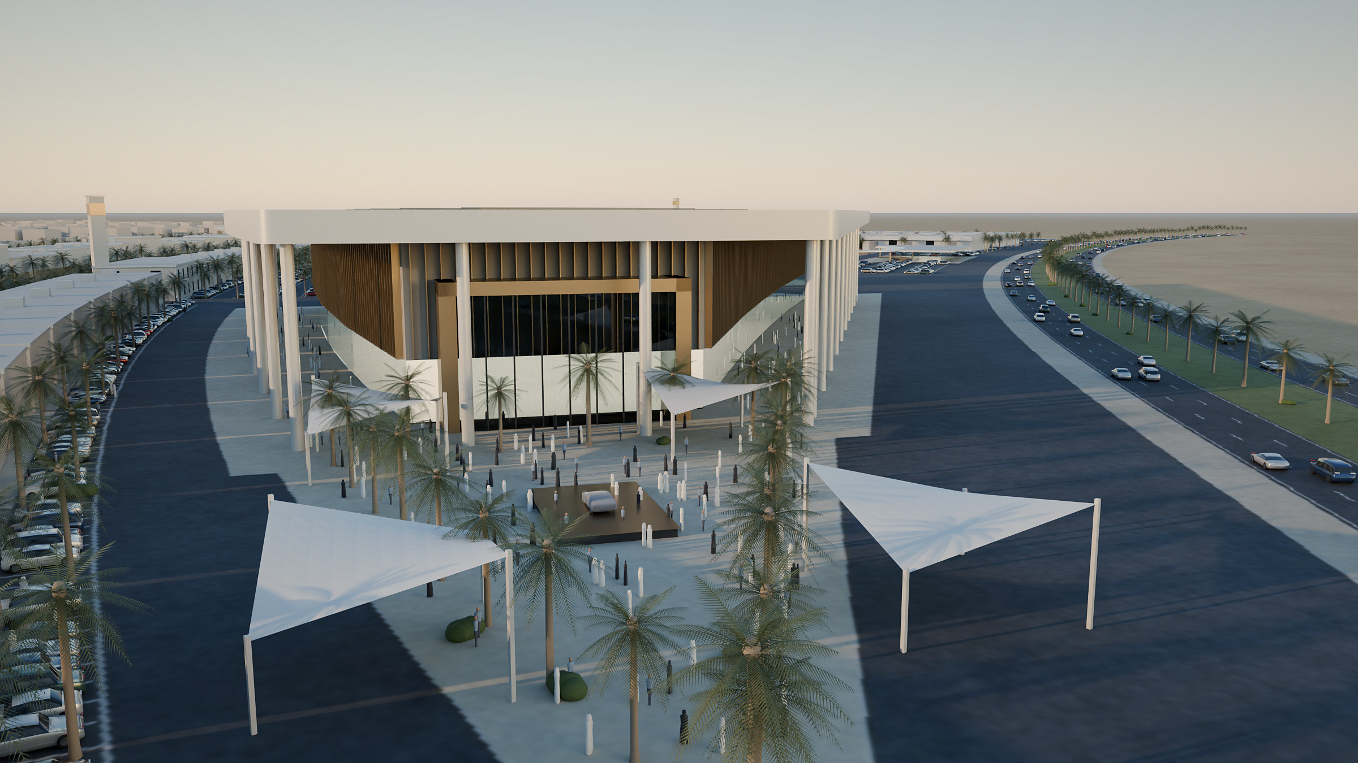
Where new models meet the public
OUTDOOR EXHIBITION AND LAUNCH PLAZA
REVEAL & ACTIVATE
A shaded plaza at the arena entrance for vehicle reveals, temporary exhibitions and brand activations.
Outdoor function area as drawn: about 2,850 m²
NEW CONCEPT VISUALISATION · ILLUSTRATIVE
Notes:
PURPOSE: Show the public-facing event space.
TALKING POINTS:
- Located at the arena's southern entrance (DWG "outdoor function area").
- Shade sails, reveal stage and planting are illustrative.
- Event-day crowd management to be developed with the municipality.
SOURCE: DWG; intent JMD Concept 1 p.16; render new.

Slide 15
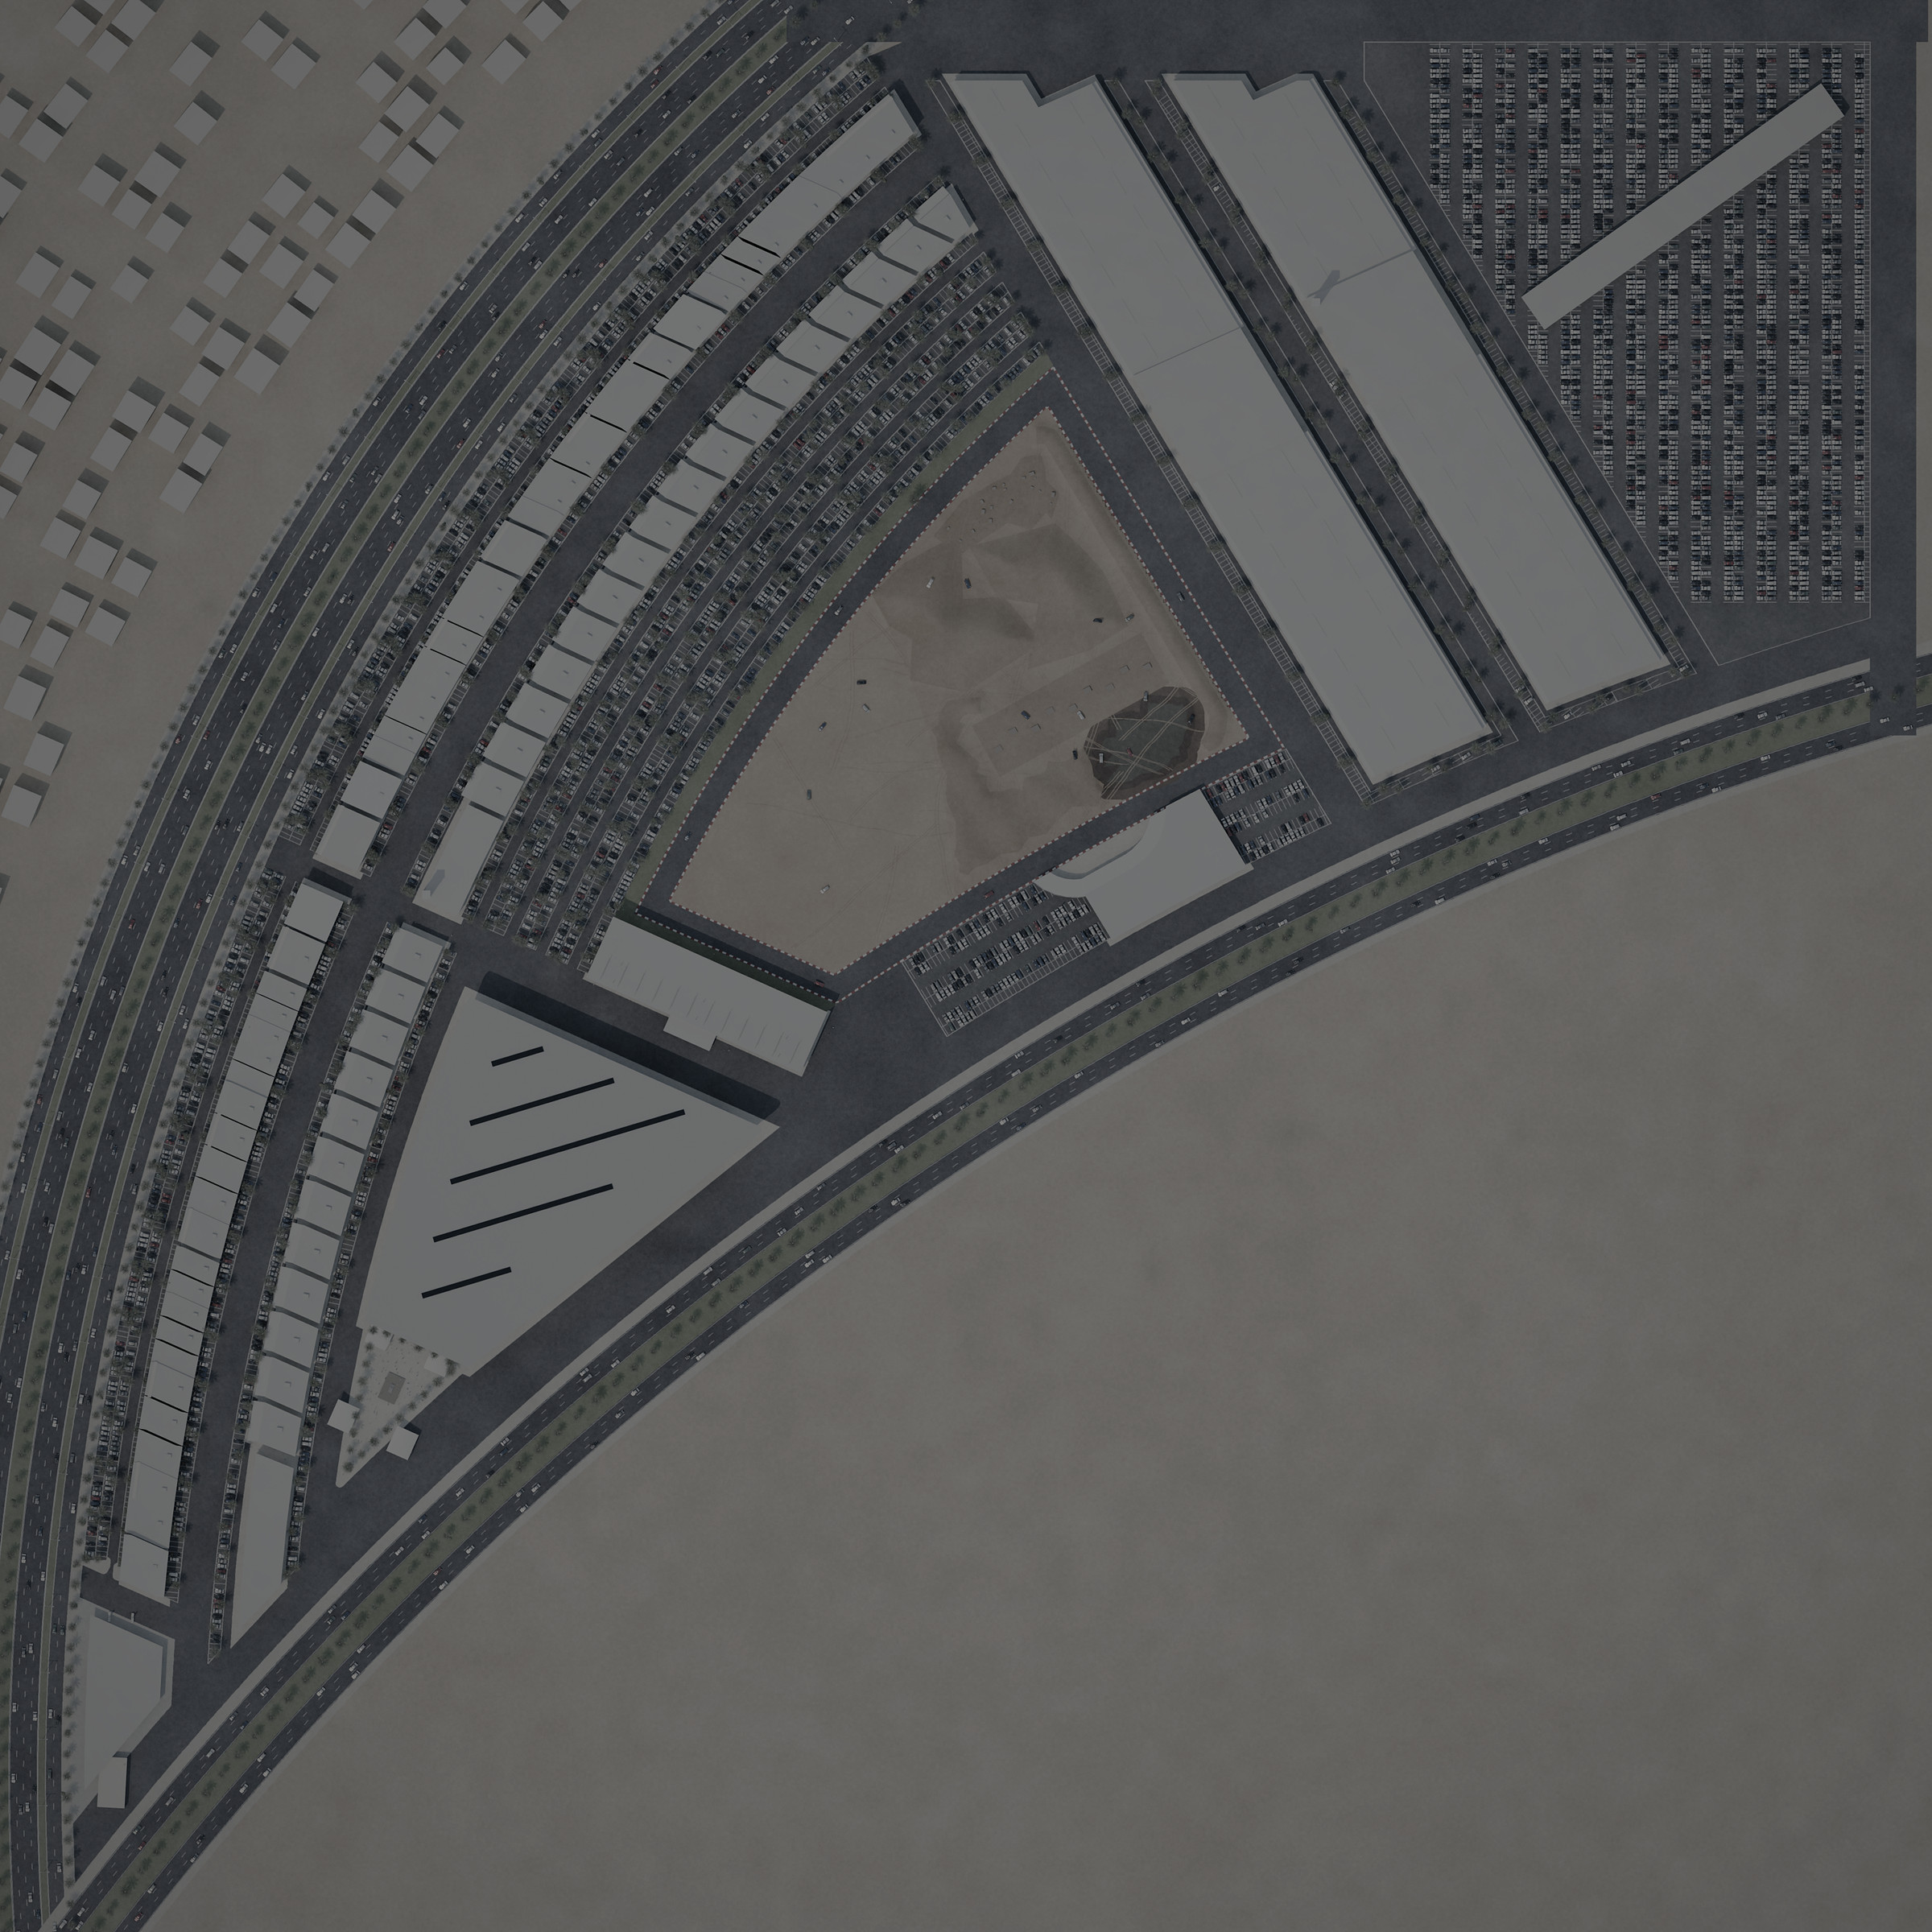
Three ways to use the district
THE INTEGRATED VISITOR EXPERIENCE
1
CUSTOMER JOURNEY
Arrive on the frontage, compare brands along the showroom row, test-drive on and off road, then use the service village.
2
2
FAMILY DAY OUT
1
Park by the retail row, walk the shaded arcade, visit the club gallery and attractions, finish at the launch plaza.
3
EVENT NIGHT
Arrive from the south-east road, gather on the plaza, enter the arena, then continue to the club.
3
FOR DISCUSSION Pedestrian routes, crossings and event-day separation of visitors and service traffic.
INDICATIVE ROUTES ON THE CONCEPT LAYOUT
Notes:
PURPOSE: Show that the components work together as one destination.
TALKING POINTS:
- Three typical visits: customer, family/day visitor, event night.
- Operational traffic (service village, dealer storage, deliveries) stays at the back of the site, away from the public frontage.
- Routes are indicative; detailed movement and access design to follow.
SOURCE: Diagram new; routes drawn on the DWG-based plan.

Slide 16
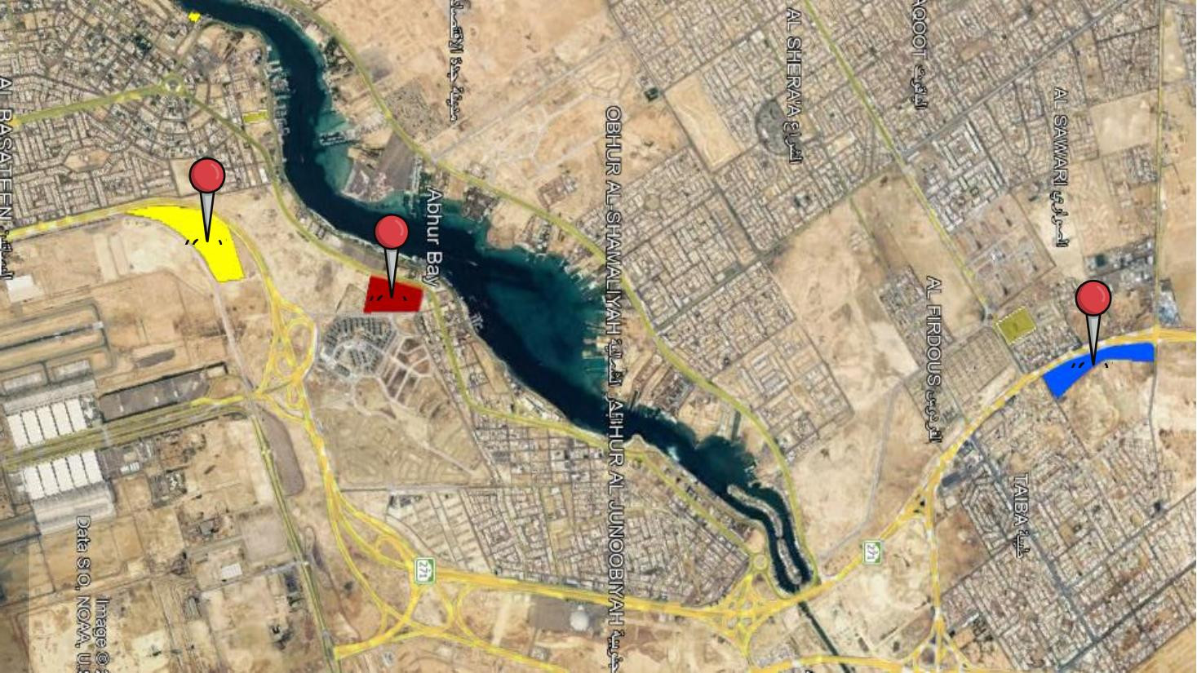
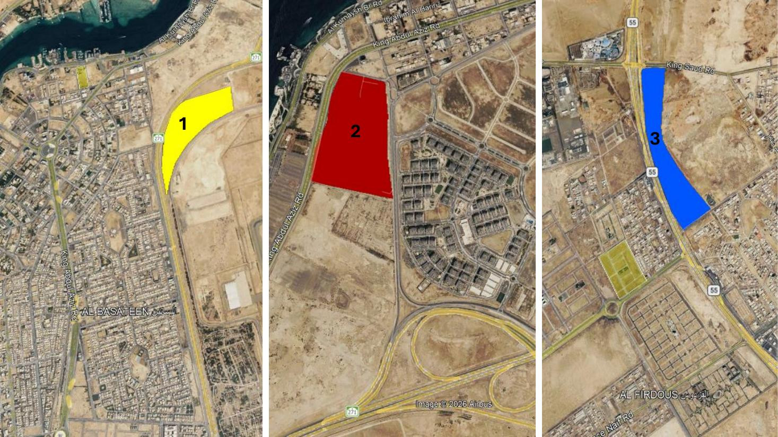
Location options under consideration
SITE OPPORTUNITIES AND DEVELOPMENT CONTEXT
SOURCE MATERIAL · JMD CONCEPT 1, P.24
SOURCE MATERIAL · JMD CONCEPT 1, P.25 · OPTIONS 1–3
OPTIONS, NOT DECISIONS
ADAPTABLE CONCEPT
NEXT STEP
Three candidate locations were identified in the concept material. No site has been selected or approved.
The district concept (components and relationships) can be adapted to the selected site.
[Confirm the preferred site, its boundary and area, then re-fit the layout.]
Notes:
PURPOSE: Separate the district concept from location-specific proposals.
TALKING POINTS:
- Three location options appear in the concept material; none is approved.
- The current drawing (FINAL 8-10-2026) is a location-specific layout; the site it relates to and its boundary are to be confirmed.
- Site areas quoted in earlier material differ (≈170,000–180,000 m²) from the current drawing's boundary (≈41 ha) — to be reconciled.
SOURCE: Images reproduced from JMD Concept 1 pp.24–25 (satellite imagery as supplied).

Slide 17
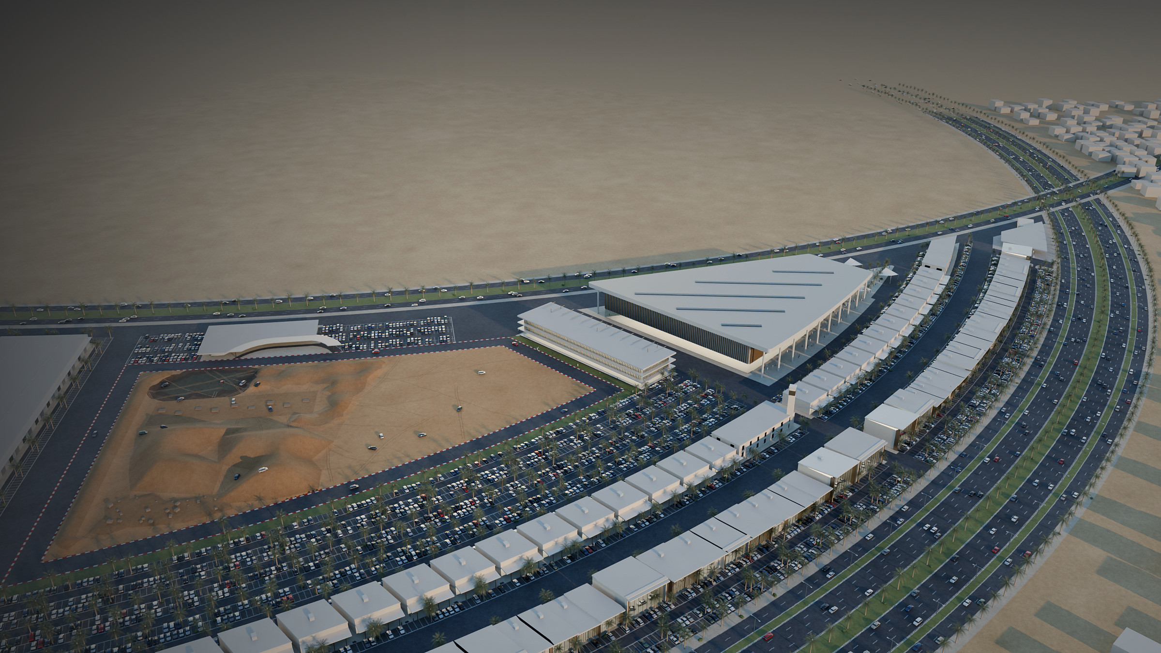
OVERALL DEVELOPMENT VISION
MATTERS FOR MUNICIPAL COORDINATION
A distinctive automotive destination for Jeddah
1
Site selection, boundary and land use
2
Access points and traffic impact
3
Parking provision and event-day management
4
Public realm, shade and pedestrian safety
5
Utilities and infrastructure interfaces
6
Off-road dust, noise and safety
7
Programme phasing
Discussion topics, not completed assessments.
NEW CONCEPT VISUALISATION · ILLUSTRATIVE
Notes:
PURPOSE: Bring the district back together and name what needs coordination next.
TALKING POINTS:
- One coherent district: commercial frontage, public attractions, events, operations at the back.
- The listed topics are proposed discussion items — no technical assessments have been completed and no approvals are implied.
SOURCE: Render new (DWG layout); coordination list new.

Slide 18
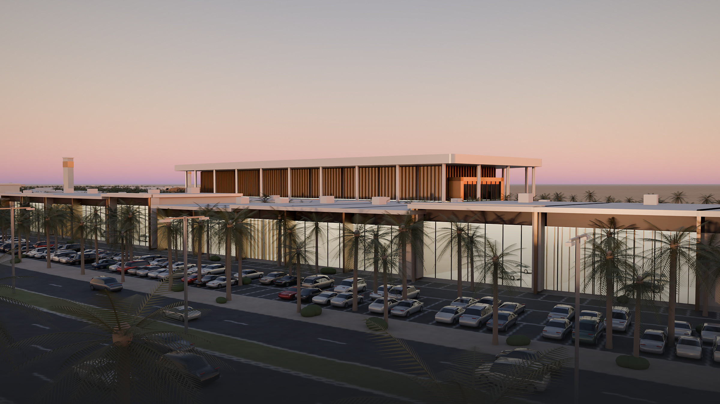
Thank you
Discussion · [Contact name, email, phone]
NEW CONCEPT VISUALISATION · ILLUSTRATIVE · SHOWROOM FRONTAGE WITH ARENA BEYOND
Notes:
PURPOSE: Close and invite discussion.
TALKING POINTS: Summarise the three roles (buy & maintain, experience & learn, gather & celebrate) and propose next steps: site confirmation, traffic and parking study, programme confirmation (museum, simulator, arena capacity).
SOURCE: Render new; this street-level view corresponds to the view described in the project narration (showrooms on the main road with the arena and club behind).

