Slide 1

Sentiment analysis in social network messages
School of information and comunication technology
Member:
Vu Tung Linh
Nguyen Van Quoc

Slide 2
Contents
About dataset
PrepareData
Processing and EDA
Model
Evaluation
Conclusion
For more info: Github:

Slide 3
01
Dataset

Slide 4
Dataset
add description here

Slide 5
02
Prepare data

Slide 6
03
Processing and EDA

Slide 7
04
Model

Slide 8
05
Evaluation

Slide 9
06
Conclusions

Slide 10
Thank you!

Slide 11
Purpose statement
What about Mercury?
Mercury is the closest planet to the Sun and the smallest one in the Solar System. The planet’s name has nothing to do with the liquid metal
What about Venus?
Venus has a beautiful name and is the second planet from the Sun. It’s terribly hot and its atmosphere is extremely poisonous
What about Jupiter?
Jupiter is a gas giant and the biggest planet in the Solar System. It's the fourth-brightest object in the sky. It was named after a Roman god

Slide 12
98,300,000
Big numbers catch your audience’s attention

Slide 13
9h 55m 23s
333,000
386,000 km
Jupiter's rotation period
The Sun’s mass compared to Earth’s
Distance between Earth and the Moon

Slide 14

A picture is worth a thousand words

Slide 15

A picture always reinforces the concept
Images reveal large amounts of data, so remember: use an image instead of a long text. Your audience will appreciate it

Slide 16
Current situation & problems statement
Current situation
01
02
03
Jupiter is a gas giant and the biggest planet in the Solar System. It's the fourth-brightest object in the night sky. It was named after the Roman god of the skies and lightning
Earth
Mars
Mercury
Earth is the third planet from the Sun and has life
Despite being red, Mars is actually a cold place
Mercury is the smallest planet in the Solar System
Problems

Slide 17
Hypotheses
Hypothesis 1
Mercury is the closest planet to the Sun.The planet’s name has nothing to do with the liquid metal
Hypothesis 2
Venus has a beautiful name and is the second planet from the Sun. It’s hot and its atmosphere is poisonous
Hypothesis 3
Jupiter is a gas giant and the biggest planet in the Solar System. It was named after the Roman god

Slide 18
—Someone Famous
“This is a quote. Words full of wisdom that someone important said and can make the reader get inspired”

Slide 19
Study objectives
Mercury
Venus
Mars
Mercury is the closest planet to the Sun and the smallest of them all
Venus has a beautiful name and is the second planet from the Sun
Despite being red, Mars is actually a cold place. It’s full of iron oxide dust

Slide 20
Reviewing concepts is a good idea
Mars
Venus
Neptune
Mars is actually a very cold place
Venus has extremely
high temperatures
Neptune is the farthest planet from the Sun
Mercury
Saturn
Jupiter
Mercury is the closest planet to the Sun
Saturn is a gas giant with several rings
Jupiter is the biggest planet of them all

Slide 21
Literature review
AUTHOR. (YEAR). Title of the publication. Publisher
Mercury is the closest planet to the Sun and the smallest one
AUTHOR. (YEAR). Title of the publication. Publisher
Mars is full of iron oxide dust, which gives the planet its reddish cast
AUTHOR. (YEAR). Title of the publication. Publisher
Jupiter is a gas giant and the biggest planet in the Solar System
AUTHOR. (YEAR). Title of the publication. Publisher
Venus has a beautiful name and is the second planet from the Sun
AUTHOR. (YEAR). Title of the publication. Publisher
Earth is the third planet from the Sun and harbors life

Slide 22
Theoretical framework
Theoretical framework
Key terms | Relevant theories | Our framework
Mercury is small Earth harbors life Jupiter is big | Theory 1 | Venus has a beautiful name and is the second planet from the Sun. It’s very hot
 | Saturn is a gas giant and has rings. It’s composed mostly of hydrogen and helium
 | Theory 2
 | Neptune is the farthest planet from the Sun in Solar System and also an ice giant

Slide 23
Schedule
Task | Description | Date | J | F | M | A | M | J | Status
Task 1 | Despite being red, Mars is cold | Jan 1 - Feb 15 |  |  |  |  |  |  | Completed
Task 2 | Earth is the planet with life | Feb 1 - Apr 30 |  |  |  |  |  |  | In progress
Task 3 | Venus has a beautiful name | Mar 15 - Apr 30 |  |  |  |  |  |  | Delayed
Task 4 | Neptune is far away from us | Apr 20 - May 15 |  |  |  |  |  |  | Unstarted
Task 5 | Jupiter is a huge gas giant | Jun 4 - Jun 30 |  |  |  |  |  |  | Unstarted

Slide 24
Methodology
Mercury is the closest planet to the Sun and the smallest one
Type of data
Venus has a beautiful name and is the second planet from the Sun
Motives
Mercury
Mars is full of iron oxide dust, which gives the planet its reddish cast
Data collection
Jupiter is a gas giant and the biggest planet in the Solar System
Sampling

Slide 25
Analysis & development
Phase 01
Phase 02
Mercury is the closest planet to the Sun and the smallest one in the Solar System—it’s a bit larger than the Moon
Jupiter is a gas giant, the biggest planet in the Solar System and the fourth-brightest object in the night sky
Neptune is the farthest planet from the Sun. It's also the fourth-largest planet by diameter in the Solar System
Venus has a beautiful name and is the second planet from the Sun. It’s terribly hot—even hotter than Mercury
Saturn is a gas giant and has several rings. This planet is composed mostly of hydrogen and helium
Earth is the third planet from the Sun and the only one that harbors life in the Solar System

Slide 26
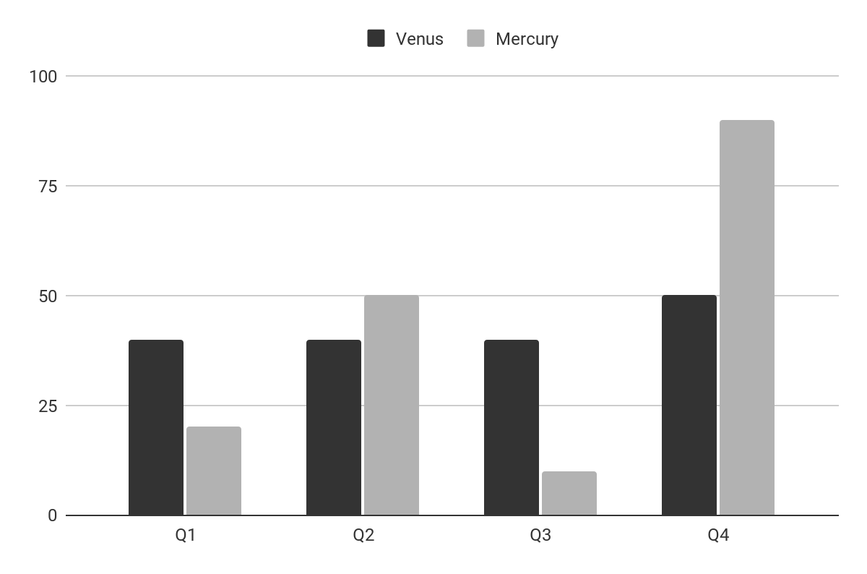
Analysis & development
Mercury is the closest planet to the Sun and the smallest one in the Solar System The planet’s name has nothing to do with the liquid metal
The Sun is the star at the center of the Solar System
Jupiter is the biggest planet in the entire Solar System
Saturn is composed mostly of hydrogen and helium
Venus
Mercury
Venus has a beautiful name
Mercury is quite a small planet
Follow the link in the graph to modify its data and then paste the new one here. For more info, click here

Slide 27
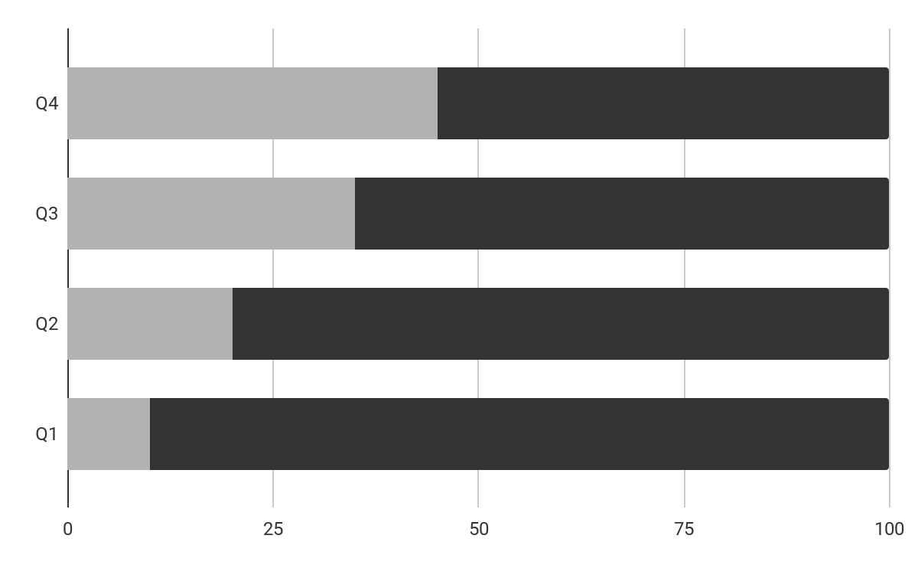
Analysis of the results
Mercury
Venus
Mercury is quite a small planet
Venus has a beautiful name
Mars
50%
Despite being red, Mars is a planet very cold
Follow the link in the graph to modify its data and then paste the new one here. For more info, click here

Slide 28
This is a map
Venus
Venus is the second planet from the Sun
Mercury
Mercury is the closest planet to the Sun
Mars
Despite being red, Mars is a cold place

Slide 29
Discussion
Mars & Earth
Discussion 1
Despite being red, Mars is actually a cold place. It's full of iron oxide dust, which gives the planet its reddish cast. Earth is the third planet from the Sun and the only one that harbors life in the Solar System. This is where we all live:
Ceres is located in the main asteroid belt
The Moon is Earth’s natural satellite
Neptune is very far away from us
Pluto is now considered a dwarf planet
Mercury is the closest planet to the Sun and the smallest one in the Solar System. It’s bit larger than the Moon
Discussion 2
Venus has a beautiful name and is the second planet from the Sun. Venus is a lot hotter than Mercury

Slide 30
Conclusions
Mars
Venus
Despite being red, Mars is actually a cold place. It’s full of iron oxide dust
Venus has a very beautiful name and is the second planet from the Sun
Mercury
Neptune
Mercury is the closest planet to the Sun and the smallest one in the Solar System
Neptune is a ig planet. It is the fourth-largest planet by diameter in the Solar System

Slide 31
Bibliographical references
Surname, A. (YEAR). Name of the source. Publisher
Surname, A. (YEAR). Name of the source. Publisher
Surname, A. (YEAR). Name of the source. Publisher
Surname, A. (YEAR). Name of the source. Publisher
Surname, A. (YEAR). Name of the source. Publisher
Surname, A. (YEAR). Name of the source. Publisher
Surname, A. (YEAR). Name of the source. Publisher
Surname, A. (YEAR). Name of the source. Publisher
Surname, A. (YEAR). Name of the source. Publisher
Surname, A. (YEAR). Name of the source. Publisher

Slide 32
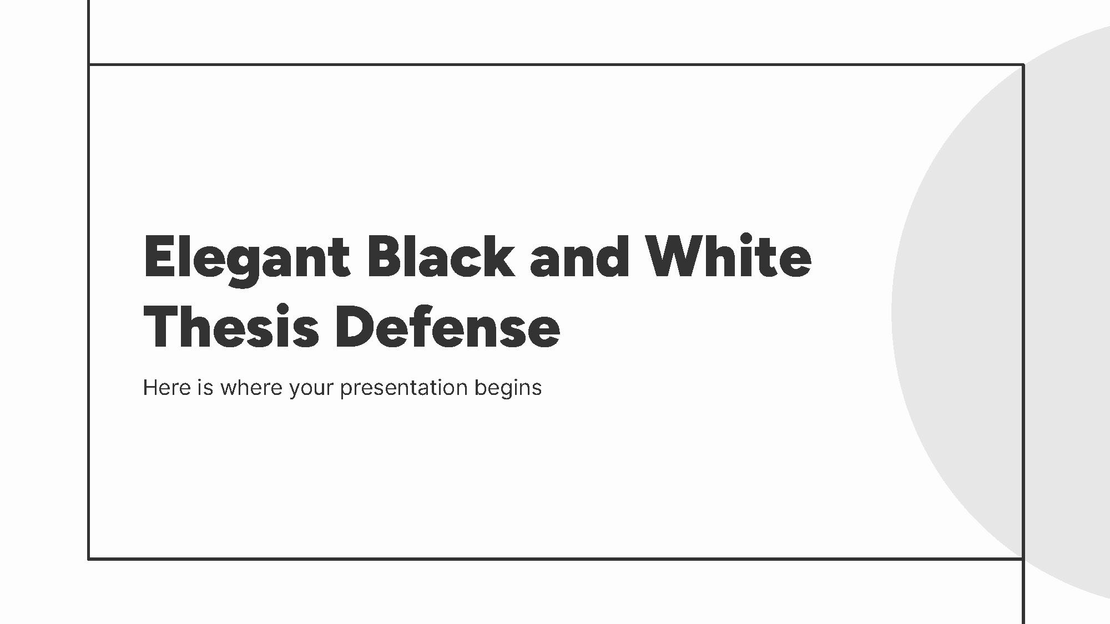

Mockups
You can replace the images on the screen with your own work. Just right-click on them and select “Replace image”

Slide 33
Thanks!

Slide 34
Table of contents
01
02
03
04
05
06
Statement
Hypothesis
Objectives
You can describe the topic of the section here
You can describe the topic of the section here
You can describe the topic of the section here
Methodology
Analysis
Conclusions
You can describe the topic of the section here
You can describe the topic of the section here
You can describe the topic of the section here

Slide 35
Icon pack

Slide 36
Alternative resources
Here’s an assortment of alternative resources whose style fits that of this template:
Flat design geometric background

