Slide 1




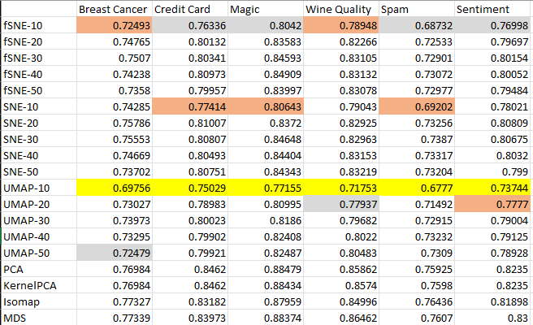
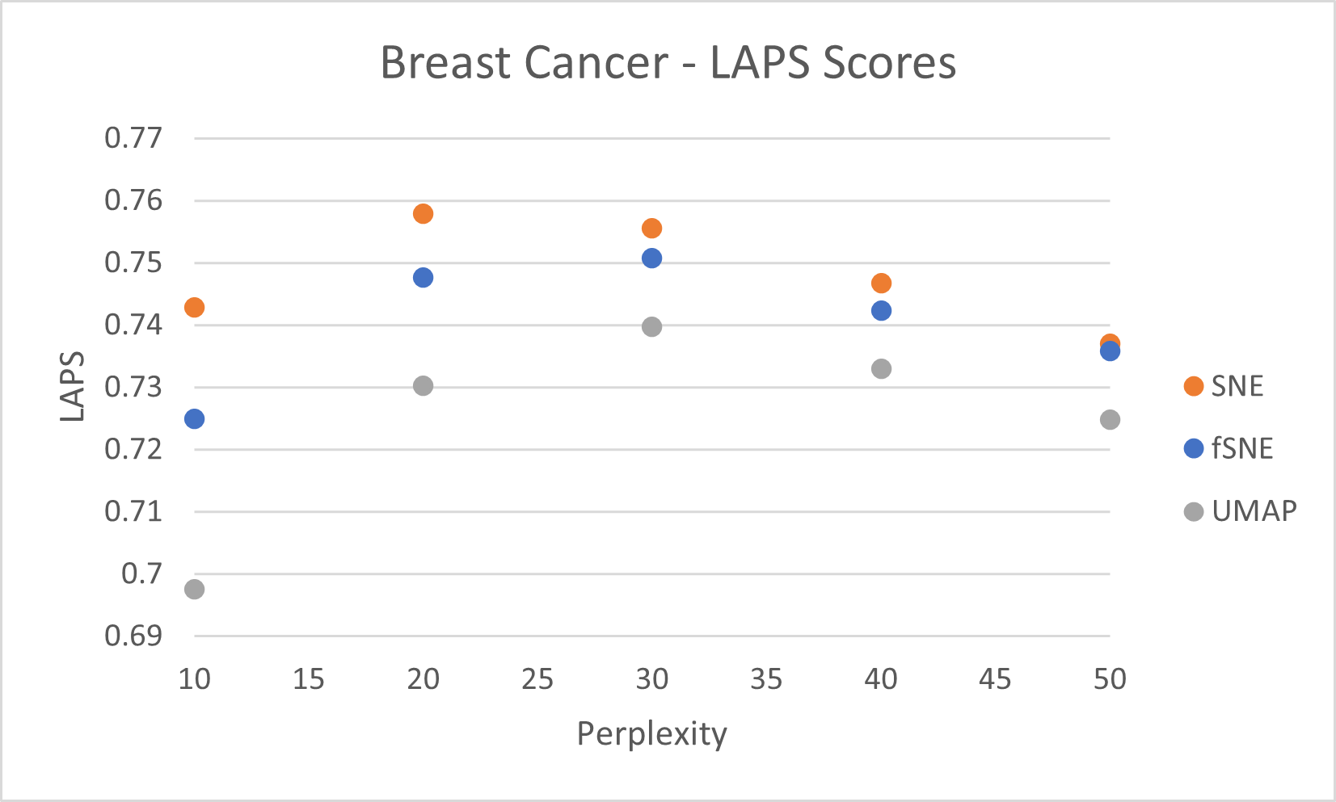

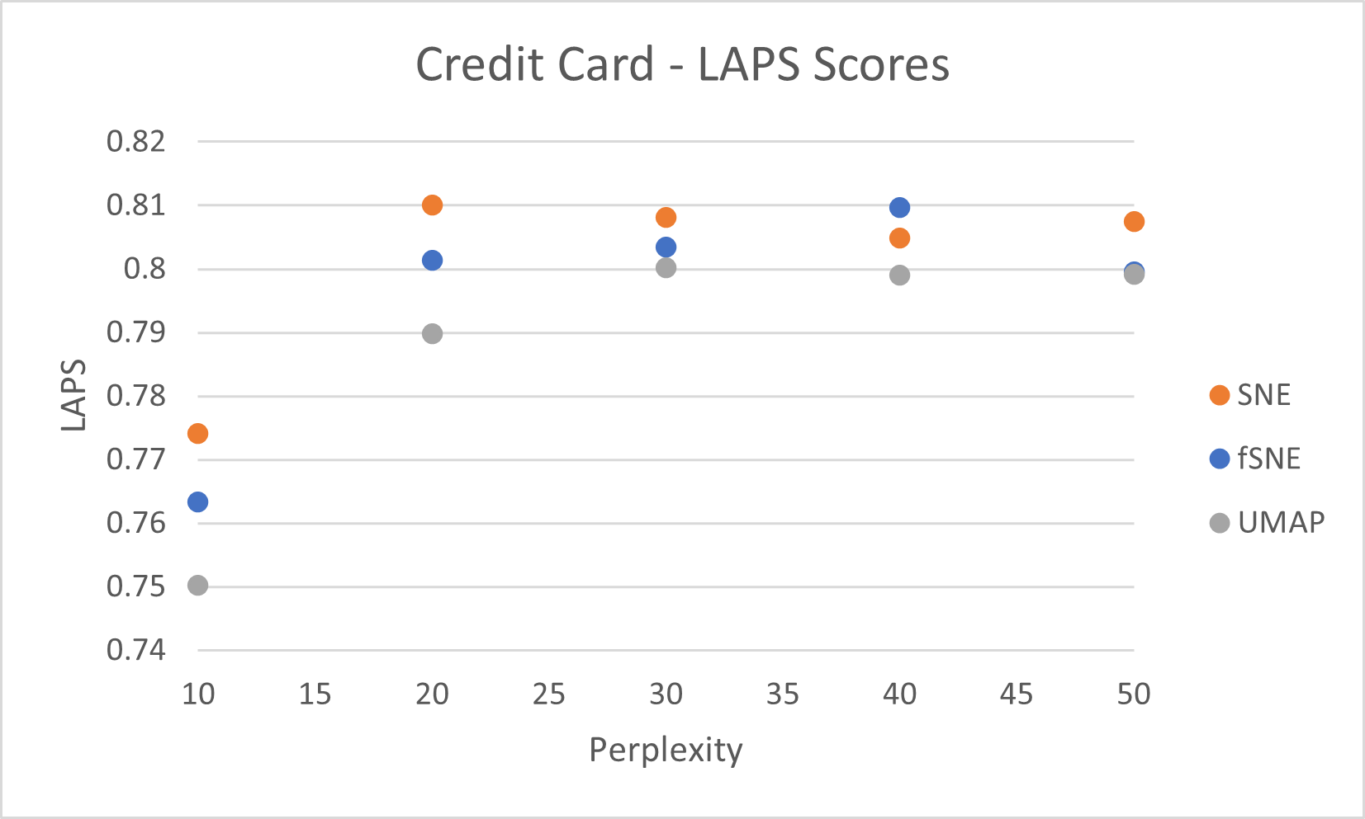
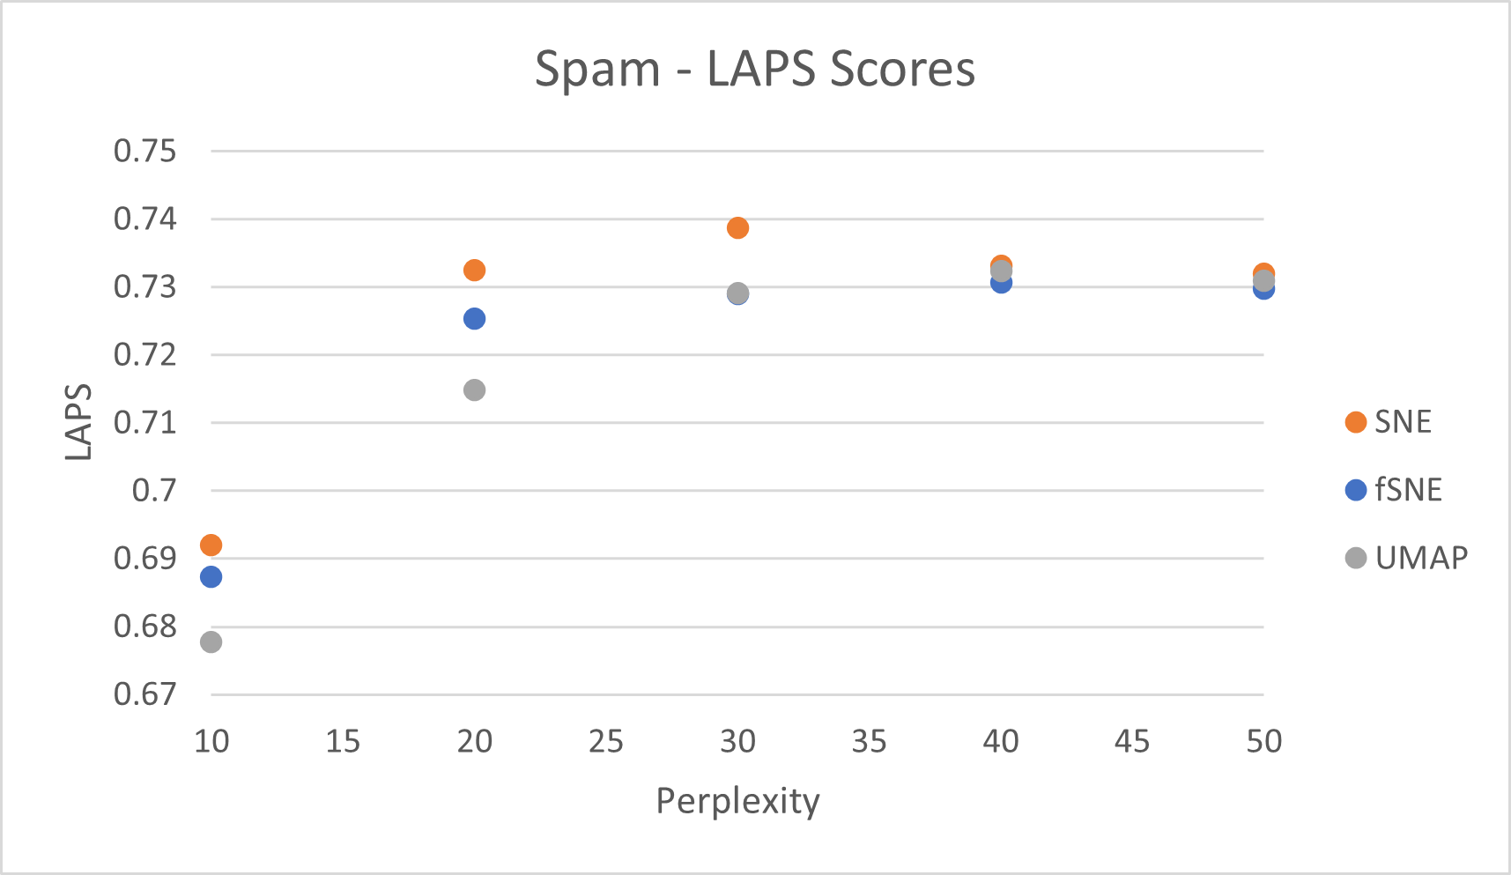

Focused Stochastic Neighbor Embedding - A dimension reduction algorithm
R. Baez Ramirez, University of Texas at El Paso; T. Lee, New Mexico State University; S. Kumar, New Mexico State University
Introduction
Conclusions
Dimensionality reduction algorithms reduce complexity in data; making computation cheaper, and making resulting models more interpretable.
Existing algorithms all differ in capabilities and effectiveness at preserving information. Complete preservation is impossible, so we focused on preserving local structure.
A new approach to further develop dimension reduction algorithms
The method shows promise as it improved the scores for SNE that focused on local structure without sacrificing representation in the global scale. Our method does not significantly improve SNE to perform better than other methods such as UMAP, but can be applied to such algorithms.
Future Activities
Methodology & Approach
Implementing our method to other dimension reduction algorithms.
Streamline getting the gradient
Test on stronger algorithms such as UMAP and tSNE
Test the resulting algorithms on larger datasets and on different types such as audio and images.
Our method builds on the original Stochastic Neighbor Embedding by Geoffrey Hinton and Sam Roweis^{[1]}, where the difference in asymmetric probabilities in the higher and low dimension space are minimized. The resulting algorithm will focus around a list of given points of interest and will be assigned a higher weight.
Separate KL Convergence into terms where the summations consider different connections between points of interest.
Add a weight parameter to terms that include points of interest.
Rederive gradient to implement in code and begin testing.
The metrics for the quality of the embeddings used are KNN accuracy and the LAPS and GAPS metrics developed by Aindrila Ghosh, et al. ^{[2]} to judge the local and preserved structure respectively. The metrics measure discrepancy, so lower scores means better representation.
The points of interests are 100 randomly sampled points from the data and are used for the LAPS scores.
The average between all LAPS scores are the final scores shown above.
LAPS metric checks for number of neighbors equal to perplexity
References
This work is funded by the National Science Foundation (NSF) award #OIA-1757207. Any opinions, findings, and conclusions or recommendations expressed in this material are those of the author(s) and do not necessarily reflect the views of the National Science Foundation.
[1] Hinton, G., & Roweis, S. (2002). Stochastic Neighbor Embedding. Advances in Neural Information Processing Systems, 15.
[2] Ghosh, A., Nashaat, M., Miller, J., & Quader, S. (2022). Interpretation of structural preservation in low-dimensional embeddings. IEEE Transactions on Knowledge and Data Engineering, 34(5), 2227–2240. https://doi.org/10.1109/tkde.2020.3005878
Results
As mentioned in the SNE paper, perplexity is the effective number of neighbors that affects the probability distribution used in the algorithm.
With lower perplexity, i.e. with a lower neighbor count and greater focus on local structure, fSNE performs better than SNE. As perplexity increases, as the metric includes more of the global structure, the difference is smaller.
Acknowledgements
This work was supported by the National Science Foundation (NSF) 1950121. Any opinions, findings, and conclusions or recommendations expressed in this material are those of the author(s) and do not necessarily reflect the views of the National Science Foundation.

