Slide 1
Cpt 6 – Combinational-Circuit Building Blocks
s
s
f
w
0
0
0
w
w
f
0
1
1
1
w
1
(a) Graphical symbol
(b) Truth table
w
w
0
0
s
f
s
w
1
w
f
1
(c) Sum-of-products circuit
(d) Circuit with transmission gates
Figure 6.1. A 2-to-1 multiplexer.
I - Design Concepts
Portions © Copyright 2009, S. Brown and Z Vranesic

Slide 2
s
0
s
1
s
1
s
0
f
w
0
00
0
0
w
0
w
1
01
f
0
1
w
1
w
2
10
1
0
w
w
3
11
w
2
1
1
3
(a) Graphic symbol
(b) Truth table
s
0
w
0
s
1
w
1
f
w
2
w
3
(c) Circuit
Figure 6.2. A 4-to-1 multiplexer.
I - Design Concepts
Portions © Copyright 2009, S. Brown and Z Vranesic

Slide 3

s
1
s
0
w
0
0
w
1
1
0
f
1
w
2
0
w
3
1
Figure 6.3. Using 2-to-1 multiplexers to build a 4-to-1 multiplexer.
I - Design Concepts
Portions © Copyright 2009, S. Brown and Z Vranesic

Slide 4
s
0
s
1
w
0
w
3
w
4
s
2
s
3
w
7
f
w
8
w
11
w
12
w
15
Figure 6.4. A 16-to-1 multiplexer.
I - Design Concepts
Portions © Copyright 2009, S. Brown and Z Vranesic

Slide 5
s
x
1
y
1
x
2
y
2
(a) A 2x2 crossbar switch
x
1
0
y
1
1
s
x
2
0
y
2
1
(b) Implementation using multiplexers
Figure 6.5. A practical application of multiplexers.
I - Design Concepts
Portions © Copyright 2009, S. Brown and Z Vranesic

Slide 6
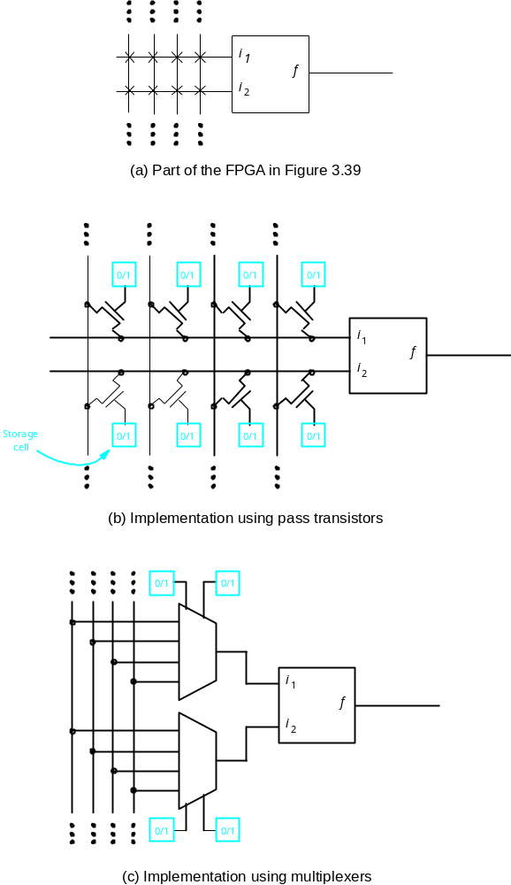
Figure 6.6. Implementing programmable switches in an FPGA.
I - Design Concepts
Portions © Copyright 2009, S. Brown and Z Vranesic

Slide 7
w
w
f
w
2
1
2
w
1
0
0
0
0
0
1
1
1
1
0
1
1
f
1
1
0
0
(a) Implementation using a 4-to-1 multiplexer
w
1
w
2
f
w
f
1
w
0
0
0
w
1
0
2
0
1
1
w
w
1
2
2
1
0
1
f
1
1
0
(b) Modified truth table
(c) Circuit
Figure 6.7. Synthesis of a logic function using multiplexers.
I - Design Concepts
Portions © Copyright 2009, S. Brown and Z Vranesic

Slide 8
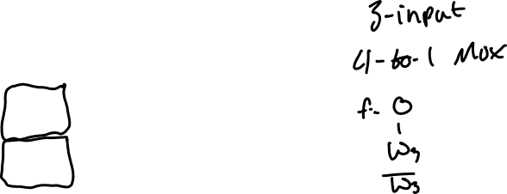
w
1
w
2
w
3
f
w
1
w
2
f
0
0
0
0
0
0
0
1
0
0
0
0
1
w
3
0
1
0
0
1
0
w
3
0
1
1
1
1
1
1
1
0
0
0
1
0
1
1
1
1
0
1
1
1
1
1
Figure 6.8. Implementation of the three-input majority function using a 4-to-1 multiplexer.
(a) Modified truth table
w
2
w
1
0
w
3
f
1
(b) Circuit
I - Design Concepts
Portions © Copyright 2009, S. Brown and Z Vranesic

Slide 9
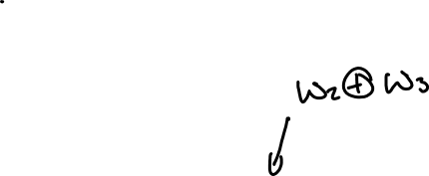
w
1
w
2
w
3
f
0
0
0
0
0
0
1
1
w
⊕
w
w
0
1
0
1
2
3
2
w
1
0
1
1
0
w
3
1
0
0
1
f
1
0
1
0
w
⊕
w
1
1
0
0
2
3
1
1
1
1
(a) Truth table
(b) Circuit
Figure 6.9. Three-input XOR implemented with 2-to-1 multiplexers.
I - Design Concepts
Portions © Copyright 2009, S. Brown and Z Vranesic

Slide 10
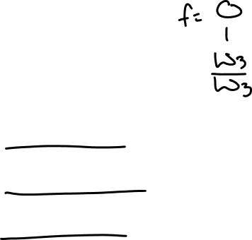
w
1
w
2
w
3
f
0
0
0
0
w
0
0
1
1
3
w
2
w
1
0
1
0
1
w
0
1
1
0
3
w
3
1
0
0
1
w
f
1
0
1
0
3
1
1
0
0
w
1
1
1
1
3
(a) Truth table
(b) Circuit
Figure 6.10. Three-input XOR function implemented with a 4-to-1 multiplexer.
I - Design Concepts
Portions © Copyright 2009, S. Brown and Z Vranesic

Slide 11
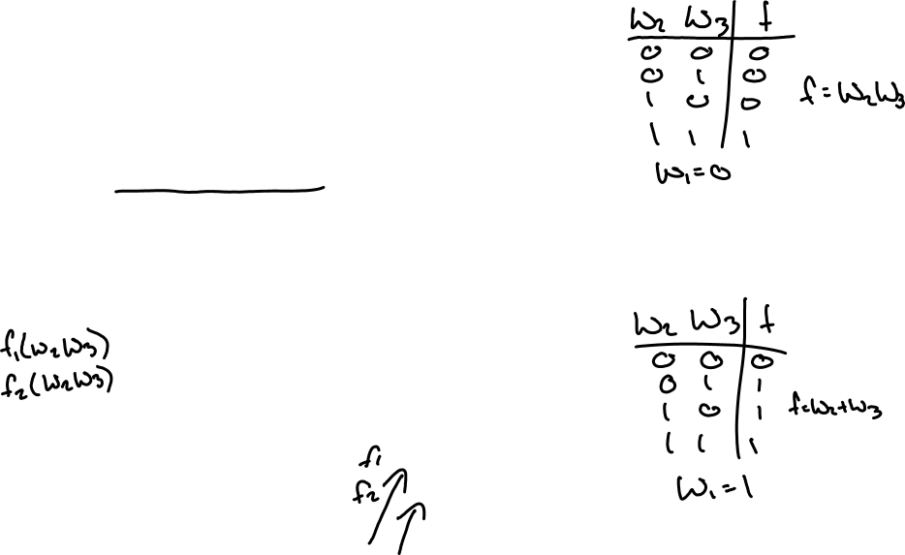
w
1
w
2
w
3
f
0
0
0
0
w
1
f
0
0
1
0
w
w
0
2
3
0
1
0
0
1
w
+
w
0
1
1
1
2
3
1
0
0
0
Figure 6.11. The three-input majority function implemented using a 2-to-1 multiplexer.
1
0
1
1
1
1
0
1
1
1
1
1
(b) Truth table
w
w
1
2
w
3
f
(b) Circuit
I - Design Concepts
Portions © Copyright 2009, S. Brown and Z Vranesic

Slide 12
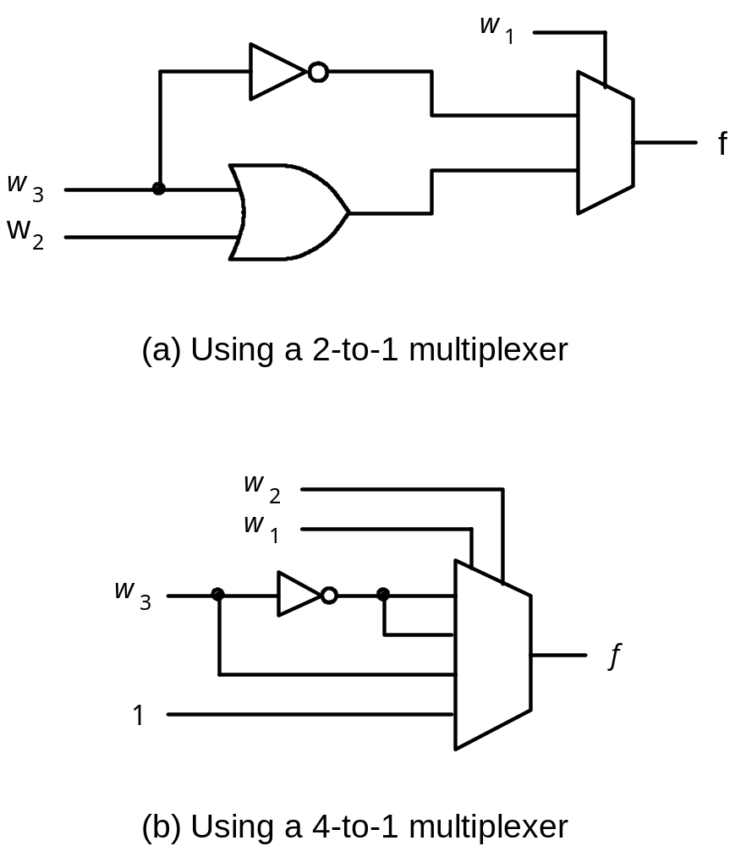
Figure 6.12. The circuits synthesized in Example 6.6.
I - Design Concepts
Portions © Copyright 2009, S. Brown and Z Vranesic

Slide 13
w
w
2
1
0
w
3
f
1
Figure 6.13. The circuit synthesized in Example 6.7
I - Design Concepts
Portions © Copyright 2009, S. Brown and Z Vranesic

Slide 14
w
1
0
f
w
w
1
2
f
w
3
f
w
1
Figure 6.14. Circuits synthesized in Example 6.8
w
4
(a) Using three 3-LUTs
w
2
0
w
1
f
f
w
w
2
3
w
4
(b) Using two 3-LUTs
I - Design Concepts
Portions © Copyright 2009, S. Brown and Z Vranesic

Slide 15
w
y
0
0
n
inputs
2
n
w
outputs
n
–
1
Enable
y
2
n
–
1
En
Figure 6.15. An n-to-2^{n} binary decoder.
I - Design Concepts
Portions © Copyright 2009, S. Brown and Z Vranesic

Slide 16
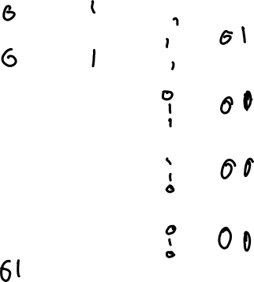
En
w
1
w
0
y
0
y
1
y
2
y
3
w
0
y
0
1
0
0
1
0
0
0
w
y
1
0
1
0
1
0
0
1
1
1
1
0
0
0
1
0
y
2
1
1
1
0
0
0
1
En
y
3
0
x
x
0
0
0
0
(a) Truth table
(b) Graphical symbol
Figure 6.16. A 2-to-4 decoder.
w
0
y
0
w
1
y
1
y
2
y
3
En
(c) Logic circuit
I - Design Concepts
Portions © Copyright 2009, S. Brown and Z Vranesic

Slide 17
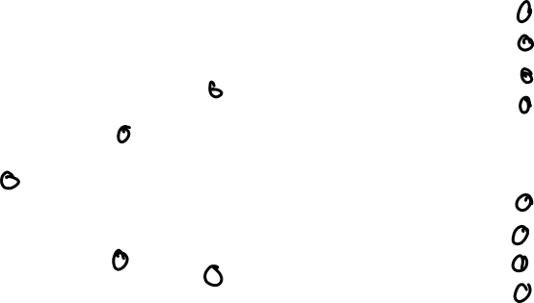
w
0
w
0
y
0
y
0
w
1
w
1
y
1
y
1
y
2
y
2
w
2
y
y
En
3
3
En
w
0
y
0
y
4
w
1
y
1
y
5
y
2
y
6
En
y
3
y
7
Figure 6.17. A 3-to-8 decoder using two 2-to-4 decoders.
I - Design Concepts
Portions © Copyright 2009, S. Brown and Z Vranesic

Slide 18

Figure 6.18. A 4-to-16 decoder built using a decoder tree.
w
w
y
y
0
0
0
0
w
w
y
y
1
1
1
1
y
y
2
2
En
y
y
3
3
w
y
y
0
0
4
w
y
y
1
1
5
y
y
w
2
6
2
w
y
En
y
y
0
0
3
7
w
w
y
3
1
1
y
2
En
En
y
w
y
y
3
0
0
8
w
y
y
1
1
9
y
y
2
10
En
y
y
3
11
w
y
y
12
0
0
w
y
y
13
1
1
y
y
2
14
En
y
y
3
15
I - Design Concepts
Portions © Copyright 2009, S. Brown and Z Vranesic

Slide 19

w
0
w
1
s
0
w
y
0
0
s
1
w
y
f
1
1
y
2
w
2
1
En
y
3
w
3
Figure 6.19. A 4-to-1 multiplexer built using a decoder.
I - Design Concepts
Portions © Copyright 2009, S. Brown and Z Vranesic

Slide 20
w
0
s
0
w
0
y
0
w
1
s
1
w
1
y
1
y
2
f
1
En
y
3
w
2
w
3
Figure 6.20. A 4-to-1 multiplexer built using a decoder and tri-state buffers.
I - Design Concepts
Portions © Copyright 2009, S. Brown and Z Vranesic

Slide 21
Sel
0
0/1
0/1
0/1
Sel
1
0/1
0/1
0/1
a
0
Sel
2
decoder
0/1
0/1
0/1
a
1
Address
m
-to-2
a
m
–
1
m
Sel
2
m
–
1
0/1
0/1
0/1
Figure 6.21. A 2^{m} x n read-only memory (ROM) block.
Read
Data
d
n
–
1
d
n
–
2
d
0
I - Design Concepts
Portions © Copyright 2009, S. Brown and Z Vranesic

Slide 22
w
0
y
0
2
n
n
inputs
outputs
y
n
–
1
w
2
n
–
1
Figure 6.22. A 2^{n}-to-n binary encoder.
I - Design Concepts
Portions © Copyright 2009, S. Brown and Z Vranesic

Slide 23
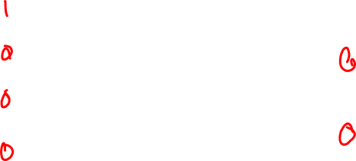
w
3
w
2
w
1
w
0
y
1
y
0
0
0
0
1
0
0
0
0
1
0
0
1
0
1
0
0
1
0
1
0
0
0
1
1
(a) Truth table
w
0
w
1
y
0
w
2
w
y
1
3
(b) Circuit
Figure 6.23. A 4-to-2 binary encoder.
I - Design Concepts
Portions © Copyright 2009, S. Brown and Z Vranesic

Slide 24
w
3
w
2
w
1
w
0
y
1
y
0
z
0
0
0
0
d
d
0
0
0
0
1
0
0
1
0
0
1
x
0
1
1
0
1
x
x
1
0
1
1
x
x
x
1
1
1
Figure 6.24. Truth table for a 4-to-2 priority encoder.
I - Design Concepts
Portions © Copyright 2009, S. Brown and Z Vranesic

Slide 25
a
a
w
b
0
c
f
b
w
1
w
d
g
Figure 6.25. A BCD-to-7-segment display code converter.
2
e
e
c
w
3
f
g
d
(a) Code converter
(b) 7-segment display
w
3
w
2
w
1
w
0
a
b
c
d
e
f
g
0
0
0
0
1
1
1
1
1
1
0
0
0
0
1
0
1
1
0
0
0
0
0
0
1
0
1
1
0
1
1
0
1
0
0
1
1
1
1
1
1
0
0
1
0
1
0
0
0
1
1
0
0
1
1
0
1
0
1
1
0
1
1
0
1
1
0
1
1
0
1
0
1
1
1
1
1
0
1
1
1
1
1
1
0
0
0
0
1
0
0
0
1
1
1
1
1
1
1
1
0
0
1
1
1
1
1
0
1
1
(c) Truth table
I - Design Concepts
Portions © Copyright 2009, S. Brown and Z Vranesic

Slide 26
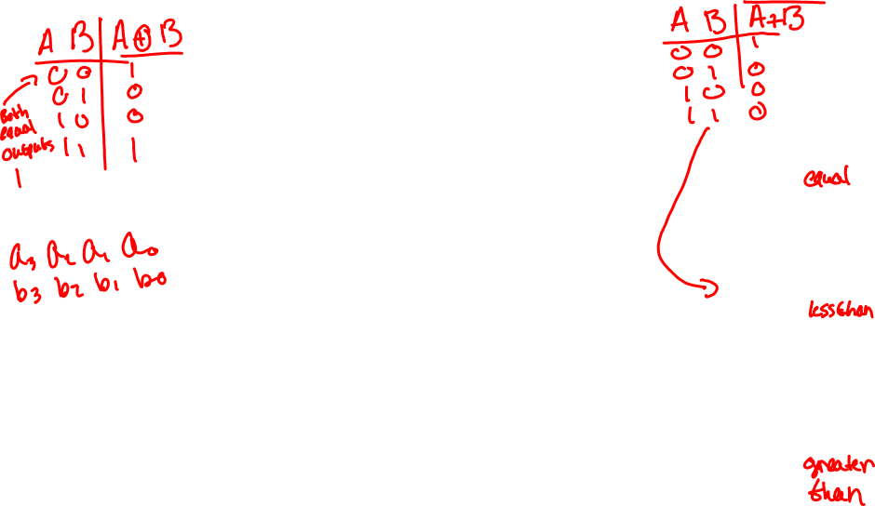
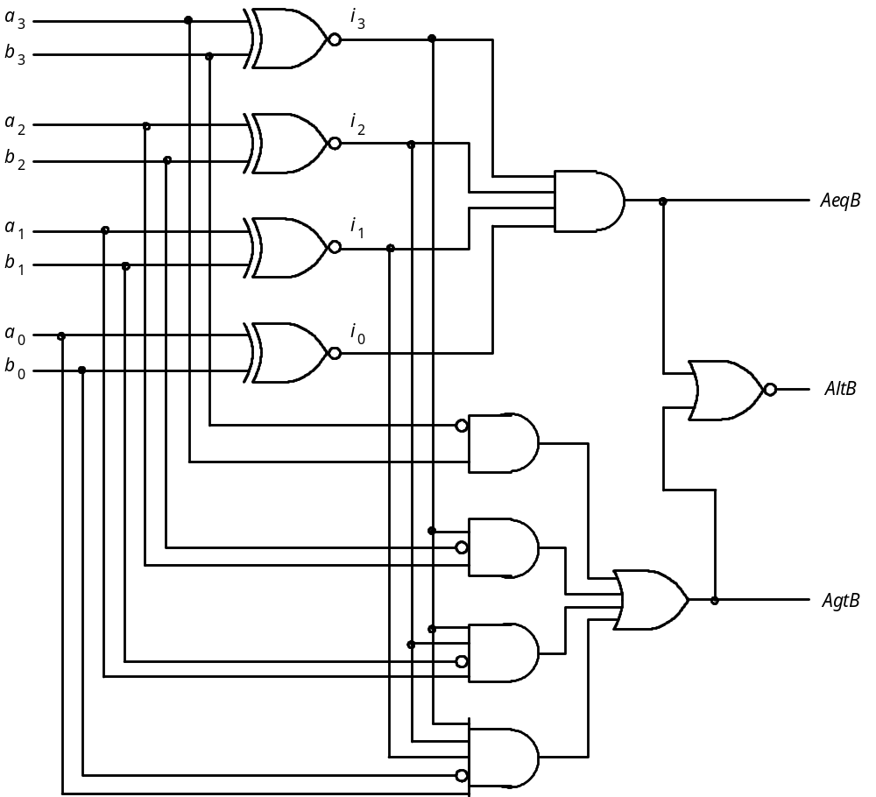
Figure 6.26. A four-bit comparator circuit.
I - Design Concepts
Portions © Copyright 2009, S. Brown and Z Vranesic

Slide 27
LIBRARY ieee ;
USE ieee.std_logic_1164.all ;
ENTITY mux2to1 IS
PORT ( w0, w1, s : IN STD_LOGIC ;
f : OUT STD_LOGIC ) ;
END mux2to1 ;
ARCHITECTURE Behavior OF mux2to1 IS
BEGIN
WITH s SELECT
f <= w0 WHEN '0',
w1 WHEN OTHERS ;
END Behavior ;
Figure 6.27. VHDL code for a A 2-to-1 multiplexer.
I - Design Concepts
Portions © Copyright 2009, S. Brown and Z Vranesic

Slide 28
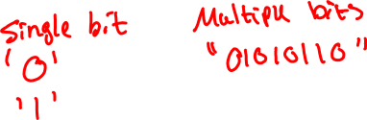
LIBRARY ieee ;
USE ieee.std_logic_1164.all ;
ENTITY mux4to1 IS
PORT ( w0, w1, w2, w3 : IN STD_LOGIC ;
s : IN STD_LOGIC_VECTOR(1 DOWNTO 0) ;
f : OUT STD_LOGIC ) ;
END mux4to1 ;
ARCHITECTURE Behavior OF mux4to1 IS
BEGIN
WITH s SELECT
f <= w0 WHEN "00",
w1 WHEN "01",
w2 WHEN "10",
w3 WHEN OTHERS ;
END Behavior ;
Figure 6.28. VHDL code for a 4-to-1 multiplexer (Part a).
I - Design Concepts
Portions © Copyright 2009, S. Brown and Z Vranesic

Slide 29
LIBRARY ieee ;
USE ieee.std_logic_1164.all ;
PACKAGE mux4to1_package IS
COMPONENT mux4to1
PORT ( w0, w1, w2, w3 : IN STD_LOGIC ;
s : IN STD_LOGIC_VECTOR(1 DOWNTO 0) ;
f : OUT STD_LOGIC ) ;
END COMPONENT ;
END mux4to1_package ;
Figure 6.28. VHDL code for a 4-to-1 multiplexer (Part b).
I - Design Concepts
Portions © Copyright 2009, S. Brown and Z Vranesic

Slide 30
1 LIBRARY ieee ;
2 USE ieee.std_logic_1164.all ;
2 LIBRARY work ;
4 USE work.mux4to1_package.all ;
5 ENTITY mux16to1 IS
6 PORT ( w : IN STD_LOGIC_VECTOR(0 TO 15) ;
7 s : IN STD_LOGIC_VECTOR(3 DOWNTO 0) ;
8 f : OUT STD_LOGIC ) ;
9 END mux16to1 ;
10 ARCHITECTURE Structure OF mux16to1 IS
11 SIGNAL m : STD_LOGIC_VECTOR(0 TO 3) ;
12 BEGIN
13 Mux1: mux4to1 PORT MAP ( w(0), w(1), w(2), w(3), s(1 DOWNTO 0), m(0) ) ;
14 Mux2: mux4to1 PORT MAP ( w(4), w(5), w(6), w(7), s(1 DOWNTO 0), m(1) ) ;
15 Mux3: mux4to1 PORT MAP ( w(8), w(9), w(10), w(11), s(1 DOWNTO 0), m(2) ) ;
16 Mux4: mux4to1 PORT MAP ( w(12), w(13), w(14), w(15), s(1 DOWNTO 0), m(3) ) ;
17 Mux5: mux4to1 PORT MAP ( m(0), m(1), m(2), m(3), s(3 DOWNTO 2), f ) ;
18 END Structure ;
Figure 6.29. Hierarchical code for a 16-to-1 multiplexer.
I - Design Concepts
Portions © Copyright 2009, S. Brown and Z Vranesic

Slide 31
LIBRARY ieee ;
USE ieee.std_logic_1164.all ;
ENTITY dec2to4 IS
PORT ( w : IN STD_LOGIC_VECTOR(1 DOWNTO 0) ;
En : IN STD_LOGIC ;
y : OUT STD_LOGIC_VECTOR(0 TO 3) ) ;
END dec2to4 ;
ARCHITECTURE Behavior OF dec2to4 IS
SIGNAL Enw : STD_LOGIC_VECTOR(2 DOWNTO 0) ;
BEGIN
Enw <= En & w ;
WITH Enw SELECT
y <= "1000" WHEN "100",
"0100" WHEN "101",
"0010" WHEN "110",
"0001" WHEN "111",
"0000" WHEN OTHERS ;
END Behavior ;
Figure 6.30. VHDL code for a 2-to-4 binary decoder.
I - Design Concepts
Portions © Copyright 2009, S. Brown and Z Vranesic

Slide 32
I - Design Concepts
Portions © Copyright 2009, S. Brown and Z Vranesic

Slide 33
LIBRARY ieee ;
USE ieee.std_logic_1164.all ;
ENTITY mux2to1 IS
PORT ( w0, w1, s : IN STD_LOGIC ;
f : OUT STD_LOGIC ) ;
END mux2to1 ;
ARCHITECTURE Behavior OF mux2to1 IS
BEGIN
f <= w0 WHEN s = '0' ELSE w1 ;
END Behavior ;
Figure 6.31. Specification of a 2-to-1 multiplexer using a conditional signal assignment.
I - Design Concepts
Portions © Copyright 2009, S. Brown and Z Vranesic

Slide 34
LIBRARY ieee ;
USE ieee.std_logic_1164.all ;
ENTITY priority IS
PORT ( w : IN STD_LOGIC_VECTOR(3 DOWNTO 0) ;
y : OUT STD_LOGIC_VECTOR(1 DOWNTO 0) ;
z : OUT STD_LOGIC ) ;
END priority ;
ARCHITECTURE Behavior OF priority IS
BEGIN
y <= "11" WHEN w(3) = '1' ELSE
"10" WHEN w(2) = '1' ELSE
"01" WHEN w(1) = '1' ELSE
"00" ;
z <= '0' WHEN w = "0000" ELSE '1' ;
END Behavior ;
Figure 6.32. VHDL code for a priority encoder.
I - Design Concepts
Portions © Copyright 2009, S. Brown and Z Vranesic

Slide 35
LIBRARY ieee ;
USE ieee.std_logic_1164.all ;
ENTITY priority IS
PORT ( w : IN STD_LOGIC_VECTOR(3 DOWNTO 0) ;
y : OUT STD_LOGIC_VECTOR(1 DOWNTO 0) ;
z : OUT STD_LOGIC ) ;
END priority ;
ARCHITECTURE Behavior OF priority IS
BEGIN
WITH w SELECT
y <= "00" WHEN "0001",
"01" WHEN "0010",
"01" WHEN "0011",
"10" WHEN "0100",
"10" WHEN "0101",
"10" WHEN "0110",
"10" WHEN "0111",
"11" WHEN OTHERS ;
WITH w SELECT
z <= '0' WHEN "0000",
'1' WHEN OTHERS ;
END Behavior ;
Figure 6.33. Less efficient code for a priority encoder.
I - Design Concepts
Portions © Copyright 2009, S. Brown and Z Vranesic

Slide 36
LIBRARY ieee ;
USE ieee.std_logic_1164.all ;
USE ieee.std_logic_unsigned.all ;
ENTITY compare IS
PORT ( A, B : IN STD_LOGIC_VECTOR(3 DOWNTO 0) ;
AeqB, AgtB, AltB : OUT STD_LOGIC ) ;
END compare ;
ARCHITECTURE Behavior OF compare IS
BEGIN
AeqB <= '1' WHEN A = B ELSE '0' ;
AgtB <= '1' WHEN A > B ELSE '0' ;
AltB <= '1' WHEN A < B ELSE '0' ;
END Behavior ;
Figure 6.34. VHDL code for a four-bit comparator.
I - Design Concepts
Portions © Copyright 2009, S. Brown and Z Vranesic

Slide 37
LIBRARY ieee ;
USE ieee.std_logic_1164.all ;
USE ieee.std_logic_arith.all ;
ENTITY compare IS
PORT ( A, B : IN SIGNED(3 DOWNTO 0) ;
AeqB, AgtB, AltB : OUT STD_LOGIC ) ;
END compare ;
ARCHITECTURE Behavior OF compare IS
BEGIN
AeqB <= '1' WHEN A = B ELSE '0' ;
AgtB <= '1' WHEN A > B ELSE '0' ;
AltB <= '1' WHEN A < B ELSE '0' ;
END Behavior ;
Figure 6.35. The code from Figure 6.34 for signed numbers.
I - Design Concepts
Portions © Copyright 2009, S. Brown and Z Vranesic

Slide 38
LIBRARY ieee ;
USE ieee.std_logic_1164.all ;
USE work.mux4to1_package.all ;
ENTITY mux16to1 IS
PORT ( w : IN STD_LOGIC_VECTOR(0 TO 15) ;
s : IN STD_LOGIC_VECTOR(3 DOWNTO 0) ;
f : OUT STD_LOGIC ) ;
END mux16to1 ;
ARCHITECTURE Structure OF mux16to1 IS
SIGNAL m : STD_LOGIC_VECTOR(0 TO 3) ;
BEGIN
G1: FOR i IN 0 TO 3 GENERATE
Muxes: mux4to1 PORT MAP (
w(4*i), w(4*i+1), w(4*i+2), w(4*i+3), s(1 DOWNTO 0), m(i) ) ;
END GENERATE ;
Mux5: mux4to1 PORT MAP ( m(0), m(1), m(2), m(3), s(3 DOWNTO 2), f ) ;
END Structure ;
Figure 6.36. Code for a 16-to-1 multiplexer using a generate statement.
I - Design Concepts
Portions © Copyright 2009, S. Brown and Z Vranesic

Slide 39
LIBRARY ieee ;
USE ieee.std_logic_1164.all ;
ENTITY dec4to16 IS
PORT ( w : IN STD_LOGIC_VECTOR(3 DOWNTO 0) ;
En : IN STD_LOGIC ;
y : OUT STD_LOGIC_VECTOR(0 TO 15) ) ;
END dec4to16 ;
ARCHITECTURE Structure OF dec4to16 IS
COMPONENT dec2to4
PORT ( w : IN STD_LOGIC_VECTOR(1 DOWNTO 0) ;
En : IN STD_LOGIC ;
y : OUT STD_LOGIC_VECTOR(0 TO 3) ) ;
END COMPONENT ;
SIGNAL m : STD_LOGIC_VECTOR(0 TO 3) ;
BEGIN
G1: FOR i IN 0 TO 3 GENERATE
Dec_ri: dec2to4 PORT MAP ( w(1 DOWNTO 0), m(i), y(4*i TO 4*i+3) );
G2: IF i=3 GENERATE
Dec_left: dec2to4 PORT MAP ( w(i DOWNTO i-1), En, m ) ;
END GENERATE ;
END GENERATE ;
END Structure ;
Figure 6.37. Hierarchical code for a 4-to-16 binary decoder.
I - Design Concepts
Portions © Copyright 2009, S. Brown and Z Vranesic

Slide 40
LIBRARY ieee ;
USE ieee.std_logic_1164.all ;
ENTITY mux2to1 IS
PORT ( w0, w1, s : IN STD_LOGIC ;
f : OUT STD_LOGIC ) ;
END mux2to1 ;
ARCHITECTURE Behavior OF mux2to1 IS
BEGIN
PROCESS ( w0, w1, s )
BEGIN
IF s = '0' THEN
f <= w0 ;
ELSE
f <= w1 ;
END IF ;
END PROCESS ;
END Behavior ;
Figure 6.38. A 2-to-1 multiplexer specified using an if-then-else statement
I - Design Concepts
Portions © Copyright 2009, S. Brown and Z Vranesic

Slide 41
LIBRARY ieee ;
USE ieee.std_logic_1164.all ;
ENTITY mux2to1 IS
PORT ( w0, w1, s : IN STD_LOGIC ;
f : OUT STD_LOGIC ) ;
END mux2to1 ;
ARCHITECTURE Behavior OF mux2to1 IS
BEGIN
PROCESS ( w0, w1, s )
BEGIN
f <= w0 ;
IF s = '1' THEN
f <= w1 ;
END IF ;
END PROCESS ;
END Behavior ;
Figure 6.39. Alternative code for a 2-to-1 multiplexer using an if-then-else statement.
I - Design Concepts
Portions © Copyright 2009, S. Brown and Z Vranesic

Slide 42
LIBRARY ieee ;
USE ieee.std_logic_1164.all ;
ENTITY priority IS
PORT ( w : IN STD_LOGIC_VECTOR(3 DOWNTO 0) ;
y : OUT STD_LOGIC_VECTOR(1 DOWNTO 0) ;
z : OUT STD_LOGIC ) ;
END priority ;
ARCHITECTURE Behavior OF priority IS
BEGIN
PROCESS ( w )
BEGIN
IF w(3) = '1' THEN
y <= "11" ;
ELSIF w(2) = '1' THEN
y <= "10" ;
ELSIF w(1) = '1' THEN
y <= "01" ;
ELSE
y <= "00" ;
END IF ;
END PROCESS ;
z <= '0' WHEN w = "0000" ELSE '1' ;
END Behavior ;
Figure 6.40. A priority encoder specified using the if-then-else statement.
I - Design Concepts
Portions © Copyright 2009, S. Brown and Z Vranesic

Slide 43
LIBRARY ieee ;
USE ieee.std_logic_1164.all ;
ENTITY priority IS
PORT ( w : IN STD_LOGIC_VECTOR(3 DOWNTO 0) ;
y : OUT STD_LOGIC_VECTOR(1 DOWNTO 0) ;
z : OUT STD_LOGIC ) ;
END priority ;
ARCHITECTURE Behavior OF priority IS
BEGIN
PROCESS ( w )
BEGIN
y <= "00" ;
IF w(1) = '1' THEN y <= "01" ; END IF ;
IF w(2) = '1' THEN y <= "10" ; END IF ;
IF w(3) = '1' THEN y <= "11" ; END IF ;
z <= '1' ;
IF w = "0000" THEN z <= '0' ; END IF ;
END PROCESS ;
END Behavior ;
Figure 6.41. Alternative code for the priority encoder.
I - Design Concepts
Portions © Copyright 2009, S. Brown and Z Vranesic

Slide 44
LIBRARY ieee ;
USE ieee.std_logic_1164.all ;
ENTITY compare1 IS
PORT ( A, B : IN STD_LOGIC ;
AeqB : OUT STD_LOGIC ) ;
END compare1 ;
ARCHITECTURE Behavior OF compare1 IS
BEGIN
PROCESS ( A, B )
BEGIN
AeqB <= '0' ;
IF A = B THEN
AeqB <= '1' ;
END IF ;
END PROCESS ;
END Behavior ;
Figure 6.42. Code for a one-bit equality comparator.
I - Design Concepts
Portions © Copyright 2009, S. Brown and Z Vranesic

Slide 45
LIBRARY ieee ;
USE ieee.std_logic_1164.all ;
ENTITY implied IS
PORT ( A, B : IN STD_LOGIC ;
AeqB : OUT STD_LOGIC ) ;
END implied ;
ARCHITECTURE Behavior OF implied IS
BEGIN
PROCESS ( A, B )
BEGIN
IF A = B THEN
AeqB <= '1' ;
END IF ;
END PROCESS ;
END Behavior ;
Figure 6.43. An example of code that results in implied memory.
I - Design Concepts
Portions © Copyright 2009, S. Brown and Z Vranesic

Slide 46
A
B
AeqB
Figure 6.44. The circuit generated from the code in Figure 6.43.
I - Design Concepts
Portions © Copyright 2009, S. Brown and Z Vranesic

Slide 47
LIBRARY ieee ;
USE ieee.std_logic_1164.all ;
ENTITY mux2to1 IS
PORT ( w0, w1, s : IN STD_LOGIC ;
f : OUT STD_LOGIC ) ;
END mux2to1 ;
ARCHITECTURE Behavior OF mux2to1 IS
BEGIN
PROCESS ( w0, w1, s )
BEGIN
CASE s IS
WHEN '0' =>
f <= w0 ;
WHEN OTHERS =>
f <= w1 ;
END CASE ;
END PROCESS ;
END Behavior ;
Figure 6.45. A case statement that represents a 2-to-1 multiplexer.
I - Design Concepts
Portions © Copyright 2009, S. Brown and Z Vranesic

Slide 48
LIBRARY ieee ;
USE ieee.std_logic_1164.all ;
ENTITY dec2to4 IS
PORT ( w : IN STD_LOGIC_VECTOR(1 DOWNTO 0) ;
En : IN STD_LOGIC ;
y : OUT STD_LOGIC_VECTOR(0 TO 3) ) ;
END dec2to4 ;
ARCHITECTURE Behavior OF dec2to4 IS
BEGIN
PROCESS ( w, En )
BEGIN
IF En = '1' THEN
CASE w IS
WHEN "00" => y <= "1000" ;
WHEN "01" => y <= "0100" ;
WHEN "10" => y <= "0010" ;
WHEN OTHERS => y <= "0001" ;
END CASE ;
ELSE
y <= "0000" ;
END IF ;
END PROCESS ;
END Behavior ;
Figure 6.46. A process statement that describes a 2-to-4 binary decoder.
I - Design Concepts
Portions © Copyright 2009, S. Brown and Z Vranesic

Slide 49
LIBRARY ieee ;
USE ieee.std_logic_1164.all ;
ENTITY seg7 IS
PORT ( bcd : IN STD_LOGIC_VECTOR(3 DOWNTO 0) ;
leds : OUT STD_LOGIC_VECTOR(1 TO 7) ) ;
END seg7 ;
ARCHITECTURE Behavior OF seg7 IS
BEGIN
PROCESS ( bcd )
BEGIN
CASE bcd IS -- abcdefg
WHEN "0000" => leds <= "1111110" ;
WHEN "0001" => leds <= "0110000" ;
WHEN "0010" => leds <= "1101101" ;
WHEN "0011" => leds <= "1111001" ;
WHEN "0100" => leds <= "0110011" ;
WHEN "0101" => leds <= "1011011" ;
WHEN "0110" => leds <= "1011111" ;
WHEN "0111" => leds <= "1110000" ;
WHEN "1000" => leds <= "1111111" ;
WHEN "1001" => leds <= "1110011" ;
WHEN OTHERS => leds <= "-------" ;
END CASE ;
END PROCESS ;
END Behavior ;
Figure 6.47. Code that represents a BCD-to-7-segment decoder.
I - Design Concepts
Portions © Copyright 2009, S. Brown and Z Vranesic

Slide 50
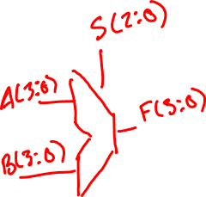
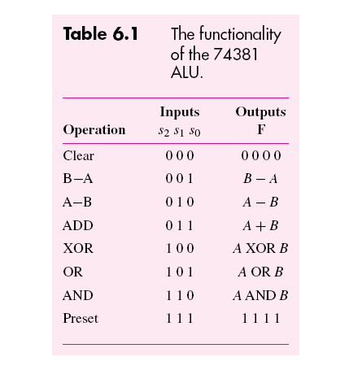
I - Design Concepts
Portions © Copyright 2009, S. Brown and Z Vranesic

Slide 51
LIBRARY ieee ;
USE ieee.std_logic_1164.all ;
USE ieee.std_logic_unsigned.all ;
ENTITY alu IS
PORT ( s : IN STD_LOGIC_VECTOR(2 DOWNTO 0) ;
A, B : IN STD_LOGIC_VECTOR(3 DOWNTO 0) ;
F : OUT STD_LOGIC_VECTOR(3 DOWNTO 0) ) ;
END alu ;
ARCHITECTURE Behavior OF alu IS
BEGIN
PROCESS ( s, A, B )
BEGIN
CASE s IS
WHEN "000" =>
F <= "0000" ;
WHEN "001" =>
F <= B - A ;
WHEN "010" =>
F <= A - B ;
WHEN "011" =>
F <= A + B ;
WHEN "100" =>
F <= A XOR B ;
WHEN "101" =>
F <= A OR B ;
WHEN "110" =>
F <= A AND B ;
WHEN OTHERS =>
F <= "1111" ;
END CASE ;
END PROCESS ;
END Behavior ;
Figure 6.48. Code that represents the functionality of the 74381 ALU chip.
I - Design Concepts
Portions © Copyright 2009, S. Brown and Z Vranesic

Slide 52
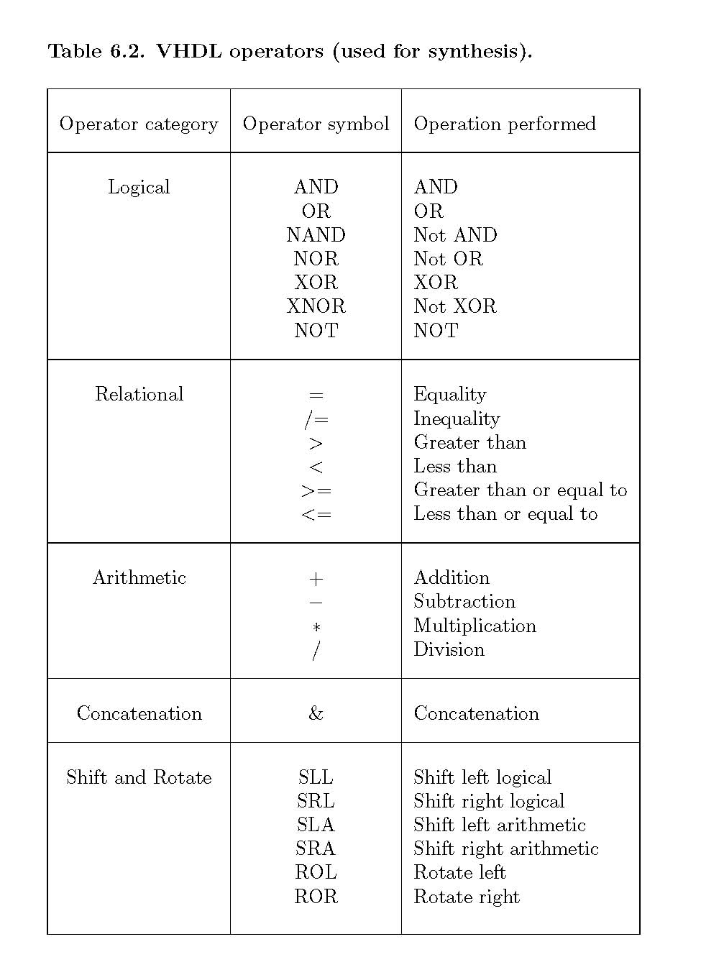
Table 6.2. VHDL operators (used for synthesis).
I - Design Concepts
Portions © Copyright 2009, S. Brown and Z Vranesic

Slide 53
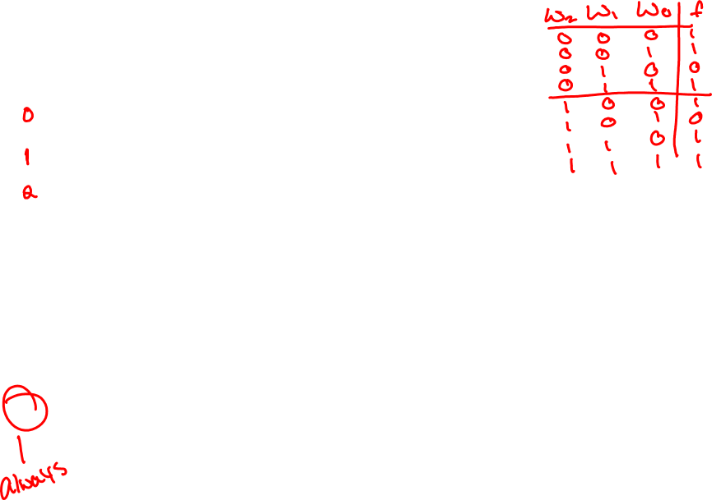
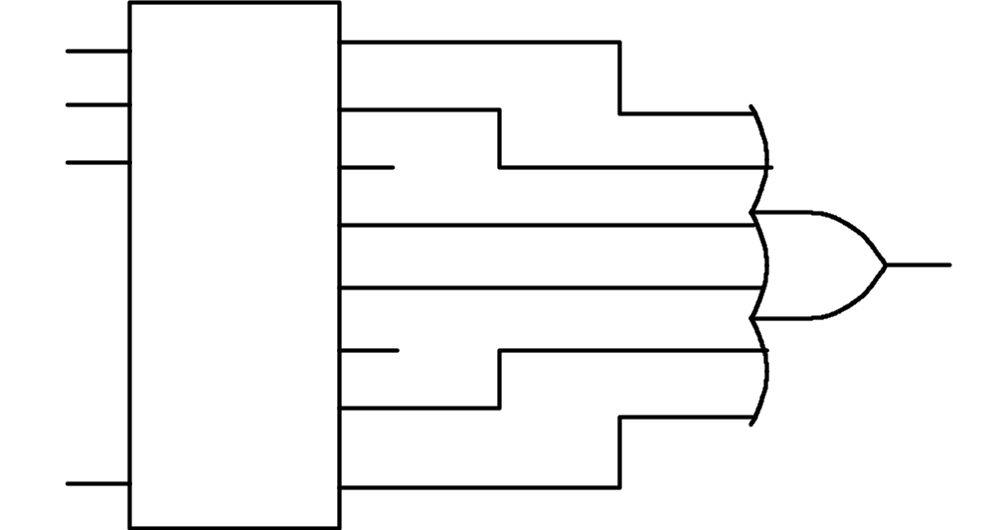
w₃
w₀
y₀
w₂
w₁
y₁
w₁
w₂
y₂
y₃
y₄
y₅
y₆
1
En
y₇
Figure 6.49. Circuit for Example 6.25.
I - Design Concepts
Portions © Copyright 2009, S. Brown and Z Vranesic

Slide 54
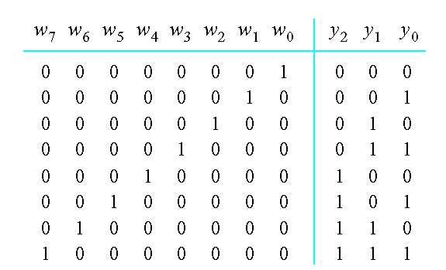
Figure 6.50. Truth table for an 8-to-3 binary encoder.
I - Design Concepts
Portions © Copyright 2009, S. Brown and Z Vranesic

Slide 55
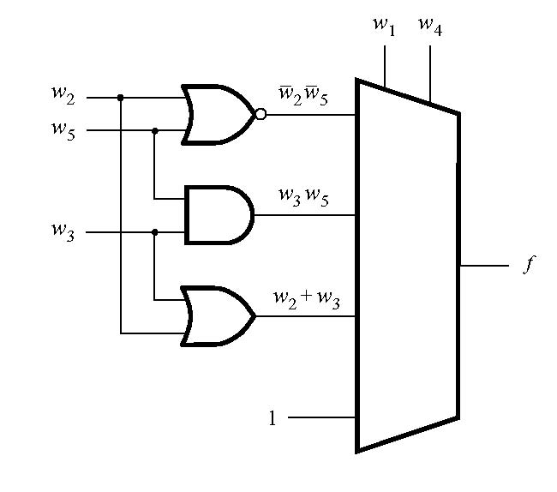
Figure 6.51. Circuit for Example 6.27.
I - Design Concepts
Portions © Copyright 2009, S. Brown and Z Vranesic

Slide 56
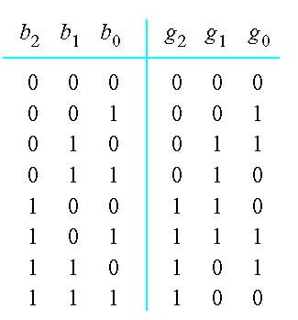
Figure 6.52. Binary to Gray code conversion.
I - Design Concepts
Portions © Copyright 2009, S. Brown and Z Vranesic

Slide 57
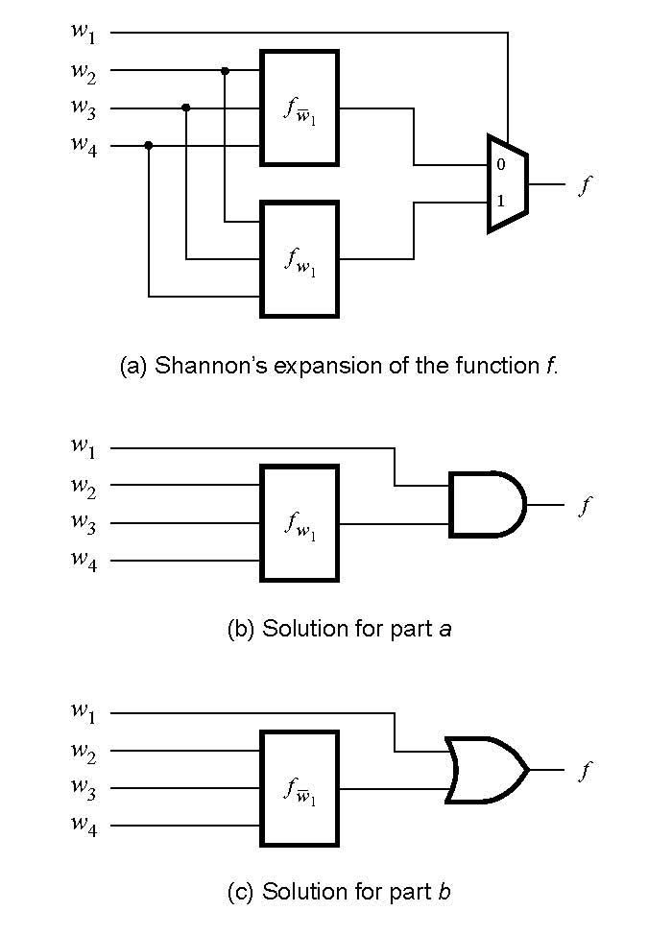
Figure 6.53. Circuits for Example 6.29.
I - Design Concepts
Portions © Copyright 2009, S. Brown and Z Vranesic

Slide 58
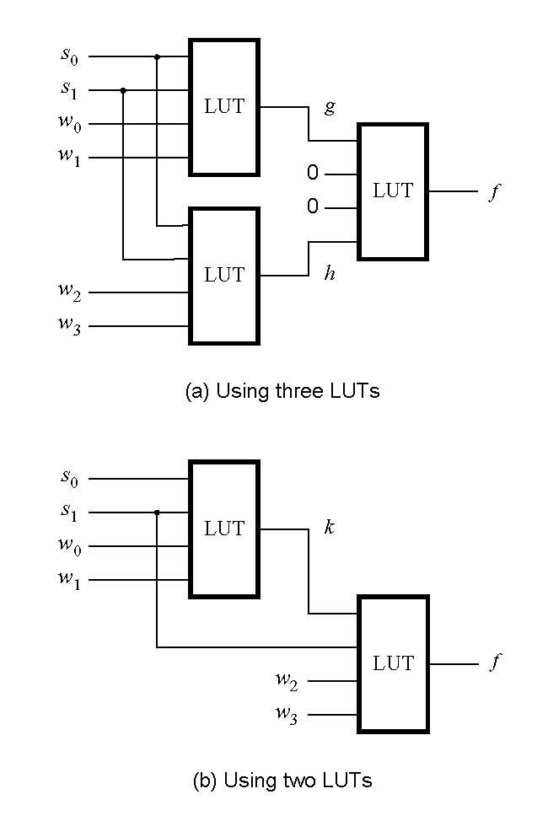
Figure 6.54. Circuits for Example 6.30.
I - Design Concepts
Portions © Copyright 2009, S. Brown and Z Vranesic

Slide 59
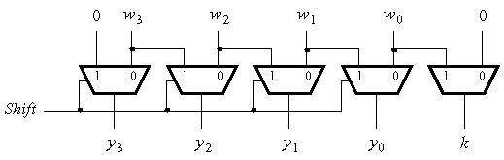
Figure 6.55. A shifter circuit.
I - Design Concepts
Portions © Copyright 2009, S. Brown and Z Vranesic

Slide 60
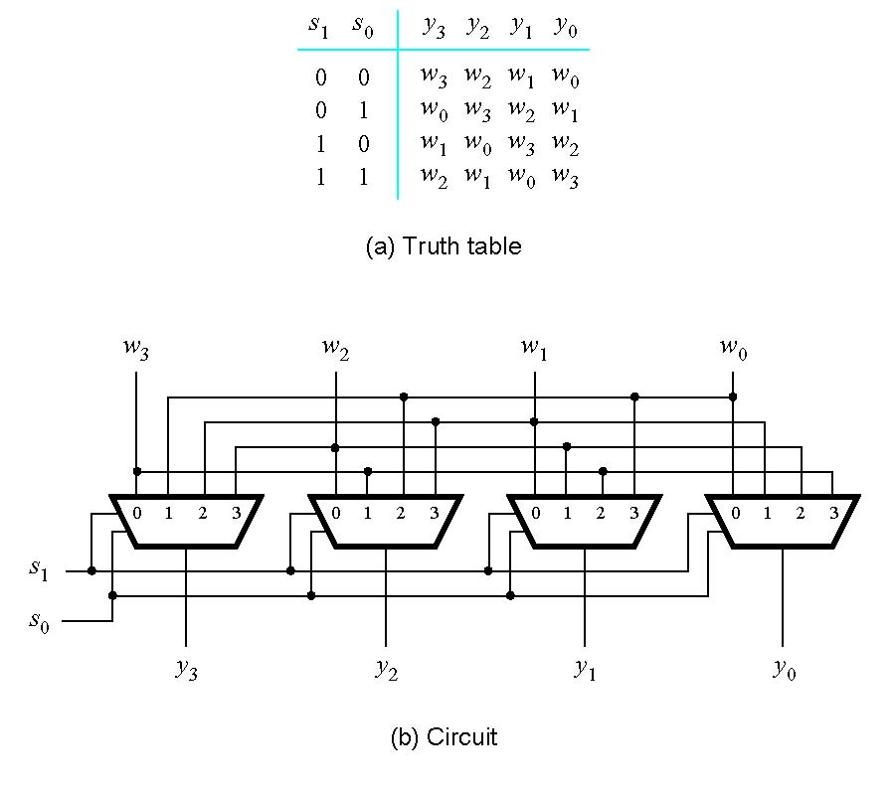
Figure 6.56. A barrel shifter circuit.
I - Design Concepts
Portions © Copyright 2009, S. Brown and Z Vranesic

Slide 61
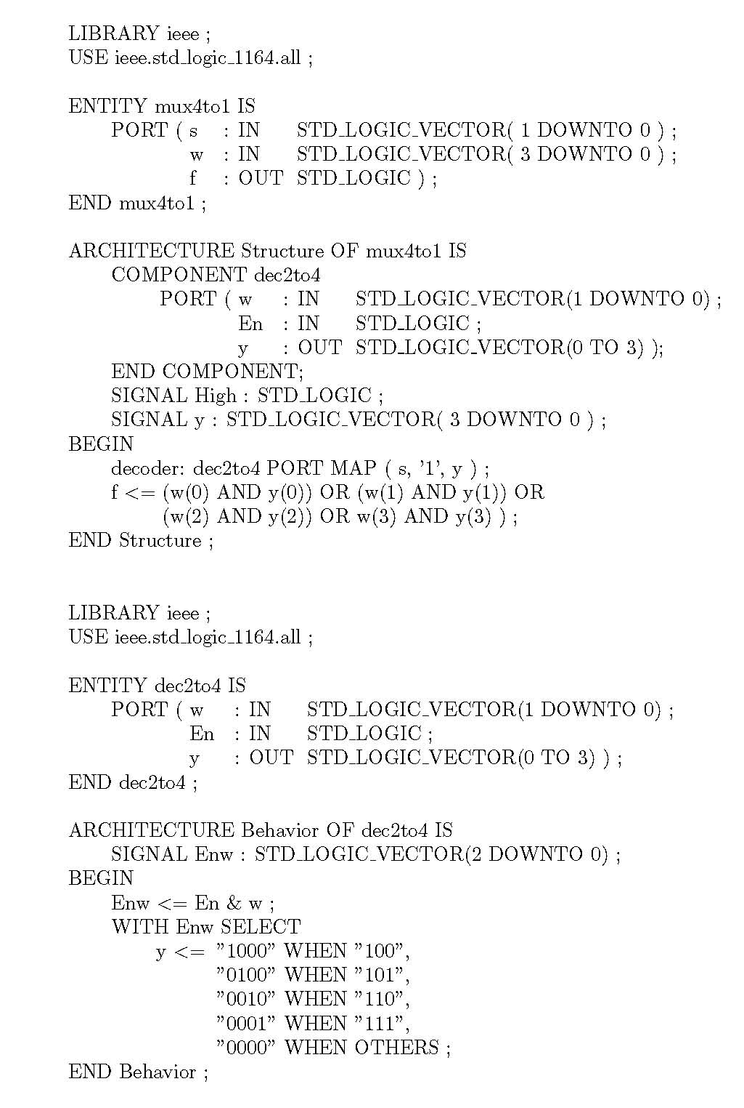
Figure 6.57. VHDL code for Example 6.38.
I - Design Concepts
Portions © Copyright 2009, S. Brown and Z Vranesic

Slide 62
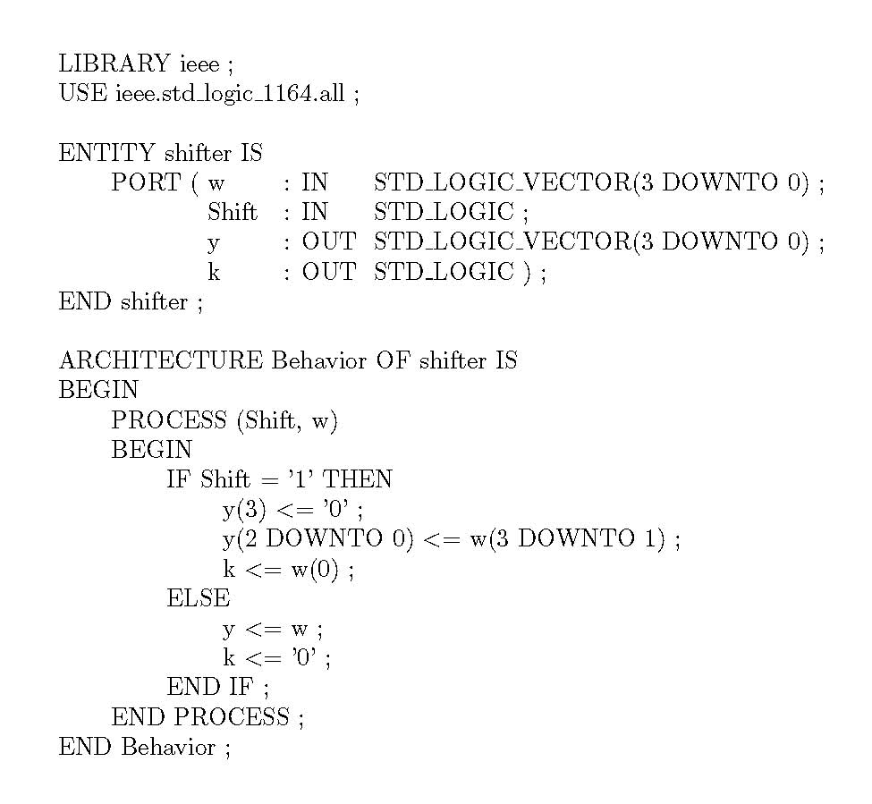
Figure 6.58. Structural VHDL code that specifies the shifter circuit in Figure 6.55.
I - Design Concepts
Portions © Copyright 2009, S. Brown and Z Vranesic

Slide 63
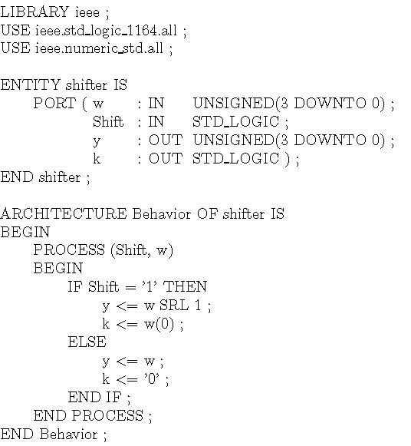
Figure 6.59. Behavioral VHDL code that specifies the shifter circuit in Figure 6.55.
I - Design Concepts
Portions © Copyright 2009, S. Brown and Z Vranesic

Slide 64
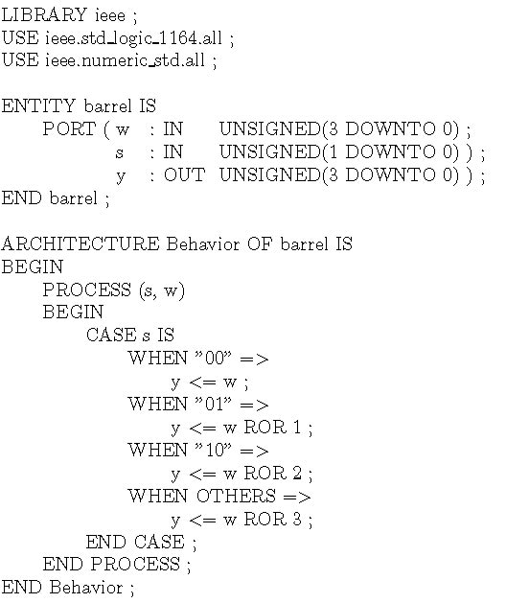
Figure 6.60. VHDL code that specifies the barrel shifter circuit in Figure 6.56.
I - Design Concepts
Portions © Copyright 2009, S. Brown and Z Vranesic

Slide 65
i
1
i
2
i
3
i
4
i
5
i
f
6
i
7
i
8
Figure P6.1. The Actel Act 1 logic block.
I - Design Concepts
Portions © Copyright 2009, S. Brown and Z Vranesic

Slide 66
LIBRARY ieee ;
USE ieee.std_logic_1164.all ;
ENTITY problem IS
PORT ( w : IN STD_LOGIC_VECTOR(1 DOWNTO 0) ;
En : IN STD_LOGIC ;
y0, y1, y2, y3 : OUT STD_LOGIC ) ;
END problem ;
ARCHITECTURE Behavior OF problem IS
BEGIN
PROCESS (w, En)
BEGIN
y0 <= '0' ; y1 <= '0' ; y2 <= '0' ; y3 <= '0' ;
IF En = '1' THEN
IF w = "00" THEN y0 <= '1' ;
ELSIF w = "01" THEN y1 <= '1' ;
ELSIF w = "10" THEN y2 <= '1' ;
ELSE y3 <= '1' ;
END IF ;
END IF ;
END PROCESS ;
END Behavior ;
Figure P6.2. Code for problem 6.18.
I - Design Concepts
Portions © Copyright 2009, S. Brown and Z Vranesic

Slide 67
V
DD
a
0
-to-4 decoder
a
1
2
d
3
d
2
d
1
d
0
Figure P6.3. A 4 x 4 ROM circuit.
I - Design Concepts
Portions © Copyright 2009, S. Brown and Z Vranesic

