Slide 1
Cpt 7: Flip-Flops, Registers, Counters, and a Simple Processor
Set
Sensor
On
⁄
Off
Memory
element
Alarm
Reset
Figure 7.1. Control of an alarm system.

Slide 2
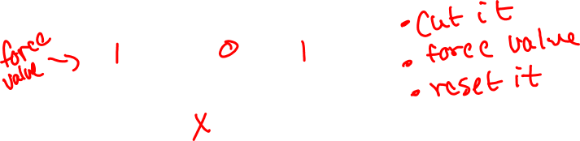
A
B
Figure 7.2. A simple memory element.

Slide 3
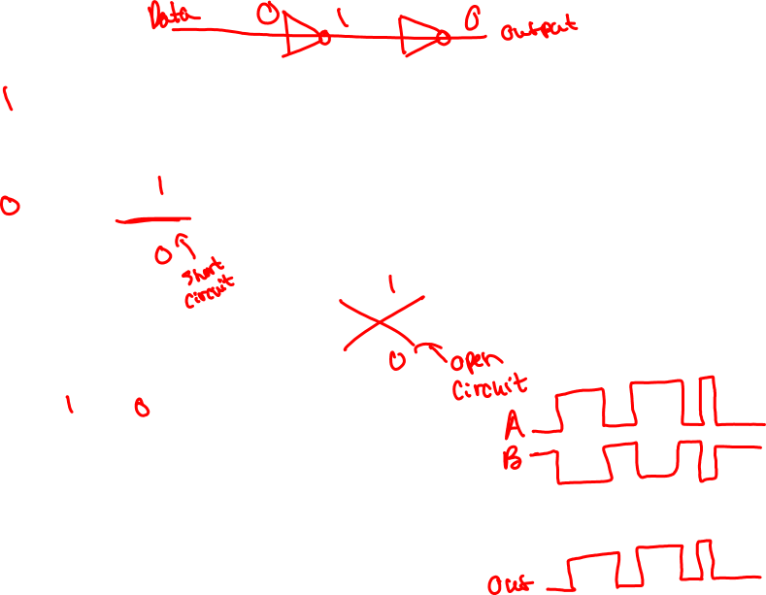
Load
A
B
Data
Output
TG1
TG2
Figure 7.3. A controlled memory element.

Slide 4
Reset
Set
Q
Figure 7.4. A memory element with NOR gates.

Slide 5
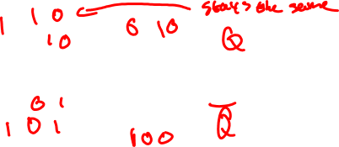
R
S
R
Q
a
Q
b
Q
a
0
0
0/1 1/0
(no change)
0
1
0
1
1
0
1
0
Q
b
1
1
0
0
S
(a) Circuit
(b) Truth table
t
1
t
2
t
3
t
4
t
5
t
6
t
7
t
8
t
9
t
10
1
R
0
1
S
0
1
Q
a
?
0
1
Q
b
?
0
Time
(c) Timing diagram
Figure 7.5. A latch built with NOR gates.

Slide 6
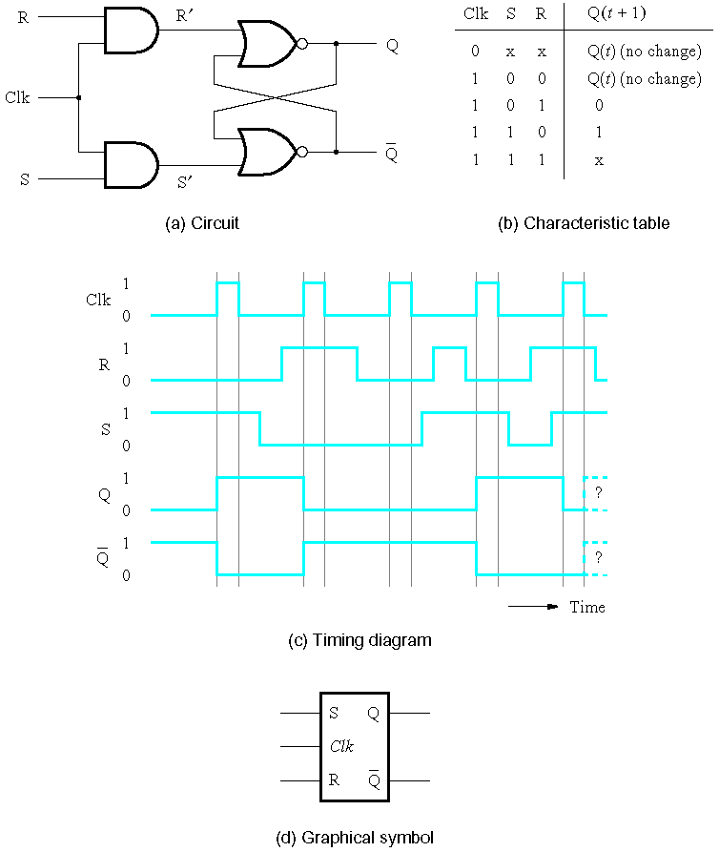
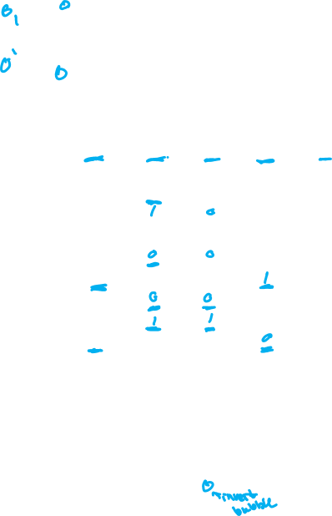
Figure 7.6. Gated SR latch.

Slide 7
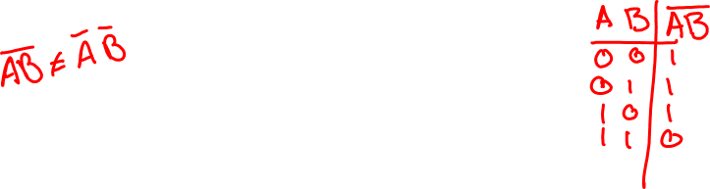
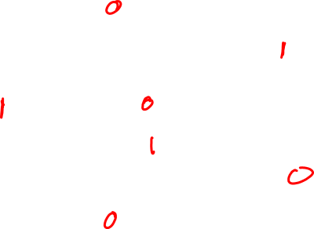
S
Q
Clk
Q
R
Figure 7.7. Gated SR latch with NAND gates.

Slide 8
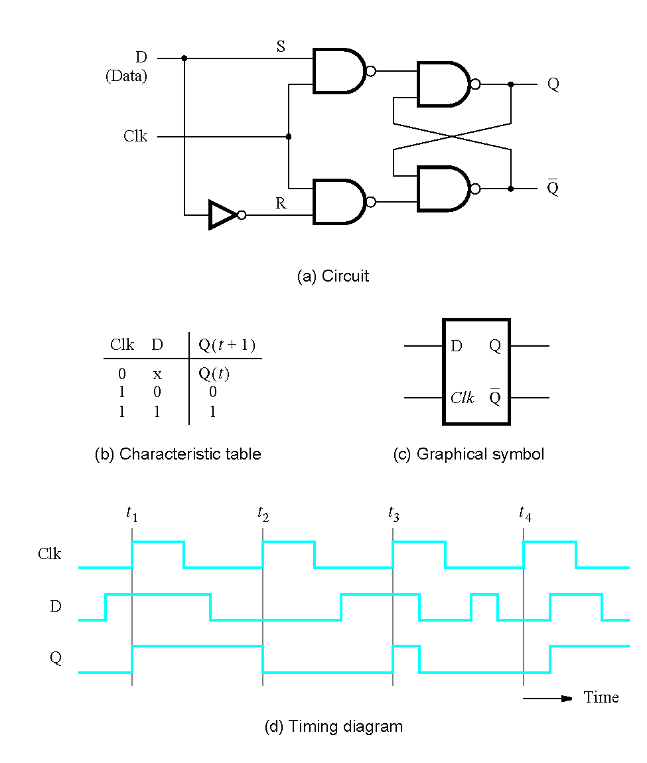
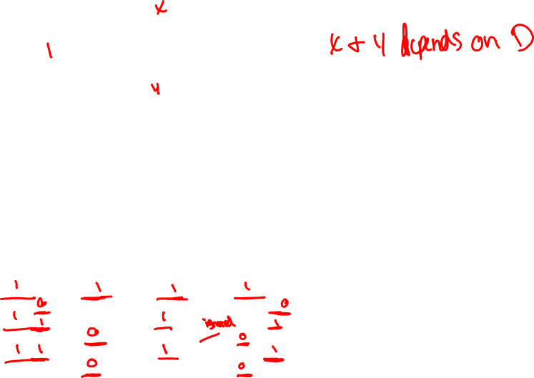
Figure 7.8. Gated D latch.

Slide 9
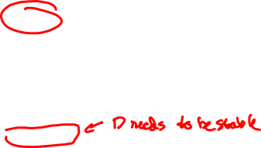
t
su
t
h
Clk
D
Q
Figure 7.9. Setup and hold times.

Slide 10

Master
Slave
Q
Q
D
D
Q
m
D
Q
s
Q
Clock
Clk
Q
Clk
Q
Q
(a) Circuit
Clock
D
Q
m
Q
=
Q
s
(b) Timing diagram
D
Q
Q
(c) Graphical symbol
Figure 7.10. Master-slave D flip-flop.

Slide 11
1
P3
2
P1
5
Q
Clock
P2
6
Q
3
D
Q
4
P4
Clock
Q
D
(a) Circuit
(b) Graphical symbol
Figure 7.11. A positive-edge-triggered D flip-flop.

Slide 12
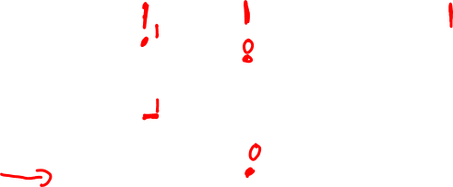
D
D
Q
Q
a
Clock
Clk
Q
Q
a
D
Q
Q
b
Q
Q
b
D
Q
Q
c
Q
Q
c
(a) Circuit
Clock
D
Q
a
Q
b
Q
c
(b) Timing diagram
Figure 7.12. Comparison of level-sensitive and edge-triggered
D storage elements.

Slide 13
Preset
D
Q
Clock
Q
Clear
(a) Circuit
Preset
D
Q
Q
Clear
(b) Graphical symbol
Figure 7.13. Master-slave D flip-flop with Clear and Preset.

Slide 14
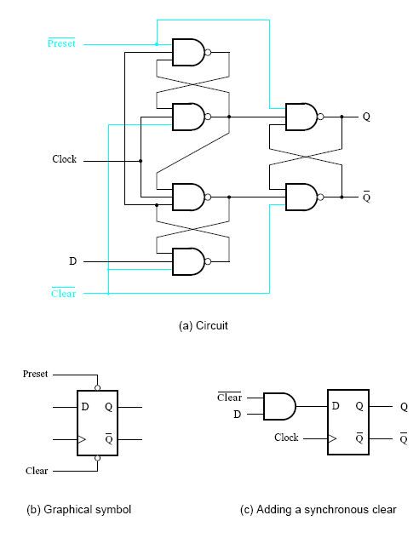

Figure 7.14. Positive-edge-triggered D flip-flop with Clear and Preset.

Slide 15
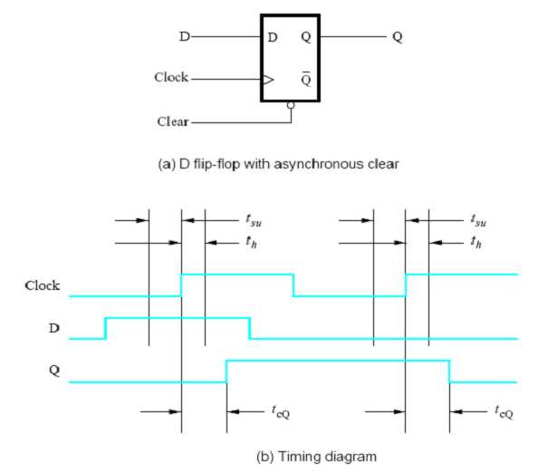
Figure 7.15. Synchronous reset for a D flip-flop.

Slide 16
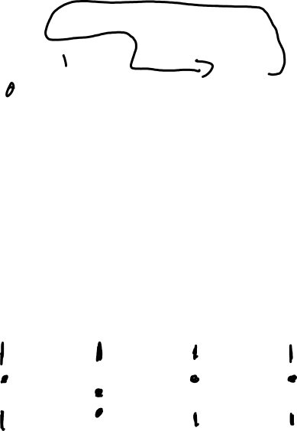
D
Q
Q
T
Q
Q
Clock
(a) Circuit
(
)
T
Q
t
+
1
T
Q
0
(
)
Q
t
1
(
)
Q
t
Q
(b) Truth table
(c) Graphical symbol
Clock
T
Q
(d) Timing diagram
Figure 7.16. T flip-flop.

Slide 17
J
D
Q
Q
K
Q
Q
Clock
(a) Circuit
J
K
Q
(
t
+
1
)
0
0
Q
(
t
)
J
Q
0
1
0
1
0
1
K
Q
1
1
Q
(
t
)
(b) Truth table
(c) Graphical symbol
Figure 7.17. JK flip-flop.

Slide 18
Q
Q
Q
Q
In
D
Q
1
D
Q
2
D
Q
3
D
Q
4
Out
Clock
Q
Q
Q
Q
(a) Circuit
In
Q
Q
Q
Q
=
Out
1
2
3
4
t
1
0
0
0
0
0
t
0
1
0
0
0
1
t
1
0
1
0
0
2
t
1
1
0
1
0
3
t
1
1
1
0
1
4
t
0
1
1
1
0
5
t
0
0
1
1
1
6
t
0
0
0
1
1
7
(b) A sample sequence
Figure 7.18. A simple shift register.

Slide 19
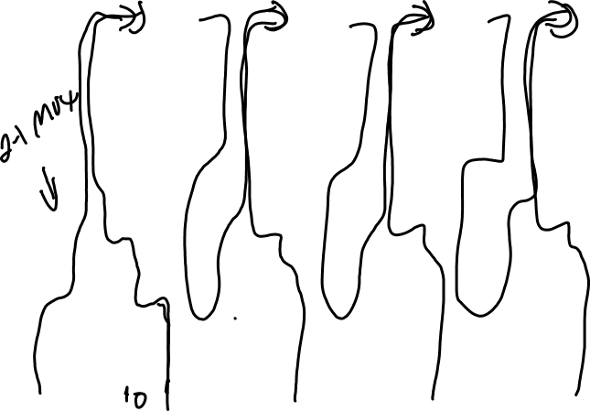
Parallel output
Q
3
Q
2
Q
1
Q
0
D
Q
D
Q
D
Q
D
Q
Q
Q
Q
Q
Serial
Shift/Load
Clock
input
Parallel input
Figure 7.19. Parallel-access shift register.

Slide 20
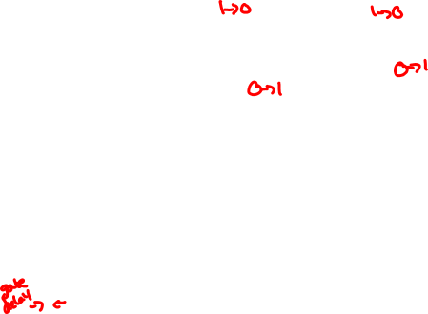
1
T
Q
T
Q
T
Q
Clock
Q
Q
Q
Q
Q
Q
0
1
2
(a) Circuit
Clock
Q
0
Q
1
Q
2
Count
0
1
2
3
4
5
6
7
0
(b) Timing diagram
Figure 7.20. A three-bit up-counter.

Slide 21
1
T
Q
T
Q
T
Q
Clock
Q
Q
Q
Q
Q
Q
0
1
2
(a) Circuit
Clock
Q
0
Q
1
Q
2
Count
0
7
6
5
4
3
2
1
0
(b) Timing diagram
Figure 7.21. A three-bit down-counter.

Slide 22

Clock cycle
Q
2
Q
1
Q
0
Q
changes
0
0
0
0
1
Q
changes
1
0
0
1
2
2
0
1
0
3
0
1
1
4
1
0
0
5
1
0
1
6
1
1
0
7
1
1
1
8
0
0
0
Table 7.1. Derivation of the synchronous up-counter.

Slide 23
1
T
Q
T
Q
T
Q
T
Q
Q
0
Q
1
Q
2
Q
3
Clock
Q
Q
Q
Q
(a) Circuit
Clock
Q
0
Q
1
Q
2
Q
3
Count
0
1
2
3
4
5
6
7
8
9
10
11
12
13
14
15
0
1
(b) Timing diagram
Figure 7.22. A four-bit synchronous up-counter.

Slide 24
Enable
T
Q
T
Q
T
Q
T
Q
Clock
Q
Q
Q
Q
Clear
Figure 7.23. Inclusion of Enable and Clear capability.

Slide 25
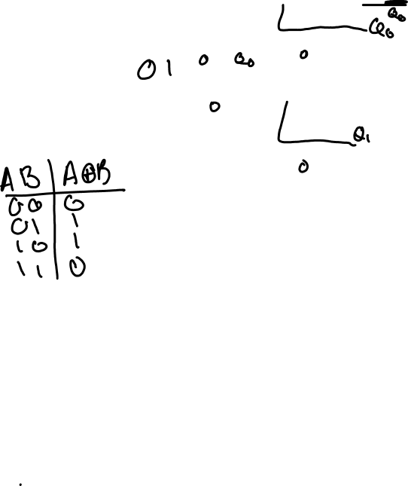
Enable
D
Q
Q
0
Q
D
Q
Q
1
Q
D
Q
Q
2
Q
D
Q
Q
3
Q
Output
Clock
carry
Figure 7.24. A four-bit counter with D flip-flops.

Slide 26
Enable
0
D
Q
Q
D
1
0
0
Q
0
D
Q
Q
D
1
1
1
Q
0
D
Q
Q
D
1
2
2
Q
0
D
Q
Q
D
1
3
3
Q
Output
carry
Load
Clock
Figure 7.25. A counter with parallel-load capability.

Slide 27
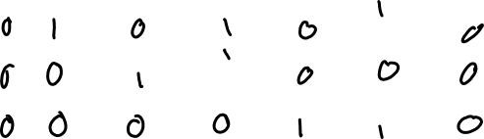
1
Enable
0
D
Q
0
0
0
D
Q
1
1
0
D
Q
2
2
Load
Clock
Clock
(a) Circuit
Clock
Q
0
Q
1
Q
2
Count
0
1
2
3
4
5
0
1
(b) Timing diagram
Figure 7.26. A modulo-6 counter with synchronous reset.

Slide 28
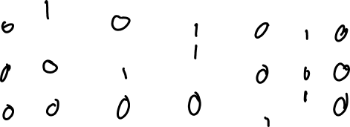
1
T
Q
T
Q
T
Q
Q
0
Q
1
Q
2
Clock
Q
Q
Q
(a) Circuit
Clock
Q
0
Q
1
Q
2
Count
0
1
2
3
4
5
0
1
2
(b) Timing diagram
Figure 7.27. A modulo-6 counter with asynchronous reset.

Slide 29
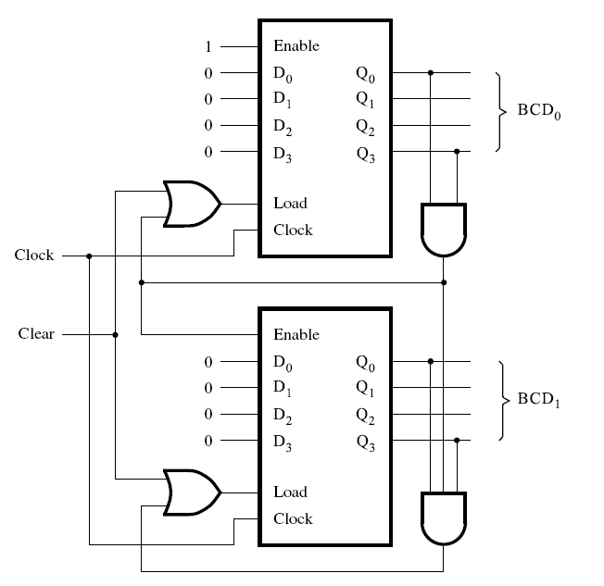
Figure 7.28. A two-digit BCD counter.

Slide 30
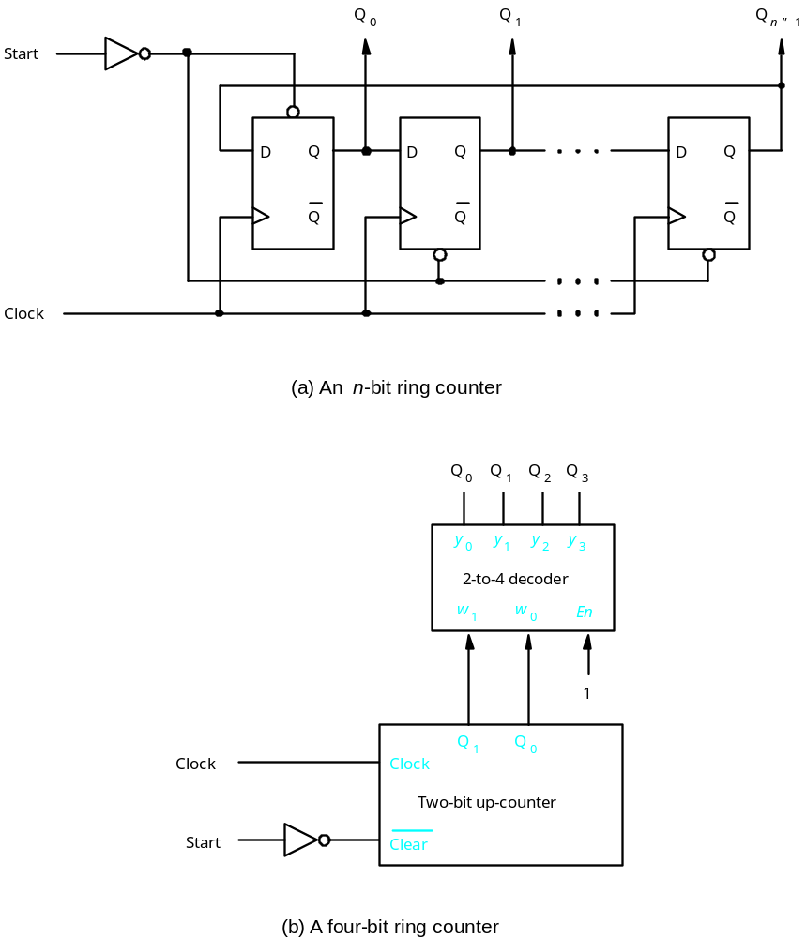
Figure 7.29. Ring counter.

Slide 31
Q
Q
Q
0
1
n
–
1
D
Q
D
Q
D
Q
Q
Q
Q
Reset
Clock
Figure 7.30. Johnson counter.

Slide 32
Figure 7.31. Three types of storage elements in a schematic.

Slide 33
Data
Clock
Latch
Figure 7.32. Gated D latch generated by CAD tools.

Slide 34
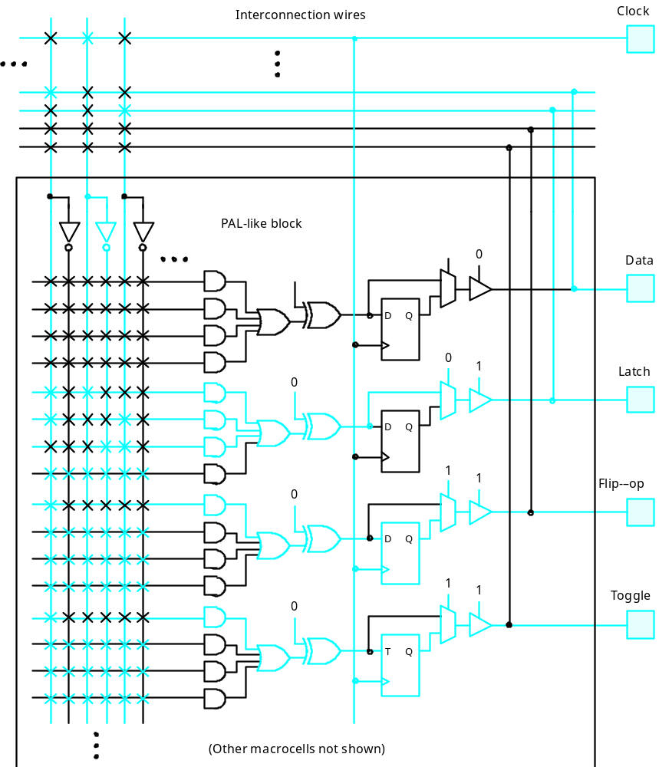
Figure 7.33. Implementation of the schematic in Figure 7.31 in a CPLD.

Slide 35
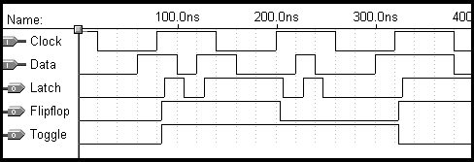
Figure 7.34. Timing simulation of storage elements in Figure 7.31.

Slide 36
LIBRARY ieee ;
USE ieee.std_logic_1164.all ;
ENTITY implied IS
PORT ( A, B : IN STD_LOGIC ;
AeqB : OUT STD_LOGIC ) ;
END implied ;
ARCHITECTURE Behavior OF implied IS
BEGIN
PROCESS ( A, B )
BEGIN
IF A = B THEN
AeqB <= '1' ;
END IF ;
END PROCESS ;
END Behavior ;
Figure 7.35. The code from Figure 6.43, illustrating implied memory.

Slide 37
LIBRARY ieee ;
USE ieee.std_logic_1164.all ;
ENTITY latch IS
PORT ( D, Clk : IN STD_LOGIC ;
Q : OUT STD_LOGIC) ;
END latch ;
ARCHITECTURE Behavior OF latch IS
BEGIN
PROCESS ( D, Clk )
BEGIN
IF Clk = '1' THEN
Q <= D ;
END IF ;
END PROCESS ;
END Behavior ;
Figure 7.36. Code for a gated D latch.

Slide 38
LIBRARY ieee ;
USE ieee.std_logic_1164.all ;
ENTITY flipflop IS
PORT ( D, Clock : IN STD_LOGIC ;
Q : OUT STD_LOGIC) ;
END flipflop ;
ARCHITECTURE Behavior OF flipflop IS
BEGIN
PROCESS ( Clock )
BEGIN
IF Clock'EVENT AND Clock = '1' THEN
Q <= D ;
END IF ;
END PROCESS ;
END Behavior ;
Figure 7.37. Code for a D flip-flop.

Slide 39
LIBRARY ieee;
USE ieee.std_logic_1164.all;
ENTITY flipflop IS
PORT ( D, Clock : IN STD_LOGIC ;
Q : OUT STD_LOGIC ) ;
END flipflop ;
ARCHITECTURE Behavior OF flipflop IS
BEGIN
PROCESS
BEGIN
WAIT UNTIL Clock'EVENT AND Clock = '1' ;
Q <= D ;
END PROCESS ;
END Behavior ;
Figure 7.38. Equivalent code for Figure 7.37, using a WAIT UNTIL statement.

Slide 40
LIBRARY ieee ;
USE ieee.std_logic_1164.all ;
ENTITY flipflop IS
PORT ( D, Resetn, Clock : IN STD_LOGIC ;
Q : OUT STD_LOGIC) ;
END flipflop ;
ARCHITECTURE Behavior OF flipflop IS
BEGIN
PROCESS ( Resetn, Clock )
BEGIN
IF Resetn = '0' THEN
Q <= '0' ;
ELSIF Clock'EVENT AND Clock = '1' THEN
Q <= D ;
END IF ;
END PROCESS ;
END Behavior ;
Figure 7.39. D flip-flop with asynchronous reset.

Slide 41
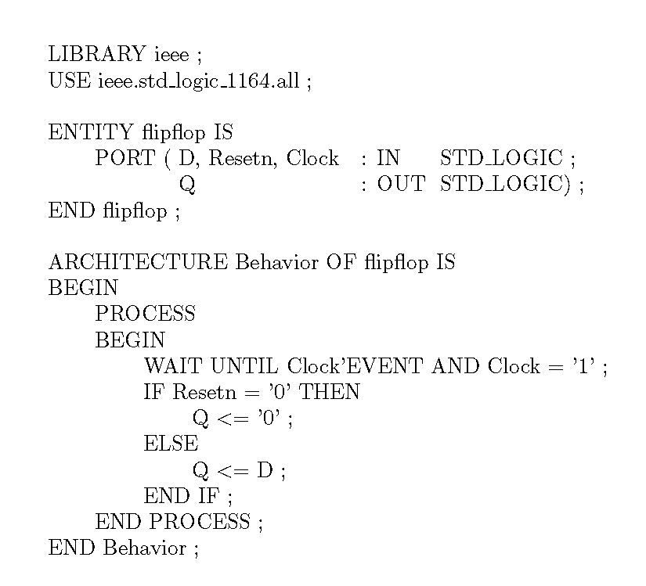
Figure 7.40. D flip-flop with synchronous reset.

Slide 42
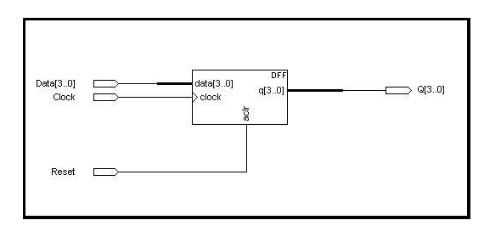
Figure 7.41. The lpm_ff parameterized flip-flop module.

Slide 43
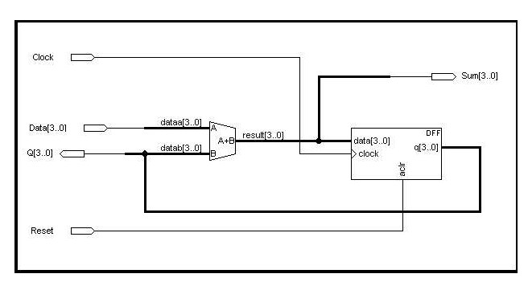
Figure 7.42. An adder with registered feedback.

Slide 44
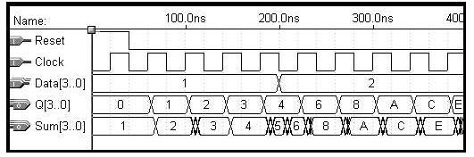
Figure 7.43. Timing simulation of the circuit from Figure 7.42.

Slide 45
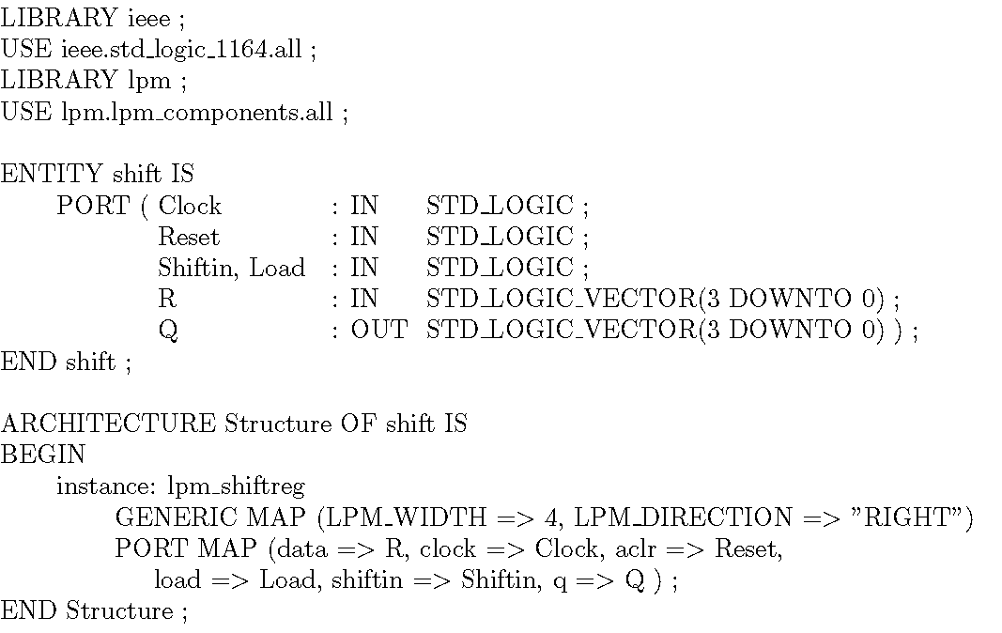
Figure 7.44. Instantiation of the lpm_shiftreg module.

Slide 46
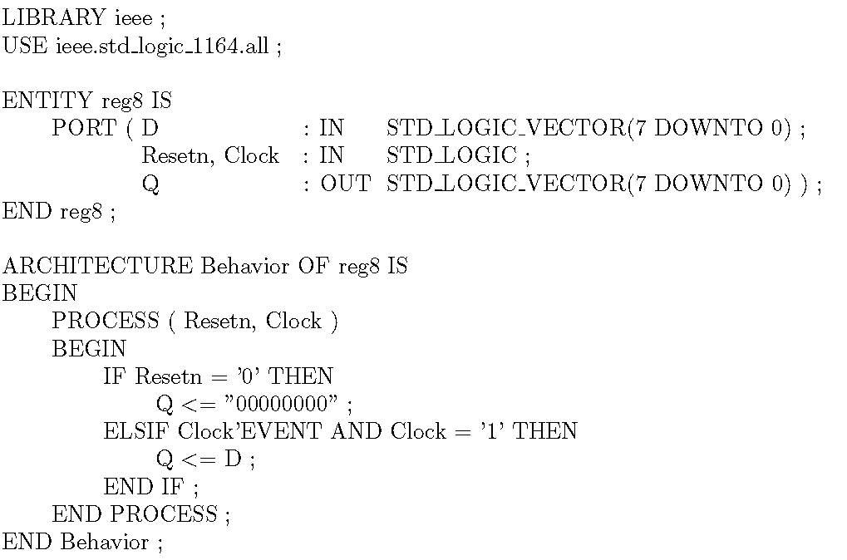
Figure 7.45. Code for an eight-bit register with asynchronous reset.

Slide 47
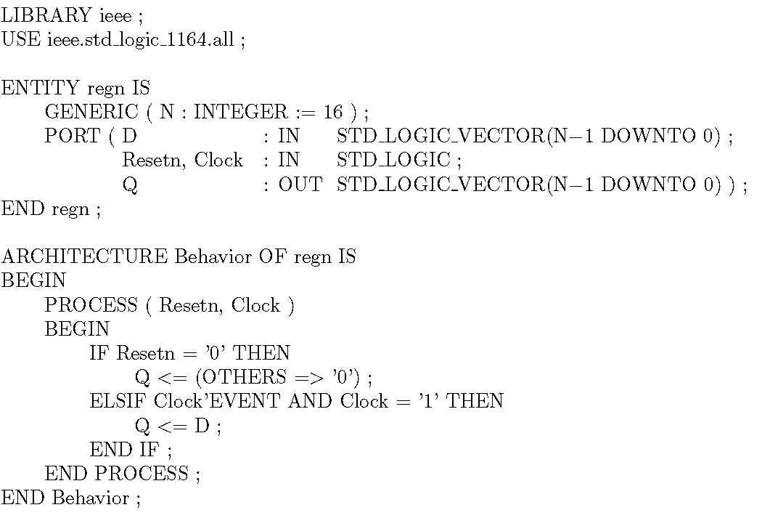
Figure 7.46. Code for an n-bit register with asynchronous clear.

Slide 48
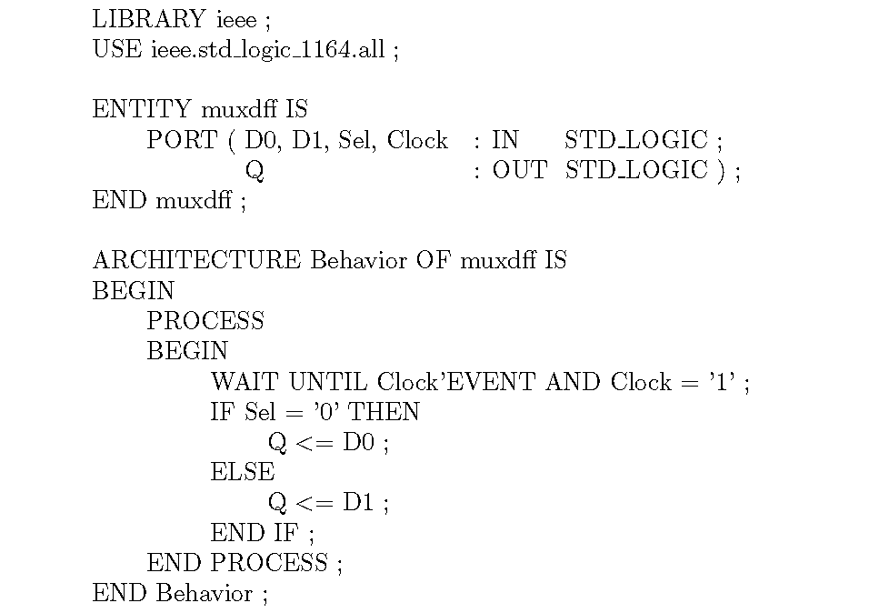
Figure 7.47. Code for a D flip-flop with a 2-to-1 multiplexer on the D input.

Slide 49
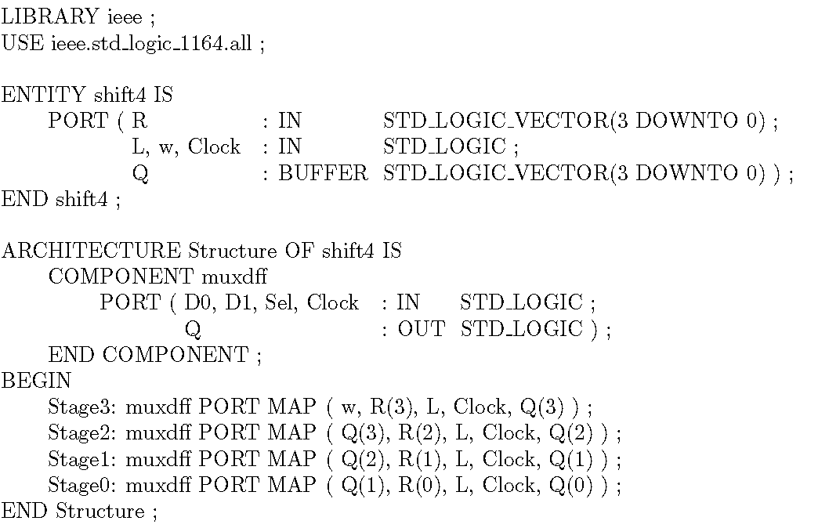
Figure 7.48. Hierarchical code for a four-bit shift register.

Slide 50
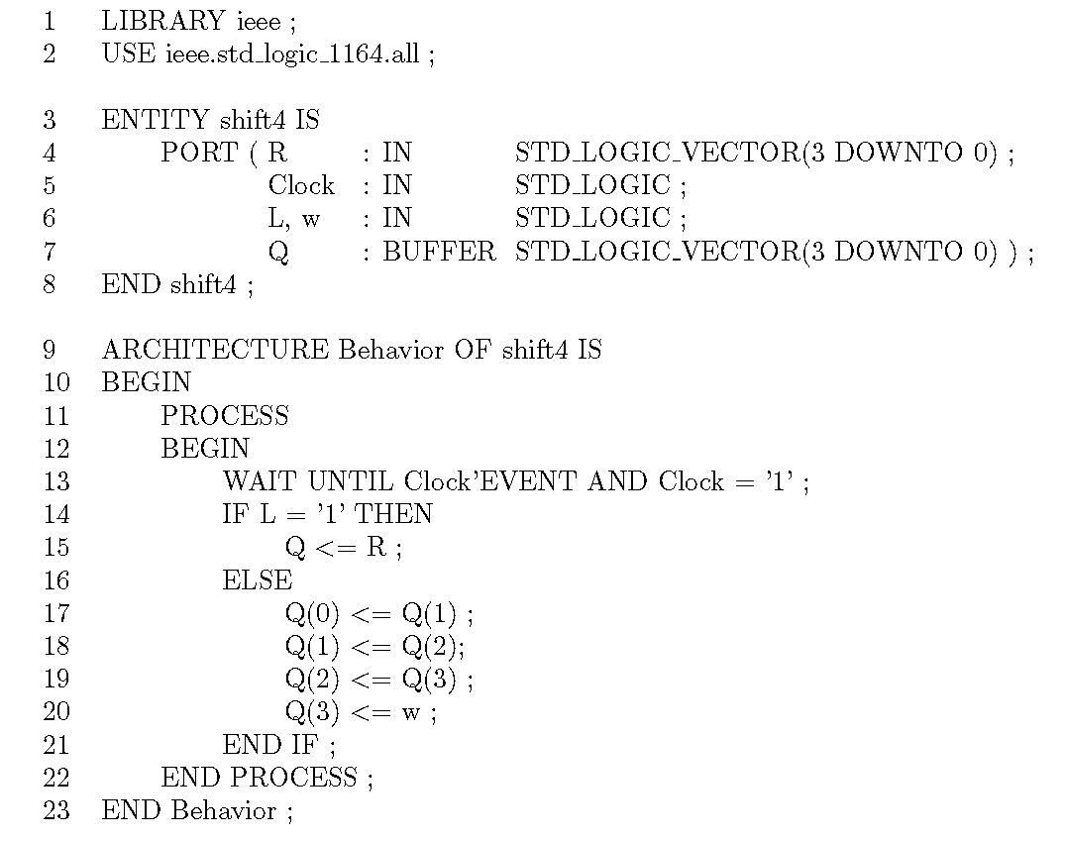
Figure 7.49. Alternative code for a shift register.

Slide 51

Figure 7.50. Code that reverses the ordering of statements in Figure 7.49.

Slide 52
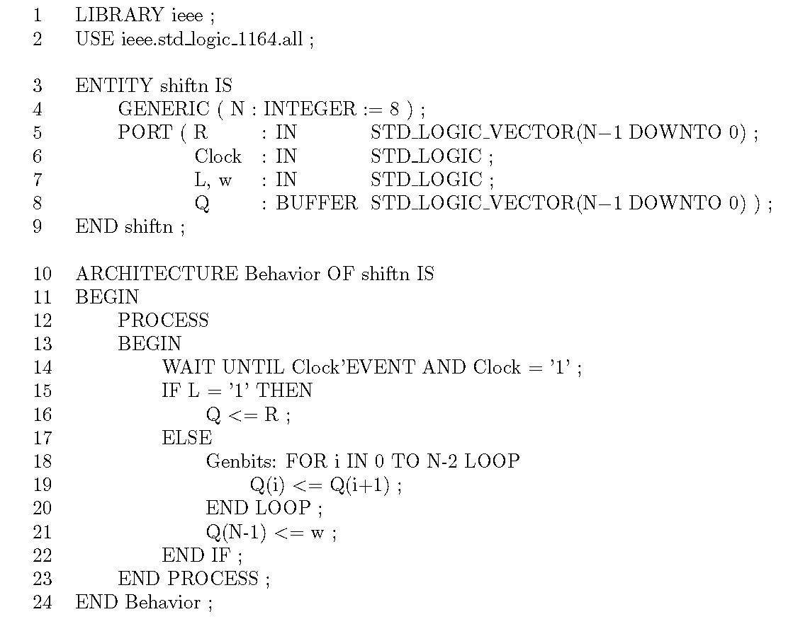
Figure 7.51. Code for an n-bit left-to-right shift register.

Slide 53
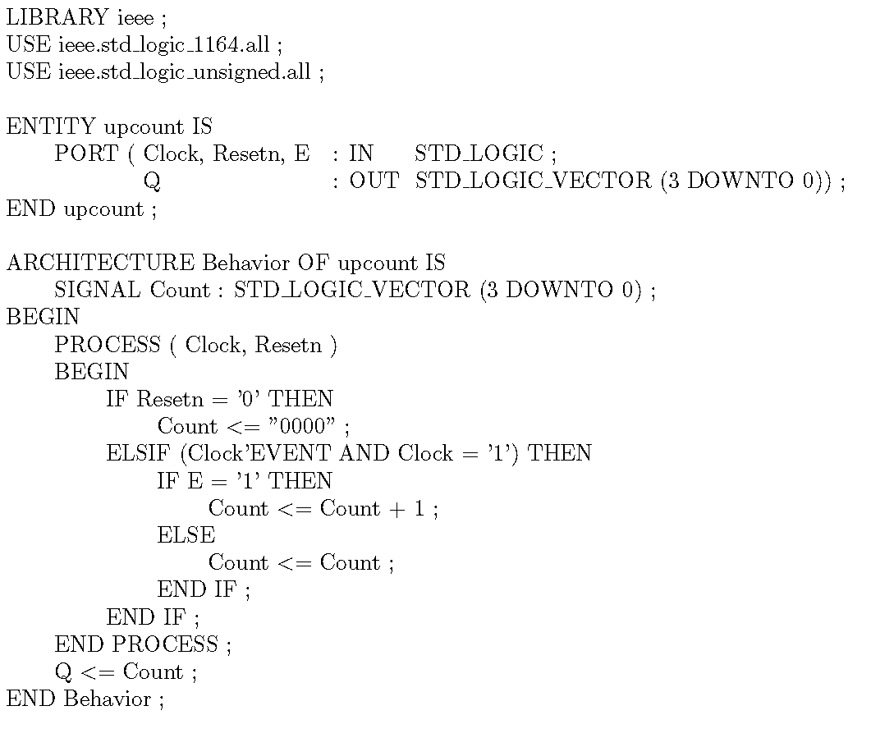
Figure 7.52. Code for a four-bit up-counter.

Slide 54
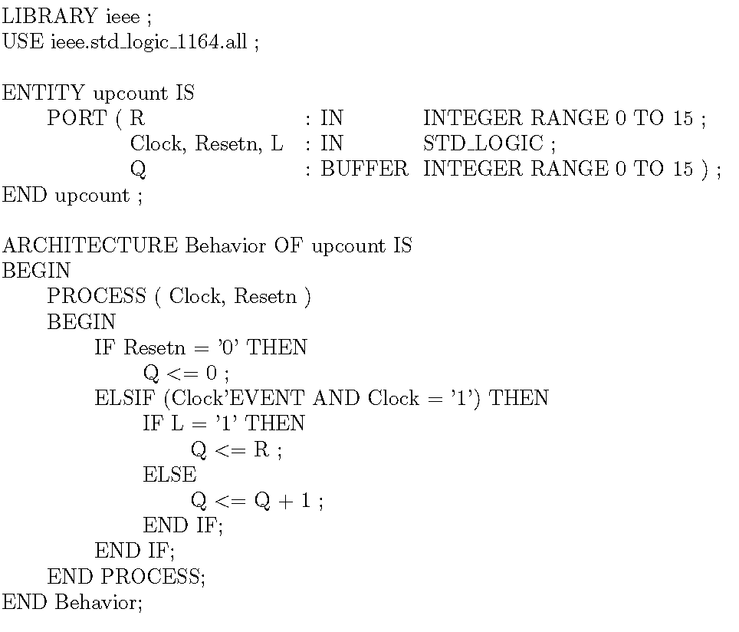
Figure 7.53. A four-bit counter with parallel load, using INTEGER signals.

Slide 55
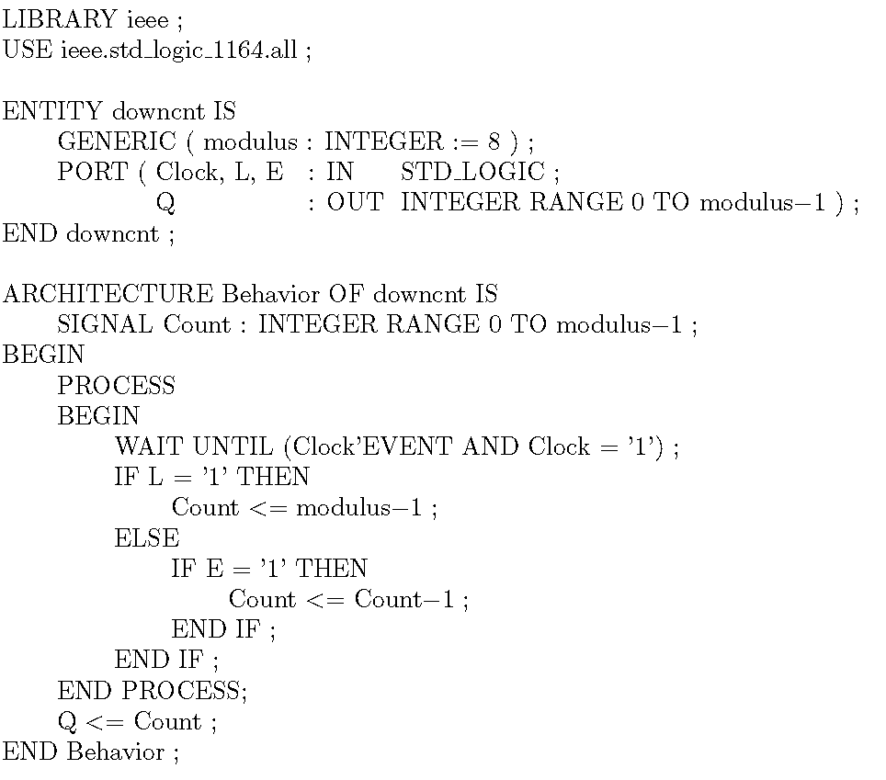
Figure 7.54. Code for a down-counter.

Slide 56
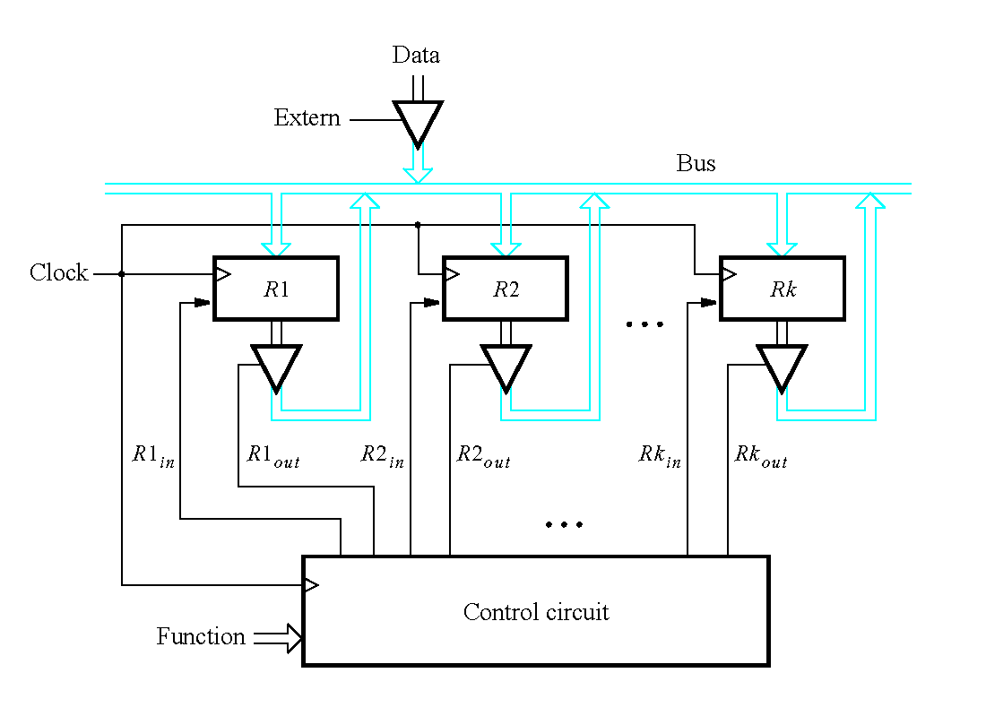
Figure 7.55. A digital system with k registers.

Slide 57
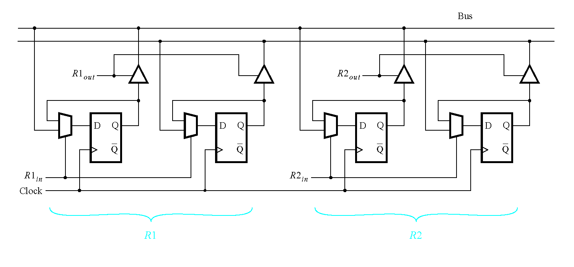
Figure 7.56. Details for connecting registers to a bus.

Slide 58
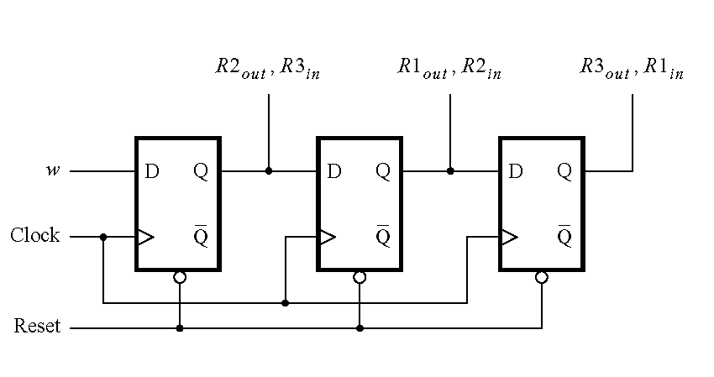
Figure 7.57. A shift-register control circuit..

Slide 59
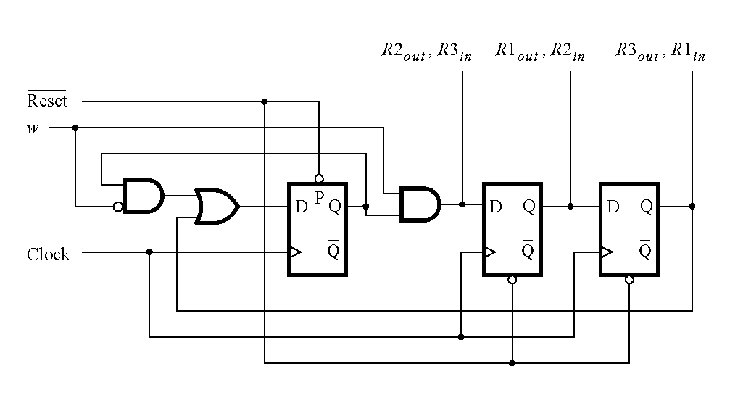
Figure 7.58. A modified control circuit.

Slide 60
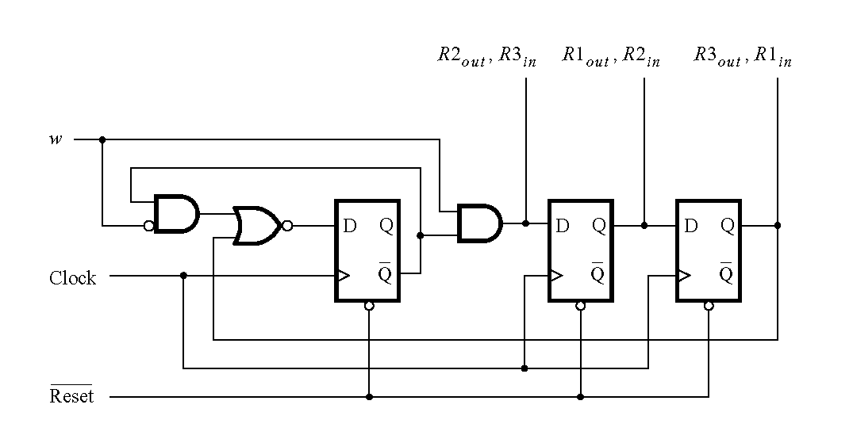
Figure 7.59. A modified version of the circuit in Figure 7.58.

Slide 61
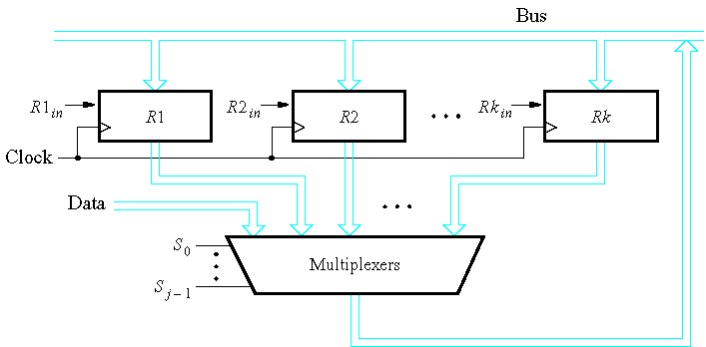
Figure 7.60. Using multiplexers to implement a bus.

Slide 62
LIBRARY ieee ;
USE ieee.std_logic_1164.all ;
ENTITY regn IS
GENERIC ( N : INTEGER := 8 ) ;
PORT ( R : IN STD_LOGIC_VECTOR(N-1 DOWNTO 0) ;
Rin, Clock : IN STD_LOGIC ;
Q : OUT STD_LOGIC_VECTOR(N-1 DOWNTO 0) ) ;
END regn ;
ARCHITECTURE Behavior OF regn IS
BEGIN
PROCESS
BEGIN
WAIT UNTIL Clock'EVENT AND Clock = '1' ;
IF Rin = '1' THEN
Q <= R ;
END IF ;
END PROCESS ;
END Behavior ;
Figure 7.61. Code for an n-bit register of the type in Figure 7.56.

Slide 63
LIBRARY ieee ;
USE ieee.std_logic_1164.all ;
ENTITY trin IS
GENERIC ( N : INTEGER := 8 ) ;
PORT ( X : IN STD_LOGIC_VECTOR(N-1 DOWNTO 0) ;
E : IN STD_LOGIC ;
F : OUT STD_LOGIC_VECTOR(N-1 DOWNTO 0) ) ;
END trin ;
ARCHITECTURE Behavior OF trin IS
BEGIN
F <= (OTHERS => 'Z') WHEN E = '0' ELSE X ;
END Behavior ;
Figure 7.62. Code for an n-bit tri-state buffer

Slide 64
LIBRARY ieee ;
USE ieee.std_logic_1164.all ;
ENTITY shiftr IS -- left-to-right shift register with async reset
GENERIC ( K : INTEGER := 4 ) ;
PORT ( Resetn, Clock, w : IN STD_LOGIC ;
Q : BUFFER STD_LOGIC_VECTOR(1 TO K) ) ;
END shiftr ;
ARCHITECTURE Behavior OF shiftr IS
BEGIN
PROCESS ( Resetn, Clock )
BEGIN
IF Resetn = '0' THEN
Q <= (OTHERS => '0') ;
ELSIF Clock'EVENT AND Clock = '1' THEN
Genbits: FOR i IN K DOWNTO 2 LOOP
Q(i) <= Q(i-1) ;
END LOOP ;
Q(1) <= w ;
END IF ;
END PROCESS ;
END Behavior ;
Figure 7.63. Code for the shift register in Figure 7.57.

Slide 65
LIBRARY ieee ;
USE ieee.std_logic_1164.all ;
PACKAGE components IS
COMPONENT regn -- register
GENERIC ( N : INTEGER := 8 ) ;
PORT ( R : IN STD_LOGIC_VECTOR(N-1 DOWNTO 0) ;
Rin, Clock : IN STD_LOGIC ;
Q : OUT STD_LOGIC_VECTOR(N-1 DOWNTO 0) ) ;
END COMPONENT ;
COMPONENT shiftr -- left-to-right shift register with async reset
GENERIC ( K : INTEGER := 4 ) ;
PORT ( Resetn, Clock, w : IN STD_LOGIC ;
Q : BUFFER STD_LOGIC_VECTOR(1 TO K) ) ;
END component ;
COMPONENT trin -- tri-state buffers
GENERIC ( N : INTEGER := 8 ) ;
PORT ( X : IN STD_LOGIC_VECTOR(N-1 DOWNTO 0) ;
E : IN STD_LOGIC ;
F : OUT STD_LOGIC_VECTOR(N-1 DOWNTO 0) ) ;
END COMPONENT ;
END components ;
Figure 7.64. Package and component declarations.

Slide 66
LIBRARY ieee ;
USE ieee.std_logic_1164.all ;
USE work.components.all ;
ENTITY swap IS
PORT ( Data : IN STD_LOGIC_VECTOR(7 DOWNTO 0) ;
Resetn, w : IN STD_LOGIC ;
Clock, Extern : IN STD_LOGIC ;
RinExt : IN STD_LOGIC_VECTOR(1 TO 3) ;
BusWires : INOUT STD_LOGIC_VECTOR(7 DOWNTO 0) ) ;
END swap ;
ARCHITECTURE Behavior OF swap IS
SIGNAL Rin, Rout, Q : STD_LOGIC_VECTOR(1 TO 3) ;
SIGNAL R1, R2, R3 : STD_LOGIC_VECTOR(7 DOWNTO 0) ;
BEGIN
control: shiftr GENERIC MAP ( K => 3 )
PORT MAP ( Resetn, Clock, w, Q ) ;
Rin(1) <= RinExt(1) OR Q(3) ;
Rin(2) <= RinExt(2) OR Q(2) ;
Rin(3) <= RinExt(3) OR Q(1) ;
Rout(1) <= Q(2) ; Rout(2) <= Q(1) ; Rout(3) <= Q(3) ;
tri_ext: trin PORT MAP ( Data, Extern, BusWires ) ;
reg1: regn PORT MAP ( BusWires, Rin(1), Clock, R1 ) ;
reg2: regn PORT MAP ( BusWires, Rin(2), Clock, R2 ) ;
reg3: regn PORT MAP ( BusWires, Rin(3), Clock, R3 ) ;
tri1: trin PORT MAP ( R1, Rout(1), BusWires ) ;
tri2: trin PORT MAP ( R2, Rout(2), BusWires ) ;
tri3: trin PORT MAP ( R3, Rout(3), BusWires ) ;
END Behavior ;
Figure 7.65. A digital system like the one in Figure 7.55.

Slide 67
LIBRARY ieee ;
USE ieee.std_logic_1164.all ;
USE work.components.all ;
ENTITY swapmux IS
PORT ( Data : IN STD_LOGIC_VECTOR(7 DOWNTO 0) ;
Resetn, w : IN STD_LOGIC ;
Clock : IN STD_LOGIC ;
RinExt : IN STD_LOGIC_VECTOR(1 TO 3) ;
BusWires : BUFFER STD_LOGIC_VECTOR(7 DOWNTO 0) ) ;
END swapmux ;
ARCHITECTURE Behavior OF swapmux IS
SIGNAL Rin, Q : STD_LOGIC_VECTOR(1 TO 3) ;
SIGNAL S : STD_LOGIC_VECTOR(1 DOWNTO 0) ;
SIGNAL R1, R2, R3 : STD_LOGIC_VECTOR(7 DOWNTO 0) ;
BEGIN
control: shiftr GENERIC MAP ( K => 3 )
PORT MAP ( Resetn, Clock, w, Q ) ;
Rin(1) <= RinExt(1) OR Q(3) ;
Rin(2) <= RinExt(2) OR Q(2) ;
Rin(3) <= RinExt(3) OR Q(1) ;
reg1: regn PORT MAP ( BusWires, Rin(1), Clock, R1 ) ;
reg2: regn PORT MAP ( BusWires, Rin(2), Clock, R2 ) ;
reg3: regn PORT MAP ( BusWires, Rin(3), Clock, R3 ) ;
encoder:
WITH Q SELECT
S <= "00" WHEN "000",
"10" WHEN "100",
"01" WHEN "010",
"11" WHEN OTHERS ;
muxes: --eight 4-to-1 multiplexers
WITH S SELECT
BusWires <=Data WHEN "00",
R1 WHEN "01",
R2 WHEN "10",
R3 WHEN OTHERS ;
END Behavior ;
Figure 7.66. Using multiplexers to implement a bus.

Slide 68
ARCHITECTURE Behavior OF swapmux IS
SIGNAL Rin, Q : STD_LOGIC_VECTOR(1 TO 3) ;
SIGNAL R1, R2, R3 : STD_LOGIC_VECTOR(7 DOWNTO 0) ;
BEGIN
control: shiftr GENERIC MAP ( K => 3 )
PORT MAP ( Resetn, Clock, w, Q ) ;
Rin(1) <= RinExt(1) OR Q(3) ;
Rin(2) <= RinExt(2) OR Q(2) ;
Rin(3) <= RinExt(3) OR Q(1) ;
reg1: regn PORT MAP ( BusWires, Rin(1), Clock, R1 ) ;
reg2: regn PORT MAP ( BusWires, Rin(2), Clock, R2 ) ;
reg3: regn PORT MAP ( BusWires, Rin(3), Clock, R3 ) ;
muxes:
WITH Q SELECT
BusWires <= Data WHEN "000",
R2 WHEN "100",
R1 WHEN "010",
R3 WHEN OTHERS ;
END Behavior ;
Figure 7.67. A simplified version of the architecture in Figure 7.66.

Slide 69
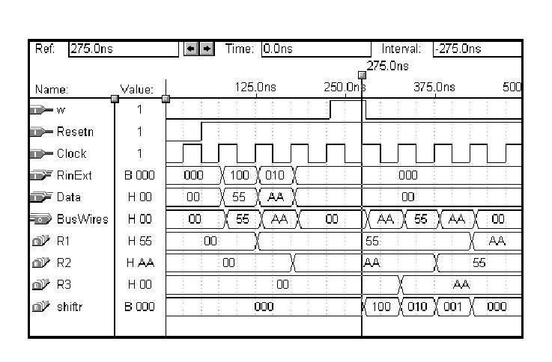
Figure 7.68. Timing simulation for the VHDL code in Figure 7.67.

Slide 70
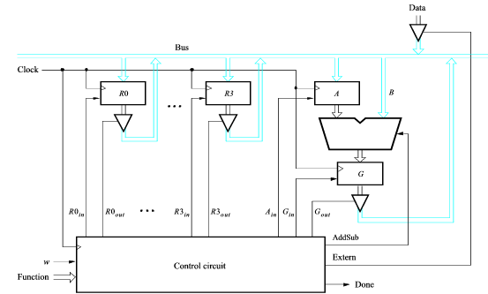
Figure 7.69. A digital system that implements a simple processor.

Slide 71
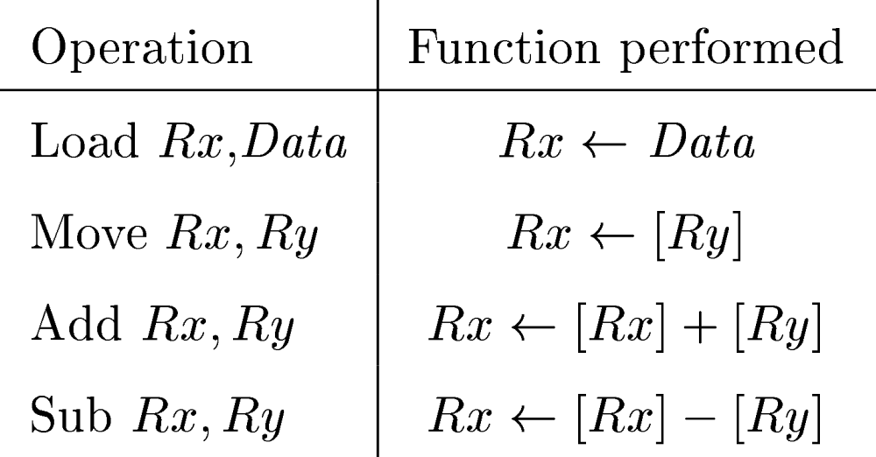

Table 7.2. Operations performed in the processor.

Slide 72
T
T
T
T
0
1
2
3
y
0
y
1
y
2
y
3
2-to-4 decoder
w
1
w
0
En
1
Q
1
Q
0
Clock
Up-counter
Clear
Reset
Figure 7.70. A part of the control circuit for the processor.

Slide 73
I
0
I
1
I
2
I
3
X
0
X
1
X
2
X
3
Y
0
Y
1
Y
2
Y
3
y
0
y
1
y
2
y
3
y
0
y
1
y
2
y
3
y
0
y
1
y
2
y
3
2-to-4 decoder
2-to-4 decoder
2-to-4 decoder
w
w
En
w
w
En
w
w
En
1
0
1
0
1
0
1
1
1
Clock
FR
Function Register
in
f
1
f
0
Rx
1
Rx
0
Ry
1
Ry
0
Function
Figure 7.71. The function register and decoders.

Slide 74
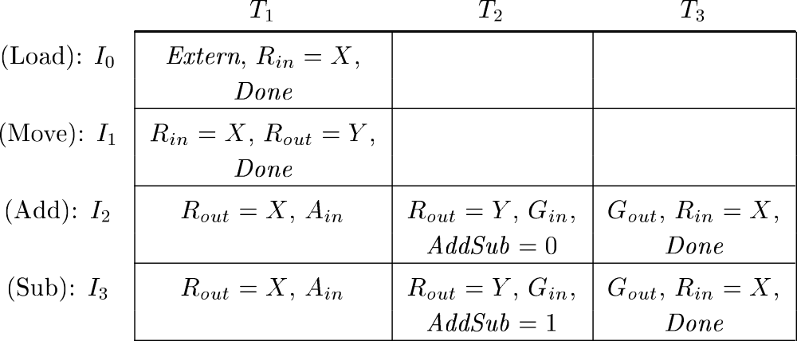
Table 7.3. Control signals asserted in each operation/time step.
Clear = W’T₀ + Done
FRin = wT₀
Extern = I₀T₁
Done = (I₀ + I₁)T₁ + (I₂ + I₃)T₃
Ain = (I₂ + I₃)T₁
Gin = (I₂ + I₃)T₂
Gout = (I₂ + I₃)T₃
AddSub = I₃
R0in = (I₀ + I₁)T₁X₀ + (I₂ + I₃)T₃X₀
R0out = I₁T₁Y₀ + (I₂ + I₃)(T₁X₀ + T₂Y₀)
Equations for R1in and R1out are as for R0in and R0out except X₁ and Y₁ are used instead of X₀ and Y₀

Slide 75
LIBRARY ieee ;
USE ieee.std_logic_1164.all ;
USE ieee.std_logic_unsigned.all ;
ENTITY upcount IS
PORT ( Clear, Clock : IN STD_LOGIC ;
Q : BUFFER STD_LOGIC_VECTOR(1 DOWNTO 0) ) ;
END upcount ;
ARCHITECTURE Behavior OF upcount IS
BEGIN
upcount: PROCESS ( Clock )
BEGIN
IF (Clock'EVENT AND Clock = '1') THEN
IF Clear = '1' THEN
Q <= "00" ;
ELSE
Q <= Q + '1' ;
END IF ;
END IF;
END PROCESS;
END Behavior ;
Figure 7.72. Code for a two-bit up-counter with synchronous reset.

Slide 76
Figure 7.75. Timing simulation for the VHDL code in Figure 7.74.

Slide 77
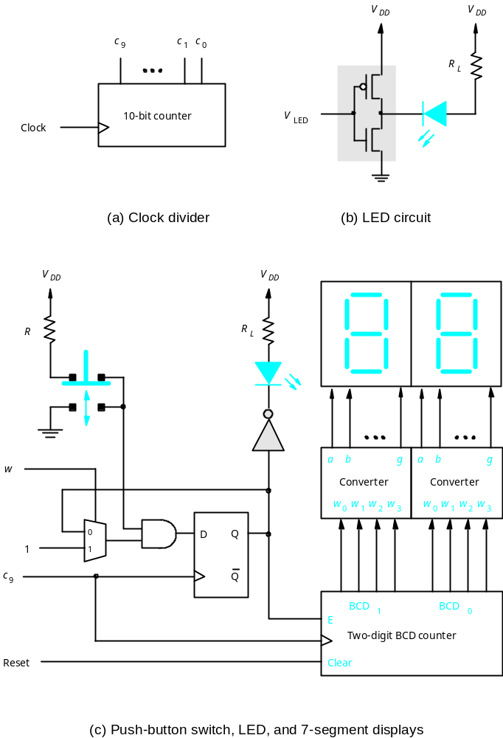
Figure 7.76. A reaction-timer circuit.

Slide 78
LIBRARY ieee ;
USE ieee.std_logic_1164.all ;
USE ieee.std_logic_unsigned.all ;
ENTITY BCDcount IS
PORT ( Clock : IN STD_LOGIC ;
Clear, E : IN STD_LOGIC ;
BCD1, BCD0 : BUFFER STD_LOGIC_VECTOR(3 DOWNTO 0) ) ;
END BCDcount ;
ARCHITECTURE Behavior OF BCDcount IS
BEGIN
PROCESS ( Clock )
BEGIN
IF Clock'EVENT AND Clock = '1' THEN
IF Clear = '1' THEN
BCD1 <= "0000" ; BCD0 <= "0000" ;
ELSIF E = '1' THEN
IF BCD0 = "1001" THEN
BCD0 <= "0000" ;
IF BCD1 = "1001" THEN
BCD1 <= "0000";
ELSE
BCD1 <= BCD1 + '1' ;
END IF ;
ELSE
BCD0 <= BCD0 + '1' ;
END IF ;
END IF ;
END IF;
END PROCESS;
END Behavior ;
Figure 7.77. Code for the two-digit BCD counter in Figure 7.28.

Slide 79
Figure 7.79. Simulation of the reaction-timer circuit.

Slide 80
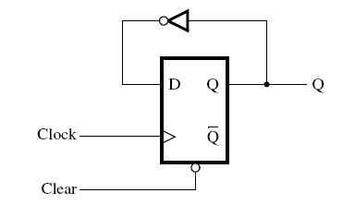
Figure 7.80. A simple flip-flop circuit.

Slide 81
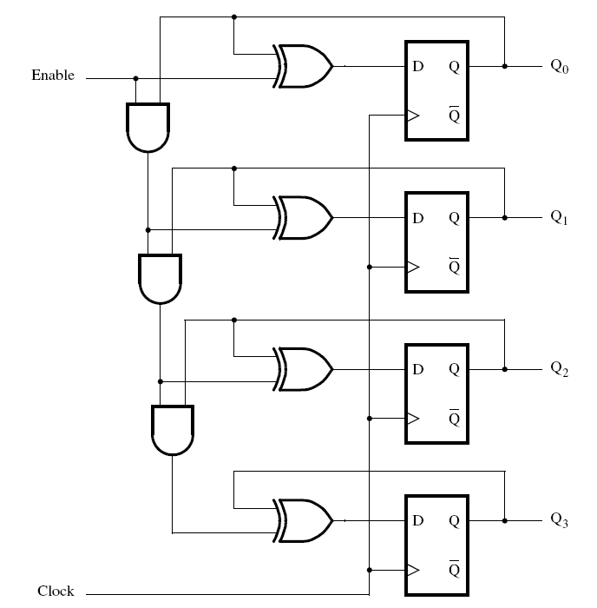
Figure 7.81. A 4-bit counter.

Slide 82

Figure 7.82. Circuit for Example 7.13.

Slide 83

Figure 7.83. Circuit for Example 7.14.

Slide 84

Figure 7.84. Summary of the behavior of the circuit in Figure 7.83.

Slide 85

Figure 7.85. Timing signals for Example 7.15.

Slide 86

Example 7.16

Slide 87

Figure 7.86. Circuit for Example 7.16.

Slide 88

Figure 7.87. Code for Example 7.17.

Slide 89

Figure 7.88. A faster 4-bit counter.

Slide 90
Clock
D
Figure P7.1. Timing diagram for problem 7.1.

Slide 91

Figure P7.2. Circuit for problem 7.9.

Slide 92
Q
0
Q
1
Q
2
1
T
Q
T
Q
T
Q
Clock
Q
Q
Q
Figure P7.3. The circuit for problem 7.18.

Slide 93
J
S
Q
S
Q
Q
Clock
Clk
Clk
K
R
Q
R
Q
Q
Figure P7.4. Circuit for problem 7.19.

Slide 94

f
Figure P7.5. A ring oscillator.

Slide 95
Reset
Interval
100 ns
Figure P7.6. Timing of signals for problem 7.31.

Slide 96
D
Q
Clock
Q
A
Clock
1
0
D
1
0
A
1
0
Q
1
0
Figure P7.7. Circuit and timing diagram for problem 7.32.

Slide 97
Clock
1
0
1
Start
0
f
1
0
g
1
0
Figure P7.8. Timing diagram for problem 7.33.

