Slide 1

Chapter 8 – Synchronous Sequential Circuits
W
Combinational
Combinational
Flip-flops
circuit
Z
circuit
Q
Clock
Figure 8.1. The general form of a sequential circuit.

Slide 2
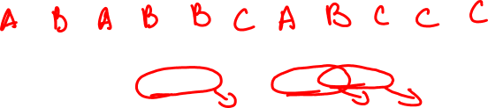
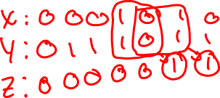
Clockcycle:
t
0
t
1
t
2
t
3
t
4
t
5
t
6
t
7
t
8
t
9
t
10
w
:
0
1
0
1
1
0
1
1
1
0
1
z
:
0
0
0
0
0
1
0
0
1
1
0
Figure 8.2. Sequences of input and output signals.

Slide 3

Moore State Machine Model
Reset
w
=
1
w
=
0
A
⁄
z
=
0
B
⁄
z
=
0
w
=
0
w
=
0
w
=
1
C
⁄
z
=
1
w
=
1
Figure 8.3. State diagram of a simple sequential circuit.

Slide 4
Present
Next state
Output
state
w
=
0
w
=
1
z
A
A
B
0
B
A
C
0
C
A
C
1
Figure 8.4. State table for the sequential circuit in Figure 8.3.

Slide 5
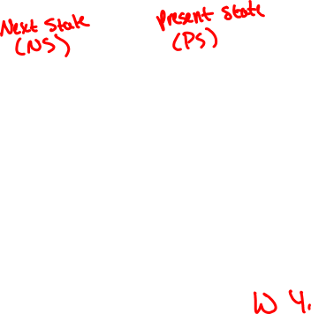
Y
1
y
1
w
Combinational
Combinational
z
circuit
circuit
Y
2
y
2
Clock
Figure 8.5. A general sequential circuit with input w, output z, and two state flip-flops.

Slide 6
Next state
Present
w
=
0
w
=
1
Output
state
z
y
2
y
1
Y
2
Y
1
Y
2
Y
1
A
00
00
01
0
B
01
00
10
0
C
10
00
10
1
11
dd
dd
d
Figure 8.6. State-assigned table for the sequential circuit in Figure 8.4.

Slide 7
y
2
y
1
00
01
11
10
Ignoring don't cares
Using don't cares
w
0
0
0
d
0
Y
1
=
wy
1
y
2
Y
1
=
wy
1
y
2
1
1
0
d
0
y
2
y
1
w
00
01
11
10
0
0
0
d
0
Y
2
=
wy
1
y
2
+
wy
1
y
2
Y
2
=
wy
1
+
wy
2
1
0
1
d
1
=
w
(
y
1
+
y
2
)
y
1
y
2
0
1
0
0
0
z
=
y
1
y
2
z
=
y
2
1
1
d
Figure 8.7. Derivation of logic expressions for the sequential circuit in Figure 8.6.

Slide 8
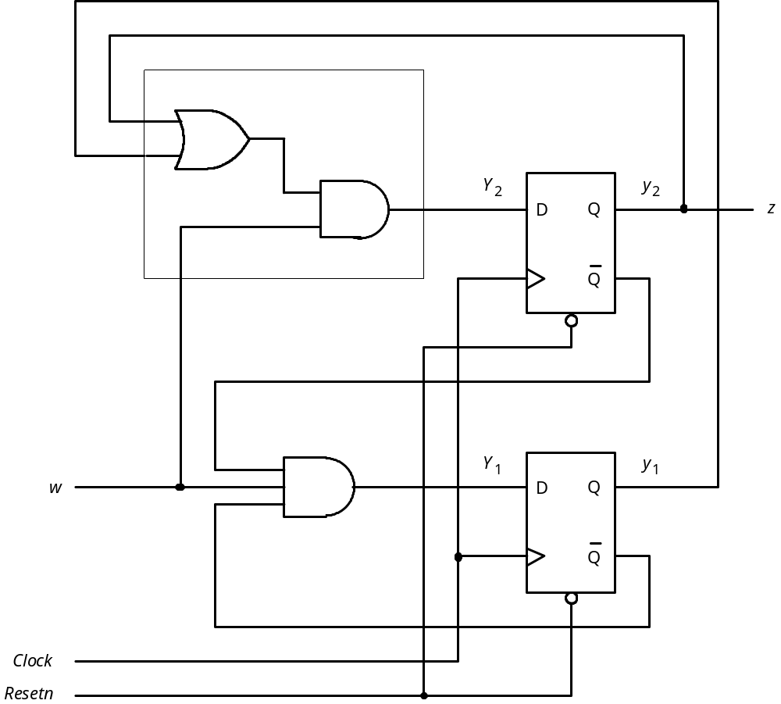
Figure 8.8. Final implementation of the sequential circuit derived
in Figure 8.7.

Slide 9
t
t
t
t
t
t
t
t
t
t
t
0
1
2
3
4
5
6
7
8
9
10
1
Clock
0
1
w
0
1
y
1
0
1
y
2
0
1
z
0
Figure 8.9. Timing diagram for the circuit in Figure 8.8.

Slide 10
R
1
out
R
1
in
w
R
2
out
Control
circuit
R
2
in
R
3
out
Clock
R
3
in
Done
Figure 8.10. Signals needed in Example 8.1.

Slide 11
w
=
0
A
⁄
No
transfer
Reset
w
=
1
B
⁄
R
2
=
,
out
1
R
3
in
=
1
w
=
0
w
=
1
w
=
0
w
=
1
C
⁄
R
1
=
,
out
1
R
2
in
=
1
w
=
0
w
=
1
D
⁄
R
3
=
,
,
out
1
R
1
in
=
1
Done
=
1
Figure 8.11. State diagram for Example 8.1.

Slide 12


Present
Next state
Outputs
state
w = 0
w = 1
A
A
B
0
0
0
0
0
0
0
B
C
C
0
0
1
0
0
1
0
C
D
D
1
0
0
1
0
0
0
D
A
A
0
1
0
0
1
0
1
Figure 8.12. State table for Example 8.1.

Slide 13

Present
Next state
state
Outputs
A
00
00
0
1
0
0
0
0
0
0
0
B
01
10
1
0
0
0
1
0
0
1
0
C
10
11
1
1
1
0
0
1
0
0
0
D
11
00
0
0
0
1
0
0
1
0
1
Figure 8.13. State-assigned table for the sequential circuit in Figure 8.12.

Slide 14
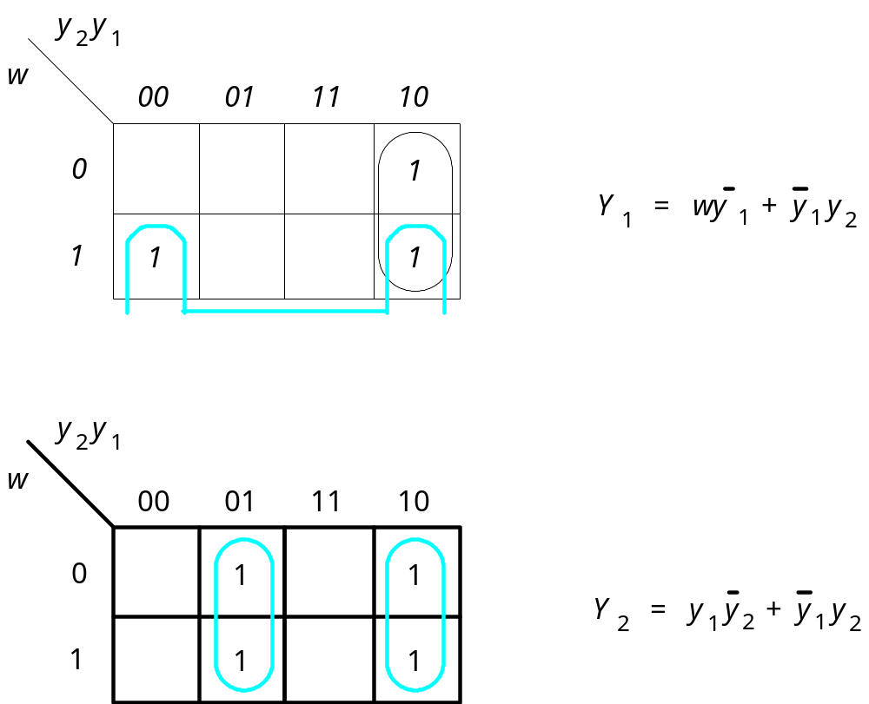
Figure 8.14. Derivation of next-state expressions for the
sequential circuit in Figure 8.13.

Slide 15
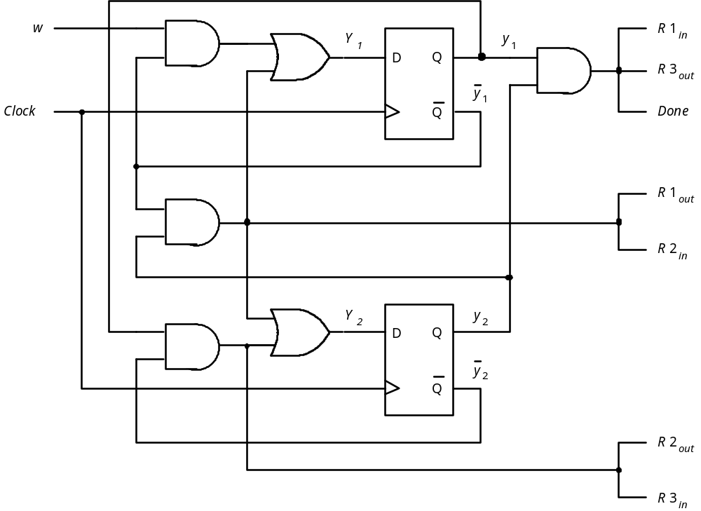
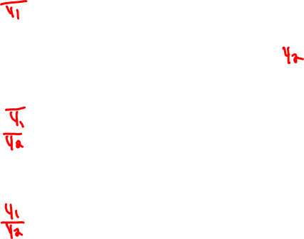
Figure 8.15. Final implementation of sequential circuit in Figure 8.13.

Slide 16
Next state
Present
state
w
=
0
w
=
1
Output
z
y
2
y
1
Y
2
Y
1
Y
2
Y
1
A
00
00
01
0
B
01
00
11
0
C
11
00
11
1
10
dd
dd
d
Figure 8.16. Improved state assignment for the sequential circuit in Figure 8.4.

Slide 17
Y
2
y
2
D
Q
z
Q
Y
1
y
1
w
D
Q
Clock
Q
Resetn
Figure 8.17. Final circuit for the improved state assignment
in Figure 8.16.

Slide 18
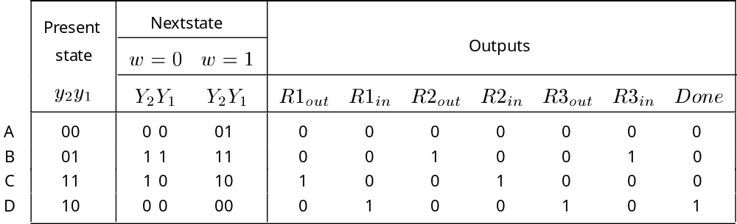
Figure 8.18. Improved state assignment for the sequential circuit in Figure 8.12.

Slide 19
y
2
y
1
w
00
01
11
10
0
1
Y
1
=
wy
2
+
y
1
y
2
1
1
1
y
2
y
1
w
00
01
11
10
0
1
1
Y
2
=
y
1
1
1
1
Figure 8.19. Derivation of next-state expressions for the sequential
circuit in Figure 8.18.

Slide 20
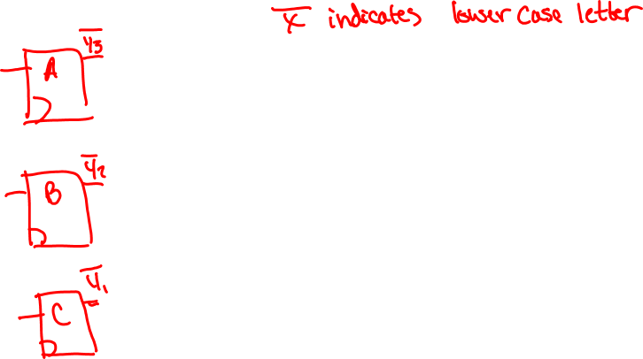
Present
Nextstate
state
w
=
0
w
=
1
Output
y
y
y
z
3
2
1
Y
3
Y
2
Y
1
Y
3
Y
2
Y
1
A
001
001
010
0
B
010
001
100
0
C
100
001
100
1
Figure 8.20. One-hot state assignment for the sequential circuit in Figure 8.4.

Slide 21
Present
Nextstate
state
Outputs
A
0
001
0001
0010
0
0
0
0
0
0
0
B
0
010
0100
0100
0
0
1
0
0
1
0
C
0
100
1000
1000
1
0
0
1
0
0
0
D
1
000
0001
0001
0
1
0
0
1
0
1
Figure 8.21. One-hot state assignment for the sequential circuit in Figure 8.12.

Slide 22
Mealy State Machine Model
Clock cycle:
t
0
t
1
t
2
t
3
t
4
t
5
t
6
t
7
t
8
t
9
t
10
w
:
0
1
0
1
1
0
1
1
1
0
1
z
:
0
0
0
0
1
0
0
1
1
0
0
Figure 8.22. Sequences of input and output signals.

Slide 23
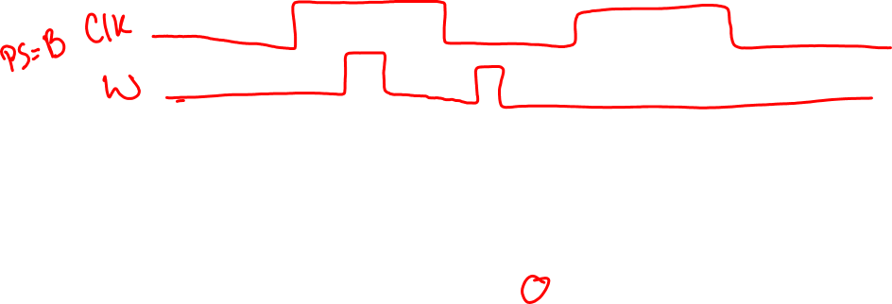

Reset
w
=
1
⁄
z
=
0
w
=
0
⁄
z
=
0
A
B
w
=
1
⁄
z
=
1
w
=
0
⁄
z
=
0
Figure 8.23. State diagram of an FSM that realizes the task in Figure 8.22.

Slide 24
Present
Next state
Output
z
state
w
=
0
w
=
1
w
=
0
w
=
1
A
A
B
0
0
B
A
B
0
1
Figure 8.24. State table for the FSM in Figure 8.23.

Slide 25
Present
Next state
Output
state
w
=
0
w
=
1
w
=
0
w
=
1
y
Y
Y
z
z
A
0
0
1
0
0
B
1
0
1
0
1
Figure 8.25. State-assigned table for the FSM in Figure 8.24.

Slide 26
z
w
D
Q
y
Clock
Q
Resetn
(a) Circuit
t
t
t
t
t
t
t
t
t
t
t
0
1
2
3
4
5
6
7
8
9
10
Clock
1
0
w
1
0
y
1
0
z
1
0
(b) Timing diagram
Figure 8.26. Implementation of FSM in Figure 8.25.

Slide 27
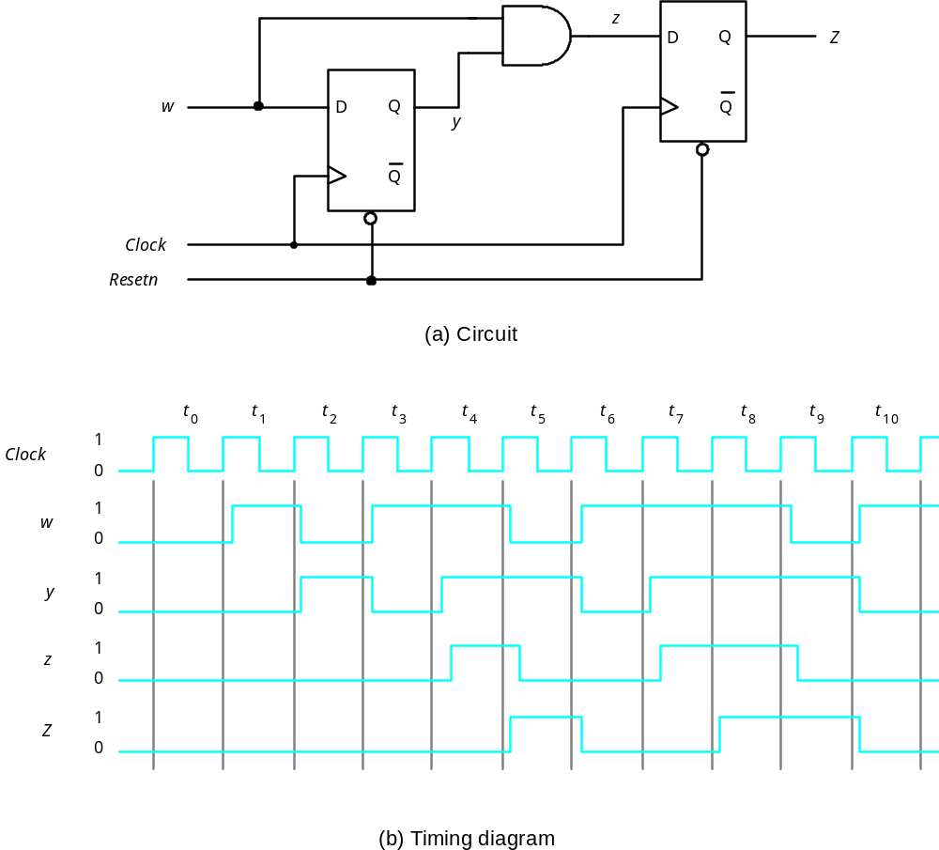
Figure 8.27. Circuit that implements the specification in Figure 8.2.

Slide 28
w
=
0
A
Reset
w
=
1
⁄
R
2
out
=
1
,
R
3
in
=
1
B
w
=
0
R
1
=
1
,
R
2
=
1
w
=
1
out
in
C
w
=
0
R
3
=
1
,
R
1
=
1
,
Done
=
1
w
=
1
out
in
Figure 8.28. State diagram for Example 8.4.

Slide 29
1 LIBRARY ieee ;
2 USE ieee.std_logic_1164.all ;
3 ENTITY simple IS
4 PORT ( Clock, Resetn, w : IN STD_LOGIC ;
z : OUT STD_LOGIC ) ;
5 END simple ;
7 ARCHITECTURE Behavior OF simple IS
8 TYPE State_type IS (A, B, C) ;
9 SIGNAL y : State_type ;
10 BEGIN
11 PROCESS ( Resetn, Clock )
12 BEGIN
13 IF Resetn = '0' THEN
14 y <= A ;
15 ELSIF (Clock'EVENT AND Clock = '1') THEN
16 CASE y IS
17 WHEN A =>
18 IF w = '0' THEN
19 y <= A ;
20 ELSE
21 y <= B ;
22 END IF ;
23 WHEN B =>
24 IF w = '0' THEN
25 y <= A ;
26 ELSE
27 y <= C ;
28 END IF ;
29 WHEN C =>
30 IF w = '0' THEN
31 y <= A ;
32 ELSE
33 y <= C ;
34 END IF ;
35 END CASE ;
36 END IF ;
37 END PROCESS ;
38 z <= '1' WHEN y = C ELSE '0' ;
39 END Behavior ;
Figure 8.29. VHDL code for the FSM in Figure 8.3.

Slide 30
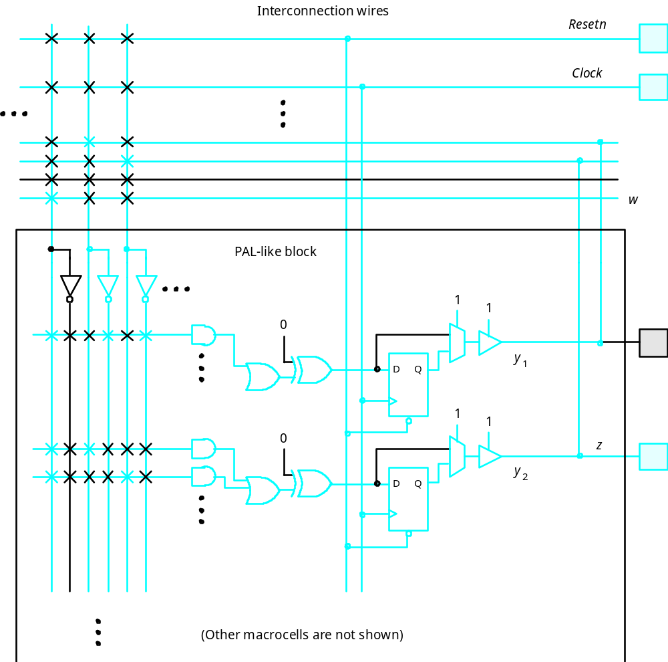
Figure 8.30. Implementation of the FSM of Figure 8.3 in a CPLD.

Slide 31
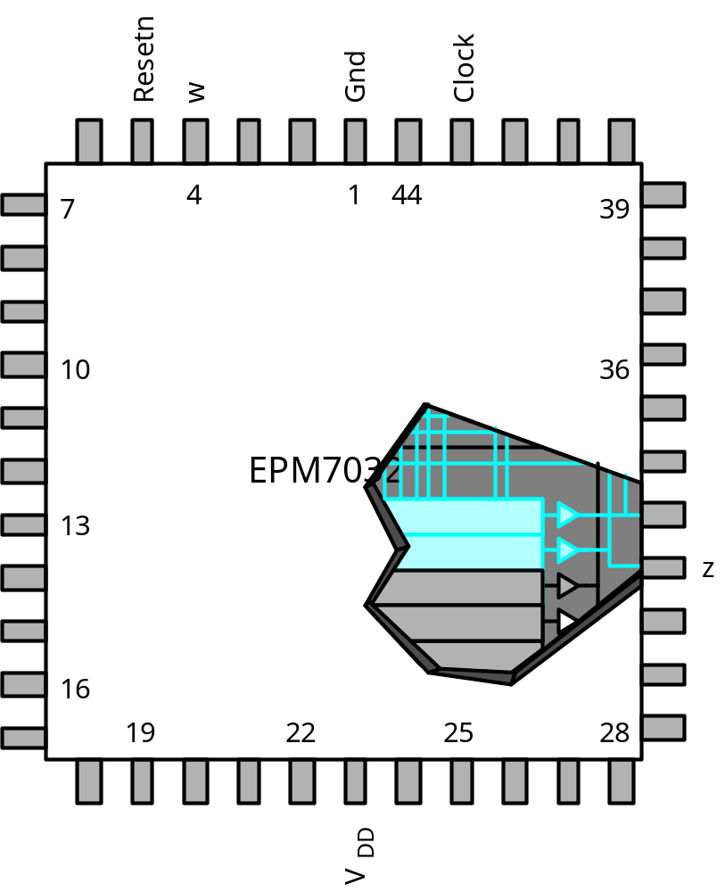
Figure 8.31. The circuit from Figure 8.30 in a small CPLD.

Slide 32
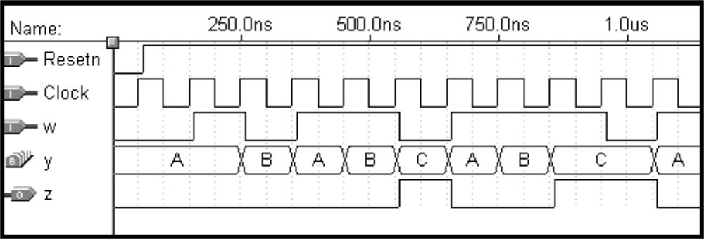
Figure 8.32. Simulation results for the circuit in Figure 8.30.

Slide 33
ARCHITECTURE Behavior OF simple IS
TYPE State_type IS (A, B, C) ;
SIGNAL y_present, y_next : State_type ;
BEGIN
PROCESS ( w, y_present )
BEGIN
CASE y_present IS
WHEN A =>
IF w = '0' THEN
y_next <= A ;
ELSE
y_next <= B ;
END IF ;
WHEN B =>
IF w = '0' THEN
y_next <= A ;
ELSE
y_next <= C ;
END IF ;
WHEN C =>
IF w = '0' THEN
y_next <= A ;
ELSE
y_next <= C ;
END IF ;
END CASE ;
END PROCESS ;
PROCESS (Clock, Resetn)
BEGIN
IF Resetn = '0' THEN
y_present <= A ;
ELSIF (Clock'EVENT AND Clock = '1') THEN
y_present <= y_next ;
END IF ;
END PROCESS ;
z <= '1' WHEN y_present = C ELSE '0' ;
END Behavior ;
Figure 8.33. Alternative style of VHDL code for the FSM in Figure 8.3.

Slide 34
ARCHITECTURE Behavior OF simple IS
TYPE State_TYPE IS (A, B, C) ;
ATTRIBUTE ENUM_ENCODING : STRING ;
ATTRIBUTE ENUM_ENCODING OF State_type : TYPE IS "00 01 11" ; SIGNAL y_present, y_next : State_type ;
BEGIN
.
.
.
Figure 8.34. A user-defined attribute for manual state assignment.

Slide 35
LIBRARY ieee ;
USE ieee.std_logic_1164.all ;
ENTITY simple IS
PORT ( Clock, Resetn, w : IN STD_LOGIC ;
z : OUT STD_LOGIC ) ;
END simple ;
ARCHITECTURE Behavior OF simple IS
SIGNAL y_present, y_next : STD_LOGIC_VECTOR(1 DOWNTO 0);
CONSTANT A : STD_LOGIC_VECTOR(1 DOWNTO 0) := "00" ;
CONSTANT B : STD_LOGIC_VECTOR(1 DOWNTO 0) := "01" ;
CONSTANT C : STD_LOGIC_VECTOR(1 DOWNTO 0) := "11" ;
BEGIN
PROCESS ( w, y_present )
BEGIN
CASE y_present IS
WHEN A =>
IF w = '0' THEN y_next <= A ;
ELSE y_next <= B ;
END IF ;
WHEN B =>
IF w = '0' THEN y_next <= A ;
ELSE y_next <= C ;
END IF ;
WHEN C =>
IF w = '0' THEN y_next <= A ;
ELSE y_next <= C ;
END IF ;
WHEN OTHERS =>
y_next <= A ;
END CASE ;
END PROCESS ;
PROCESS ( Clock, Resetn )
BEGIN
IF Resetn = '0' THEN
y_present <= A ;
ELSIF (Clock'EVENT AND Clock = '1') THEN
y_present <= y_next ;
END IF ;
END PROCESS ;
z <= '1' WHEN y_present = C ELSE '0' ;
END Behavior ;
Figure 8.35. Using constants for manual state assignment.

Slide 36
LIBRARY ieee ;
USE ieee.std_logic_1164.all ;
ENTITY mealy IS
PORT ( Clock, Resetn, w : IN STD_LOGIC ;
z : OUT STD_LOGIC ) ;
END mealy ;
ARCHITECTURE Behavior OF mealy IS
TYPE State_type IS (A, B) ;
SIGNAL y : State_type ;
BEGIN
PROCESS ( Resetn, Clock )
BEGIN
IF Resetn = '0' THEN
y <= A ;
ELSIF (Clock'EVENT AND Clock = '1') THEN
CASE y IS
WHEN A =>
IF w = '0' THEN y <= A ;
ELSE y <= B ;
END IF ;
WHEN B =>
IF w = '0' THEN y <= A ;
ELSE y <= B ;
END IF ;
END CASE ;
END IF ;
END PROCESS ;
PROCESS ( y, w )
BEGIN
CASE y IS
WHEN A =>
z <= '0' ;
WHEN B =>
z <= w ;
END CASE ;
END PROCESS ;
END Behavior ;
Figure 8.36. VHDL code for the Mealy machine of Figure 8.23.

Slide 37
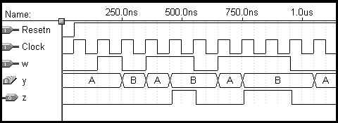
Figure 8.37. Simulation results for the Mealy machine.

Slide 38
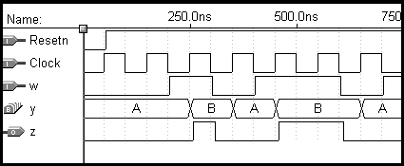
Figure 8.38. Potential problem with asynchronous inputs to a Mealy FSM.

Slide 39
A
a
Shift register
Adder
s
FSM
Shift register
Shift register
b
Sum
=
A
+
B
B
Clock
Figure 8.39. Block diagram for the serial adder.

Slide 40
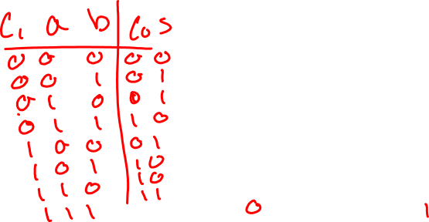
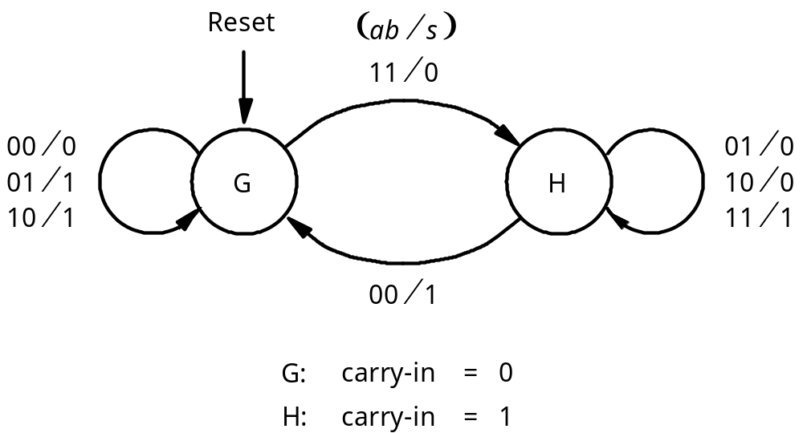
Figure 8.40. State diagram for the serial adder FSM.

Slide 41
Present
Next state
Output
s
state
ab
=00
01
10
11
00
01
10
11
G
G
G
G
H
0
1
1
0
H
G
H
H
H
1
0
0
1
Figure 8.41. State table for the serial adder FSM.

Slide 42
Next state
Output
Present
state
ab
=00
01
10
11
00
01
10
11
y
Y
s
0
0
0
0
1
0
1
1
0
1
0
1
1
1
1
0
0
1
Figure 8.42. State-assigned table for Figure 8.41.

Slide 43
a
s
b
Full
adder
Y
y
D
Q
carry-out
Clock
Q
Reset
Figure 8.43. Circuit for the adder FSM in Figure 8.39.

Slide 44
Reset
⁄
11
⁄
01
00
G
0
s
=
0
H
0
s
=
0
10
00
01
00
11
01
10
11
10
01
G
⁄
s
=
1
H
⁄
s
=
1
11
10
1
00
1
Figure 8.44. State diagram for the Moore-type serial adder FSM.

Slide 45
Present
Nextstate
Output
state
ab
=00
01
10
11
s
G
0
G
0
G
1
G
1
H
0
0
G
1
G
0
G
1
G
1
H
0
1
H
0
G
1
H
0
H
0
H
1
0
H
1
G
1
H
0
H
0
H
1
1
Figure 8.45. State table for the Moore-type serial adder FSM.

Slide 46
Nextstate
Present
state
ab
=00
01
10
11
Output
y
2
y
1
s
Y
2
Y
1
00
0
0
01
0
1
10
0
01
0
0
01
0
1
10
1
10
0
1
10
1
0
11
0
11
0
1
10
1
0
11
1
Figure 8.46. State-assigned table for Figure 8.45.

Slide 47
Sum bit
Y
1
y
1
a
D
Q
s
b
Full
adder
Carry-out
Q
Y
2
y
2
D
Q
Clock
Q
Reset
Figure 8.47. Circuit for the Moore-type serial adder FSM.

Slide 48
LIBRARY ieee ;
USE ieee.std_logic_1164.all ;
-- left-to-right shift register with parallel load and enable
ENTITY shiftrne IS
GENERIC ( N : INTEGER := 4 ) ;
PORT ( R : IN STD_LOGIC_VECTOR(N-1 DOWNTO 0) ;
L, E, w : IN STD_LOGIC ;
Clock : IN STD_LOGIC ;
Q : BUFFER STD_LOGIC_VECTOR(N-1 DOWNTO 0) ) ;
END shiftrne ;
ARCHITECTURE Behavior OF shiftrne IS
BEGIN
PROCESS
BEGIN
WAIT UNTIL Clock'EVENT AND Clock = '1' ;
IF E = '1' THEN
IF L = '1' THEN
Q <= R ;
ELSE
Genbits: FOR i IN 0 TO N-2 LOOP
Q(i) <= Q(i+1) ;
END LOOP ;
Q(N-1) <= w ;
END IF ;
END IF ;
END PROCESS ;
END Behavior ;
Figure 8.48. Code for a left-to-right shift register with an enable input.

Slide 49
1 LIBRARY ieee ;
2 USE ieee.std_logic_1164.all ;
3 ENTITY serial IS
4 GENERIC ( length : INTEGER := 8 ) ;
5 PORT ( Clock : IN STD_LOGIC ;
6 Reset : IN STD_LOGIC ;
7 A, B : IN STD_LOGIC_VECTOR(length-1 DOWNTO 0) ;
8 Sum : BUFFER STD_LOGIC_VECTOR(length-1 DOWNTO 0) );
9 END serial ;
10 ARCHITECTURE Behavior OF serial IS
11 COMPONENT shiftrne
12 GENERIC ( N : INTEGER := 4 ) ;
13 PORT ( R : IN STD_LOGIC_VECTOR(N-1 DOWNTO 0) ;
14 L, E, w : IN STD_LOGIC ;
15 Clock : IN STD_LOGIC ;
16 Q : BUFFER STD_LOGIC_VECTOR(N-1 DOWNTO 0) ) ;
17 END COMPONENT ;
18 SIGNAL QA, QB, Null_in : STD_LOGIC_VECTOR(length-1 DOWNTO 0) ;
19 SIGNAL s, Low, High, Run : STD_LOGIC ;
20 SIGNAL Count : INTEGER RANGE 0 TO length ;
21 TYPE State_type IS (G, H) ;
22 SIGNAL y : State_type ;
… continued in Part b
Figure 8.49. VHDL code for the serial adder.

Slide 50
23 BEGIN
24 Low <= '0' ; High <= '1' ;
25 ShiftA: shiftrne GENERIC MAP (N => length)
26 PORT MAP ( A, Reset, High, Low, Clock, QA ) ;
27 ShiftB: shiftrne GENERIC MAP (N => length)
28 PORT MAP ( B, Reset, High, Low, Clock, QB ) ;
29 AdderFSM: PROCESS ( Reset, Clock )
30 BEGIN
31 IF Reset = '1' THEN
32 y <= G ;
33 ELSIF Clock'EVENT AND Clock = '1' THEN
34 CASE y IS
35 WHEN G =>
36 IF QA(0) = '1' AND QB(0) = '1' THEN y <= H ;
37 ELSE y <= G ;
38 END IF ;
39 WHEN H =>
40 IF QA(0) = '0' AND QB(0) = '0' THEN y <= G ;
41 ELSE y <= H ;
42 END IF ;
43 END CASE ;
44 END IF ;
45 END PROCESS AdderFSM ;
… continued in Part c
Figure 8.49. VHDL code for the serial adder (Part b).

Slide 51
46 WITH y SELECT
47 s <= QA(0) XOR QB(0) WHEN G,
48 NOT ( QA(0) XOR QB(0) ) WHEN H ;
49 Null_in <= (OTHERS => '0') ;
50 ShiftSum: shiftrne GENERIC MAP ( N => length )
51 PORT MAP ( Null_in, Reset, Run, s, Clock, Sum ) ;
52 Stop: PROCESS
53 BEGIN
54 WAIT UNTIL (Clock'EVENT AND Clock = '1') ;
55 IF Reset = '1' THEN
56 Count <= length ;
57 ELSIF Run = '1' THEN
58 Count <= Count -1 ;
59 END IF ;
60 END PROCESS ;
61 Run <= '0' WHEN Count = 0 ELSE '1' ; -- stops counter and ShiftSum
62 END Behavior ;
Figure 8.49. VHDL code for the serial adder (Part c).

Slide 52

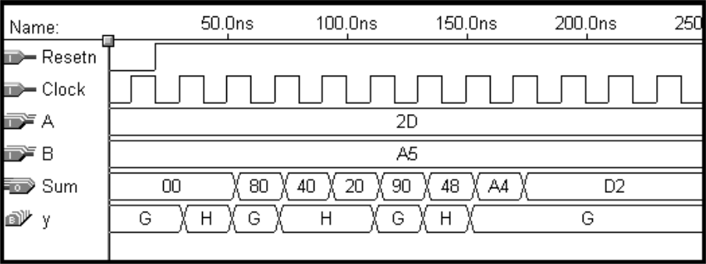
1
0
0
0
a
a
D
D
D
D
7
0
3
2
1
0
L
E
Counter
L
0
w
Q
Q
Q
Q
1
E
3
2
1
0
b
b
Adder
7
0
FSM
Run
L
0
0
0
w
1
E
L
w
E
Clock
Reset
Sum
Sum
7
0
Figure 8.50. Synthesized serial adder.

Slide 53
Reset
000
Idle
0xx
1xx
gnt1
⁄
g
=
1
1
x0x
1xx
01x
gnt2
⁄
g
=
1
2
xx0
x1x
001
gnt3
⁄
g
=
1
3
xx1
Figure 8.72. State diagram for the arbiter.

Slide 54
Reset
r
1
r
2
r
3
Idle
r
1
r
1
gnt1
⁄
g
=
1
1
r
r
1
r
r
2
1
2
gnt2
⁄
g
=
1
2
r
3
r
2
r
r
r
1
2
3
gnt3
⁄
g
=
1
3
r
3
Figure 8.73. Alternative style of state diagram for the arbiter.

Slide 55
LIBRARY ieee;
USE ieee.std_logic_1164.all;
ENTITY arbiter IS
PORT ( Clock, Resetn : IN STD_LOGIC ;
r : IN STD_LOGIC_VECTOR(1 TO 3) ;
g : OUT STD_LOGIC_VECTOR(1 TO 3) ) ;
END arbiter ;
ARCHITECTURE Behavior OF arbiter IS
TYPE State_type IS (Idle, gnt1, gnt2, gnt3) ;
SIGNAL y : State_type ;
BEGIN
PROCESS ( Resetn, Clock )
BEGIN
IF Resetn = '0' THEN y <= Idle ;
ELSIF (Clock'EVENT AND Clock = '1') THEN
CASE y IS
WHEN Idle =>
IF r(1) = '1' THEN y <= gnt1 ;
ELSIF r(2) = '1' THEN y <= gnt2 ;
ELSIF r(3) = '1' THEN y <= gnt3 ;
ELSE y <= Idle ;
END IF ;
WHEN gnt1 =>
IF r(1) = '1' THEN y <= gnt1 ;
ELSE y <= Idle ;
END IF ;
WHEN gnt2 =>
IF r(2) = '1' THEN y <= gnt2 ;
ELSE y <= Idle ;
END IF ;
WHEN gnt3 =>
IF r(3) = '1' THEN y <= gnt3 ;
ELSE y <= Idle ;
END IF ;
END CASE ;
END IF ;
END PROCESS ;
g(1) <= '1' WHEN y = gnt1 ELSE '0' ;
g(2) <= '1' WHEN y = gnt2 ELSE '0' ;
g(3) <= '1' WHEN y = gnt3 ELSE '0' ;
END Behavior ;
Figure 8.74. VHDL code for the arbiter.

Slide 56
.
.
.
PROCESS( y )
BEGIN
IF y = gnt1 THEN g(1) <= '1' ;
ELSIF y = gnt2 THEN g(2) <= '1' ;
ELSIF y = gnt3 THEN g(3) <= '1' ;
END IF ;
END PROCESS ;
END Behavior ;
Figure 8.75. Incorrect VHDL code for the grant signals.

Slide 57
.
.
.
PROCESS( y )
BEGIN
g(1) <= '0' ;
g(2) <= '0' ;
g(3) <= '0' ;
IF y = gnt1 THEN g(1) <= '1' ;
ELSIF y = gnt2 THEN g(2) <= '1' ;
ELSIF y = gnt3 THEN g(3) <= '1' ;
END IF ;
END PROCESS ;
END Behavior ;
Figure 8.76. Correct VHDL code for the grant signals.

Slide 58
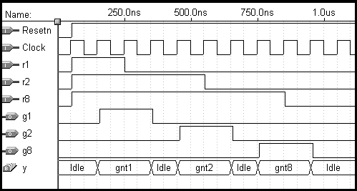
Figure 8.77. Simulation results for the arbiter circuit.

Slide 59
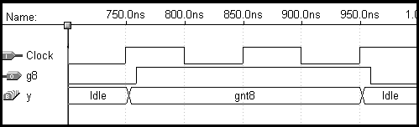
Figure 8.78. Output delays in the arbiter circuit.

Slide 60
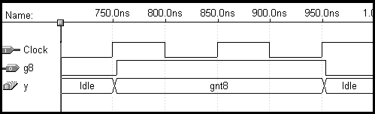
Figure 8.79. Output delay when using one-hot encoding.

