Slide 1

Chapter 4 - Optimized Implementation of Logic Functions
Figure 4.1. The function f (x₁, x₂, x₃) = Σ m(0, 2, 4, 5, 6).
Cpt 4
Portions © Copyright 2009, S. Brown and Z Vranesic

Slide 2
x
1
x
2
x
x
1
0
0
m
2
0
1
0
0
1
m
1
0
m
0
m
2
1
0
m
2
1
m
1
m
3
1
1
m
3
(a) Truth table
(b) Karnaugh map
Figure 4.2. Location of two-variable minterms.
Cpt 4
Portions © Copyright 2009, S. Brown and Z Vranesic

Slide 3
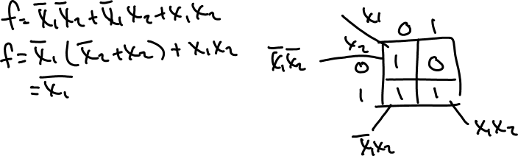
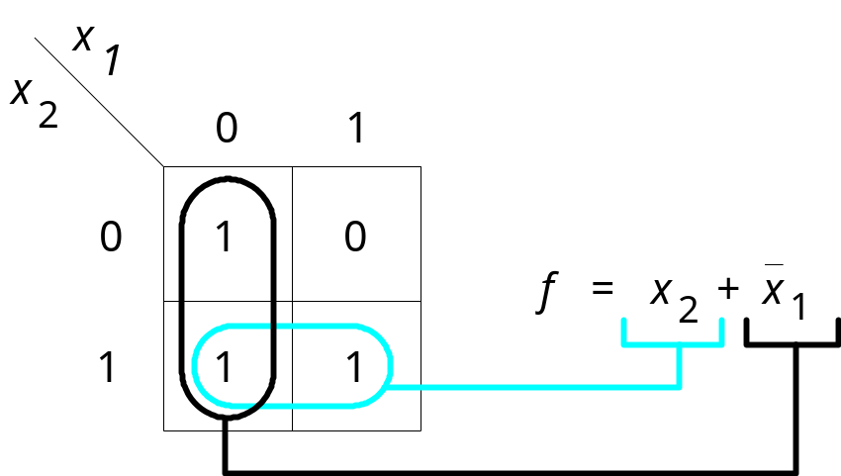
1
Figure 4.3. The function of Figure 2.15.
Cpt 4
Portions © Copyright 2009, S. Brown and Z Vranesic

Slide 4
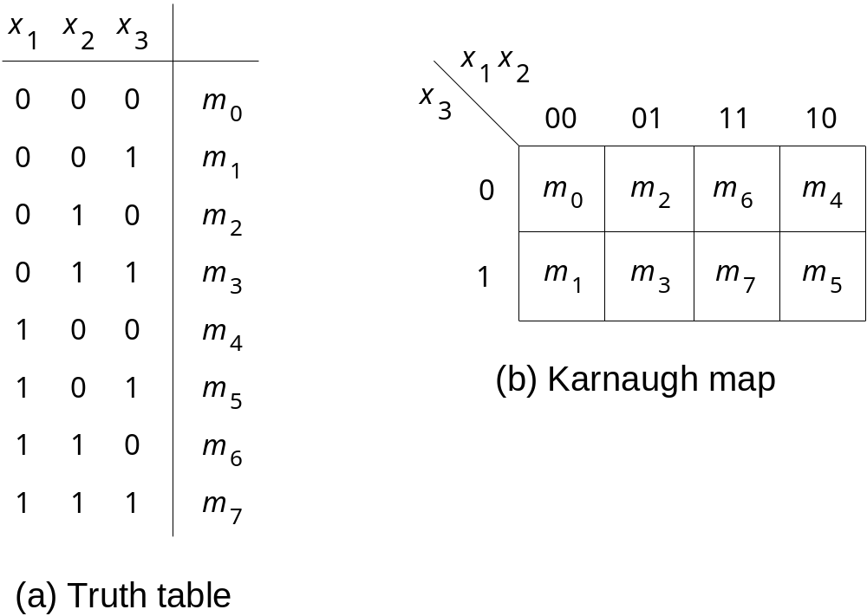
Figure 4.4. Location of three-variable minterms.
Cpt 4
Portions © Copyright 2009, S. Brown and Z Vranesic

Slide 5
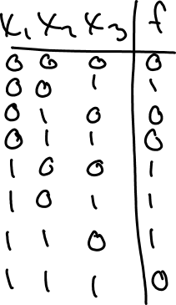
x
1
x
2
x
3
00
01
11
10
0
0
0
1
1
f
=
x
1
x
3
+
x
2
x
3
1
1
0
0
1
(a) The function of Figure 2.18
x
1
x
2
x
3
00
01
11
10
0
1
1
1
1
f
=
x
3
+
x
1
x
2
1
0
0
0
1
(b) The function of Figure 4.1
Figure 4.5. Examples of three-variable Karnaugh maps.
Cpt 4
Portions © Copyright 2009, S. Brown and Z Vranesic

Slide 6
4 Input Truth Table
X1 X2 X3 X4 MINTERM (PRODUCT) MAXTERM (SUM) F(X1,X2,X3,X4)
0 0 0 0 m0 = X1’X2’X3’X4’ M0 = X1 + X2 + X3 + X4 1
0 0 0 1 m1 = X1’X2’X3’X4 M1 = X1 + X2 + X3 + X4’ 1
0 0 1 0 m2 = X1’X2’X3 X4’ M2 = X1 + X2 + X3’ + X4 0
0 0 1 1 m3 = X1’X2’X3 X4 M3 = X1 + X2 + X3’ + X4’ 0
0 1 0 0 m4 = X1’X2 X3’X4’ M4 = X1 + X2’ + X3 + X4 0
0 1 0 1 m5 = X1’X2 X3’X4 M5 = X1 + X2’ + X3 + X4’ 1
0 1 1 0 m6 = X1’X2 X3 X4’ M6 = X1 + X2’ + X3’ + X4 1
0 1 1 1 m7 = X1’X2 X3 X4 M7 = X1 + X2’ + X3’ + X4’ 0
1 0 0 0 m8 = X1 X2’X3’X4’ M8 = X1’ + X2 + X3 + X4 0
1 0 0 1 m9 = X1 X2’X3’X4 M9 = X1’ + X2 + X3 + X4’ 1
1 0 1 0 m10 = X1 X2’X3 X4’ M10 = X1’ + X2 + X3’ + X4 0
1 0 1 1 m11 = X1 X2’X3 X4 M11 = X1’ + X2 + X3’ + X4’ 0
1 1 0 0 m12 = X1 X2 X3’X4’ M12 = X1’ + X2’ + X3 + X4 0
1 1 0 1 m13 = X1 X2 X3’X4 M13 = X1’ + X2’ + X3 + X4’ 1
1 1 1 0 m14 = X1 X2 X3 X4’ M14 = X1’ + X2’ + X3’ + X4 1
1 1 1 1 m15 = X1 X2 X3 X4 M15 = X1’ + X2’ + X3’ + X4’ 0
Cpt 4
Portions © Copyright 2009, S. Brown and Z Vranesic

Slide 7
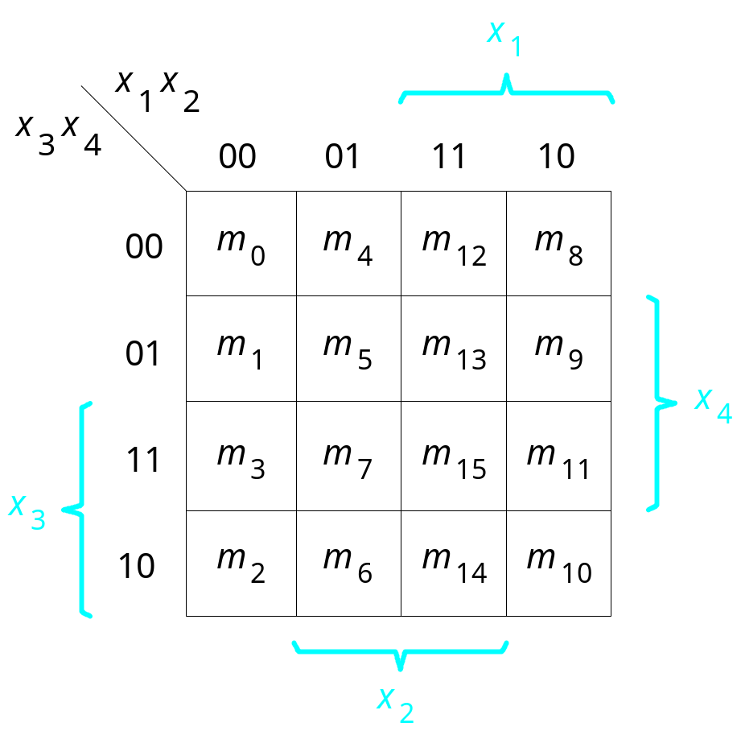
Figure 4.6. A four-variable Karnaugh map.
Cpt 4
Portions © Copyright 2009, S. Brown and Z Vranesic

Slide 8
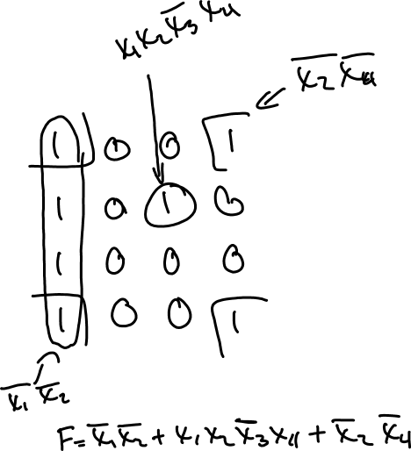
x
1
x
x
x
x
1
2
3
4
00
01
11
10
00
01
x
4
11
x
3
10
x
2
A four-variable Blank Karnaugh map.
Cpt 4
Portions © Copyright 2009, S. Brown and Z Vranesic

Slide 9
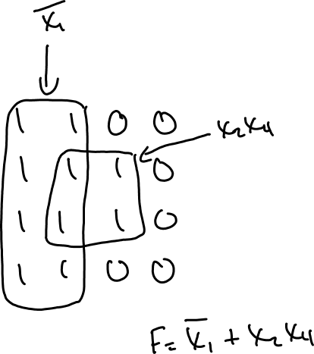
x
1
x
x
x
x
1
2
3
4
00
01
11
10
00
01
x
4
11
x
3
10
x
2
A four-variable Blank Karnaugh map.
Cpt 4
Portions © Copyright 2009, S. Brown and Z Vranesic

Slide 10
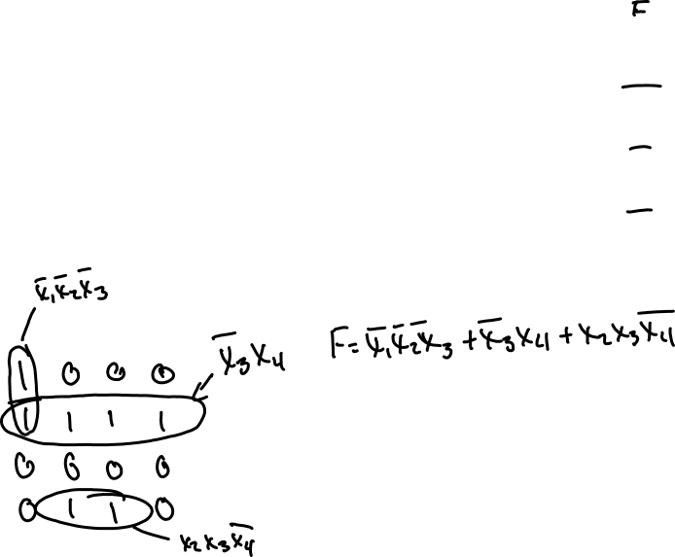
4 Input Truth Table
X1 X2 X3 X4 MINTERM (PRODUCT) MAXTERM (SUM) F(X1,X2,X3,X4)
0 0 0 0 m0 = X1’X2’X3’X4’ M0 = X1 + X2 + X3 + X4 1
0 0 0 1 m1 = X1’X2’X3’X4 M1 = X1 + X2 + X3 + X4’ 1
0 0 1 0 m2 = X1’X2’X3 X4’ M2 = X1 + X2 + X3’ + X4 0
0 0 1 1 m3 = X1’X2’X3 X4 M3 = X1 + X2 + X3’ + X4’ 0
0 1 0 0 m4 = X1’X2 X3’X4’ M4 = X1 + X2’ + X3 + X4 0
0 1 0 1 m5 = X1’X2 X3’X4 M5 = X1 + X2’ + X3 + X4’ 1
0 1 1 0 m6 = X1’X2 X3 X4’ M6 = X1 + X2’ + X3’ + X4 1
0 1 1 1 m7 = X1’X2 X3 X4 M7 = X1 + X2’ + X3’ + X4’ 0
1 0 0 0 m8 = X1 X2’X3’X4’ M8 = X1’ + X2 + X3 + X4 0
1 0 0 1 m9 = X1 X2’X3’X4 M9 = X1’ + X2 + X3 + X4’ 1
1 0 1 0 m10 = X1 X2’X3 X4’ M10 = X1’ + X2 + X3’ + X4 0
1 0 1 1 m11 = X1 X2’X3 X4 M11 = X1’ + X2 + X3’ + X4’ 0
1 1 0 0 m12 = X1 X2 X3’X4’ M12 = X1’ + X2’ + X3 + X4 0
1 1 0 1 m13 = X1 X2 X3’X4 M13 = X1’ + X2’ + X3 + X4’ 1
1 1 1 0 m14 = X1 X2 X3 X4’ M14 = X1’ + X2’ + X3’ + X4 1
1 1 1 1 m15 = X1 X2 X3 X4 M15 = X1’ + X2’ + X3’ + X4’ 0
x
x
x
1
x
x
1
2
3
4
00
01
11
10
00
01
x
4
11
x
3
10
A four-variable Karnaugh map.
Cpt 4
Portions © Copyright 2009, S. Brown and Z Vranesic
x
2

Slide 11
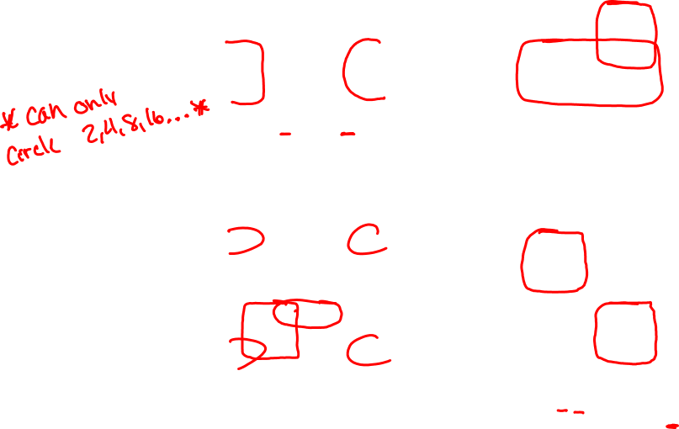
x
1
x
2
x
1
x
2
x
3
x
4
00
01
11
10
x
3
x
4
00
01
11
10
00
0
0
0
0
00
0
0
0
0
01
0
0
1
1
01
0
0
1
1
11
1
0
0
1
11
1
1
1
1
10
1
0
0
1
10
1
1
1
1
f
1
=
x
2
x
3
+
x
1
x
3
x
4
f
2
=
x
3
+
x
1
x
4
x
1
x
2
x
1
x
2
x
3
x
4
00
01
11
10
x
3
x
4
00
01
11
10
00
1
0
0
1
00
1
1
1
0
01
0
0
0
0
01
1
1
1
0
11
1
1
1
0
11
0
0
1
1
10
1
1
0
1
10
0
0
1
1
x
1
x
2
f
3
=
x
2
x
4
+
x
1
x
3
+
x
2
x
3
x
4
f
4
=
x
1
x
3
+
x
1
x
3
+
or
x
2
x
3
Figure 4.7. Examples of four-variable Karnaugh maps.
Cpt 4
Portions © Copyright 2009, S. Brown and Z Vranesic

Slide 12
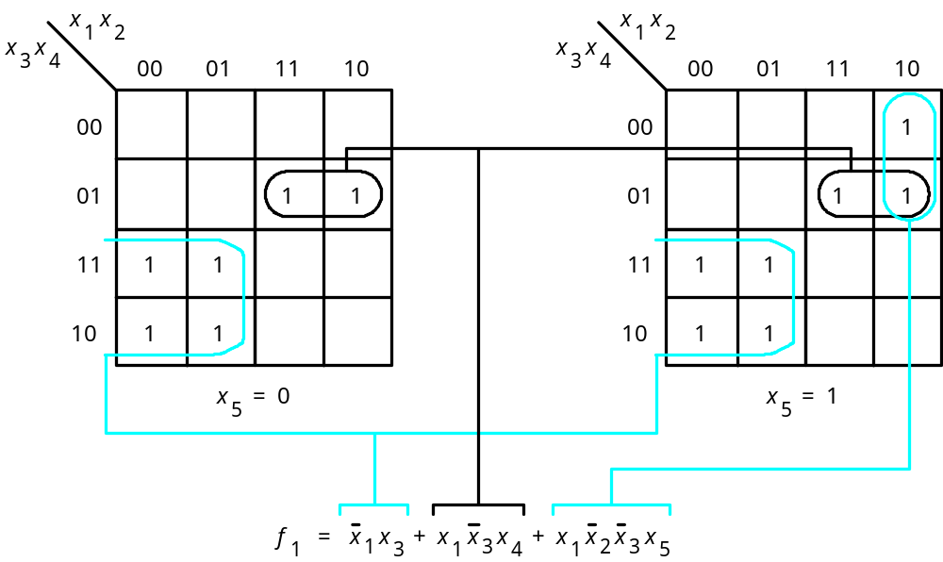
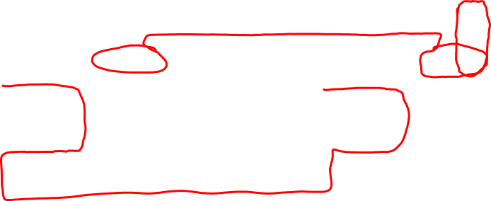
Figure 4.8. A five-variable Karnaugh map.
Cpt 4
Portions © Copyright 2009, S. Brown and Z Vranesic

Slide 13
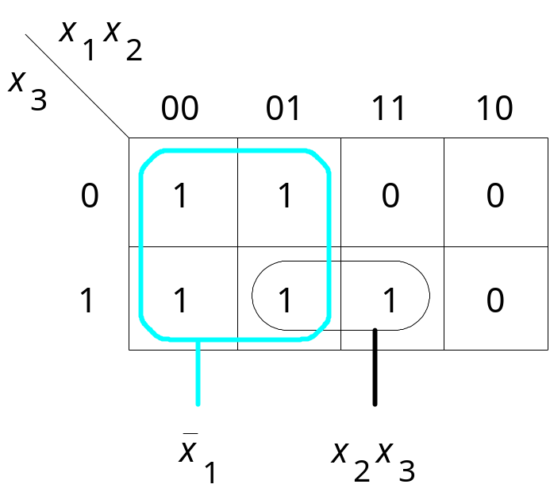
Figure 4.9. Three-variable function f (x₁, x₂, x₃) = Σ m(0, 1, 2, 3, 7).
Cpt 4
Portions © Copyright 2009, S. Brown and Z Vranesic

Slide 14
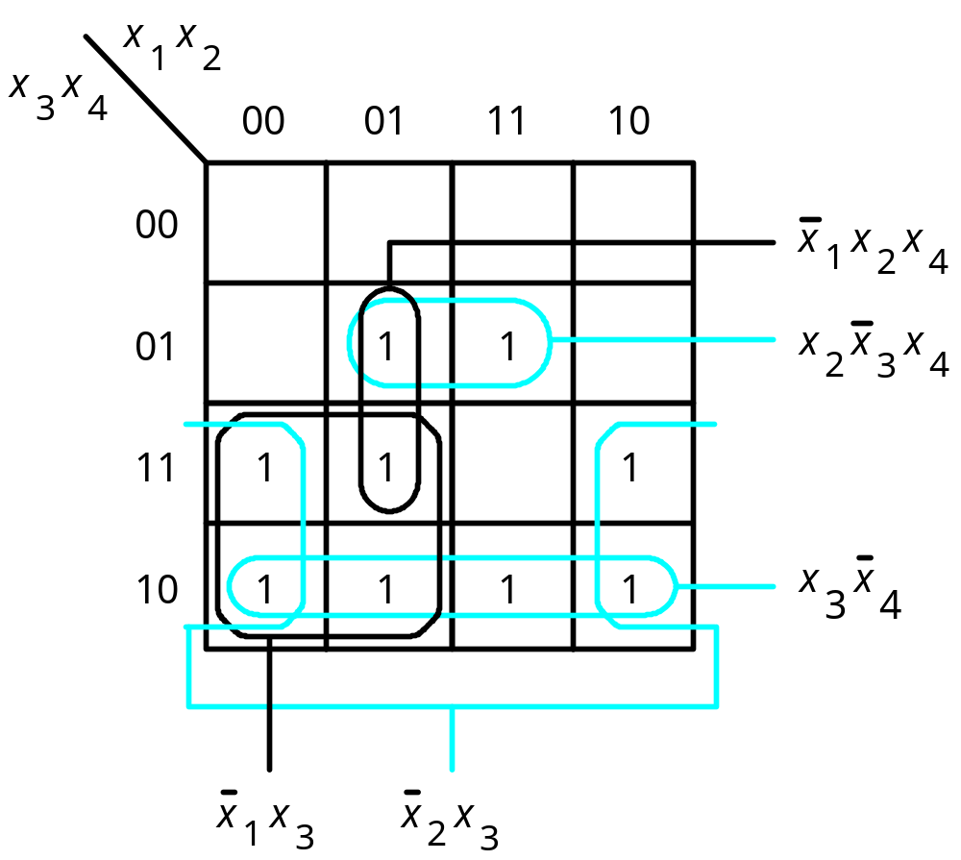
Figure 4.10. Four-variable function f ( x₁,…, x₄) =
Σ m(2, 3, 5, 6, 7, 10, 11, 13, 14).
Cpt 4
Portions © Copyright 2009, S. Brown and Z Vranesic

Slide 15
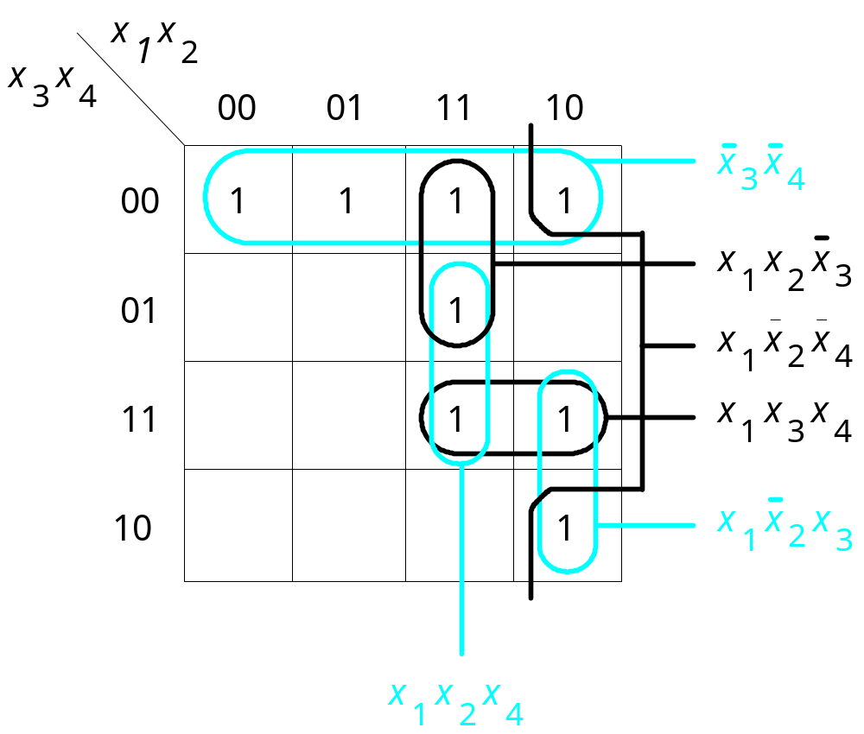
Figure 4.11. The function f ( x₁,…, x₄) =
Σ m(0, 4, 8, 10, 11, 12, 13, 15).
Cpt 4
Portions © Copyright 2009, S. Brown and Z Vranesic

Slide 16
x
1
x
2
x
3
x
4
00
01
11
10
00
1
1
x
1
x
3
x
4
01
1
1
x
2
x
3
x
4
11
1
1
x
1
x
3
x
4
10
1
1
x
2
x
3
x
4
x
1
x
2
x
4
x
1
x
2
x
4
x
1
x
2
x
3
x
1
x
2
x
3
Figure 4.12. The function f ( x₁,…, x₄) =
Σ m(0, 2, 4, 5, 10, 11, 13, 15).
Cpt 4
Portions © Copyright 2009, S. Brown and Z Vranesic

Slide 17
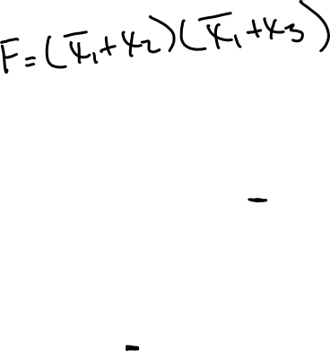
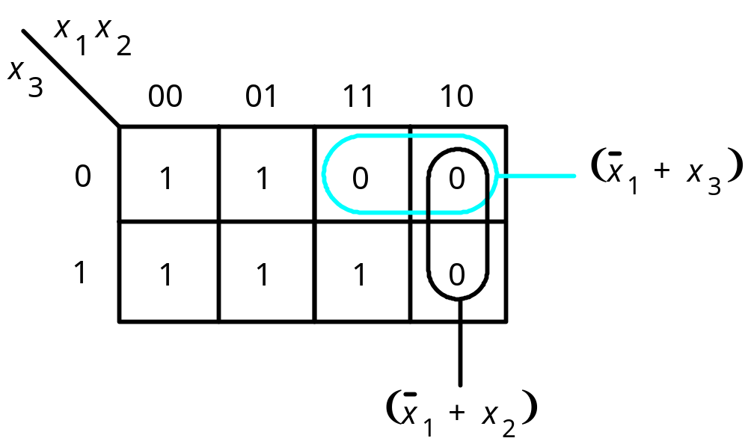
Figure 4.13. POS minimization of f (x₁, x₂, x₃) = Π M(4, 5, 6).
Cpt 4
Portions © Copyright 2009, S. Brown and Z Vranesic

Slide 18
x
x
x
x
1
2
3
4
00
01
11
10
(
)
00
0
0
0
0
x
3
+
x
4
01
0
1
1
0
(
)
x
2
+
x
3
11
1
1
0
1
10
1
1
1
1
(
)
x
1
+
x
2
+
x
3
+
x
4
Figure 4.14. POS minimization of f ( x₁,…, x₄) =
Π M(0, 1, 4, 8, 9, 12, 15).
Cpt 4
Portions © Copyright 2009, S. Brown and Z Vranesic

Slide 19
x
x
x
1
x
2
x
x
1
2
x
x
3
4
00
01
11
10
3
4
00
01
11
10
(
x
2
+
x
)
00
0
1
d
0
3
00
0
1
d
0
x
2
x
3
01
0
1
d
0
01
0
1
d
0
11
0
0
d
0
11
0
0
d
0
(
x
3
+
x
)
4
10
1
1
d
1
x
3
x
4
10
1
1
d
1
(a) SOP implementation
(b) POS implementation
Figure 4.15. Two implementations of the function f ( x₁,…, x₄) =
Σ m(2, 4, 5, 6, 10) + D(12, 13, 14, 15).
Cpt 4
Portions © Copyright 2009, S. Brown and Z Vranesic

Slide 20
x
1
x
2
x
1
x
2
x
3
x
4
00
01
11
10
x
3
x
4
00
01
11
10
00
1
1
00
1
1
01
1
1
1
01
1
1
11
1
1
11
1
1
1
10
1
1
10
1
1
(a) Function
f
1
(b) Function
f
2
x
2
x
3
x
4
f
1
Figure 4.16. An example of multiple-output synthesis.
x
1
x
3
x
1
x
3
x
f
2
2
x
3
x
4
Cpt 4
(c) Combined circuit for
f
1
and
f
2
Portions © Copyright 2009, S. Brown and Z Vranesic

Slide 21
x
1
x
2
x
1
x
2
x
3
x
4
00
01
11
10
x
3
x
4
00
01
11
10
00
00
01
1
1
1
01
1
1
1
11
1
1
1
11
1
1
1
10
1
10
1
(a) Optimal realization of
f
3
(b) Optimal realization of
f
4
x
1
x
2
x
1
x
2
x
3
x
4
00
01
11
10
x
3
x
4
00
01
11
10
00
00
01
1
1
1
01
1
1
1
11
1
1
1
11
1
1
1
10
1
10
1
(c) Optimal realization of
f
3
and
f
4
together
Figure 4.17. An example of multiple-output synthesis.
Cpt 4
Portions © Copyright 2009, S. Brown and Z Vranesic

Slide 22
x
1
x
4
x
1
f
3
x
2
x
4
x
1
x
2
x
3
x
4
f
4
x
2
x
4
(d) Combined circuit for
f
3
and
f
4
Figure 4.17. An example of multiple-output synthesis.
Cpt 4
Portions © Copyright 2009, S. Brown and Z Vranesic

Slide 23
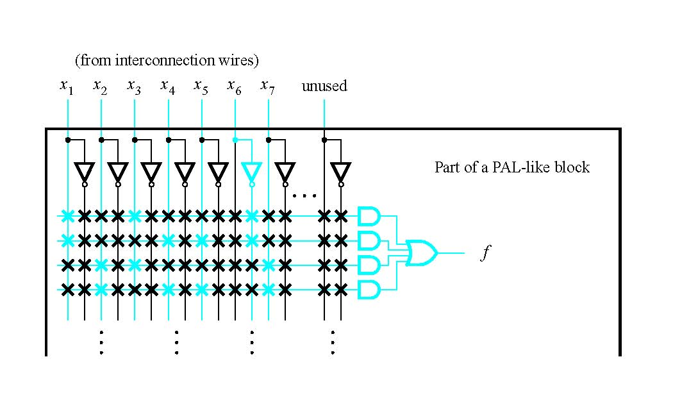
Figure 4.18. Implementation in a CPLD.
Cpt 4
Portions © Copyright 2009, S. Brown and Z Vranesic

Slide 24
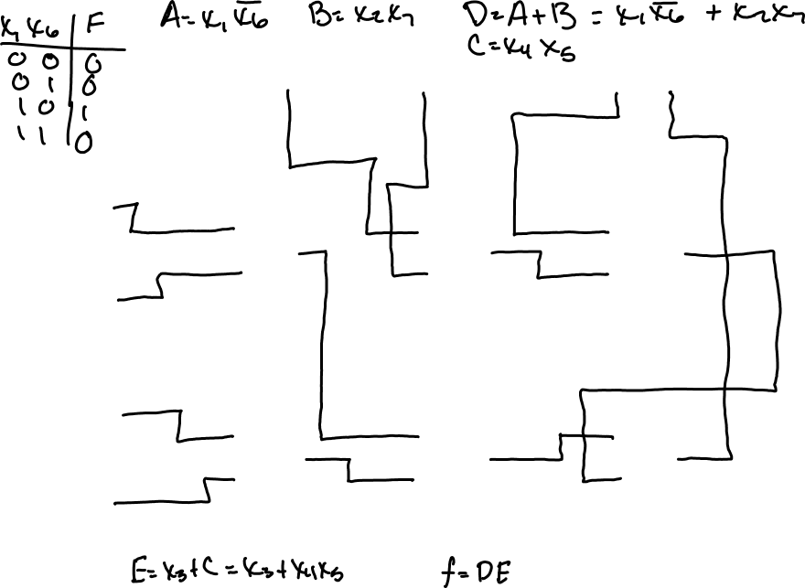
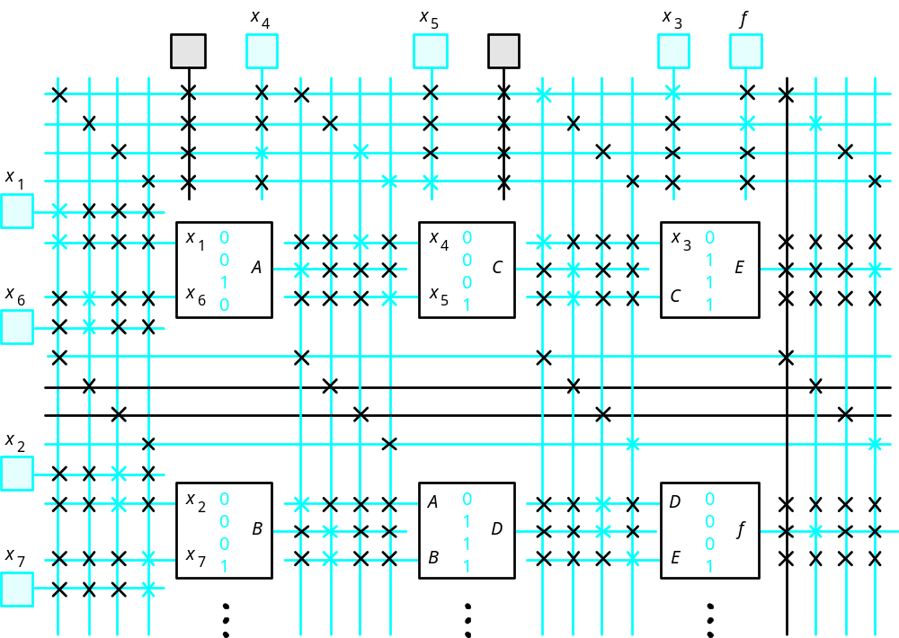
Figure 4.19. Implementation in an FPGA.
Cpt 4
Portions © Copyright 2009, S. Brown and Z Vranesic

Slide 25
7 inputs
Figure 4.20. Using four-input AND gates to realize a seven-input product term.
Cpt 4
Portions © Copyright 2009, S. Brown and Z Vranesic

Slide 26
x
1
x
2
x
4
x
x
6
3
x
5
x
2
x
3
x
5
f = x1 x2’ x3 x4’ x5 x6 + x1 x2 x3’ x4’ x5’ x6
f = x1 x4’ x6 (x2’ x3 x5 + x2 x3’ x5’)
Figure 4.21. A factored circuit.
Cpt 4
Portions © Copyright 2009, S. Brown and Z Vranesic

Slide 27
x
1
x
2
f
1
x
3
f
2
x
4
Figure 4.22. Circuit for Example 4.5.
Cpt 4
Portions © Copyright 2009, S. Brown and Z Vranesic

Slide 28
x
1
x
3
g
f
x
2
x
4
f = x1’ x2 x3 + x1 x2’ x3 + x1 x2 x4 + x1’ x2’ x4
f = (x1’ x2 +x1 x2’) x3 + (x1 x2 +x1’ x2’) x4
Let g(x1, x2) = x1’ x2 + x1 x2’
Then f = g x3 + g’ x4
Figure 4.23. Logic circuit for Example 4.6.
Cpt 4
Portions © Copyright 2009, S. Brown and Z Vranesic

Slide 29
x
1
x
3
g
f
x
2
x
4
x
1
x
g
2
x
h
f
3
x
4
Figure 4.24. The structure of decomposition in Example 4.6.
Cpt 4
Portions © Copyright 2009, S. Brown and Z Vranesic

Slide 30
x
1
x
1
⊕
x
2
x
2
(a) Sum-of-products implementation
x
1
Figure 4.26. Implementation of XOR.
x
⊕
x
1
2
x
2
(b) NAND gate implementation
Cpt 4
Portions © Copyright 2009, S. Brown and Z Vranesic

Slide 31
x
1
g
x
⊕
x
1
2
x
2
(c) Optimal NAND gate implementation
Figure 4.26. Implementation of XOR.
Cpt 4
Portions © Copyright 2009, S. Brown and Z Vranesic

Slide 32
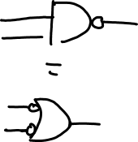
x
1
x
2
x
3
x
f
4
x
5
x
6
x
7
(a) Circuit with AND and OR gates
x
1
x
2
x
3
x
f
4
x
5
x
6
x
7
(b) Inversions needed to convert to NANDs
Figure 4.27. Conversion to a NAND-gate circuit.
Cpt 4
Portions © Copyright 2009, S. Brown and Z Vranesic

Slide 33
x
1
x
2
x
3
x
f
4
x
5
x
6
x
7
(c) NAND-gate circuit
Figure 4.27. Conversion to a NAND-gate circuit.
Cpt 4
Portions © Copyright 2009, S. Brown and Z Vranesic

Slide 34
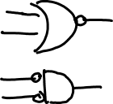
x
1
x
2
x
3
x
f
4
x
5
x
6
x
7
(a) Inversions needed to convert to NORs
Figure 4.28. Conversion to a NOR-gate circuit.
Cpt 4
Portions © Copyright 2009, S. Brown and Z Vranesic

Slide 35
x
1
x
2
x
3
f
x
4
x
5
x
6
x
7
(b) NOR-gate circuit
Figure 4.28. Conversion to a NOR-gate circuit.
Cpt 4
Portions © Copyright 2009, S. Brown and Z Vranesic

Slide 36
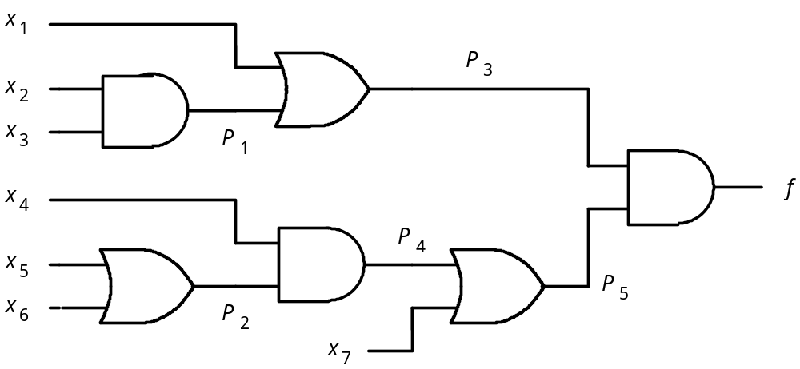
Figure 4.29. Circuit for Example 4.10.
Cpt 4
Portions © Copyright 2009, S. Brown and Z Vranesic

Slide 37
LIBRARY ieee ;
USE ieee.std logic_1164.all ;
ENTITY func1 IS
PORT ( x1, x2, x3 : IN STD_LOGIC ;
f : OUT STD_ LOGIC ) ;
END func1 ;
ARCHITECTURE LogicFunc OF func1 IS
BEGIN
f <= (NOT x1 AND NOT x2 AND NOT x3) OR
(NOT x1 AND x2 AND NOT x3) OR
(x1 AND NOT x2 AND NOT x3) OR
(x1 AND NOT x2 AND x3) OR
(x1 AND x2 AND NOT x3) ;
END LogicFunc ;
Figure 4.44. The VHDL code for the function in Figure 4.1.
Cpt 4
Portions © Copyright 2009, S. Brown and Z Vranesic

Slide 38
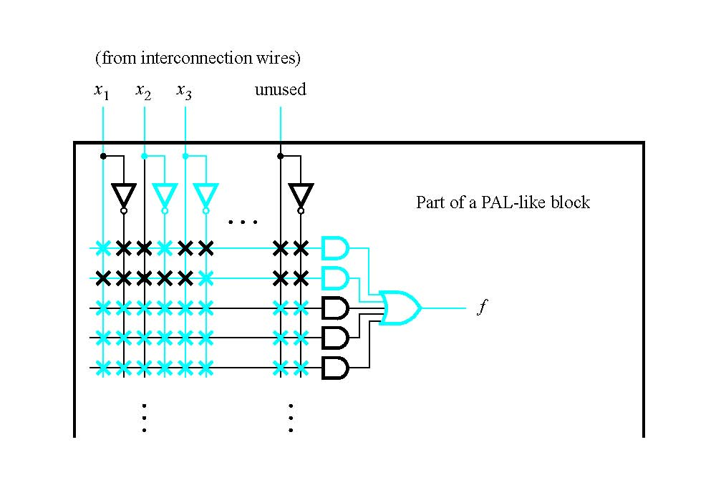
Figure 4.45. Implementation of the VHDL code in Figure 4.44.
Cpt 4
Portions © Copyright 2009, S. Brown and Z Vranesic

Slide 39
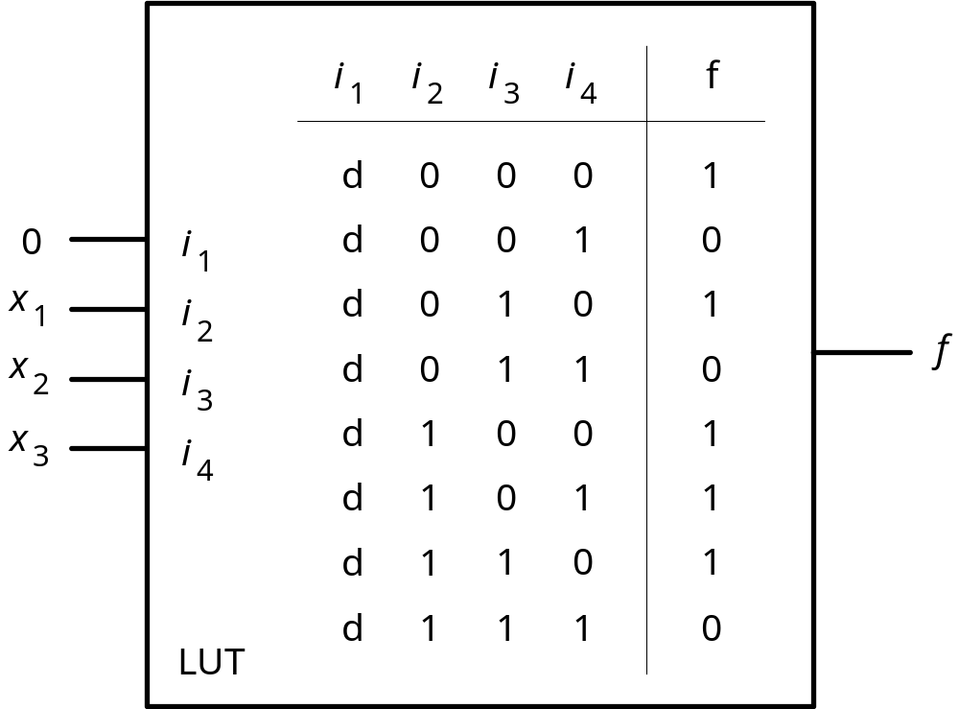
Figure 4.46. The VHDL code in Figure 4.44 implemented in a LUT.
Cpt 4
Portions © Copyright 2009, S. Brown and Z Vranesic

Slide 40
LIBRARY ieee ;
USE ieee.std_logic_1164.all ;
ENTITY func2 IS
PORT ( x1, x2, x3, x4 : IN STD_LOGIC ;
f : OUT STD_LOGIC ) ;
END func2 ;
ARCHITECTURE LogicFunc OF func2 IS
BEGIN
f <= (NOT x1 AND NOT x2 AND x3 AND NOT x4) OR
(NOT x1 AND NOT x2 AND x3 AND x4) OR
(x1 AND NOT x2 AND NOT x3 AND x4) OR
(x1 AND NOT x2 AND x3 AND NOT x4) OR
(x1 AND NOT x2 AND x3 AND x4) OR
(x1 AND x2 AND NOT x3 AND x4) ;
END LogicFunc ;
Figure 4.47. The VHDL code for f₁ in Figure 4.7.
Cpt 4
Portions © Copyright 2009, S. Brown and Z Vranesic

Slide 41
LIBRARY ieee ;
USE ieee.std_logic_1164.all ;
ENTITY func3 IS
PORT ( x1, x2, x3, x4, x5, x6, x7 : IN STD_LOGIC ;
f : OUT STD_LOGIC ) ;
END func3 ;
ARCHITECTURE LogicFunc OF func3 IS
BEGIN
f <= (x1 AND x3 AND NOT x6) OR
(x1 AND x4 AND x5 AND NOT x6) OR
(x2 AND x3 AND x7) OR
(x2 AND x4 AND x5 AND x7) ;
END LogicFunc ;
Figure 4.48. The VHDL code for the function of section 4.7.
Cpt 4
Portions © Copyright 2009, S. Brown and Z Vranesic

Slide 42
0
x
x
x
x
1
1
3
6
x
3
x
6
x
x
1
x
x
x
x
4
1
4
5
6
x
5
x
6
f
0
x
x
x
x
2
2
3
7
x
3
x
7
x
2
x
x
x
x
x
2
4
5
7
4
x
5
x
7
(a) Sum-of-products realization
Figure 4.49. Implementation of the VHDL code in Figure 4.48.
Cpt 4
Portions © Copyright 2009, S. Brown and Z Vranesic

Slide 43
x
1
x
x
1
x
+
x
x
2
6
2
7
x
6
x
7
x
3
f
x
4
x
5
(b) Factored realization
Figure 4.49. Implementation of the VHDL code in Figure 4.48.
Cpt 4
Portions © Copyright 2009, S. Brown and Z Vranesic

