Slide 1
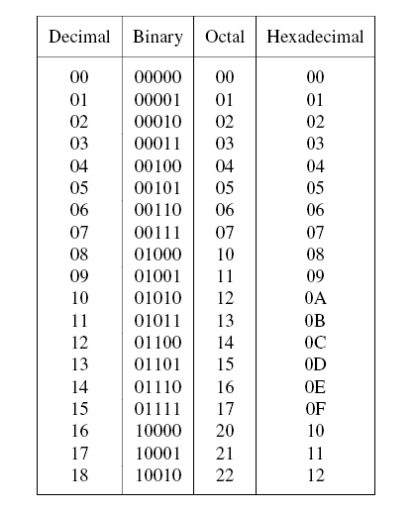
Chapter 5 – Number Representation and Arithmetic Circuits
Figure 5.1. Numbers in different systems.
Cpt 5
Portions © Copyright 2009, S. Brown and Z Vranesic

Slide 2
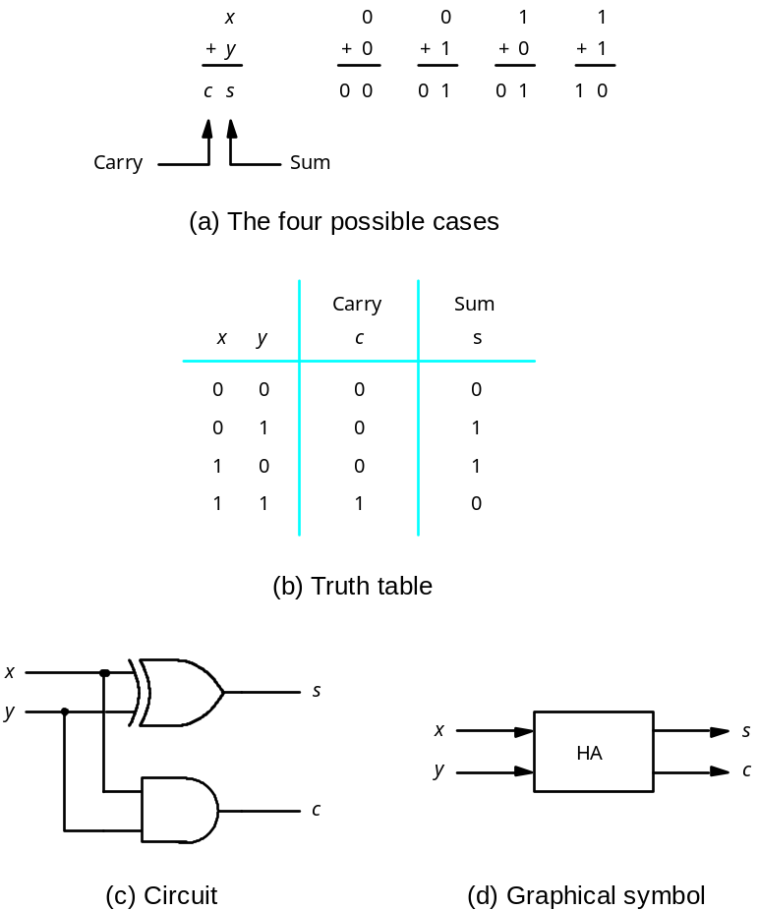
Addition of Unsigned Numbers
Figure 5.2. Half-adder.
Cpt 5
Portions © Copyright 2009, S. Brown and Z Vranesic

Slide 3

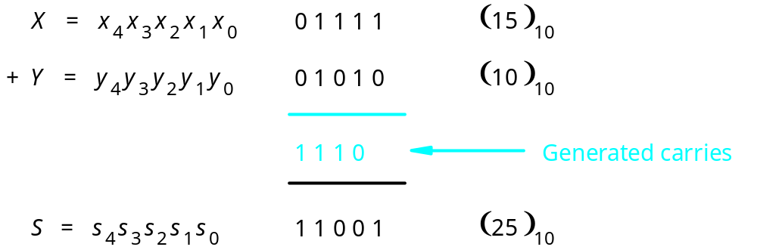
Figure 5.3. An example of addition.
Cpt 5
Portions © Copyright 2009, S. Brown and Z Vranesic

Slide 4
Full Adder
x
y
c
i
i
i
00
01
11
10
c
x
y
c
s
0
1
1
i
i
i
i
+
1
i
1
1
1
0
0
0
0
0
0
0
1
0
1
s
=
⊕
⊕
i
x
y
c
0
1
0
0
1
i
i
i
0
1
1
1
0
x
y
1
0
0
0
1
c
i
i
1
0
1
1
0
i
00
01
11
10
1
1
0
1
0
0
1
1
1
1
1
1
1
1
1
1
(a) Truth table
c
=
x
y
+
i
+
1
i
i
x
c
+
y
c
i
i
i
i
(b) Karnaugh maps
x
i
y
s
i
i
c
i
Figure 5.4. Full-adder.
c
i
+
1
Cpt 5
(c) Circuit
Portions © Copyright 2009, S. Brown and Z Vranesic

Slide 5
c
s
s
i
s
HA
c
i
x
i
HA
c
c
y
i
+
1
i
(a) Block diagram
c
i
s
i
x
i
y
i
c
i
+
1
(b) Detailed diagram
Figure 5.5. A decomposed implementation of the full-adder circuit.
Cpt 5
Portions © Copyright 2009, S. Brown and Z Vranesic

Slide 6
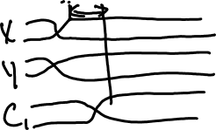
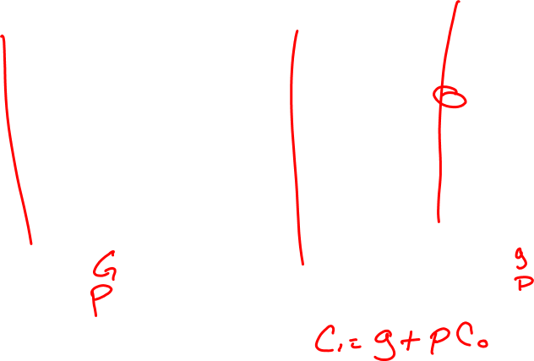
x
y
x
y
x
y
n –
1
n
–
1
1
1
0
0
c
c
c
c
1
c
n
FA
n
”
1
2
FA
FA
0
s
s
s
n
–
1
1
0
MSB position
LSB position
Figure 5.6. An n-bit ripple-carry adder.
Cpt 5
Portions © Copyright 2009, S. Brown and Z Vranesic

Slide 7
b
n
–
1
b
1
b
0
Magnitude
MSB
(a) Unsigned number
b
n
–
1
b
n
–
2
b
1
b
0
Sign
Magnitude
0 denotes
+
1 denotes
–
MSB
(b) Signed number
Figure 5.8. Formats for representation of integers.
Cpt 5
Portions © Copyright 2009, S. Brown and Z Vranesic

Slide 8
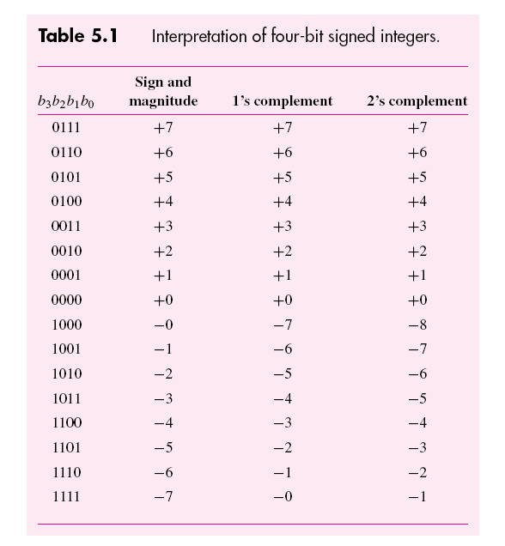
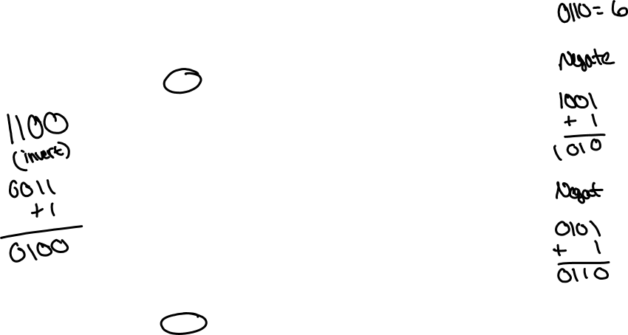
Cpt 5
Portions © Copyright 2009, S. Brown and Z Vranesic

Slide 9
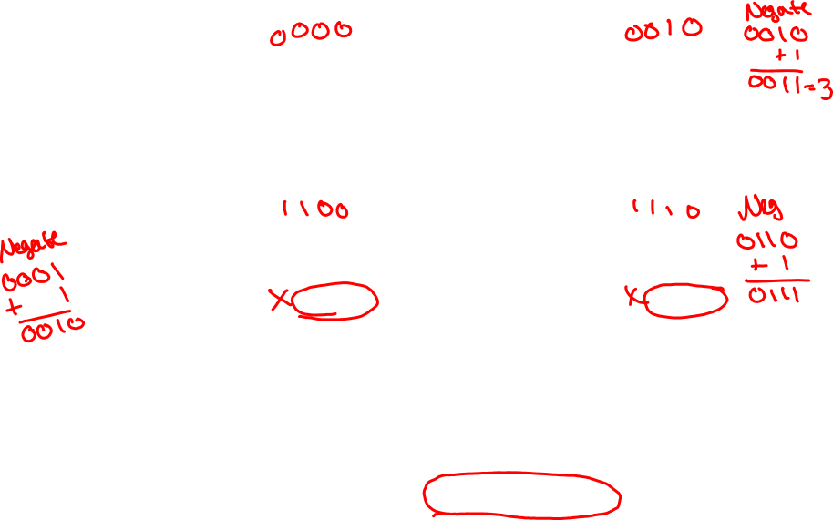
(
+
5
)
0 1 0 1
(
–
5
)
1 0 1 1
+
(
+
2
)
+
0 0 1 0
+
(
+
2
)
+
0 0 1 0
(
+
7
)
0 1 1 1
(
–
3
)
1 1 0 1
(
+
5
)
0 1 0 1
(
–
5
)
1 0 1 1
+
(
–
2
)
+
1 1 1 0
+
(
–
2
)
+
1 1 1 0
(
+
3
)
1
0 0 1 1
(
–
7
)
1
1 0 0 1
ignore
ignore
Figure 5.10. Examples of 2’s complement addition.
Cpt 5
Portions © Copyright 2009, S. Brown and Z Vranesic

Slide 10
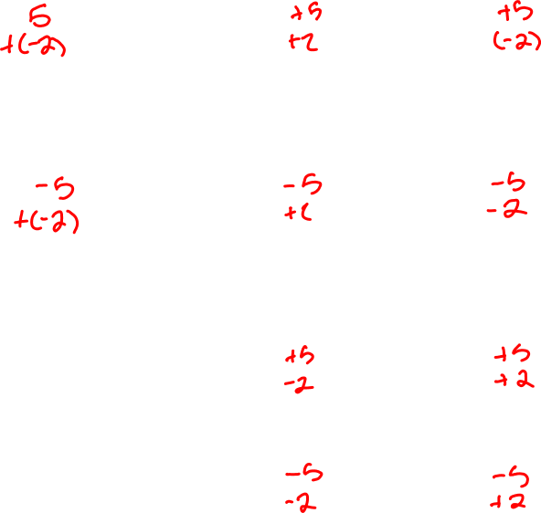
(
+
5
)
0 1 0 1
0 1 0 1
–
(
+
2
)
–
0 0 1 0
+
1 1 1 0
(
+
3
)
1
0 0 1 1
ignore
(
–
5
)
1 0 1 1
1 0 1 1
–
(
+
2
)
–
0 0 1 0
+
1 1 1 0
(
–
7
)
1
1 0 0 1
ignore
(
+
5
)
0 1 0 1
0 1 0 1
–
(
–
2
)
–
1 1 1 0
+
0 0 1 0
(
+
7
)
0 1 1 1
(
–
5
)
1 0 1 1
1 0 1 1
–
(
–
2
)
–
1 1 1 0
+
0 0 1 0
(
–
3
)
1 1 0 1
Figure 5.11. Examples of 2’s complement subtraction.
Cpt 5
Portions © Copyright 2009, S. Brown and Z Vranesic

Slide 11
0000
1111
0001
1110
0
0010
–
1
+
1
1101
–
2
+
2
0011
–
3
+
3
1100
–
4
+
4
0100
–
5
+
5
1011
0101
–
6
+
6
–
7
–
8
+
7
1010
0110
1001
0111
1000
Figure 5.12. Graphical interpretation of four-bit 2’s complement numbers.
Cpt 5
Portions © Copyright 2009, S. Brown and Z Vranesic

Slide 12
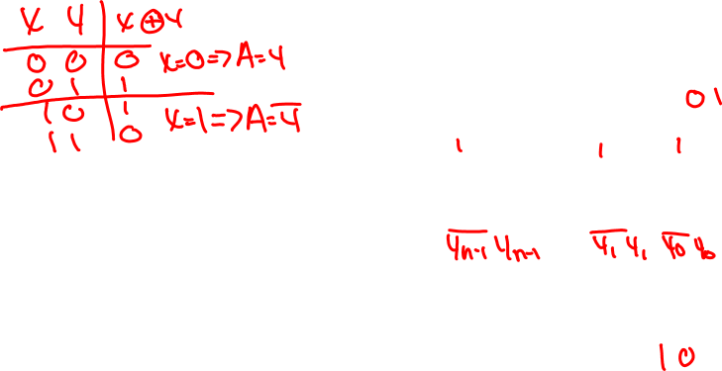
y
y
y
n
–
1
1
0
Add
⁄
Sub
control
x
x
x
n
–
1
1
0
c
n
c
n
-bit adder
0
s
s
s
n
–
1
1
0
Figure 5.13. Adder/subtractor unit.
Cpt 5
Portions © Copyright 2009, S. Brown and Z Vranesic

Slide 13
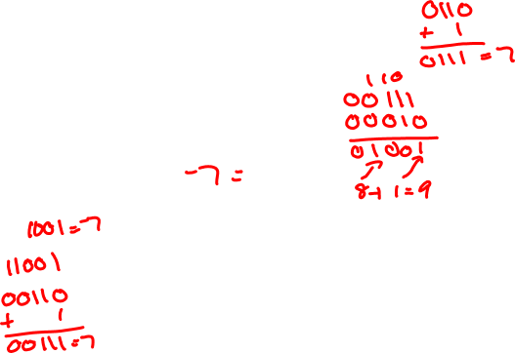
(
+
7
)
0 1 1 1
(
–
7
)
1 0 0 1
+
(
+
2
)
+
0 0 1 0
+
(
+
2
)
+
0 0 1 0
(
+
9
)
1 0 0 1
(
–
5
)
1 0 1 1
c
4
=
0
c
4
=
0
c
3
=
1
c
3
=
0
(
+
7
)
0 1 1 1
(
–
7
)
1 0 0 1
+
(
–
2
)
+
1 1 1 0
+
(
–
2
)
+
1 1 1 0
(
+
5
)
1
0 1 0 1
(
–
9
)
1
0 1 1 1
c
4
=
1
c
4
=
1
c
3
=
1
c
3
=
0
Figure 5.14. Examples of determination of overflow.
Cpt 5
Portions © Copyright 2009, S. Brown and Z Vranesic

Slide 14
x
y
x
y
1
1
0
0
g
p
g
p
1
1
0
0
c
1
c
2
c
0
Stage 1
Stage 0
s
s
1
0
Figure 5.15. A ripple-carry adder based on expression 5.3.
Cpt 5
Portions © Copyright 2009, S. Brown and Z Vranesic

Slide 15

Carry-lookahead adder
An approach in-between our two extremes
Motivation:
  If we didn't know the value of carry-in, what could we do?
  When would we always generate a carry? gi = xi • yi
  When would we propagate the carry? pi = xi + yi
Did we get rid of the ripple?
c1 = g0 + p0c0
c2 = g1 + p1c1 = g1 + p1g0 + p1p0c0
c3 = g2 + p2c2 = g2 + p2g1 + p2p1g0 + p2p1p0c0
c4 = g3 + p3c3 = g3 + p3g2 + p3p2g1 + p3p2p1g0 + p3p2p1p0c0
Cpt 5
Portions © Copyright 2009, S. Brown and Z Vranesic

Slide 16
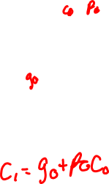
x
1
y
x
y
1
0
0
x
0
y
0
g
p
g
p
1
1
0
0
c
0
c
2
c
1
s
s
1
0
Figure 5.16. The first two stages of a carry-lookahead adder.
Cpt 5
Portions © Copyright 2009, S. Brown and Z Vranesic

Slide 17
x
31
–
24
y
31
–
24
x
15
–
8
y
15
–
8
x
7
–
0
y
7
–
0
c
8
c
Block
c
c
Block
Block
c
32
3
24
16
1
0
0
s
31
–
24
s
15
–
8
s
7
–
0
Figure 5.17. A hierarchical carry-lookahead adder with
ripple-carry between blocks.
Cpt 5
Portions © Copyright 2009, S. Brown and Z Vranesic

Slide 18

x
31
–
24
y
31
–
24
x
15
–
8
y
15
–
8
x
y
7
–
0
7
–
0
Block
Block
Block
c
3
c
1
0
0
24
G
3
P
3
G
1
P
1
G
0
P
0
s
s
s
31
–
24
15
–
8
7
–
0
c
32
c
c
16
8
Second-level lookahead
Figure 5.18. A hierarchical carry-lookahead adder.
Cpt 5
Portions © Copyright 2009, S. Brown and Z Vranesic

Slide 19
x
1
y
1
x
y
0
0
g
p
g
p
1
1
0
0
c
0
c
2
c
1
s
s
1
0
Figure 5.19. An alternative design for a carry-lookahead adder.
Cpt 5
Portions © Copyright 2009, S. Brown and Z Vranesic

Slide 20
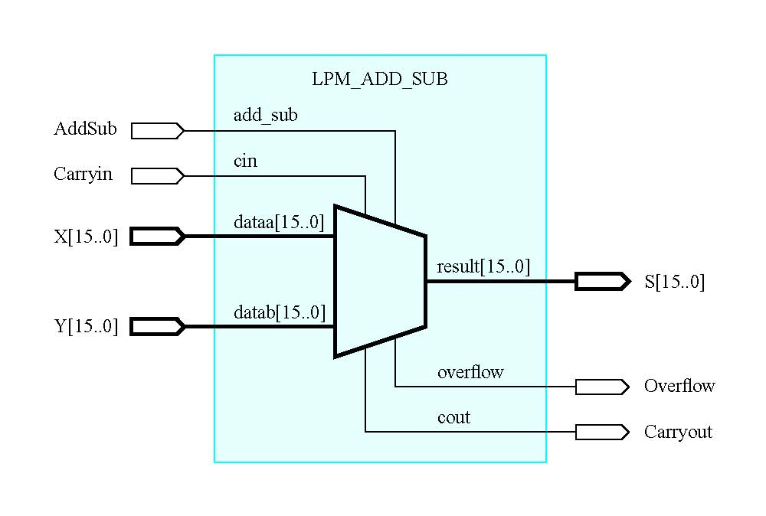
Figure 5.20. Schematic using an LPM adder/subtractor module.
Cpt 5
Portions © Copyright 2009, S. Brown and Z Vranesic

Slide 21
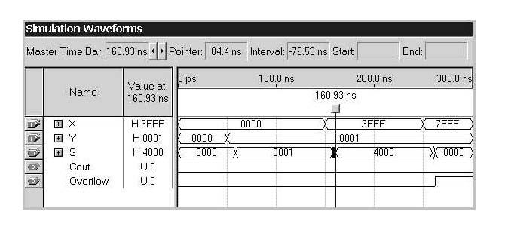
Figure 5.21. Simulation results for the LPM adder.
Cpt 5
Portions © Copyright 2009, S. Brown and Z Vranesic

Slide 22
LIBRARY ieee ;
USE ieee.std_logic_1164.all ;
ENTITY fulladd IS
PORT ( Cin, x, y : IN STD_LOGIC ;
s, Cout : OUT STD_LOGIC ) ;
END fulladd ;
ARCHITECTURE LogicFunc OF fulladd IS
BEGIN
s <= x XOR y XOR Cin ;
Cout <= (x AND y) OR (Cin AND x) OR (Cin AND y) ;
END LogicFunc ;
Figure 5.22. VHDl code for the full-adder.
Cpt 5
Portions © Copyright 2009, S. Brown and Z Vranesic

Slide 23
LIBRARY ieee ;
USE ieee.std_logic_1164.all ;
ENTITY adder4 IS
PORT ( Cin : IN STD LOGIC ;
x3, x2, x1, x0 : IN STD_LOGIC ;
y3, y2, y1, y0 : IN STD_LOGIC ;
s3, s2, s1, s0 : OUT STD_OGIC ;
Cout : OUT STD_LOGIC ) ;
END adder4 ;
ARCHITECTURE Structure OF adder4 IS
SIGNAL c1, c2, c3 : STD_LOGIC ;
COMPONENT fulladd
PORT ( Cin, x, y : IN STD_LOGIC ;
s, Cout : OUT STD_LOGIC ) ;
END COMPONENT ;
BEGIN
stage0: fulladd PORT MAP ( Cin, x0, y0, s0, c1 ) ;
stage1: fulladd PORT MAP ( c1, x1, y1, s1, c2 ) ;
stage2: fulladd PORT MAP ( c2, x2, y2, s2, c3 ) ;
stage3: fulladd PORT MAP (
Cin => c3, Cout => Cout, x => x3, y => y3, s => s3 ) ;
END Structure ;
Figure 5.23. VHDL code for a four-bit adder.
Cpt 5
Portions © Copyright 2009, S. Brown and Z Vranesic

Slide 24
LIBRARY ieee ;
USE ieee.std_logic_1164.all ;
PACKAGE fulladd_package IS
COMPONENT fulladd
PORT ( Cin, x, y : IN STD_LOGIC ;
s, Cout : OUT STD_LOGIC ) ;
END COMPONENT ;
END fulladd_package ;
Figure 5.24. Declaration of a package.
Cpt 5
Portions © Copyright 2009, S. Brown and Z Vranesic

Slide 25
LIBRARY ieee ;
USE ieee.std_logic_1164.all ;
USE work.fulladd_package.all ;
ENTITY adder4 IS
PORT ( Cin : IN STD_LOGIC ;
x3, x2, x1, x0 : IN STD_LOGIC ;
y3, y2, y1, y0 : IN STD_LOGIC ;
s3, s2, s1, s0 : OUT STD_LOGIC ;
Cout : OUT STD_LOGIC ) ;
END adder4 ;
ARCHITECTURE Structure OF adder4 IS
SIGNAL c1, c2, c3 : STD_LOGIC ;
BEGIN
stage0: fulladd PORT MAP ( Cin, x0, y0, s0, c1 ) ;
stage1: fulladd PORT MAP ( c1, x1, y1, s1, c2 ) ;
stage2: fulladd PORT MAP ( c2, x2, y2, s2, c3 ) ;
stage3: fulladd PORT MAP (
Cin => c3, Cout => Cout, x => x3, y => y3, s => s3 ) ;
END Structure ;
Figure 5.25. A different way of specifying a four-bit adder.
Cpt 5
Portions © Copyright 2009, S. Brown and Z Vranesic

Slide 26
LIBRARY ieee ;
USE ieee.std_logic_1164.all ;
USE work.fulladd_package.all ;
ENTITY adder4 IS
PORT ( Cin : IN STD_LOGIC ;
X, Y : IN STD_LOGIC_VECTOR(3 DOWNTO 0) ;
S : OUT STD_LOGIC_VECTOR(3 DOWNTO 0) ;
Cout : OUT STD_LOGIC ) ;
END adder4 ;
ARCHITECTURE Structure OF adder4 IS
SIGNAL C : STD_LOGIC_VECTOR(1 TO 3) ;
BEGIN
stage0: fulladd PORT MAP ( Cin, X(0), Y(0), S(0), C(1) ) ;
stage1: fulladd PORT MAP ( C(1), X(1), Y(1), S(1), C(2) ) ;
stage2: fulladd PORT MAP ( C(2), X(2), Y(2), S(2), C(3) ) ;
stage3: fulladd PORT MAP ( C(3), X(3), Y(3), S(3), Cout ) ;
END Structure ;
Figure 5.26. A four-bit adder defined using multibit signals.
Cpt 5
Portions © Copyright 2009, S. Brown and Z Vranesic

Slide 27
LIBRARY ieee ;
USE ieee.std_logic_1164.all ;
USE ieee.std_logic_signed.all ;
ENTITY adder16 IS
PORT ( X, Y : IN STD_LOGIC_VECTOR(15 DOWNTO 0) ;
S : OUT STD_LOGIC_VECTOR(15 DOWNTO 0) ) ;
END adder16 ;
ARCHITECTURE Behavior OF adder16 IS
BEGIN
S <= X + Y ;
END Behavior ;
Figure 5.27. VHDL code for a 16-bit adder.
Cpt 5
Portions © Copyright 2009, S. Brown and Z Vranesic

Slide 28
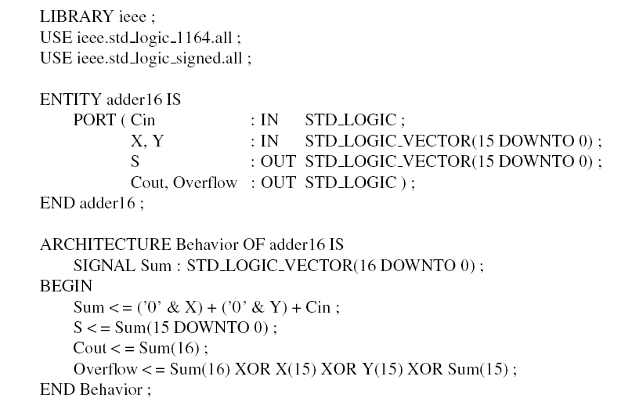
Figure 5.28. The 16-bit adder from Figure 5.27 with carry and
overflow signals.
Cpt 5
Portions © Copyright 2009, S. Brown and Z Vranesic

Slide 29
LIBRARY ieee ;
USE ieee.std_logic_1164.all ;
USE ieee.std_logic_arith.all ;
ENTITY adder16 IS
PORT ( Cin : IN STD_LOGIC ;
X, Y : IN SIGNED(15 DOWNTO 0) ;
S : OUT SIGNED(15 DOWNTO 0) ;
Cout, Overflow : OUT STD_LOGIC ) ;
END adder16 ;
ARCHITECTURE Behavior OF adder16 IS
SIGNAL Sum : SIGNED(16 DOWNTO 0) ;
BEGIN
Sum <= ('0' & X) + Y + Cin ;
S <= Sum(15 DOWNTO 0) ;
Cout <= Sum(16) ;
Overflow <= Sum(16) XOR X(15) XOR Y(15) XOR Sum(15) ;
END Behavior ;
Figure 5.29. Use of the arithmetic package.
Cpt 5
Portions © Copyright 2009, S. Brown and Z Vranesic

Slide 30
ENTITY adder16 IS
PORT ( X, Y : IN INTEGER RANGE -32768 TO 32767 ;
S : OUT INTEGER RANGE -32768 TO 32767 ) ;
END adder16 ;
ARCHITECTURE Behavior OF adder16 IS
BEGIN
S <= X + Y ;
END Behavior ;
Figure 5.30. The 16-bit adder from Figure 5.27 using INTEGER signals.
Cpt 5
Portions © Copyright 2009, S. Brown and Z Vranesic

Slide 31
Multiplicand M
(11)
1 1 1 0
Multiplier Q
(14)
×
1 0 1 1
Partial product 0
1 1 1 0
Multiplicand M
(14)
1 1 1 0
×
+
1 1 1 0
Multiplier Q
(11)
1 0 1 1
Partial product 1
1 0 1 0 1
1 1 1 0
+
0 0 0 0
1 1 1 0
0 0 0 0
Partial product 2
0 1 0 1 0
1 1 1 0
+
1 1 1 0
Product P
(154)
1 0 0 1 1 0 1 0
Product P
(154)
1 0 0 1 1 0 1 0
(a) Multiplication by hand
(b) Multiplication for implementation in hardware
Figure 5.31. Multiplication of unsigned numbers.
Cpt 5
Portions © Copyright 2009, S. Brown and Z Vranesic

Slide 32
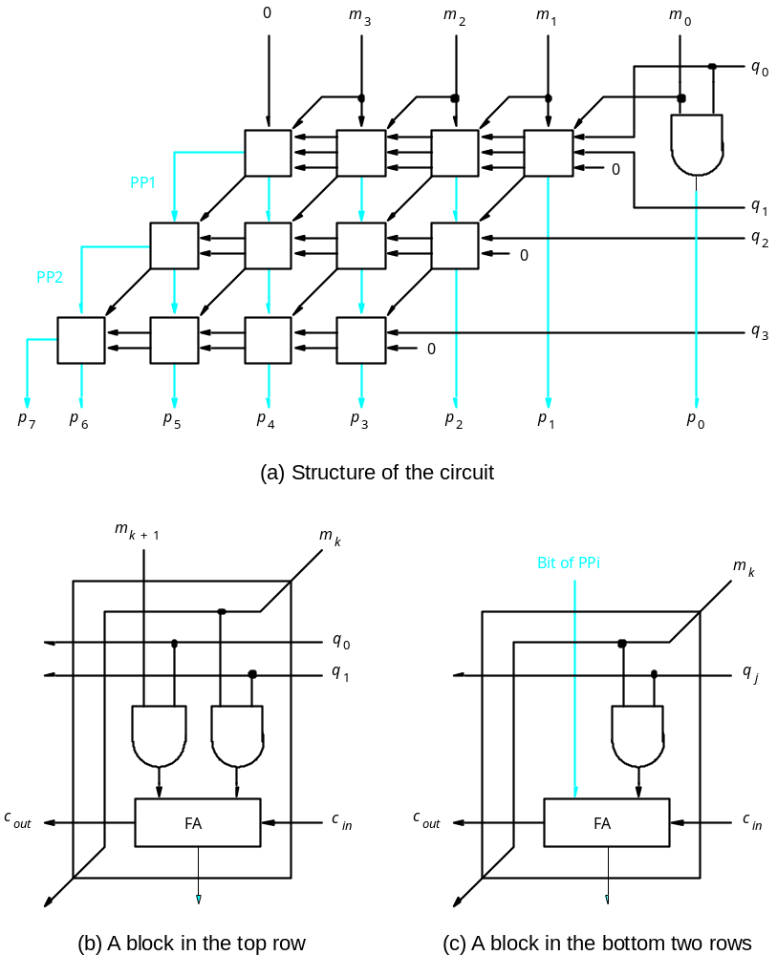
Figure 5.32. A 4 x 4 multiplier circuit.
Cpt 5
Portions © Copyright 2009, S. Brown and Z Vranesic

Slide 33
Multiplicand M
( 14)
Multiplicand M
(+14)
0 1 1 1 0
–
1 0 0 1 0
Multiplier Q
(+11)
x
0 1 0 1 1
Multiplier Q
(+11)
×
0 1 0 1 1
Partial product 0
0 0
0 1 1 1 0
Partial product 0
1 1
1 0 0 1 0
+
0
0 1 1 1 0
+
1
1 0 0 1 0
Partial product 1
0
0 1 0 1 0 1
Partial product 1
1
1 0 1 0 1 1
+
0
0 0 0 0 0
+
0
0 0 0 0 0
Partial product 2
0
0 0 1 0 1 0
Partial product 2
1
1 1 0 1 0 1
+
0
0 1 1 1 0
+
1
1 0 0 1 0
Partial product 3
0
0 1 0 0 1 1
Partial product 3
1
1 0 1 1 0 0
+
0
0 0 0 0 0
+
0
0 0 0 0 0
Product P
–
Product P
(+154)
0 0 1 0 0 1 1 0 1 0
( 154)
1 1 0 1 1 0 0 1 1 0
(a) Positive multiplicand
(b) Negative multiplicand
Figure 5.33. Multiplication of signed numbers.
Cpt 5
Portions © Copyright 2009, S. Brown and Z Vranesic

Slide 34

32 bits
S
E
M
Sign
0 denotes
+
8-bit
23 bits of mantissa
1 denotes
–
excess-127
exponent
(a) Single precision
64 bits
S
E
M
Sign
11-bit excess-1023
52 bits of mantissa
exponent
(b) Double precision
Figure 5.34. IEEE Standard floating-point formats.
Cpt 5
Portions © Copyright 2009, S. Brown and Z Vranesic

Slide 35


Table 5.2. Binary-coded decimal digits.
Cpt 5
Portions © Copyright 2009, S. Brown and Z Vranesic

Slide 36

X
0 1 1 1
7
+
Y
+
0 1 0 1
+
5
Z
1 1 0 0
12
+
0 1 1 0
carry
1 0 0 1 0
S = 2
X
1 0 0 0
8
+
Y
+
1 0 0 1
+
9
Z
1 0 0 0 1
17
+
0 1 1 0
carry
1 0 1 1 1
Figure 5.35. Addition of BCD digits.
S = 7
Cpt 5
Portions © Copyright 2009, S. Brown and Z Vranesic

Slide 37
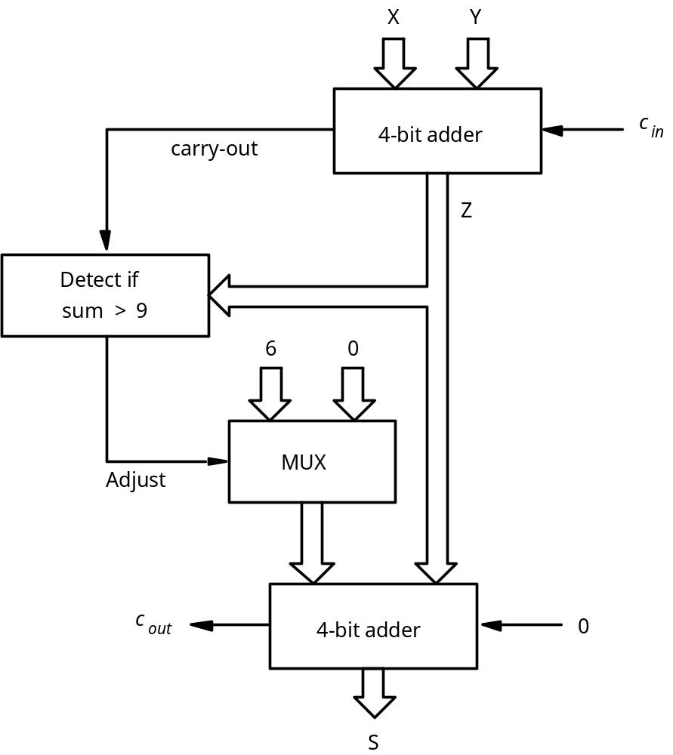
Figure 5.36. Block diagram for a one-digit BCD adder.
Cpt 5
Portions © Copyright 2009, S. Brown and Z Vranesic

Slide 38
LIBRARY ieee ;
USE ieee.std_logic_1164.all ;
USE ieee.std_logic_unsigned.all ;
ENTITY BCD IS
PORT ( X, Y : IN STD_LOGIC_VECTOR(3 DOWNTO 0) ;
S : OUT STD_LOGIC_VECTOR(4 DOWNTO 0) ) ;
END BCD ;
ARCHITECTURE Behavior OF BCD IS
SIGNAL Z : STD_LOGIC_VECTOR(4 DOWNTO 0) ;
SIGNAL Adjust : STD_LOGIC ;
BEGIN
Z <= ('0' & X) + Y ;
Adjust <= '1' WHEN Z > 9 ELSE '0' ;
S <= Z WHEN (Adjust = '0') ELSE Z + 6 ;
END Behavior ;
Figure 5.37. VHDL code for a one-digit BCD adder.
Cpt 5
Portions © Copyright 2009, S. Brown and Z Vranesic

Slide 39
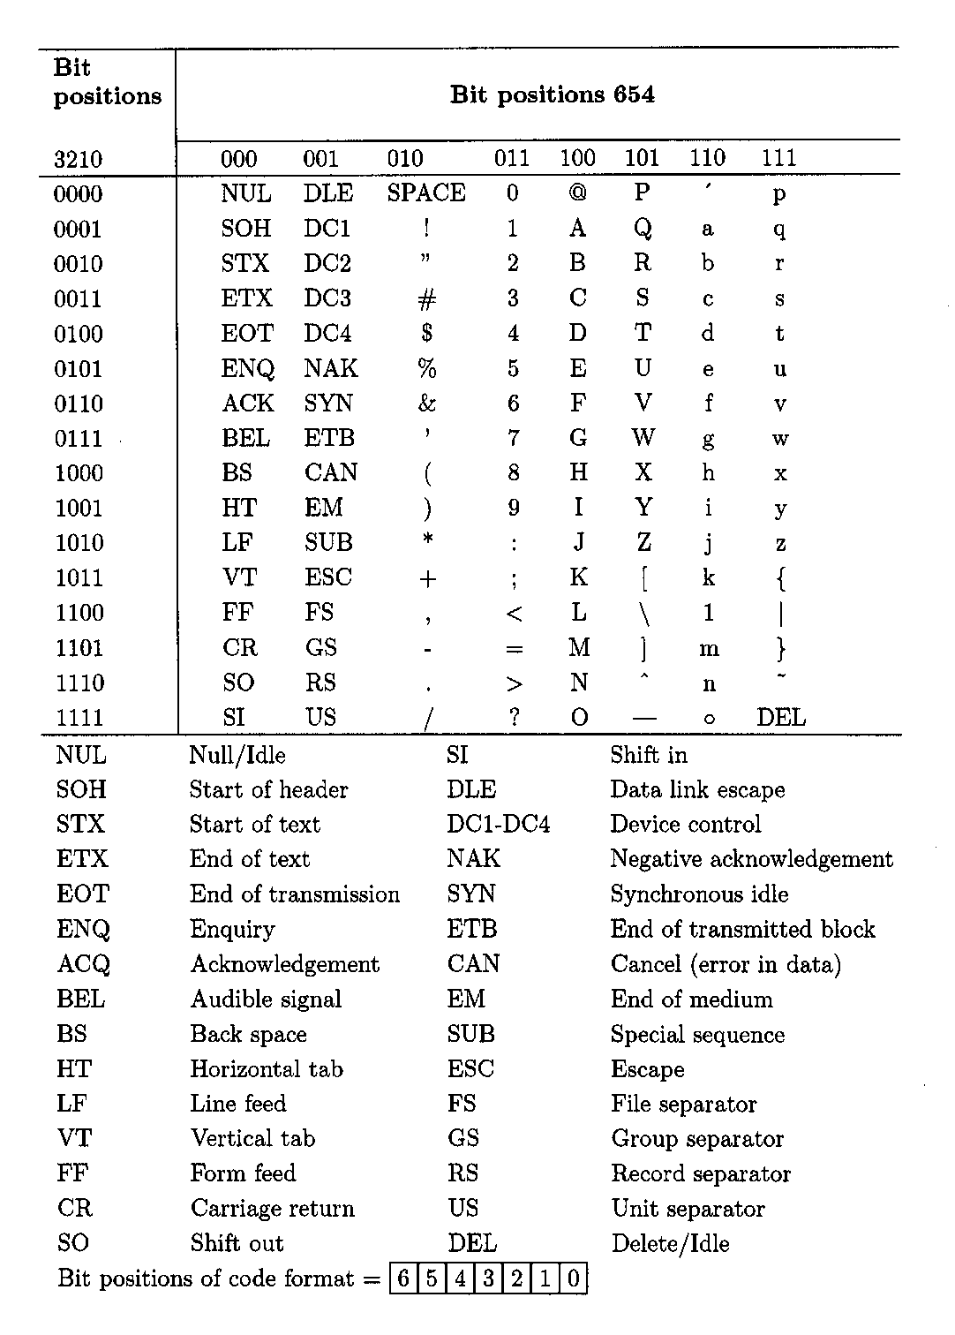
Table 5.3. The seven-bit ASCII code.
Cpt 5
Portions © Copyright 2009, S. Brown and Z Vranesic

