Slide 1
VHDL (VHSIC Hardware Description Language)
VHSIC (Very High Speed Integrated Circuits)
An acronym within an acronym
A complex language that can be simple to understand as long as you use only the part of the language you need and understand (e.g. the following notes). The examples show specific syntax and code structures that work well for synthesis and simulation. They are easy to understand so you will be able to modify the examples for you specific needs in the future.
If you deviate from the examples you may experience problems. If you google VHDL, good luck, hope you know what you are doing. Yet check at opencores.org, once you are more advanced you may have fun building systems with VHDL cores (later CSCE classes).
The examples cover a broad range of combinatorial and sequential circuits. THIS MAY BE VALUABLE FOR YOU IN THE FUTURE, KEEP THESE NOTES.

Slide 2
VHDL Language
There are three things to include in a VHDL component.
Libraries, Packages:
LIBRARY and USE packages define the language, etc.
LIBRARY ieee;
USE ieee.std_logic_1164.all;
Entity:
Defines the interface to the VHDL component. The inputs, outputs, or other types of I/O are defined here.
Architecture:
Defines the function of the component. The outputs are a function of the inputs for combinational circuits (FSM are more complex).

Slide 3
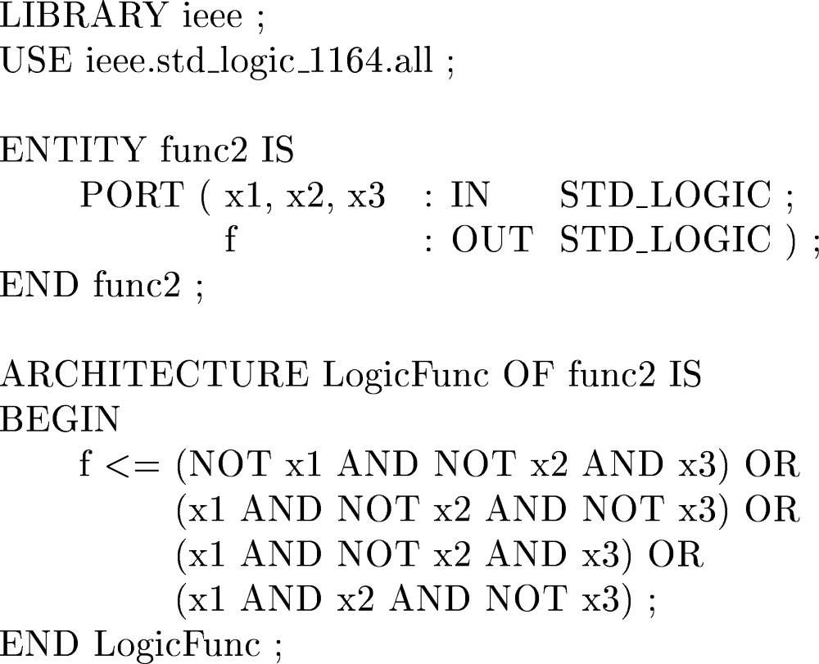
VHDL code for a function f(x1,x2,x3) = ?

Slide 4
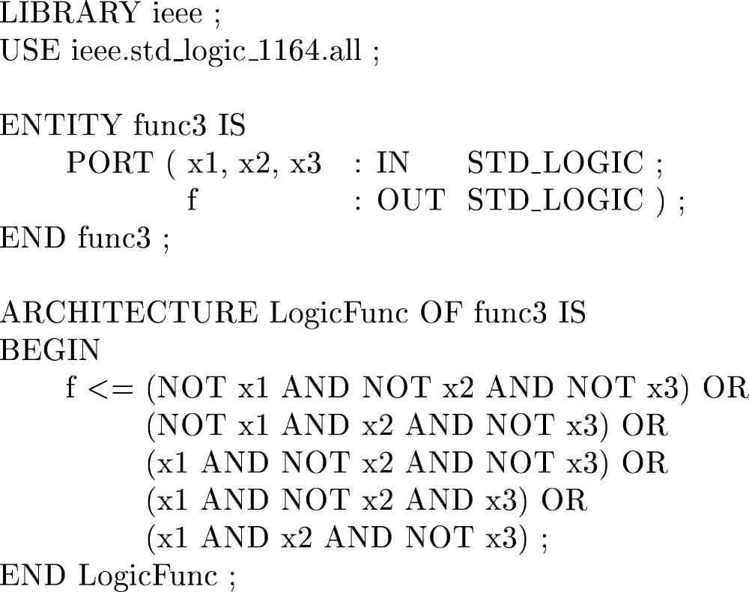
VHDL code for the function f = Σ m(0, 2, 4, 5, 6)

Slide 5
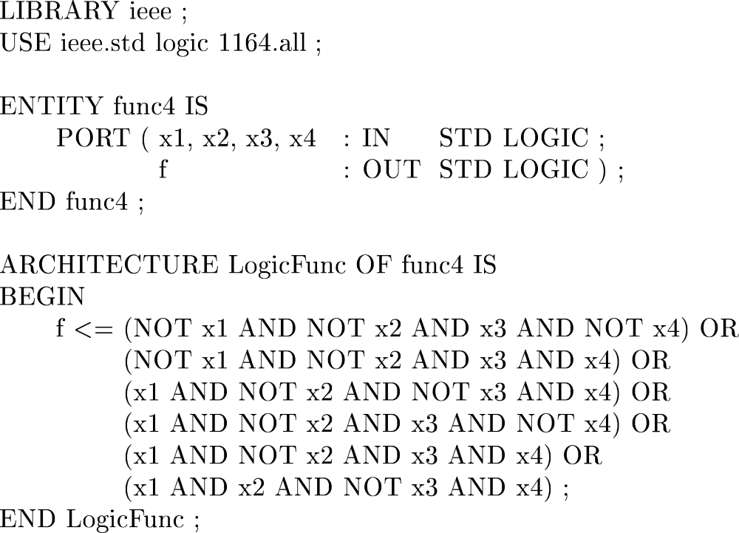
The VHDL code for f = Σ m(2, 3, 9, 10, 11, 13)

Slide 6
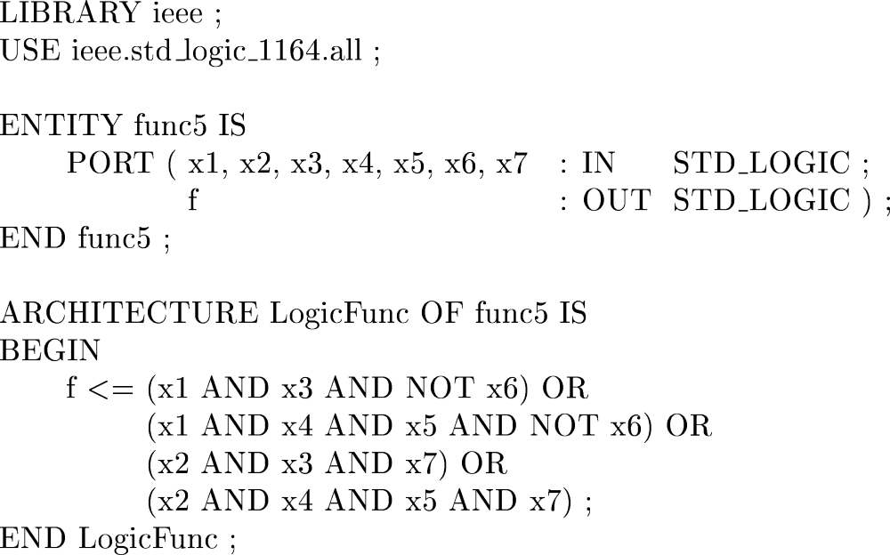
VHDL code for a 7-variable function

Slide 7
LIBRARY ieee ;
USE ieee.std_logic_1164.all ;
ENTITY fulladd IS
PORT ( Cin, x, y : IN STD_LOGIC ;
s, Cout : OUT STD_LOGIC ) ;
END fulladd ;
ARCHITECTURE LogicFunc OF fulladd IS
BEGIN
s <= x XOR y XOR Cin ;
Cout <= (x AND y) OR (Cin AND x) OR (Cin AND y) ;
END LogicFunc ;
VHDL code for a full-adder

Slide 8
LIBRARY ieee ;
USE ieee.std_logic_1164.all ;
USE ieee.std_logic_signed.all ;
ENTITY adder16 IS
PORT ( X, Y : IN STD_LOGIC_VECTOR(15 DOWNTO 0) ;
S : OUT STD_LOGIC_VECTOR(15 DOWNTO 0) ) ;
END adder16 ;
ARCHITECTURE Behavior OF adder16 IS
BEGIN
S <= X + Y ;
END Behavior ;
VHDL code for a 16-bit adder

Slide 9
LIBRARY ieee ;
USE ieee.std_logic_1164.all ;
USE ieee.std_logic_signed.all ;
ENTITY adder16 IS
PORT ( Cin : IN STD_LOGIC ;
X, Y : IN STD_LOGIC_VECTOR(15 DOWNTO 0) ;
S : OUT STD_LOGIC_VECTOR(15 DOWNTO 0) ;
Cout, Overflow : OUT STD_LOGIC ) ;
END adder16 ;
ARCHITECTURE Behavior OF adder16 IS
SIGNAL Sum : STD_LOGIC_VECTOR(16 DOWNTO 0) ;
BEGIN
Sum <= ('0' & X) + Y + Cin ;
S <= Sum(15 DOWNTO 0) ;
Cout <= Sum(16) ;
Overflow <= Sum(16) XOR X(15) XOR Y(15) XOR Sum(15) ;
END Behavior ;
A 16-bit adder with carry and overflow

Slide 10
LIBRARY ieee ;
USE ieee.std_logic_1164.all ;
ENTITY mux2to1 IS
PORT ( w0, w1, s : IN STD_LOGIC ;
f : OUT STD_LOGIC ) ;
END mux2to1 ;
ARCHITECTURE Behavior OF mux2to1 IS
BEGIN
WITH s SELECT
f <= w0 WHEN '0',
w1 WHEN OTHERS ;
END Behavior ;
VHDL code for a 2-to-1 multiplexer

Slide 11
s
0
s
1
s
1
s
0
f
w
0
00
0
0
w
0
w
1
01
f
0
1
w
1
w
2
10
1
0
w
w
3
11
w
2
1
1
3
(a) Graphic symbol
(b) Truth table
s
0
w
0
s
1
w
1
f
w
2
w
3
(c) Circuit
A 4-to-1 multiplexer

Slide 12
LIBRARY ieee ;
USE ieee.std_logic_1164.all ;
ENTITY mux4to1 IS
PORT ( w0, w1, w2, w3 : IN STD_LOGIC ;
s : IN STD_LOGIC_VECTOR(1 DOWNTO 0) ;
f : OUT STD_LOGIC ) ;
END mux4to1 ;
ARCHITECTURE Behavior OF mux4to1 IS
BEGIN
WITH s SELECT
f <= w0 WHEN "00",
w1 WHEN "01",
w2 WHEN "10",
w3 WHEN OTHERS ;
END Behavior ;
VHDL code for a 4-to-1 multiplexer

Slide 13
En
w
w
y
y
y
y
1
0
0
1
2
3
w
y
1
0
0
1
0
0
0
0
0
w
y
1
0
1
0
1
0
0
1
1
y
1
1
0
0
0
1
0
2
En
y
1
1
1
0
0
0
1
3
0
x
x
0
0
0
0
(a) Truth table
(b) Graphic symbol
w
0
y
0
w
1
y
1
y
2
y
3
En
(c) Logic circuit
A 2-to-4 decoder

Slide 14
LIBRARY ieee ;
USE ieee.std_logic_1164.all ;
ENTITY dec2to4 IS
PORT ( w : IN STD_LOGIC_VECTOR(1 DOWNTO 0) ;
En : IN STD_LOGIC ;
y : OUT STD_LOGIC_VECTOR(0 TO 3) ) ;
END dec2to4 ;
ARCHITECTURE Behavior OF dec2to4 IS
SIGNAL Enw : STD_LOGIC_VECTOR(2 DOWNTO 0) ;
BEGIN
Enw <= En & w ;
WITH Enw SELECT
y <= "1000" WHEN "100",
"0100" WHEN "101",
"0010" WHEN "110",
"0001" WHEN "111",
"0000" WHEN OTHERS ;
END Behavior ;
VHDL code for a 2-to-4 binary decoder

Slide 15
LIBRARY ieee ;
USE ieee.std_logic_1164.all ;
ENTITY mux2to1 IS
PORT ( w0, w1, s : IN STD_LOGIC ;
f : OUT STD_LOGIC ) ;
END mux2to1 ;
ARCHITECTURE Behavior OF mux2to1 IS
BEGIN
f <= w0 WHEN s = '0' ELSE w1 ;
END Behavior ;
A 2-to-1 multiplexer using a conditional signal assignment

Slide 16
w
3
w
2
w
1
w
0
y
1
y
0
z
0
0
0
0
d
d
0
0
0
0
1
0
0
1
0
0
1
x
0
1
1
0
1
x
x
1
0
1
1
x
x
x
1
1
1
Truth table for a 4-to-2 priority encoder

Slide 17
LIBRARY ieee ;
USE ieee.std_logic_1164.all ;
ENTITY priority IS
PORT ( w : IN STD_LOGIC_VECTOR(3 DOWNTO 0) ;
y : OUT STD_LOGIC_VECTOR(1 DOWNTO 0) ;
z : OUT STD_LOGIC ) ;
END priority ;
ARCHITECTURE Behavior OF priority IS
BEGIN
y <= "11" WHEN w(3) = '1' ELSE
"10" WHEN w(2) = '1' ELSE
"01" WHEN w(1) = '1' ELSE
"00" ;
z <= '0' WHEN w = "0000" ELSE '1' ;
END Behavior ;
VHDL code for a priority encoder

Slide 18
LIBRARY ieee ;
USE ieee.std_logic_1164.all ;
ENTITY priority IS
PORT ( w : IN STD_LOGIC_VECTOR(3 DOWNTO 0) ;
y : OUT STD_LOGIC_VECTOR(1 DOWNTO 0) ;
z : OUT STD_LOGIC ) ;
END priority ;
ARCHITECTURE Behavior OF priority IS
BEGIN
WITH w SELECT
y <= "00" WHEN "0001",
"01" WHEN "0010",
"01" WHEN "0011",
"10" WHEN "0100",
"10" WHEN "0101",
"10" WHEN "0110",
"10" WHEN "0111",
"11" WHEN OTHERS ;
WITH w SELECT
z <= '0' WHEN "0000",
'1' WHEN OTHERS ;
END Behavior ;
Less efficient code for a priority encoder

Slide 19
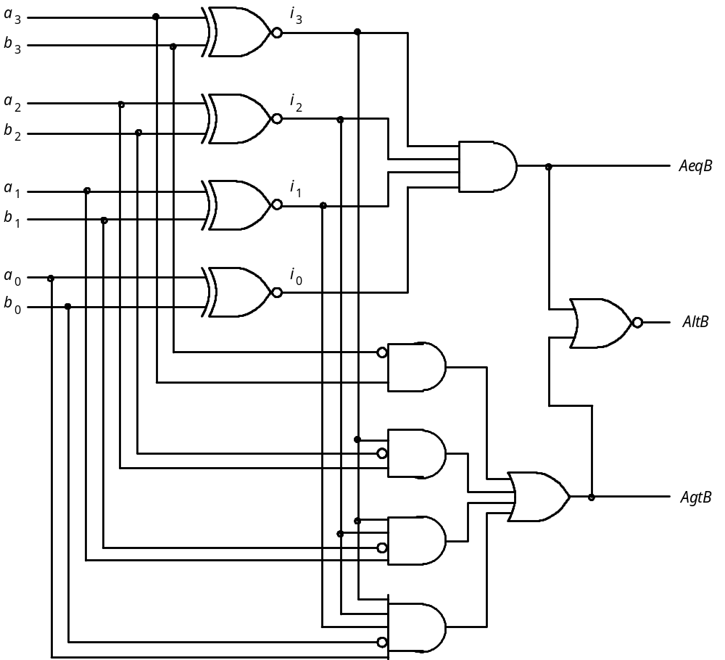
A four-bit comparator circuit

Slide 20
LIBRARY ieee ;
USE ieee.std_logic_1164.all ;
USE ieee.std_logic_unsigned.all ;
ENTITY compare IS
PORT ( A, B : IN STD_LOGIC_VECTOR(3 DOWNTO 0) ;
AeqB, AgtB, AltB : OUT STD_LOGIC ) ;
END compare ;
ARCHITECTURE Behavior OF compare IS
BEGIN
AeqB <= '1' WHEN A = B ELSE '0' ;
AgtB <= '1' WHEN A > B ELSE '0' ;
AltB <= '1' WHEN A < B ELSE '0' ;
END Behavior ;
VHDL code for a four-bit comparator

Slide 21
LIBRARY ieee ;
USE ieee.std_logic_1164.all ;
ENTITY mux2to1 IS
PORT ( w0, w1, s : IN STD_LOGIC ;
f : OUT STD_LOGIC ) ;
END mux2to1 ;
ARCHITECTURE Behavior OF mux2to1 IS
BEGIN
PROCESS ( w0, w1, s )
BEGIN
IF s = '0' THEN
f <= w0 ;
ELSE
f <= w1 ;
END IF ;
END PROCESS ;
END Behavior ;
A 2-to-1 multiplexer specified using an if-then-else statement

Slide 22
LIBRARY ieee ;
USE ieee.std_logic_1164.all ;
ENTITY mux2to1 IS
PORT ( w0, w1, s : IN STD_LOGIC ;
f : OUT STD_LOGIC ) ;
END mux2to1 ;
ARCHITECTURE Behavior OF mux2to1 IS
BEGIN
PROCESS ( w0, w1, s )
BEGIN
f <= w0 ;
IF s = '1' THEN
f <= w1 ;
END IF ;
END PROCESS ;
END Behavior ;
Alternative code for a 2-to-1 multiplexer

Slide 23
LIBRARY ieee ;
USE ieee.std_logic_1164.all ;
ENTITY priority IS
PORT ( w : IN STD_LOGIC_VECTOR(3 DOWNTO 0) ;
y : OUT STD_LOGIC_VECTOR(1 DOWNTO 0) ;
z : OUT STD_LOGIC ) ;
END priority ;
ARCHITECTURE Behavior OF priority IS
BEGIN
PROCESS ( w )
BEGIN
IF w(3) = '1' THEN
y <= "11" ;
ELSIF w(2) = '1' THEN
y <= "10" ;
ELSIF w(1) = '1' THEN
y <= "01" ;
ELSE
y <= "00" ;
END IF ;
END PROCESS ;
z <= '0' WHEN w = "0000" ELSE '1' ;
END Behavior ;
A priority encoder specified using if-then-else

Slide 24
LIBRARY ieee ;
USE ieee.std_logic_1164.all ;
ENTITY priority IS
PORT ( w : IN STD_LOGIC_VECTOR(3 DOWNTO 0) ;
y : OUT STD_LOGIC_VECTOR(1 DOWNTO 0) ;
z : OUT STD_LOGIC ) ;
END priority ;
ARCHITECTURE Behavior OF priority IS
BEGIN
PROCESS ( w )
BEGIN
y <= "00" ;
IF w(1) = '1' THEN y <= "01" ; END IF ;
IF w(2) = '1' THEN y <= "10" ; END IF ;
IF w(3) = '1' THEN y <= "11" ; END IF ;
z <= '1' ;
IF w = "0000" THEN z <= '0' ; END IF ;
END PROCESS ;
END Behavior ;
Alternative code for the priority encoder

Slide 25
LIBRARY ieee ;
USE ieee.std_logic_1164.all ;
ENTITY compare1 IS
PORT ( A, B : IN STD_LOGIC ;
AeqB : OUT STD_LOGIC ) ;
END compare1 ;
ARCHITECTURE Behavior OF compare1 IS
BEGIN
PROCESS ( A, B )
BEGIN
AeqB <= '0' ;
IF A = B THEN
AeqB <= '1' ;
END IF ;
END PROCESS ;
END Behavior ;
Code for a one-bit equality comparator

Slide 26
LIBRARY ieee ;
USE ieee.std_logic_1164.all ;
ENTITY mux2to1 IS
PORT ( w0, w1, s : IN STD_LOGIC ;
f : OUT STD_LOGIC ) ;
END mux2to1 ;
ARCHITECTURE Behavior OF mux2to1 IS
BEGIN
PROCESS ( w0, w1, s )
BEGIN
CASE s IS
WHEN '0' =>
f <= w0 ;
WHEN OTHERS =>
f <= w1 ;
END CASE ;
END PROCESS ;
END Behavior ;
A CASE statement that represents a 2-to-1 multiplexer

Slide 27
LIBRARY ieee ;
USE ieee.std_logic_1164.all ;
ENTITY dec2to4 IS
PORT ( w : IN STD_LOGIC_VECTOR(1 DOWNTO 0) ;
En : IN STD_LOGIC ;
y : OUT STD_LOGIC_VECTOR(0 TO 3) ) ;
END dec2to4 ;
ARCHITECTURE Behavior OF dec2to4 IS
BEGIN
PROCESS ( w, En )
BEGIN
IF En = '1' THEN
CASE w IS
WHEN "00" => y <= "1000" ;
WHEN "01" => y <= "0100" ;
WHEN "10" => y <= "0010" ;
WHEN OTHERS => y <= "0001" ;
END CASE ;
ELSE
y <= "0000" ;
END IF ;
END PROCESS ;
END Behavior ;
A 2-to-4 binary decoder

Slide 28
a
a
w
b
0
c
f
b
w
1
d
w
g
2
e
e
c
w
3
f
g
d
(a) Code converter
(b) 7-segment display
w
3
w
2
w
1
w
0
a
b
c
d
e
f
g
0
0
0
0
1
1
1
1
1
1
0
0
0
0
1
0
1
1
0
0
0
0
0
0
1
0
1
1
0
1
1
0
1
0
0
1
1
1
1
1
1
0
0
1
0
1
0
0
0
1
1
0
0
1
1
0
1
0
1
1
0
1
1
0
1
1
0
1
1
0
1
0
1
1
1
1
1
0
1
1
1
1
1
1
0
0
0
0
1
0
0
0
1
1
1
1
1
1
1
1
0
0
1
1
1
1
1
0
1
1
(c) Truth table
BCD-to-7-segment display code converter

Slide 29
LIBRARY ieee ;
USE ieee.std_logic_1164.all ;
ENTITY seg7 IS
PORT ( bcd : IN STD_LOGIC_VECTOR(3 DOWNTO 0) ;
leds : OUT STD_LOGIC_VECTOR(1 TO 7) ) ;
END seg7 ;
ARCHITECTURE Behavior OF seg7 IS
BEGIN
PROCESS ( bcd )
BEGIN
CASE bcd IS -- abcdefg
WHEN "0000" => leds <= "1111110" ;
WHEN "0001" => leds <= "0110000" ;
WHEN "0010" => leds <= "1101101" ;
WHEN "0011" => leds <= "1111001" ;
WHEN "0100" => leds <= "0110011" ;
WHEN "0101" => leds <= "1011011" ;
WHEN "0110" => leds <= "1011111" ;
WHEN "0111" => leds <= "1110000" ;
WHEN "1000" => leds <= "1111111" ;
WHEN "1001" => leds <= "1110011" ;
WHEN OTHERS => leds <= "-------" ;
END CASE ;
END PROCESS ;
END Behavior ;
a
f
b
e
g
c
d
BCD-to-7-segment decoder

Slide 30
LIBRARY ieee ;
USE ieee.std_logic_1164.all ;
USE ieee.std_logic_unsigned.all ;
ENTITY alu IS
PORT ( s : IN STD_LOGIC_VECTOR(2 DOWNTO 0) ;
A, B : IN STD_LOGIC_VECTOR(3 DOWNTO 0) ;
F : OUT STD_LOGIC_VECTOR(3 DOWNTO 0) ) ;
END alu ;
ARCHITECTURE Behavior OF alu IS
BEGIN
PROCESS ( s, A, B )
BEGIN
CASE s IS
WHEN "000" =>
F <= "0000" ;
WHEN "001" =>
F <= B - A ;
WHEN "010" =>
F <= A - B ;
WHEN "011" =>
F <= A + B ;
WHEN "100" =>
F <= A XOR B ;
WHEN "101" =>
F <= A OR B ;
WHEN "110" =>
F <= A AND B ;
WHEN OTHERS =>
F <= "1111" ;
END CASE ;
END PROCESS ;
END Behavior ;
Code that represents the functionality of the 74381 ALU

Slide 31
LIBRARY ieee ;
USE ieee.std_logic_1164.all ;
ENTITY reg8 IS
PORT ( D : IN STD_LOGIC_VECTOR(7 DOWNTO 0) ;
Resetn, Clock : IN STD_LOGIC ;
Q : OUT STD_LOGIC_VECTOR(7 DOWNTO 0) ) ;
END reg8 ;
ARCHITECTURE Behavior OF reg8 IS
BEGIN
PROCESS ( Resetn, Clock )
BEGIN
IF Resetn = '0' THEN
Q <= "00000000" ;
ELSIF Clock'EVENT AND Clock = '1' THEN
Q <= D ;
END IF ;
END PROCESS ;
END Behavior ;
Code for an eight-bit register with asynchronous clear

Slide 32
LIBRARY ieee ;
USE ieee.std_logic_1164.all ;
ENTITY regn IS
GENERIC ( N : INTEGER := 16 ) ;
PORT ( D : IN STD_LOGIC_VECTOR(N-1 DOWNTO 0) ;
Resetn, Clock : IN STD_LOGIC ;
Q : OUT STD_LOGIC_VECTOR(N-1 DOWNTO 0) ) ;
END regn ;
ARCHITECTURE Behavior OF regn IS
BEGIN
PROCESS ( Resetn, Clock )
BEGIN
IF Resetn = '0' THEN
Q <= (OTHERS => '0') ;
ELSIF Clock'EVENT AND Clock = '1' THEN
Q <= D ;
END IF ;
END PROCESS ;
END Behavior ;
Code for an n-bit register with asynchronous clear

Slide 33
Parallel output
Q
3
Q
2
Q
1
Q
0
D
Q
D
Q
D
Q
D
Q
Q
Q
Q
Q
Serial
Shift/Load
Clock
input
Parallel input
Figure 7.19 A simple shift register

Slide 34
LIBRARY ieee ;
USE ieee.std_logic_1164.all ;
ENTITY shift4 IS
PORT ( R : IN STD_LOGIC_VECTOR(3 DOWNTO 0) ;
Clock : IN STD_LOGIC ;
L, w : IN STD_LOGIC ;
Q : BUFFER STD_LOGIC_VECTOR(3 DOWNTO 0) ) ;
END shift4 ;
ARCHITECTURE Behavior OF shift4 IS
BEGIN
PROCESS
BEGIN
WAIT UNTIL Clock'EVENT AND Clock = '1' ;
IF L = '1' THEN
Q <= R ;
ELSE
Q(0) <= Q(1) ;
Q(1) <= Q(2);
Q(2) <= Q(3) ;
Q(3) <= w ;
END IF ;
END PROCESS ;
END Behavior ;
Code for a shift register

Slide 35
LIBRARY ieee ;
USE ieee.std_logic_1164.all ;
ENTITY shift4 IS
PORT ( R : IN STD_LOGIC_VECTOR(3 DOWNTO 0) ;
Clock : IN STD_LOGIC ;
L, w : IN STD_LOGIC ;
Q : BUFFER STD_LOGIC_VECTOR(3 DOWNTO 0) ) ;
END shift4 ;
ARCHITECTURE Behavior OF shift4 IS
BEGIN
PROCESS
BEGIN
WAIT UNTIL Clock'EVENT AND Clock = '1' ;
IF L = '1' THEN
Q <= R ;
ELSE
Q(3) <= w ;
Q(2) <= Q(3) ;
Q(1) <= Q(2);
Q(0) <= Q(1) ;
END IF ;
END PROCESS ;
END Behavior ;
Code that reverses the ordering of statements

Slide 36
LIBRARY ieee ;
USE ieee.std_logic_1164.all ;
USE ieee.std_logic_unsigned.all ;
ENTITY upcount IS
PORT ( Clock, Resetn, E : IN STD_LOGIC ;
Q : OUT STD_LOGIC_VECTOR (3 DOWNTO 0)) ;
END upcount ;
ARCHITECTURE Behavior OF upcount IS
SIGNAL Count : STD_LOGIC_VECTOR (3 DOWNTO 0) ;
BEGIN
PROCESS ( Clock, Resetn )
BEGIN
IF Resetn = '0' THEN
Count <= "0000" ;
ELSIF (Clock'EVENT AND Clock = '1') THEN
IF E = '1' THEN
Count <= Count + 1 ;
ELSE
Count <= Count ;
END IF ;
END IF ;
END PROCESS ;
Q <= Count ;
END Behavior ;
Code for a four-bit up-counter

Slide 37
Reset
w
=
1
w
=
0
A
⁄
z
=
0
B
⁄
z
=
0
w
=
0
w
=
0
w
=
1
C
⁄
z
=
1
w
=
1
State diagram of a simple sequential circuit (Moore Machine)

Slide 38
USE ieee.std_logic_1164.all ;
ENTITY simple IS
PORT ( Clock, Resetn, w : IN STD_LOGIC ;
z : OUT STD_LOGIC ) ;
END simple ;
ARCHITECTURE Behavior OF simple IS
TYPE State_type IS (A, B, C) ;
SIGNAL y : State_type ;
BEGIN
PROCESS ( Resetn, Clock )
BEGIN
IF Resetn = '0' THEN
y <= A ;
ELSIF (Clock'EVENT AND Clock = '1') THEN
con’t ...
VHDL code for a simple FSM

Slide 39
CASE y IS
WHEN A =>
IF w = '0' THEN
y <= A ;
ELSE
y <= B ;
END IF ;
WHEN B =>
IF w = '0' THEN
y <= A ;
ELSE
y <= C ;
END IF ;
WHEN C =>
IF w = '0' THEN
y <= A ;
ELSE
y <= C ;
END IF ;
END CASE ;
END IF ;
END PROCESS ;
z <= '1' WHEN y = C ELSE '0' ;
END Behavior ;
VHDL code for a simple FSM (con’t)

Slide 40
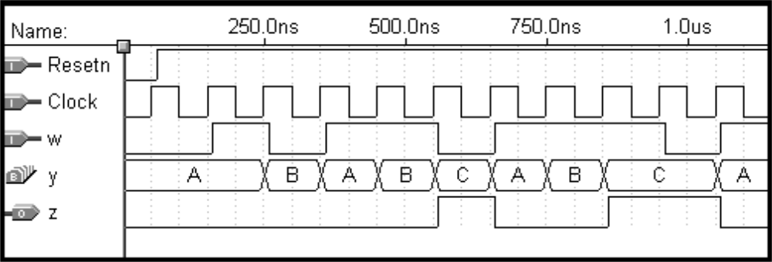
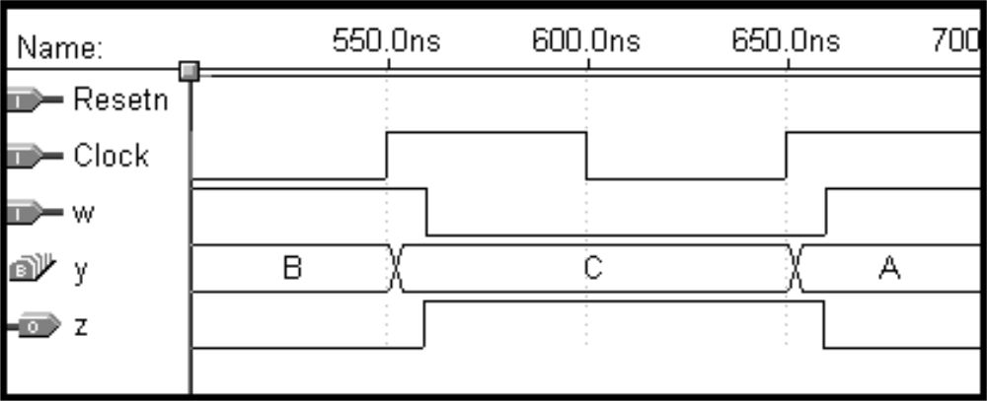
(a) Timing simulation results
(b) Magnified simulation results, showing timing details
Simulation results

Slide 41
(ENTITY declaration not shown)
ARCHITECTURE Behavior OF simple IS
TYPE State_type IS (A, B, C) ;
SIGNAL y_present, y_next : State_type ;
BEGIN
PROCESS ( w, y_present )
BEGIN
CASE y_present IS
WHEN A =>
IF w = '0' THEN
y_next <= A ;
ELSE
y_next <= B ;
END IF ;
WHEN B =>
IF w = '0' THEN
y_next <= A ;
ELSE
y_next <= C ;
END IF ;
Alternative style of code for an FSM

Slide 42
WHEN C =>
IF w = '0' THEN
y_next <= A ;
ELSE
y_next <= C ;
END IF ;
END CASE ;
END PROCESS ;
PROCESS (Clock, Resetn)
BEGIN
IF Resetn = '0' THEN
y_present <= A ;
ELSIF (Clock'EVENT AND Clock = '1') THEN
y_present <= y_next ;
END IF ;
END PROCESS ;
z <= '1' WHEN y_present = C ELSE '0' ;
END Behavior ;
Alternative style of code for an FSM (con’t)

Slide 43
Reset
w
=
1
⁄
z
=
0
w
=
0
⁄
z
=
0
A
B
w
=
1
⁄
z
=
1
w
=
0
⁄
z
=
0
Mealy FSM State diagram

Slide 44
LIBRARY ieee ;
USE ieee.std_logic_1164.all ;
ENTITY mealy IS
PORT ( Clock, Resetn, w : IN STD_LOGIC ;
z : OUT STD_LOGIC ) ;
END mealy ;
ARCHITECTURE Behavior OF mealy IS
TYPE State_type IS (A, B) ;
SIGNAL y : State_type ;
BEGIN
PROCESS ( Resetn, Clock )
BEGIN
IF Resetn = '0' THEN
y <= A ;
ELSIF (Clock'EVENT AND Clock = '1') THEN
CASE y IS
WHEN A =>
IF w = '0' THEN y <= A ;
ELSE y <= B ;
END IF ;
… con’t
Reset
w
=
1
⁄
z
=
0
A
B
w
=
1
⁄
z
=
1
w
=
0
⁄
z
=
0
w
=
0
⁄
z
=
0
VHDL code for a Mealy machine

Slide 45
WHEN B =>
IF w = '0' THEN y <= A ;
ELSE y <= B ;
END IF ;
END CASE ;
END IF ;
END PROCESS ;
PROCESS ( y, w )
BEGIN
CASE y IS
WHEN A =>
z <= '0' ;
WHEN B =>
z <= w ;
END CASE ;
END PROCESS ;
END Behavior ;
Reset
w
=
1
⁄
z
=
0
w
=
0
⁄
z
=
0
A
B
w
=
1
⁄
z
=
1
w
=
0
⁄
z
=
0
VHDL code for a Mealy machine (con’t)

Slide 46
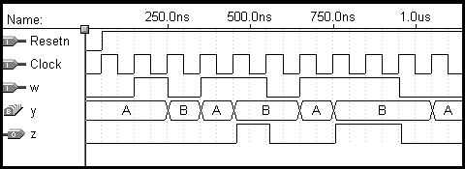
Reset
w
=
1
⁄
z
=
0
w
=
0
⁄
z
=
0
A
B
w
=
1
⁄
z
=
1
w
=
0
⁄
z
=
0
Simulation results for the Mealy machine

Slide 47
A
a
Shift register
Adder
s
FSM
Shift register
Shift register
b
Sum
=
A
+
B
B
Clock
Block diagram of a serial adder

Slide 48
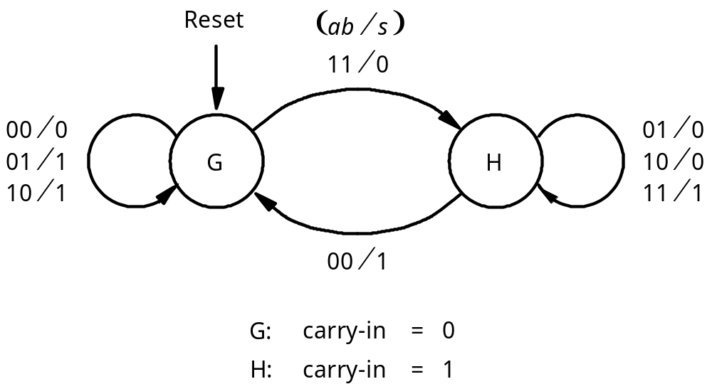
State diagram for the serial adder

Slide 49
Present
Next state
Output
s
state
ab
=00
01
10
11
00
01
10
11
G
G
G
G
H
0
1
1
0
H
G
H
H
H
1
0
0
1
State table for the serial adder

Slide 50
Next state
Output
Present
state
ab
=00
01
10
11
00
01
10
11
y
Y
s
0
0
0
0
1
0
1
1
0
1
0
1
1
1
1
0
0
1
State-assigned table for the serial adder

Slide 51
a
s
b
Full
adder
Y
y
D
Q
carry-out
Clock
Q
Reset
Circuit for the adder FSM

Slide 52
Reset
⁄
11
⁄
01
00
G
0
s
=
0
H
0
s
=
0
10
00
01
00
11
01
10
11
10
01
G
⁄
s
=
1
H
⁄
s
=
1
11
10
1
00
1
State diagram for the Moore-type serial adder FSM

Slide 53
Present
Nextstate
Output
state
ab
=00
01
10
11
s
G
0
G
0
G
1
G
1
H
0
0
G
1
G
0
G
1
G
1
H
0
1
H
0
G
1
H
0
H
0
H
1
0
H
1
G
1
H
0
H
0
H
1
1
State table for the Moore-type serial adder FSM

Slide 54
Nextstate
Present
state
ab
=00
01
10
11
Output
y
2
y
1
s
Y
2
Y
1
00
0
0
01
0
1
10
0
01
0
0
01
0
1
10
1
10
0
1
10
1
0
11
0
11
0
1
10
1
0
11
1
State-assigned table for the Moore-type serial adder FSM

Slide 55
Sum bit
Y
1
y
1
a
D
Q
s
b
Full
adder
Carry-out
Q
Y
2
y
2
D
Q
Clock
Q
Reset
Circuit for the Moore-type serial adder FSM

Slide 56
LIBRARY ieee ;
USE ieee.std_logic_1164.all ;
-- left-to-right shift register with parallel load and enable
ENTITY shiftrne IS
GENERIC ( N : INTEGER := 4 ) ;
PORT ( R : IN STD_LOGIC_VECTOR(N-1 DOWNTO 0) ;
L, E, w : IN STD_LOGIC ;
Clock : IN STD_LOGIC ;
Q : BUFFER STD_LOGIC_VECTOR(N-1 DOWNTO 0) ) ;
END shiftrne ;
ARCHITECTURE Behavior OF shiftrne IS
BEGIN
PROCESS
BEGIN
… con’t
Code for a left-to-right shift register with an enable input

Slide 57
WAIT UNTIL Clock'EVENT AND Clock = '1' ;
IF E = '1' THEN
IF L = '1' THEN
Q <= R ;
ELSE
Genbits: FOR i IN 0 TO N-2 LOOP
Q(i) <= Q(i+1) ;
END LOOP ;
Q(N-1) <= w ;
END IF ;
END IF ;
END PROCESS ;
END Behavior ;
Code for a left-to-right shift register with an enable input (con’t)

Slide 58
LIBRARY ieee ;
USE ieee.std_logic_1164.all ;
ENTITY serial IS
GENERIC ( length : INTEGER := 8 ) ;
PORT ( Clock : IN STD_LOGIC ;
Reset : IN STD_LOGIC ;
A, B : IN STD_LOGIC_VECTOR(length-1 DOWNTO 0) ;
Sum : BUFFER STD_LOGIC_VECTOR(length-1 DOWNTO 0) );
END serial ;
ARCHITECTURE Behavior OF serial IS
COMPONENT shiftrne
GENERIC ( N : INTEGER := 4 ) ;
PORT ( R : IN STD_LOGIC_VECTOR(N-1 DOWNTO 0) ;
L, E, w : IN STD_LOGIC ;
Clock : IN STD_LOGIC ;
Q : BUFFER STD_LOGIC_VECTOR(N-1 DOWNTO 0) ) ;
END COMPONENT ;
SIGNAL QA, QB, Null_in : STD_LOGIC_VECTOR(length-1 DOWNTO 0) ;
SIGNAL s, Low, High, Run : STD_LOGIC ;
SIGNAL Count : INTEGER RANGE 0 TO length ;
TYPE State_type IS (G, H) ;
SIGNAL y : State_type ;
… con’t
VHDL code for the serial adder

Slide 59
BEGIN
Low <= '0' ; High <= '1' ;
ShiftA: shiftrne GENERIC MAP (N => length)
PORT MAP ( A, Reset, High, Low, Clock, QA ) ;
ShiftB: shiftrne GENERIC MAP (N => length)
PORT MAP ( B, Reset, High, Low, Clock, QB ) ;
AdderFSM: PROCESS ( Reset, Clock )
BEGIN
IF Reset = '1' THEN
y <= G ;
ELSIF Clock'EVENT AND Clock = '1' THEN
CASE y IS
WHEN G =>
IF QA(0) = '1' AND QB(0) = '1' THEN y <= H ;
ELSE y <= G ;
END IF ;
WHEN H =>
IF QA(0) = '0' AND QB(0) = '0' THEN y <= G ;
ELSE y <= H ;
END IF ;
END CASE ;
END IF ;
END PROCESS AdderFSM ;
… con’t
VHDL code for the serial adder (con’t)

Slide 60
WITH y SELECT
s <= QA(0) XOR QB(0) WHEN G,
NOT ( QA(0) XOR QB(0) ) WHEN H ;
Null_in <= (OTHERS => '0') ;
ShiftSum: shiftrne GENERIC MAP ( N => length )
PORT MAP ( Null_in, Reset, Run, s, Clock, Sum ) ;
Stop: PROCESS
BEGIN
WAIT UNTIL (Clock'EVENT AND Clock = '1') ;
IF Reset = '1' THEN
Count <= length ;
ELSIF Run = '1' THEN
Count <= Count -1 ;
END IF ;
END PROCESS ;
Run <= '0' WHEN Count = 0 ELSE '1' ; -- stops counter and ShiftSum
END Behavior ;
VHDL code for the serial adder (con’t)

Slide 61
1
0
0
0
a
a
D
D
D
D
7
0
3
2
1
0
L
E
Counter
L
0
w
Q
Q
Q
Q
1
E
3
2
1
0
b
b
Adder
7
0
FSM
Run
L
0
0
0
w
1
E
L
w
E
Clock
Reset
Sum
Sum
7
0
Synthesized serial adder

Slide 62
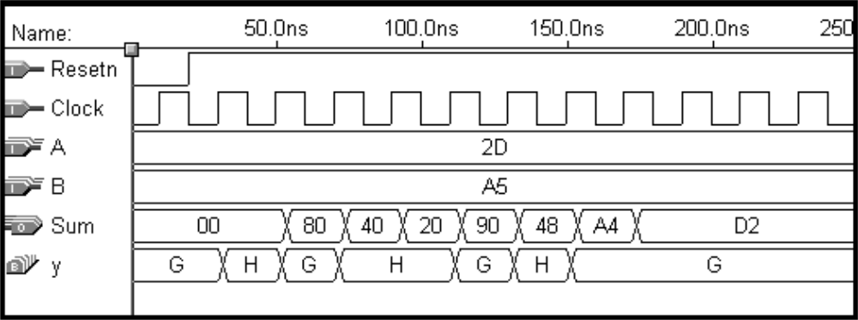
Simulation results for the synthesized serial adder

Slide 63
Reset
w
=
1
w
=
0
A
⁄
z
=
0
B
⁄
z
=
0
w
=
0
w
=
0
w
=
1
C
⁄
z
=
1
w
=
1
State diagram of a simple sequential circuit (Moore Machine)

Slide 64
USE ieee.std_logic_1164.all ;
ENTITY simple IS
PORT ( Clock, Resetn, w : IN STD_LOGIC ;
z : OUT STD_LOGIC ) ;
END simple ;
ARCHITECTURE Behavior OF simple IS
TYPE State_type IS (A, B, C) ;
SIGNAL y : State_type ;
BEGIN
PROCESS ( Resetn, Clock )
BEGIN
IF Resetn = '0' THEN
y <= A ;
ELSIF (Clock'EVENT AND Clock = '1') THEN
con’t ...
VHDL code for a simple FSM

Slide 65
CASE y IS
WHEN A =>
IF w = '0' THEN
y <= A ;
ELSE
y <= B ;
END IF ;
WHEN B =>
IF w = '0' THEN
y <= A ;
ELSE
y <= C ;
END IF ;
WHEN C =>
IF w = '0' THEN
y <= A ;
ELSE
y <= C ;
END IF ;
END CASE ;
END IF ;
END PROCESS ;
z <= '1' WHEN y = C ELSE '0' ;
END Behavior ;
VHDL code for a simple FSM (con’t)

Slide 66
(a) Timing simulation results
(b) Magnified simulation results, showing timing details
Simulation results

Slide 67
(ENTITY declaration not shown)
ARCHITECTURE Behavior OF simple IS
TYPE State_type IS (A, B, C) ;
SIGNAL y_present, y_next : State_type ;
BEGIN
PROCESS ( w, y_present )
BEGIN
CASE y_present IS
WHEN A =>
IF w = '0' THEN
y_next <= A ;
ELSE
y_next <= B ;
END IF ;
WHEN B =>
IF w = '0' THEN
y_next <= A ;
ELSE
y_next <= C ;
END IF ;
Alternative style of code for an FSM

Slide 68
WHEN C =>
IF w = '0' THEN
y_next <= A ;
ELSE
y_next <= C ;
END IF ;
END CASE ;
END PROCESS ;
PROCESS (Clock, Resetn)
BEGIN
IF Resetn = '0' THEN
y_present <= A ;
ELSIF (Clock'EVENT AND Clock = '1') THEN
y_present <= y_next ;
END IF ;
END PROCESS ;
z <= '1' WHEN y_present = C ELSE '0' ;
END Behavior ;
Alternative style of code for an FSM (con’t)

Slide 69
Reset
w
=
1
⁄
z
=
0
w
=
0
⁄
z
=
0
A
B
w
=
1
⁄
z
=
1
w
=
0
⁄
z
=
0
Mealy FSM State diagram

Slide 70
LIBRARY ieee ;
USE ieee.std_logic_1164.all ;
ENTITY mealy IS
PORT ( Clock, Resetn, w : IN STD_LOGIC ;
z : OUT STD_LOGIC ) ;
END mealy ;
ARCHITECTURE Behavior OF mealy IS
TYPE State_type IS (A, B) ;
SIGNAL y : State_type ;
BEGIN
PROCESS ( Resetn, Clock )
BEGIN
IF Resetn = '0' THEN
y <= A ;
ELSIF (Clock'EVENT AND Clock = '1') THEN
CASE y IS
WHEN A =>
IF w = '0' THEN y <= A ;
ELSE y <= B ;
END IF ;
… con’t
Reset
w
=
1
⁄
z
=
0
A
B
w
=
1
⁄
z
=
1
w
=
0
⁄
z
=
0
w
=
0
⁄
z
=
0
VHDL code for a Mealy machine

Slide 71
WHEN B =>
IF w = '0' THEN y <= A ;
ELSE y <= B ;
END IF ;
END CASE ;
END IF ;
END PROCESS ;
PROCESS ( y, w )
BEGIN
CASE y IS
WHEN A =>
z <= '0' ;
WHEN B =>
z <= w ;
END CASE ;
END PROCESS ;
END Behavior ;
Reset
w
=
1
⁄
z
=
0
w
=
0
⁄
z
=
0
A
B
w
=
1
⁄
z
=
1
w
=
0
⁄
z
=
0
VHDL code for a Mealy machine (con’t)

Slide 72
Reset
w
=
1
⁄
z
=
0
w
=
0
⁄
z
=
0
A
B
w
=
1
⁄
z
=
1
w
=
0
⁄
z
=
0
Simulation results for the Mealy machine

Slide 73
A
a
Shift register
Adder
s
FSM
Shift register
Shift register
b
Sum
=
A
+
B
B
Clock
Block diagram of a serial adder

Slide 74
State diagram for the serial adder

Slide 75
Present
Next state
Output
s
state
ab
=00
01
10
11
00
01
10
11
G
G
G
G
H
0
1
1
0
H
G
H
H
H
1
0
0
1
State table for the serial adder

Slide 76
Next state
Output
Present
state
ab
=00
01
10
11
00
01
10
11
y
Y
s
0
0
0
0
1
0
1
1
0
1
0
1
1
1
1
0
0
1
State-assigned table for the serial adder

Slide 77
a
s
b
Full
adder
Y
y
D
Q
carry-out
Clock
Q
Reset
Circuit for the adder FSM

Slide 78
Reset
⁄
11
⁄
01
00
G
0
s
=
0
H
0
s
=
0
10
00
01
00
11
01
10
11
10
01
G
⁄
s
=
1
H
⁄
s
=
1
11
10
1
00
1
State diagram for the Moore-type serial adder FSM

Slide 79
Present
Nextstate
Output
state
ab
=00
01
10
11
s
G
0
G
0
G
1
G
1
H
0
0
G
1
G
0
G
1
G
1
H
0
1
H
0
G
1
H
0
H
0
H
1
0
H
1
G
1
H
0
H
0
H
1
1
State table for the Moore-type serial adder FSM

Slide 80
Nextstate
Present
state
ab
=00
01
10
11
Output
y
2
y
1
s
Y
2
Y
1
00
0
0
01
0
1
10
0
01
0
0
01
0
1
10
1
10
0
1
10
1
0
11
0
11
0
1
10
1
0
11
1
State-assigned table for the Moore-type serial adder FSM

Slide 81
Sum bit
Y
1
y
1
a
D
Q
s
b
Full
adder
Carry-out
Q
Y
2
y
2
D
Q
Clock
Q
Reset
Circuit for the Moore-type serial adder FSM

Slide 82
LIBRARY ieee ;
USE ieee.std_logic_1164.all ;
-- left-to-right shift register with parallel load and enable
ENTITY shiftrne IS
GENERIC ( N : INTEGER := 4 ) ;
PORT ( R : IN STD_LOGIC_VECTOR(N-1 DOWNTO 0) ;
L, E, w : IN STD_LOGIC ;
Clock : IN STD_LOGIC ;
Q : BUFFER STD_LOGIC_VECTOR(N-1 DOWNTO 0) ) ;
END shiftrne ;
ARCHITECTURE Behavior OF shiftrne IS
BEGIN
PROCESS
BEGIN
… con’t
Code for a left-to-right shift register with an enable input

Slide 83
WAIT UNTIL Clock'EVENT AND Clock = '1' ;
IF E = '1' THEN
IF L = '1' THEN
Q <= R ;
ELSE
Genbits: FOR i IN 0 TO N-2 LOOP
Q(i) <= Q(i+1) ;
END LOOP ;
Q(N-1) <= w ;
END IF ;
END IF ;
END PROCESS ;
END Behavior ;
Code for a left-to-right shift register with an enable input (con’t)

Slide 84
LIBRARY ieee ;
USE ieee.std_logic_1164.all ;
ENTITY serial IS
GENERIC ( length : INTEGER := 8 ) ;
PORT ( Clock : IN STD_LOGIC ;
Reset : IN STD_LOGIC ;
A, B : IN STD_LOGIC_VECTOR(length-1 DOWNTO 0) ;
Sum : BUFFER STD_LOGIC_VECTOR(length-1 DOWNTO 0) );
END serial ;
ARCHITECTURE Behavior OF serial IS
COMPONENT shiftrne
GENERIC ( N : INTEGER := 4 ) ;
PORT ( R : IN STD_LOGIC_VECTOR(N-1 DOWNTO 0) ;
L, E, w : IN STD_LOGIC ;
Clock : IN STD_LOGIC ;
Q : BUFFER STD_LOGIC_VECTOR(N-1 DOWNTO 0) ) ;
END COMPONENT ;
SIGNAL QA, QB, Null_in : STD_LOGIC_VECTOR(length-1 DOWNTO 0) ;
SIGNAL s, Low, High, Run : STD_LOGIC ;
SIGNAL Count : INTEGER RANGE 0 TO length ;
TYPE State_type IS (G, H) ;
SIGNAL y : State_type ;
… con’t
VHDL code for the serial adder

Slide 85
BEGIN
Low <= '0' ; High <= '1' ;
ShiftA: shiftrne GENERIC MAP (N => length)
PORT MAP ( A, Reset, High, Low, Clock, QA ) ;
ShiftB: shiftrne GENERIC MAP (N => length)
PORT MAP ( B, Reset, High, Low, Clock, QB ) ;
AdderFSM: PROCESS ( Reset, Clock )
BEGIN
IF Reset = '1' THEN
y <= G ;
ELSIF Clock'EVENT AND Clock = '1' THEN
CASE y IS
WHEN G =>
IF QA(0) = '1' AND QB(0) = '1' THEN y <= H ;
ELSE y <= G ;
END IF ;
WHEN H =>
IF QA(0) = '0' AND QB(0) = '0' THEN y <= G ;
ELSE y <= H ;
END IF ;
END CASE ;
END IF ;
END PROCESS AdderFSM ;
… con’t
VHDL code for the serial adder (con’t)

Slide 86
WITH y SELECT
s <= QA(0) XOR QB(0) WHEN G,
NOT ( QA(0) XOR QB(0) ) WHEN H ;
Null_in <= (OTHERS => '0') ;
ShiftSum: shiftrne GENERIC MAP ( N => length )
PORT MAP ( Null_in, Reset, Run, s, Clock, Sum ) ;
Stop: PROCESS
BEGIN
WAIT UNTIL (Clock'EVENT AND Clock = '1') ;
IF Reset = '1' THEN
Count <= length ;
ELSIF Run = '1' THEN
Count <= Count -1 ;
END IF ;
END PROCESS ;
Run <= '0' WHEN Count = 0 ELSE '1' ; -- stops counter and ShiftSum
END Behavior ;
VHDL code for the serial adder (con’t)

Slide 87
1
0
0
0
a
a
D
D
D
D
7
0
3
2
1
0
L
E
Counter
L
0
w
Q
Q
Q
Q
1
E
3
2
1
0
b
b
Adder
7
0
FSM
Run
L
0
0
0
w
1
E
L
w
E
Clock
Reset
Sum
Sum
7
0
Synthesized serial adder

Slide 88
Simulation results for the synthesized serial adder

