Slide 1
Chapter 2 Introduction to Logic Circuits
Chapter Objectives:
You will be introduced to:
Logic functions and circuits
Boolean algebra for dealing with logic functions
Logic gates and synthesis of simple circuits
CAD tools and the VHDL hardware description language
Cpt2 - Intro. to Logic Ckts.
Portions © Copyright 2009, S. Brown and Z Vranesic

Slide 2
2.1 Variables and Functions
x
=
0
x
=
1
(a) Two states of a switch
S
x
(b) Symbol for a switch
Figure 2.1. A binary switch.
Cpt2 - Intro. to Logic Ckts.
Portions © Copyright 2009, S. Brown and Z Vranesic

Slide 3
S
Battery
x
Light
(a) Simple connection to a battery
S
Power
supply
x
Light
(b) Using a ground connection as the return path
Figure 2.2. A light controlled by a switch.
Cpt2 - Intro. to Logic Ckts.
Portions © Copyright 2009, S. Brown and Z Vranesic

Slide 4
S
S
Power
x₁
x₂
supply
Light
(a) The logical AND function (series connection)
S
x₁
Power
Light
supply
S
x₂
(b) The logical OR function (parallel connection)
Figure 2.3. Two basic functions.
Cpt2 - Intro. to Logic Ckts.
Portions © Copyright 2009, S. Brown and Z Vranesic

Slide 5
S
X₁
S
Power
X₃
Light
supply
S
X₂
Figure 2.4. A series-parallel connection.
Cpt2 - Intro. to Logic Ckts.
Portions © Copyright 2009, S. Brown and Z Vranesic

Slide 6
2.2 Inversion
R
Power
supply
x
S
Light
Figure 2.5. An inverting circuit.
Cpt2 - Intro. to Logic Ckts.
Portions © Copyright 2009, S. Brown and Z Vranesic

Slide 7






2.3 Truth Table
Figure 2.6. A truth table for the AND and OR operations.
Cpt2 - Intro. to Logic Ckts.
Portions © Copyright 2009, S. Brown and Z Vranesic

Slide 8
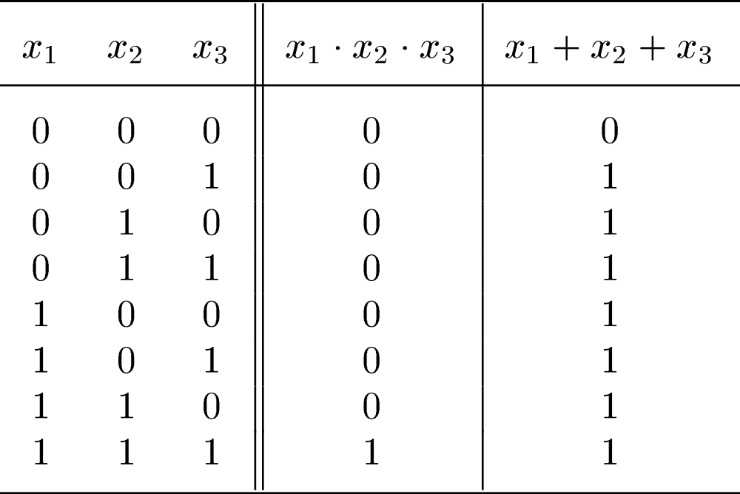
Figure 2.7. Three-input AND and OR operations.
Cpt2 - Intro. to Logic Ckts.
Portions © Copyright 2009, S. Brown and Z Vranesic

Slide 9
2.4 Logic Gates and Networks
x
1
x
2
x
1
x
⋅
x
x
⋅
x
⋅
…
⋅
x
x
1
2
1
2
n
2
x
n
(a) AND gates
x
1
x
2
x
1
x
x
1
+
x
2
x
1
+
x
2
+
…
+
x
n
2
x
n
(b) OR gates
x
x
Figure 2.8. The basic gates.
(c) NOT gate
Cpt2 - Intro. to Logic Ckts.
Portions © Copyright 2009, S. Brown and Z Vranesic

Slide 10
x
1
x
2
f
=
(
x
1
+
x
)
⋅
x
x
2
3
3
Figure 2.9. The function from Figure 2.4.
Cpt2 - Intro. to Logic Ckts.
Portions © Copyright 2009, S. Brown and Z Vranesic

Slide 11
x
0
→
0
→
1
→
1
1
→
1
→
0
→
0
1
A
1
→
1
→
0
→
1
f
0
→
0
→
0
→
1
B
x
0
→
1
→
0
→
1
2
Figure 2.10. An example of logic networks.
f
=
x
+
x
⋅
x
(a) Network that implements
1
1
2
x
x
f
(
x
,
x
)
A B
1 0
1 0
0 0
0 1
1
2
1
2
0
0
1
0
1
1
1
0
0
1
1
1
(b) Truth table
x
1
1
0
x
1
2
0
A
1
0
(c) Timing diagram
B
1
0
f
1
0
Time
Cpt2 - Intro. to Logic Ckts.
Portions © Copyright 2009, S. Brown and Z Vranesic

Slide 12
x
0
→
0
→
1
→
1
1
→
1
→
0
→
0
1
1
→
1
→
0
→
1
g
x
0
→
1
→
0
→
1
2
g
=
x
+
x
(d) Network that implements
1
2
Cpt2 - Intro. to Logic Ckts.
Portions © Copyright 2009, S. Brown and Z Vranesic

Slide 13
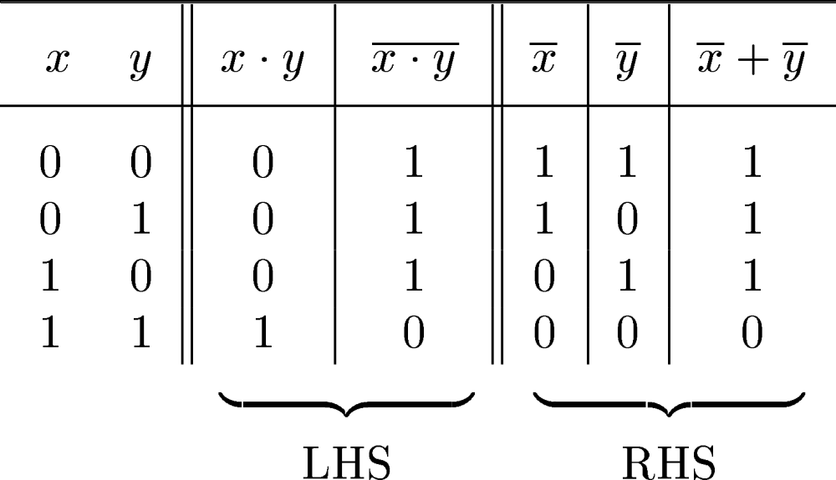
2.5 Boolean Algebra
Figure 2.11. Proof of DeMorgan’s theorem in 15a.
Cpt2 - Intro. to Logic Ckts.
Portions © Copyright 2009, S. Brown and Z Vranesic

Slide 14
2.5 Boolean Algebra
identity
1. X + 0 = X 1D. X • 1 = X
null
2. X + 1 = 1 2D. X • 0 = 0
idempotency:
3. X + X = X 3D. X • X = X
involution:
4. (X’)’ = X
complementarity:
5. X + X’ = 1 5D. X • X’ = 0
commutativity:
6. X + Y = Y + X 6D. X • Y = Y • X
associativity:
7. (X + Y) + Z = X + (Y + Z) 7D. (X • Y) • Z = X • (Y • Z)
Cpt2 - Intro. to Logic Ckts.
Portions © Copyright 2009, S. Brown and Z Vranesic

Slide 15
2.5 Boolean Algebra
distributivity:
8. X • (Y + Z) = (X • Y) + (X • Z) 8D. X + (Y • Z) = (X + Y) • (X + Z)
uniting:
9. X • Y + X • Y’ = X 9D. (X + Y) • (X + Y’) = X
absorption:
10. X + X • Y = X 10D. X • (X + Y) = X
11. (X + Y’) • Y = X • Y 11D. (X • Y’) + Y = X + Y
factoring:
12. (X + Y) • (X’ + Z) = 12D. X • Y + X’ • Z =
X • Z + X’ • Y (X + Z) • (X’ + Y)
concensus:
13. (X • Y) + (Y • Z) + (X’ • Z) = 13D. (X + Y) • (Y + Z) • (X’ + Z) =
X • Y + X’ • Z (X + Y) • (X’ + Z)
Cpt2 - Intro. to Logic Ckts.
Portions © Copyright 2009, S. Brown and Z Vranesic

Slide 16
2.5 Boolean Algebra
de Morgan’s:
14. (X + Y + ...)’ = X’ • Y’ • ... 14D. (X • Y • ...)’ = X’ + Y’ + ...
generalized de Morgan’s:
15. f’(X₁,X₂,...,X_{n},0,1,+,•) = f(X₁’,X₂’,...,X_{n}’,1,0,•,+)
establishes relationship between • and +
Cpt2 - Intro. to Logic Ckts.
Portions © Copyright 2009, S. Brown and Z Vranesic

Slide 17
Duality
  a dual of a Boolean expression is derived by replacing
  • by +, + by •, 0 by 1, and 1 by 0, and leaving variables unchanged
  any theorem that can be proven is thus also proven for its dual!
  a meta-theorem (a theorem about theorems)
Different than deMorgan’s Law
  this is a statement about theorems
  this is not a way to manipulate (re-write) expressions
Cpt2 - Intro. to Logic Ckts.
Portions © Copyright 2009, S. Brown and Z Vranesic

Slide 18
2.5.1 The Venn Diagram
(a) Constant 1
(b) Constant 0
x
x
x
x
(c) Variable
x
(d)
x
Cpt2 - Intro. to Logic Ckts.
Portions © Copyright 2009, S. Brown and Z Vranesic

Slide 19
x
y
x
y
(e)
x
⋅
y
(f)
x
+
y
x
y
x
y
z
(g)
⋅
(h)
x
⋅
y
+
z
x
y
Figure 2.12. The Venn diagram representation.
Cpt2 - Intro. to Logic Ckts.
Portions © Copyright 2009, S. Brown and Z Vranesic

Slide 20
Figure 2.13. Verification of the distributive property
x (y + z) = x y + x z
x
y
x
y
z
z
(a)
x
(d)
x
⋅
y
x
y
x
y
z
z
(b)
(e)
⋅
y
+
z
x
z
x
y
x
y
z
z
(c)
⋅
(f)
x
(
y
+
)
⋅
⋅
z
x
y
+
x
z
Cpt2 - Intro. to Logic Ckts.
Portions © Copyright 2009, S. Brown and Z Vranesic

Slide 21
Proving theorems (perfect induction)
Using perfect induction (complete truth table):
  e.g., de Morgan’s:
(X + Y)’ = X’ • Y’
NOR is equivalent to AND
with inputs complemented
X Y X’ Y’ (X + Y)’ X’ • Y’
0 0 1 1
0 1 1 0
1 0 0 1
1 1 0 0
1
0
0
0
1
0
0
0
(X • Y)’ = X’ + Y’
NAND is equivalent to OR
with inputs complemented
X Y X’ Y’ (X • Y)’ X’ + Y’
0 0 1 1
0 1 1 0
1 0 0 1
1 1 0 0
1
1
1
0
1
1
1
0
Cpt2 - Intro. to Logic Ckts.
Portions © Copyright 2009, S. Brown and Z Vranesic

Slide 22
2.5.3 Precedence of Operators
NOT, then AND, then OR
Cpt2 - Intro. to Logic Ckts.
Portions © Copyright 2009, S. Brown and Z Vranesic

Slide 23
From Boolean expressions to logic gates
More than one way to map expressions to gates
  e.g., Z = A’ • B’ • (C + D) = (A’ • (B’ • (C + D)))
T2
T1
use of 3-input gate
A
Z
A
B
T1
B
Z
C
T2
C
D
D
Cpt2 - Intro. to Logic Ckts.
Portions © Copyright 2009, S. Brown and Z Vranesic

Slide 24
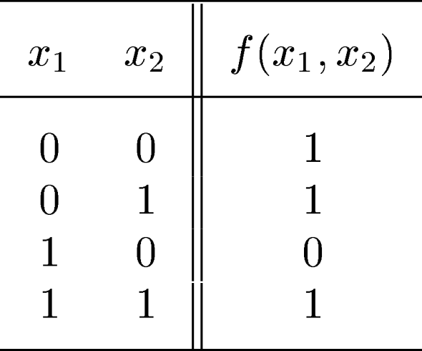
2.6 Synthesis Using AND, OR, and NOT Gates
Figure 2.15. A function to be synthesized.
Cpt2 - Intro. to Logic Ckts.
Portions © Copyright 2009, S. Brown and Z Vranesic

Slide 25
x
1
x
2
f
(a) Canonical sum-of-products
x
1
x
f
2
(b) Minimal-cost realization
Figure 2.16. Two implementations of a function in Figure 2.15.
Cpt2 - Intro. to Logic Ckts.
Portions © Copyright 2009, S. Brown and Z Vranesic

Slide 26
Canonical forms (Sum of Products and Product of Sums)
Truth table is the unique signature of a Boolean function
The same truth table can have many gate realizations
Canonical forms
  standard forms for a Boolean expression
  provides a unique algebraic signature
Cpt2 - Intro. to Logic Ckts.
Portions © Copyright 2009, S. Brown and Z Vranesic

Slide 27
Sum-of-products canonical forms
Also known as disjunctive normal form
Also known as minterm expansion
F = 001 011 101 110 111
A’B’C
+ A’BC
+ AB’C
+ ABC’
+ ABC
A B C F F’
0 0 0 0 1
0 0 1 1 0
0 1 0 0 1
0 1 1 1 0
1 0 0 0 1
1 0 1 1 0
1 1 0 1 0
1 1 1 1 0
F’ = A’B’C’ + A’BC’ + AB’C’
Cpt2 - Intro. to Logic Ckts.
Portions © Copyright 2009, S. Brown and Z Vranesic

Slide 28
Sum-of-products canonical form (cont’d)
Product term (or minterm)
  ANDed product of literals – input combination for which output is true
  each variable appears exactly once, true or inverted (but not both)
A B C minterms
0 0 0 A’B’C’ m0
0 0 1 A’B’C m1
0 1 0 A’BC’ m2
0 1 1 A’BC m3
1 0 0 AB’C’ m4
1 0 1 AB’C m5
1 1 0 ABC’ m6
1 1 1 ABC m7
F in canonical form:
F(A, B, C) = Σm(1,3,5,6,7)
= m1 + m3 + m5 + m6 + m7
= A’B’C + A’BC + AB’C + ABC’ + ABC
canonical form ≠ minimal form
F(A, B, C) = A’B’C + A’BC + AB’C + ABC + ABC’
      = (A’B’ + A’B + AB’ + AB)C + ABC’
      = ((A’ + A)(B’ + B))C + ABC’
      = C + ABC’
      = ABC’ + C
= AB + C
short-hand notation for
minterms of 3 variables
Cpt2 - Intro. to Logic Ckts.
Portions © Copyright 2009, S. Brown and Z Vranesic

Slide 29
Product-of-sums canonical form
Also known as conjunctive normal form
Also known as maxterm expansion
F = 000 010 100
F =
(A + B + C)
(A + B’ + C)
(A’ + B + C)
A B C F F’
0 0 0 0 1
0 0 1 1 0
0 1 0 0 1
0 1 1 1 0
1 0 0 0 1
1 0 1 1 0
1 1 0 1 0
1 1 1 1 0
F’ = (A + B + C’) (A + B’ + C’) (A’ + B + C’) (A’ + B’ + C) (A’ + B’ + C’)
Cpt2 - Intro. to Logic Ckts.
Portions © Copyright 2009, S. Brown and Z Vranesic

Slide 30
Product-of-sums canonical form (cont’d)
Sum term (or maxterm)
  ORed sum of literals – input combination for which output is false
  each variable appears exactly once, true or inverted (but not both)
A B C maxterms
0 0 0 A+B+C M0
0 0 1 A+B+C’ M1
0 1 0 A+B’+C M2
0 1 1 A+B’+C’ M3
1 0 0 A’+B+C M4
1 0 1 A’+B+C’ M5
1 1 0 A’+B’+C M6
1 1 1 A’+B’+C’ M7
F in canonical form:
F(A, B, C) = ΠM(0,2,4)
= M0 • M2 • M4
= (A + B + C) (A + B’ + C) (A’ + B + C)
canonical form ≠ minimal form
F(A, B, C) = (A + B + C) (A + B’ + C) (A’ + B + C)
      = (A + B + C) (A + B’ + C)
      (A + B + C) (A’ + B + C)
      = (A + C) (B + C)
short-hand notation for
maxterms of 3 variables
Cpt2 - Intro. to Logic Ckts.
Portions © Copyright 2009, S. Brown and Z Vranesic

Slide 31
S-o-P, P-o-S, and de Morgan’s theorem
Sum-of-products
  F’ = A’B’C’ + A’BC’ + AB’C’
Apply de Morgan’s
  (F’)’ = (A’B’C’ + A’BC’ + AB’C’)’
  F = (A + B + C) (A + B’ + C) (A’ + B + C)
Product-of-sums
  F’ = (A + B + C’) (A + B’ + C’) (A’ + B + C’) (A’ + B’ + C) (A’ + B’ + C’)
Apply de Morgan’s
  (F’)’ = ( (A + B + C’)(A + B’ + C’)(A’ + B + C’)(A’ + B’ + C)(A’ + B’ + C’) )’
  F = A’B’C + A’BC + AB’C + ABC’ + ABC
Cpt2 - Intro. to Logic Ckts.
Portions © Copyright 2009, S. Brown and Z Vranesic

Slide 32
Four alternative two-level implementations of F = AB + C
A
B
canonical sum-of-products
minimized sum-of-products
canonical product-of-sums
minimized product-of-sums
F1
C
F2
F3
F4
Cpt2 - Intro. to Logic Ckts.
Portions © Copyright 2009, S. Brown and Z Vranesic

Slide 33
Mapping between canonical forms
Minterm to maxterm conversion
  use maxterms whose indices do not appear in minterm expansion
  e.g., F(A,B,C) = Σm(1,3,5,6,7) = ΠM(0,2,4)
Maxterm to minterm conversion
  use minterms whose indices do not appear in maxterm expansion
  e.g., F(A,B,C) = ΠM(0,2,4) = Σm(1,3,5,6,7)
Minterm expansion of F to minterm expansion of F’
  use minterms whose indices do not appear
  e.g., F(A,B,C) = Σm(1,3,5,6,7) F’(A,B,C) = Σm(0,2,4)
Maxterm expansion of F to maxterm expansion of F’
  use maxterms whose indices do not appear
  e.g., F(A,B,C) = ΠM(0,2,4) F’(A,B,C) = ΠM(1,3,5,6,7)
Cpt2 - Intro. to Logic Ckts.
Portions © Copyright 2009, S. Brown and Z Vranesic

Slide 34




Figure 2.17 Three-variable minterms and maxterms.
Cpt2 - Intro. to Logic Ckts.
Portions © Copyright 2009, S. Brown and Z Vranesic

Slide 35
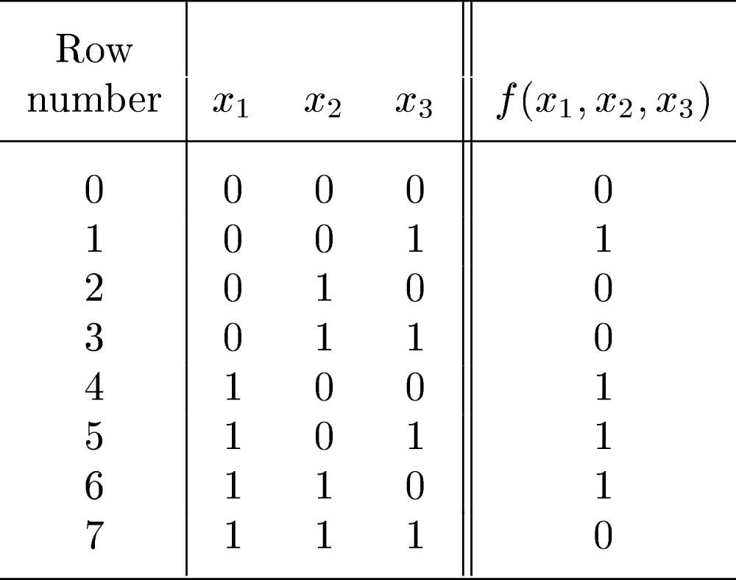
Figure 2.18. A three-variable function.
Cpt2 - Intro. to Logic Ckts.
Portions © Copyright 2009, S. Brown and Z Vranesic

Slide 36
x
2
f
x
3
x
1
(a) A minimal sum-of-products realization
x
1
x
3
f
x
2
(b) A minimal product-of-sums realization
Figure 2.19. Two realizations of a function in Figure 2.18.
Cpt2 - Intro. to Logic Ckts.
Portions © Copyright 2009, S. Brown and Z Vranesic

Slide 37
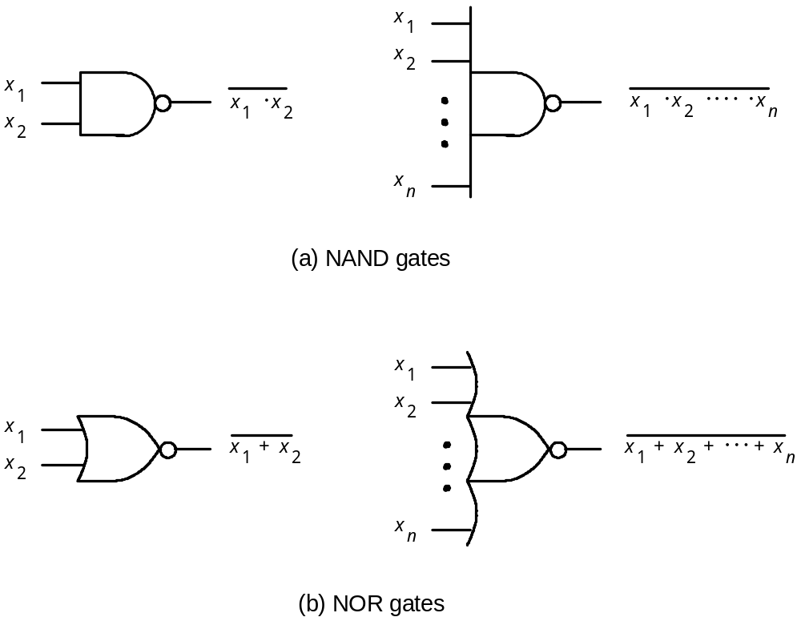
NAND and NOR Logic Networks
Figure 2.20. NAND and NOR gates.
Cpt2 - Intro. to Logic Ckts.
Portions © Copyright 2009, S. Brown and Z Vranesic

Slide 38
x
1
x
1
x
1
x
2
x
2
x
2
(a)
x
1
x
2
=
x
1
+
x
2
x
1
x
1
x
1
x
2
x
2
x
2
(b)
x
1
+
x
2
=
x
1
x
2
Figure 2.21. DeMorgan’s theorem in terms of logic gates.
Cpt2 - Intro. to Logic Ckts.
Portions © Copyright 2009, S. Brown and Z Vranesic

Slide 39
x
x
1
1
x
x
2
2
x
x
3
3
x
x
4
4
x
x
5
5
x
1
x
2
x
3
x
4
x
5
Figure 2.22. Using NAND gates to implement a sum-of-products.
Cpt2 - Intro. to Logic Ckts.
Portions © Copyright 2009, S. Brown and Z Vranesic

Slide 40
x
x
1
1
x
x
2
2
x
x
3
3
x
x
4
4
x
x
5
5
x
1
x
2
x
3
x
4
x
5
Figure 2.23. Using NOR gates to implement a product-of sums.
Cpt2 - Intro. to Logic Ckts.
Portions © Copyright 2009, S. Brown and Z Vranesic

Slide 41
x₁
x₂
f
x₃
(a) POS implementation
x₁
x₂
f
x₃
(b) NOR implementation
Figure 2.24 NOR-gate realization of the function in Example 2.4.
Cpt2 - Intro. to Logic Ckts.
Portions © Copyright 2009, S. Brown and Z Vranesic

Slide 42
x₁
f
x₂
x₃
(a) SOP implementation
x₁
x₂
f
x₃
(b) NAND implementation
Figure 2.25. NAND-gate realization of the function in Example 2.3.
Cpt2 - Intro. to Logic Ckts.
Portions © Copyright 2009, S. Brown and Z Vranesic

Slide 43
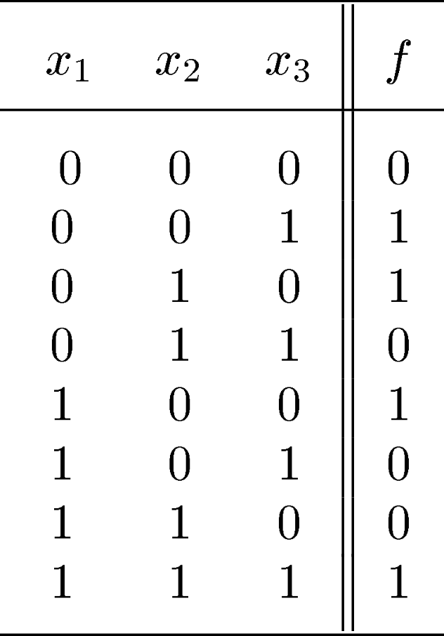
Figure 2.26. Truth table for a three-way light control.
Cpt2 - Intro. to Logic Ckts.
Portions © Copyright 2009, S. Brown and Z Vranesic

Slide 44
f
x₁
x₂
x₃
(a) Sum-of-products realization
x₃
x₂
x₁
Figure 2.27. Implementation of the function in Figure 2.26.
f
Cpt2 - Intro. to Logic Ckts.
(b) Product-of-sums realization
Portions © Copyright 2009, S. Brown and Z Vranesic

Slide 45
s
x₁
x₂
f (s, x₁, x₂)
0
0
0
0
0
0
1
0
x
s
0
1
0
1
1
0
1
1
1
x
f
1
0
1
0
0
0
f
s
x
1
1
0
1
1
2
x
1
1
0
0
2
1
1
1
1
(b) Circuit
(c) Graphical symbol
(a)
Truth
table
s
f (s, x₁, x₂)
0
x₁
1
x₂
(d)
More
compact
truth-table
representation
Figure 2.28. Implementation of a multiplexer.
Cpt2 - Intro. to Logic Ckts.
Portions © Copyright 2009, S. Brown and Z Vranesic

Slide 46
Introduction to VHDL
Design conception
Figure 2.29. A typical CAD system.
DESIGN ENTRY
Schematic capture
VHDL
No
Design correct?
Synthesis
Yes
Functional simulation
Physical design
No
Design correct?
Timing simulation
Yes
No
Timing requirements met?
Physical design
Chip configuration
Cpt2 - Intro. to Logic Ckts.
Portions © Copyright 2009, S. Brown and Z Vranesic

Slide 47
x
1
x
2
f
x
3
Figure 2.30. A simple logic function.
ENTITY example1 IS
PORT ( x1, x2, x3 : IN BIT ;
f : OUT BIT ) ;
END example1 ;
Figure 2.31. VHDL entity declaration for the circuit in Figure 2.30.
Cpt2 - Intro. to Logic Ckts.
Portions © Copyright 2009, S. Brown and Z Vranesic

Slide 48
ARCHITECTURE LogicFunc OF example1 IS
BEGIN
f <= (x1 AND x2) OR (NOT x2 AND x3) ;
END LogicFunc ;
Figure 2.32. VHDL architecture for the entity in Figure 2.31.
Cpt2 - Intro. to Logic Ckts.
Portions © Copyright 2009, S. Brown and Z Vranesic

Slide 49
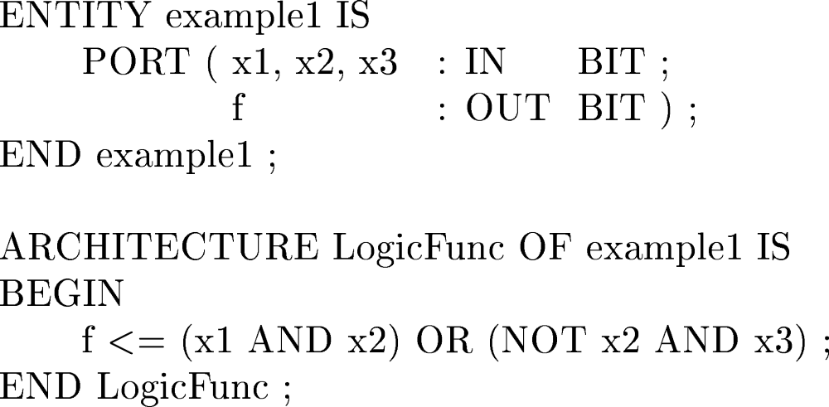
Figure 2.33. Complete VHDL code for the circuit in Figure 2.30.
Cpt2 - Intro. to Logic Ckts.
Portions © Copyright 2009, S. Brown and Z Vranesic

Slide 50
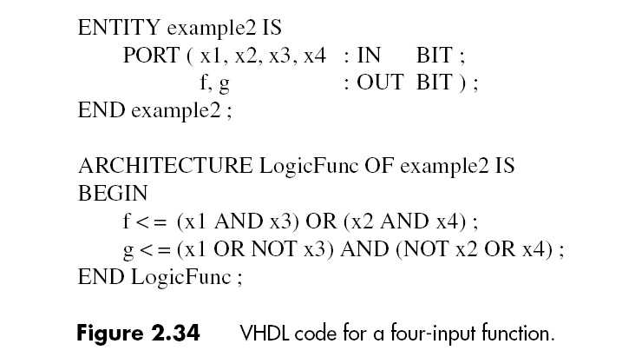
Cpt2 - Intro. to Logic Ckts.
Portions © Copyright 2009, S. Brown and Z Vranesic

Slide 51
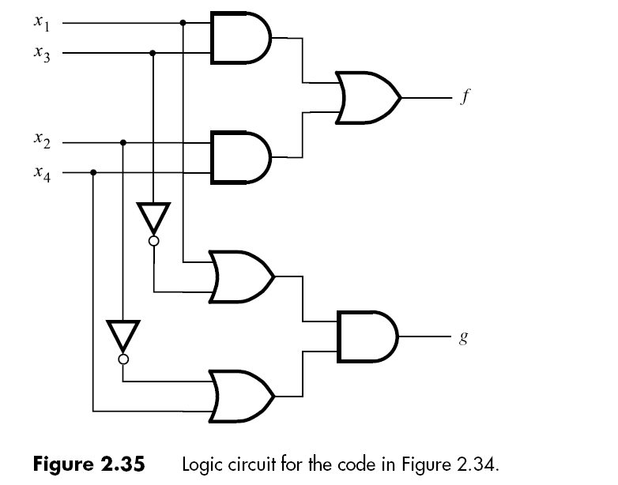
Cpt2 - Intro. to Logic Ckts.
Portions © Copyright 2009, S. Brown and Z Vranesic

