Slide 1
Inverted Indexing for Text Retrieval

Slide 2
Three components of the web search problem
Gathering web content
Web crawling
Construction of the inverted index
Indexing
Ranking documents given a query
Retrieval
First two steps are typically carried out off-line
The retrieval step needs to be operated in real time

Slide 3
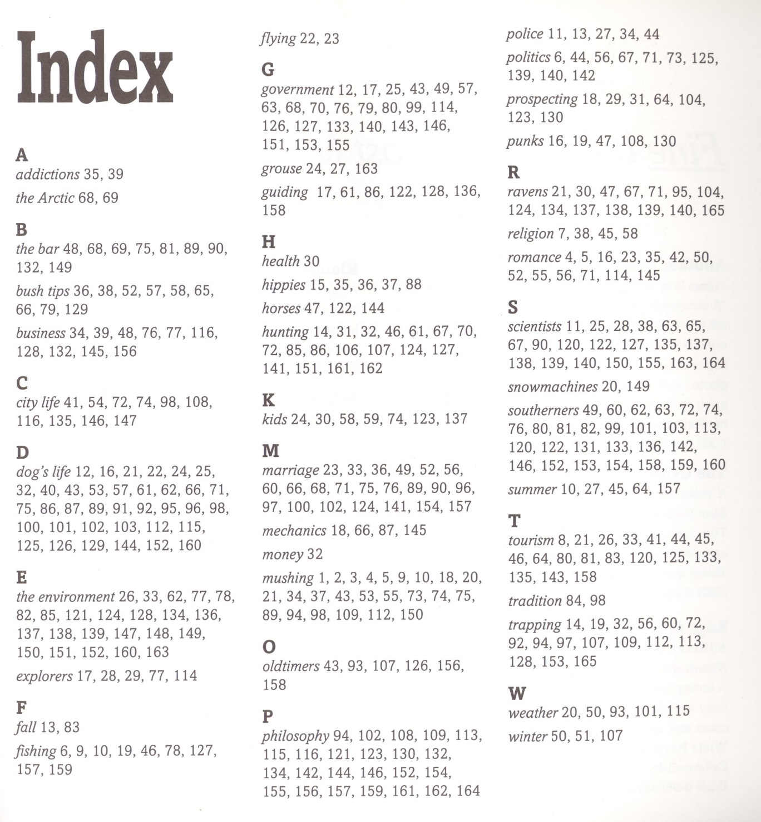
What is inverted index?
First, what is index?

Slide 4
Example of inverted index
Doc 1
Doc 2
Doc 3
Doc 4
one fish, two fish
red fish, blue fish
cat in the hat
green eggs and ham
1
2
3
4
blue
1
blue
2
cat
1
cat
3
egg
1
egg
4
fish
1
1
fish
1
2
green
1
green
4
ham
1
ham
4
hat
1
hat
3
one
1
one
1
red
1
red
2
two
1
two
1

Slide 5
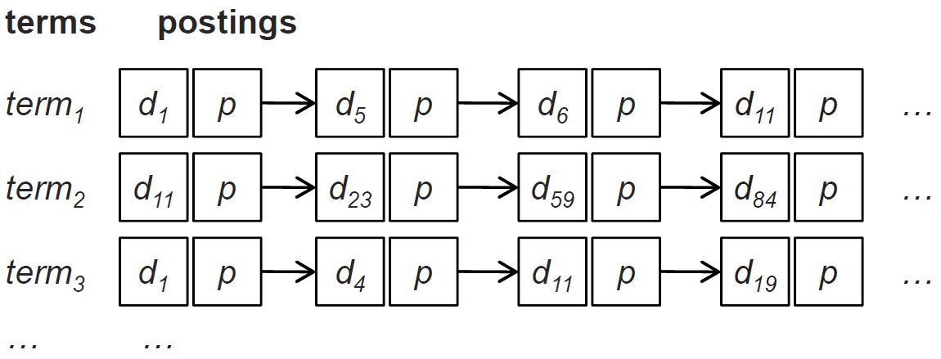
More abstract view of inverted index
An inverted index consists of posting lists
A posting list is comprised of individual postings
Each posting consists of a document id and a payload
Payload example: the occurrence frequency of the term in the corresponding document
Generally, postings are sorted by document id

Slide 6
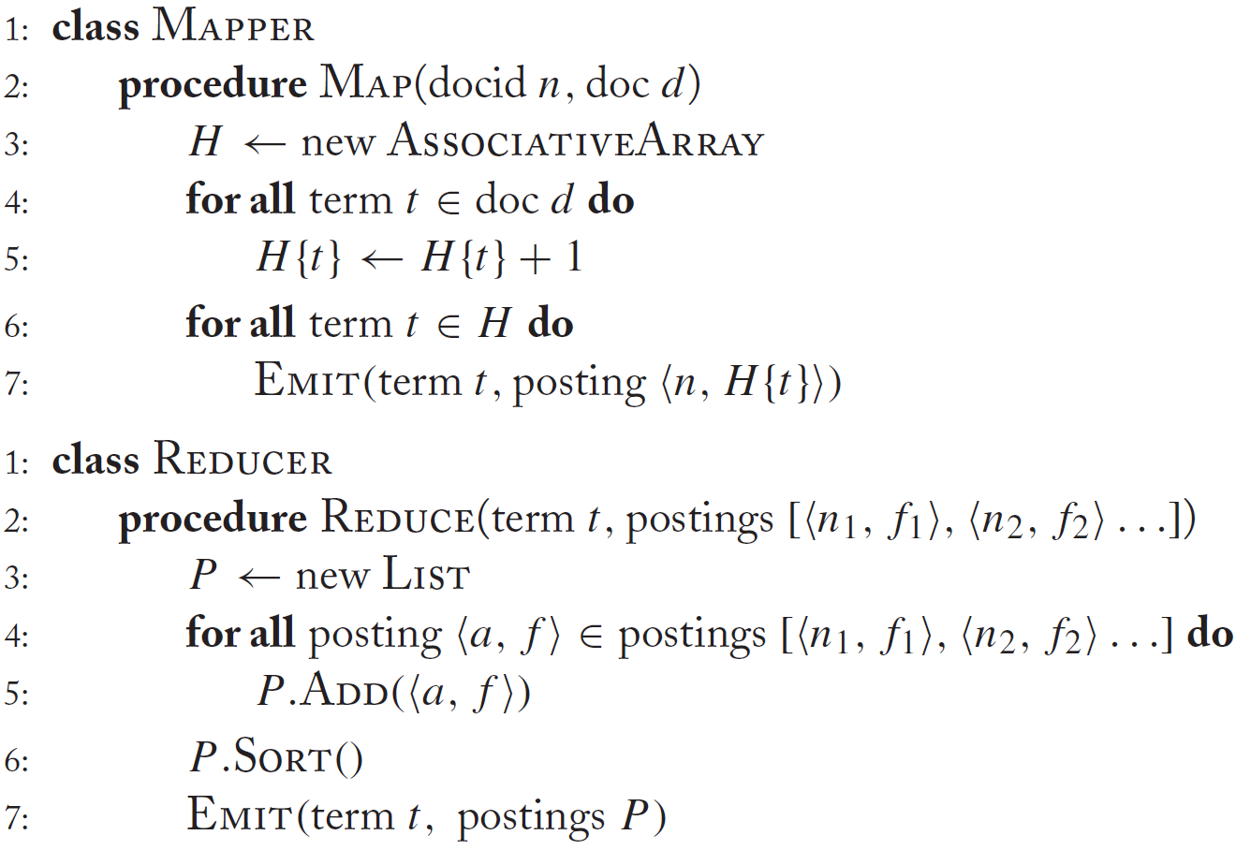
Baseline implementation of inverted indexing

Slide 7
Illustration of the baseline algorithm
Doc 1
Doc 2
Doc 3
one fish, two fish
red fish, blue fish
cat in the hat
one
1
1
red
2
1
cat
3
1
Map
two
blue
hat
1
1
2
1
3
1
fish
1
2
fish
2
2
Shuffle and Sort: aggregate values by keys
cat
3
1
Reduce
blue
2
1
fish
1
2
2
2
hat
3
1
one
1
1
two
1
1
red
2
1

Slide 8
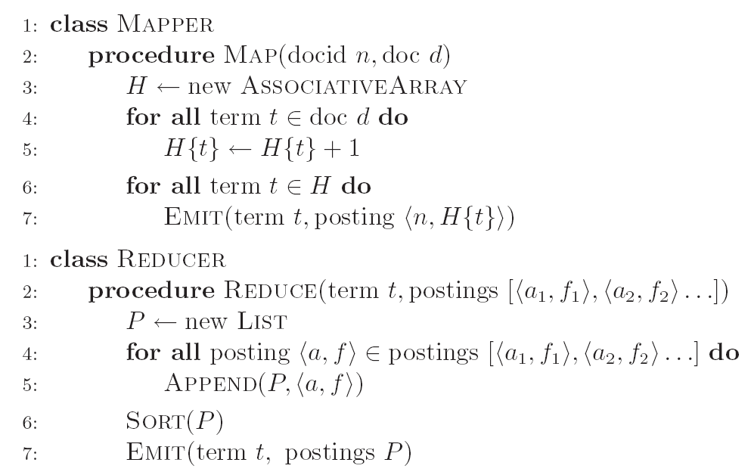
Inverted Indexing: Pseudo-Code
What’s the problem?

Slide 9
Scalability issue of the baseline implementation
Initial implementation: terms as keys, postings as values
Reducers must buffer all postings associated with key (to sort)
What if we run out of memory to buffer postings?

Slide 10
Another try
(key)
(values)
(keys)
(values)
fish
1
2
fish
1
2
34
1
fish
9
1
21
3
fish
21
3
35
2
fish
34
1
80
3
fish
35
2
9
1
fish
80
3
Value-to-key conversion

Slide 11
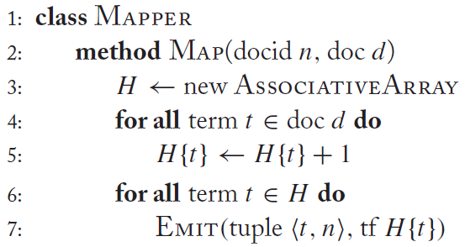
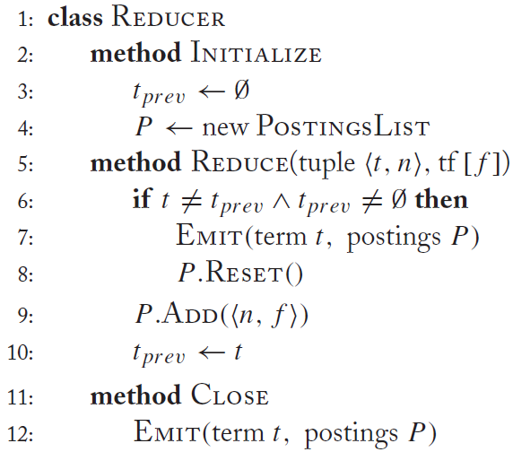
Revised implementation

