Slide 1
Graph Algorithms
Adapted from UMD Jimmy Lin’s slides, which is licensed under a Creative Commons Attribution-Noncommercial-Share Alike 3.0 United States. See http://creativecommons.org/licenses/by-nc-sa/3.0/us/ for details
Revised based on the slides by Ruoming Jin @ Kent State

Slide 2
Outlines
Graph problems and representations
Parallel breadth-first search
PageRank

Slide 3
Outlines
Graph problems and representations
Parallel breadth-first search
PageRank

Slide 4
What’s a graph?
G = (V,E), where
V represents the set of vertices (nodes)
E represents the set of edges (links)
Both vertices and edges may contain additional information
Different types of graphs:
Directed vs. undirected edges
Presence or absence of cycles
Graphs are everywhere:
Hyperlink structure of the Web
Physical structure of computers on the Internet
Interstate highway system
Social networks

Slide 5
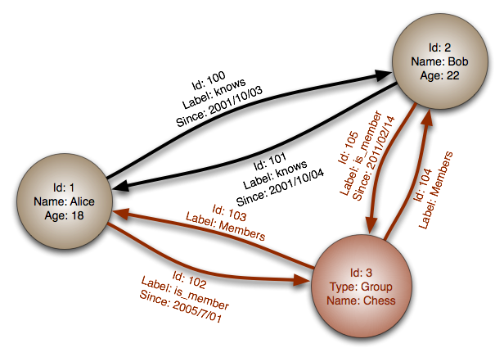

Slide 6
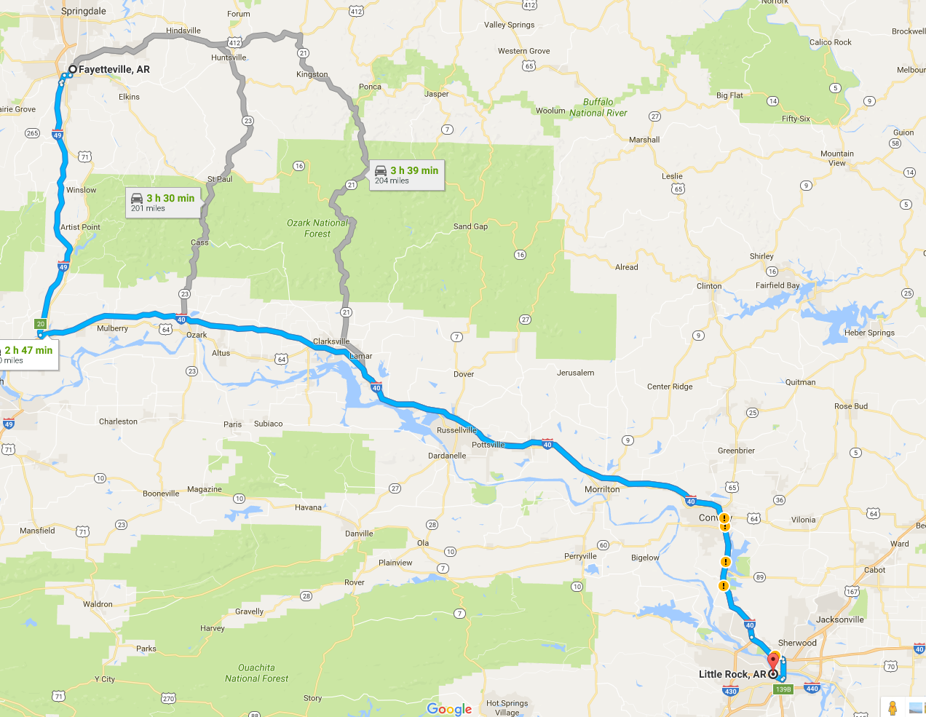
Source: Wikipedia (Königsberg)

Slide 7
Some Graph Problems
Finding shortest paths
Routing Internet traffic and UPS trucks
Finding minimum spanning trees
Telco laying down fiber
Finding Max Flow
Airline scheduling
Identify “special” nodes and communities
Breaking up terrorist cells, spread of avian flu
Bipartite matching
Monster.com, Match.com
And of course... PageRank

Slide 8
Graphs and MapReduce
Graph algorithms typically involve:
Performing computations at each node: based on node features, edge features, and local link structure
Propagating computations: “traversing” the graph
Key questions:
How do you represent graph data in MapReduce?
How do you traverse a graph in MapReduce?

Slide 9
Representing Graphs
G = (V, E)
Two common representations
Adjacency matrix
Adjacency list

Slide 10
Adjacency Matrices
Represent a graph as an n x n square matrix M
n = |V|
M_{ij} = 1 means a link from node i to j
n2
 | n1 | n2 | n3 | n4
n1 | 0 | 1 | 0 | 1
n2 | 1 | 0 | 1 | 1
n3 | 1 | 0 | 0 | 0
n4 | 1 | 0 | 1 | 0
n1
n3
n4

Slide 11
Adjacency Matrices: Critique
Advantages:
Amenable to mathematical manipulation
Iteration over rows and columns corresponds to computations on outlinks and inlinks
Disadvantages:
Lots of zeros for sparse matrices
Lots of wasted space

Slide 12
Adjacency Lists
Take adjacency matrices… and throw away all the zeros
 | n1 | n2 | n3 | n4
n1 | 0 | 1 | 0 | 1
n2 | 1 | 0 | 1 | 1
n3 | 1 | 0 | 0 | 0
n4 | 1 | 0 | 1 | 0
1: 2, 4
2: 1, 3, 4
3: 1
4: 1, 3

Slide 13
Adjacency Lists: Critique
Advantages:
Much more compact representation
Easy to compute over outlinks
Disadvantages:
Much more difficult to compute over inlinks

Slide 14
Outlines
Graph problems and representations
Parallel breadth-first search
PageRank

Slide 15
Single Source Shortest Path
Problem: find shortest path from a source node to one or more target nodes
Shortest might also mean lowest weight or cost
First, a refresher: Dijkstra’s Algorithm

Slide 16
Dijkstra’s Algorithm
Assign to every node a tentative distance value: set it to zero for our initial node and to infinity for all other nodes.
Mark all nodes unvisited. Create a set of all the unvisited nodes called the unvisited set. Set the initial node as the current node.
For the current node, consider all of its unvisited neighbors and calculate their tentative distances. Compare the newly calculated tentative distance with the current assigned value, and assign the smaller one.
When we are done considering all of the neighbors of the current node, mark the current node as visited and remove it from the unvisited set. A visited node will never be checked again.
If all of destination nodes have been marked visited or if the smallest tentative distance among the nodes in the unvisited set is infinity, then stop. The algorithm has finished.
Otherwise, select the unvisited node that is marked with the smallest tentative distance, set it as the new "current node", and go back to step 3.

Slide 17
Dijkstra’s Algorithm Example
n2
n4
∞
1
∞
10
0
2
3
9
4
6
n1
5
7
∞
∞
2
n3
n5
Example from CLR

Slide 18
Dijkstra’s Algorithm Example
n2
n4
10
1
∞
10
0
2
3
9
4
6
n1
5
7
5
∞
2
n3
n5
Example from CLR

Slide 19
Dijkstra’s Algorithm Example
n2
n4
8
1
14
10
0
2
3
9
4
6
n1
5
7
5
7
2
n3
n5
Example from CLR

Slide 20
Dijkstra’s Algorithm Example
n2
n4
8
1
13
10
0
2
3
9
4
6
n1
5
7
5
7
2
n3
n5
Example from CLR

Slide 21
Dijkstra’s Algorithm Example
n2
n4
8
1
9
1
10
0
2
3
9
4
6
n1
5
7
5
7
2
n3
n5
Example from CLR

Slide 22
Dijkstra’s Algorithm Example
n2
n4
8
1
9
10
0
2
3
9
4
6
n1
5
7
5
7
2
n3
n5
Example from CLR

Slide 23
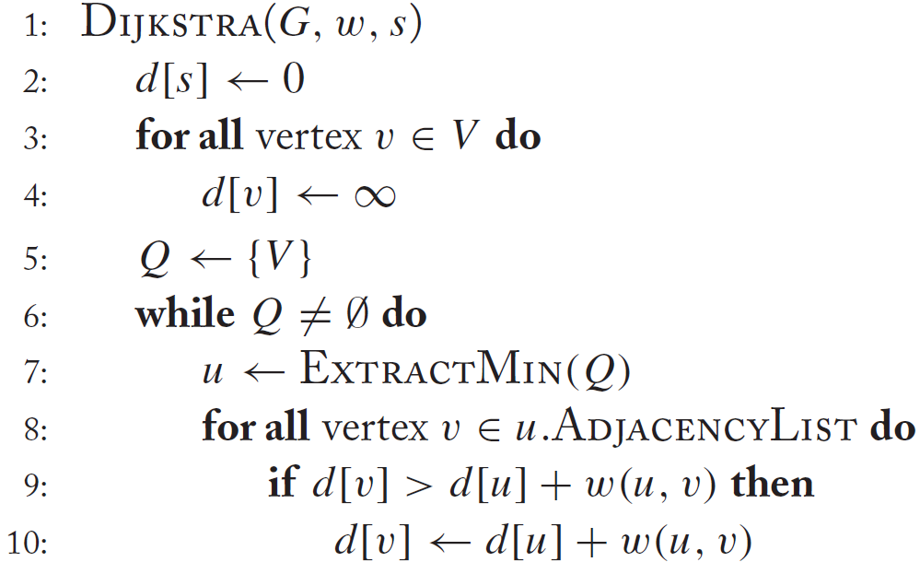
Dijkstra’s Algorithm
d[s]←0

Slide 24
Single Source Shortest Path
Problem: find shortest path from a source node to one or more target nodes
Shortest might also mean lowest weight or cost
Single processor machine: Dijkstra’s Algorithm
MapReduce: parallel Breadth-First Search (BFS)

Slide 25
Finding the Shortest Path
Consider simple case of equal edge weights (i.e., weight=1)
Solution to the problem can be defined inductively
Here’s the intuition:
Define: b is reachable from a if b is on adjacency list of a
DistanceTo(s) = 0
For all nodes p reachable from s, DistanceTo(p) = 1
For all nodes n reachable from some other set of nodes M, DistanceTo(n) = 1 + min(DistanceTo(m), m ∈ M)
d₁
m₁
…
d₂
s
…
n
m₂
…
d₃
m₃

Slide 26
Visualizing Parallel BFS
n₇
n₀
n₁
n₃
n₂
n₆
n₅
n₄
n₈
n₉

Slide 27
From Intuition to Algorithm
Data representation:
Key: node n
Value: d (distance from start), adjacency list (list of nodes reachable from n)
Initialization: for all nodes except for start node, d = ∞
Mapper:
∀m ∈ adjacency list: emit (m, d + 1)
Sort/Shuffle
Groups distances by reachable nodes
Reducer:
Selects minimum distance path for each reachable node
Additional bookkeeping needed to keep track of actual path

Slide 28
Multiple Iterations Needed
Each MapReduce iteration advances the “known frontier” by one hop
Subsequent iterations include more and more reachable nodes as frontier expands
Multiple iterations are needed to explore entire graph
Preserving graph structure:
Problem: Where did the adjacency list go?
Solution: mapper emits (n, adjacency list) as well

Slide 29
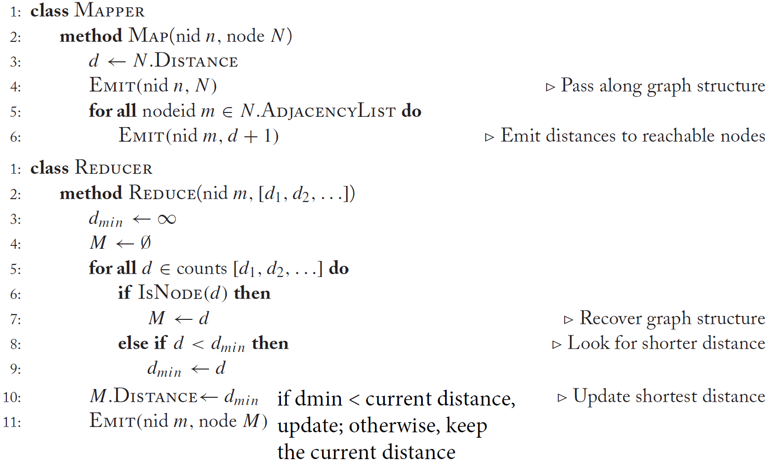
BFS Pseudo-Code

Slide 30
Stopping Criterion
How many iterations are needed in parallel BFS (equal edge weight case)?
Six degrees of separation?
Practicalities of implementation in MapReduce

Slide 31
Comparison with Dijkstra
Dijkstra’s algorithm is more efficient
At any step it only pursues edges from the minimum-cost path inside the frontier
MapReduce explores all paths in parallel
Lots of “waste”
Useful work is only done at the “frontier”
Non-useful work can be avoided

Slide 32
Weighted Edges
Now add positive weights to the edges
Simple change: adjacency list now includes a weight w for each edge
In mapper, emit (m, d + w_{p}) instead of (m, d + 1) for each node m

Slide 33
Stopping Criterion
How many iterations are needed in parallel BFS (positive edge weight case)?
Convince yourself: when a node is first “discovered”, we’ve found the shortest path
A node becomes “discovered” when the cost of the node becomes non-infinity.
Not true!

Slide 34
Additional Complexities
search frontier
1
n₆
1
n₇
1
n₈
r
10
1
n₅
n₉
n₁
s
1
1
p
q
n₄
1
n₂
1
n₃

Slide 35
Graphs and MapReduce
Graph algorithms typically involve:
Performing computations at each node: based on node features, edge features, and local link structure
Propagating computations: “traversing” the graph
Generic recipe:
Represent graphs as adjacency lists
Perform local computations in mapper
Pass along partial results via outlinks, keyed by destination node
Perform aggregation in reducer on inlinks to a node
Iterate until convergence: controlled by external “driver”
Don’t forget to pass the graph structure between iterations

Slide 36
A practical implementation
Referenced from the following link
http://www.johnandcailin.com/blog/cailin/breadth-first-graph-search-using-iterative-map-reduce-algorithm
A node is represented by a string as follows
ID EDGES|WEIGHTS|DISTANCE_FROM_SOURCE|COLOR

Slide 37
Three statuses of a node
Unvisited
Color white
Being visited
Color gray
Visited
Color black
Gray
White
Black

Slide 38
The mappers
All white nodes and black nodes only reproduce themselves
For each gray node (e.g., an exploding node)
For each node n in the adjacency list, emit a gray node
n null|null|distance of exploding node + weight|gray
Turn its own color to black and emit itself
ID edges|weights|distance from source|black

Slide 39
The reducers
Receive the data for all “copies” of each node
Construct a new node for each node
The non-null list of edges and weights
The minimum distance from the source
The proper color

Slide 40
Choose the proper color
If only receiving a copy of white node, color is white
If only receiving a copy of black node, color is black
If receiving copies consisting of white node and gray nodes, color is gray
If receiving copies consisting of gray nodes and black node
If minimum distance comes from black node, color is black
Otherwise, color is gray

Slide 41
Outlines
Graph problems and representations
Parallel breadth-first search
PageRank

Slide 42
Random Walks Over the Web
Random surfer model:
User starts at a random Web page
User randomly clicks on links, surfing from page to page
Or, sometimes, user jumps to a random page
PageRank
Characterizes the amount of time spent on any given page
Mathematically, a probability distribution over pages
PageRank captures notions of page importance
One of thousands of features used in web search

Slide 43
PageRank: Defined
Given page x with inlinks t₁…t_{n}, where
C(t_{i}) is the out-degree of t_{i}, i.e., the number of outgoing links from t_{i}
α is probability of random jump
N is the total number of nodes in the graph
t₁
X
t₂
…
t_{n}

Slide 44
Computing PageRank
Properties of PageRank
Can be computed iteratively
Effects at each iteration are local
Sketch of algorithm (ignoring random jump):
Start with seed PR_{i} values
Each page distributes PR_{i} mass to all pages it links
Each target page adds up mass from multiple in-bound links to compute PR_{i+1}
Iterate until values converge

Slide 45
Sample PageRank Iteration (1)
Iteration 1
n₂ (0.2)
n₂ (0.166)
n₁ (0.2)
0.1
0.1
0.1
n₁ (0.066)
0.1
0.066
0.066
0.066
n₅ (0.2)
n₃ (0.2)
n₅ (0.3)
n₃ (0.166)
0.2
0.2
n₄ (0.2)
n₄ (0.3)

Slide 46
Sample PageRank Iteration (2)
Iteration 2
n₂ (0.166)
n₂ (0.133)
n₁ (0.066)
0.033
0.083
0.083
n₁ (0.1)
0.033
0.1
0.1
0.1
n₅ (0.3)
n₃ (0.166)
n₅ (0.383)
n₃ (0.183)
0.3
0.166
n₄ (0.3)
n₄ (0.2)

Slide 47
PageRank in MapReduce
n₁ [n₂, n₄]
n₂ [n₃, n₅]
n₃ [n₄]
n₄ [n₅]
n₅ [n₁, n₂, n₃]
Map
n₂
n₄
n₃
n₅
n₄
n₅
n₁
n₂
n₃
n₁
n₂
n₂
n₃
n₃
n₄
n₄
n₅
n₅
Reduce
n₁ [n₂, n₄]
n₂ [n₃, n₅]
n₃ [n₄]
n₄ [n₅]
n₅ [n₁, n₂, n₃]

Slide 48
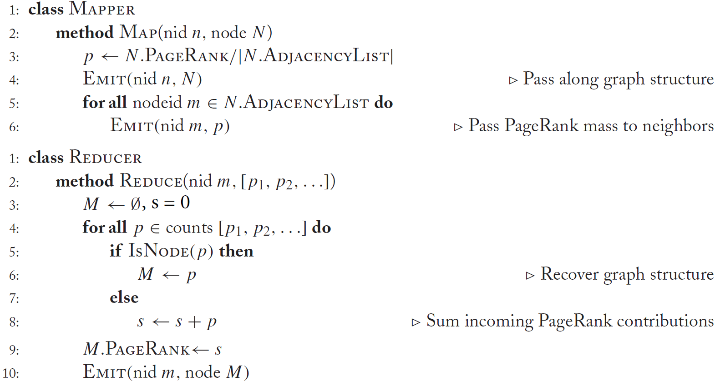
PageRank Pseudo-Code

Slide 49
Complete PageRank
Two additional complexities
What is the proper treatment of dangling nodes?
How do we factor in the random jump factor?

Slide 50
Dangling nodes
A dangling node is a node that has no outgoing edges
The adjacency list is empty
t₁
X
t₂
…
t_{n}
The PageRank mass of a dangling node will get lost during the mapper stage due to the lack of outgoing edges
Solution
Reserve a special key (i.e., a special node id) for storing PageRank mass from dangling nodes
Mapper: dangling nodes emit the mass with the special key
Reducer: sum up all the missing mass with the special key

Slide 51
Second pass
Second pass to redistribute “missing PageRank mass” and account for random jumps
p is PageRank value from the first pass, p' is updated PageRank value
|G| is the number of nodes in the graph
m is the combined missing PageRank mass

Slide 52
Complete PageRank
One iteration of PageRank requires two passes (i.e., two MapReduce jobs)
The first to distribute PageRank mass along graph edges
Also take care of the missing mass due to dangling nodes
The second to redistribute the missing mass and take into account the random jump factor
This job requires no reducers

Slide 53
Sample PageRank Iteration (1)
Iteration 1
Pass 1
n₂ (0.2)
n₂ (0.166)
n₁ (0.2)
0.1
0.1
0.1
n₁ (0.066)
0.1
0.066
0.066
0.066
n₅ (0.2)
n₃ (0.2)
n₅ (0.3)
n₃ (0.166)
0.2
n₄ (0.2)
n₄ (0.1)
Missing PR mass = 0.2

Slide 54
Sample PageRank Iteration (1)
Iteration 1
Pass 2
n₂ (0.166)
n₂ (0.2054)
n₁ (0.066)
n₁ (0.1154)
n₅ (0.3)
n₃ (0.166)
n₅ (0.326)
n₃ (0.2054)
n₄ (0.1)
n₄ (0.146)
Missing PR mass = 0.2
α = 0.1, m = 0.2

Slide 55
PageRank Convergence
Convergence criteria
Iterate until PageRank values don’t change
Fixed number of iterations
Convergence for web graphs?
52 iterations for a graph with 322 million edges

