Slide 1
INVESTMENT ASSIGNMENT SUBMISSION
Name: Minal Bafna

Slide 2
Spark Fund - Investment Analysis
Spark Funds, an asset management company, is looking for an investment in few companies.
The overall strategy is to invest where most other investors are investing with best sectors and countries
Business Constraints:
It wants to invest between 5 to 15 million USD per round of investment
It wants to invest only in English-speaking countries because of the ease of communication with the companies it would invest in
Business Objective:
The objective is to identify the best sectors, countries, and a suitable investment type for making investments. The overall strategy is to invest where others are investing, implying that the 'best' sectors and countries are the ones 'where most investors are investing’.
Goals of data analysis:
Investment type analysis
Country analysis
Sector analysis

Slide 3
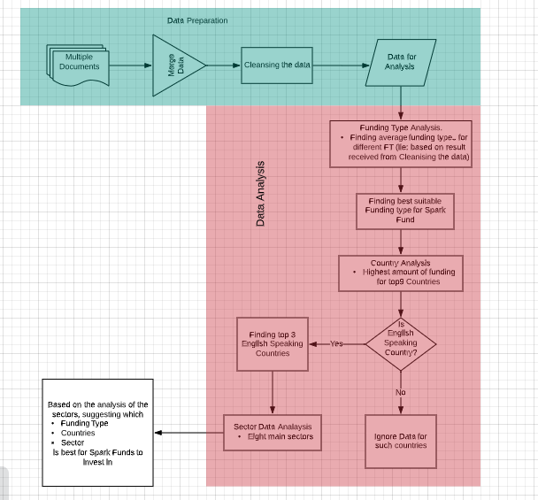
Problem solving methodology

Slide 4
Data For Analysis
Real investment data is taken from crunchbase.com
1. Company details: File with basic data of companies
2. Funding round details: File with data containing Type of funding – venture, angel, private equity etc., Date of funding and Money raised in funding (USD)
3. Sector Classification: mapping file maps the numerous sector category names in the companies table
4. English Speaking countries reference document
Data Cleansing Process:
Removed rows having null values from all the files which is not required for analysis.
Removed columns having null values from all the files which is not required for analysis.

Slide 5
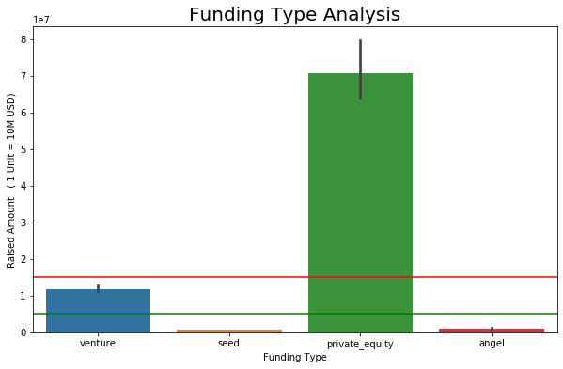
Funding Type Analysis
There are 14 different types of investments.
Spark Funds wants to invest between 5 to 15 million
USD per investment.
Angel and Seed type of investments have average
funding amount less than 5 Millions.
Private Equity have average funding amount more than 15 Millions.
Venture is most suitable investment Spark Fund can invest
as average amount is between 5 to 15 Millions.

Slide 6
Country Analysis
Spark Funds wants top 9 countries based on the
total investment amount each country
has received.
USA tops among all the countries based on
the total investment amount received.
Identifying top 3 English Speaking Countries.
China tops 2nd based on total investment, but
since it is not English speaking country,
data for China won't be considered.
1. Top English-speaking country : USA
2. Second English-speaking country : GBR
3. Third English-speaking country : IND
Country | Amount in USD
USA | 419,443,200,000.00
CHN | 36,950,870,000.00
GBR | 19,235,530,000.00
IND | 14,167,810,000.00
CAN | 9,435,487,000.00
FRA | 6,825,021,000.00
ISR | 6,551,761,000.00
DEU | 6,180,782,000.00
JPN | 3,018,150,000.00

Slide 7
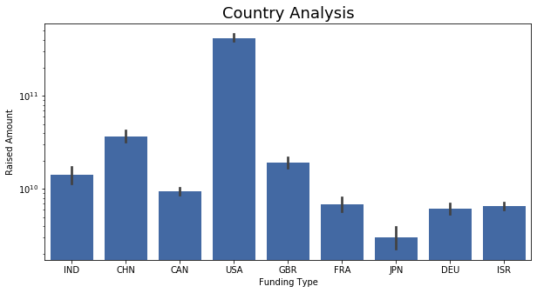
Country Analysis
USA tops among all the countries based on the total investment
amount received.
China follows the second, but is not an English speaking Country.
United Kingdom (GBR) and India (IND) tops as 2nd and 3rd
among top 9 countries.
Followed by Canada, France, Germany, Israel and Japan.

Slide 8
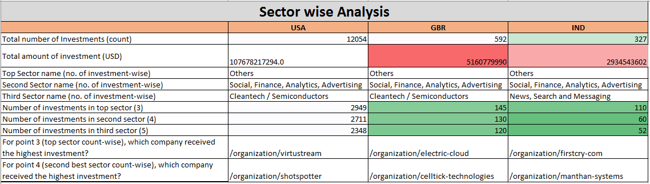
Sector Analysis
Sector Analysis is done based on eight main sectors.

Slide 9
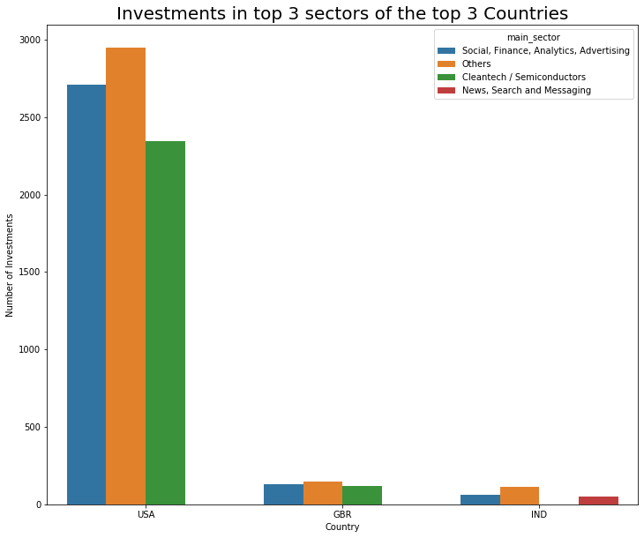
Sector Analysis

Slide 10
Conclusions
Based on the analysis, Spark Funds considers investments in following countries and sectors.
Funding Type: Venture
Investment Countries | Sectors
USA | Others Social, Finance, Analytics, Advertising Cleantech / Semiconductors
GBR | Others Social, Finance, Analytics, Advertising Cleantech / Semiconductors
IND | Others Social, Finance, Analytics, Advertising News, Search and Messaging

