Slide 1

Hangman in Haskell
Implementing Hangman guessing game
using functional programming
Student:
Baftjar Jusufi, ID:30228
Mentor:
Prof. Dr. Arbana Kadriu
Asst. Prof. Shqipe Salii

Slide 2
Outline
Introduction to Hangman Guessing Game
How to run it?
Implementation of Hangman in Haskell
Modules
Main.hs
Hangman.hs
Conclusion

Slide 3
Introduction to Hangman Guessing game
Hangman is a guessing game for two or more players. One player thinks of a word, phrase or sentence and the other tries to guess it by suggesting letters within a certain number of guesses.
I also made this a little more special by adding only Albanian name cities from Albania, Kosova and North Macedonia and the player can guess to 7 letters wrong.
Game is simple , you guess a letter and if it is correct it is added to the game.
Though the origins of the game are unknown, a variant is mentioned in a book of children's games assembled by Alice Gomme in 1894 called Birds, Beasts, and Fishes. This version lacks the image of a hanged man, instead relying on keeping score as to the number of attempts it took each player to fill in the blanks.

Slide 4
How to run it?
In order to run the code you need to make sure that you have ghcup installed in your machine and you just simply need to download it and open it with any IDE or code editor, but I recommend using Visual Studio Code since it is a free code editor platform and I used it. After opening the folder of the game in the VS code, write in the terminal the following to start playing the Hangman Guessing Game:
First we need carefully to check the path so if you are not in the correct path always use the “cd (folder name)” but if it is in correct path just write this:
stack build ; You need to wait a little and then you type:
stack exec hangman;

Slide 5
How to run it? p2
After the code above the game starts and you can try guessing an Albanian city , if you make a mistake by guessing up to 7 times you lose because that is the maximum allowed, but if you find a letter the game will add that letter to the puzzle, and the letters you used you can check them on the right.
If you win or lose to play another game you need to type the
stack exec hangman , again. Every single time.

Slide 6
Implementation of Hangman guessing game in Haskell
The code is made of 2 modules such as:
Hangman.hs;
Main.hs;
As for librarys , I have imported the followings:
import Control.Monad (forever) -provides some useful functions for working with monads(it is used to describe computations as sequence of steps and to handle side effects). It contains functions like forever, which can be used to repeat an action indefinitely, and join, which combines two monadic values into a single monad.
import Data.List (intersperse) –is library that provides a variety of useful functions for working with lists. It contains functions like intersperse, which can be used to insert elements between the elements of a list, and nub, which can be used to remove duplicate elements from a list.
import Data.Maybe (isJust) - provides functions for working with values of the Maybe type. It contains functions like isJust, which can be used to test if a value is of type Maybe, and fromJust, which can be used to extract the value contained in a Maybe.
import System.Exit (exitSuccess) - provides functions for exiting a program. It contains functions like exitSuccess, which can be used to exit a program without an error, and exitFailure, which can be used to exit a program with an error.
import System.Random (randomRIO) - provides functions for generating random numbers. It contains functions like randomRIO, which can be used to generate a random number within a certain range, and randomRs, which can be used to generate a list of random numbers within a certain range.
import Data.Char (toLower) - provides a variety of useful functions for working with characters. It contains functions like toLower, which can be used to convert a character to lower case, and ord, which can be used to get the numerical value of a character.
import Hangman (freshPuzzle, randomWord', runGame) - provides functions for running the Hangman game. It contains functions like freshPuzzle, which can be used to generate a new Hangman puzzle, and runGame, which can be used to run the game.
import System.IO (BufferMode (NoBuffering), hSetBuffering, stdout) - functions for working with input and output. It contains functions like hSetBuffering, which can be used to set the buffering mode of a handle, and getLine, which can be used to read a line of input from a handle.

Slide 7
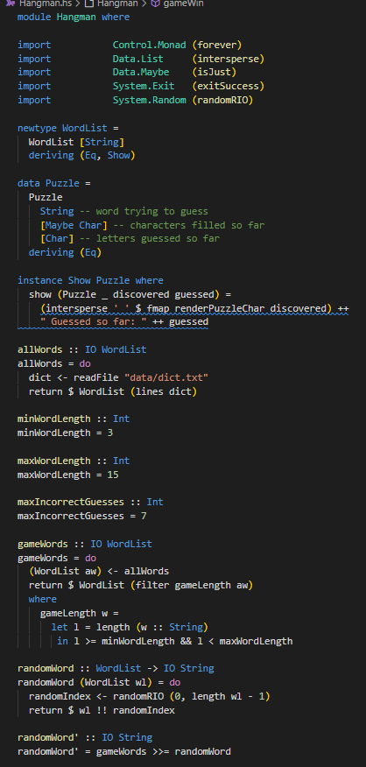
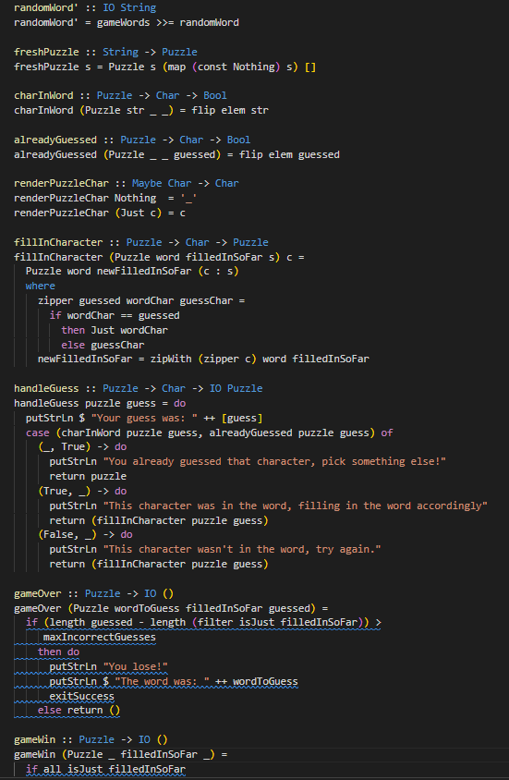
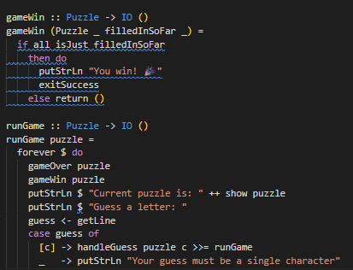
Module Hangman.hs
Hangman is the starting module which constists all the other modules and imports all the required libraries.

Slide 8
Module Hangman.hs
This code is setting up functions and data types for playing the game of Hangman.
When the module is first imported, it sets up the minimum and maximum word lengths, as well as the maximum number of incorrect guesses. It also imports functions from other modules to help with the game logic. The allWords function reads the dictionary file and loads all the words into a WordList, while gameWords filters out the words that are too long or too short. The randomWord function is then used to choose a random word from the list.
The code also includes several utility functions and constants such as allWords, minWordLength, maxWordLength, maxIncorrectGuesses,
gameWords, randomWord and randomWord'. These functions and constants help set the parameters for the game. The game is started with the freshPuzzle function, which takes a string and creates a Puzzle object. This object contains the word to be guessed, the characters that have been filled in so far, and the list of letters that have been guessed by the player. The show function is used to render the Puzzle object, showing the characters that have been guessed and the guesses that have been made. The handleGuess function takes in the Puzzle and the user's guess and checks if the letter is in the word or has already been guessed. If the letter is already guessed, the player is prompted to enter another letter. Otherwise, the letter is added to the list of letters guessed and the word is filled in accordingly. Finally, the runGame function is used to control the game loop, prompting the user to enter a letter and then processing the guess. It also checks if the game is over by calling the gameOver and gameWin functions. If the maximum number of incorrect guesses is exceeded, the game is lost. If all the letters in the word are guessed, the game is won.

Slide 9
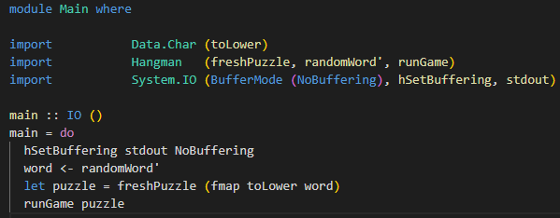
Module Main.hs
Main.hs is the module which consists all the logic of the game which indicates which word (in our case which city name will be used , turns it to a lower case word) and it creates the guessing city and then it starts the game;
It imports all the required libraries;
This code is setting up a game of Hangman. It is importing the necessary functions from the Hangman module and System.IO module. It sets the standard output buffer to NoBuffering.
The last four lines of code make up the main function. It starts by setting the buffering mode of the standard output stream. Then it uses the randomWord' function from the Hangman module to get a random word. It then uses the toLower function from the Data.Char module to convert the word to lower case. Then it uses the freshPuzzle function from the Hangman module to create a new Hangman puzzle from the word. Finally, it ivokes the runGame function from the Hangman module to start the Hangman game.

Slide 10
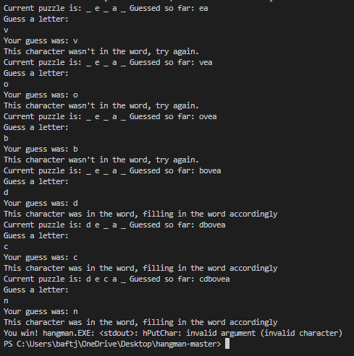
How does it look?
We guess letters and if the letter is correctly guessed it will be added on the puzzle and if it is not it will only be added on the right side on the ‘’Guessed so far: ..’’, if we guess correctly the game is finished and it will show a message , if you guess incorrectly 7 times the game will end and it will show you a message.
For the picture shown the city was ‘’Decan’’ and we guessed it correctly as we can see in the picture on the right side.

Slide 11
Conclusion
Used Haskell for development since, its is a great development language to start on because of the following reasons:
It is a powerful, expressive, and flexible language that is used in many fields, including finance, artificial intelligence, and web development.
Haskell is a functional programming language, which means it is well-suited to representing and manipulating the data structures and algorithms involved in a game like hangman guessing game.
It has a strong type system and a focus on immutability, which can help make your code more reliable and easier .
Haskell is a declarative, functional language, which means that it focuses on what should be done rather than how it should be done.

