Slide 1
OOP#1

Slide 2
Agenda
Class & Object
Static Class
Three principle
Modifier
Interface
SOLID
IoC - Inversion of Control
Composite vs Inheritance
Trade-off
Q&A

Slide 3
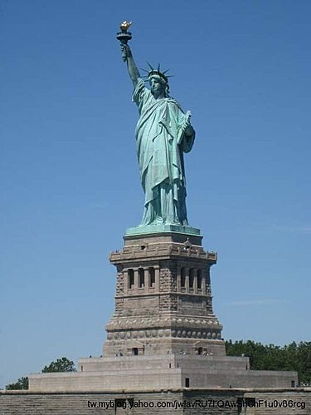
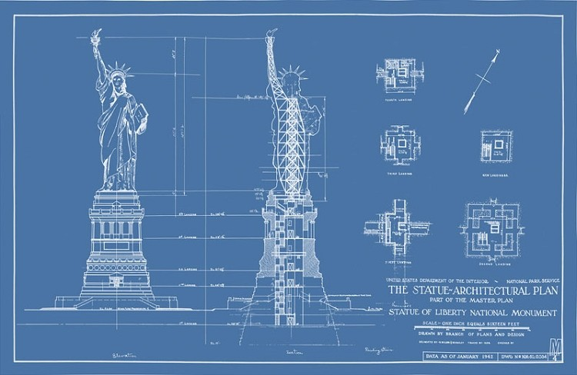
Class & Object
An Object is a instance of a class
Class is like a blueprint
Object is what actually allocated in the memory

Slide 4
Static class
They only contain static members.
They cannot be instantiated.
They are sealed.
They cannot contain Instance Constructor
https://msdn.microsoft.com/en-us/library/79b3xss3(v=vs.80).aspx

Slide 5
Encapsulation
Hiding informations from others

Slide 6
Inheritance
To reduce duplicate code.
Make a “Is-A” relationship

Slide 7
Polymorphism
To reduce duplicate code.

Slide 8
Access Modifier
Public
Private
Internal
Protected

Slide 9
Other Modifier
https://docs.microsoft.com/en-us/dotnet/csharp/language-reference/keywords/modifiers

Slide 10
SOLID
S - Single Responsibility Principle
O - Open Closed Principle
L - Liskov Substitution Principle
L - Least Knowledge Principle
I - Interface Segregation Principle
D - Dependency Inversion Principle

Slide 11
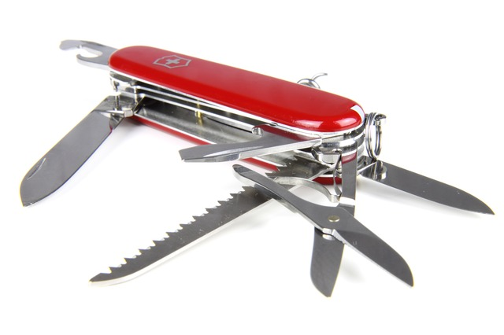
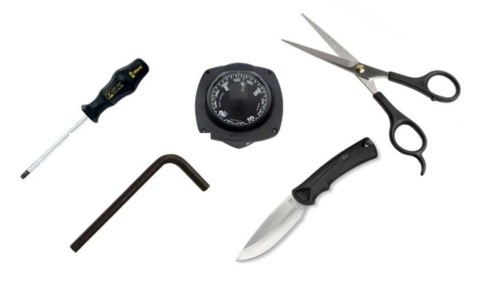
SOLID
Single Responsibility Principle
A class should have only a single responsibility.

Slide 12
SOLID
Single Responsibility Principle
Why
Easy to understand and maintain
Reusable modules
How
Define the responsibility of each class
Extract similar responsibility logic

Slide 13
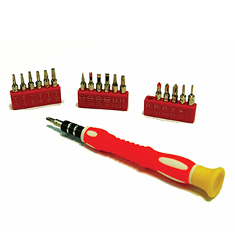
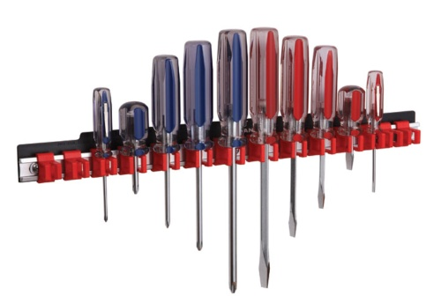
SOLID
Open Closed Principle
Open for extension, closed for modification.

Slide 14
SOLID
Open Closed Principle
Why
Easy to extend new feature
Isolate the changes from unrelated parts
How
Abstract a group of similar methods
Depend on abstractions

Slide 15

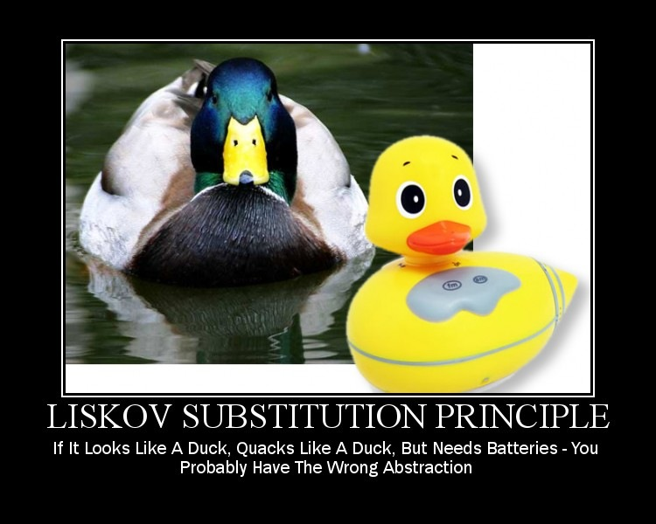
SOLID
Liskov Substitution Principle
Objects in a program should be replaceable with instances of their subtypes without altering the correctness of that program.

Slide 16
SOLID
Liskov Substitution Principle
Why
Meet the client side’s expectation
How
Use inheritance carefully
Distinguish is-a and has-a relationship

Slide 17
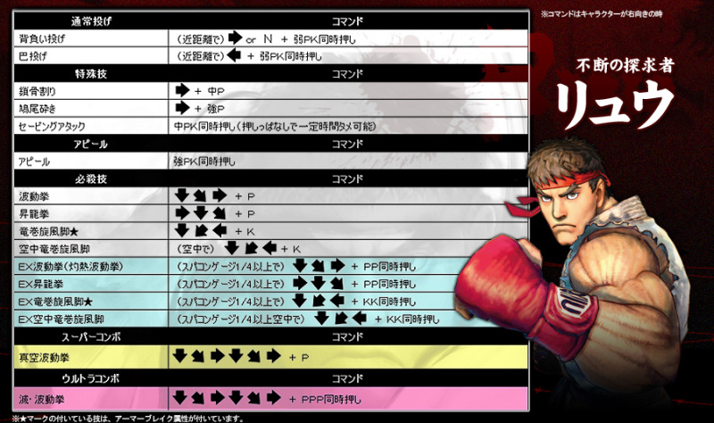

SOLID
Least Knowledge Principle (aka Law of Demeter)
Each unit should have only limited knowledge about other units: only units "closely" related to the current unit.
Each unit should only talk to its friends; don't talk to strangers.
Only talk to your immediate friends.

Slide 18
SOLID
Least Knowledge Principle (aka Law of Demeter)
Why
Reduce unnecessary coupling
How
Don’t make property public or return objects which are unnecessary to client side
Use something only when you have to

Slide 19

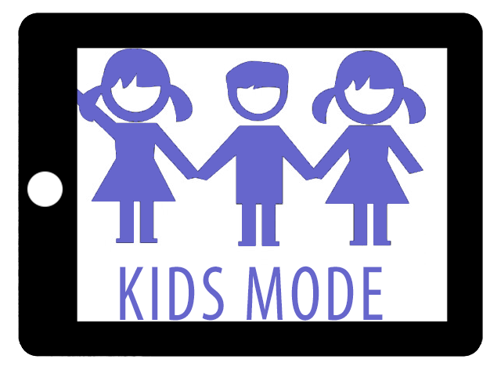
SOLID
Interface Segregation Principle
Many client-specific interfaces are better than one general-purpose interface.

Slide 20
SOLID
Interface Segregation Principle
Why
Reduce unnecessary coupling
How
Split specific interface for specific client side
Use wrapper for third party API

Slide 21


SOLID
Dependency Inversion Principle
High-level modules should not depend on low-level modules. Both should depend on abstractions.
Abstractions should not depend on details. Details should depend on abstractions.

Slide 22
SOLID
Dependency Inversion Principle
Why
Remove direct dependency interface
Reduce impact of client side when API modify logic
How
Abstract a group of similar methods
Depend on abstractions

Slide 23
IoC - Inversion of Control
Dependency Injection
Setter
Constructor
Pros and Cons
How to ensure dependencies are injected?
How many dependencies need to inject?

Slide 24
Composite vs Inheritance
Aggregate
A has a B
Classroom has a teacher and students
Composite
A contains a B (same life circle)
Bird has two wings
Inheritance
A is a B
Monkey is an animal

Slide 25
Composite vs Inheritance
 | Composite | Inheritance
Pros | Keeps encapsulation Low coupling Better scalability Support dynamic dependency binding | Sub class obtains signature automatically Easy to create instances of sub class
Cons | Cannot obtain signature automatically Need to create sets of instances of interface | Breaks encapsulation High coupling Hard to control relationships and complexity

Slide 26
Trade-Off
Reusability
Scalability
Readability
Testability
Performance

Slide 27
Q&A

