Slide 1
Controller for 3 Phase Motor

Slide 2
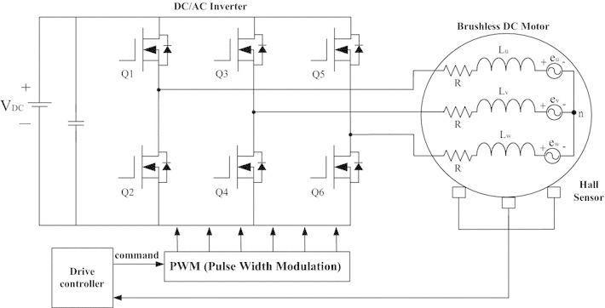
https://www.st.com/en/applications/industrial-motor-control.html

Slide 3
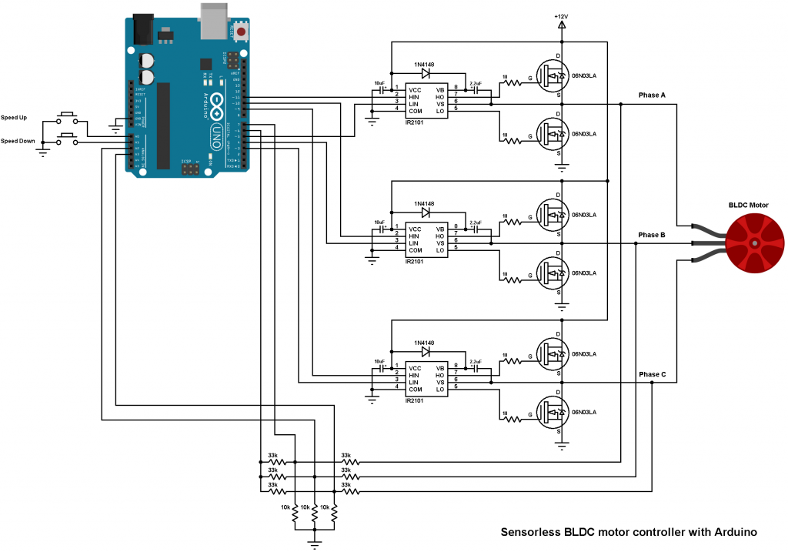
Brushless DC Motor Controller Using Arduino
https://simple-circuit.com/arduino-brushless-dc-motor-controller/

Slide 4
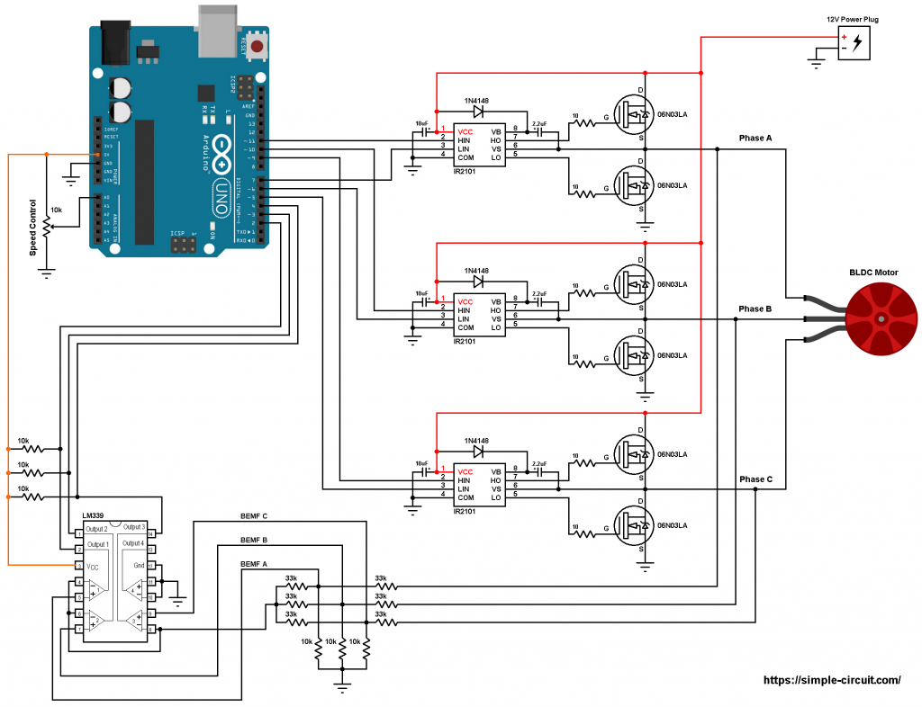
BLDC Motor control using Arduino
https://simple-circuit.com/arduino-sensorless-brushless-motor-bldc/

Slide 5
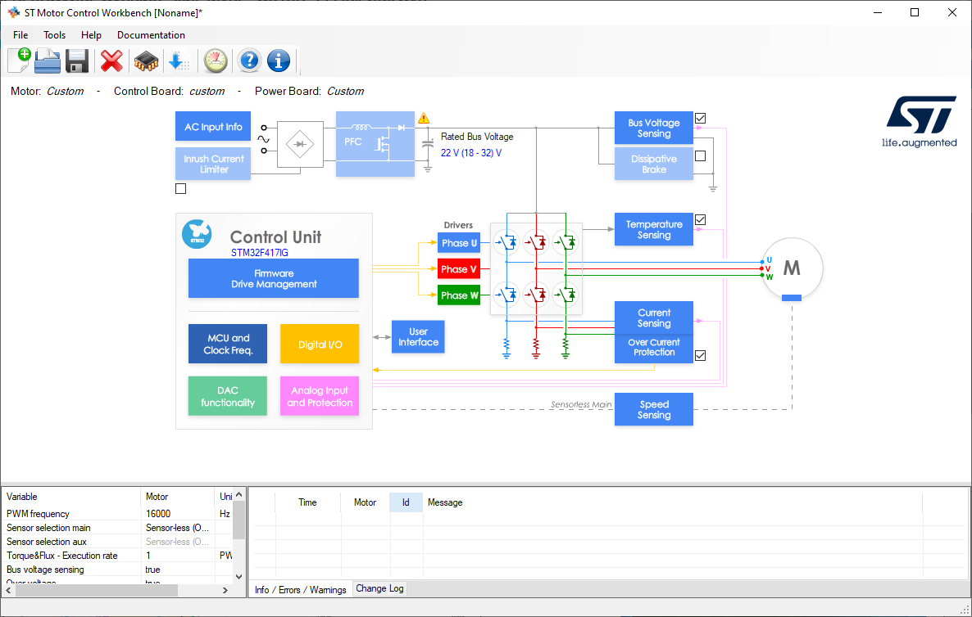
ST Motor Control Workbench 5.4.8
Software: https://www.st.com/en/embedded-software/x-cube-mcsdk.html
Tutorial: https://comm.eefocus.com/media/download/index/id-1014656

