Slide 2
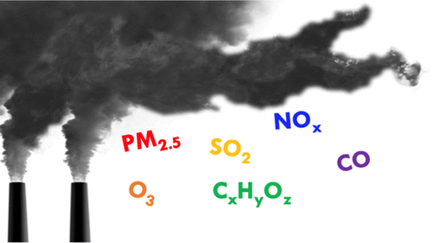
Domain Description
The domain in air pollution monitoring systems involves the integration of various technologies and components to collect, analyze, and communicate air quality data. This includes
IoT devices such as sensors
data communication networks, data storage and processing
web-based applications.

Slide 3
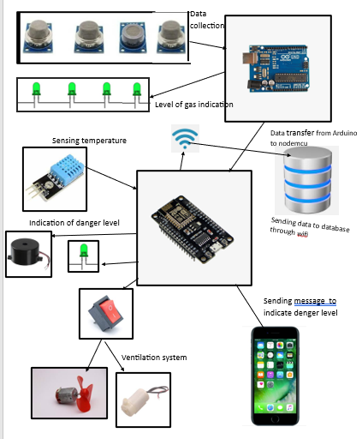
The IoT domain in air pollution monitoring systems involves the use of sensors and other IoT devices to collect data on air quality parameters such as particulate matter, carbon monoxide, nitrogen oxides, and ozone. This data is then transmitted to a central system where it can be analyzed and used to generate insights

Slide 4
Web Domain:
The web domain in air pollution monitoring systems involves the use of web-based applications to display and analyze air quality data collected from various sensors and other IoT devices. The web-based application provides a user-friendly interface that allows users to view real-time air quality data, and other relevant information.

Slide 5
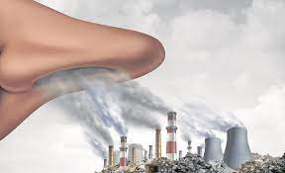
Motivation
The purpose of a smart air pollution monitoring system is to provide real-time information about the quality of the air in a given location.
can measure a variety of air pollutants
By providing real-time data on the levels of these pollutants, the system can help individuals and organizations understand the sources and extent of air pollution in their area, and take appropriate measures to protect themselves and others.
Overall, the purpose of a smart air pollution monitoring system is to promote public health and well-being by providing accurate, timely information about the quality of the air we breathe.

Slide 6
Scope of work
System Design and Installation:
Assessing the monitoring requirements and objectives.
Designing a system that meets the specific needs of the monitoring project.
Installing monitoring equipment and sensors at the designated sites.
Establishing communication infrastructure to transmit data from monitoring stations to a central data management system.
Data Collection and Measurement:
Ensuring the proper functioning of monitoring equipment and sensors.
Collecting real-time or periodic air quality data, including various pollutants such as particulate matter (PM), nitrogen dioxide (NO2), sulphur dioxide (SO2), ozone (O3), carbon monoxide (CO), etc.
Monitoring meteorological parameters that can affect air quality, such as temperature, humidity,

Slide 7
Data Management and Analysis:
Developing a centralized database or data management system to store and organize the collected data.
Implementing data processing techniques to clean, filter, and aggregate the raw data.
Analyzing the collected data to identify trends, patterns, and potential sources of pollution.
Generating reports and visualizations that present the air quality information in a comprehensible manner.
Conducting statistical analysis and modeling to assess the impact of air pollution and evaluate the effectiveness of pollution control measures.
System Maintenance and Calibration:
Conducting regular maintenance and calibration of monitoring equipment and sensors to ensure accurate and reliable measurements.
Performing routine checks and troubleshooting to address any technical issues or malfunctions.

Slide 8
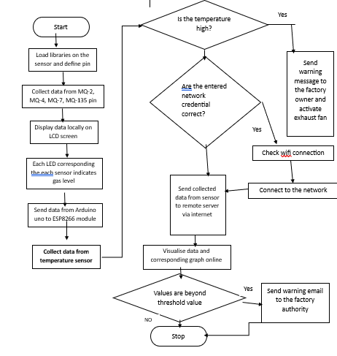
Methodology
Working Flow

Slide 9
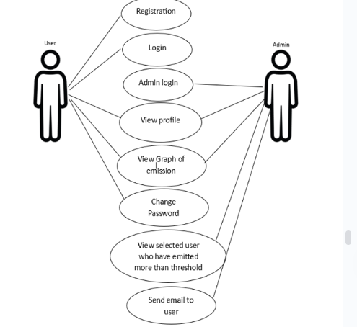
Use Case Diagram:
To ensure data security and restrict unauthorized access, implement user authentication and access control mechanisms. Consider the following:
User Registration: Provide a registration form for users to create an account. Collect necessary information, such as name, email, and password, to establish user credentials.
Login System: Implement a login system where users and admin can enter their credentials to access the system. This ensures that only authenticated users and admin can view and interact with the website.
Role-Based Access Control: Assign different roles (e.g., administrator, farmer, researcher) to users and define access privileges based on their roles. Administrators will have full access, while other users may have limited access to specific features or data.

