Slide 1
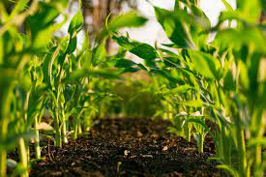
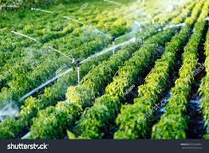
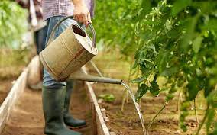
Smart Farming System
Presented by-
Kaushik Das, Sem VI, Department of Computer Science, Bangabasi morning college.
Shrobona Sil, Sem VI, Department of Computer Science, Bangabsi morning college.
In the Reference of -
Prof Mithun K. Bhowal

Slide 2
Abstract
Smart Farming and auto-pumping Monitoring System whose main moto is to reduce the overhead of monitoring a farm every day. A farmer has to check the moisture of the soil and has to pump water himself. After checking the soil, the recognition of the perfect moisture for the farming and pumpimg water, can be difficult for him/her. So we are creating small project to check the moisture and auto pump water to the soil through the motor whenever there is low moisture in it. And lastly keeping a track of the pumping of water and the soil moisture for further betterment.
KeyWords
Soil Moisture;
Transistor;
Volumetric Content;
Auto pumping;
Conductors;

Slide 3
System Requirements
NodeMcu ESP8266 (Microcontroller, a Wifi module)
Soil moisture sensor
Motor (12V)
Transistor (used for regulating the current to control the Motor)

Slide 4
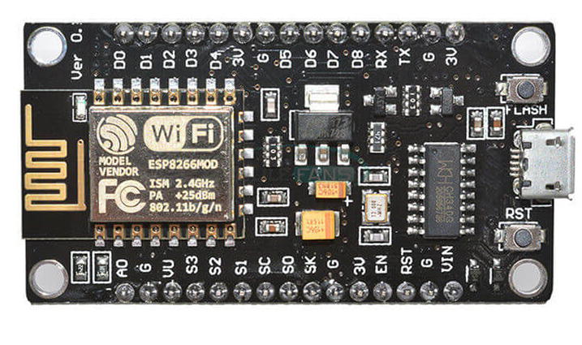
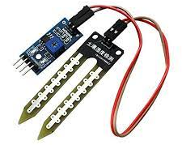
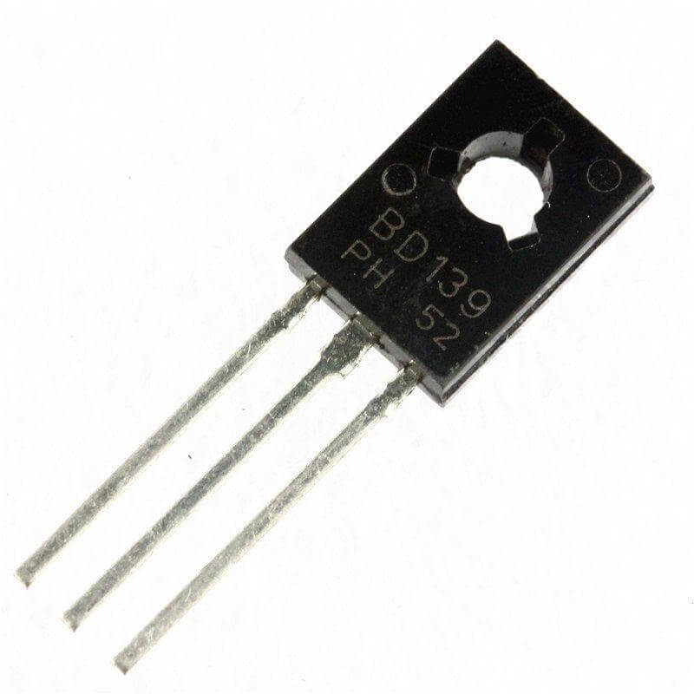
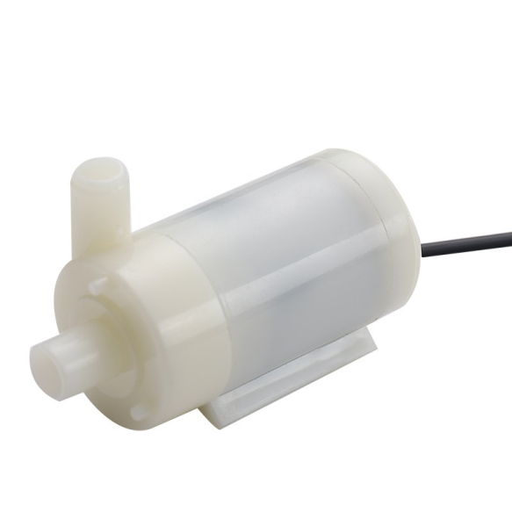
NodeMCU
Soil Moisture Sensor
Transistor(BD139)
Motor

Slide 5
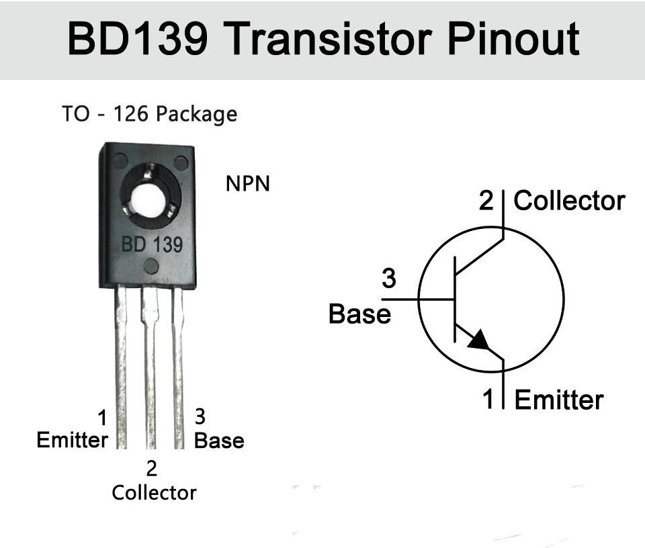
Transistor
The NPN transistor consists of two n-type semiconductors that sandwich a p-type semiconductor.
Features
Products are pre-selected in DC current gain
Application
General purpose
Description
These epitaxial planar transistors are mounted in the SOT-32 plastic package. They are designed for audio amplifiers and drivers utilizing complementary circuits. Here we are using the BD139 Transistor as our switch to regulate our water pump.

Slide 6
Design & Methodology- (Sensing the soil Moisture)
This soil moisture sensor module is used to detect the moisture of the soil. It measures the volumetric content of water inside the soil and gives us the moisture level as output. The fork-shaped probe with two exposed conductors acts as a variable resistor, whose resistance varies with the soil’s moisture content. This resistance varies inversely with soil moisture:
The more water in the soil, the better the conductivity and the lower the resistance.
The less water in the soil, the lower the conductivity and thus the higher the resistance.
These two probes are used to pass the current through the soil and then the sensor reads the resistance to get the moisture values. The sensor produces an output voltage according to the resistance, which by measuring we can determine the soil moisture level.

Slide 7
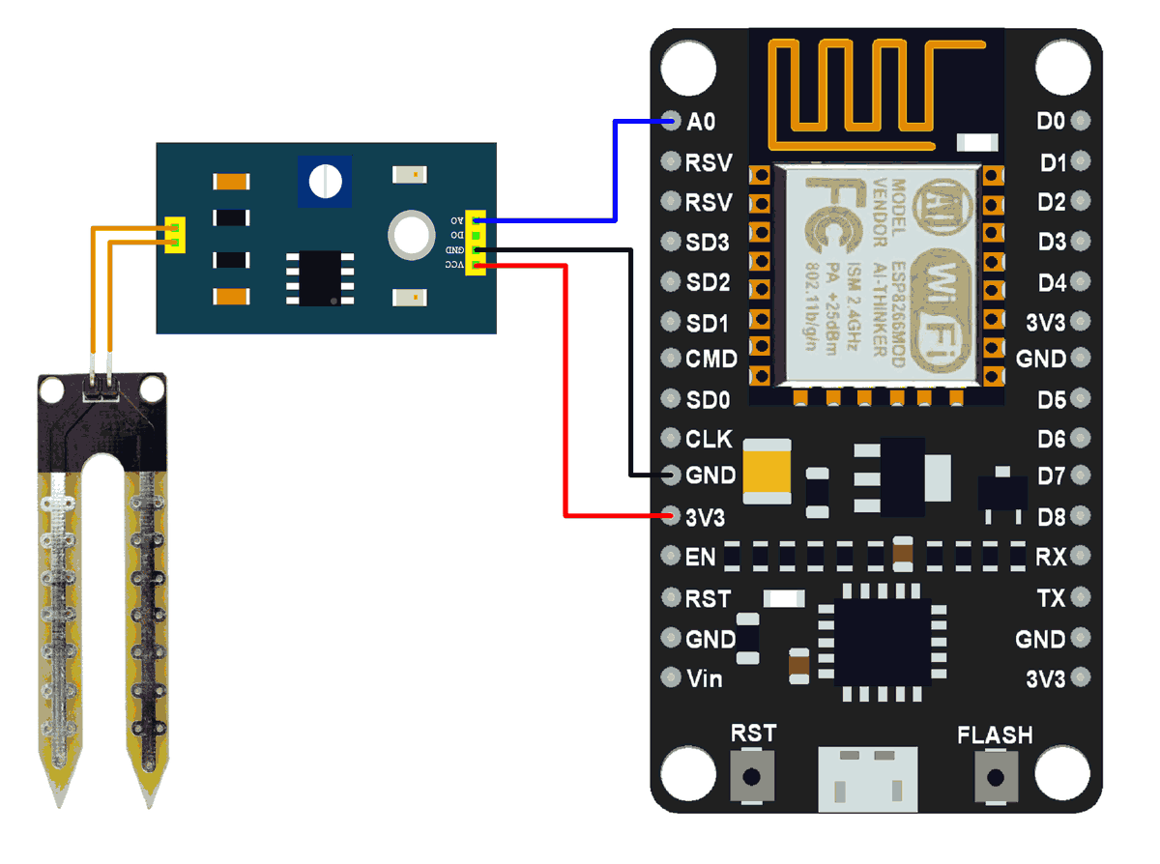
Circuit Diagram- (Sensing the soil Moisture)

Slide 8
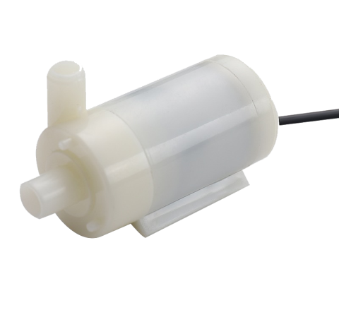
Transistor Circuit
AC
5V/0V from NodeMcu
GND
Water to plants

Slide 9
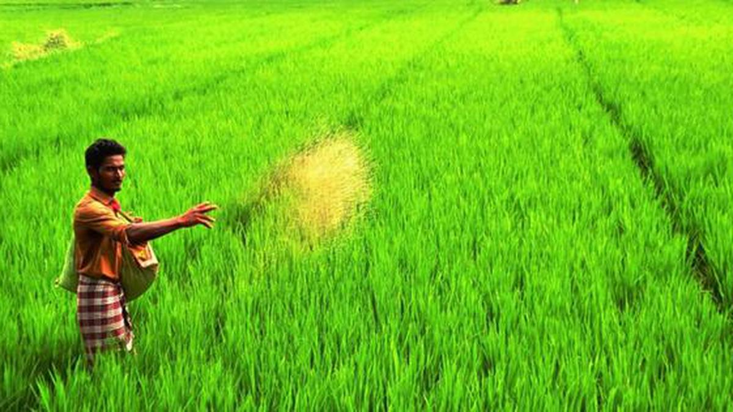
Database
We are storing the Soil moisture data in the database through our hardware model in the form of table . The attributes of the tables are-
Date/Time | Soil Moisture | Pump Status
We are Storing the data for further utilization or for better monitoring the farm which can be accessed by any person. For which we are presenting a website through which data will be shown.

Slide 10
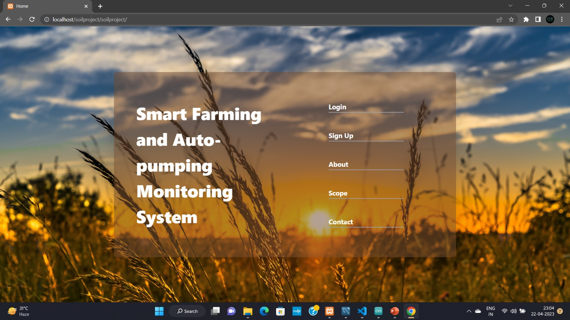

Slide 11


Slide 12


Slide 13
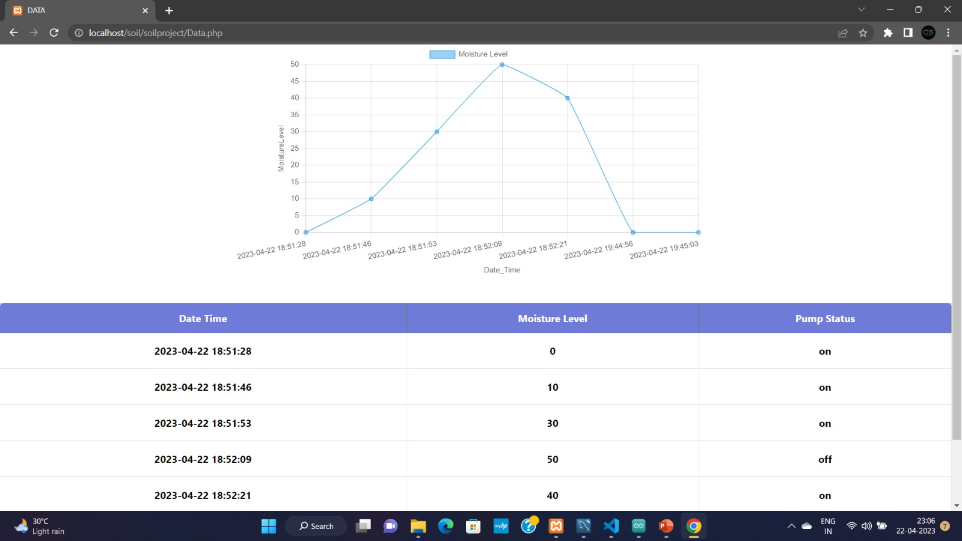

Slide 14
Scope
Water pumping in the huge area by any person can be a difficult function. So in future this can be effective in the purpose of agriculture.
The primary function of our project is to have a landscape irrigation system which ensures that water is spread regularly, timely and evenly throughout any given landscape.

Slide 15
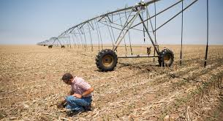
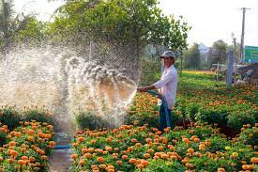
Scope
It is being made in very low cost. So that can be effective for farmers
In the case of gardener, this system is very useful.

