Slide 1
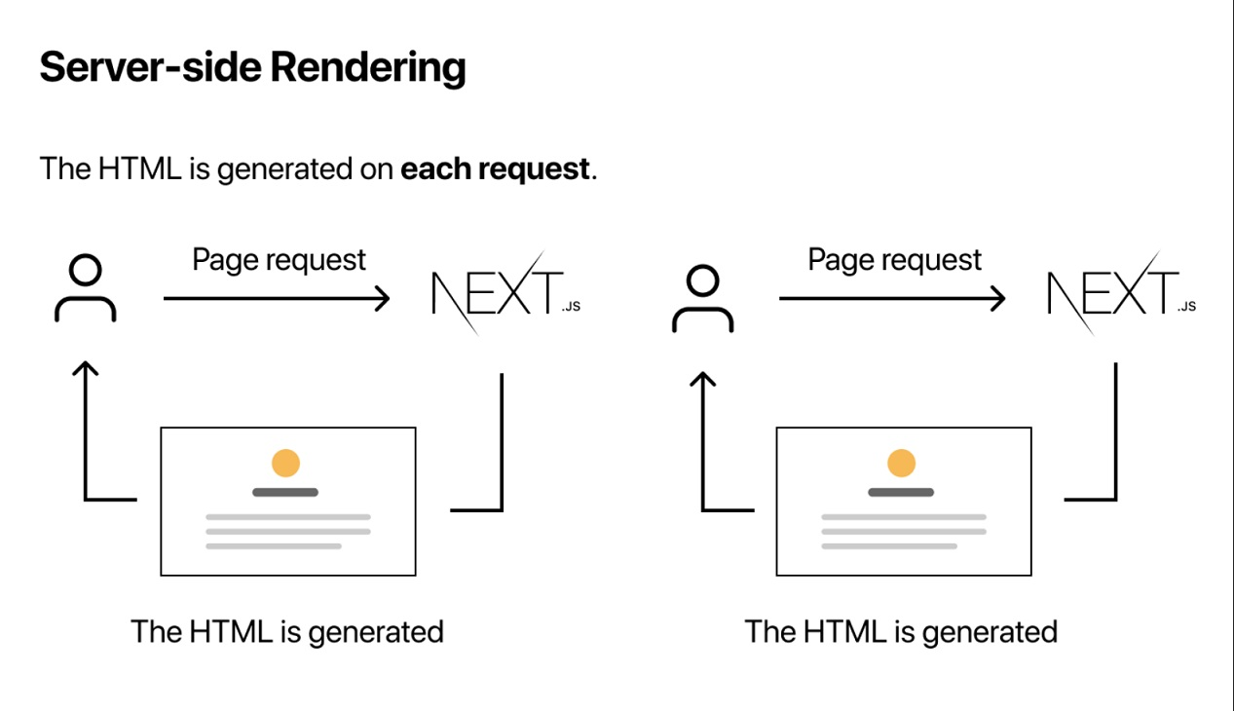
File HTML digenerate setiap request
Page Request
Page Request
File HTML digenerate
File HTML digenerate

Slide 2
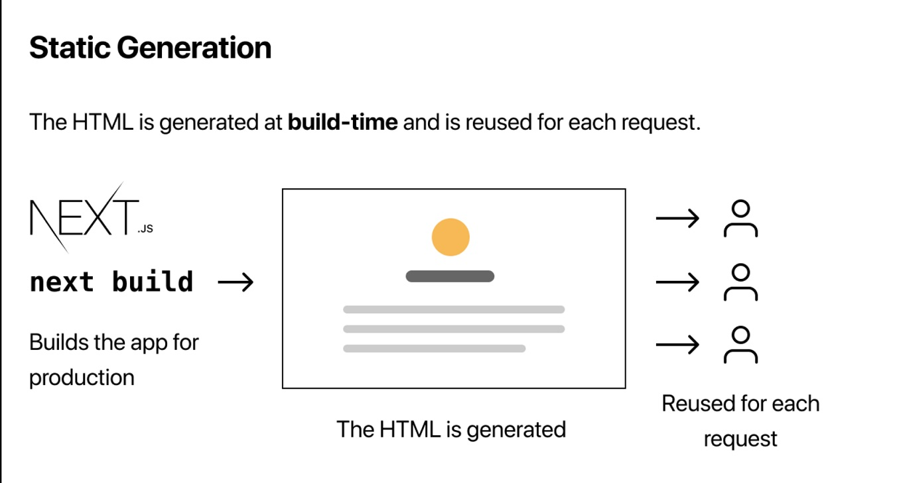
File HTML digenerate saat build-time dan digunakan kembali tiap request
Digunakan kembali tiap request
File HTML digenerate

