Slide 1


Cyber-Physical Security for the Energy Grid: From the Micro to the Macro
Saurabh Bagchi
School of Electrical and Computer Engineering
Department of Computer Science
Purdue University
Joint work with:
Alefiya Hussain (USC/ISI), Rakesh Bobba (Oregon), Robin Berthier (Network Perception Inc.)
Presentation available at: engineering.purdue.edu/~sbagchi

Slide 2
Motivation
Energy grid is the largest interconnected Cyber-Physical System (CPS) today
Questions to answer:
What are the most likely attack vectors?
At a micro scale, such as, within a neighborhood mesh network
At a macro scale, such as, individual CPSs of multiple energy producers and utilities
What are the most economically beneficial ways of protecting the critical assets?
Cost versus benefit tradeoff
Degree of cooperation among multiple stakeholders
Role of information deception in protection

Slide 3
Security at the Micro-Scale
Within the AMI infrastructure
The meters are connected via a wireless mesh network to the Data Concentrator Unit (DCU)
Vulnerabilities in individual meters can be exploited to gain remote access to them
Using compromised nodes, it is possible to launch:
Control flow attack: attacker explores the network, taking control of each visited node, until she reaches the DCU and can issue a mass disconnect
Data flow attack: attacker injects false data about the load at each meter into the network, eventually causing a failure

Slide 4
Our Contribution: SecAMI
We have developed a tool that lets anyone experiment with different attack scenarios to determine
Extent of damage, given a particular level of protection
Level of protection needed to limit damage to a given level
Inputs:
Network Topology
Timing characteristics of the network: communication latency, time to execute relevant commands
Virulence of the spread of the attack
Can experiment with different response strategies: disconnect, re-key, …

Slide 5
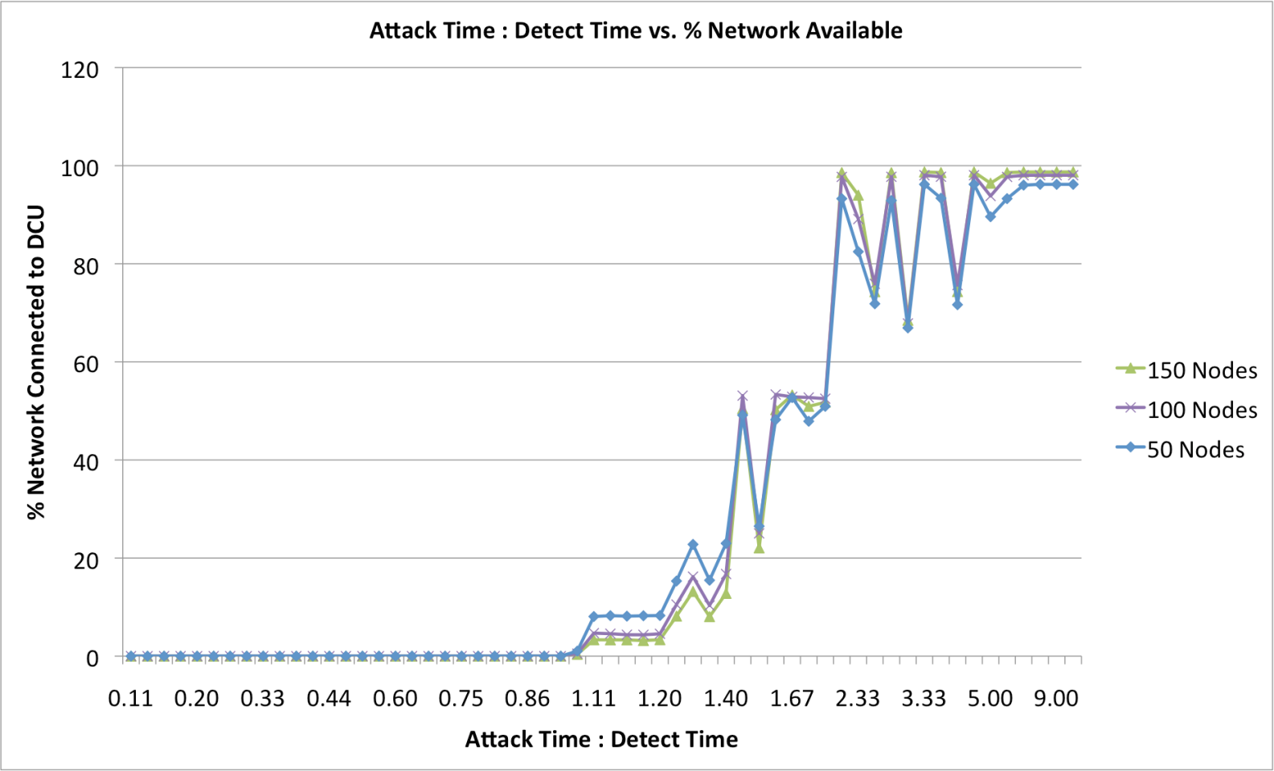
Results
SecAMI tool. [Online]. Available: https://github.com/nburow/SecAMI/
Shawly, Tawfeeq, Jun Liu, Nathan Burow, Saurabh Bagchi, Robin Berthier, and Rakesh B. Bobba. "A risk assessment tool for advanced metering infrastructures." In Smart Grid Communications (SmartGridComm), 2014 IEEE International Conference on, pp. 989-994. IEEE, 2014.
Network Size does not impact our metric
Need 2 : 1 ratio between attack time : detect time

Slide 6
Security at the Macro Scale
Cyberattacks in seemingly distant parts of energy grid can have local consequences
Model:
Autonomous organizations (“actors”) own and operate various assets, and cooperate to provide some end-user visible service
Strategic adversaries: Optimally select a subset of actors (i.e., their assets) and targets them to have a large positive benefit to the attacker.
Defenders: Estimate the adversary strategy and independently select assets to defend
Questions:
What is the strategic adversary’s rational attack strategy? Under bounded resource considerations?

Slide 7
Security at the Macro Scale
Questions:
How should defenders cooperate to defend the assets? Remember that impacts cross organizational boundaries.
How should deceptive information be used to increase asymmetry of knowledge in defender’s favor?
How do market forces – price of commodity, marginal utility of commodity, level of competition – affect the defensive investments
Solution approach:
Game theoretic model created
Can provide optimal decision strategy under given information advantage
Can provide semi-optimal decision strategy under real-time considerations (work in progress)
Paul Wood, Saurabh Bagchi, and Alefiya Hussain. "Optimizing Defensive Investments in Energy-Based Cyber-Physical Systems" Accepted to appear at the Dependable Parallel, Distributed and Network-Centric Systems (DPDNS) Workshop, to be held with 29th IEEE International Parallel &
Distributed Processing Symposium (IPDPS), May 25-29, 2015.

Slide 8
Conclusions
Protecting the energy grid needs a rational scientific decision making strategy, i.e., algorithmic support
Needs to operate at multiple system scales
Needs to consider adversary strategies for rational adversaries
Needs to consider real-life constraints on cooperation and information sharing
Needs to have a a planning component as well as a real-time component
Our contributions
Tool for “What If” attack-defense scenarios in the AMI
Game theoretic formulation for system-wide CPS
Very much work in progress

Slide 9
Presentation available on: Research group web page engineering.purdue.edu/dcsl

