Slide 1
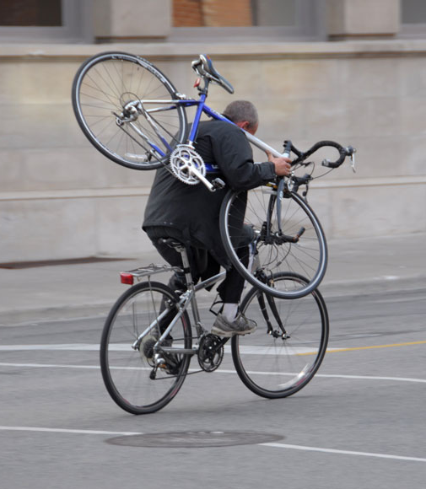
MIE1624 - Fall 2018
Introduction to Data Science and Analytics
Bicycle Theft in Toronto
By Group 28:
L. Chu 1005375345
S. Bagde 1004676745
A. Sokol 1000811543

Slide 2
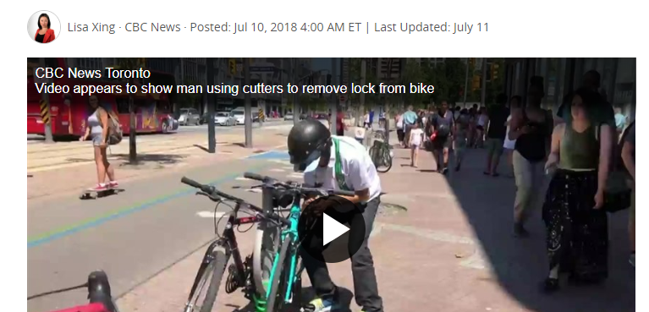
Bike Theft Crisis

Slide 3

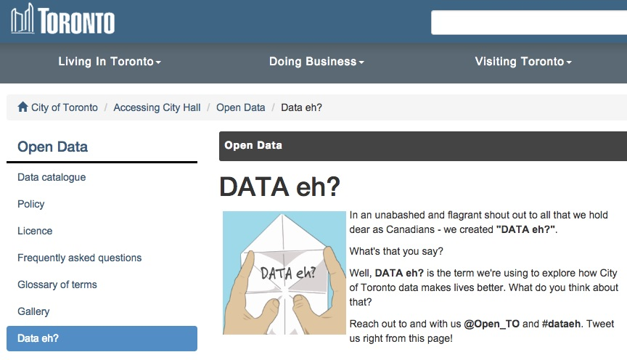
Data Sources
…attributes include time and location of the incident; cost, type and colour of stolen bikes

Slide 4
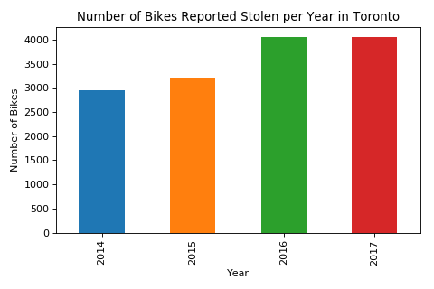
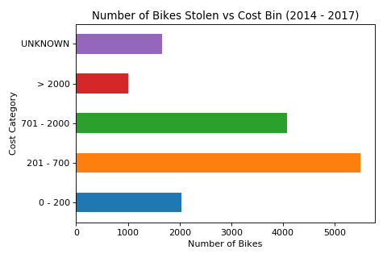
Economic Impact
..thousands of bikes are stolen in Toronto worth about $3 million dollars each year

Slide 5
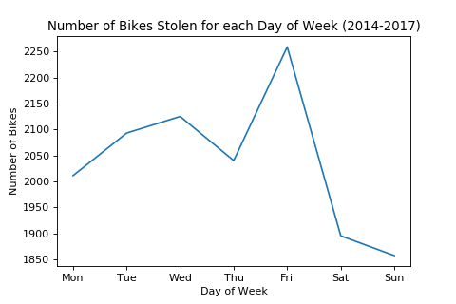
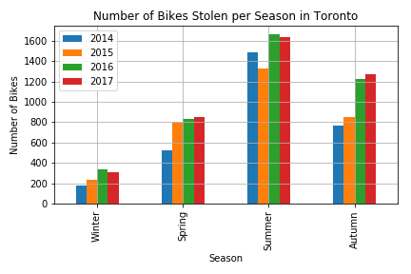
Temporal Analysis
… weekdays and summer months are generally more common for bike theft

Slide 6
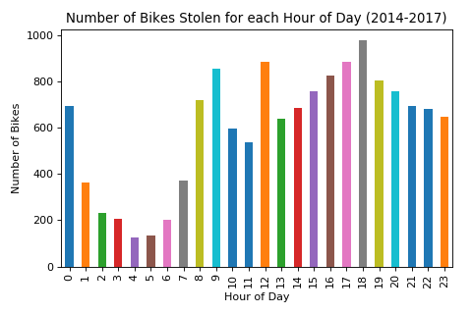
Temporal Analysis
…the highest number of reported stolen bikes happened between 5-7pm and 12-1pm

Slide 7
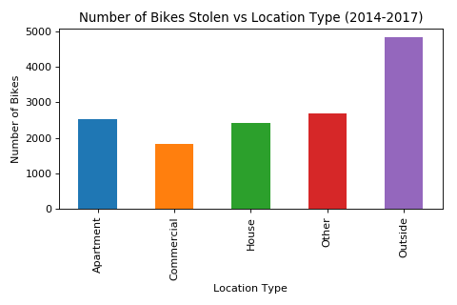
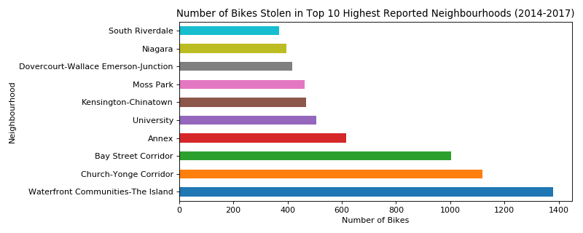
Geographical Analysis
…while the order of the neighbourhoods may change, a neighbourhood in the top 10
is very likely to remain in the top 10 the following year or season

Slide 8
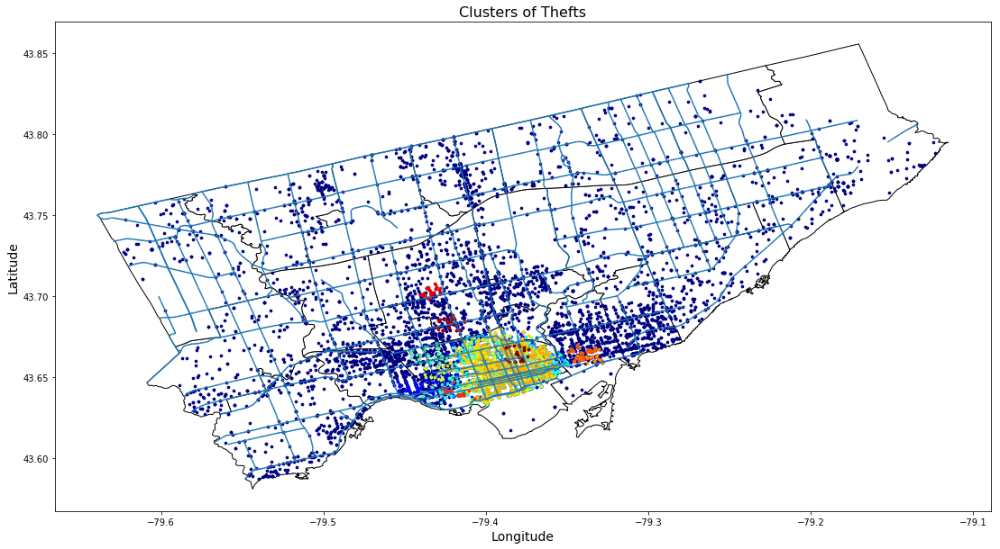
Bike Theft Clustering
…temporal - spatial clustering identifies the areas of high bike theft density

Slide 9
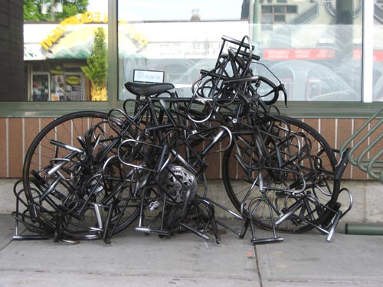
Recommendations and Future Research
Allocate more resources for summer-autumn months, as more than half (56%) of bike thefts between 2014-2017 happened during the 4 months: June, July, August and September.
Concentrate law enforcement resources on top-10 communities: almost half (47%) of thefts between 2014-2017 happened in top-10 communities.
Use clustering map to identify high density areas.
Educate general public and authorities on the trends and insights provided by the data.
Promote and facilitate bike theft reporting.

Slide 10
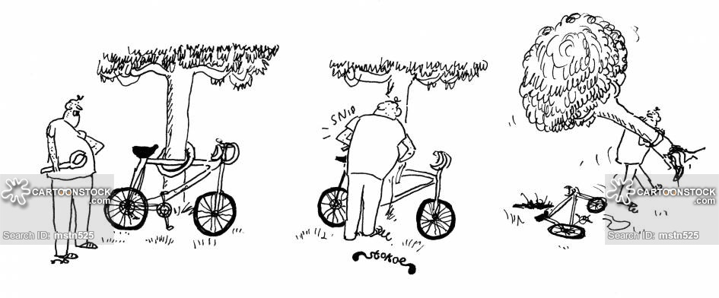
Thank you!

