Slide 1

2018 NAMIC-Carolinas Career Lifecycle: Focus Forward

Slide 2
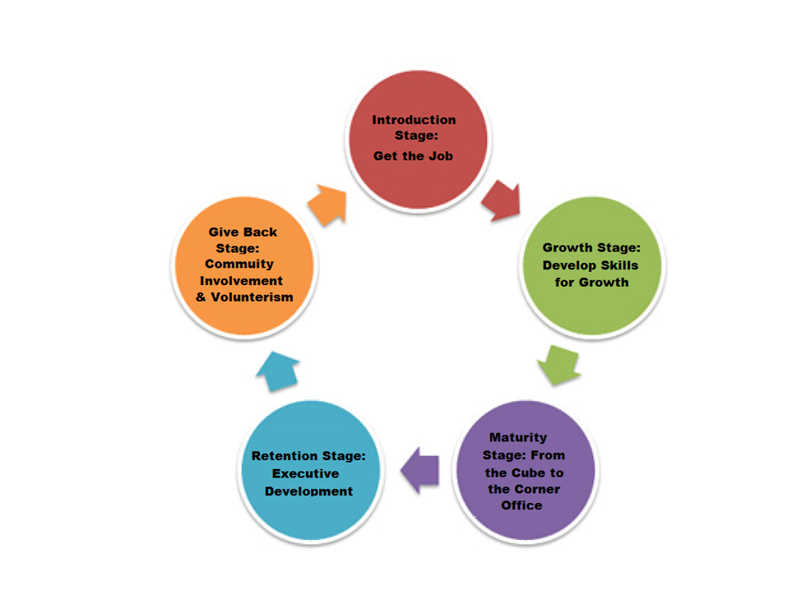
Focus Forward
We want our members to remain ‘focused forward ‘on what’s next in their careers. Programming provided this year will allow opportunities for members to proactively prepare and plan for those future opportunities.

Slide 3
Introduction Stage Get the Job
For college students, individuals seeking jobs and those looking for new opportunities within their companies.
Researching what is out there
Resume building
Interviewing tips
Dressing for success

Slide 4
Growth Stage Develop Skills for Growth
For individuals who have received the job but need help with growth in that new role.
Strength finding
Getting the experience
Refresher courses and professional development
Mentors, advocates, sponsors

Slide 5
Maturity Stage From the Cube to the Corner Office
For Supervisors, Managers, Analysts, and Coordinators.
Succession planning
Coaching and development
Preparing your team for future opportunities
Effective communication
Self-awareness
Team development, connecting with your team
Screening and selecting candidates
Work-life balance
Courses, certifications, etc. that are helpful for growth

Slide 6
Retention Stage Executive Development
For Directors and Above.
Obtaining and maintaining an Executive presence
Retaining your role as an Executive in your industry
Retaining education needed to remain relevant
Financial planning
Planning for retirement

Slide 7
Giving Back Stage Community Events
For all members, local community groups and organizations.
Links Scholarship
TutorMate
Community Service & Donations
Partnering with local organizations to participate in their events or to market our materials at their events, and allow them to do the same at ours.

