Slide 1
Which jobs are most preferred by udacity undergraduates?
The following clustered bar chart drawn for job level vs frequency of udacity undergraduates, it clearly depicts that most of the undergraduates are individual contributors with a value of 289.
While comparing the other professions it’s been noticed that other than individual contributors, many Udacity students are having jobs like managers ,director ,c-level and many are doing intern.
There are no students who are not having jobs except some students who are not applicable(76) for jobs .

Slide 2
On average, how many hours Udacity students spend sitting per day?
The following clustered bar chart represents the count of Udacity students according to their sitting hours per day.
Observing the Skewnees of the graph, it appears to bimodal(both left and right skewed).
It can be easily seen that the maximum students(exactly 172) spends 10 hours sitting per day.
Other than 10 hours sitting, other common sitting hours are 8 and 12 with count of students as 119 and 122.
Minimum number of hours(1) is spent by 3 students while maximum hours (800 which is not possible in day) is spent by one student.
Hours more than 25 are giving us less resourceful information(because there can’t be more than 24 hours in day). So they are acting outliers to the dataset.

Slide 3
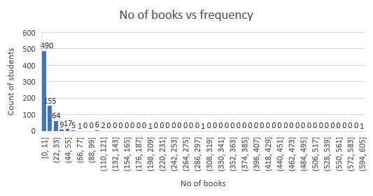
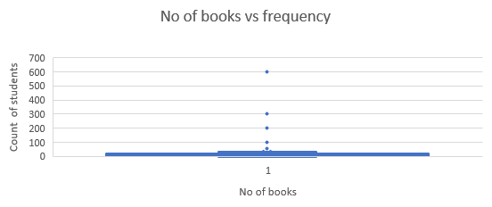
On average, how many books are read by Udacity students in a year?
The histogram represents the no of books read by Udacity students in a year who has taken the survey.
While analysing the graph, it can be noticed that most students (exactly 490) has read the books between 0 and 11 books per year. While there are some students (155) wo read between 12-23 books.
Median of the data is 8 and mean is 13.51 i.e (mean>median). It is the case of right skewed plot(can be verified from histogram). Mode of the data is 10 .which depicts that most of the students has read 10 books in a year.
Standard deviation(SD) is 28.86, which is a great reason for this large spread of the data.
Observing the box plot, it can be seen that quartiles values are Q1(4),Q2/median(8) and Q3(15). Which gives the IQR as 11.
Range lies between a minimum value of 0 (i.e zero books read per year) to a maximum value of 600 books read per year.

Slide 4
Analysing the student’s age to their books reading capacity per year?
The following scatter plot shows the comparison between no of books read to the age of students.
Observing the plot, it can be perfectly noticed that maximum number of books read(600) is by the student at the age of 40. Minimum books read are 0.
Interesting point to be noticed is that as slowly as age of students are increasing ,it is observed that number of books read per year are also increasing.
Which show positive correlation between books read and age.

