Slide 1
Word Embedding
Ayoub Bagheri

Slide 2
Outline
Word embedding
Skipgram learning
Pre-trained embeddings
State-of-the-Art

Slide 3
Word Embedding Slides are partly based on the word embedding lecture by Dong Nguyen in the Applied Text Mining Utrecht summer school (linkToRCourse, linkToPythonCouse)

Slide 4
Word representations
How can we represent the meaning of words?
So, we can ask:
How similar is cat to dog, or Paris to London?
How similar is document A to document B?

Slide 5
Word as vectors
Can we represent words as vectors?
The vector representations should:
capture semantics
similar words should be close to each other in the vector space
relation between two vectors should reflect the relationship between the two words
be efficient (vectors with fewer dimensions are easier to work with)
be interpretable

Slide 6
Word as vectors
How similar are the following two words? (not similar 0–10 very similar)
smart and intelligent:
easy and big:
easy and difficult:
hard and difficult:

Slide 7
Word as vectors
How similar are the following two words? (not similar 0–10 very similar)
smart and intelligent: 9.20
easy and big: 1.12
easy and difficult: 0.58
hard and difficult: 8.77
(SimLex-999 dataset, https://fh295.github.io/simlex.html)

Slide 8
Words as Vectors

Slide 9
One-hot encoding
Map each word to a unique identifier
e.g. cat (3) and dog (5).
Vector representation: all zeros, except 1 at the ID

Slide 10
One-hot encoding
Map each word to a unique identifier
e.g. cat (3) and dog (5).
Vector representation: all zeros, except 1 at the ID
What are limitations
of one-hot encodings?

Slide 11
One-hot encoding
Map each word to a unique identifier
e.g. cat (3) and dog (5).
Vector representation: all zeros, except 1 at the ID
Even related words
have distinct vectors!
High number of
dimensions

Slide 12
Distributional hypothesis: Words that occur in similar contexts tend to have similar meanings.
You shall know a word by the company it keeps.
(Firth, J. R. 1957:11)

Slide 13
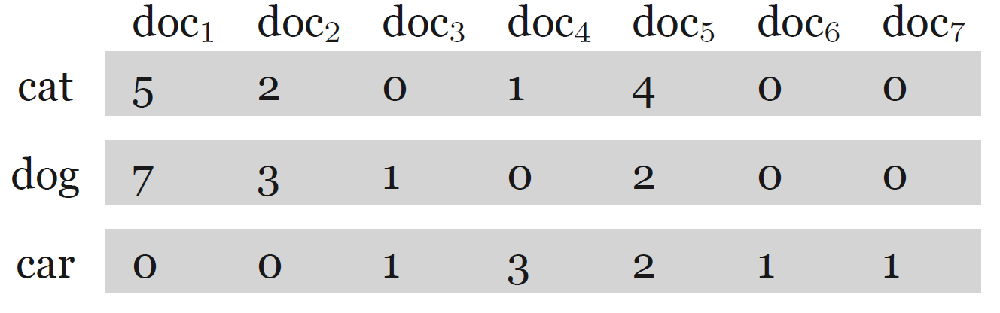
Word vectors based on co-occurrences
documents as context
word-document matrix

Slide 14
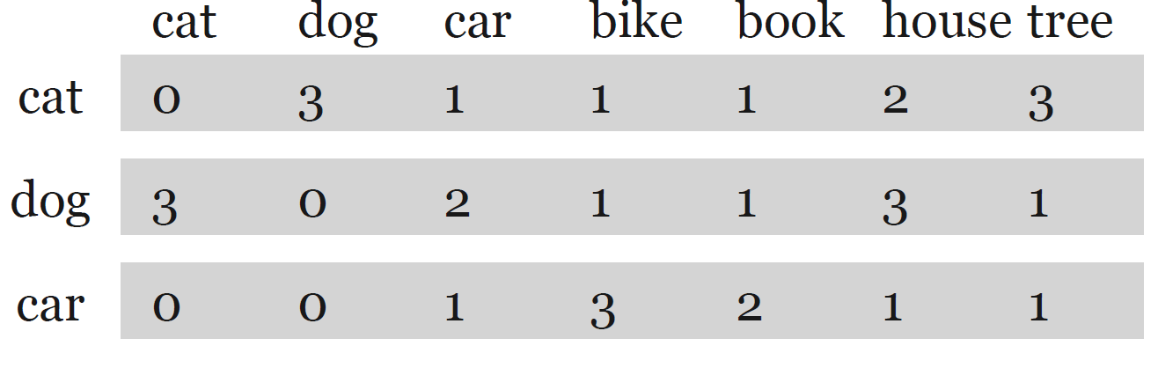
Word vectors based on co-occurrences
documents as context
word-document matrix
neighboring words as context
word-word matrix

Slide 15
Word vectors based on co-occurrences
There are many variants:
Context (words, documents, which window size, etc.)
Weighting (raw frequency, etc.)
Vectors are sparse: Many zero entries.
Therefore: Dimensionality reduction is often used (e.g., SVD)
These methods are sometimes called count-based methods as they work directly on co-occurrence counts.

Slide 16

Word embeddings
Vectors are short;
typically 50-1024
dimensions ☺
Vectors are dense
(mostly non-zero values)
Very effective for many
NLP tasks ☺
Individual dimensions
are less interpretable ☹

Slide 17
How do we learn word embeddings?

Slide 18
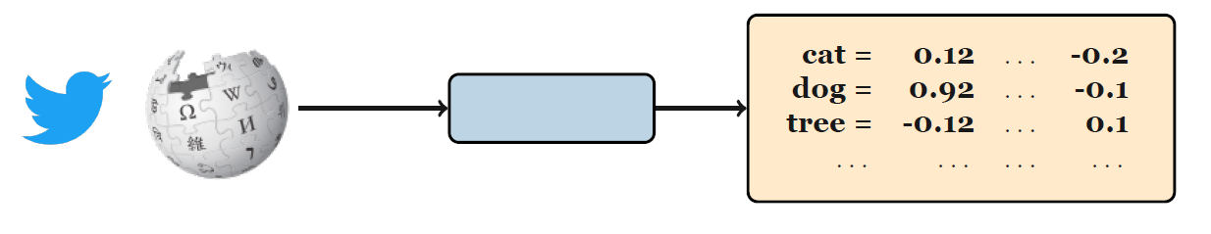
Learning word embeddings

Slide 19
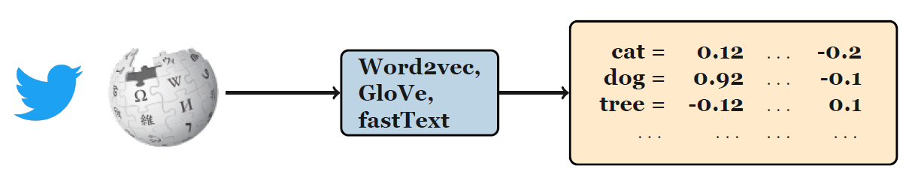
Learning word embeddings

Slide 20
Training data for word embeddings
Use text itself as training data for the model!
A form of self-supervision.
Train a classifier (neural network, logistic regression, or SVM, etc.) to predict the next word given previous words.

Slide 21
Exercise: Word prediction task
Yesterday I went to the ?
A new study has highlighted the positive ?
Which word comes next?

Slide 22
Word2Vec
Popular embedding method
Very fast to train
Idea: predict rather than count
https://projector.tensorflow.org/

Slide 23
Word2Vec
We have target words (cat) and context words (here: window size = 5).

Slide 24
Word2Vec
Instead of counting how often each word w occurs near a target word
Train a classifier on a binary prediction task:
Is w likely to show up near target?
We don’t actually care about this task
But we'll take the learned classifier weights as the word embeddings
Big idea: self-supervision
A word c that occurs near target in the corpus as the gold "correct answer" for supervised learning
No need for human labels
Bengio et al. (2003); Collobert et al. (2011)

Slide 25
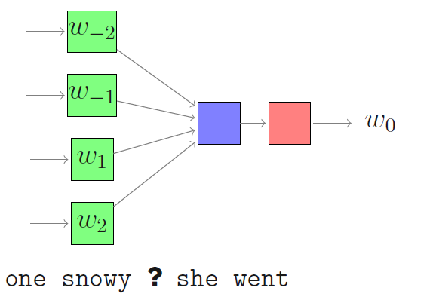
Word2Vec algorithms
Continuous Bag-Of-Words (CBOW)

Slide 26
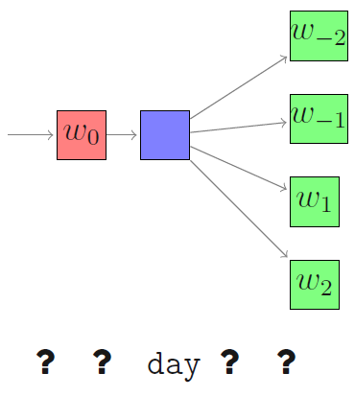
Word2Vec algorithms
Continuous Bag-Of-Words (CBOW) skipgram

Slide 27
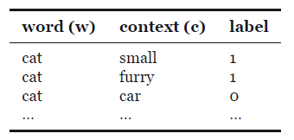
Skipgram overview
The domestic cat is a small, typically furry carnivorous mammal
Create examples
Positive examples: Target word and
neighboring context
Negative examples: Target word and
randomly sampled words from the
lexicon (negative sampling)
Train a logistic regression model
to distinguish between the positive
and negative examples
The resulting weights are the
embeddings!
Embedding vectors are essentially
a byproduct!

Slide 28
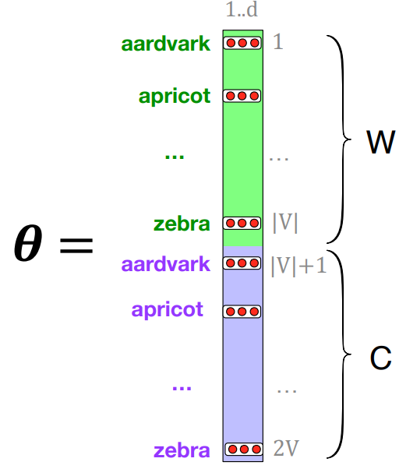
Skipgram embeddings
target words
context words

Slide 29
Learning the classifier
How to learn?
Stochastic gradient descent!
SGNS learns two sets of embeddings
Target embeddings matrix W
Context embedding matrix C
It's common to just add them together, representing word i as the vector Wi + Ci

Slide 30
Skipgram
Treat the target word t and a neighboring context word c as positive examples.
Randomly sample other words in the lexicon to get negative examples
Use logistic regression to train a classifier to distinguish those two cases
Use the learned weights as the embeddings

Slide 31
Skipgram classifier
A probabilistic classifier, given
a test target word w
its context window of L words c1:L
Estimates probability that w occurs in this window based on similarity of w (embeddings) to c1:L (embeddings).
To compute this, we just need embeddings for all the words.

Slide 32
Pre-trained Embeddings

Slide 33
Pre-trained embeddings
I want to build a system to solve a task (e.g., sentiment analysis)
Use pre-trained embeddings. Should I fine-tune?
Lots of data: yes
Just a small dataset: no
Analysis (e.g., bias, semantic change)
Train embeddings from scratch

Slide 34
State-of-the-Art

Slide 35
State-of-the-Art
Recurrent neural networks
LSTM
GRU
Bi-directional network
Transformers
Contextual embeddings
ChatGPT
We will discuss the details during the summer text mining courses:
Click to go to the Intro to Text Mining with R course
Click to go to the Applied Text Mining course (Python)

Slide 36
Practical
Word embedding

Slide 37
Questions?

Slide 38
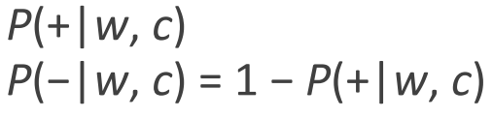
Skipgram
We have target words (cat) and context words (here: window size = 5).
The probability that c is a real context word, and the probability that c is not a real context word:

Slide 39

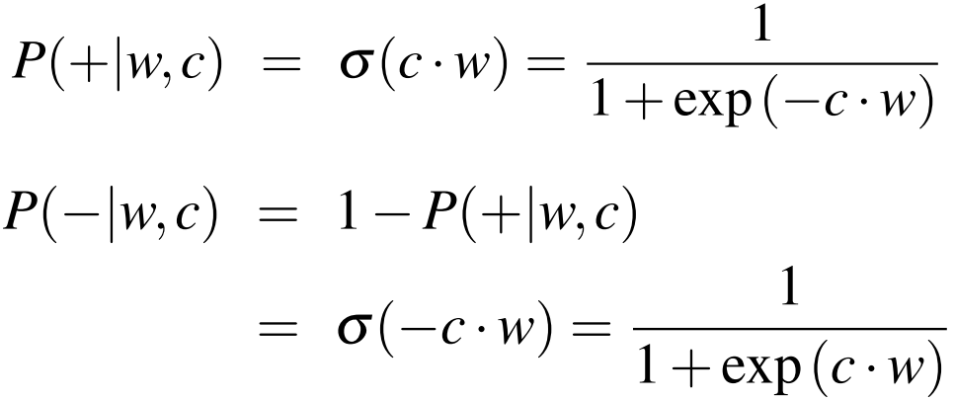
Skipgram
Similarity is computed from dot product
Intuition: A word c is likely to occur near the target w if its embedding is similar to the target embedding.
Two vectors are similar if they have a high dot product
Cosine similarity is just a normalized dot product
Turn this into a probability using
the sigmoid function:

Slide 40
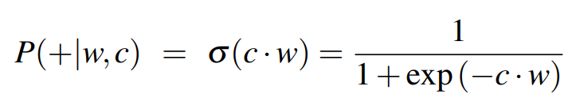
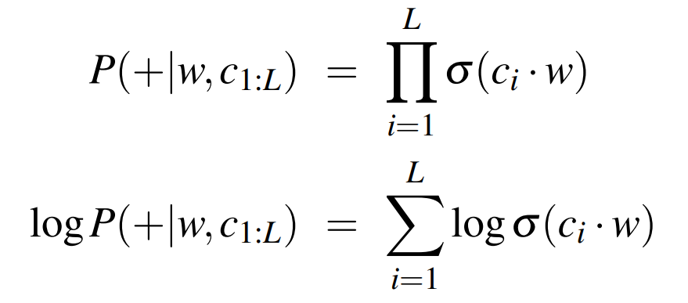
How Skipgram classifier computes P(+|w, c)
This is for one context word, but we have lots of context words. We'll assume independence and just multiply them:

Slide 41
Word2vec: how to learn vectors
Given the set of positive and negative training instances, and an initial set of embedding vectors
The goal of learning is to adjust those word vectors such that we:
Maximize the similarity of the target word, context word pairs (w , cpos) drawn from the positive data
Minimize the similarity of the (w , cneg) pairs drawn from the negative data.

Slide 42
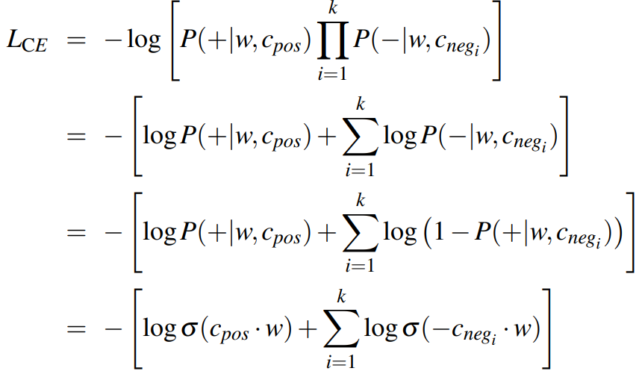
Loss function for one w with cpos , cneg1 ...cnegk
Maximize the similarity of the target with the actual context words, and minimize the similarity of the target with the k negative sampled non-neighbor words.

Slide 43
Learning the classifier
How to learn?
Stochastic gradient descent!

