Slide 1

FGT
U.S. Small Business Administrasion
Loan Approval Prediction
Application
BAGJA SATIARAHARJA
Purwadhika Startup and Coding School
Data Science Trainee

Slide 2
Project Mission

Slide 3

Project Mission
From the U.S. Small Business Administration dataset.
We can learn that around 17.6% of loans guaranteed by
the U.S. Small Business Administration have a financial problem.
If this condition happens with a big frequency and amount of loan,
it can make a big loss to SBA and the bank as a lender and lead to
bankruptcy to the institution.
The project's main mission is to reduce the risk of charge off credit
loans for U.S.Small Business Administration institutions by making
machine learning-based applications to determine the
loan request based on historical data.

Slide 4
Datasets

Slide 5
Datasets
The dataset is from the U.S. Small Business Administration (SBA)
01
The Source
02
The Rows
Kaggle
“Should This Loan be Approved or Denied?” by Mirbek Toktogaraev
899164 rows of Data
03
The Feature
04
Final Cleaned Dataset
27 Features
459297 rows
26 Features (include dummies)

Slide 6
Machine Learning
Algorithm

Slide 7
Machine Learning Algorithm
Logistic Regression
Decision Tree Classifier
Logreg
DTC
Send part drawing and request quotation to vendor
01
02
K-Nearest Neighbors
KNN
RFC
Random Forest Classifier
Control and monitoring part quality and regular delivery.
Vendor selection and doing a negotiation to preferably vendor
06
03
Developt and control vendor to meet KMI’s new model preparation.
GBC
ABC
Send the letter of intent to chosen vendor as a agreement.
Gradient Boost Classifer
05
04
Ada Boost Classifier

Slide 8
Evaluation Method
01
Confusion Matrix, Accuration, Precision & Recall
02
ROC & AUC

Slide 9
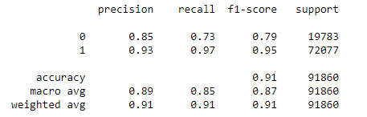

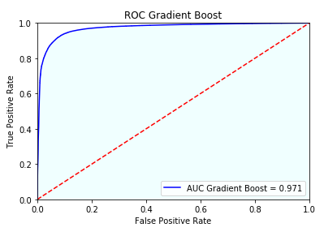
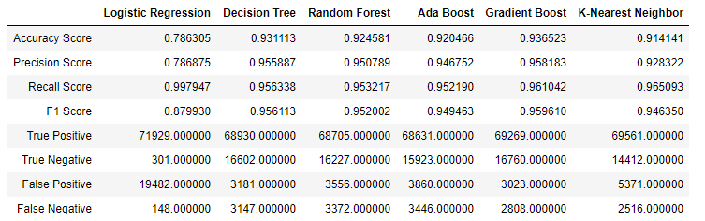
Chosen Algorithm
Gradient Boost Classifier
Confusion Matrix
Classification Report
Prediction
No Yes
No
Yes
Actual
AUC Graphs
Classification Report Comparation

Slide 10
Flask Application

Slide 11
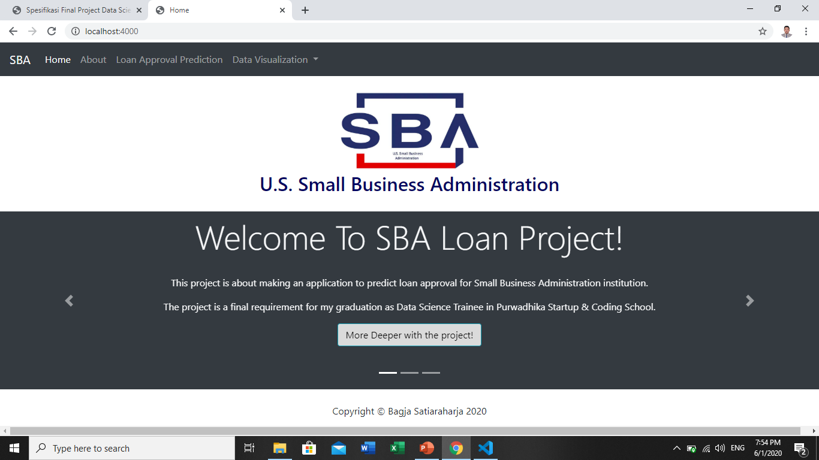
Home Interface

Slide 12
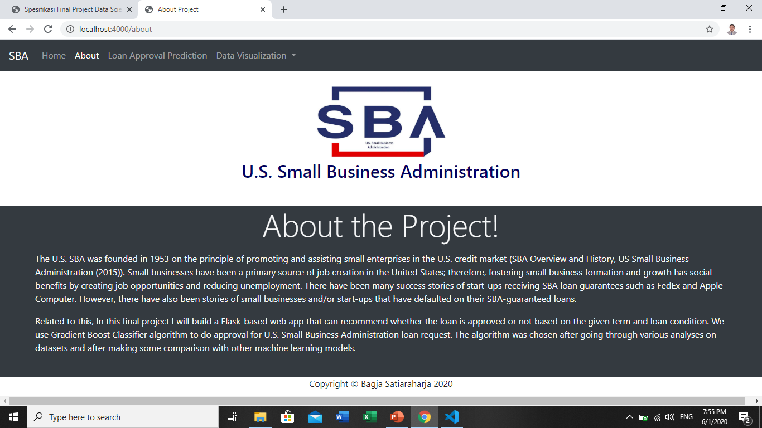
About Interface

Slide 13
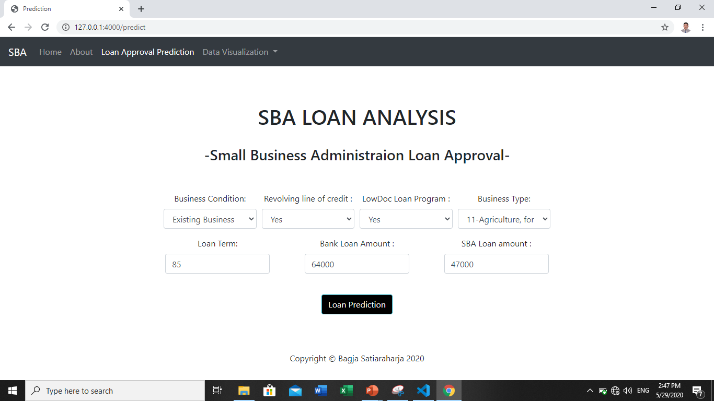
Prediction Interface

Slide 14
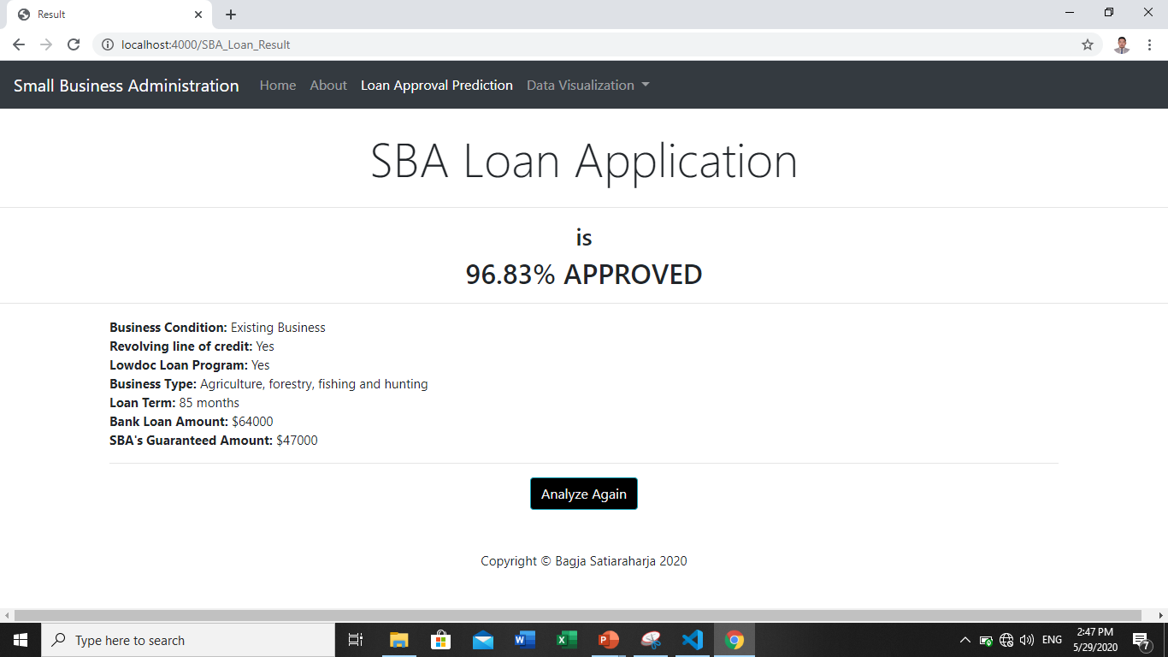
Result Interface

Slide 15
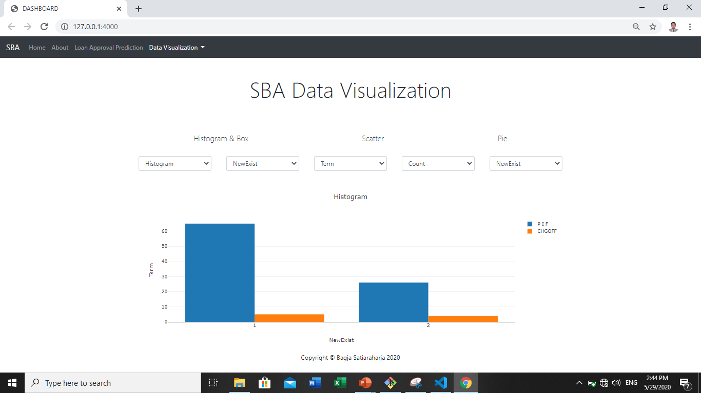
Data Visualization Interface

Slide 16
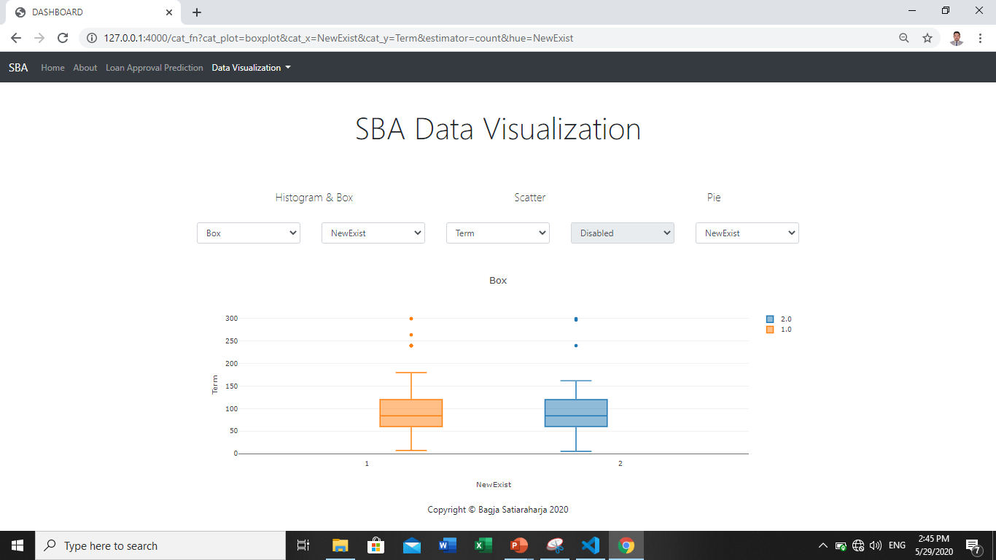
Data Visualization Interface

Slide 17
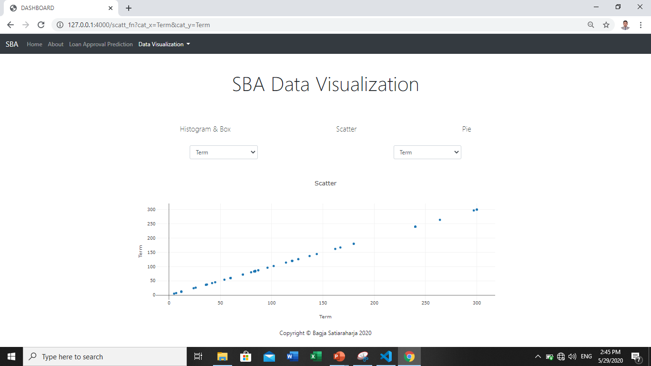
Data Visualization Interface

Slide 18
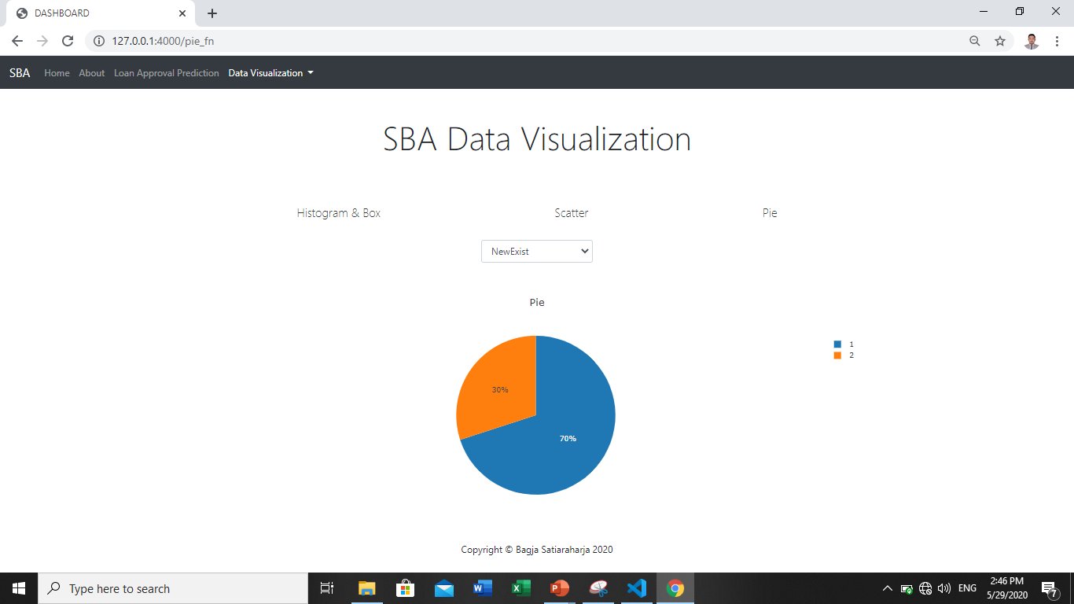
Data Visualization Interface

Slide 19
Conclusion

Slide 20
Conclusion
CONCLUSION
We can make a new loan approval application using the Gradient Boost Classifier algorithm. The Gradient Boost Classifier was chosen because it has the highest AUC and accuracy scores than the other five models with 91% accuracy and 0,971 AUC score. This model also has the least False Positive result.
SUGGESTION
For the next future development for the SBA Loan approval application, we need to prepare more critical data such as annual business income statements and debt status for each business.

Slide 21

Thank you

